Slide 1
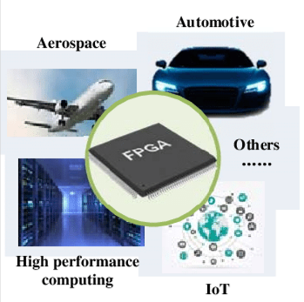

Field
Programmable Gate Arrays
(FPGAs)
Notes:
jake-blucker-VEdLCjdUtRY-unsplash

Slide 2
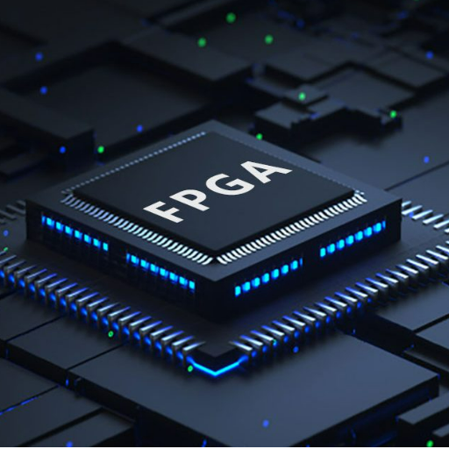
WHAT IS FPGA
Field-Programmable Gate Arrays (FPGAs) available even to system developers of modest means. As the name implies, FPGAs are gate arrays that can be reprogrammed at any time, even after an embedded system has been assembled and delivered to its end user.
Notes:
bruce-mars-8YG31Xn4dSw-unsplash

Slide 3
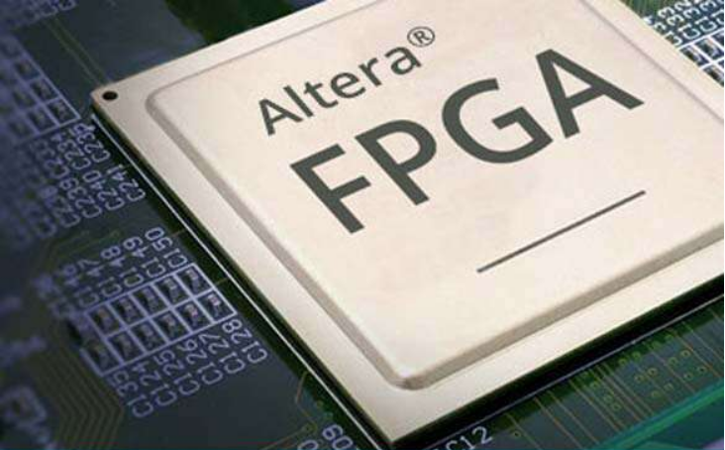


Why FPGA is used in embedded systems?
FPGAs provide many advantages in embedded systems that are not seen in popular components like MCUs or MPUs.
FPGAs have a remarkable role in embedded system development due to their capability to start system software development simultaneously with hardware, enable system performance simulations at a very early phase of the development, and allow various system trials and design iterations before finalizing the system ..
microcontroller, DSP processor, ASIC, and now FPGA. Field programmable gate arrays (FPGA) from Xilinx started as glue logic usage stitching functions together.
Notes:
keila-hotzel-lFmuWU0tv4M-unsplash

Slide 4
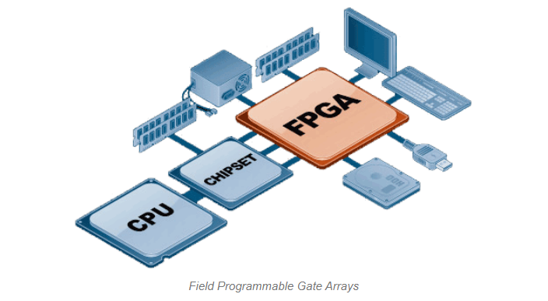
Structure of an FPGA
What are 4 basic elements of FPGA?
CLB 1
Configurable Logic Block (CLB) A CLB is the fundamental piece of an FPGA and is what gives it its ability to take on different hardware configurations It implements the user logic..
DSB 2
digital signal processing (DSP) and communication systems, include the following: Digital signals can convey information with less noise, distortion, and interference (audio signal, speech processing, RADAR.)
Transceivers. 3
Input/Output (IO) Blocks.4
I/O Pads used for the outside world to communicate with different applications.

Slide 5
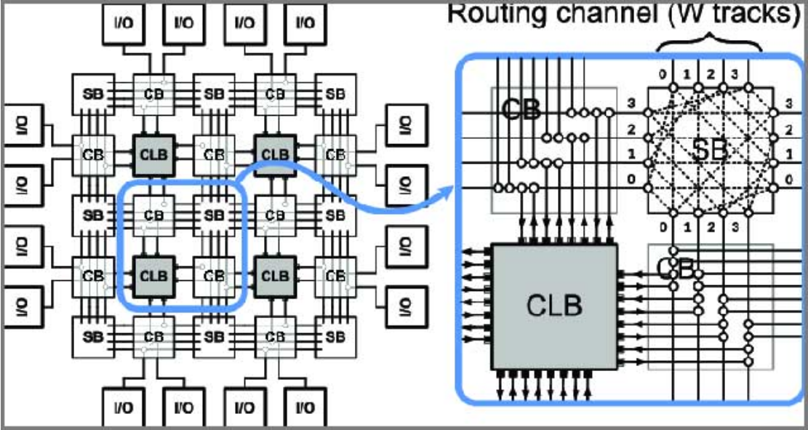
WHY FPGA IS NOT A MC?
CLB (Configurable Logic Block) includes digital logic, inputs, outputs. It implements the user logic.
Interconnects provide direction between the logic blocks to implement the user logic.
Depending on the logic, switch matrix provides switching between interconnects.
I/O Pads used for the outside world to communicate with different applications.
They're ideal for more complex applications: Because FPGAs allow for parallel processes, you can implement more inputs with an FPGA than with a microcontroller, without running into a bottlenecking issue. This makes them ideal for more complex operations
Notes:
gustavo-alves-YOXSC4zRcxw-unsplash

Slide 6
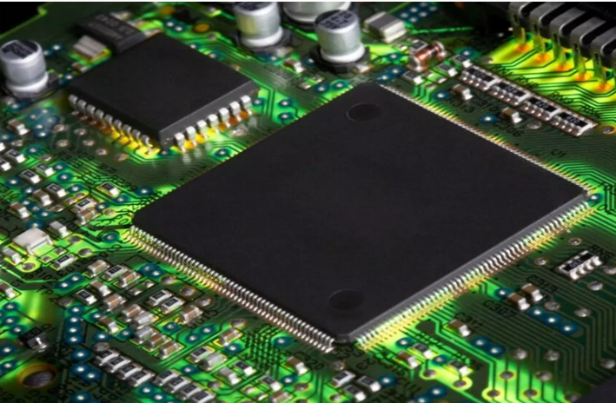
Can FPGA Replace Microcontroller?
A FPGA can be used if the design requires complex logic and requires high processing ability and if the cost is comparable to the performance achieved. In case of a design that requires limited hardware, and is set to perform only some specific functions, then Microcontroller is preferred.

Slide 7

THANK YOU!
Notes:
christian-perner-1fEQTFhcEXU-unsplash

