Slide 1
Breast Cancer Wisconsin

Slide 2
Agenda
Introduction
Data Description
Data Preprocessing
Model Selection and Evaluation
Results

Slide 3
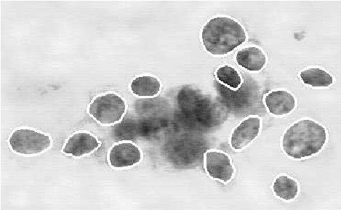
The Breast Cancer Wisconsin dataset comprises 569 instances of breast cancer cases.
Each case is described by 30 numerical features derived from digitized images of fine needle aspirates (FNAs) of breast masses.
Features include measurements such as radius, texture, perimeter, area, and smoothness, computed for mean, standard error, and worst-case scenarios.
The dataset's primary objective is to predict breast tumor diagnosis, with the outcome variable 'diagnosis' denoting malignancy (M) or benignancy (B).
Researchers leverage advanced machine learning techniques to enhance breast cancer diagnosis accuracy and efficiency.
Ultimately, the dataset aims to improve patient outcomes by providing insights into breast cancer diagnosis.

Slide 4
Data Description
Total Entries: 569
Columns: 33
Data Types:
int64: 1 column (id)
object: 1 column (diagnosis)
float64: 31 columns (numerical features)
Non-Null Counts: All columns have 569 non-null entries.
Description:
The dataset contains clinical data related to breast cancer.
Features include mean, standard error, and worst-case measurements of various parameters such as radius, texture, perimeter, area, smoothness, compactness, concavity, concave points, symmetry, and fractal dimension.
The target variable is diagnosis, indicating whether the tumor is malignant (M) or benign (B).
Unnamed Column: There's an unnamed column (Unnamed: 32) with 0 non-null entries, possibly an artifact that should be dropped.

Slide 5
Data Preprocessing
Loaded the Breast Cancer Wisconsin dataset and inspected its structure to understand its features and target variable.
Handled missing values by checking for any null values and applying appropriate methods to handle them, ensuring data integrity.
Encoded categorical variables, such as the diagnosis column, into numerical format to make them suitable for modeling.
Scaled numerical features using StandardScaler to ensure that all features have a similar scale, enhancing the performance of machine learning algorithms.
Split the dataset into training and testing subsets to evaluate the model's performance on unseen data.

Slide 6
Model Training and Evaluation
Explored various machine learning models for breast cancer classification, including Logistic Regression, Random Forest, and Support Vector Machines (SVM).
Trained the models on preprocessed data to uncover patterns and relationships between features and breast cancer diagnosis.
Initially used logistic regression but encountered multicollinearity issues due to interrelated features.
Transitioned to Random Forest, leveraging its ensemble nature to handle non-linear relationships and interactions between variables effectively.
Evaluated model performance using metrics such as ROC-AUC to assess effectiveness in classifying breast cancer instances.
Compared and selected the Random Forest model based on its robust performance and ability to manage complex datasets inherent in breast cancer classification tasks.

Slide 7
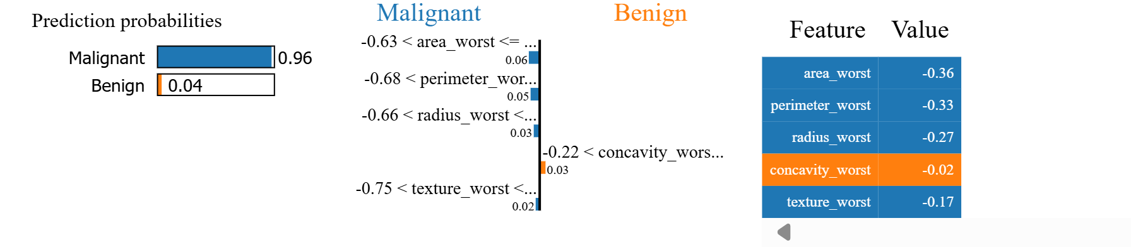
Model Training and Evaluation
Random Forest Modeling:
Utilized the Random Forest algorithm for classification due to its ability to handle complex data and provide insights into feature importance.
Tuned hyperparameters, such as the number of estimators and maximum depth, using techniques like GridSearchCV to optimize model performance.
Analyzed feature importance using RandomForestClassifier to identify key predictors contributing to the classification of breast cancer instances.
LIME Explanation

Slide 8
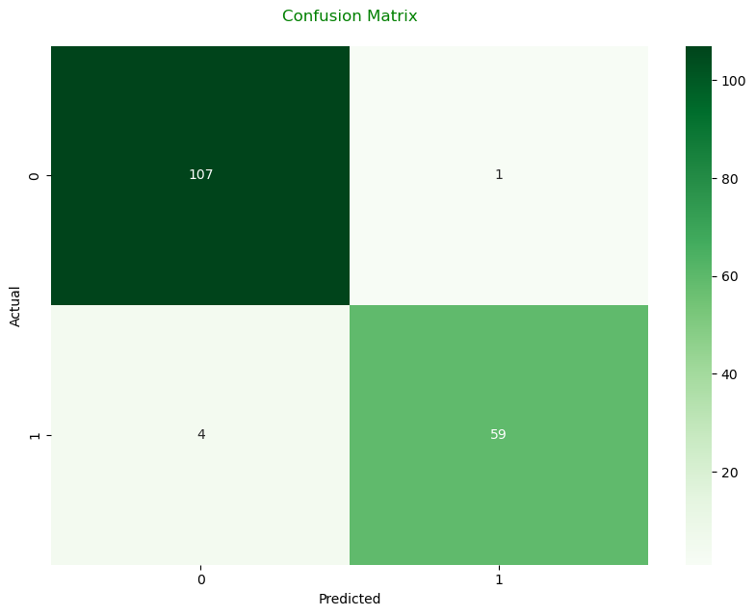
Confusion Matrix
The confusion matrix provides a detailed breakdown of the model's performance in classifying breast cancer tumors.
True Positives (TP): 107 instances were correctly classified as malignant tumors, demonstrating the model's ability to accurately identify cancerous growths.
False Positives (FP): Only 1 benign tumor was incorrectly classified as malignant, indicating a low rate of false alarms.
False Negatives (FN): 4 malignant tumors were mistakenly classified as benign, which is concerning as it represents cases where cancerous growths were missed by the model.
True Negatives (TN): 59 instances were correctly classified as benign tumors, reflecting the model's proficiency in identifying non-cancerous growths.

Slide 9
Conclusion
Summary of Results:
Achieved high accuracy and predictive performance with the Random Forest model, which accurately classified breast cancer instances as malignant or benign.
Identified key features contributing to the classification, such as concave points_mean, concave points_worst, area_worst, and concavity_mean.

Slide 10
Thank you
Dina Batros

