Slide 1
Predicting Sleep Disorders

Slide 2
Agenda
2
Dataset Overview
Data Wrangling
Exploratory Data Analysis (EDA)
Preprocessing Overview
Model Evaluation Metrics
Confusion Matrix
Conclusion

Slide 3
Dataset Overview
The Sleep Health and Lifestyle Dataset comprises 400 rows and 13 columns, covering a wide range of variables related to sleep and daily habits. It includes details such as gender, age, occupation, sleep duration, quality of sleep, physical activity level, stress levels, BMI category, blood pressure, heart rate, daily steps, and the presence or absence of sleep disorders.

Slide 4
Data Wrangling
4
Identified Missing Values: Addressed missing data to ensure completeness and accuracy.
Handled Duplicates: Removed duplicate entries for data consistency.
Descriptive Statistics: Calculated mean and median values to understand central tendencies.
Data Exploration: Used initial data exploration to inform subsequent analytical steps.

Slide 5
Exploratory Data Analysis (EDA)
Objective: Gained insights into dataset characteristics and relationships between variables.
Methods: Utilized descriptive statistics (describe() function) and visualizations (histograms, count plots) to explore data distributions and categorical variables.
Insights: Highlighted key findings and initial observations to guide further analysis and modeling decisions.

Slide 6
Preprocessing Overview
Handling Missing Values:
Checked and filled missing values in 'Sleep Disorder' with 'Unknown' category.
Ensured dataset integrity with no remaining missing values.
Data Transformation:
Converted categorical variables into dummy variables for modeling.
Applied StandardScaler to normalize numeric features.
Feature Selection:
Identified and prepared relevant features (X) and target (y) variables.
Ensured data readiness for machine learning tasks.
Train-Test Split:
Segmented data into training (80%) and testing (20%) sets.
Verified data split integrity for modeling.

Slide 7
Selection of Random Forest Algorithm:
Upon thorough evaluation, Random Forest was selected for its robustness in managing complex data structures, ability to mitigate overfitting, and capacity to discern significant features, thereby enhancing predictive accuracy in sleep disorder classification.

Slide 8
Random Forest Classifier
Model Training and Evaluation
Utilized Random Forest Classifier to predict 'Sleep Disorder'.
Achieved an accuracy of 87.1% on the test dataset.
Evaluation Metrics
Precision: 85.7%
Recall: 85.7%
F1-score: 85.7%
ROC-AUC score: 0.87
Confusion Matrix
Provides insight into model performance:
[[12 2] [ 2 15]]
Hyperparameter Tuning
GridSearchCV Results
Best parameters:
n_estimators: 300
max_depth: None
min_samples_split: 10
min_samples_leaf: 4
Best accuracy: 88.8%

Slide 9
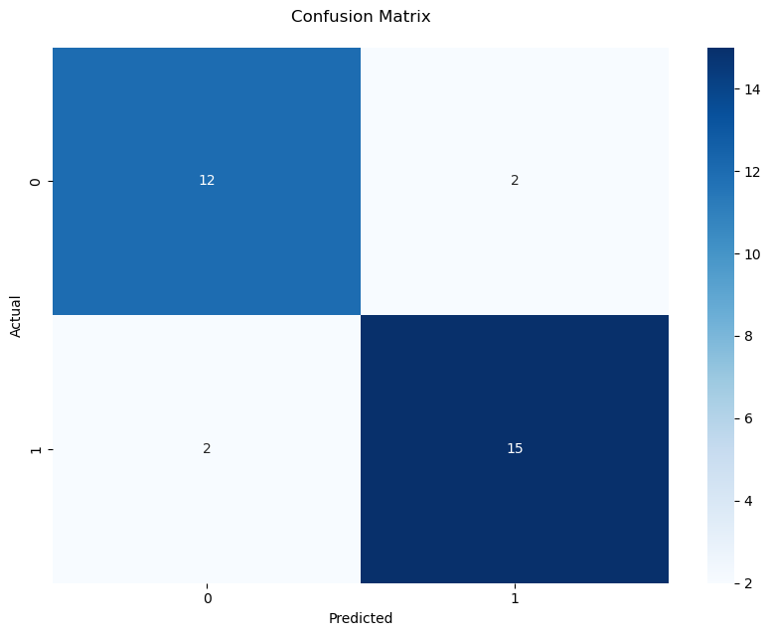

Slide 10
Conclusion
The model exhibits robust performance with high accuracy, precision, recall, and F1-score.
ROC-AUC score indicates strong class differentiation capability.
Hyperparameter tuning has further optimized model accuracy.
Overall, the model proves effective for predicting sleep disorders, particularly insomnia, offering valuable insights for healthcare applications.

Slide 11
Thank You
Dina Batros

