Slide 1
Get the openssl zip and extract the files inside C:\users\<username>\openssl
Configure the bin directory of the openssl in the Environmental Variables - Path
Configure the below variable in the User’s Environmental Variables
OPENSSL_CONF = C:\users\<username>\openssl\openssl.cnf
4. Open a command prompt and just try openssl. It should open the OpnSSl prompt. Close this window.
5. Create a directory C:\ Localhost_sslkeys 6. Open a command prompt from this directory. execute the below commands one by one. You can give passphrase as ‘admin’ wherever it asks. This is just to remember easily. You should not get any error in any of the command execution. openssl genrsa -aes256 -out localhostprivate.key 4096 openssl rsa -in localhostprivate.key -out localhostprivate.key openssl req -sha256 -new -key C:\Localhost_sslkeys\localhostprivate.key -out C:\Localhost_sslkeys\localhost.csr -subj "/CN=aemlocal.ford.com" openssl x509 -req -days 565 -in localhost.csr -signkey localhostprivate.key -out localhost.crt openssl pkcs8 -topk8 -inform PEM -outform DER -in localhostprivate.key -out localhostprivate.der –nocrypt

Slide 2
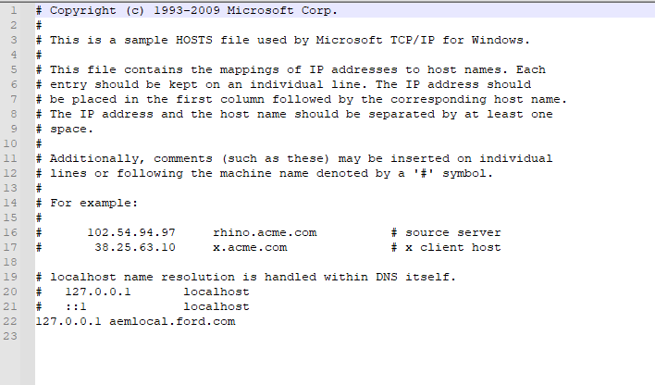
Go to this path : ‘C:\Windows\System32\drivers\etc’
open ‘hosts’ file in notepad
Make sure you add only line 22( at last) with “127.0.0.1 aemlocal.ford.com" and saved it.

Slide 3
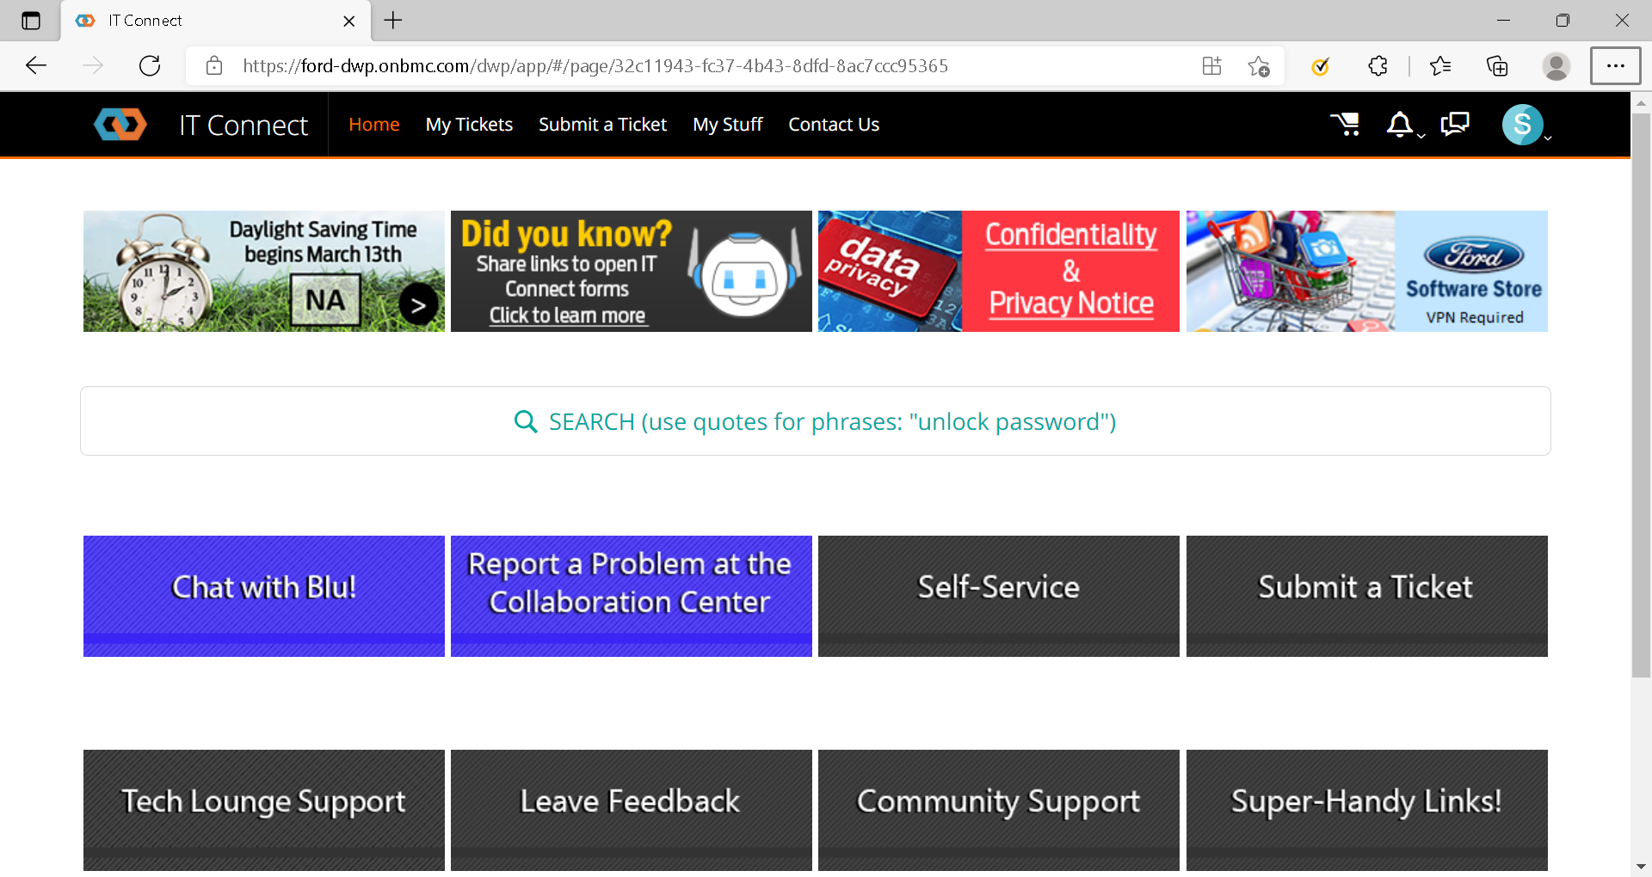
If you can’t save the ‘hosts’ file in ‘C:\Windows\System32\drivers\etc’, you have to connect with an Ford IT personnel in this link
https://www.itconnect.ford.com/
In there you can chat in Live with an agent and they will help you to add the text in ‘hosts’ file.

Slide 4
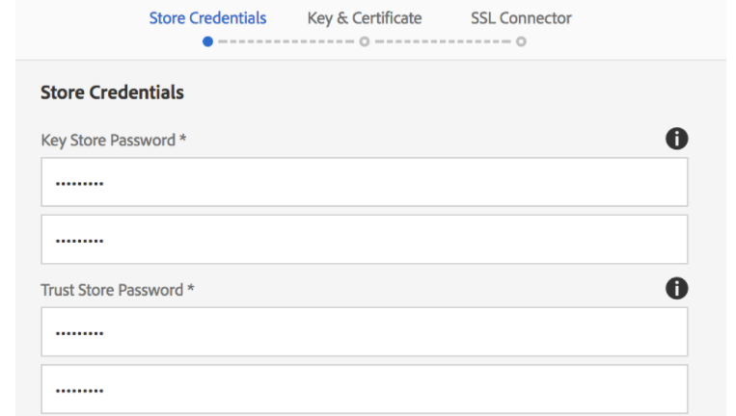
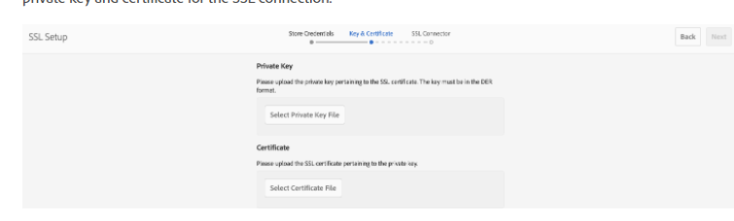
Access the below url in your local instance
http://aemlocal.ford.com:4502/libs/granite/security/content/sslConfig.html?item=configuration%2Fconfiguressl&_charset_=utf-8
Give all passwords as "admin" to remember and click next
Upload the localhostprivate.der as the Private Key and localhost.crt as the SSL Certificate

Slide 5
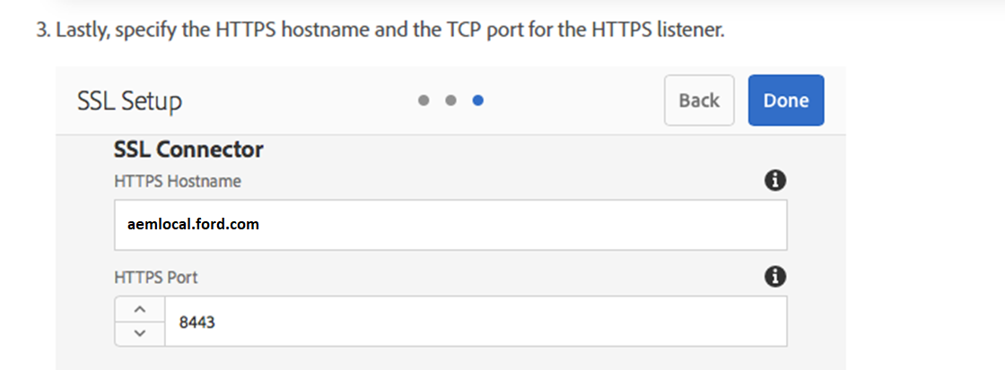
Add the below values and click Done.
You should be able to access your local instance as https://aemlocal.ford.com:8443

