Slide 1
VMRFDU ACTIVITY PORTAL
End User Guide
Step-by-Step Instructions for Creating and Managing Activities
For: College Admin / DEO Role
06 August 2026
✓ 📤 🔒

Slide 2
In This Guide
User Login
1
Sign in to the portal with your DEO / College Admin credentials.
Creating a New Activity
2
Fill in the Past Event or Future Event form with your activity details.
Submitting an Activity
3
Review, submit, and track your activity through Pending Verification.
Profile Management
4
View your profile, edit your details, and change your password.

Slide 3
🔒
SECTION 1
User Login
Signing in to the VMRFDU Activity Portal

Slide 4
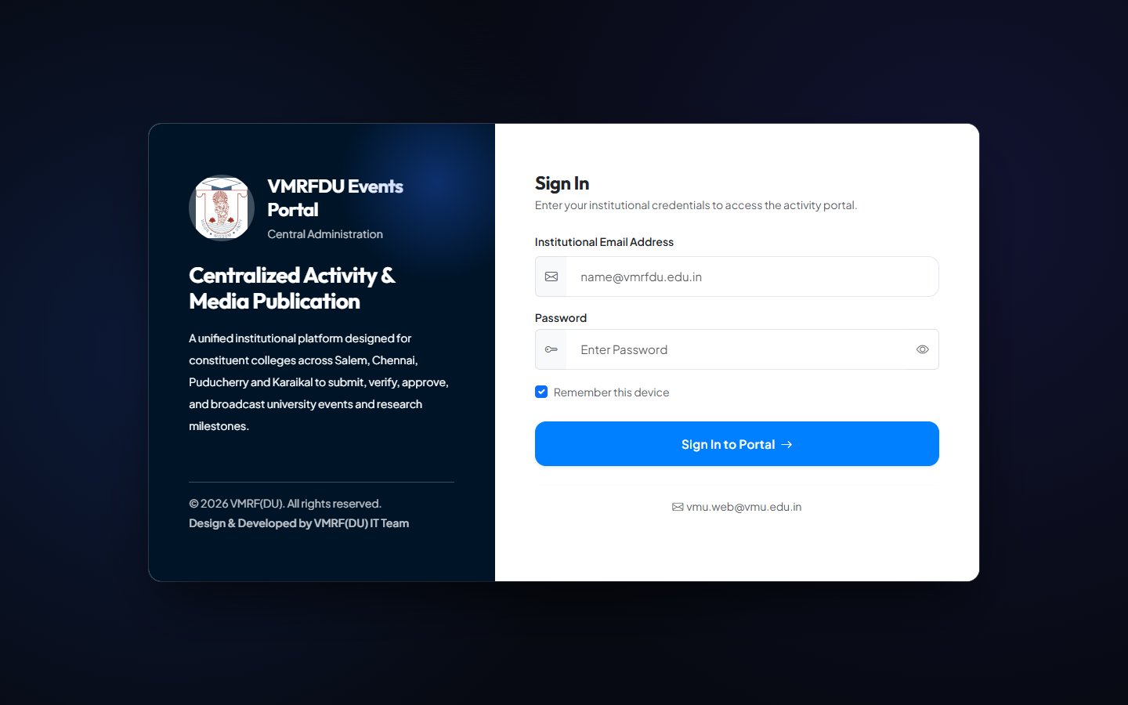
SECTION 1 - USER LOGIN
Step 1: Open the Login Page
1
Open your web browser and go to the VMRFDU Activity Portal address given by your administrator.
2
The portal shows the Login page automatically if you are not signed in.
1
3
You will see two boxes: one for your Email Address and one for your Password.
4
Make sure Caps Lock is off before you start typing your password.

Slide 5
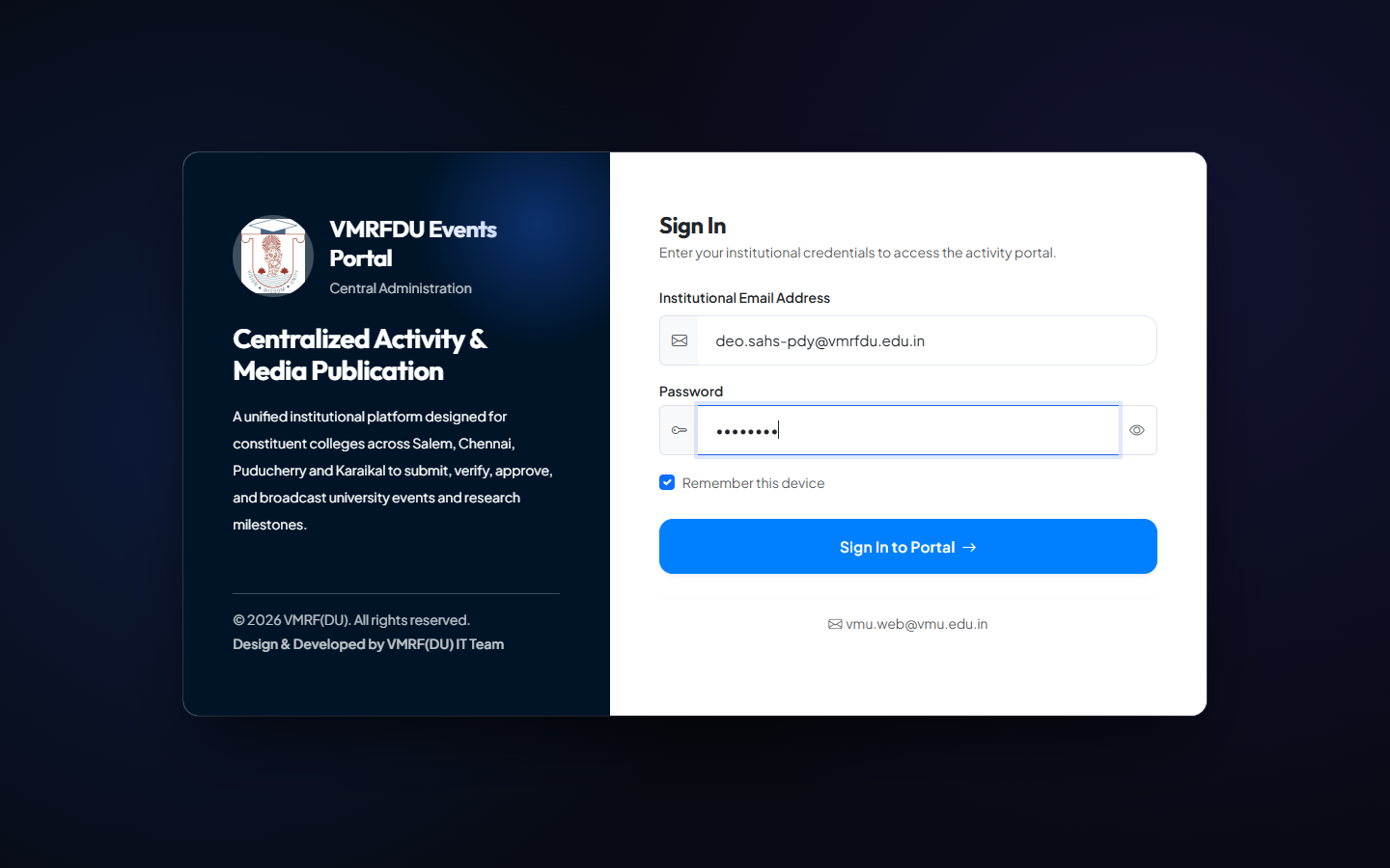
SECTION 1 - USER LOGIN
Step 2: Enter Your Credentials and Sign In
1
Step 1: Click the Email Address field and type your official college email address (example: deo.sahs-pdy@vmrfdu.edu.in).
2
Step 2: Click the Password field and type your password carefully.
3
Step 3: Click the Sign In button to continue.
4
If your details are correct, the portal will take you straight to your Dashboard.

Slide 6
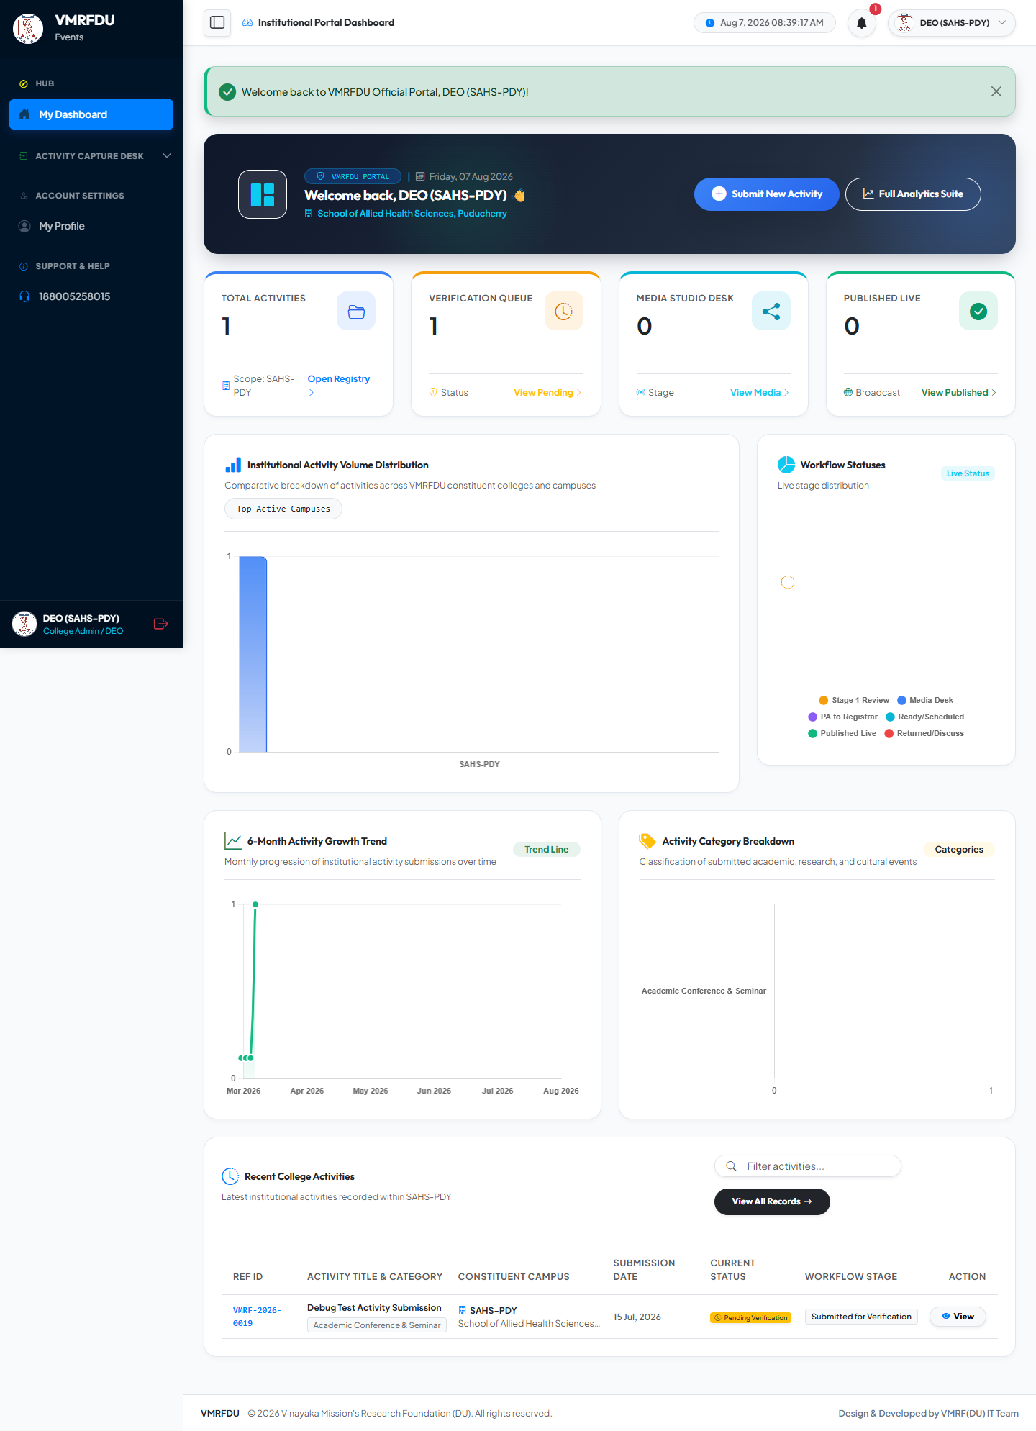
SECTION 1 - USER LOGIN
Step 3: Your Dashboard
1
After signing in, you land on My Dashboard - your home screen.
2
2
The left-hand Sidebar Menu lets you open Submit New Activity, Submission History, and My Profile.
3
The top summary cards show Total Activities, Verification Queue, Media Studio Desk, and Published Live counts for your college.
4
Use the blue Submit New Activity button at any time to start recording a new activity.

Slide 7
📤
SECTION 2
Creating a New Activity
Filling in the Past Event and Future Event forms

Slide 8
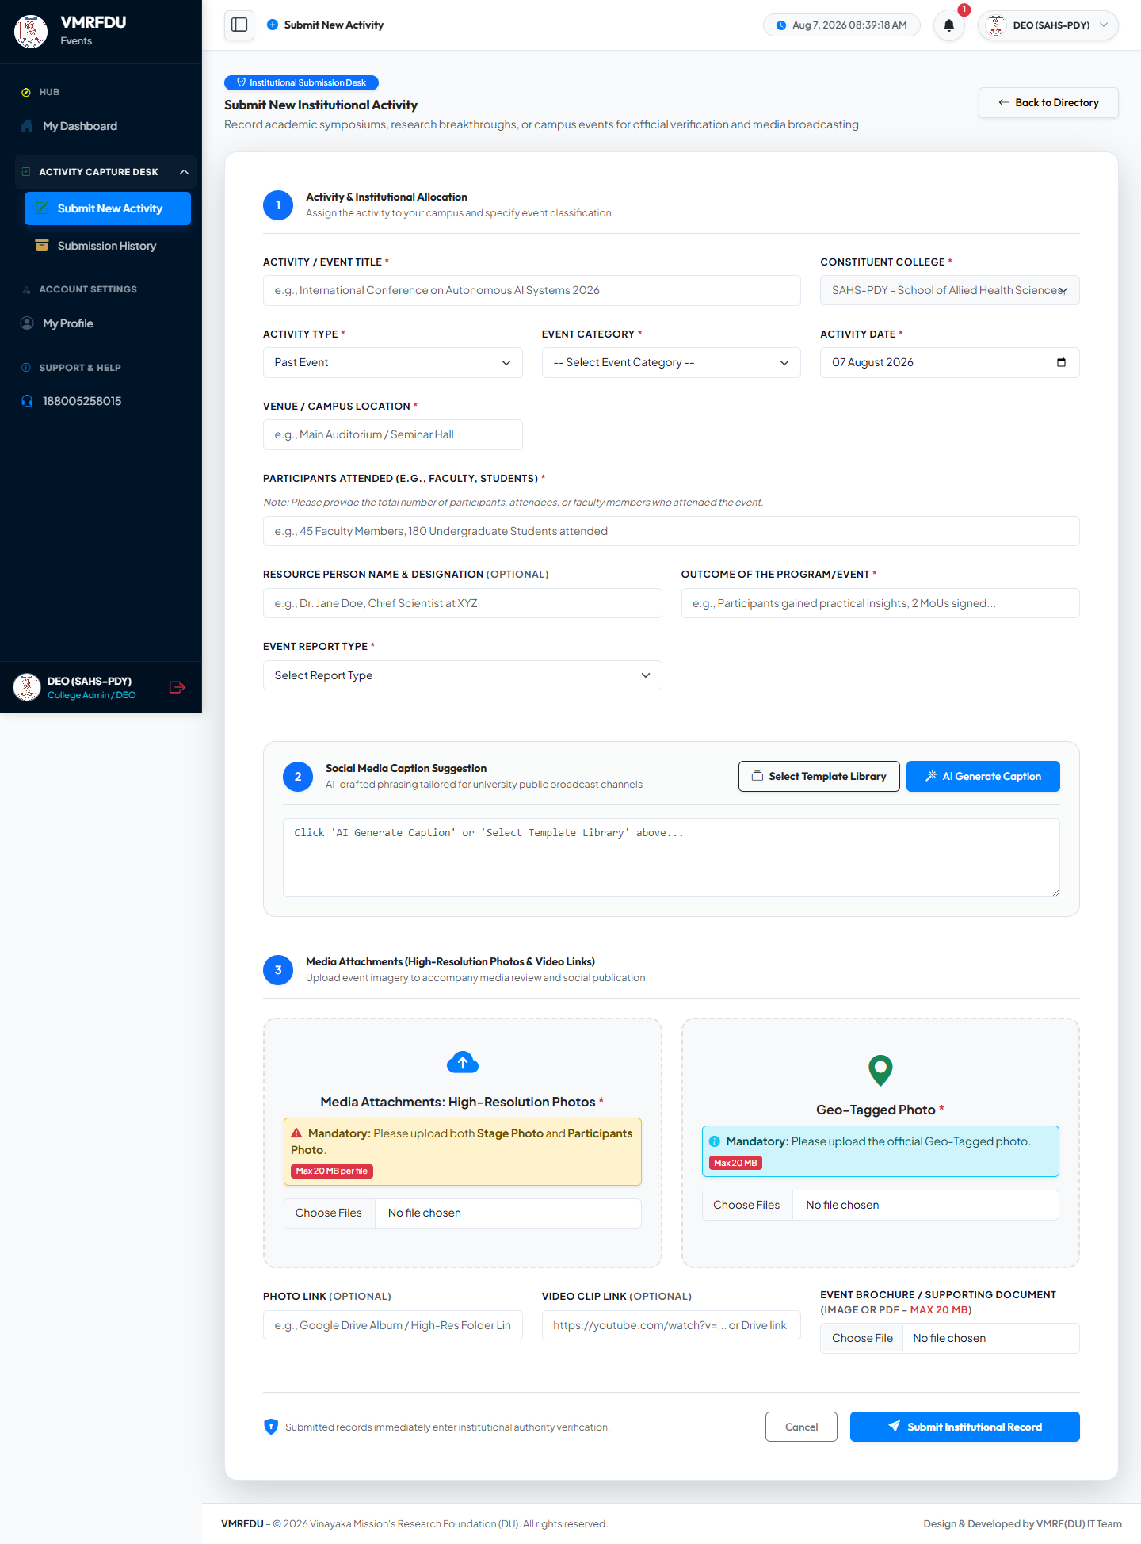
SECTION 2 - PAST EVENT FLOW
Step 1: Open the Activity Submission Form
1
Step 1: From the sidebar, click Activity Capture Desk, then Submit New Activity.
1
2
Step 2: Enter the Activity / Event Title (for example, the name of your seminar or workshop).
3
Step 3: Your Constituent College is filled in automatically and cannot be changed.
4
Step 4: Choose the Activity Type: select "Past Event" for an event that has already happened.
5
Step 5: Choose the Event Category, Activity Date, and Venue / Campus Location.

Slide 9
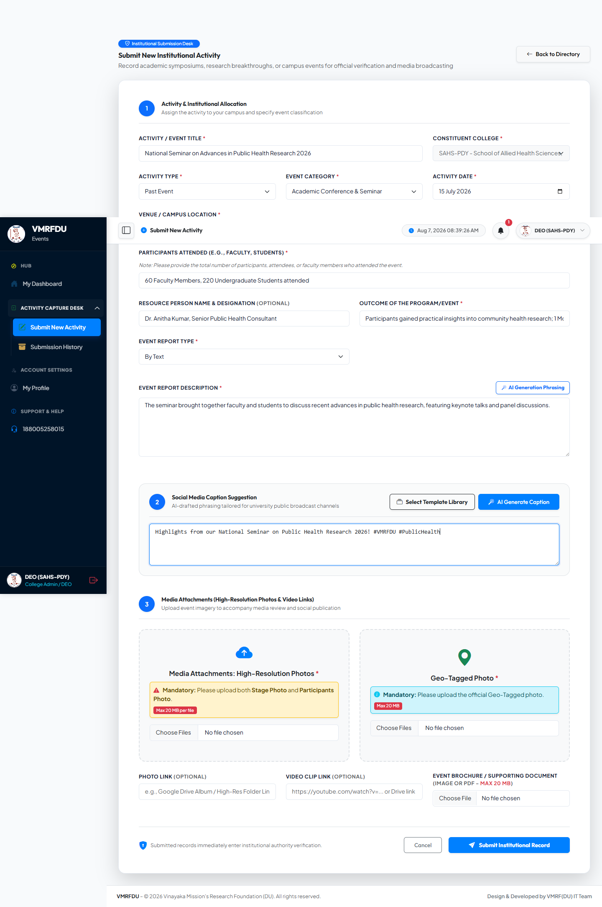
SECTION 2 - PAST EVENT FLOW
Step 2: Complete Event Details (Past Event)
1
Step 1: Fill in Participants Attended, for example "60 Faculty Members, 220 Students attended".
2
Step 2: Optionally add the Resource Person Name & Designation.
3
Step 3: Describe the Outcome of the Program / Event in a few sentences.
4
Step 4: Choose the Event Report Type - "By Text" to type a description, or "By Attach File" to upload a report document.
5
Step 5: A social media caption is suggested for you automatically. You may edit it or click AI Generate Caption for a new suggestion.

Slide 10
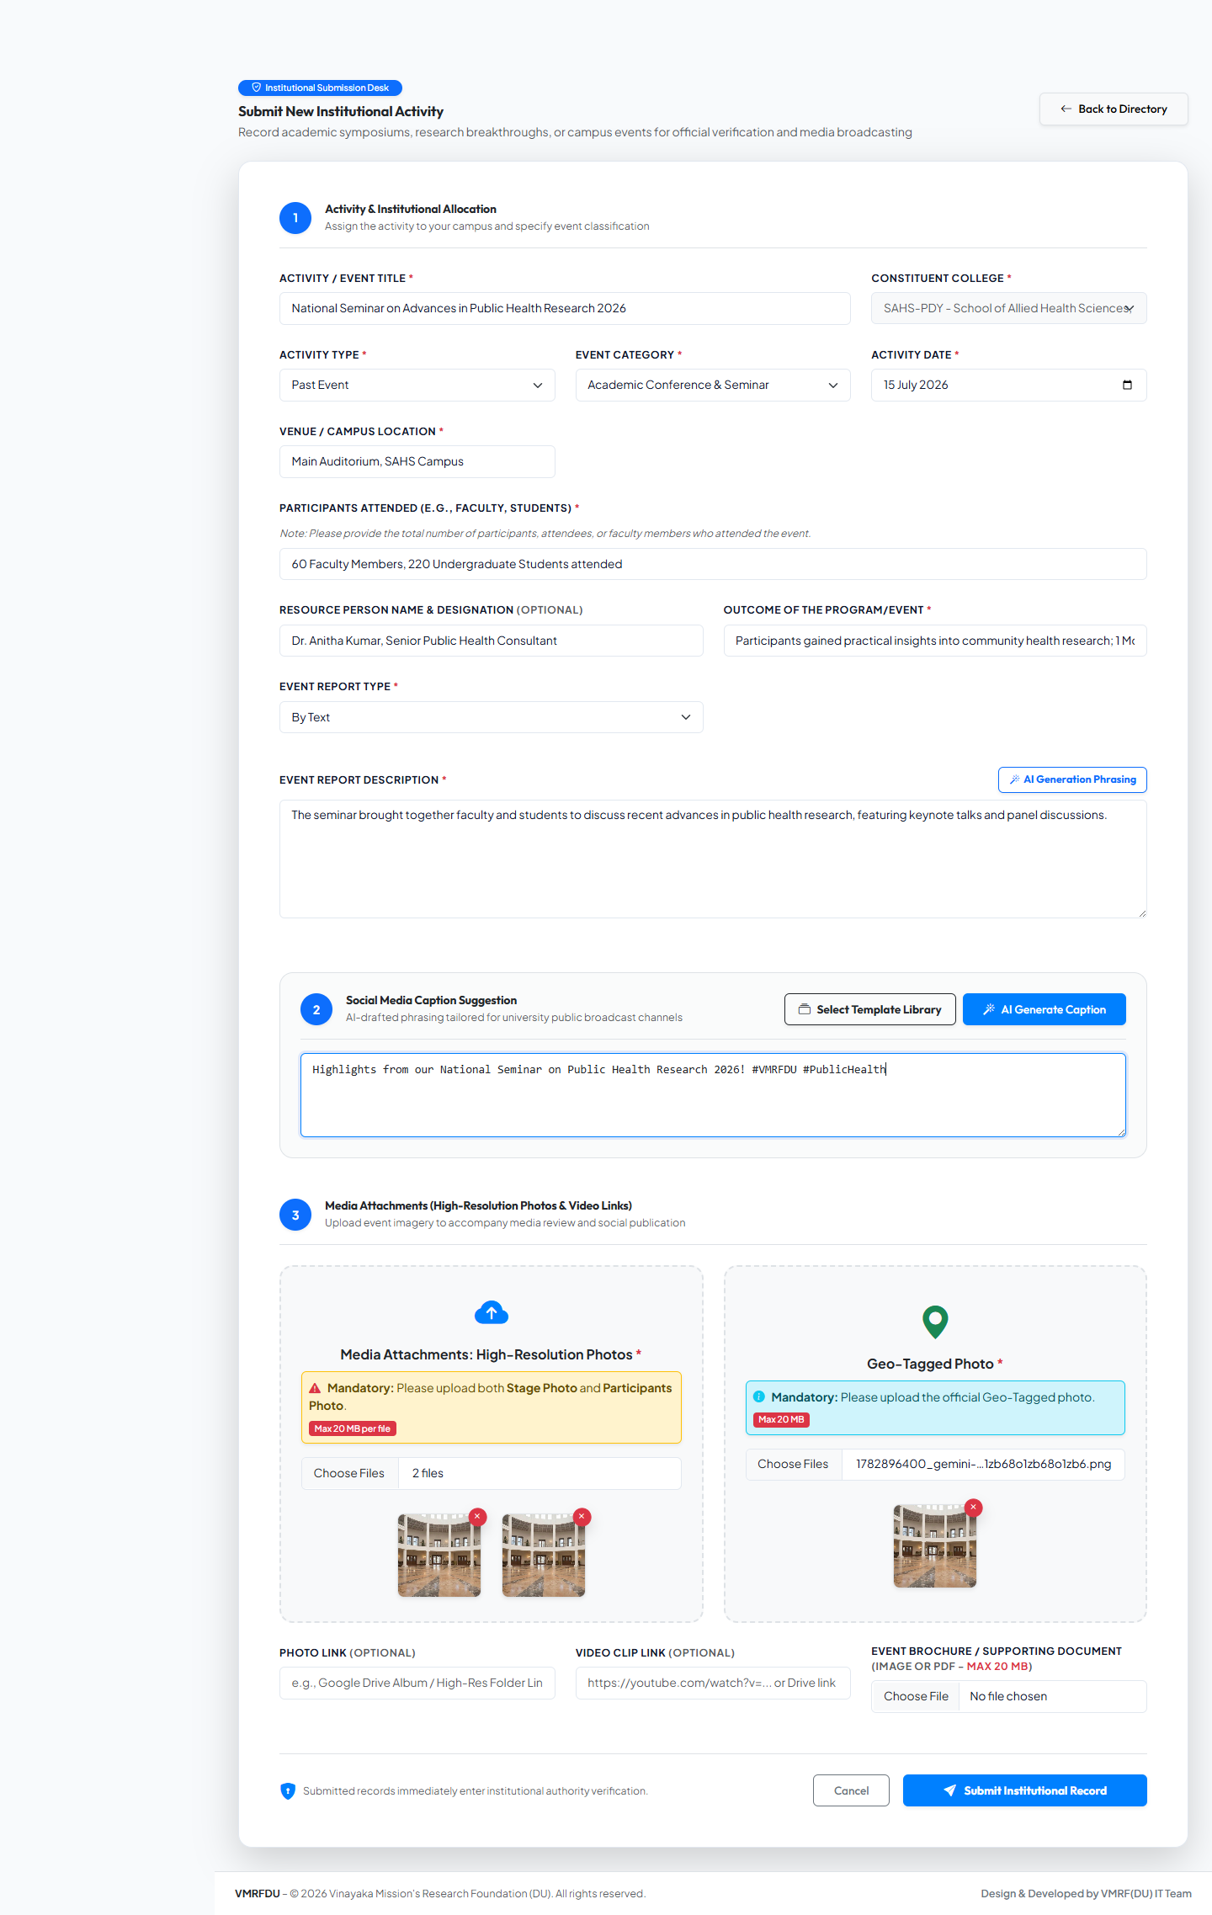
SECTION 2 - PAST EVENT FLOW
Step 3: Upload Photos and Supporting Files
1
Step 1: Under Media Attachments, click Choose Files and select your event photos. At least one Stage Photo and one Participants Photo are required.
2
Step 2: Under Geo-Tagged Photo, click Choose Files and upload the official geo-tagged photo of the venue.
3
Step 3: Optionally add a Photo Link, Video Clip Link, or an Event Brochure document.
4
Step 4: Selected photos appear as small previews. Click the red X on a photo to remove it before submitting.
1
2

Slide 11
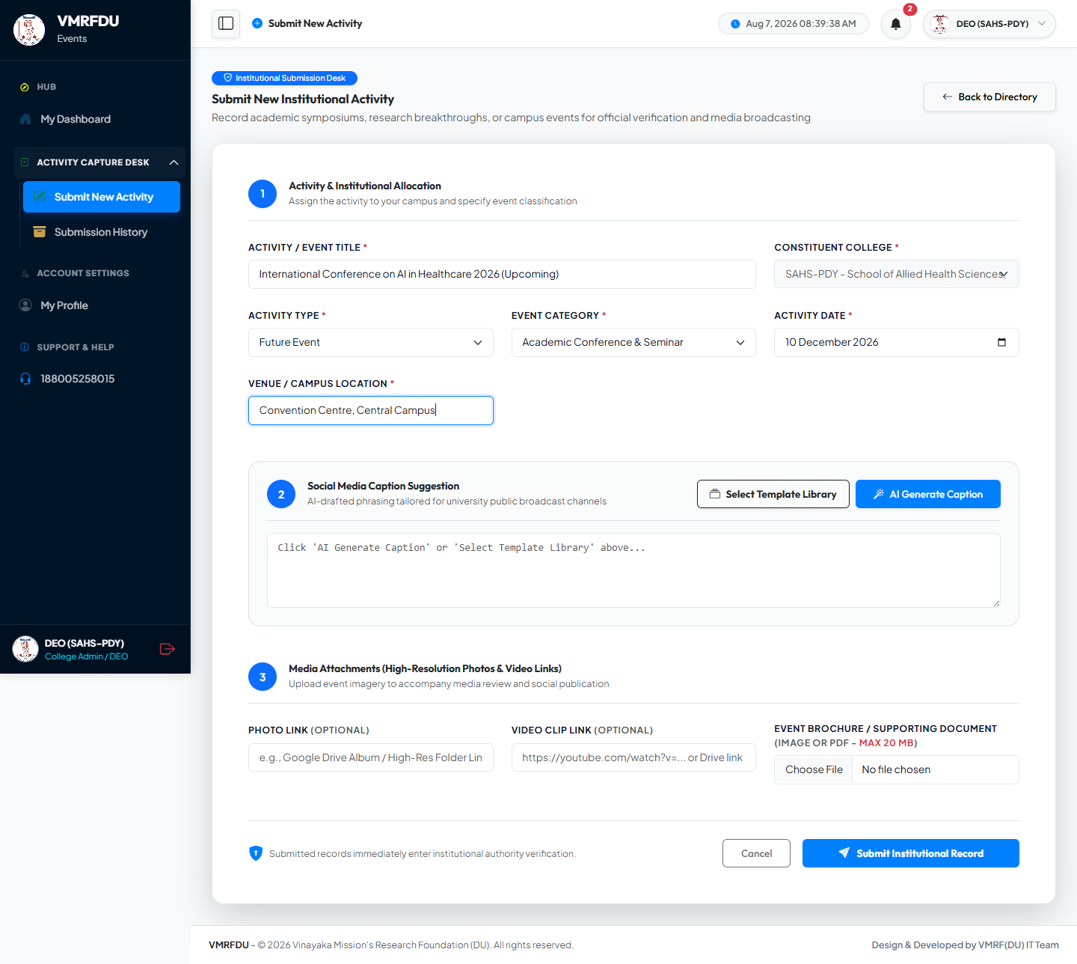
SECTION 2 - FUTURE EVENT FLOW
Future Event: What Is Different
1
Step 1: On the Activity Type dropdown, select "Future Event" instead of "Past Event".
2
Step 2: The Activity Date now accepts any upcoming date - it is no longer limited to today or earlier.
1
3
Step 3: The Participants, Resource Person, Outcome, Report Type, and Photo Upload sections are hidden and not required, because the event has not happened yet.
4
Step 4: Simply fill in the Title, Event Category, Date, and Location, then submit - you can add photos and outcomes later once the event takes place.

Slide 12
✓
SECTION 3
Submitting an Activity
Sending your activity for institutional verification

Slide 13
SECTION 3 - SUBMIT
Step 1: Review and Submit the Record
1
Step 1: Scroll to the bottom of the form and review all the details you entered.
2
Step 2: Click Cancel if you want to go back without saving.
3
Step 3: Click the blue Submit Institutional Record button to send your activity for verification.
4
Step 4: The portal automatically optimizes your uploaded images and processes your submission - please do not close the window while this happens.
3

Slide 14
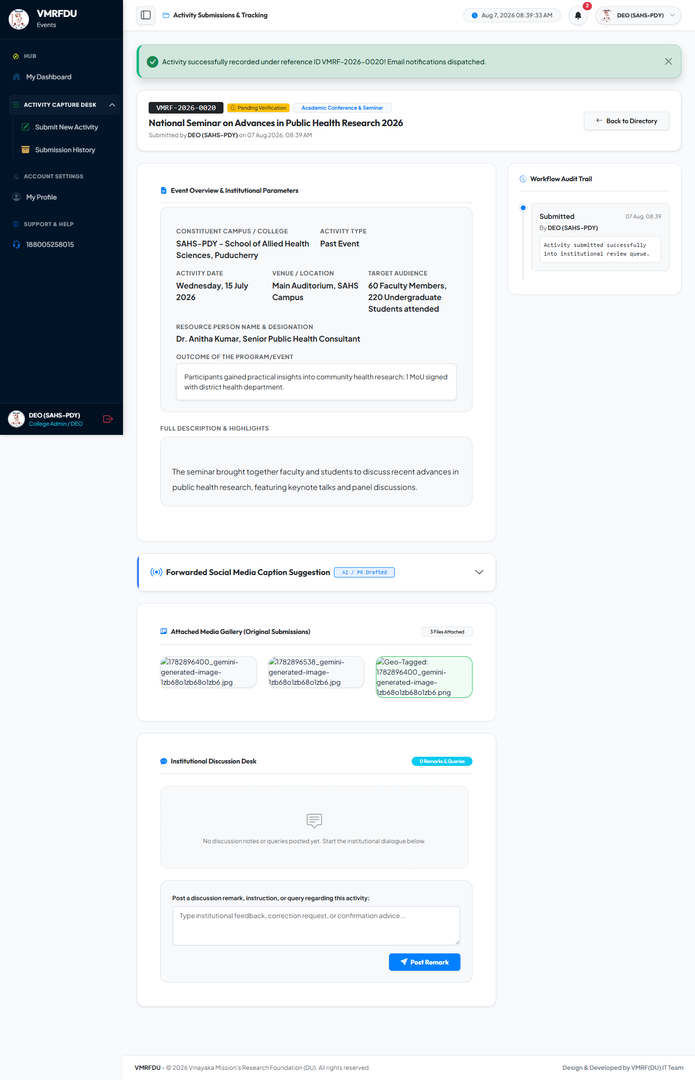
SECTION 3 - SUBMIT
Step 2: Confirmation and Pending Verification Status
1
Step 1: After submitting, the portal shows a green success message with your unique Reference ID (example: VMRF-2026-0020).
1
2
Step 2: Your activity status is displayed as "Pending Verification" - this means your college authorities will review it next.
3
Step 3: The Workflow Audit Trail on the right shows the submission history for this activity.
4
Step 4: You can add follow-up notes in the Institutional Discussion Desk if needed.

Slide 15
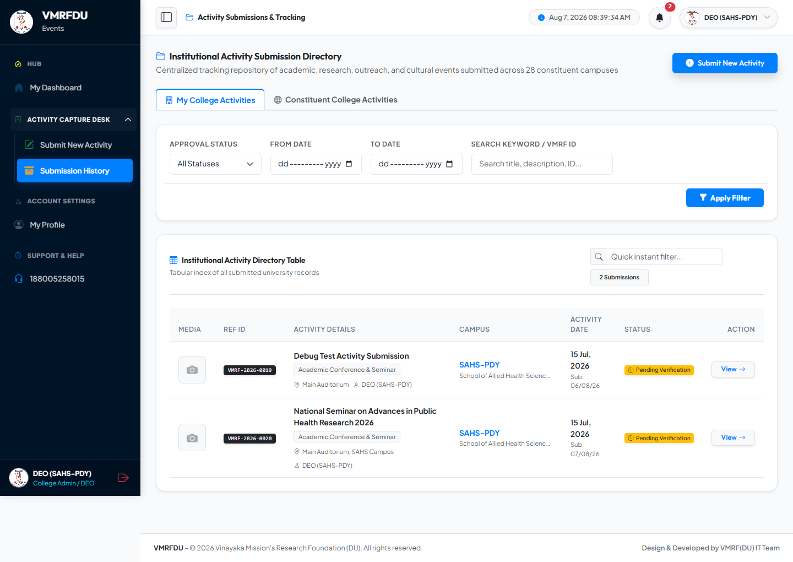
SECTION 3 - SUBMIT
Step 3: Track Your Submission in the List
1
Step 1: From the sidebar, click Activity Capture Desk, then Submission History to see all your submitted activities.
2
Step 2: Your new activity appears at the top of the Institutional Activity Directory Table with a "Pending Verification" status badge.
3
Step 3: Use Approval Status, From Date, To Date, or the search box to find a specific activity.
4
Step 4: Click View next to any record to see its full details and audit trail.
1

Slide 16
🔒
SECTION 4
Profile Management
Viewing your profile, editing details, and changing your password

Slide 17
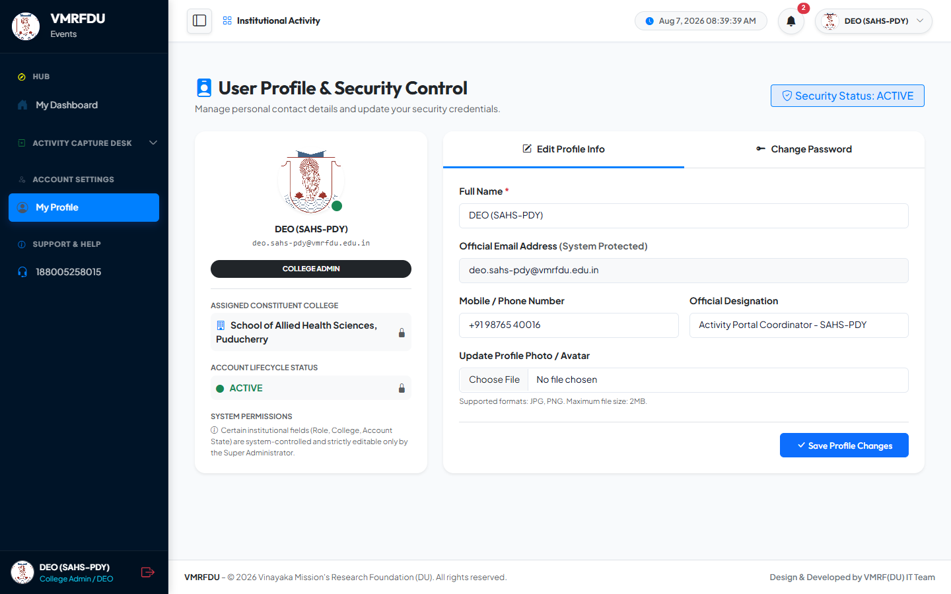
SECTION 4 - PROFILE
Step 1: View Your Profile
1
Step 1: Click My Profile in the left sidebar under Account Settings.
1
2
Step 2: Your name, email, role, assigned college, and account status appear on the left card.
3
Step 3: Fields marked with a lock icon (Role, College, Account State) are managed only by the Super Administrator and cannot be changed here.
4
Step 4: Use the two tabs on the right - Edit Profile Info and Change Password - to manage your account.

Slide 18

SECTION 4 - PROFILE
Step 2: Edit Your Profile Information
1
Step 1: On the Edit Profile Info tab, update your Full Name if needed.
1
2
Step 2: Your Official Email Address is system-protected and cannot be edited here.
3
Step 3: Add or update your Mobile / Phone Number and Official Designation.
4
Step 4: Optionally upload a new Profile Photo (JPG or PNG, max 2MB).
5
Step 5: Click Save Profile Changes to update your details.

Slide 19
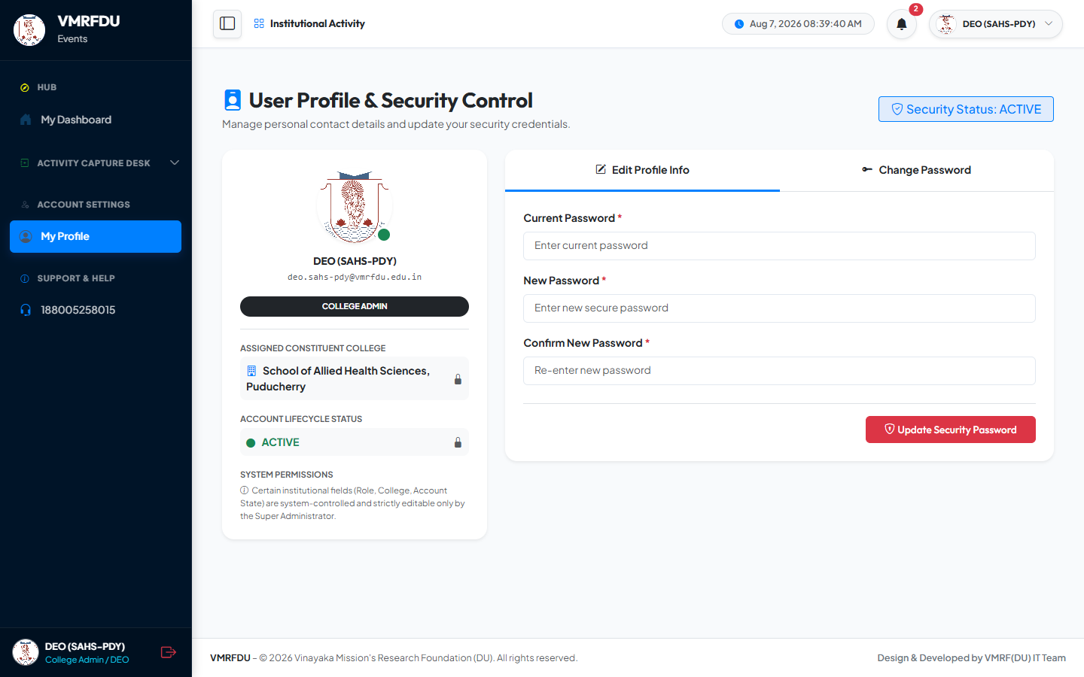
SECTION 4 - PROFILE
Step 3: Change Your Password
1
Step 1: On your profile page, click the Change Password tab.
1
2
Step 2: Enter your Current Password to confirm your identity.
3
Step 3: Type a New Password (minimum 6 characters), then re-enter it in Confirm New Password.
2
4
Step 4: Click Update Security Password to save your new password.
5
Tip: Choose a strong password and keep it confidential. Change it periodically for account security.

Slide 20
✓
You Are Ready to Use the VMRFDU Activity Portal
For further assistance, contact your Institutional Support Desk: 1880-052-58015

