Slide 1
VINAYAKA MISSION'S RESEARCH FOUNDATION (DU)
VMRFDU Activity Portal — User Manual
Step-by-Step Guide: Login to All Roles
06 August 2026
Covers: Super Admin • Vice Chancellor • Pro Vice Chancellor • Registrar • Office of Registrar • Media Editor • College Admin

Slide 2
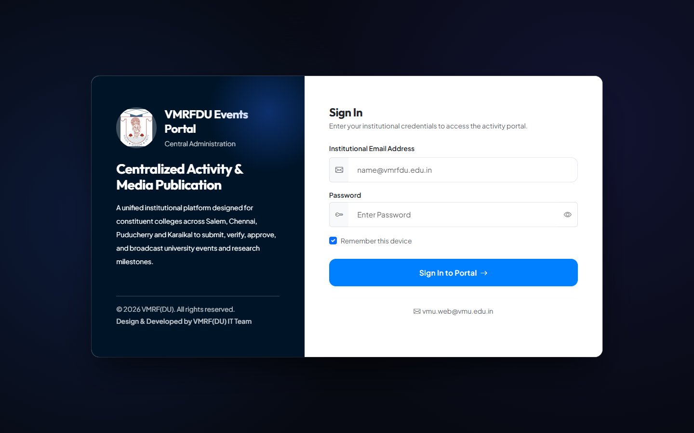
GETTING STARTED
How to Login
Navigate to the portal's /login page, enter your registered email and password, then click Sign In. The system validates your account status (active/locked), enforces any pending force-password-reset, and redirects you to your role-specific dashboard.
Role | Login Email | Password
Super Admin | vmu.web@vmu.edu.in | password
Vice Chancellor (VC) | vc@vmrfdu.edu.in | password
Pro Vice Chancellor (Pro VC) | provc@vmrfdu.edu.in | password
Registrar | registrar@vmrfdu.edu.in | password
Office of Registrar | officeregistrar@vmrfdu.edu.in | password
Media Editor | editor@vmrfdu.edu.in | password
College Admin (SAHS-PDY DEO) | deo.sahs-pdy@vmrfdu.edu.in | password

Slide 3
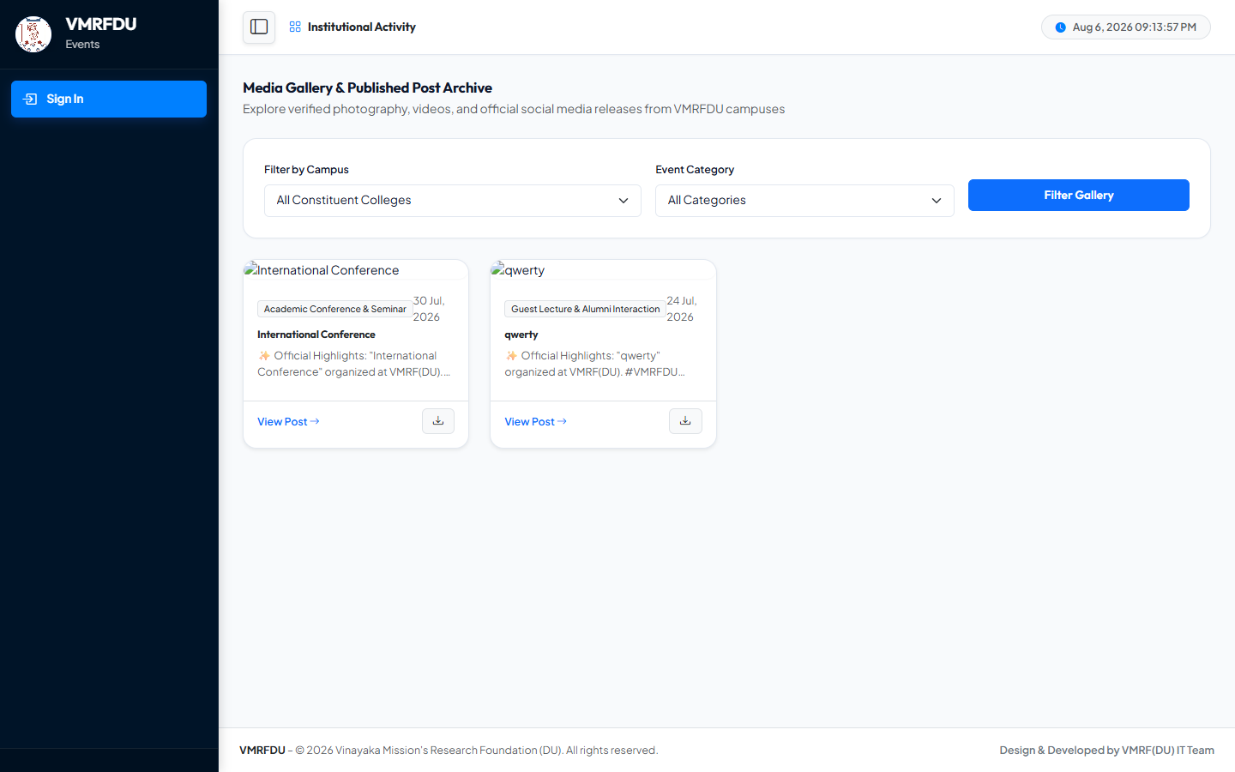
PUBLIC ACCESS
Public Gallery (No Login Required)
Publicly accessible showcase of all published institutional activities — searchable by keyword, category, college, and date range. No login required.

Slide 4
Super Admin
Account: vmu.web@vmu.edu.in
13 pages covered in this section

Slide 5
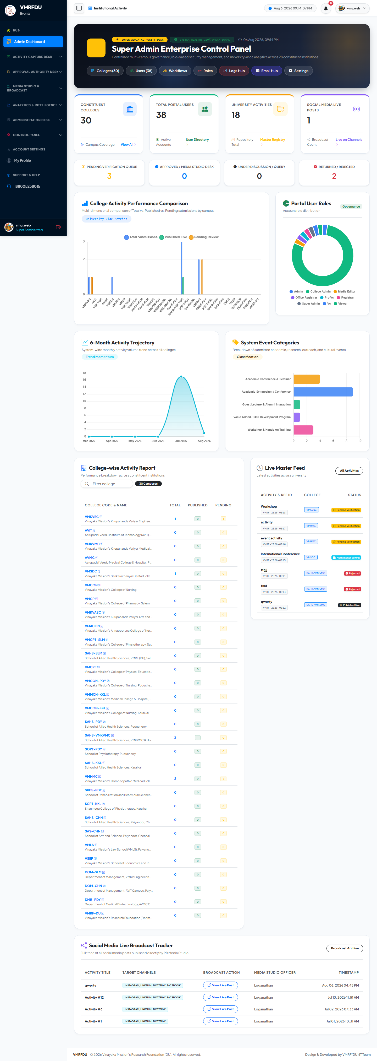
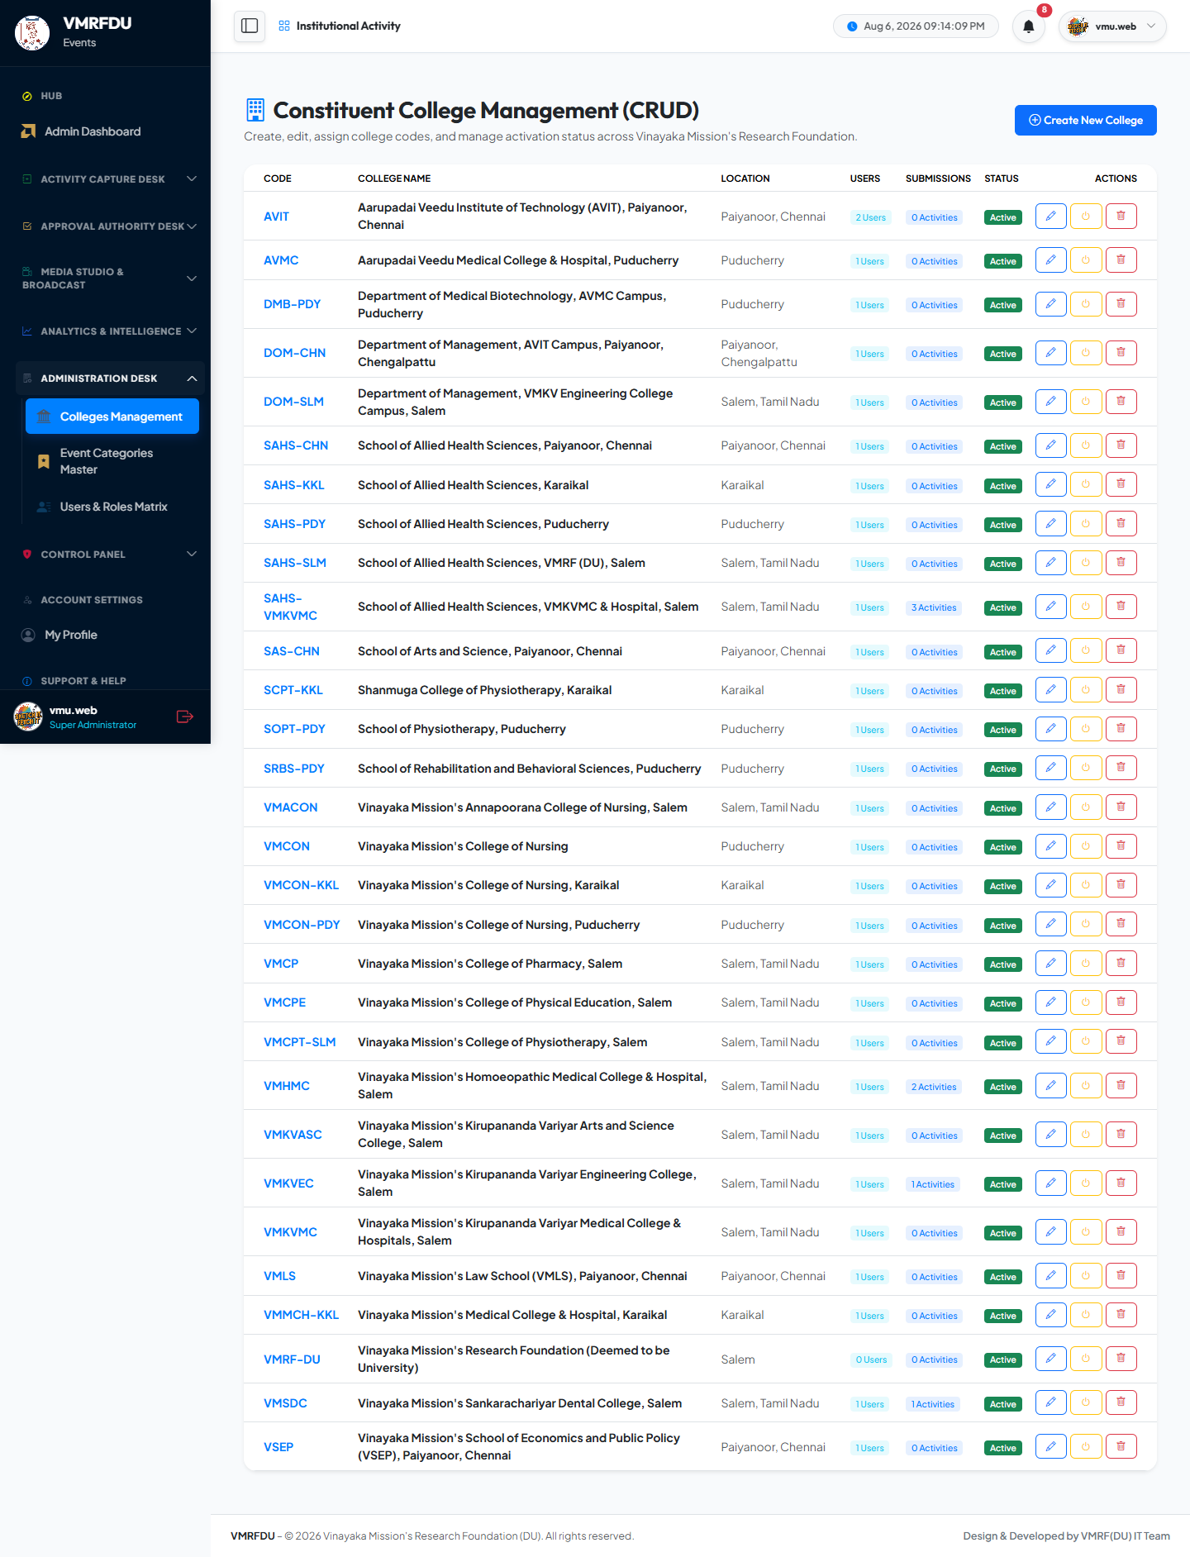
SUPER ADMIN
Dashboard & More
Super Admin: Dashboard
Super Admin: Colleges
The role's homepage: key stats, pending counts, and quick links to core actions.
Manage constituent colleges: create, edit, and toggle active status with unique college codes.

Slide 6
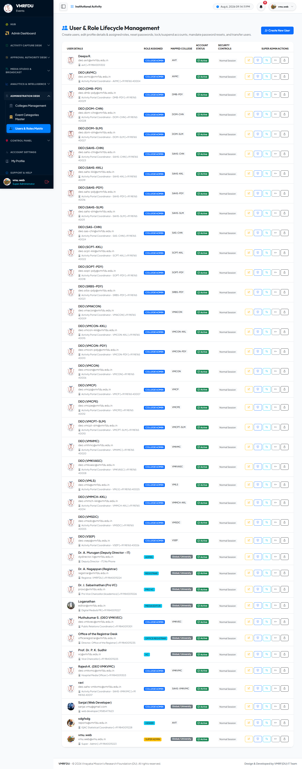
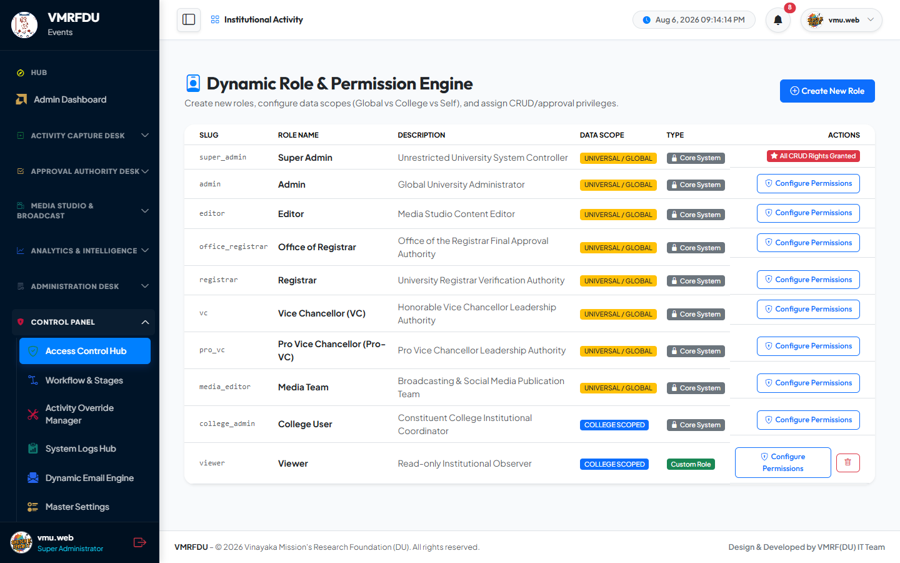
SUPER ADMIN
Users & More
Super Admin: Users
Super Admin: Roles
Create and manage user accounts: assign roles, colleges, lock/unlock, and force password resets.
Build dynamic roles with JSON permission matrices and assign global or college-scoped access.

Slide 7
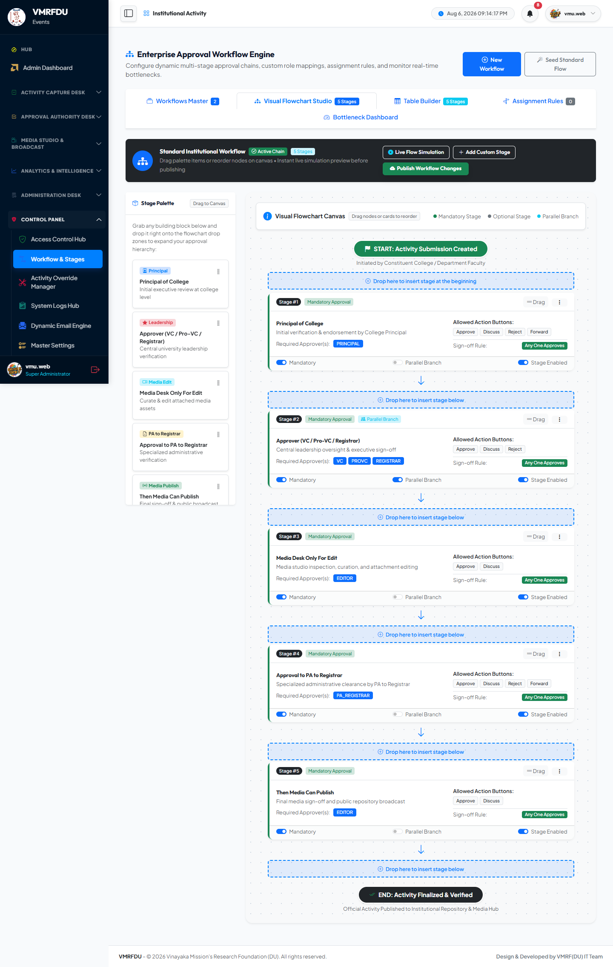
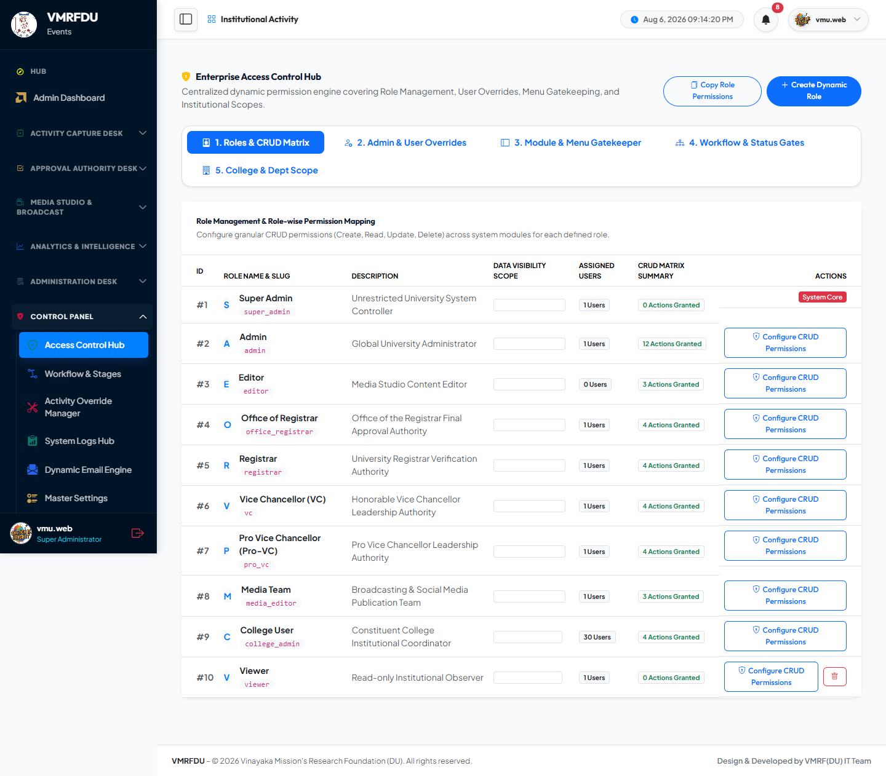
SUPER ADMIN
Workflows & More
Super Admin: Workflows
Super Admin: Access Control
Configure multi-stage approval workflow templates: stage order, roles, and allowed actions.
Per-user permission overrides beyond role defaults, and cross-role permission matrix view.

Slide 8
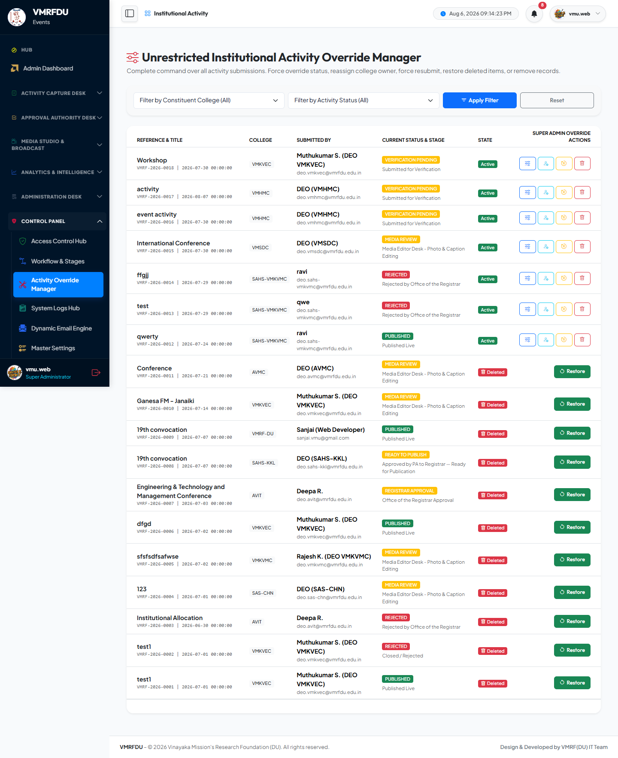
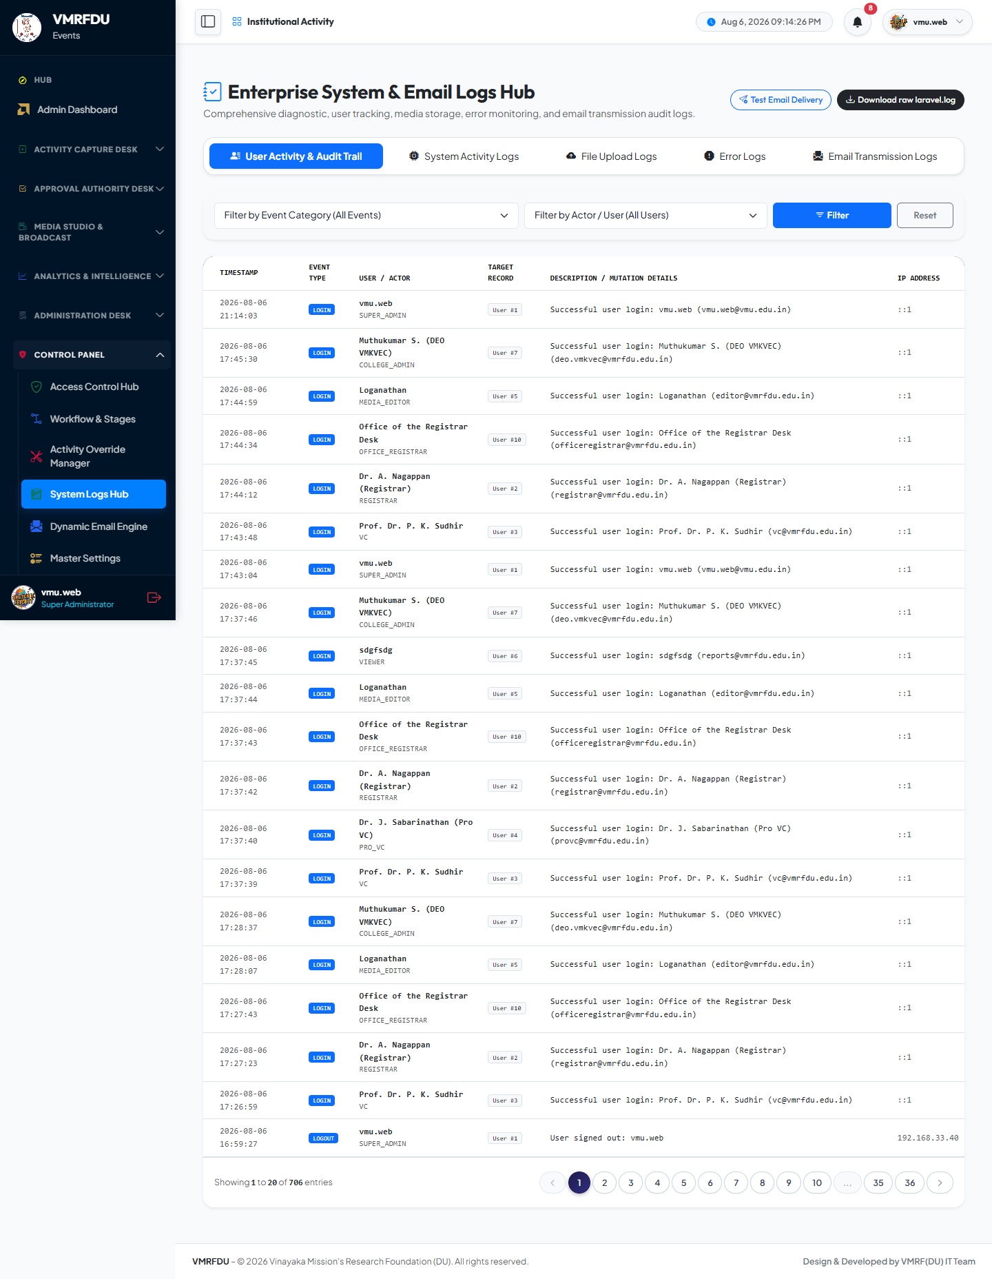
SUPER ADMIN
Activities & More
Super Admin: Activities
Super Admin: Audit Logs
Unrestricted activity management: force status changes, reassign, restore, or hard-delete records.
Immutable system-wide audit trail of every critical action, with actor, IP, and timestamp.

Slide 9
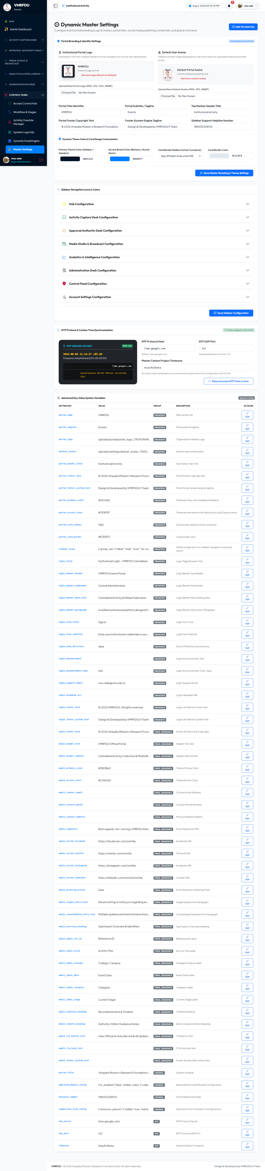
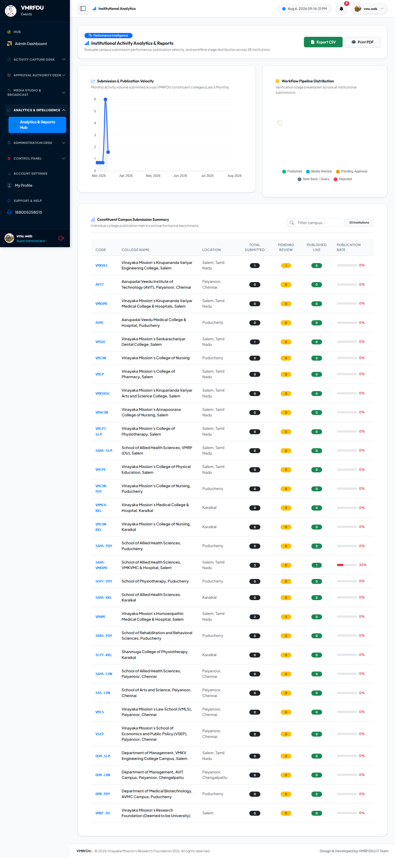
SUPER ADMIN
Settings & More
Super Admin: Settings
Super Admin: Analytics
Portal-wide branding and configuration: logo, favicon, NTP sync, and session settings.
Analytics dashboard with charts on submission volume, categories, and trends. Supports CSV/print export.

Slide 10
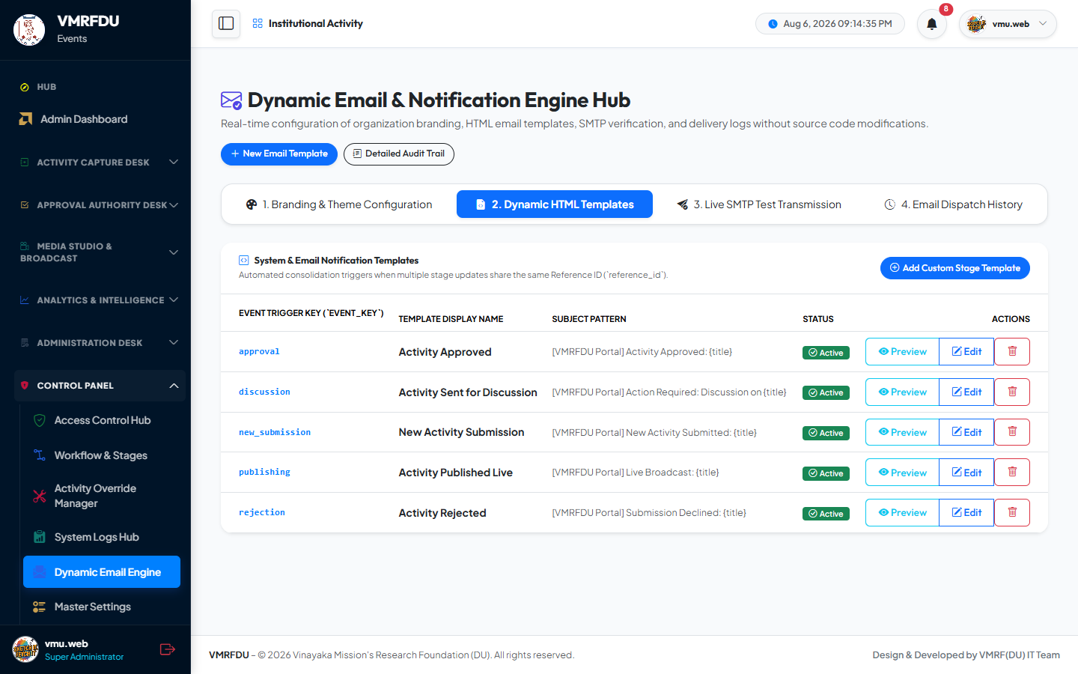
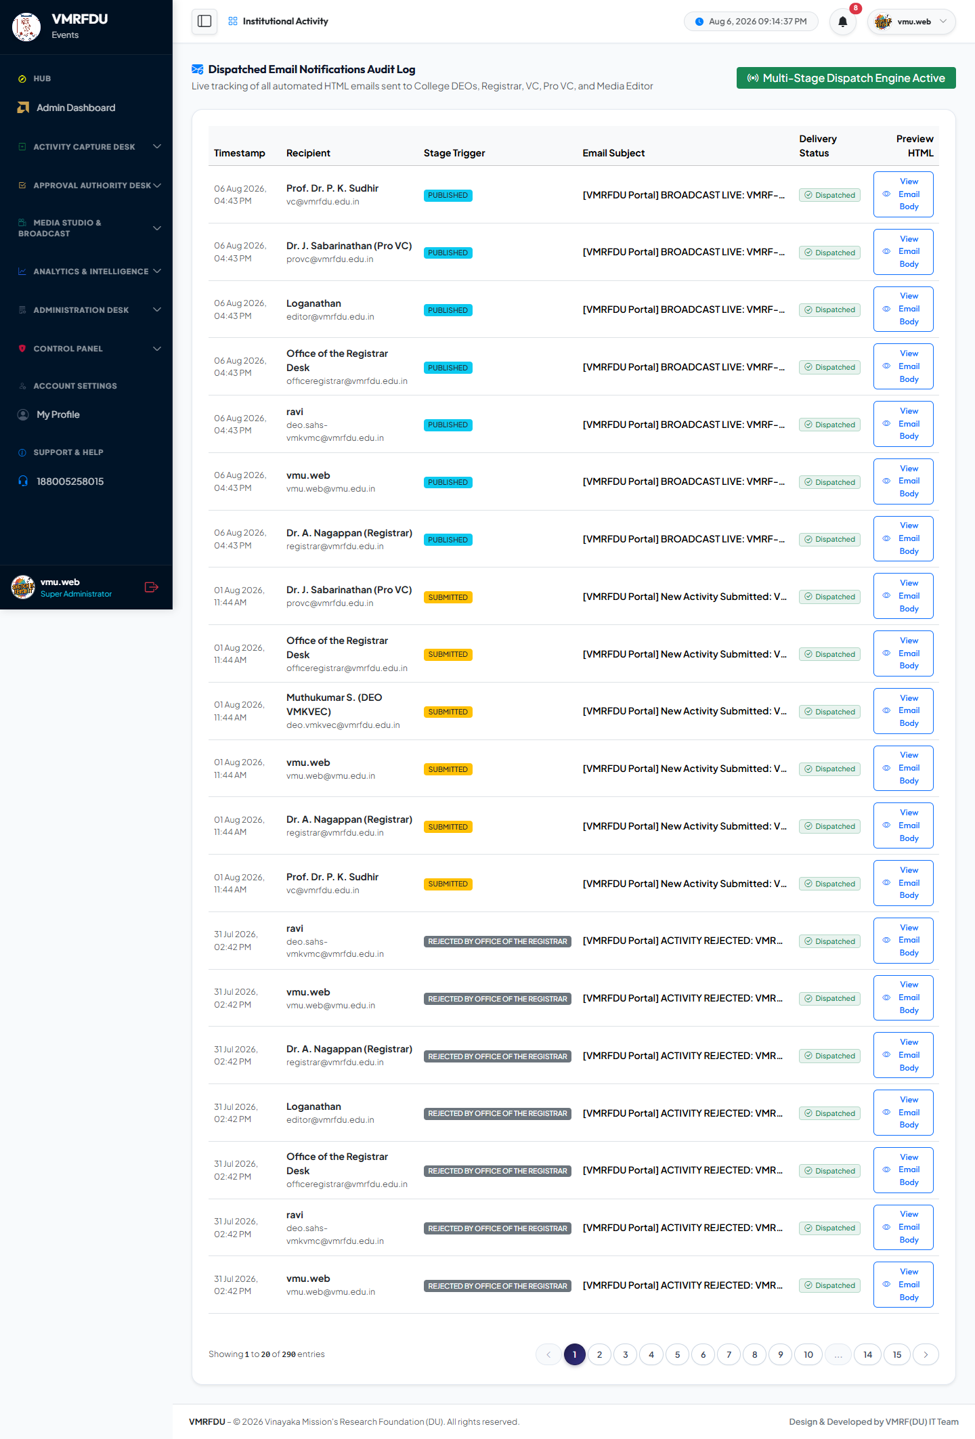
SUPER ADMIN
Notifications & More
Super Admin: Notifications
Super Admin: Email Logs
In-app notification inbox. Alerts on stage transitions, feedback, approvals, and publication.
Complete email transmission log with delivery status and full HTML body preview.

Slide 11
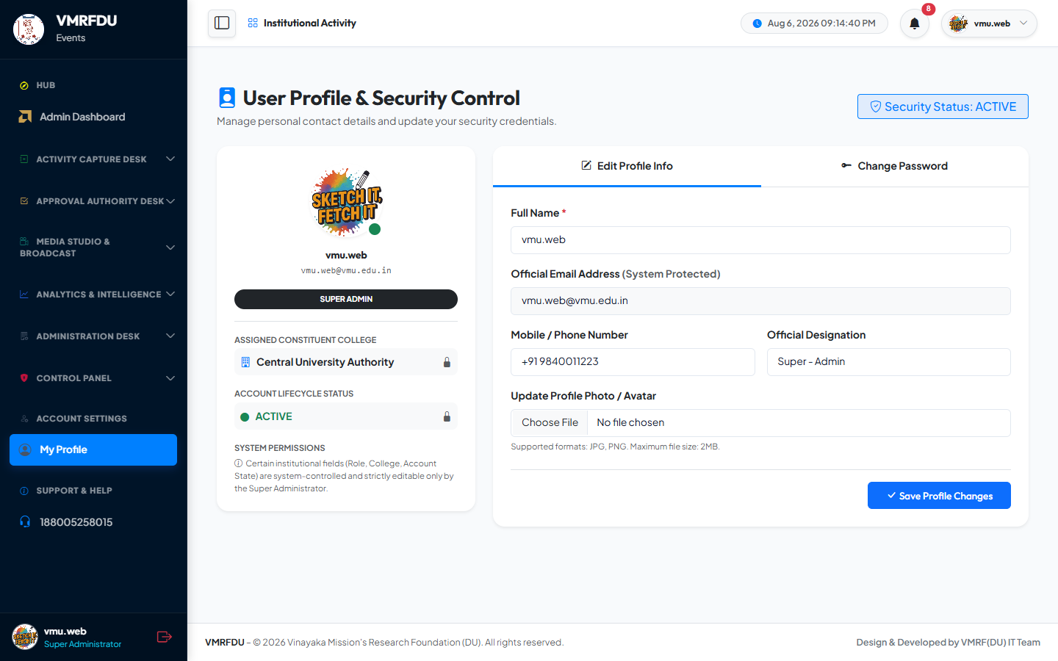
SUPER ADMIN
Super Admin: Profile
Super Admin: Profile
Personal profile page: edit name/phone/designation, upload an avatar, and change password.

Slide 12
Vice Chancellor (VC)
Account: vc@vmrfdu.edu.in
8 pages covered in this section

Slide 13
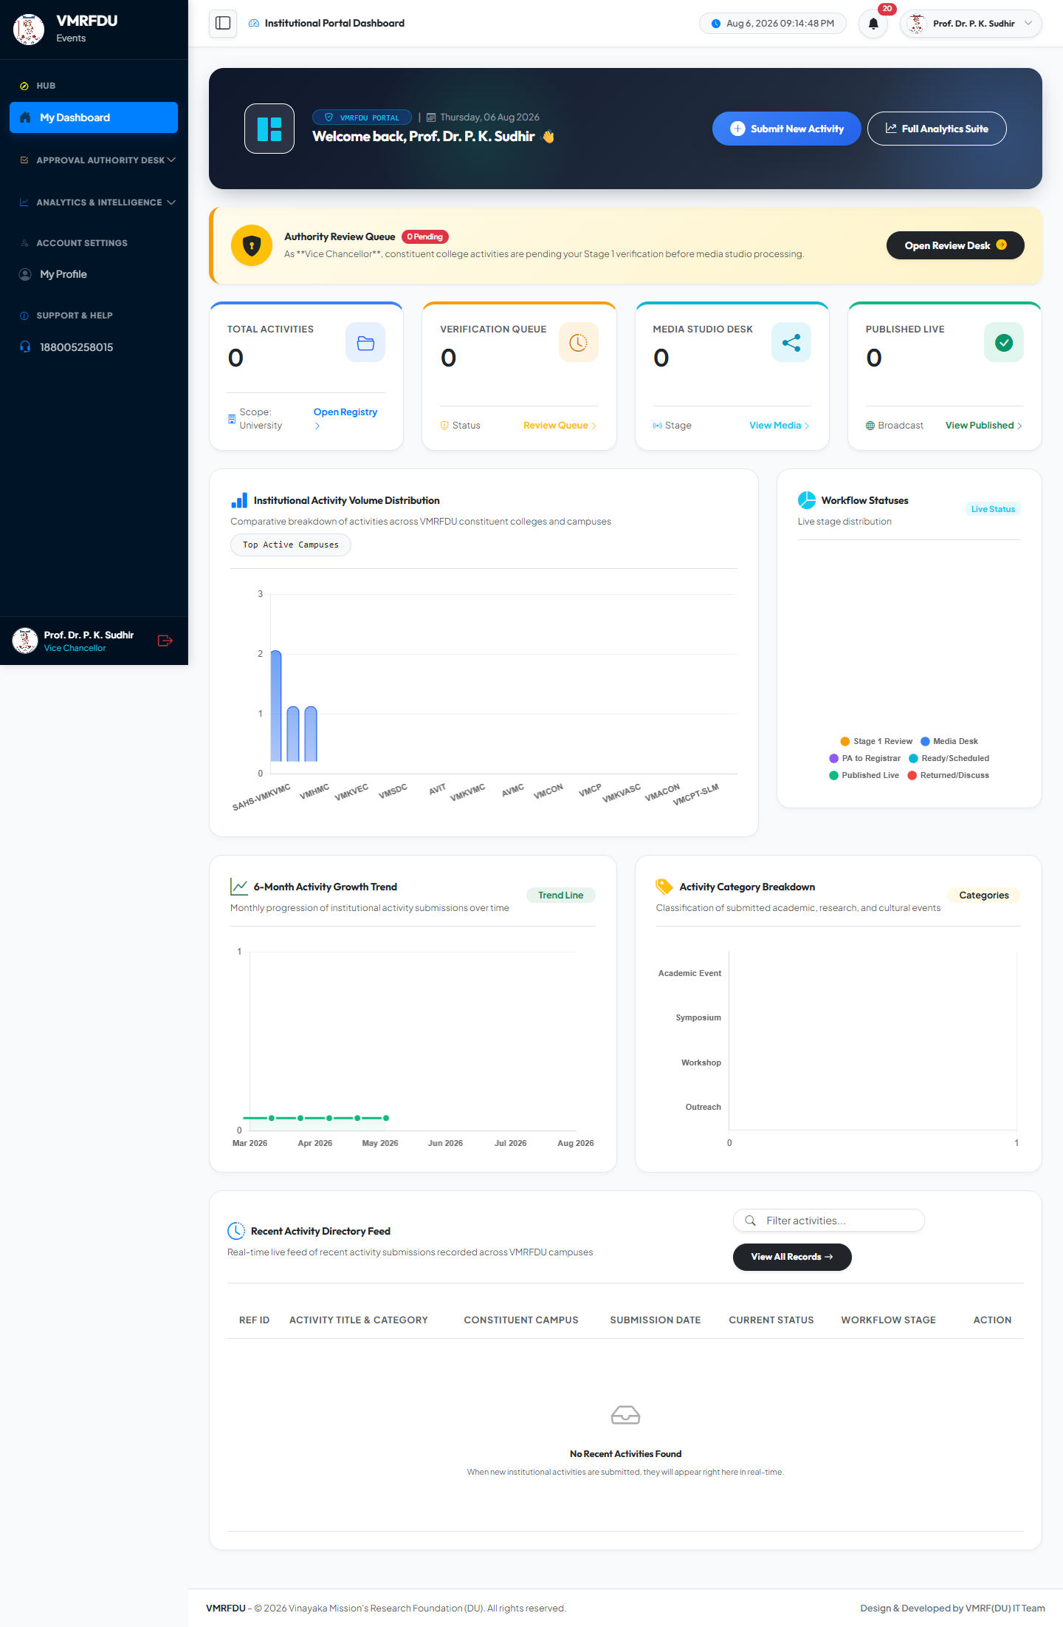
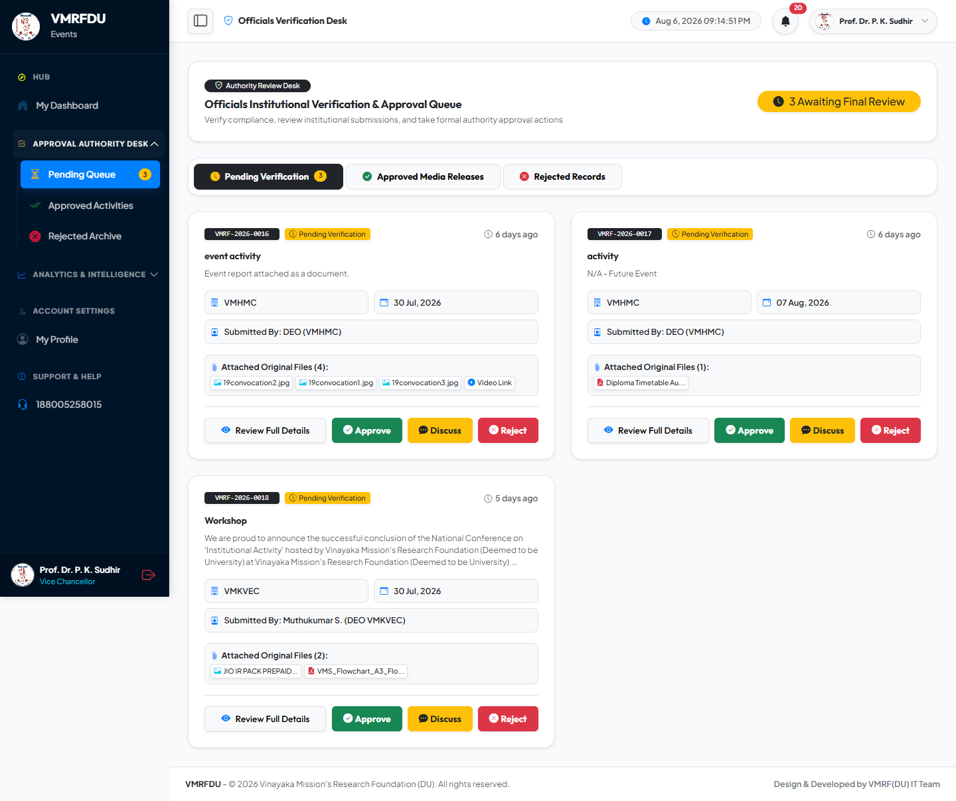
VICE CHANCELLOR (VC)
Dashboard & More
Vice Chancellor (VC): Dashboard
Vice Chancellor (VC): Verification Queue
The role's homepage: key stats, pending counts, and quick links to core actions.
Stage 1 review queue. Approve, Discuss, or Reject each submitted activity with mandatory remarks on Discuss/Reject.

Slide 14
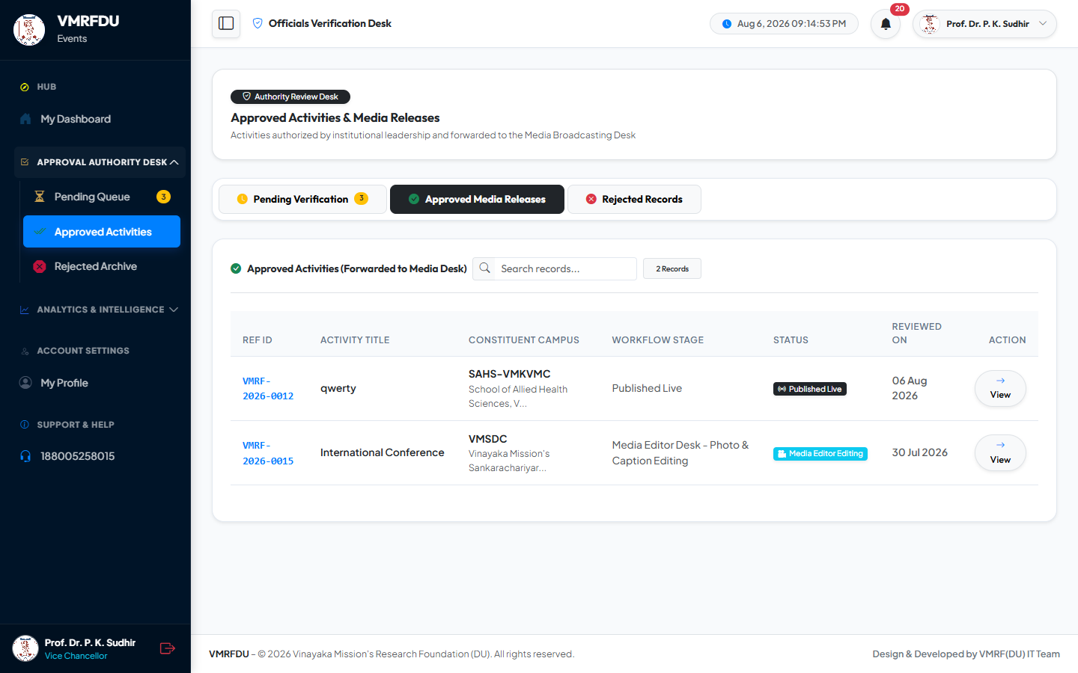
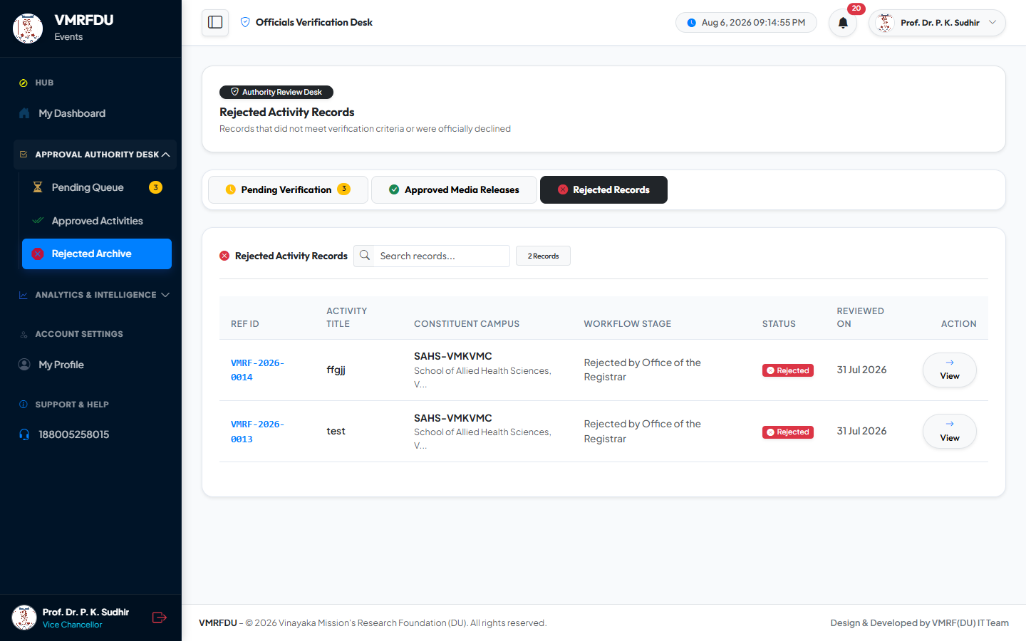
VICE CHANCELLOR (VC)
Approved List & More
Vice Chancellor (VC): Approved List
Vice Chancellor (VC): Rejected List
Historical list of activities already approved by this role, with timestamps and downstream status.
Archive of rejected activities with the mandatory rejection reason and timestamp for each record.

Slide 15
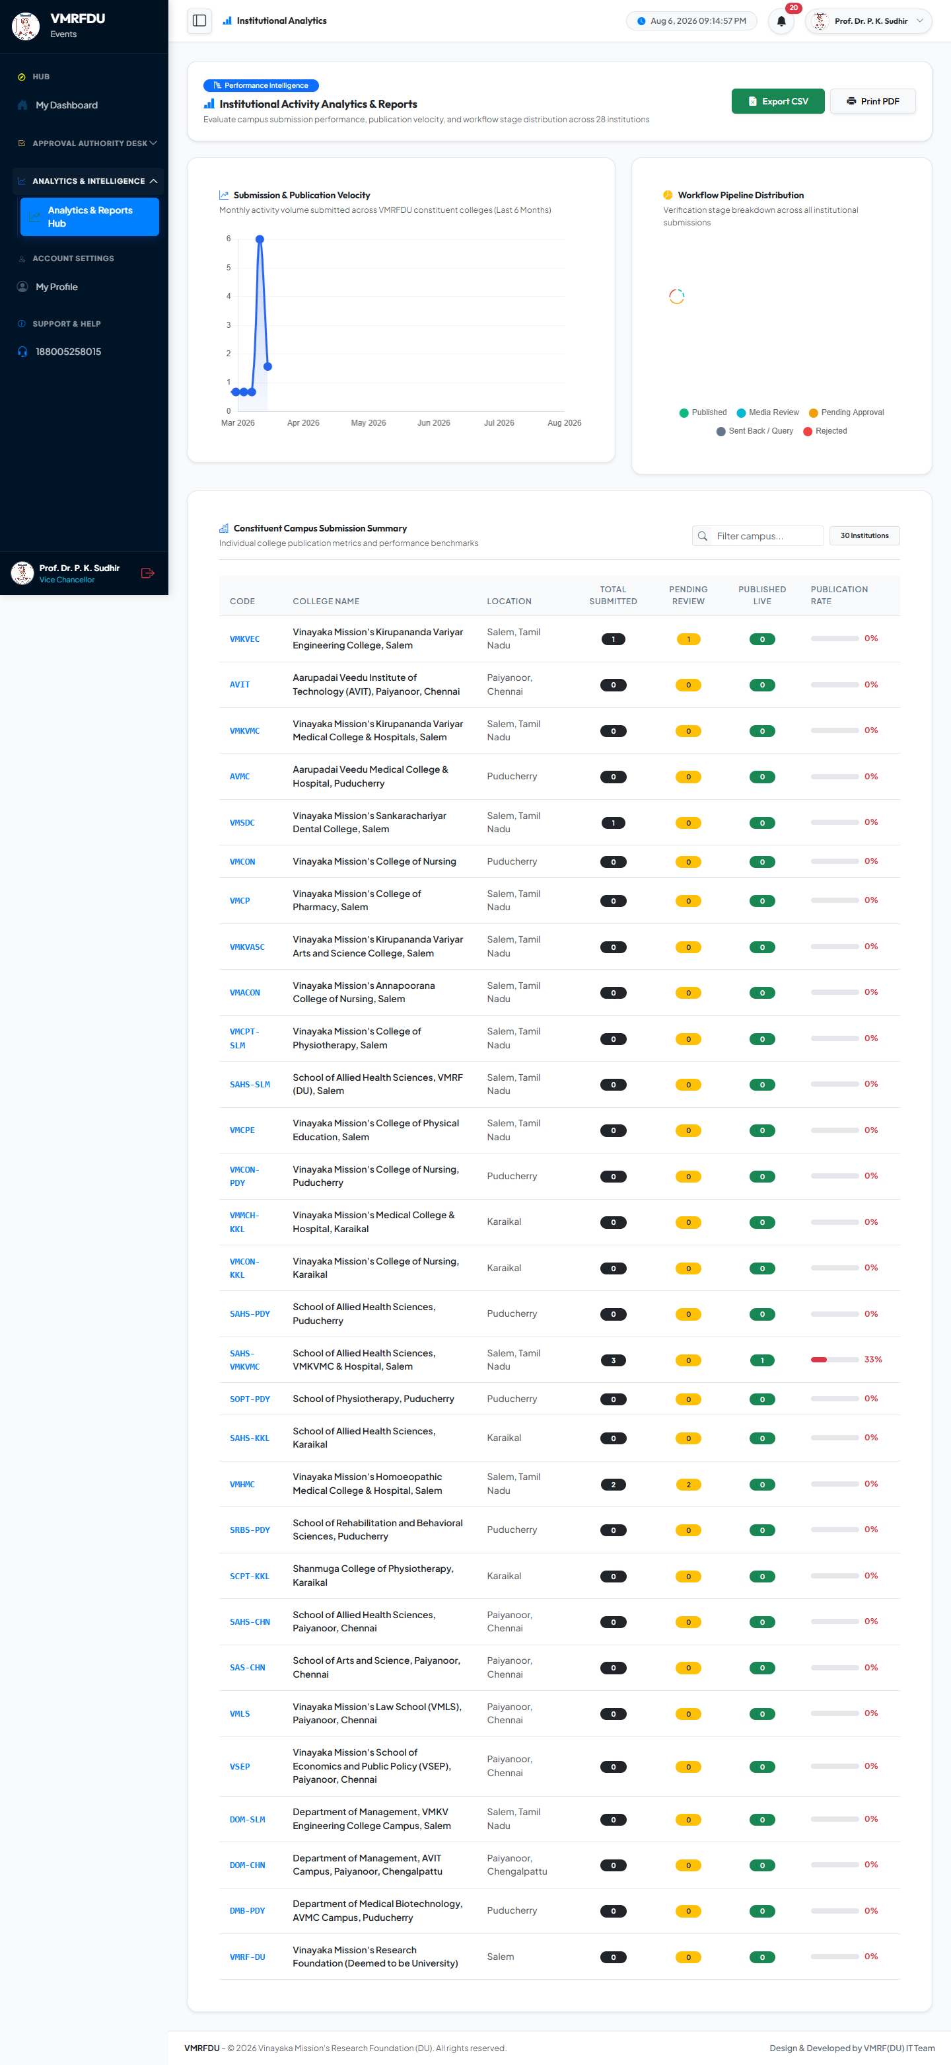
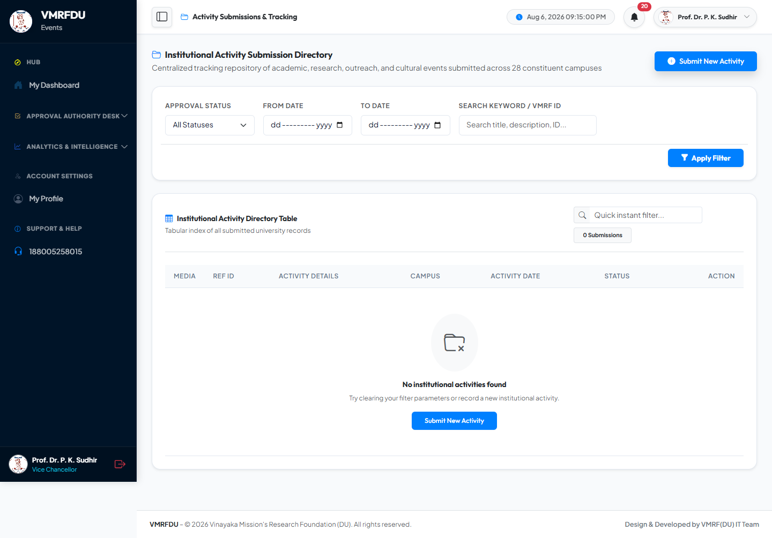
VICE CHANCELLOR (VC)
Analytics & More
Vice Chancellor (VC): Analytics
Vice Chancellor (VC): Submissions View
Analytics dashboard with charts on submission volume, categories, and trends. Supports CSV/print export.
Read-only global view of all activity submissions across colleges and statuses, for oversight.

Slide 16
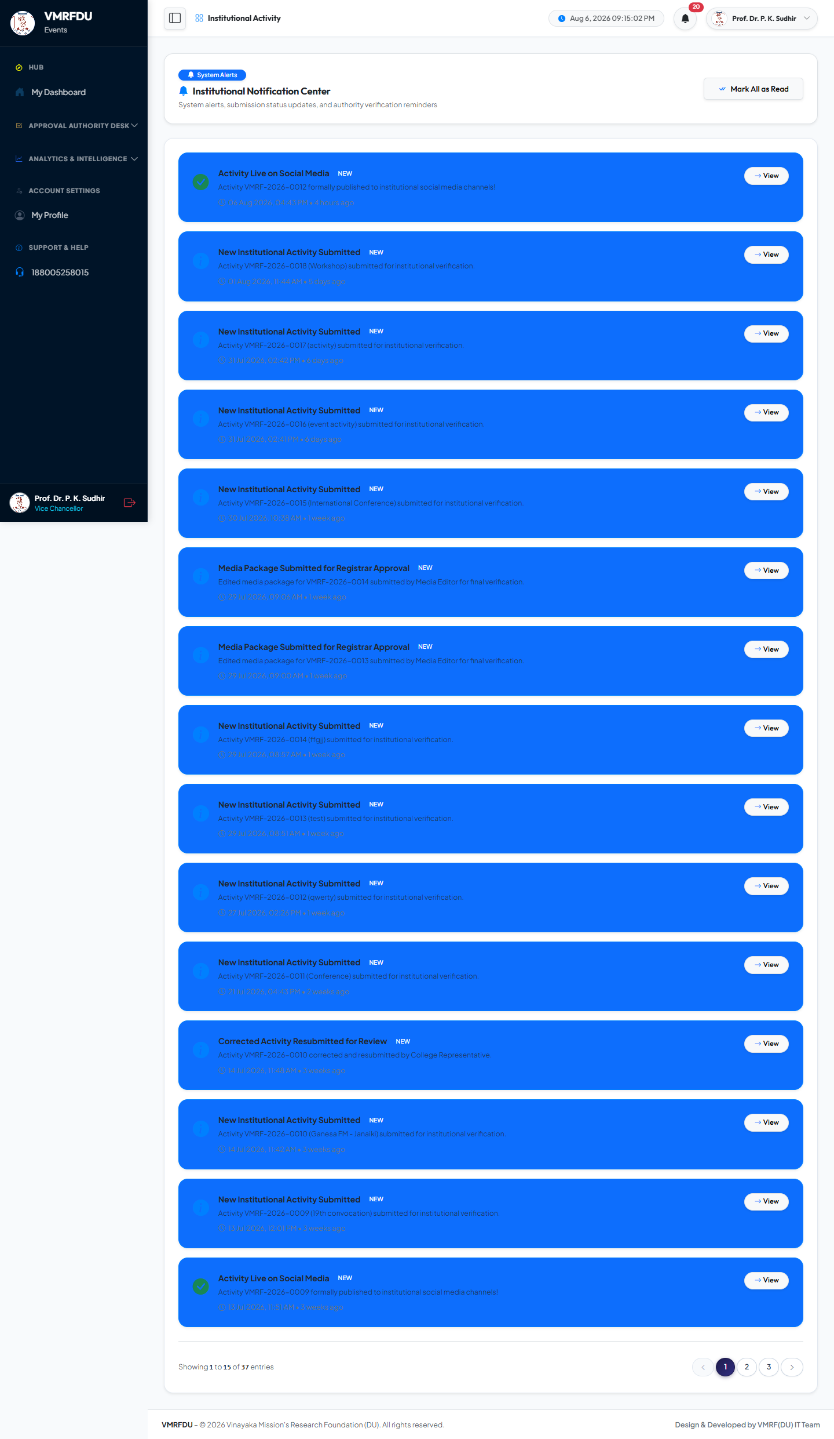
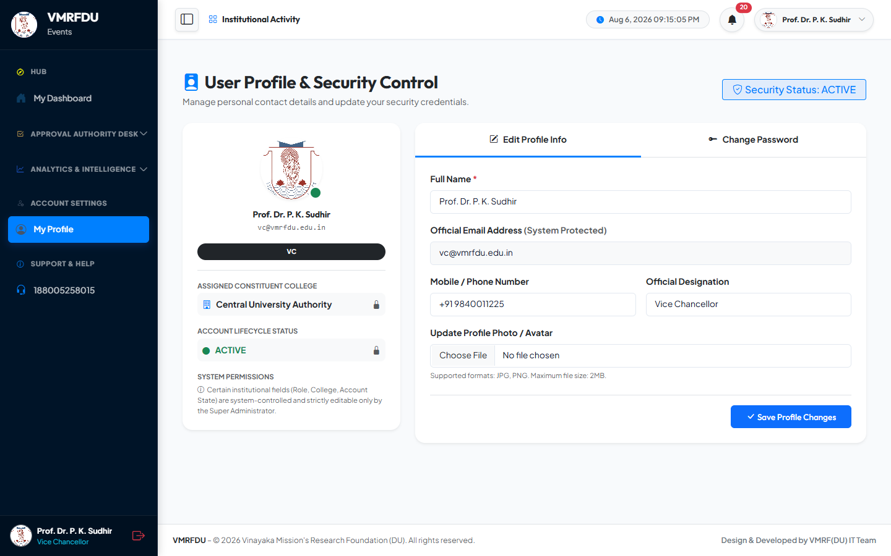
VICE CHANCELLOR (VC)
Notifications & More
Vice Chancellor (VC): Notifications
Vice Chancellor (VC): Profile
In-app notification inbox. Alerts on stage transitions, feedback, approvals, and publication.
Personal profile page: edit name/phone/designation, upload an avatar, and change password.

Slide 17
Registrar
Account: registrar@vmrfdu.edu.in
7 pages covered in this section

Slide 18
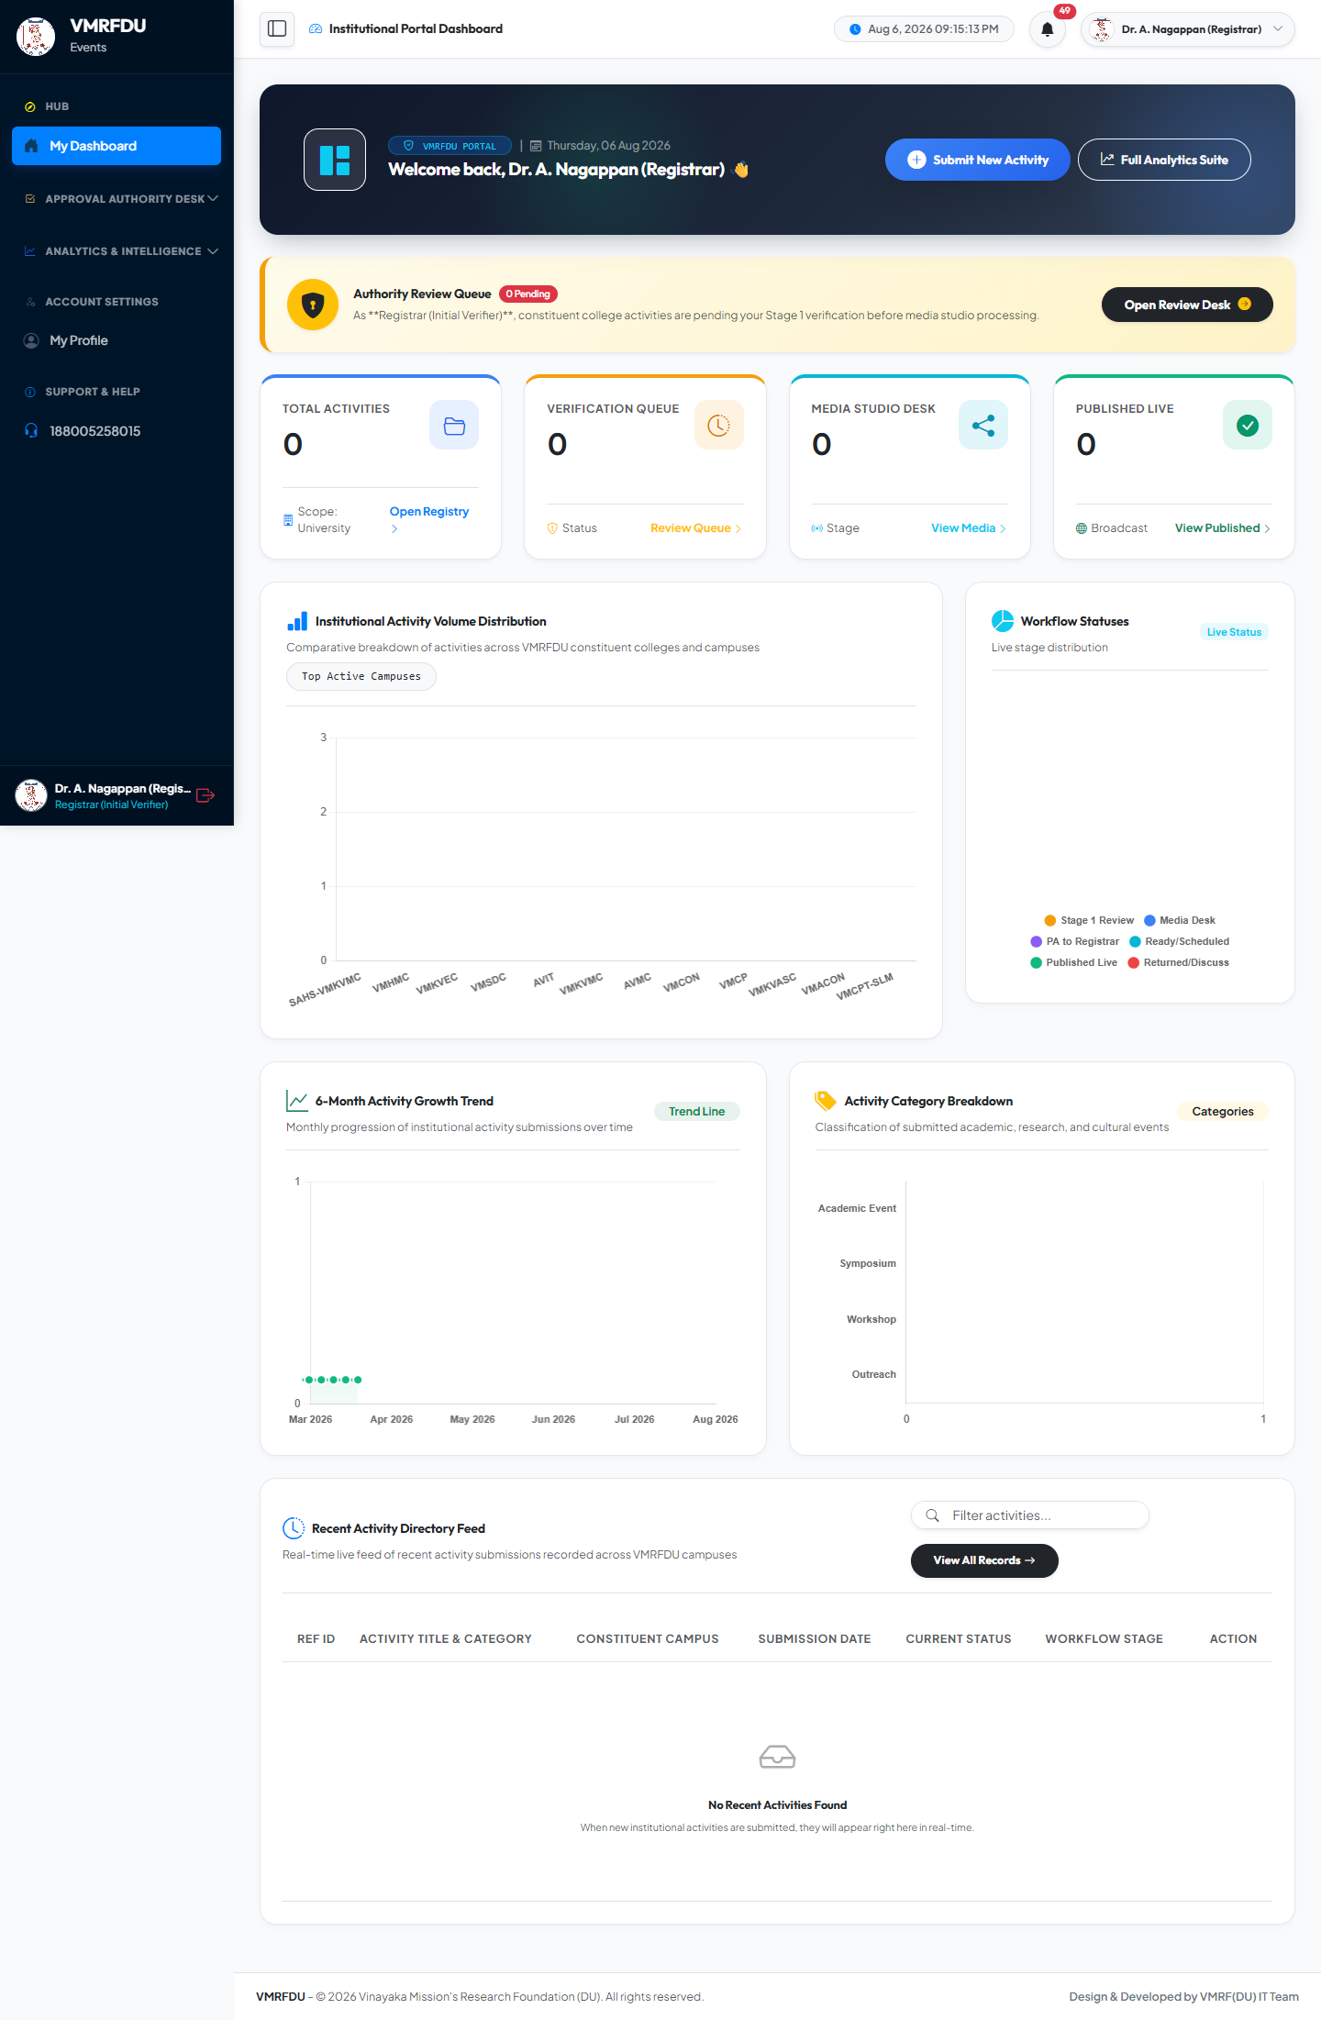

REGISTRAR
Dashboard & More
Registrar: Dashboard
Registrar: Approval Queue
The role's homepage: key stats, pending counts, and quick links to core actions.
Pending approvals awaiting this role's decision. Approve, Discuss, or Reject with remarks.

Slide 19
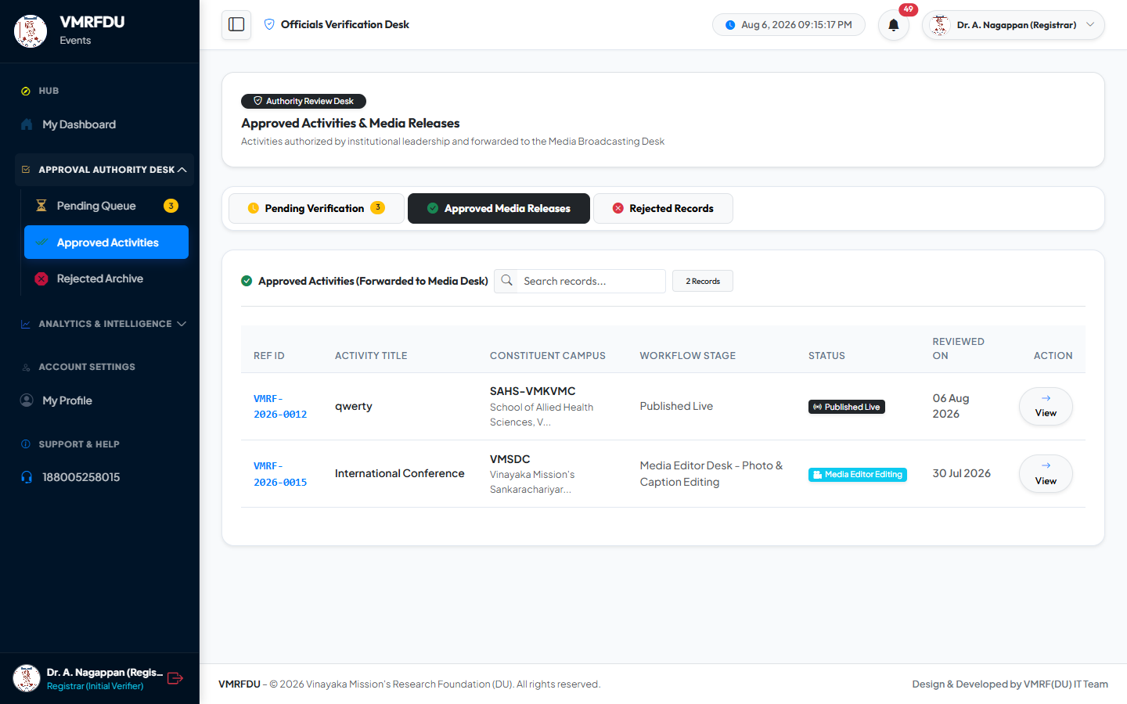

REGISTRAR
Approved List & More
Registrar: Approved List
Registrar: Rejected List
Historical list of activities already approved by this role, with timestamps and downstream status.
Archive of rejected activities with the mandatory rejection reason and timestamp for each record.

Slide 20

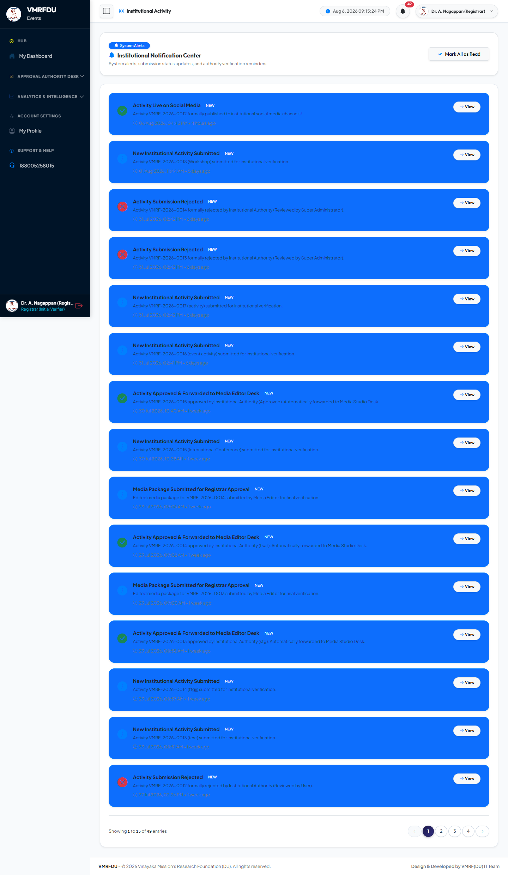
REGISTRAR
Analytics & More
Registrar: Analytics
Registrar: Notifications
Analytics dashboard with charts on submission volume, categories, and trends. Supports CSV/print export.
In-app notification inbox. Alerts on stage transitions, feedback, approvals, and publication.

Slide 21

REGISTRAR
Registrar: Profile
Registrar: Profile
Personal profile page: edit name/phone/designation, upload an avatar, and change password.

Slide 22
Office of Registrar
Account: officeregistrar@vmrfdu.edu.in
9 pages covered in this section

Slide 23


OFFICE OF REGISTRAR
Dashboard & More
Office of Registrar: Dashboard
Office of Registrar: Dashboard
The role's homepage: key stats, pending counts, and quick links to core actions.
The role's homepage: key stats, pending counts, and quick links to core actions.

Slide 24
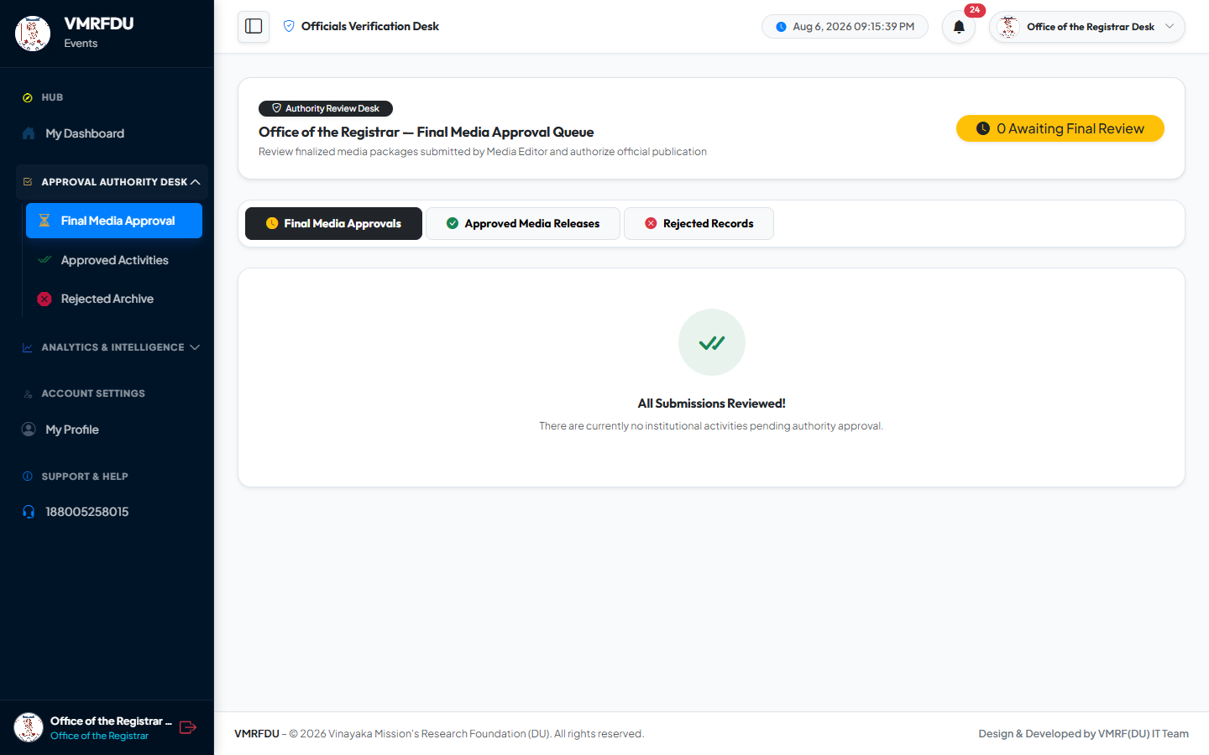

OFFICE OF REGISTRAR
Media Queue & More
Office of Registrar: Media Queue
Office of Registrar: Notifications
Queue of media packages awaiting this role's review before broadcast.
In-app notification inbox. Alerts on stage transitions, feedback, approvals, and publication.

Slide 25


OFFICE OF REGISTRAR
Review Queue & More
Office of Registrar: Review Queue
Office of Registrar: Approvals
Stage 2 executive review queue for locked media packages. Approve to publish or discuss to return.
Full audit view of approvals and discussions handled by this role, with decision timeline.

Slide 26


OFFICE OF REGISTRAR
Analytics & More
Office of Registrar: Analytics
Office of Registrar: Notifications
Analytics dashboard with charts on submission volume, categories, and trends. Supports CSV/print export.
In-app notification inbox. Alerts on stage transitions, feedback, approvals, and publication.

Slide 27

OFFICE OF REGISTRAR
Office of Registrar: Profile
Office of Registrar: Profile
Personal profile page: edit name/phone/designation, upload an avatar, and change password.

Slide 28
Media Editor
Account: editor@vmrfdu.edu.in
12 pages covered in this section

Slide 29
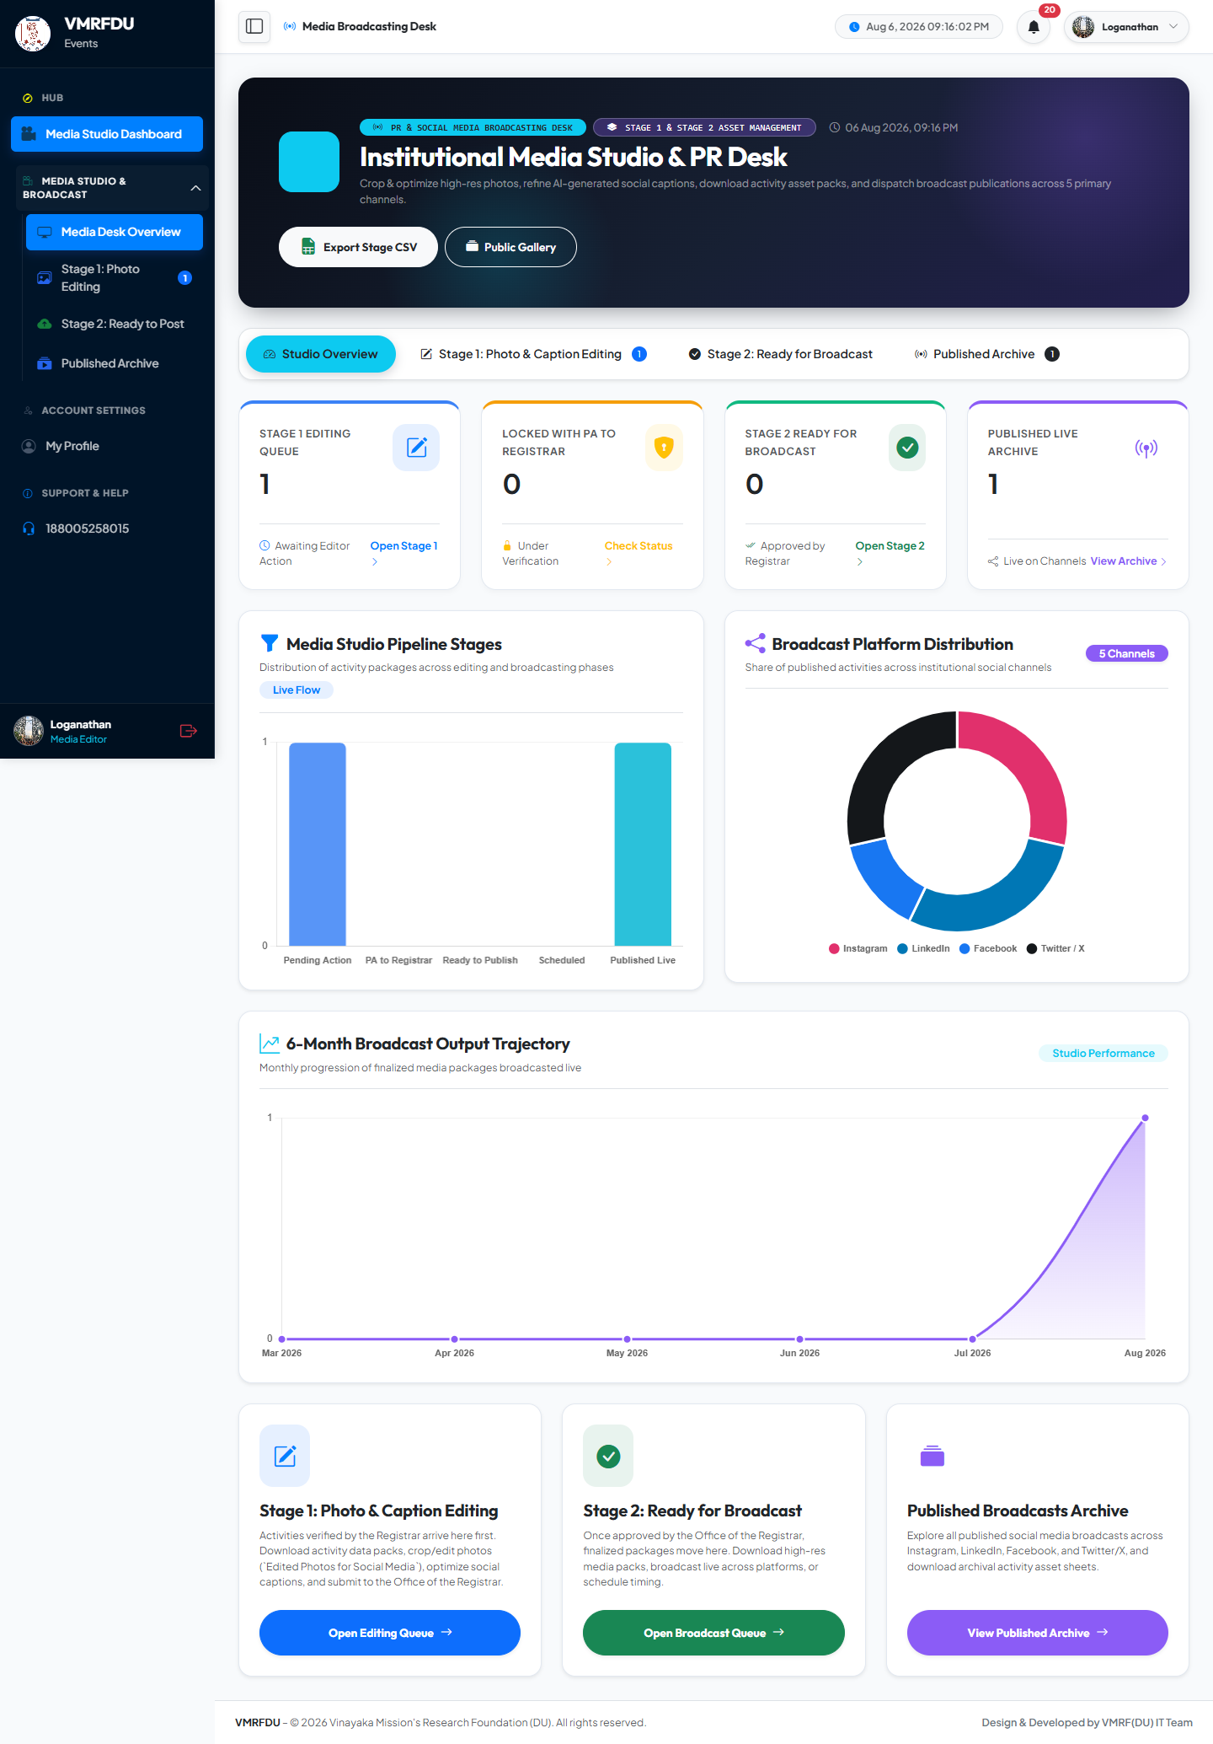
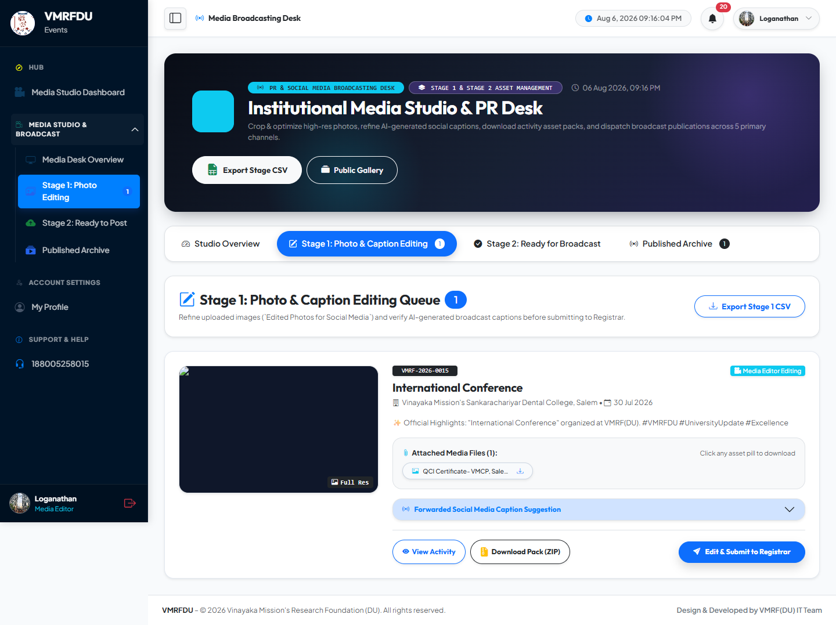
MEDIA EDITOR
Dashboard & More
Media Editor: Dashboard
Media Editor: Queue
The role's homepage: key stats, pending counts, and quick links to core actions.
Media Studio editing queue: photo optimization and caption refinement before submission.

Slide 30

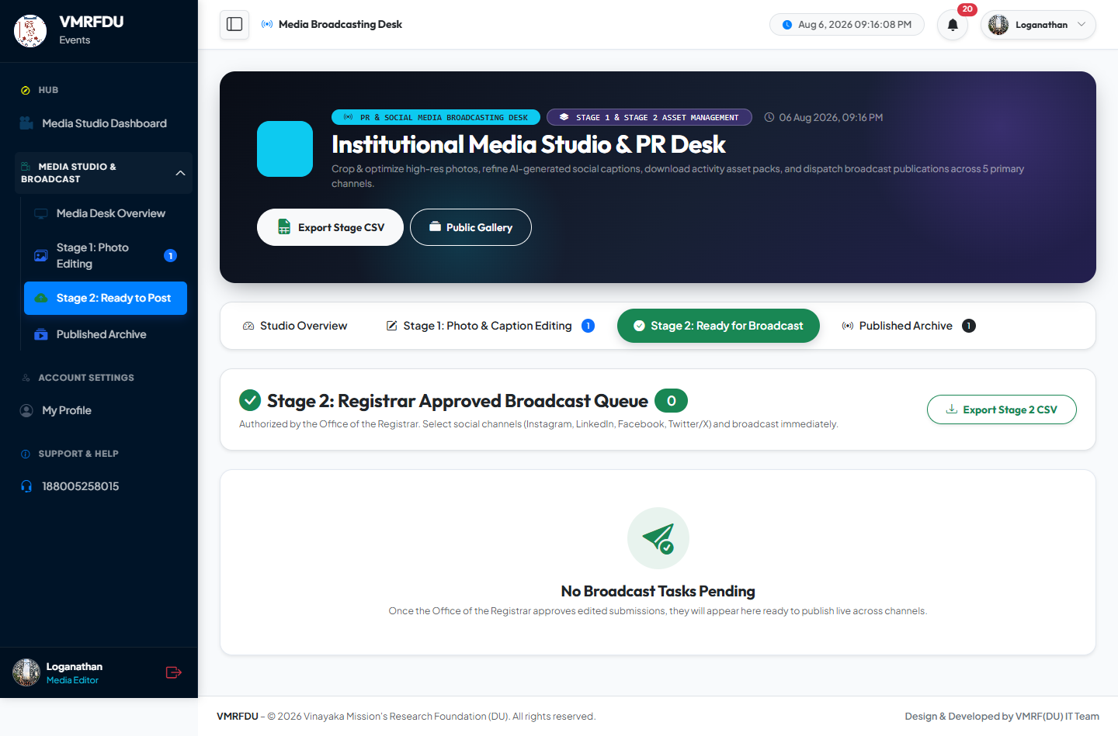
MEDIA EDITOR
Locked & More
Media Editor: Locked
Media Editor: Ready
Locked submissions pending Stage 2 review — read-only until the Office of Registrar resolves them.
Activities marked ready to publish after passing every approval stage.

Slide 31
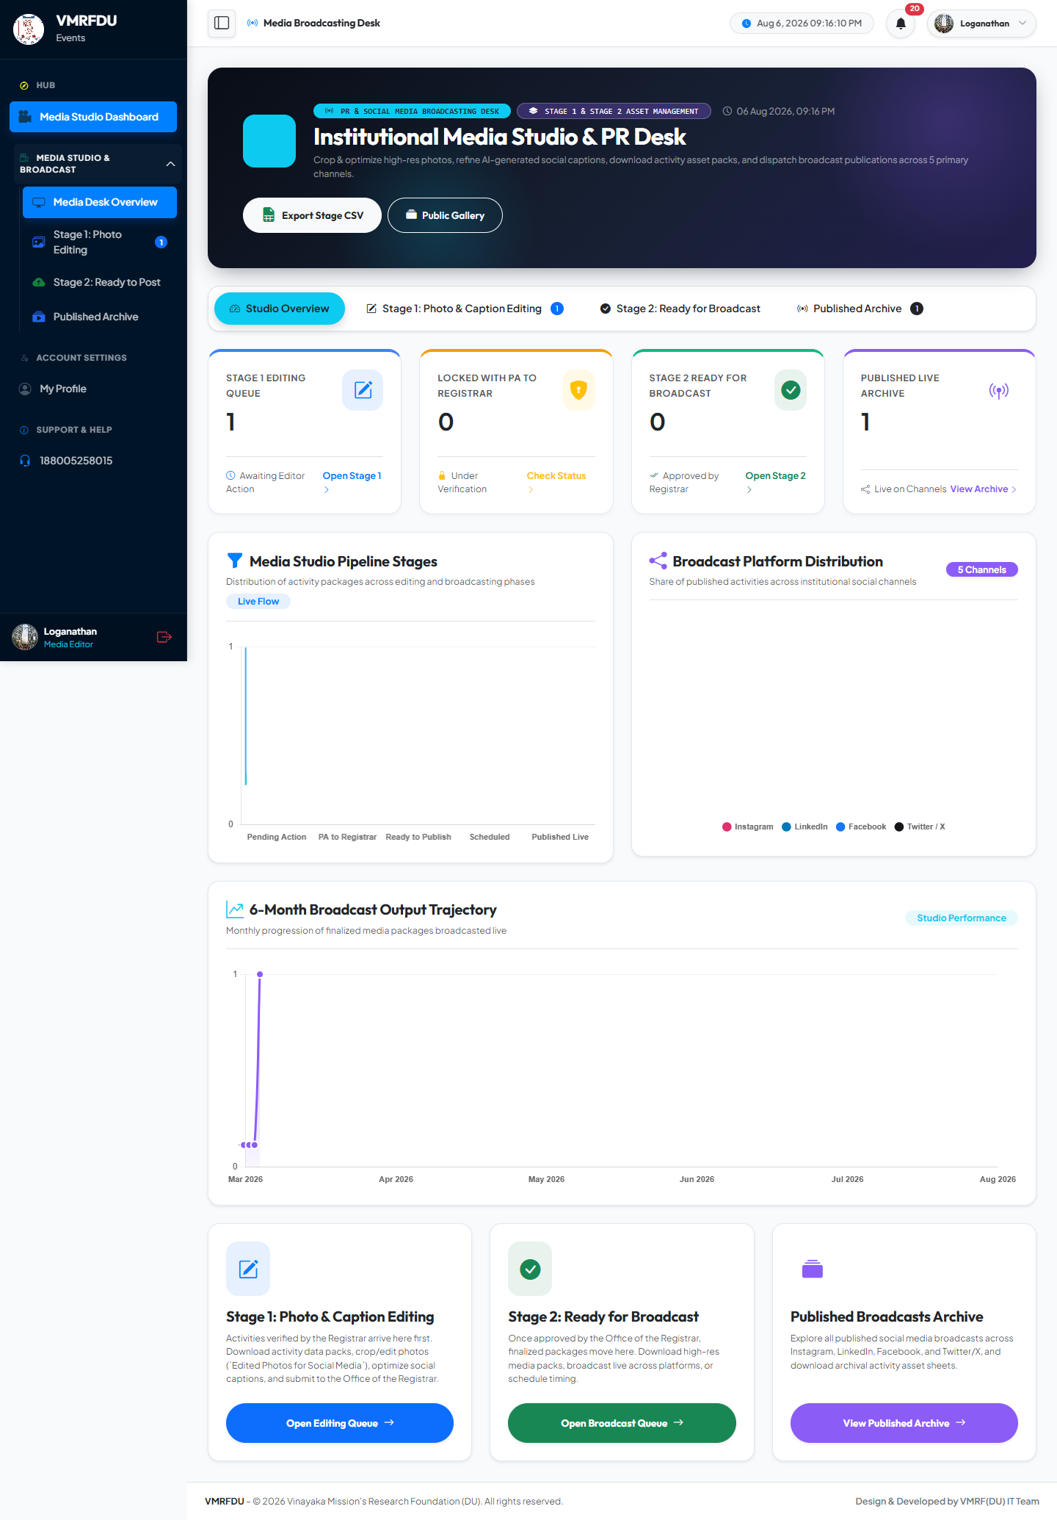

MEDIA EDITOR
Dashboard & More
Media Editor: Dashboard
Media Editor: Notifications
The role's homepage: key stats, pending counts, and quick links to core actions.
In-app notification inbox. Alerts on stage transitions, feedback, approvals, and publication.

Slide 32
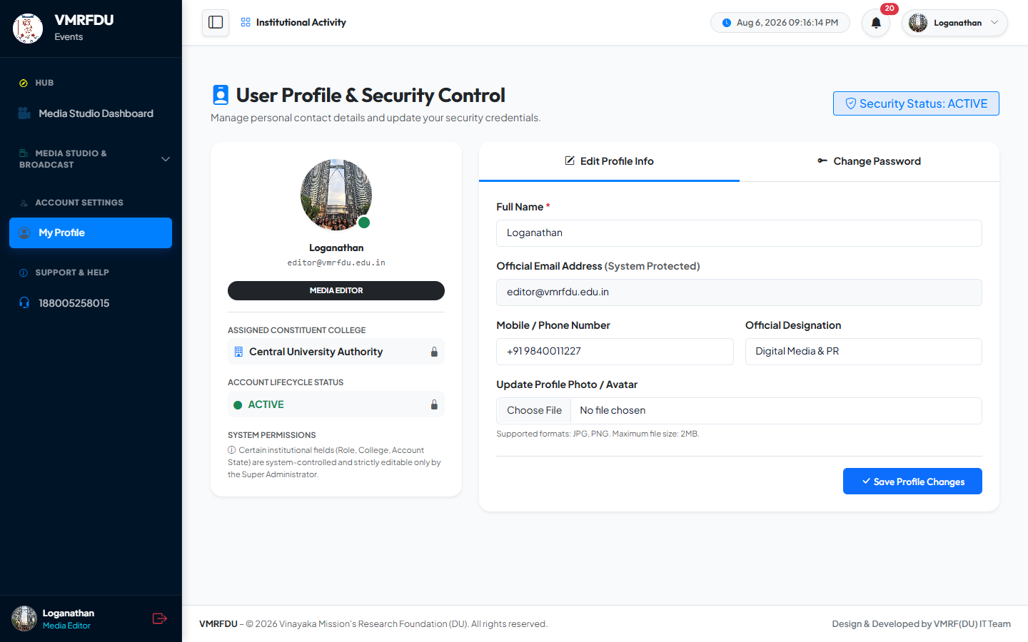

MEDIA EDITOR
Profile & More
Media Editor: Profile
Media Editor: Studio Queue
Personal profile page: edit name/phone/designation, upload an avatar, and change password.
Media Studio combined view: editing queue plus locked records pending Stage 2 resolution.

Slide 33
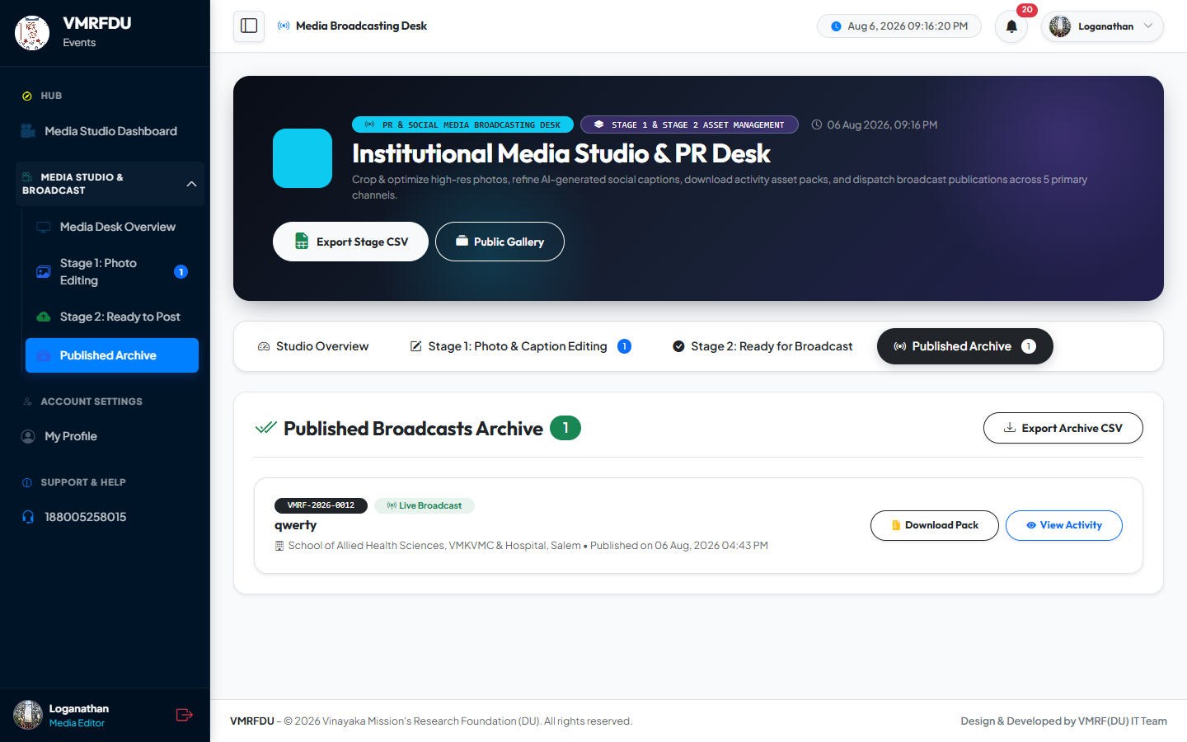
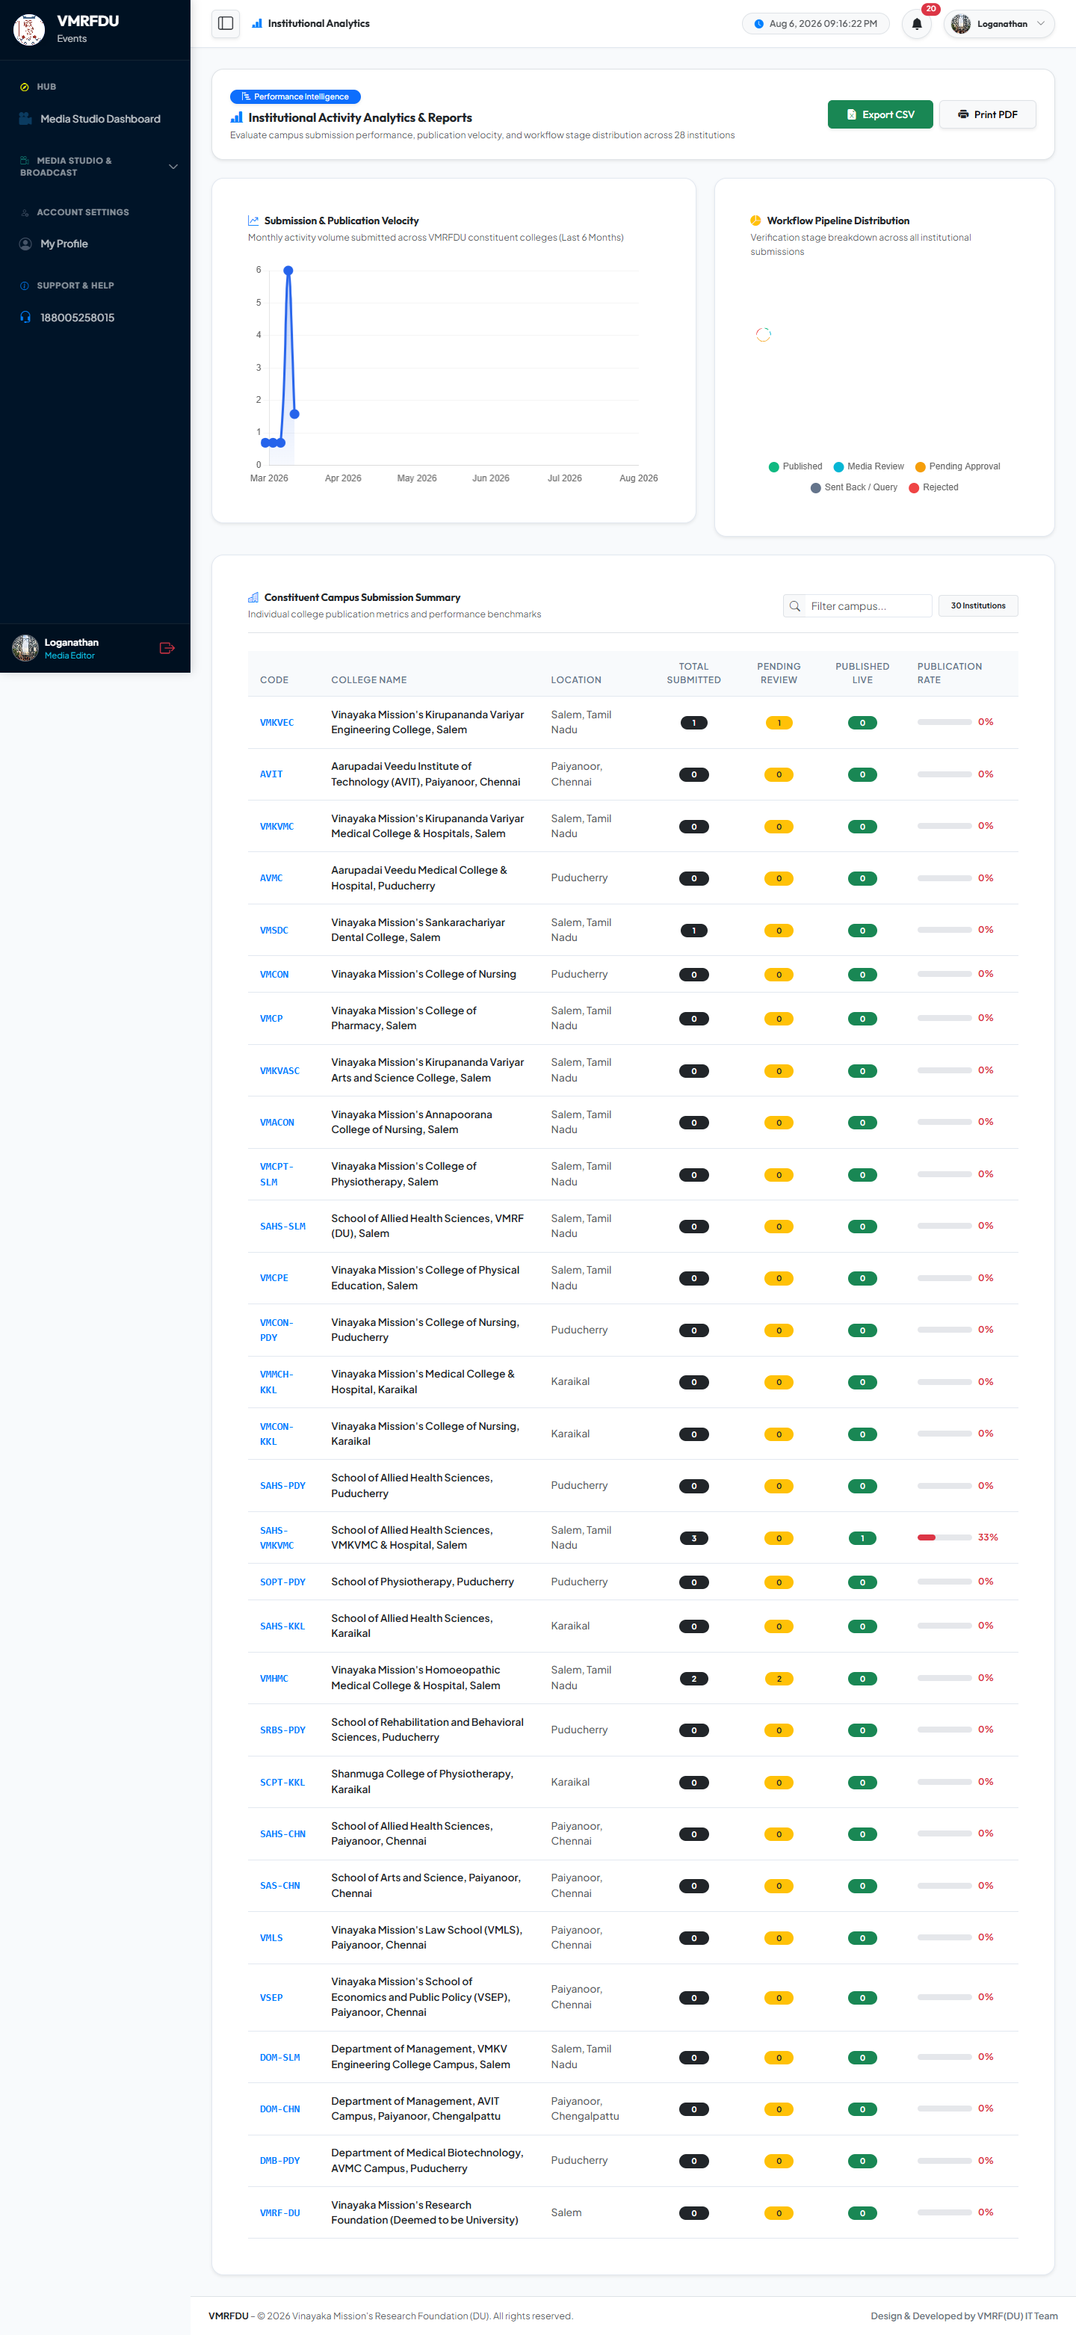
MEDIA EDITOR
Submissions & More
Media Editor: Submissions
Media Editor: Analytics
List of submissions scoped to this account, filterable by status, with reference IDs and actions.
Analytics dashboard with charts on submission volume, categories, and trends. Supports CSV/print export.

Slide 34


MEDIA EDITOR
Notifications & More
Media Editor: Notifications
Media Editor: Profile
In-app notification inbox. Alerts on stage transitions, feedback, approvals, and publication.
Personal profile page: edit name/phone/designation, upload an avatar, and change password.

Slide 35
College Admin / DEO
Account: deo.sahs-pdy@vmrfdu.edu.in
12 pages covered in this section

Slide 36
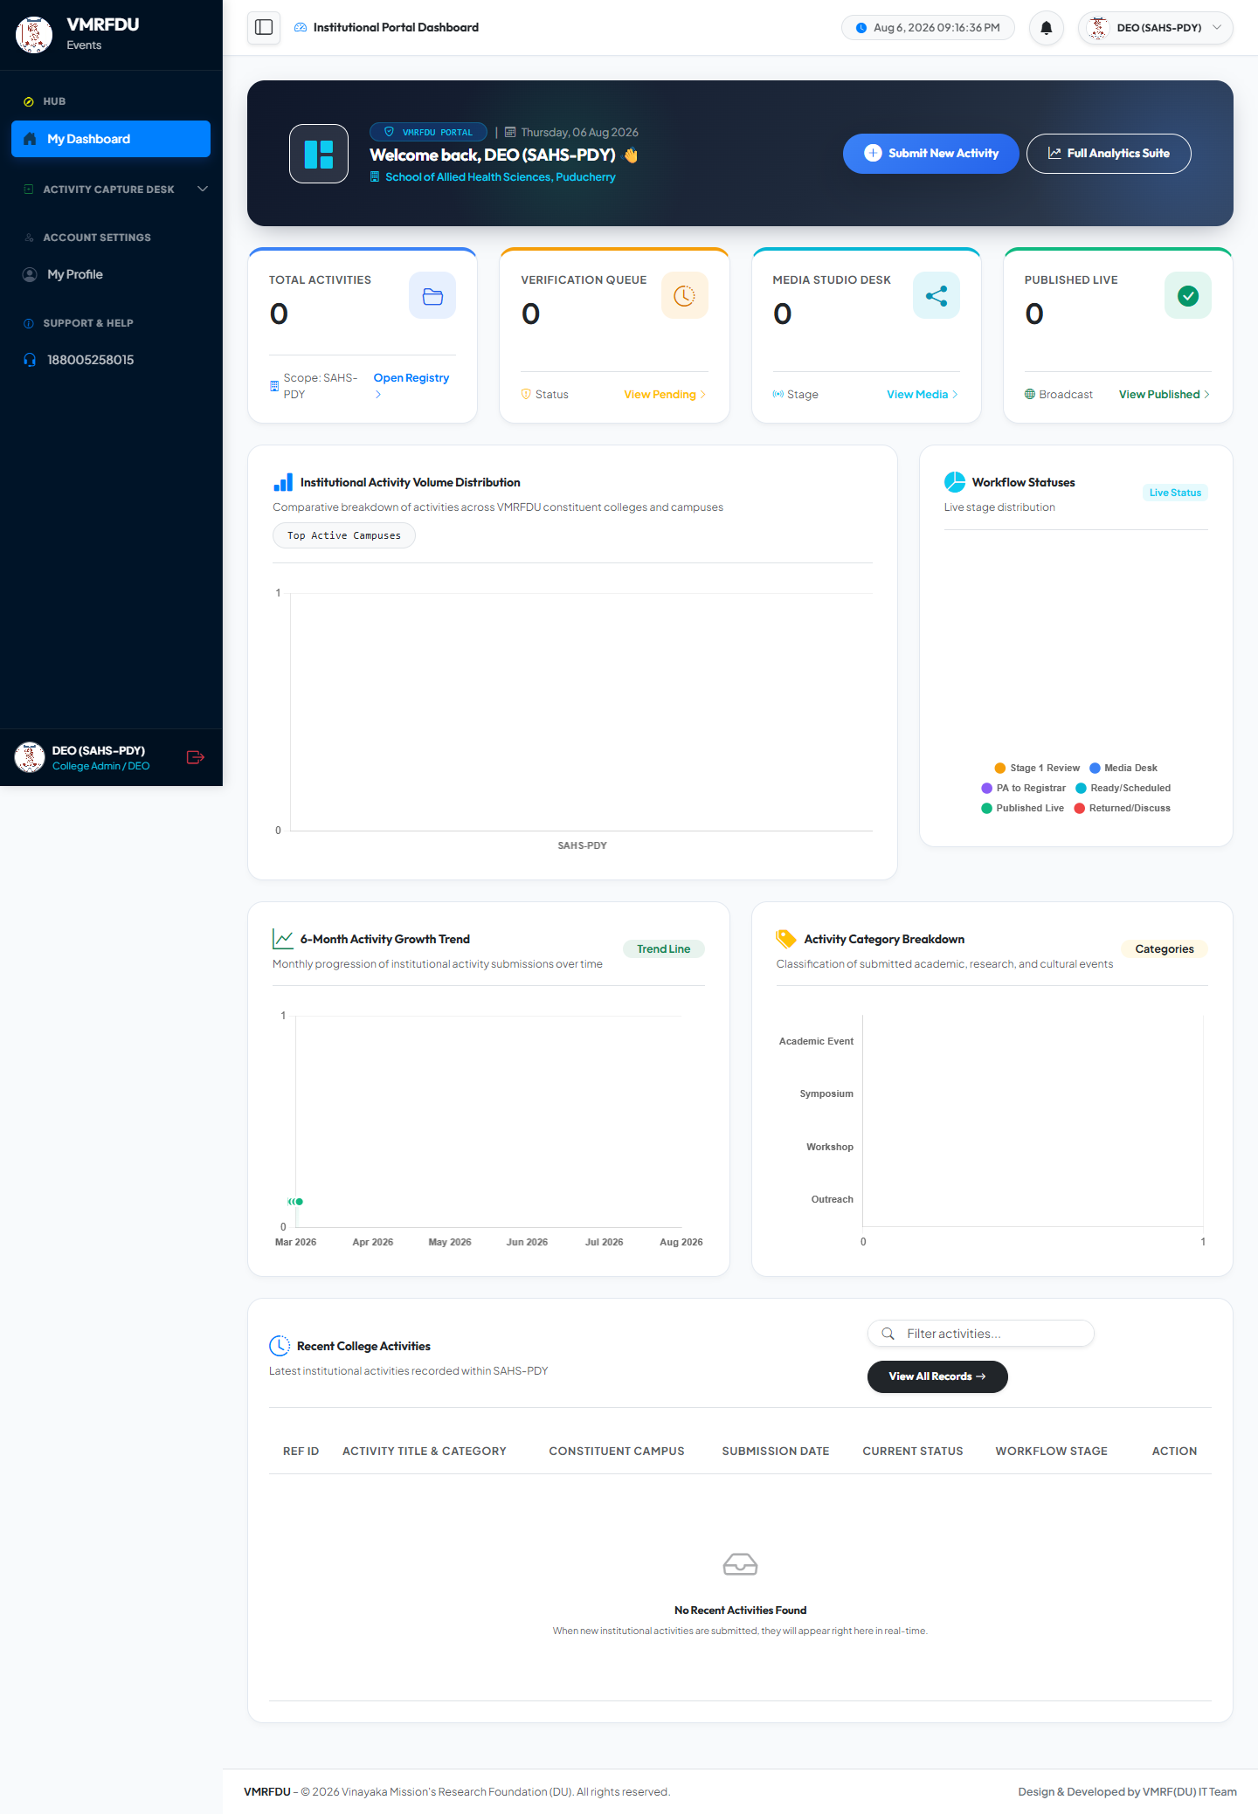
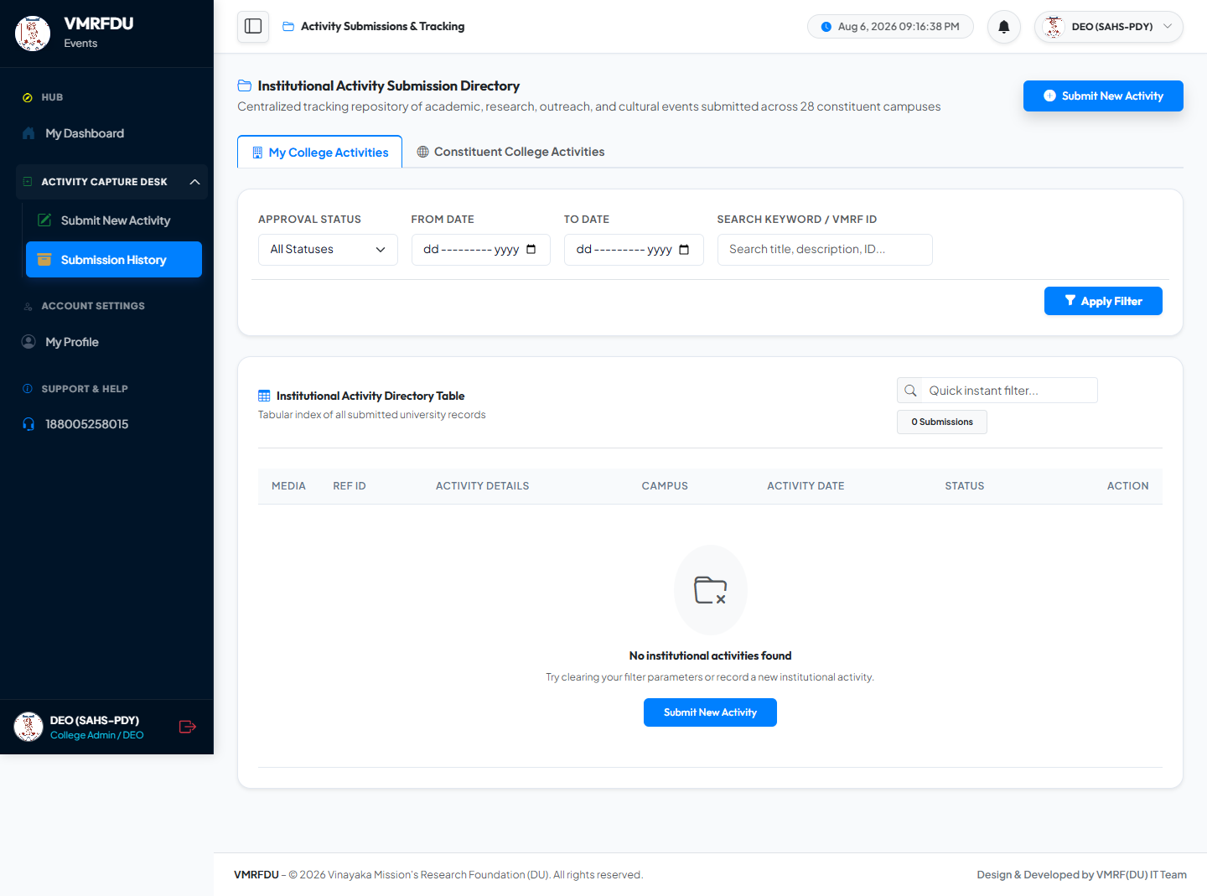
COLLEGE ADMIN / DEO
Dashboard & More
College Admin / DEO: Dashboard
College Admin / DEO: Submissions
The role's homepage: key stats, pending counts, and quick links to core actions.
List of submissions scoped to this account, filterable by status, with reference IDs and actions.

Slide 37
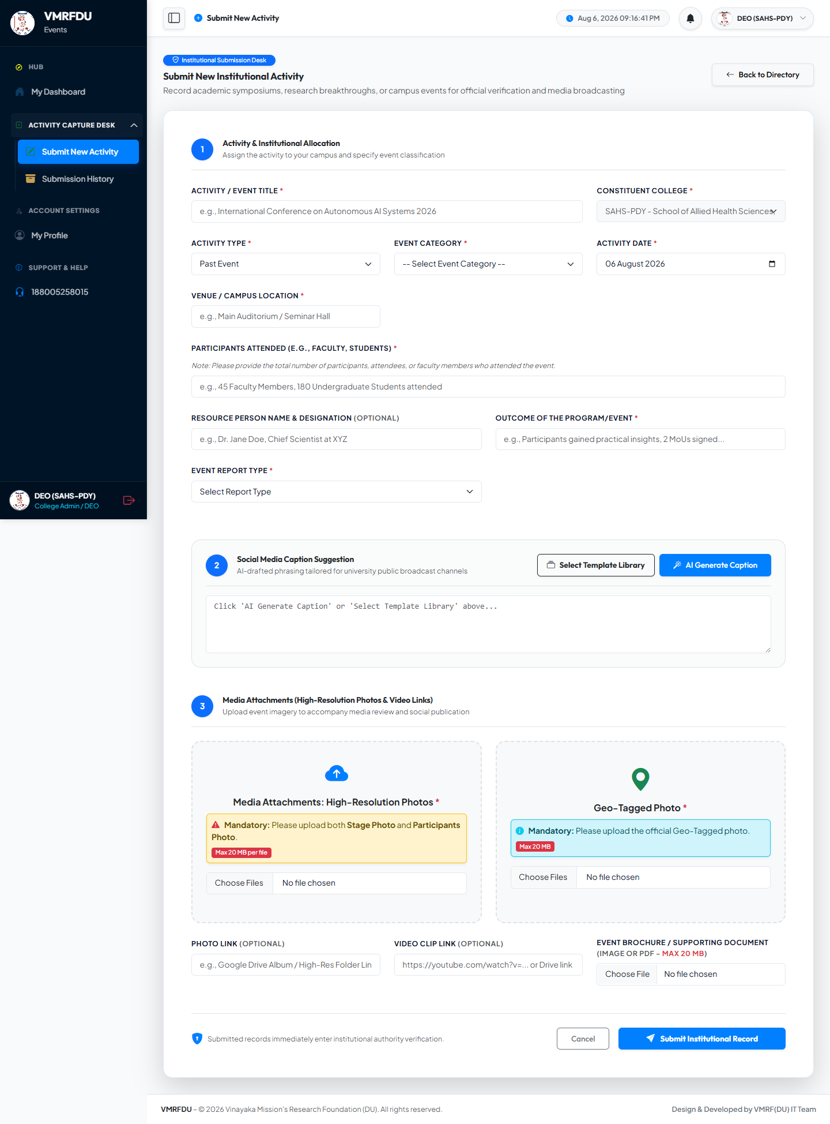
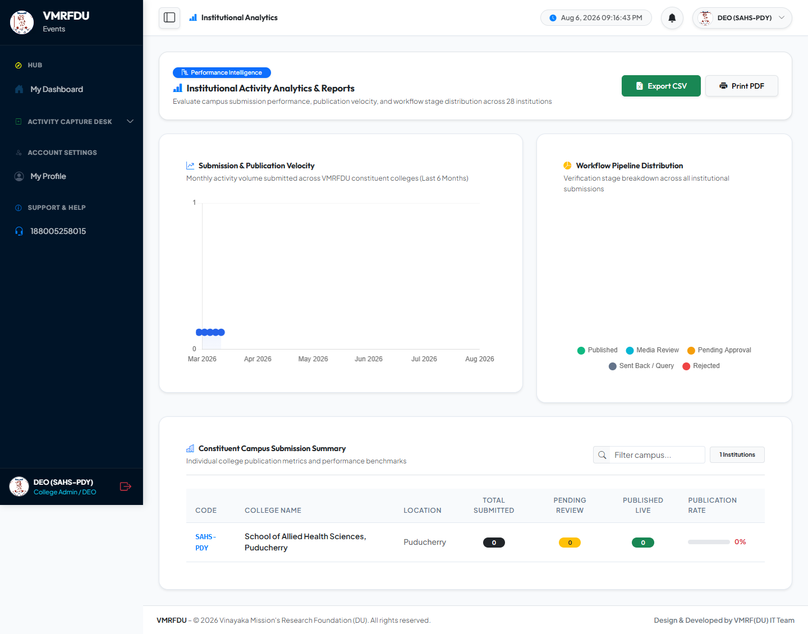
COLLEGE ADMIN / DEO
Create Activity & More
College Admin / DEO: Create Activity
College Admin / DEO: Analytics
Activity submission form: title, description, category, photos, optional PDF, and AI caption generator. Save as draft or submit.
Analytics dashboard with charts on submission volume, categories, and trends. Supports CSV/print export.

Slide 38

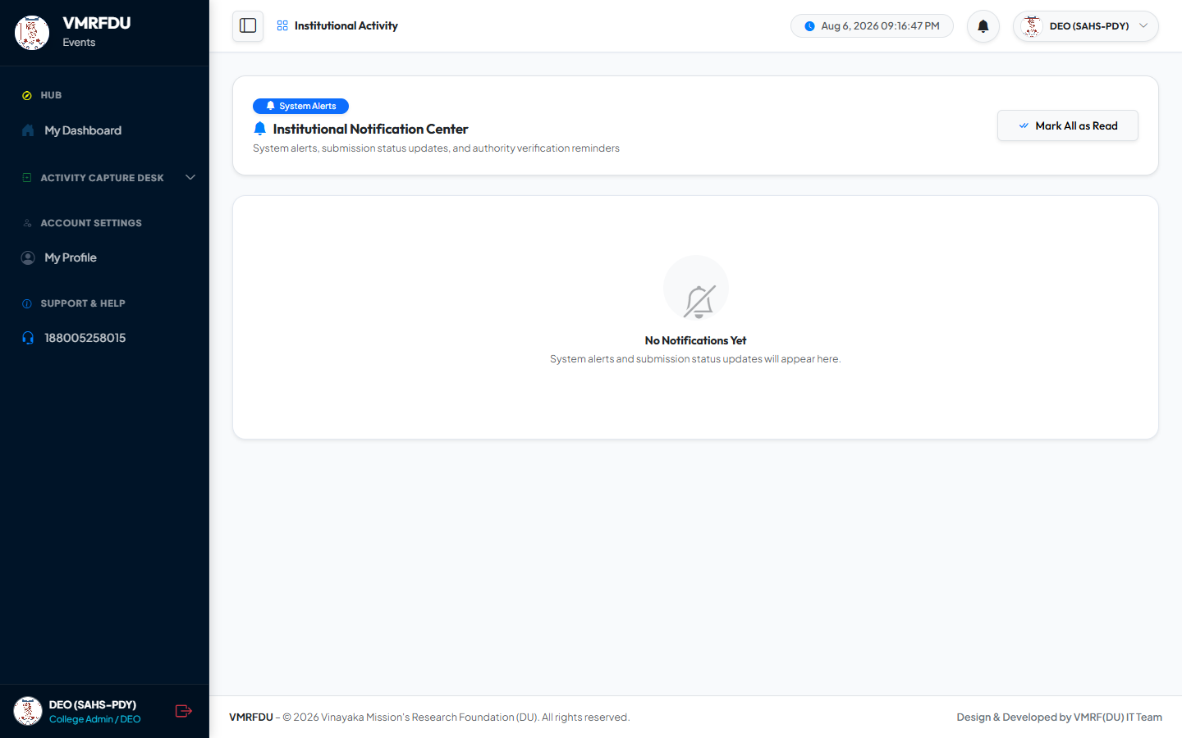
COLLEGE ADMIN / DEO
Dashboard & More
College Admin / DEO: Dashboard
College Admin / DEO: Notifications
The role's homepage: key stats, pending counts, and quick links to core actions.
In-app notification inbox. Alerts on stage transitions, feedback, approvals, and publication.

Slide 39
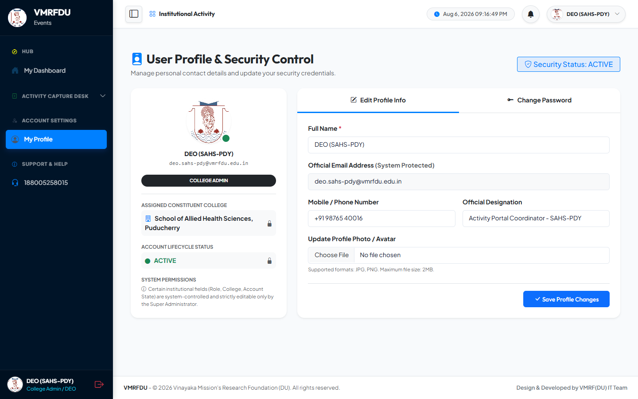

COLLEGE ADMIN / DEO
Profile & More
College Admin / DEO: Profile
College Admin / DEO: Submissions
Personal profile page: edit name/phone/designation, upload an avatar, and change password.
List of submissions scoped to this account, filterable by status, with reference IDs and actions.

Slide 40


COLLEGE ADMIN / DEO
Create Activity & More
College Admin / DEO: Create Activity
College Admin / DEO: Analytics
Activity submission form: title, description, category, photos, optional PDF, and AI caption generator. Save as draft or submit.
Analytics dashboard with charts on submission volume, categories, and trends. Supports CSV/print export.

Slide 41


COLLEGE ADMIN / DEO
Notifications & More
College Admin / DEO: Notifications
College Admin / DEO: Profile
In-app notification inbox. Alerts on stage transitions, feedback, approvals, and publication.
Personal profile page: edit name/phone/designation, upload an avatar, and change password.

