Slide 1

VINAYAKA MISSION'S RESEARCH FOUNDATION
Vendor Management System
University Tender Portal — Phase I Demonstration
Presented by Dr. Murugan, Deputy Director – IT
To the Management · Vice-Chancellor · Registrar
Prepared by the In-House IT Web Development Team

Slide 2
BACKGROUND
How It Began
The Origin
From Request to Platform
The initiative began with Registrar Mr. Nagappan, who first raised the need for a proper, transparent system for handling University procurement and vendor tenders.
What started as a request to publish vendor tenders on the University website
Grew, under Dr. Murugan’s direction, into a complete, phased procurement platform
Covers tender publication, vendor registration, online & postal responses, evaluation, and contract management
Built entirely in-house by the University’s own IT web development team
He brought this forward to Dr. Murugan, Deputy Director – IT, who took up the initiative and, together with the in-house web development team, translated it into a working Tender Portal.
Vendor Management System — University Tender Portal
2

Slide 3
CREDITS
The Project Team
Guided By
Dr. Murugan — Deputy Director, IT
Project sponsor & technical guidance
In-House Web Development Team
Functional Requirements & Domain Input
Mr. M. Dinakaran — Team Lead, Full-Stack Development
Dr. Nanthini R O — Digital Librarian
Sanjai — UI / UX Design & Testing
Initiated the tender-publication requirement for the Library Vendor Rate Contract, extensively tested Phase I, and provided ongoing functional feedback throughout development.
IT Department
Vendor Management System — University Tender Portal
3

Slide 4
“
What began as a request for publishing tenders has evolved into a comprehensive and well-designed system. The team’s proactive approach, technical expertise, and commitment to creating a scalable solution are truly commendable.
I have tested the portal extensively, and the identified issues have been addressed.
Dr. Nanthini R O
Digital Librarian — in an email to the IT Department following Phase I review

Slide 5
OVERVIEW
What the Portal Does
An end-to-end e-procurement platform: tenders are published, vendors respond, applications are evaluated, and awards become signed contracts — all tracked in one system.
Publish
Respond
Evaluate
Award & Contract
Create and publish tenders — online submission or traditional postal mode
Vendors register, get approved, and submit eligibility-checked bids
Applications reviewed, shortlisted, and evaluated — with an optional committee
Winning bids become contracts with auto-generated Work / Purchase Orders
Vendor Management System — University Tender Portal
5

Slide 6
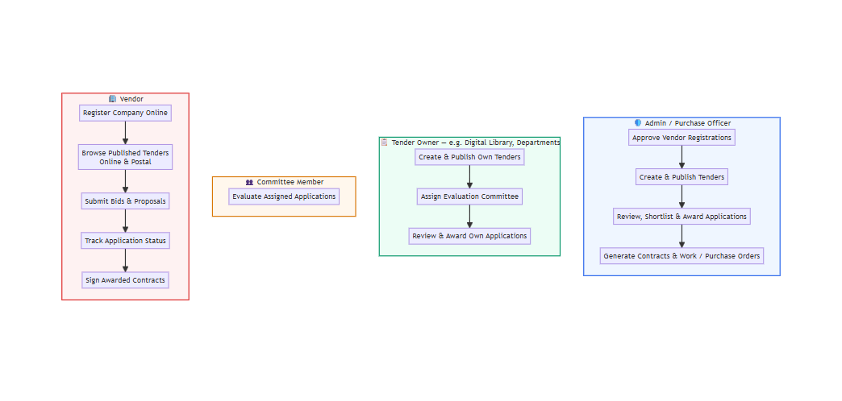
SYSTEM DESIGN
Roles & Access
Vendor Management System — University Tender Portal
6

Slide 7
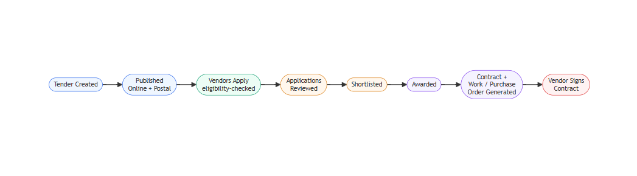
SYSTEM DESIGN
End-to-End Tender Process
Vendor Management System — University Tender Portal
7

Slide 8
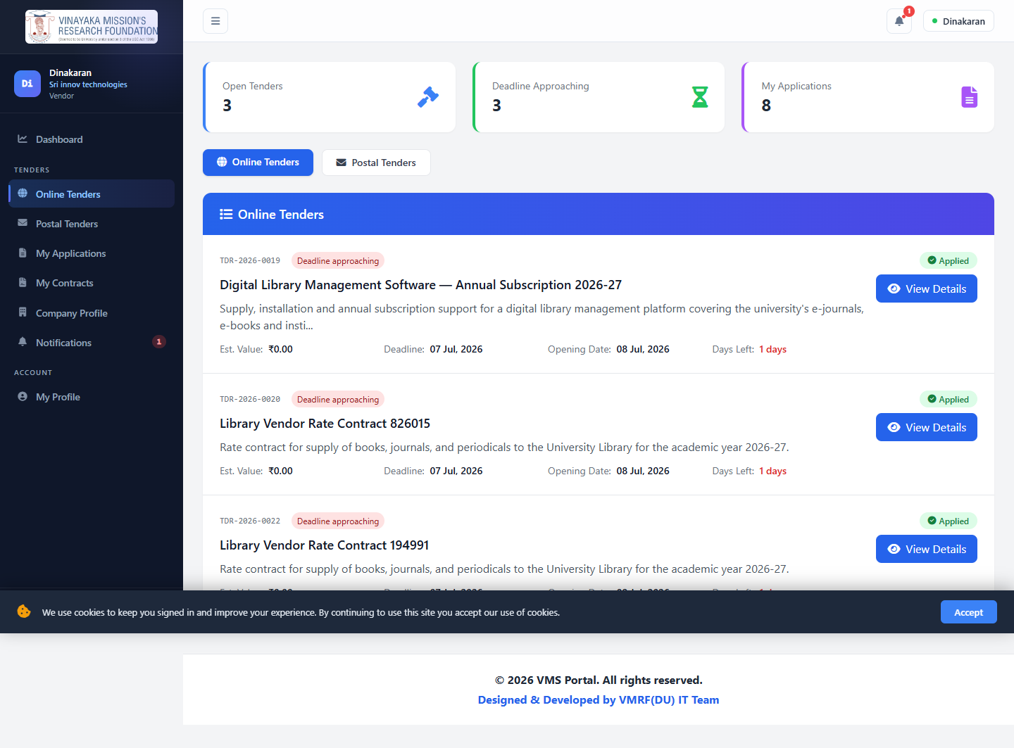
PROJECT STATUS
Phase I — Completed ✅
Tender creation and publication
Dual submission modes — Online and Postal
Vendor self-registration with Admin approval workflow
Configurable eligibility screening before a vendor can bid
Extensively tested by the Digital Librarian — identified issues addressed
Vendor Management System — University Tender Portal
8

Slide 9
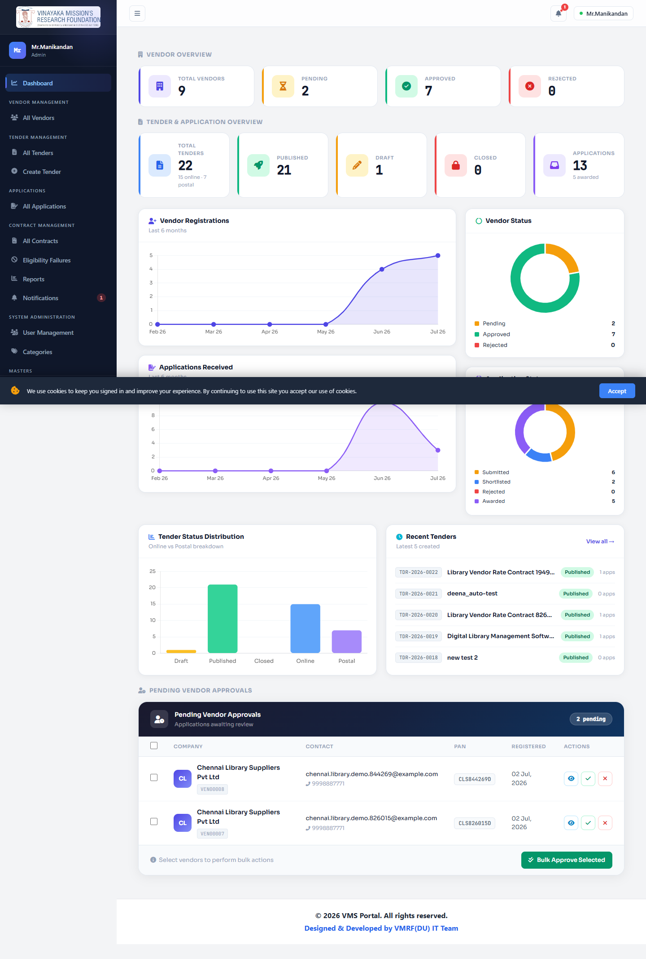
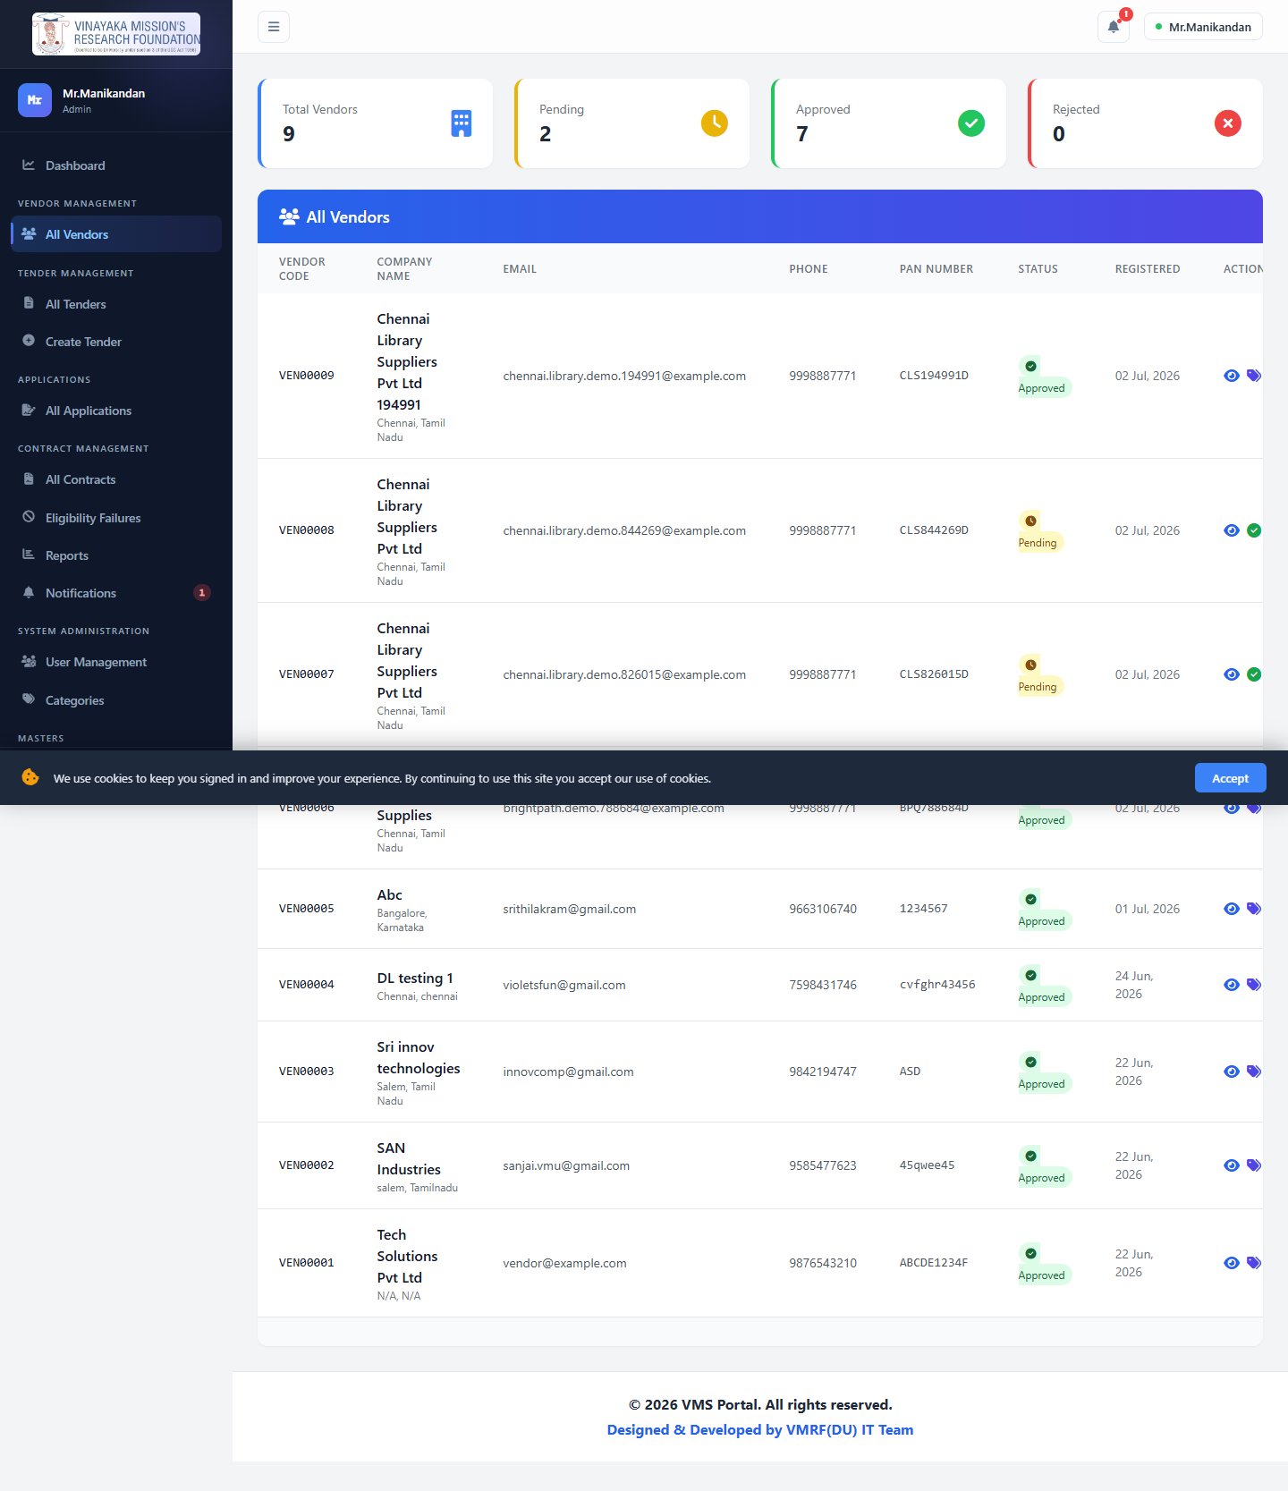
FUNCTIONALITY — ADMIN / PURCHASE OFFICER
Dashboard & Vendor Management
KPI dashboard — vendor counts, tender counts by status/type, application funnel, trend charts, recent activity
Approve, reject, suspend or reactivate vendor registrations
Assign vendor categories; bulk-approve; export vendor lists to CSV
Manage Users, Categories, and Terms & Conditions masters
Vendor Management System — University Tender Portal
9

Slide 10
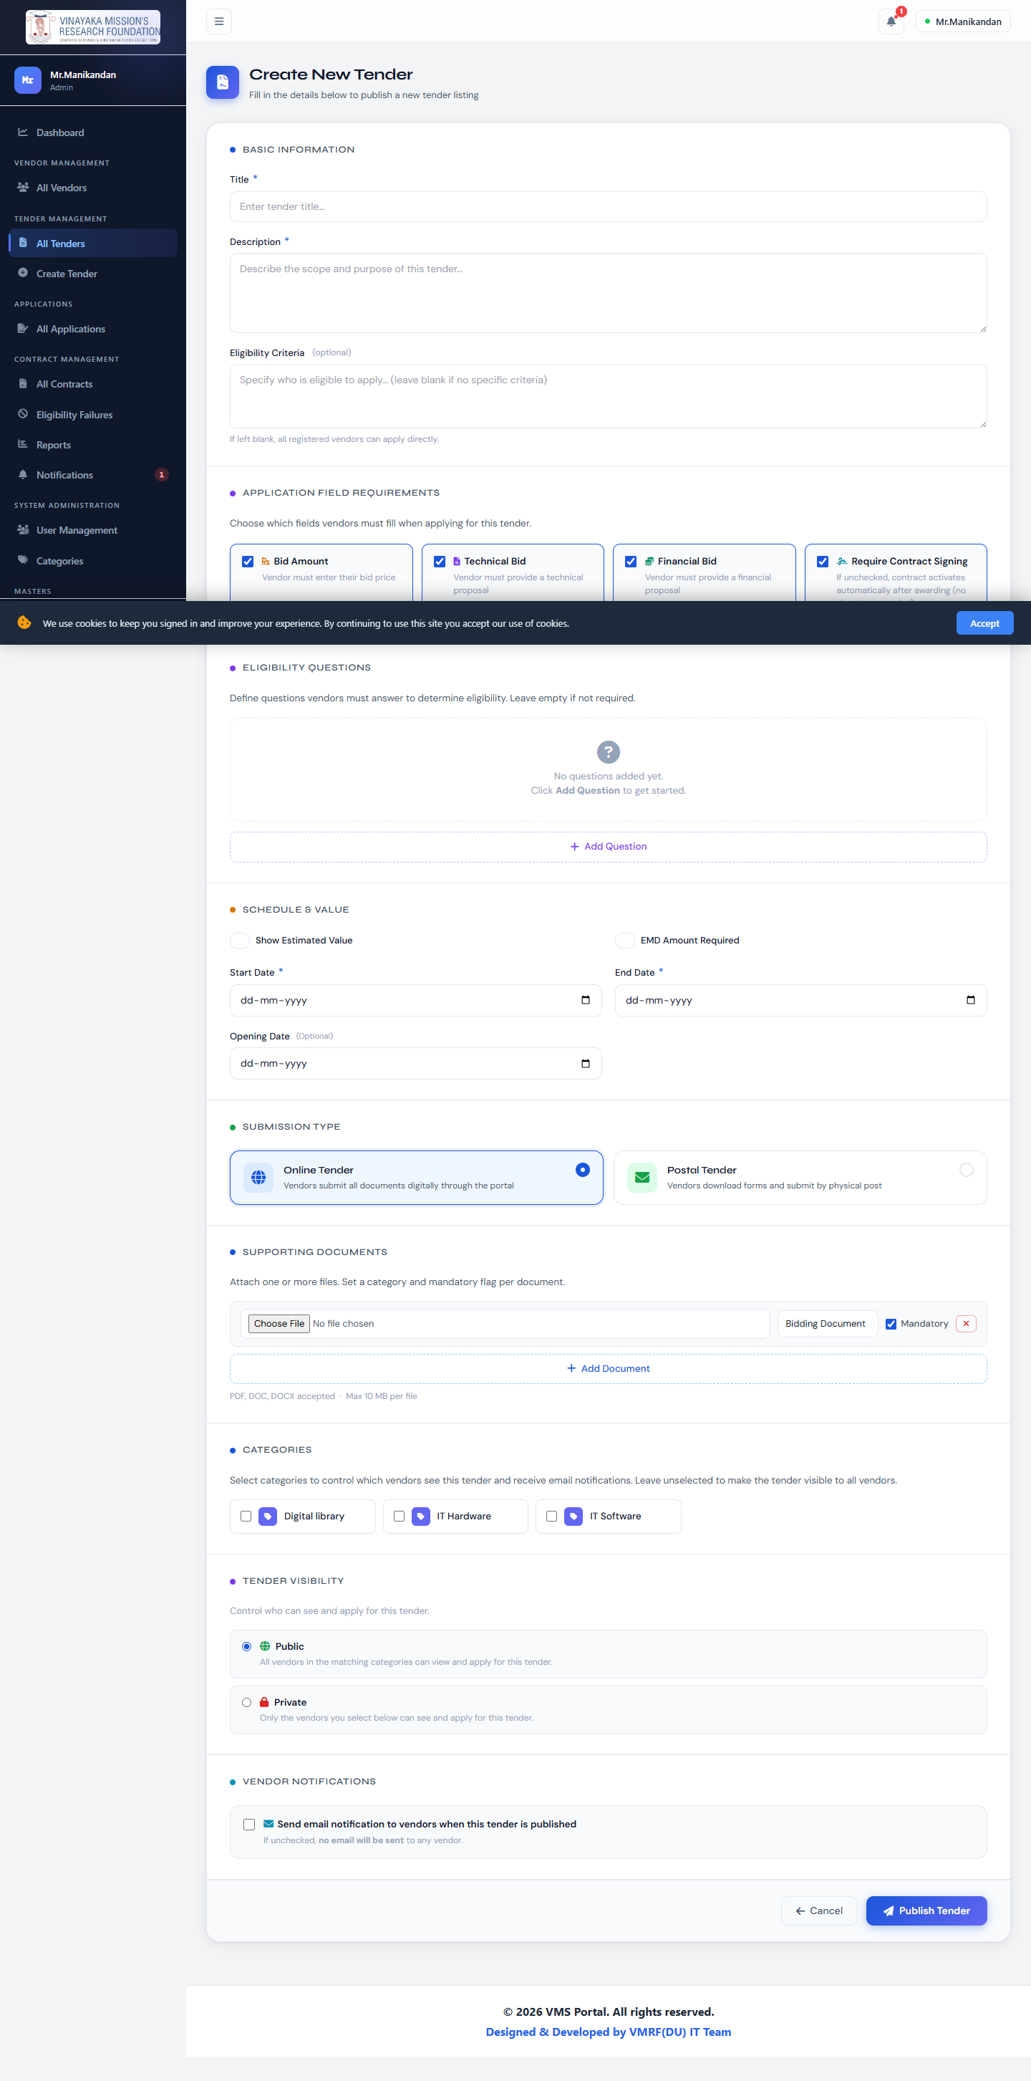
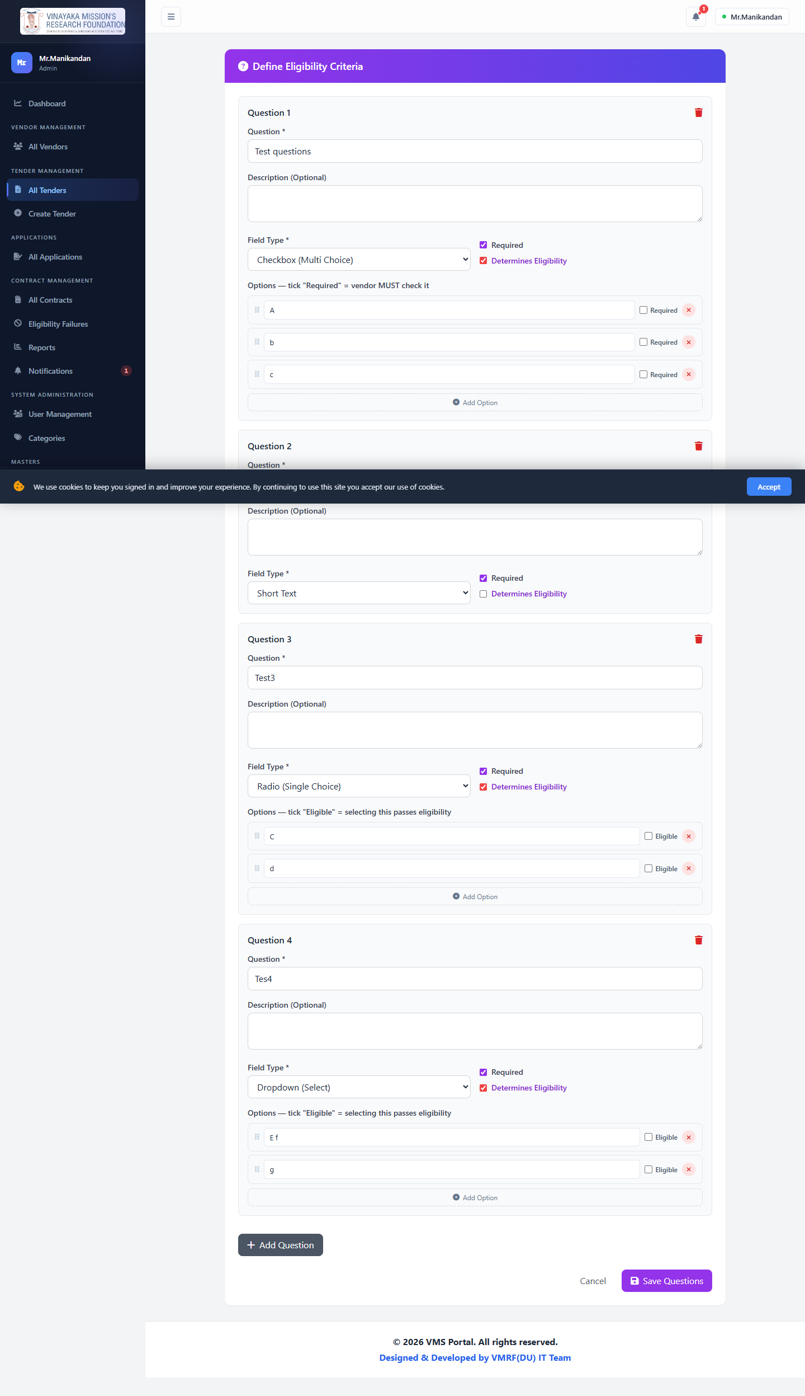
FUNCTIONALITY — ADMIN / PURCHASE OFFICER
Tender Creation & Eligibility Screening
Create tenders — online or postal, deadlines, EMD amount, estimated value, public/private visibility
Build a custom pre-bid eligibility questionnaire — text, dropdown, radio, checkbox, number, date, or file answers
Publish manually, or schedule auto-publish on a chosen start date
Assign an evaluation committee to a specific tender with scoped permissions
Vendor Management System — University Tender Portal
10

Slide 11
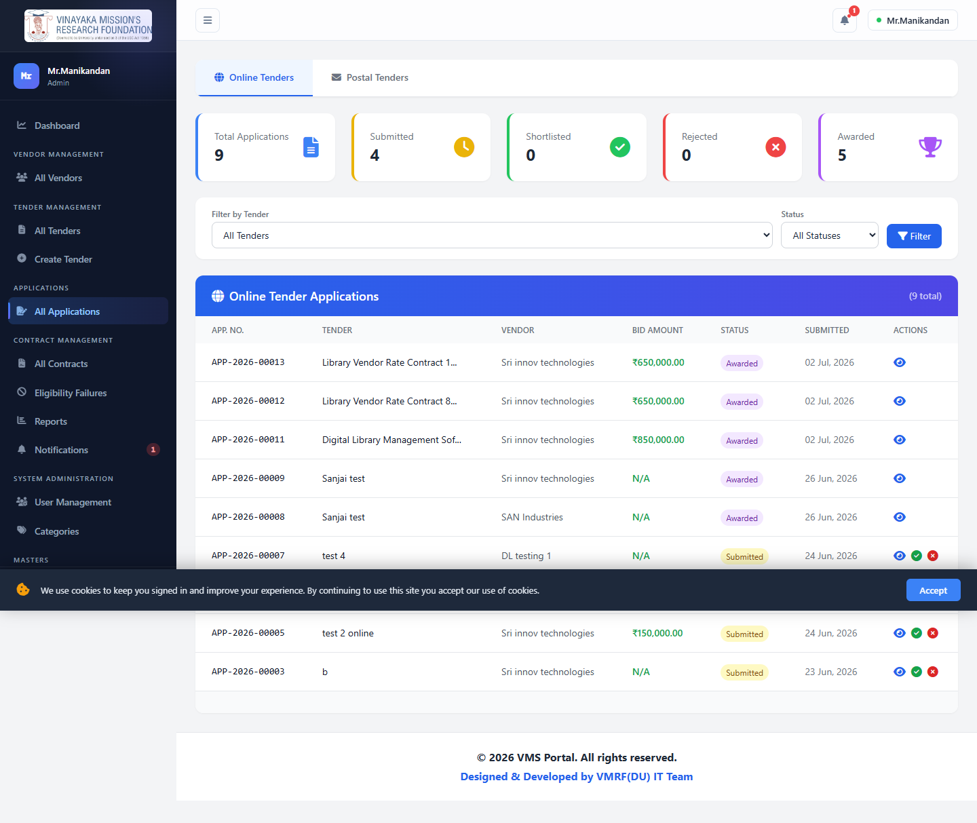
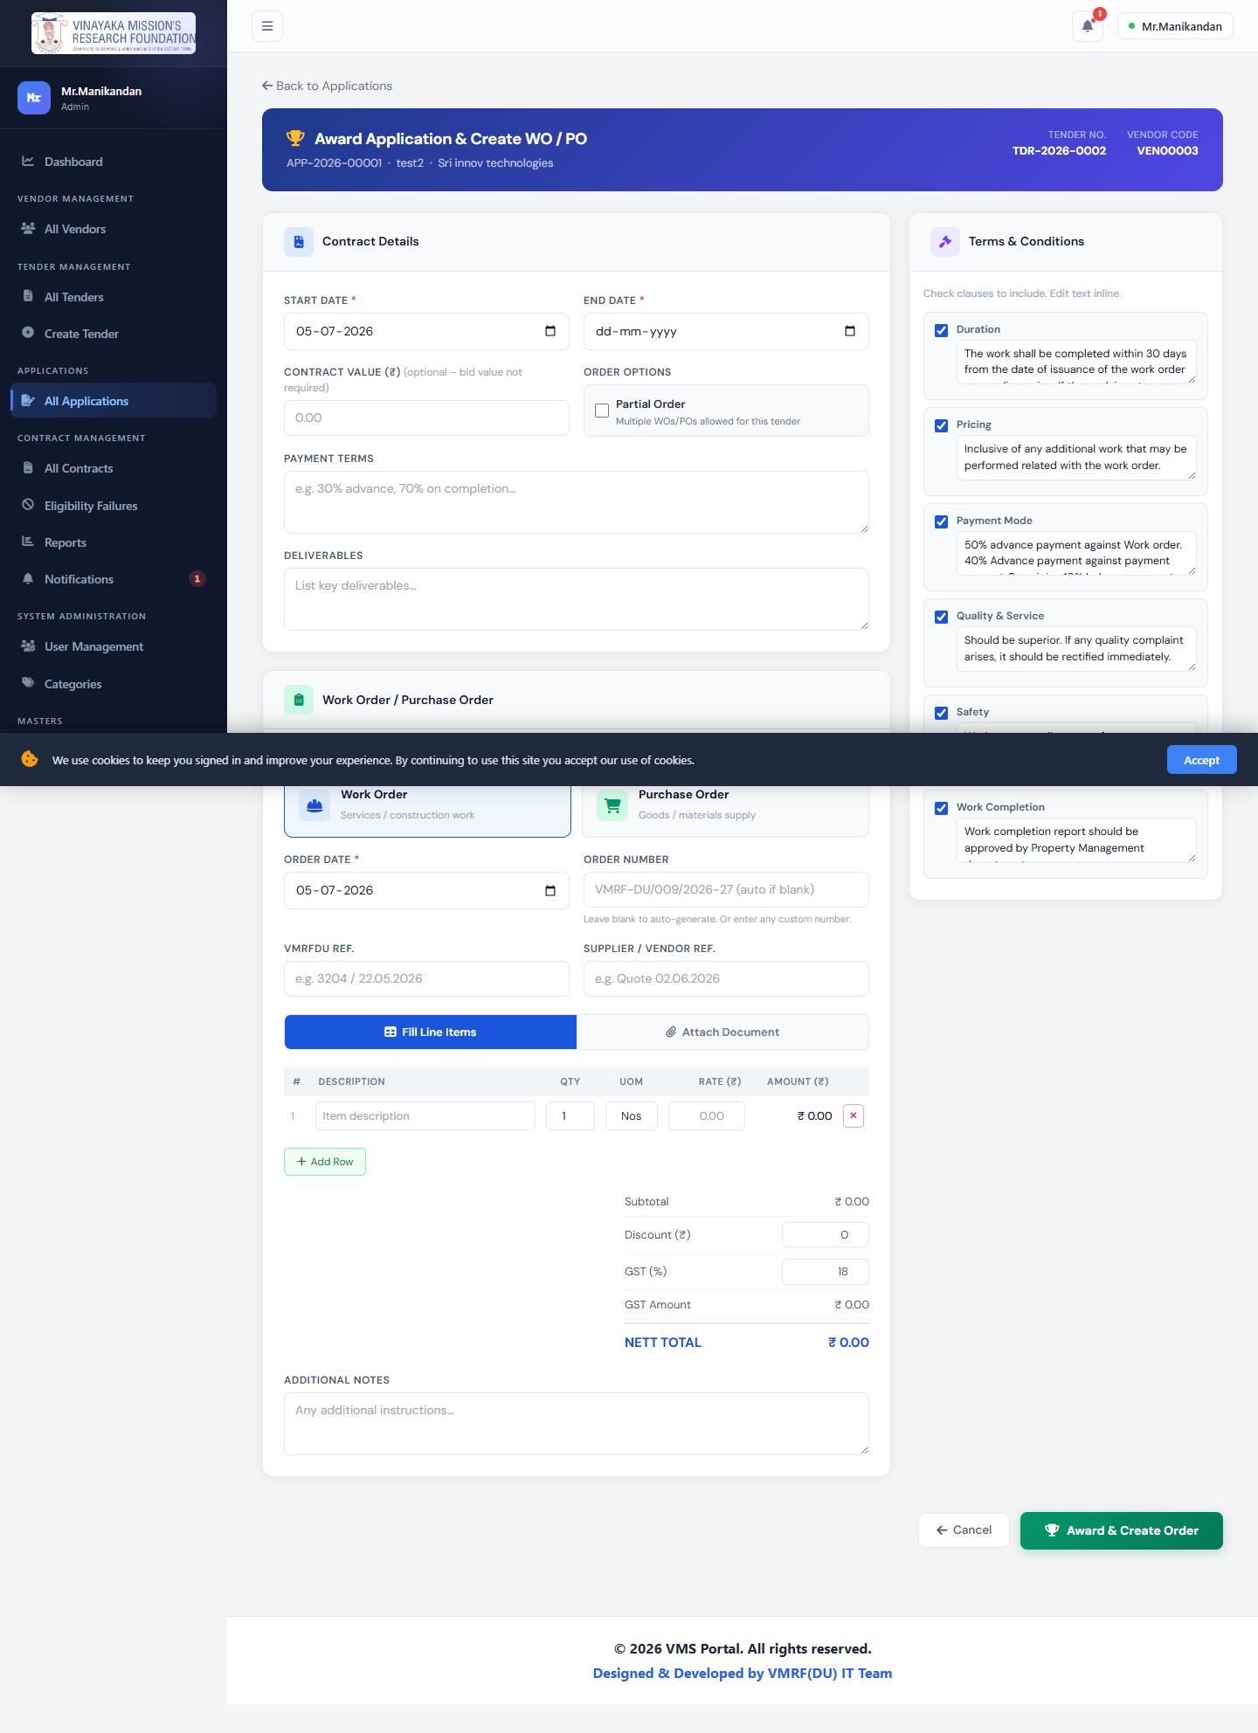
FUNCTIONALITY — ADMIN / PURCHASE OFFICER
Applications, Award & Contracts
Every application received, across every tender, in one list
Received → Shortlist → Award workflow — an application can only be awarded once shortlisted
Awarding auto-generates the Contract and Work/Purchase Order
Contract signature collection is a configurable, optional choice per tender — not a fixed requirement
Tracks eligibility-check failures, reports, and notifications
Vendor Management System — University Tender Portal
11

Slide 12
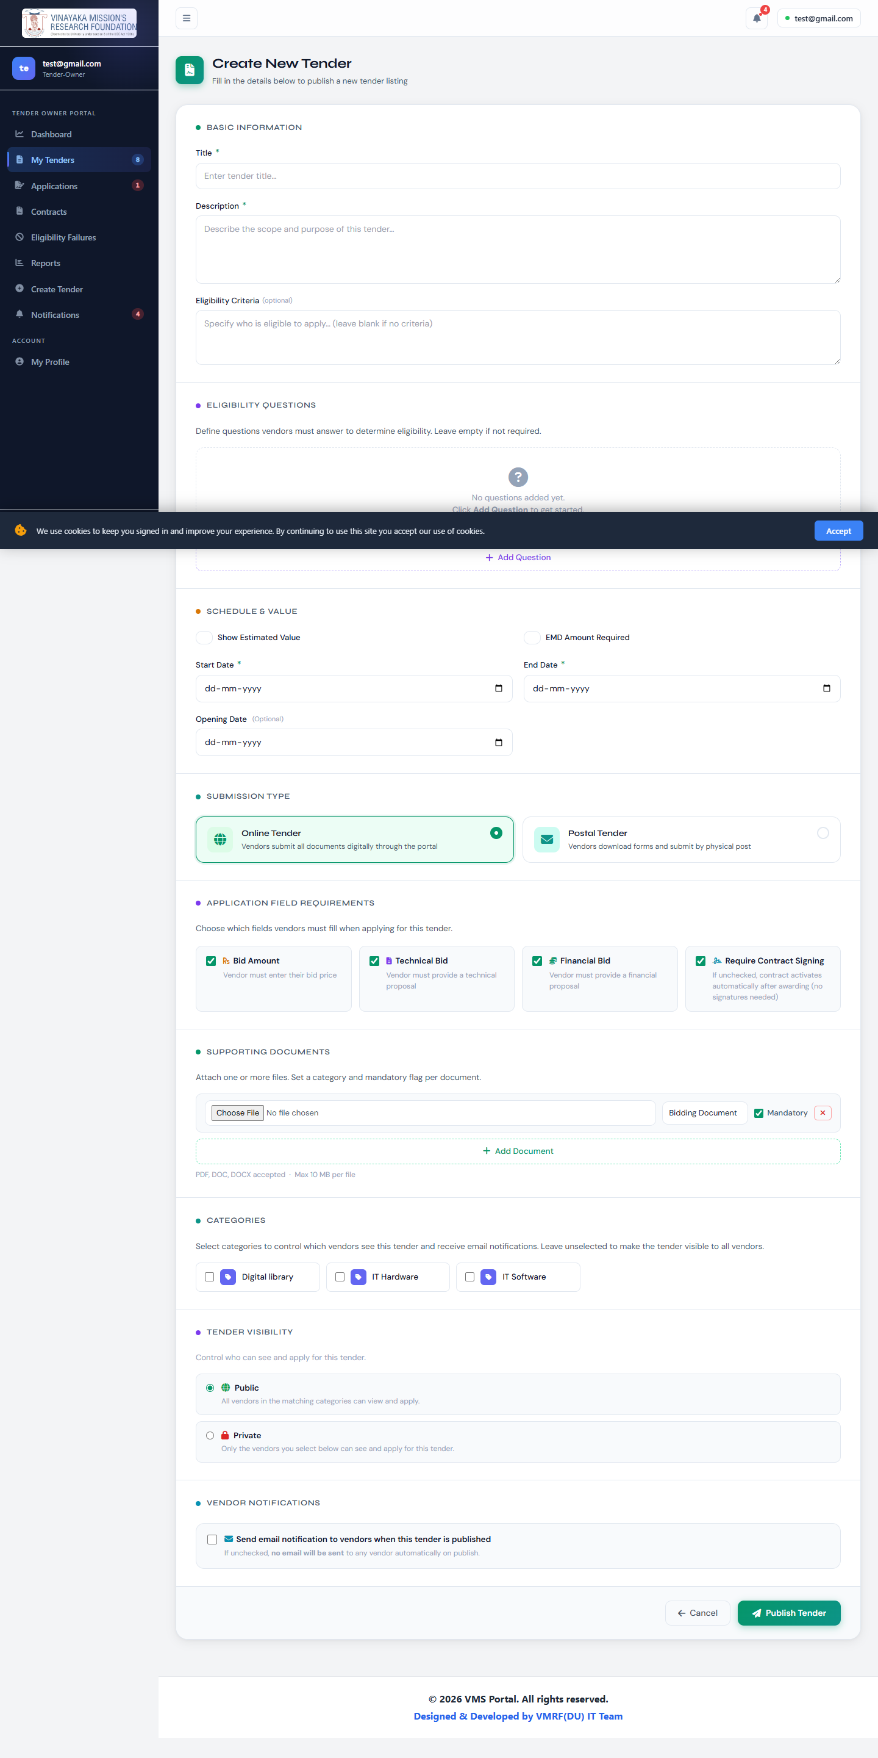
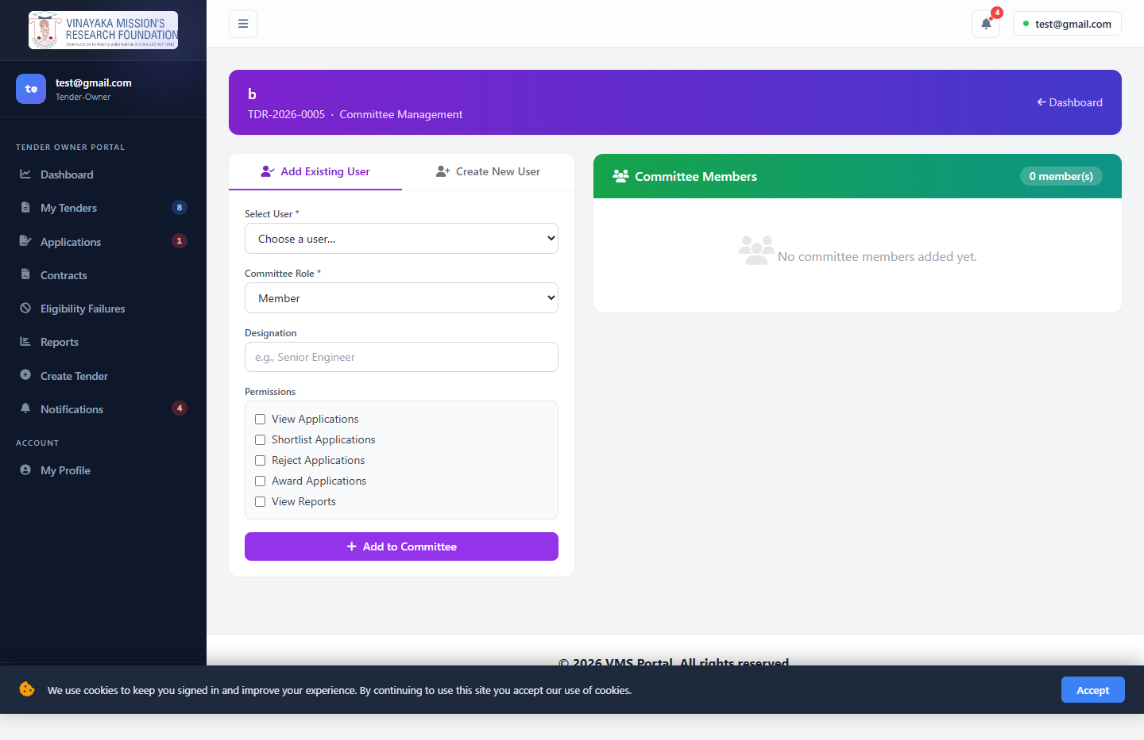
FUNCTIONALITY — TENDER OWNER
Publishing & Managing Own Tenders
Full tender lifecycle for tenders they own — create, edit, publish, assign committee
Same eligibility-builder, analytics, and management tools as Admin, scoped to "my tenders"
Access enforced server-side via User::canAccessTender() / canManageTender()
Auto-publish works the same way — a scheduled job publishes the tender on its start date
Vendor Management System — University Tender Portal
12

Slide 13
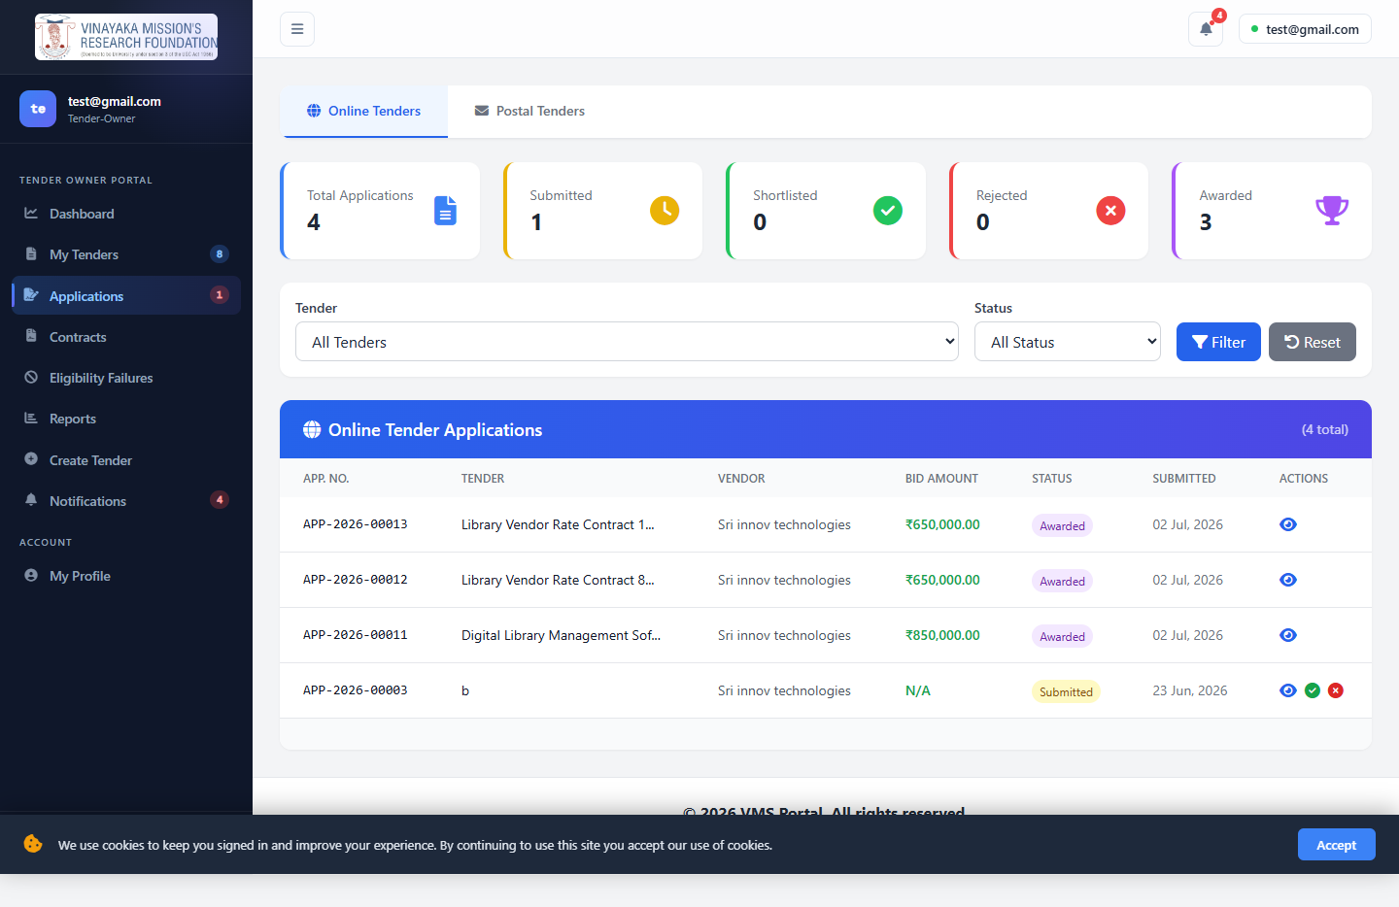
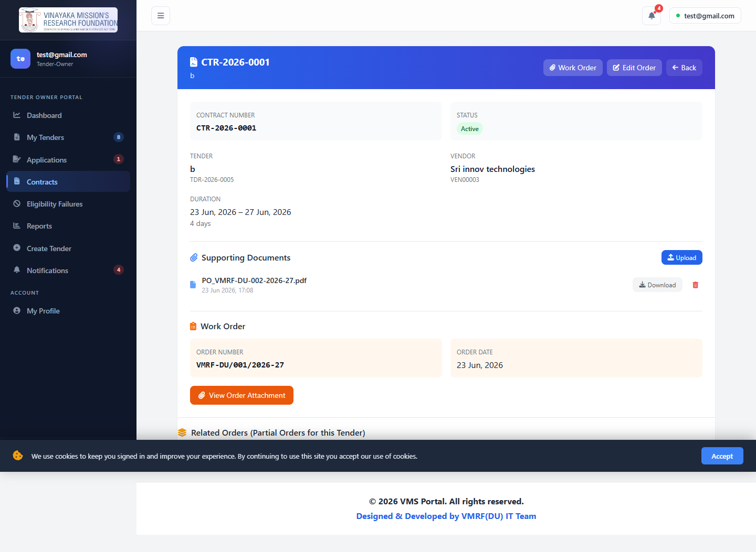
FUNCTIONALITY — TENDER OWNER
Reviewing, Shortlisting & Awarding
Applications list: Received → Shortlist → Award (trophy icon) for owned tenders
Awarding auto-generates the Contract and Work/Purchase Order, same as Admin
Tracks eligibility failures, contracts, and reports scoped to owned tenders
Automatic email to the vendor at every stage — shortlisted, rejected, awarded
Vendor Management System — University Tender Portal
13

Slide 14
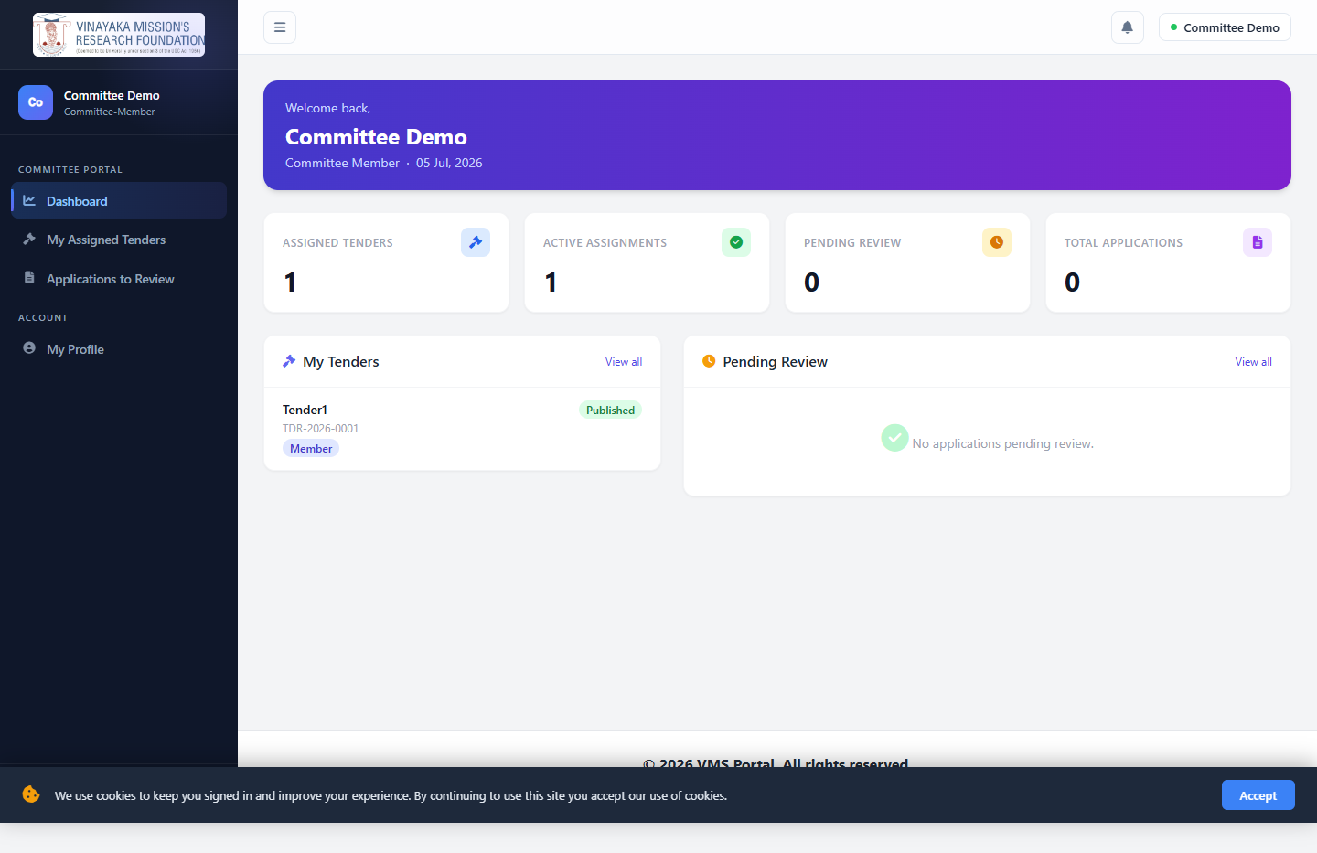
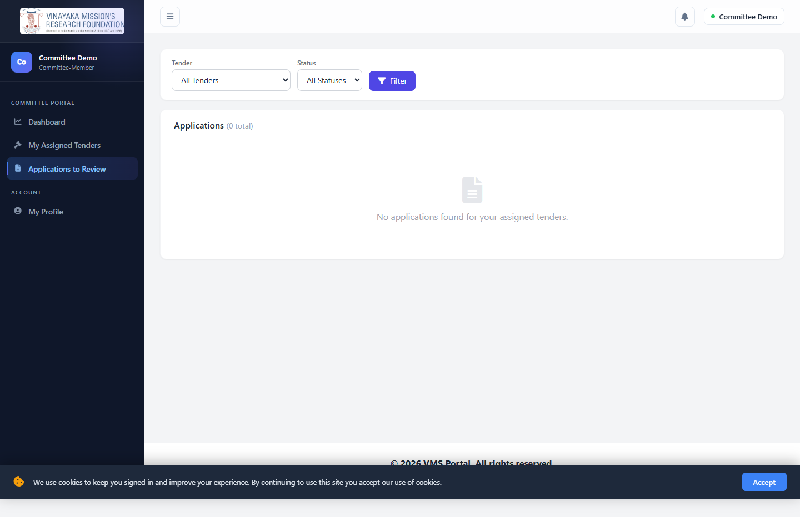
FUNCTIONALITY — EVALUATION COMMITTEE
Scoped Review Access
Assigned to a specific tender by Admin or Tender Owner, with a scoped JSON permission set (e.g. shortlist, reject)
Sees only assigned tenders and their applications — no tender-management or vendor-management rights
Gives evaluators visibility into bids without exposing the rest of the portal
A second committee member was added live through this exact screen — see the recorded proof later in this deck
Vendor Management System — University Tender Portal
14

Slide 15
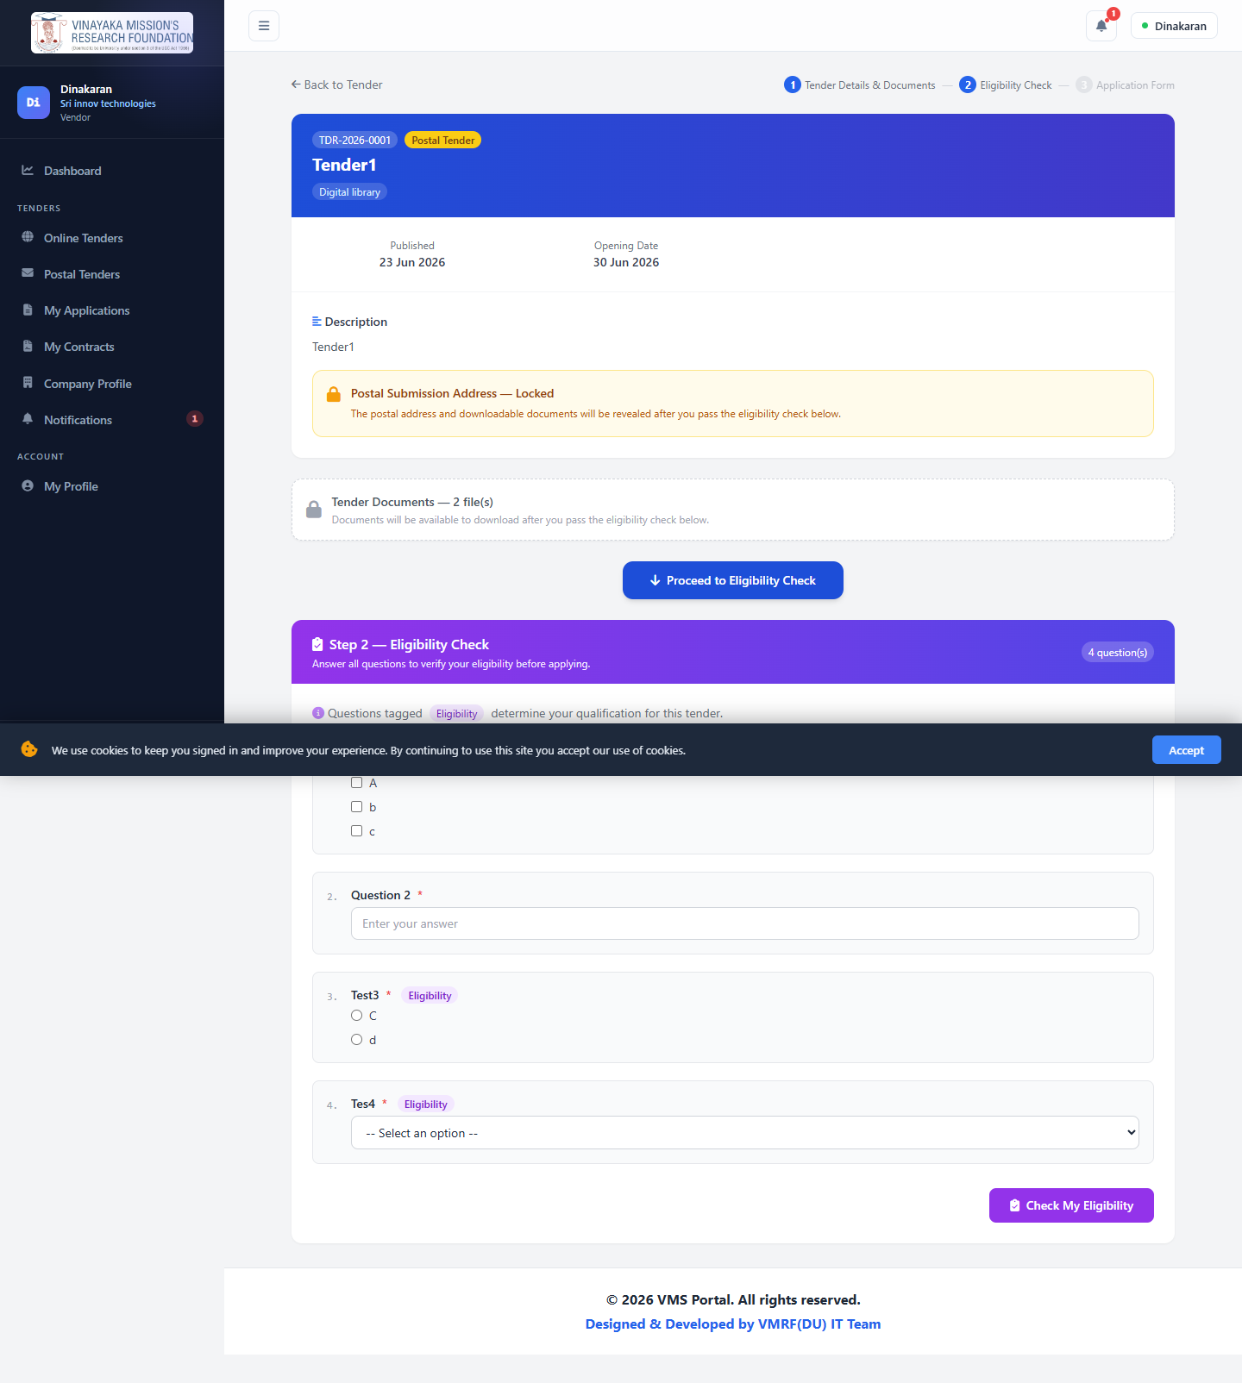
FUNCTIONALITY — VENDOR
Registration & Bidding
Self-registration, reviewed and approved by Admin before login access is granted
Browse Online and Postal tenders — postal tenders lock documents/address until eligibility passes
Guided apply wizard: tender details → eligibility questionnaire (checked live via AJAX) → bid/technical/financial proposal
Proposal fields unlock only after the eligibility check passes
Vendor Management System — University Tender Portal
15

Slide 16
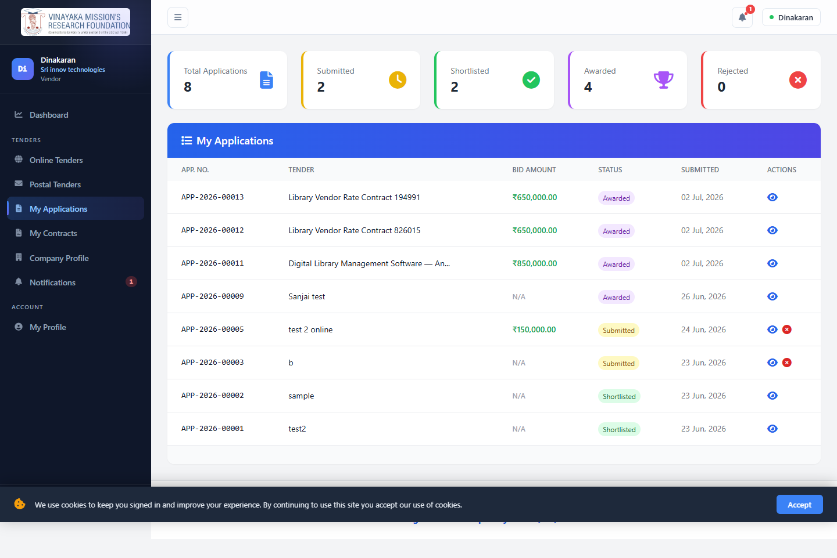
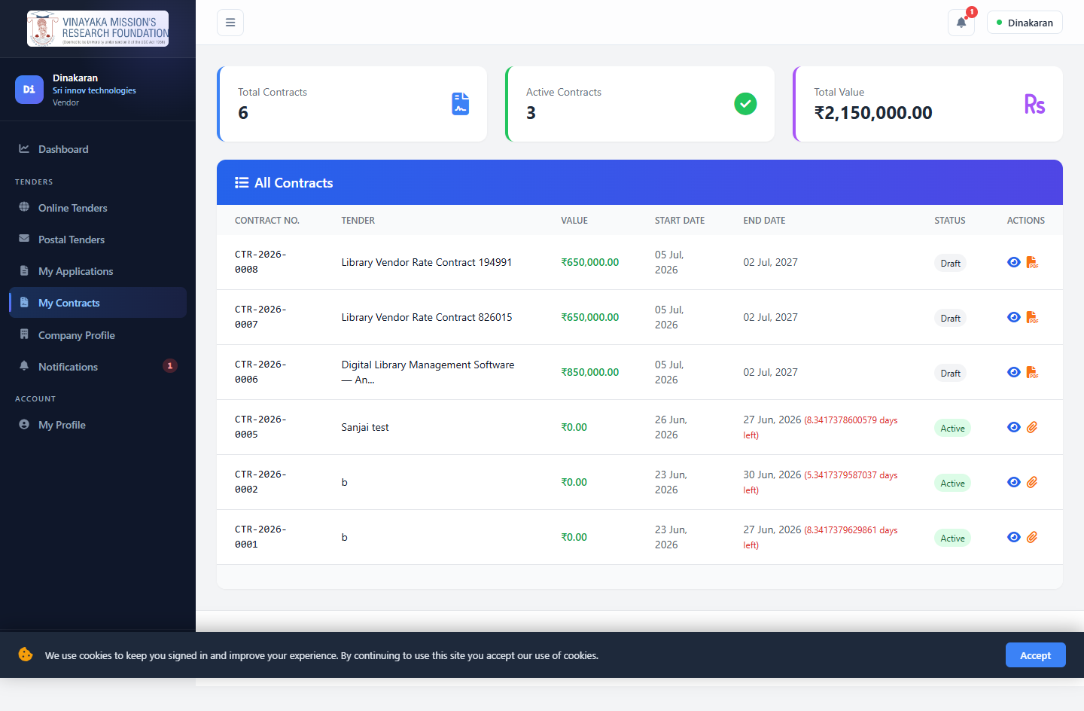
FUNCTIONALITY — VENDOR
Tracking Applications & Contracts
Track every application's status: Received → Shortlisted → Awarded
Sign an awarded contract online; a University counter-signature is only required if the Tender Owner configured that tender to need one
For standing rate contracts, signing can be skipped entirely and the contract activated immediately on award
Company profile management and a full notification center
Vendor Management System — University Tender Portal
16

Slide 17
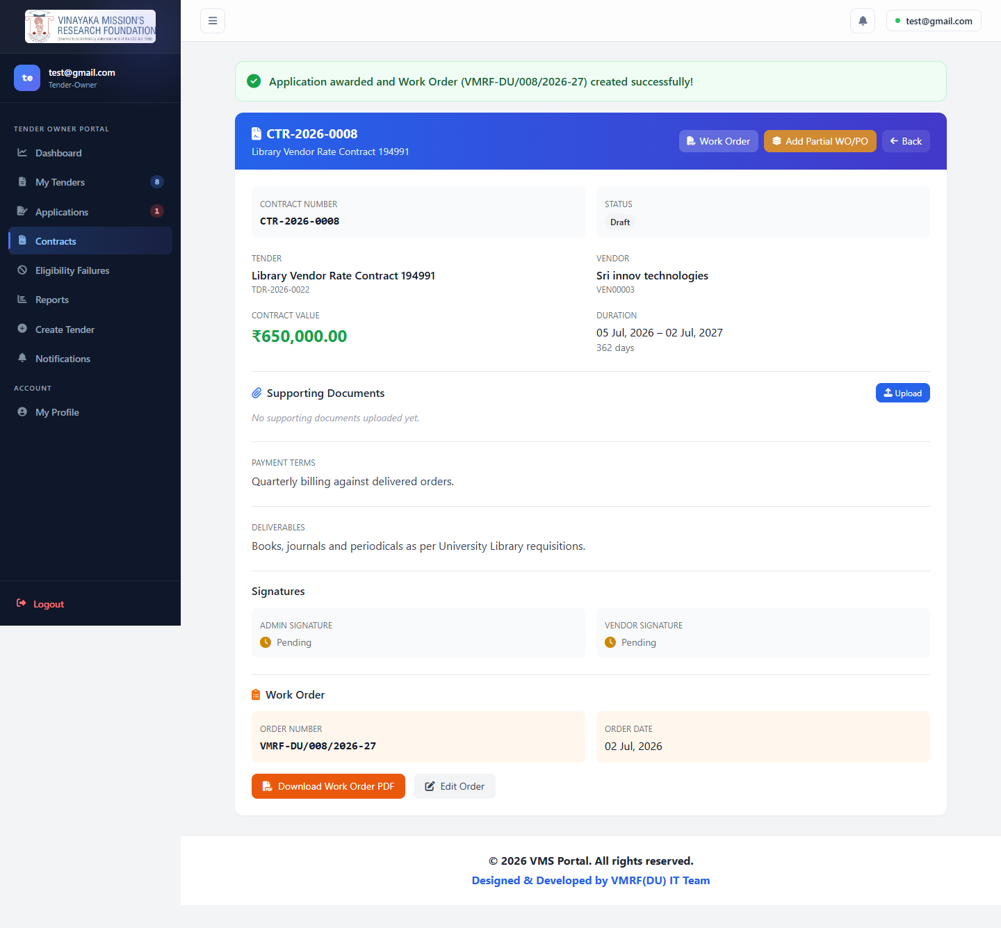
PROJECT STATUS
Phase II — In Development & Refinement
Application review, shortlisting and award workflow
Automatic Contract generation on award
Work Order / Purchase Order generation with line items and GST
Being refined in ongoing consultation with the Purchase Officer, who will serve as the system’s primary administrator
Reporting and analytics modules
Vendor Management System — University Tender Portal
17

Slide 18
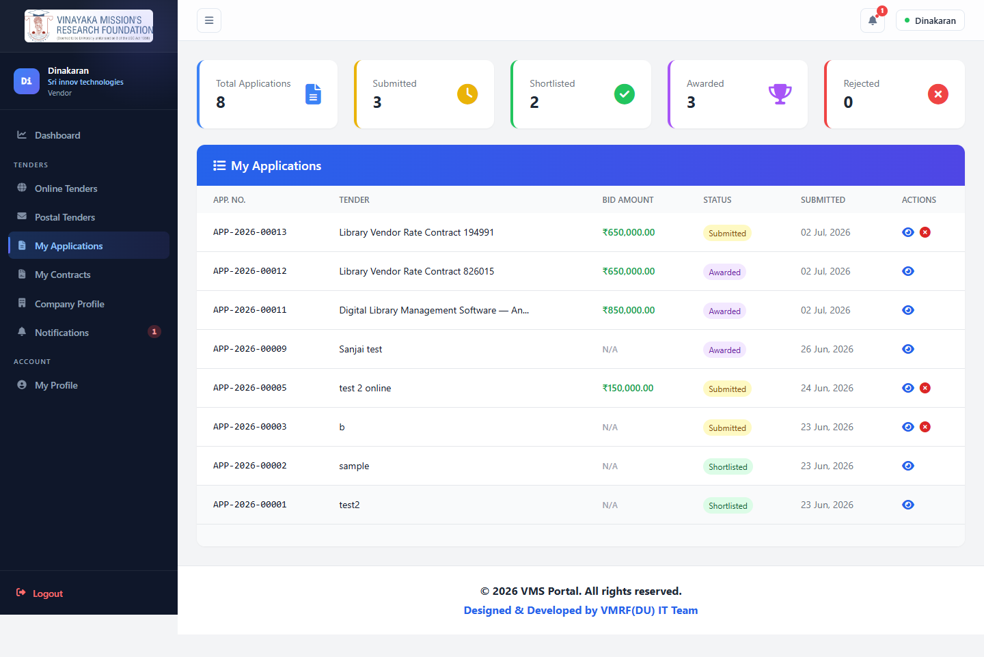
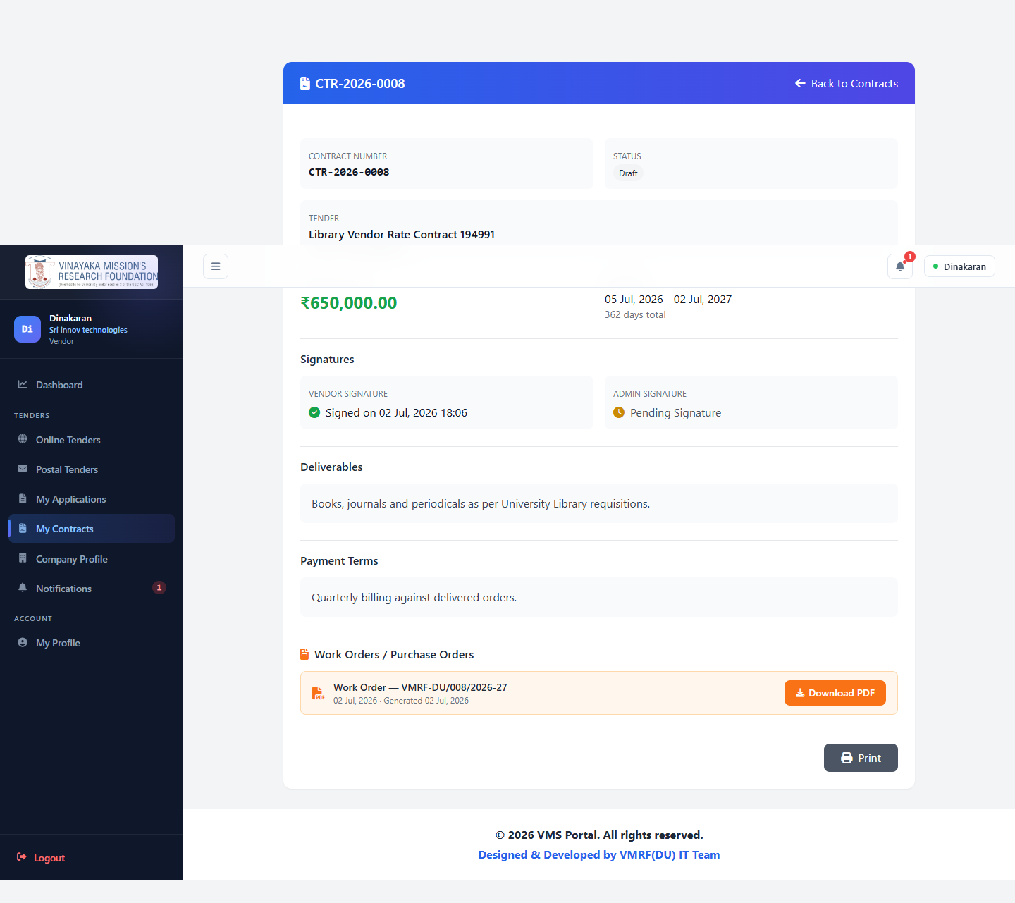
VERIFICATION
Proven With a Real, Live Test Run
Before this demonstration, the complete workflow was executed live on the running system — a real vendor registered, a real tender was published, a real application was submitted, reviewed, awarded, and the contract signed.
Vendor Management System — University Tender Portal
18

Slide 19
RECOMMENDATION
Phase I is Complete, Tested, and Ready to Go Live
Recommend Management approval to make the portal live immediately
First live tender: the Library Vendor Rate Contract, as requested by the Digital Librarian
Phase II (evaluation, award, contracts) continues refinement with the Purchase Officer
Further Management suggestions welcomed and will be incorporated as development continues

Slide 20
NEXT STEPS
Where We Go From Here
1
2
3
Management Review
Approve Phase I
Continue Phase II
Review the portal design and current functionality demonstrated today
Authorize the portal to go live for the Library Vendor Rate Contract Tender
Ongoing refinement of the review, award and contract workflow with the Purchase Officer
Vendor Management System — University Tender Portal
20

Slide 21
Thank You
Questions & Discussion
Dr. Murugan
Deputy Director – IT
In-House Web Development Team: Mr. M. Dinakaran · Sanjai
Vinayaka Mission's Research Foundation — IT Department

