Slide 1


P.A. COLLEGE OF ENGINEERING
DEPARTMENT OF COMPUTER SCIENCE & ENGINEERING
SynCura
Predictive ICU Monitoring System Using Attention-Based LSTM with Real-Time Explainability
TEAM MEMBERS :
Abdul Ahad Ikkeri – 4PA24CS002
Fathima Reeha – 4PA24CS026
Fizan Feroz – 4PA24CS032

Slide 2
P.A. COLLEGE OF ENGINEERING
DEPARTMENT OF COMPUTER SCIENCE & ENGINEERING
PROBLEM STATEMENT
ICU deterioration is difficult to identify early from isolated measurements and manual score calculations.
Existing rule-based scores do not fully capture the direction, duration, and interaction of changing observations.
Need: an early-warning aid reading recent history, with understandable reasons.
The challenge is to build and evaluate a real-time, explainable prototype without presenting it as a validated clinical device.

Slide 3
P.A. COLLEGE OF ENGINEERING
DEPARTMENT OF COMPUTER SCIENCE & ENGINEERING
MOTIVATION / NEED FOR THE PROJECT
ICU deterioration can progress rapidly, making early recognition important for timely clinical intervention.
Rule-based scores such as NEWS2 and SOFA use threshold-driven assessments and do not directly model longitudinal trends.
SynCura applies temporal deep learning to streaming-style vital and clinical measurements.
The project focuses on an explainable software prototype, not autonomous clinical decision-making.

Slide 4
P.A. COLLEGE OF ENGINEERING
DEPARTMENT OF COMPUTER SCIENCE & ENGINEERING
EXISTING SYSTEM / RELATED WORK
BASE PAPER - Zheng et al. (2025): Time-aware bidirectional attention LSTM for real-time ICU mortality (MIMIC-IV + eICU, dynamic AUROC 0.936). Adapted by SynCura on PhysioNet 2012.
Supporting papers:
Wang, Bai and Jin (2026) - Explainable LSTM models for ICU outcomes; AUC 0.79-0.87.
Yan et al. (2026) - Sequential ICU mortality models; plain LSTM AUC 0.802.
Sadanandan (2026) - Multimodal time-series and clinical-note fusion; AUROC 0.7857.
Wu et al. (2024) - Real-time vital-sign mortality prediction; LSTM AUC 0.9263.
Xie et al. (2025) - RealMIP continuous-data recovery for ICU mortality prediction.
Choi et al. (2020) - Deep interpretable early warning with BiLSTM attention.
Li et al. (2025) - Attention residual LSTM-FCN for clinical time-series prediction.
Scheid et al. (2025) - Wearable deep learning for continuous in-hospital deterioration prediction.

Slide 5
P.A. COLLEGE OF ENGINEERING
DEPARTMENT OF COMPUTER SCIENCE & ENGINEERING
BASE PAPER / REFERENCE PAPER
Title: Development and Validation of a Dynamic Real-Time Risk Prediction Model for ICU Patients Based on Longitudinal Irregular Data.
Authors: Zheng, Luo, Zhu, Du, Lan, Zhou, Yang and Huang. Year: 2025. Journal: JMIR, vol. 27, e69293.
Method: time-aware bidirectional attention LSTM (TBAL) on 176,344 ICU stays from MIMIC-IV with eICU cross-validation; hourly risk updates.
Results: dynamic AUROC 0.936 on MIMIC-IV and 0.919 on external eICU data; recall 79.1%.
Adaptation: same architecture-task match - attention LSTM for real-time ICU risk; SynCura adds SHAP feature explanations.
Limitation: retrospective data till discharge; AUROC rises to 0.989 at discharge (hindsight bias). SynCura fixes this with 90-min only, no future info.

Slide 6
P.A. COLLEGE OF ENGINEERING
DEPARTMENT OF COMPUTER SCIENCE & ENGINEERING
PROPOSED SOLUTION
Idea: SynCura - an attention-based LSTM over a rolling 90-minute window of 12 clinical features, returning a 0-100 risk score with explanations.
Different/better - metrics: reports false alarms, sensitivity, specificity, precision, lead time, and a NEWS2 comparison; most papers report AUC only.
Different/better - evidence: fresh unseen 20% set-B holdout AUC 0.844 exceeds validation AUC 0.840.
Different/better - deployment: an end-to-end FastAPI serving path, alerts, and HTTP and MQTT ingestion - not just a trained model.
Design goal - learns from mistakes: confirmed misses/false alarms queue into weighted retraining.

Slide 7
P.A. COLLEGE OF ENGINEERING
DEPARTMENT OF COMPUTER SCIENCE & ENGINEERING
METHODOLOGY / PROPOSED APPROACH
1 · DATA
PhysioNet 2012
12 vitals + labs
2 · PREPARE
Interpolate
Train-only z-score
3 · WINDOW
90-min rolling
Stride 15
4 · MODEL
LSTM-96 + attention
Risk 0–100
5 · SERVE
FastAPI + dashboard
SHAP explains
Leakage controls: train-only stats · patient-level split · past-only windows

Slide 8
P.A. COLLEGE OF ENGINEERING
DEPARTMENT OF COMPUTER SCIENCE & ENGINEERING
EXPECTED OUTCOME
A working real-time ICU dashboard displaying deterioration risk from recent clinical measurements.
A 0-to-100 risk score with temporal and feature-level explanations for each patient.
An AUC-ROC target in the realistic 0.78-0.93 range for a single-dataset vitals-plus-labs system.
Investigate earlier warning relative to the NEWS2 baseline, via quantified lead time.
Demonstrate a feasible, explainable research prototype - not clinical deployment readiness.

Slide 9
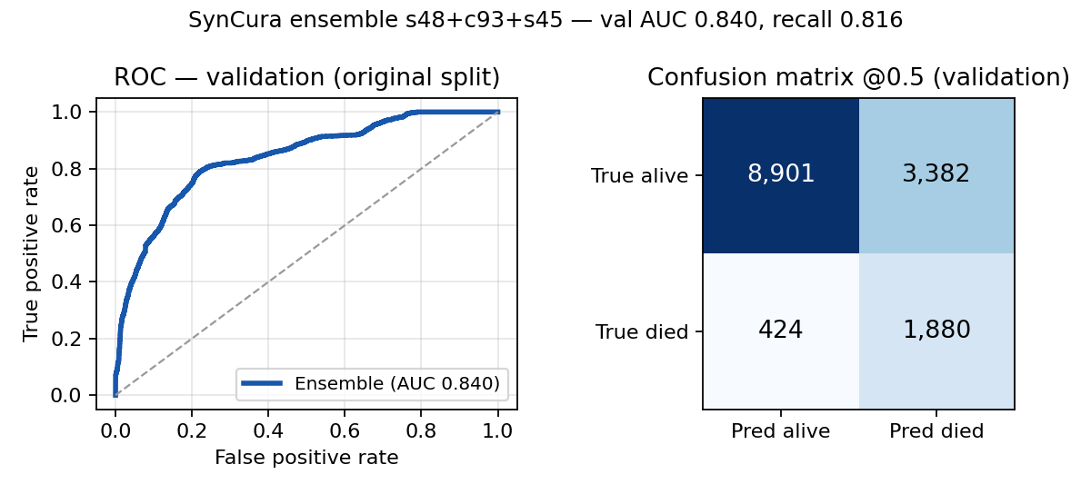
P.A. COLLEGE OF ENGINEERING
DEPARTMENT OF COMPUTER SCIENCE & ENGINEERING
EXPERIMENTAL RESULT
Ensemble s48+c93+s45: val 0.840, fresh holdout 0.844.
Full metrics: sensitivity, precision, false alarms, lead time vs NEWS2.
Holdout ≥ val suggests no major overfit (CIs pending).

Slide 10
P.A. COLLEGE OF ENGINEERING
DEPARTMENT OF COMPUTER SCIENCE & ENGINEERING
LIMITATIONS & IMPROVEMENT PATH
Paper: 0.936, 0.989 at discharge (hindsight); 0.81/0.76 cross-hospital, no bedside test.
Reality: US-only retrospective, missing/async vitals, age bias.
Stricter by design: 90-min past-only windows; holdout 0.844 ≥ val 0.840.
Reports what papers skip: false alarms, lead time vs NEWS2, calibration.
Path: eICU/MIMIC validation, RealMIP imputation, time-aware attention, pilot.

Slide 11
P.A. COLLEGE OF ENGINEERING
DEPARTMENT OF COMPUTER SCIENCE & ENGINEERING
TECHNOLOGY / TOOLS REQUIRED
Programming: Python for machine learning and backend services; JavaScript for the frontend.
ML and backend: PyTorch, FastAPI, SQLite, scikit-learn, and SHAP.
Frontend: React, Vite, and Tailwind CSS.
Dataset: PhysioNet / Computing in Cardiology Challenge 2012.
SENSE
ESP32 + MAX30105
INGEST
FastAPI + SQLite
SCORE
AttentionLSTM 0–100
ACT
Dashboard + alerts

Slide 12
P.A. COLLEGE OF ENGINEERING
DEPARTMENT OF COMPUTER SCIENCE & ENGINEERING
SDG RELEVANCE
SDG 3 - Good Health and Well-Being: earlier detection of ICU deterioration supports timely clinical review and better patient monitoring.
SDG 9 - Industry, Innovation and Infrastructure: explainable deep learning integrated into a modern monitoring workflow - ML, APIs, visualization, and sensor-ready architecture.

Slide 13
P.A. COLLEGE OF ENGINEERING
DEPARTMENT OF COMPUTER SCIENCE & ENGINEERING
FUTURE SCOPE
Calibration + decision-curve analysis for bedside thresholds.
Subgroup and fairness validation across age, sex, and hospitals.
Edge/TinyML deployment for wearable live vitals.
Prospective clinical pilot with collaborators.
Privacy-preserving multi-hospital training.

Slide 14
P.A. COLLEGE OF ENGINEERING
DEPARTMENT OF COMPUTER SCIENCE & ENGINEERING
CONCLUSION
SynCura demonstrates an end-to-end explainable ICU risk-monitoring workflow from clinical time-series input to dashboard output.
Temporal attention and SHAP provide an interpretable view of which time steps and features influenced the prediction.
The deployed ensemble achieved 0.840 validation AUC and 0.844 set-B holdout AUC.
These results support the prototype concept, while further clinical and external validation is required before real-world use.

Slide 15
P.A. COLLEGE OF ENGINEERING
DEPARTMENT OF COMPUTER SCIENCE & ENGINEERING
REFERENCES
[1] Zheng et al. (2025). Development and Validation of a Dynamic Real-Time Risk Prediction Model for ICU Patients Based on Longitudinal Irregular Data. JMIR 27, e69293. doi:10.2196/69293
[2] Wang, Bai & Jin (2026). Explainable Deep-Learning Models for ICU Outcomes. Frontiers in Physiology 17.
[3] Yan et al. (2026). Deep Learning-Based In-Hospital Mortality Prediction Using Long-Term Sequential Data in ICU Patients. PeerJ 14, e21631.
[4] Sadanandan (2026). Multimodal Deep Learning for Early Prediction of Patient Deterioration in the ICU. arXiv:2603.14719.
[5] Wu et al. (2024). Revisiting the Potential Value of Vital Signs in Real-Time Prediction of Mortality Risk in ICU Patients. J Big Data 11, 40.
[6] Xie et al. (2025). Unlocking Real-Time ICU Mortality Prediction: RealMIP Continuous Data Recovery. npj Digital Medicine 8, 733.
[7] Choi et al. (2020). Deep Interpretable Early Warning System for Clinical Deterioration. IEEE JBHI 24(9).
[8] Li et al. (2025). Attention Residual LSTM-FCN for Clinical Time-Series Prediction. IEEE Access 13.
[9] Scheid et al. (2025). Wearable Deep Learning for Continuous In-Hospital Deterioration Prediction. Nature Communications 16, 9513.
[10] PhysioNet Challenge 2012. Predicting Mortality of ICU Patients. physionet.org/content/challenge-2012/

Slide 16
P.A. COLLEGE OF ENGINEERING
DEPARTMENT OF COMPUTER SCIENCE & ENGINEERING
THANK YOU

