Slide 1



P.A. COLLEGE OF ENGINEERING
DEPARTMENT OF COMPUTER SCIENCE & ENGINEERING
SynCura
Predictive ICU Monitoring System Using Attention-Based LSTM with Real-Time Explainability
TEAM MEMBERS :
Abdul Ahad Ikkeri – 4PA24CS002
Fathima Reeha – 4PA24CS026
Fizan Feroz – 4PA24CS032

Slide 2
P.A. COLLEGE OF ENGINEERING
DEPARTMENT OF COMPUTER SCIENCE & ENGINEERING
PROBLEM STATEMENT
ICU deterioration is difficult to identify early from isolated measurements and manual score calculations.
Existing rule-based scores do not fully capture the direction, duration, and interaction of changing observations.
Need: an early-warning aid reading recent history, with understandable reasons.
The challenge is to build and evaluate a real-time, explainable prototype without presenting it as a validated clinical device.

Slide 3
P.A. COLLEGE OF ENGINEERING
DEPARTMENT OF COMPUTER SCIENCE & ENGINEERING
MOTIVATION / NEED FOR THE PROJECT
ICU deterioration can progress rapidly, making early recognition important for timely clinical intervention.
Rule-based scores such as NEWS2 and SOFA use threshold-driven assessments and do not directly model longitudinal trends.
SynCura applies temporal deep learning to streaming-style vital and clinical measurements.
The project focuses on an explainable software prototype, not autonomous clinical decision-making.

Slide 4
P.A. COLLEGE OF ENGINEERING
DEPARTMENT OF COMPUTER SCIENCE & ENGINEERING
EXISTING SYSTEM / RELATED WORK
Base paper: Zheng et al. (2025) - Temporal-Branch Attention LSTM (TBAL), MIMIC-IV + eICU, dynamic AUROC ~0.936. SynCura adapts TBAL to PhysioNet 2012.
Support 1: Yan et al. (2026) - single LSTM, multi-centre ICU, AUC 0.802.
Support 2: Sadanandan (2026) - multimodal LSTM + ClinicalBERT, AUROC 0.786.
Support 3: Wu et al. (2024) - vital-signs-only LSTM, AUC 0.926.
Support 4: Xie et al. (2025) - RealMIP missing-data recovery, AUC 0.957-0.968.
Support 5: Choi et al. (2020) - interpretable BiLSTM early-warning, AUROC ~0.880.
Support 6: Scheid et al. (2025) - continuous wearable deep learning, AUROC ~0.890.
Support 7: Wang, Bai & Jin (2026) - explainable LSTM, AUC 0.79-0.87.
Gap: models report single AUC only; few validate on unseen patients; none ship a real-time explainable risk path.

Slide 5
P.A. COLLEGE OF ENGINEERING
DEPARTMENT OF COMPUTER SCIENCE & ENGINEERING
BASE PAPER / REFERENCE PAPER
Title: Development and Validation of a Dynamic Real-Time Risk Prediction Model for ICU Patients based on Longitudinal Irregular Data
Authors: Zheng et al. (2025) - JMIR vol. 27, e69293
Method: Temporal-Branch Attention LSTM (TBAL); longitudinal irregular EHR; MIMIC-IV + eICU
Dynamic AUROC ~0.936; static ~0.812; recall 79.1%
SynCura adapts TBAL: 90-min rolling window, 12 features, temporal attention, PhysioNet 2012
Caution - hindsight bias: with retrospective data till discharge AUROC rises to 0.989 (future info); cross-hospital drops to 0.81

Slide 6
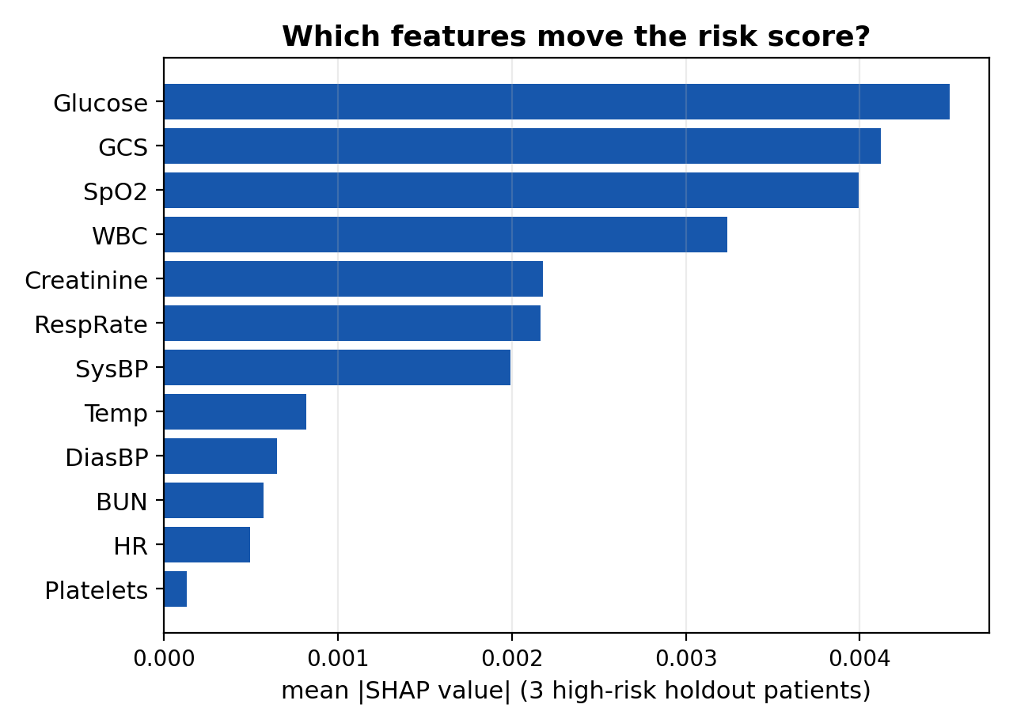
P.A. COLLEGE OF ENGINEERING
DEPARTMENT OF COMPUTER SCIENCE & ENGINEERING
PROPOSED SOLUTION
Idea: attention-based LSTM over a rolling 90-minute window of 12 clinical features -> 0-100 risk score with an explanation panel.
Evaluation honesty: reports what papers skip - false alarms, sensitivity, specificity, precision, lead time, vs NEWS2.
Holdout check: unseen 20% set-B AUC 0.844 (95% CI 0.836-0.852) vs validation 0.840.
Deployable path: FastAPI alerting, HTTP/MQTT ingestion; misses/false alarms queue into weighted retraining.

Slide 7
P.A. COLLEGE OF ENGINEERING
DEPARTMENT OF COMPUTER SCIENCE & ENGINEERING
METHODOLOGY / PROPOSED APPROACH
1 · DATA
PhysioNet 2012
12 vitals + labs
2 · PREPARE
Interpolate
Train-only z-score
3 · WINDOW
90-min rolling
Stride 15
4 · MODEL
LSTM-96 + attention
Risk 0–100
5 · SERVE
FastAPI + dashboard
SHAP explains
Leakage controls: train-only stats · patient-level split · past-only windows

Slide 8
P.A. COLLEGE OF ENGINEERING
DEPARTMENT OF COMPUTER SCIENCE & ENGINEERING
EXPECTED OUTCOME
Working real-time ICU dashboard for deterioration risk from recent measurements.
0-to-100 risk score with temporal attention and SHAP explanations.
Evaluate earlier warning relative to NEWS2 using quantified lead time.
Measure false alarms, sensitivity, specificity, precision, and calibration.
Research prototype only - not clinical deployment readiness.

Slide 9
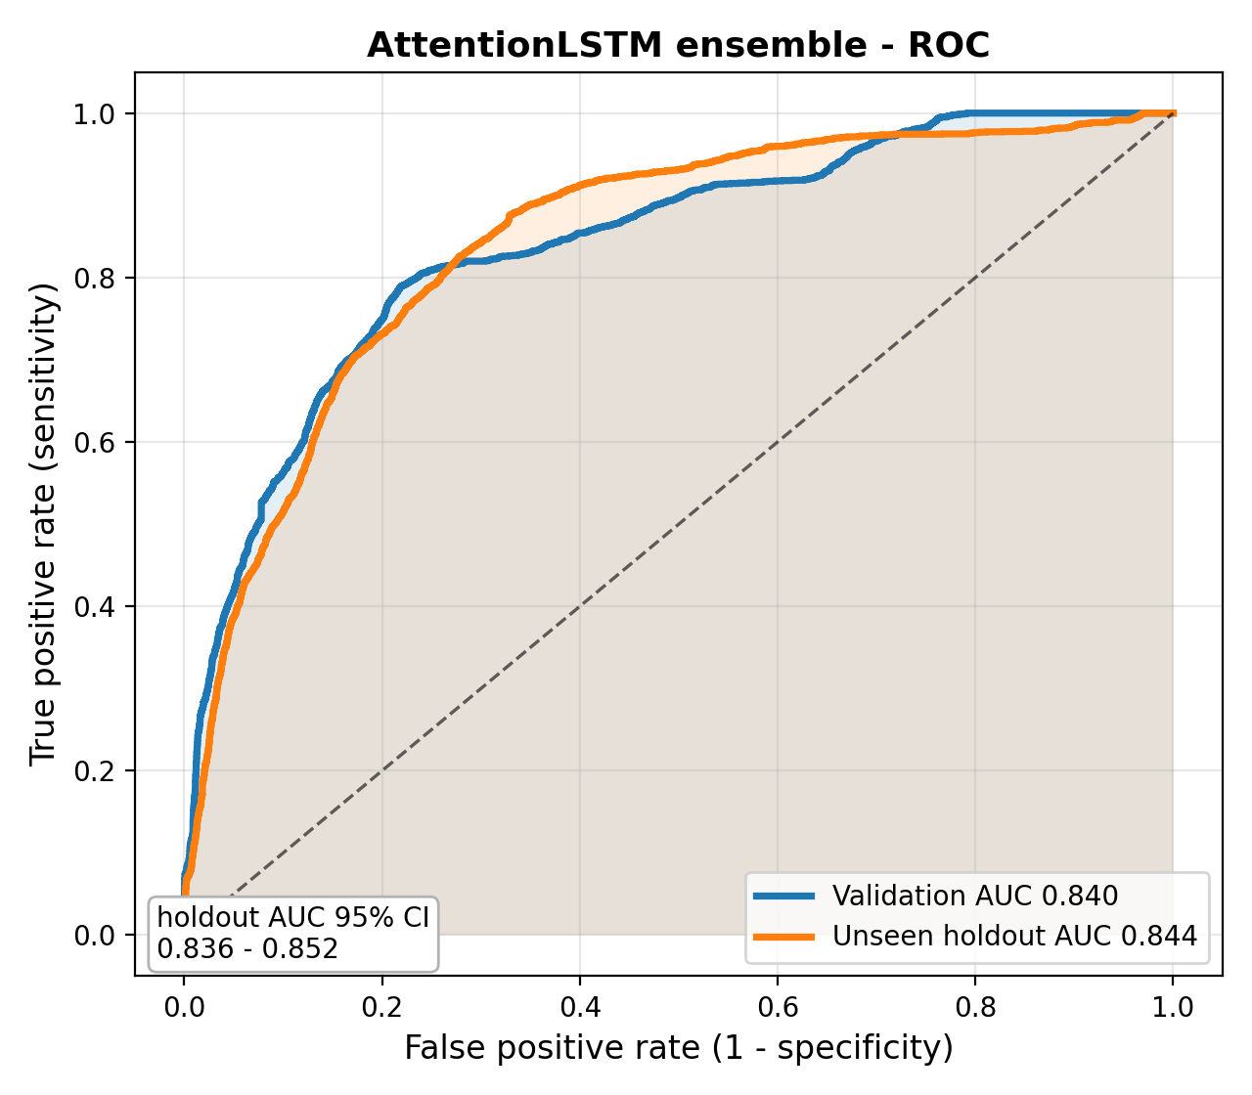
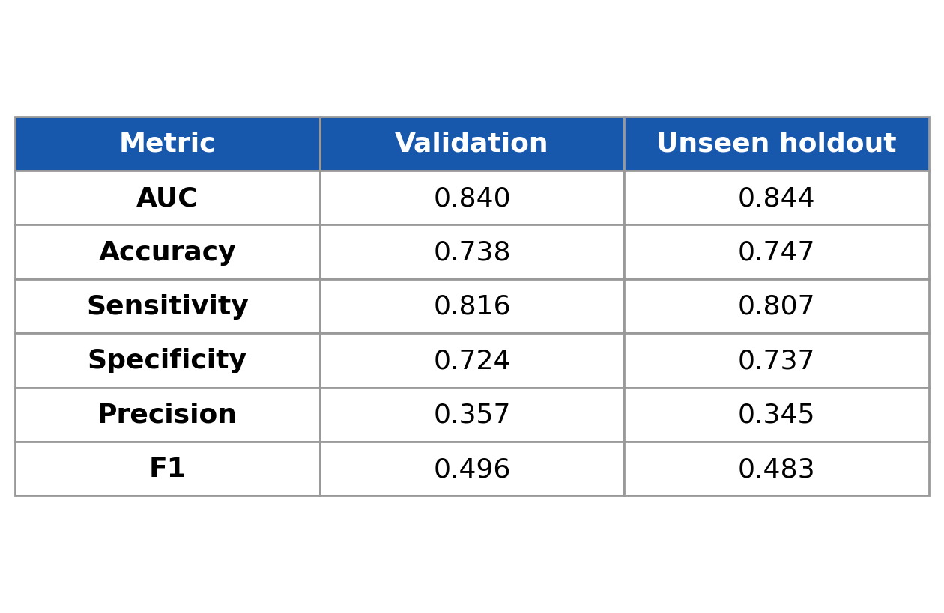
P.A. COLLEGE OF ENGINEERING
DEPARTMENT OF COMPUTER SCIENCE & ENGINEERING
EXPERIMENTAL RESULT
Ensemble: 3 LSTMs (s48, c93, s45), logit-averaged as deployed.
Fresh unseen holdout: AUC 0.844 (95% CI 0.836-0.852) vs validation 0.840.
Holdout AUC is close to validation AUC; confidence intervals for other metrics are pending.

Slide 10
P.A. COLLEGE OF ENGINEERING
DEPARTMENT OF COMPUTER SCIENCE & ENGINEERING
LIMITATIONS & IMPROVEMENT PATH
Base-paper ceiling: 0.936 dynamic, but 0.989 only at discharge (hindsight bias); cross-hospital AUROC falls to 0.81/0.76; no prospective trial.
Our stricter bar: 90-minute past-only windows; holdout AUC 0.844 is close to validation AUC 0.840.
Reported what papers often skip: false-alarm rate, specificity, precision, F1, lead time vs NEWS2, and calibration.
Next steps: eICU/MIMIC external validation, robust missing-data handling, time-aware attention, and a prospective clinical pilot.

Slide 11
P.A. COLLEGE OF ENGINEERING
DEPARTMENT OF COMPUTER SCIENCE & ENGINEERING
TECHNOLOGY / TOOLS REQUIRED
Backend: Python 3.10, FastAPI, uvicorn, NumPy, scikit-learn, PyTorch
Two LSTM hidden layers (96 units) + Temporal Attention
Microservices: FastAPI real-time backend, React + Vite frontend
Edge/stream ingestion: MQTT with Eclipse Mosquitto
SENSE
ESP32 + MAX30105
INGEST
FastAPI + SQLite
SCORE
AttentionLSTM 0–100
ACT
Dashboard + alerts

Slide 12
P.A. COLLEGE OF ENGINEERING
DEPARTMENT OF COMPUTER SCIENCE & ENGINEERING
SDG RELEVANCE
SDG 3 - Good Health and Well-Being: earlier detection of ICU deterioration supports timely clinical review and better patient monitoring.
SDG 9 - Industry, Innovation and Infrastructure: explainable deep learning integrated into a modern monitoring workflow - ML, APIs, visualization, and sensor-ready architecture.

Slide 13
P.A. COLLEGE OF ENGINEERING
DEPARTMENT OF COMPUTER SCIENCE & ENGINEERING
FUTURE SCOPE
Calibration and decision-curve analysis for bedside thresholds.
Subgroup and fairness validation across age, sex, and hospitals.
External validation on MIMIC-IV and eICU patient cohorts.
Prospective clinical pilot with collaborators.
Privacy-preserving multi-hospital training and safer edge deployment.

Slide 14
P.A. COLLEGE OF ENGINEERING
DEPARTMENT OF COMPUTER SCIENCE & ENGINEERING
CONCLUSION
SynCura demonstrates an end-to-end explainable ICU risk-monitoring workflow from clinical time-series input to dashboard output.
Temporal attention and SHAP provide an interpretable view of which time steps and features influenced the prediction.
The deployed ensemble achieved 0.840 validation AUC and 0.844 set-B holdout AUC.
These results support the prototype concept, while further clinical and external validation is required before real-world use.

Slide 15
P.A. COLLEGE OF ENGINEERING
DEPARTMENT OF COMPUTER SCIENCE & ENGINEERING
REFERENCES
[1] Zheng et al. (2025): Development and Validation of a Dynamic Real-Time Risk Prediction Model for ICU Patients Based on Longitudinal Irregular Data: Multicenter Retrospective Study. JMIR 27:e69293.
[2] Wang, Bai & Jin (2026): Explainable Deep-Learning Models for Predicting ICU Patient Outcome. Frontiers in Physiology 17.
[3] Yan et al. (2026): Deep Learning-Based In-Hospital Mortality Prediction Using Long-Term Sequential Data in ICU Patients. PeerJ 14:e21631.
[4] Sadanandan (2026): Multimodal Deep Learning for Early Prediction of Patient Deterioration in the ICU: Integrating Time-Series EHR Data with Clinical Notes. arXiv:2603.14719.
[5] Wu et al. (2024): Revisiting the Potential Value of Vital Signs in the Real-Time Prediction of Mortality Risk in ICU Patients. J Big Data 11:40.
[6] Xie et al. (2025): Unlocking the Potential of Real-Time ICU Mortality Prediction: Redefining Risk Assessment with Continuous Data Recovery. npj Digital Medicine 8:733.
[7] Choi et al. (2020): Deep Interpretable Early Warning System for the Detection of Clinical Deterioration. IEEE J-BHI 24(9).
[8] Scheid et al. (2025): Development and Validation of a Clinical Wearable Deep Learning Based Continuous In-Hospital Deterioration Prediction Model. Nature Communications 16:9513.
[9] PhysioNet (2012): Computing in Cardiology Challenge 2012 dataset. physionet.org/content/challenge-2012.

Slide 16
P.A. COLLEGE OF ENGINEERING
DEPARTMENT OF COMPUTER SCIENCE & ENGINEERING
THANK YOU

