Slide 1
SRA

Slide 2
Introduction
Name of repository : (Sequence Read Archive)
Description :is a bioinformatics database that provides a public repository for DNA sequencing data, especially the "short reads" generated by high-throughput sequencing. The preferred data format for files submitted to the SRA is the BAM format, which is capable of storing both aligned and unaligned reads. Internally the SRA relies on the NCBI SRA Toolkit, used at all three INSDC member databases, to provide flexible data compression, API access and conversion to other formats such as FASTQ

Slide 3
Repository URL : https://www.ncbi.nlm.nih.gov/sra
Format : FASTQ Sequences
BAM data
Keyword(s) : DNA
Run : The runs are where the actual DNA sequences reside and are what
you want to download from NCBI.
Tools and Software : Download SRA Toolkit

Slide 4
SRA archive data : SRA archive data is normalized by the SRA load process and used by the SRA Toolkit to read and produce formats like FASTQ, SAM, etc.
The default toolkit configuration enables it to find and retrieve SRA runs by accession.
Public SRA files are now available NCBI
Original format : The original files submitted to SRA. These files may require specific software to download data.
Type | Size | Location | Name | Free Egress | Access Type
run | 12,504 Kb | NCBI | https://sra-download.ncbi.nlm.nih.gov/traces/sra12/SRR/017244/SRR17658599 | worldwide | anonymous
Type | Size | Location | Name | Free Egress | Access Type
fastq | 10,074 Kb | NCBI | https://sra-download.ncbi.nlm.nih.gov/traces/sra37/SRZ/017658/SRR17658599/EF25_S25_L001_R1_001.fastq.gz | worldwide | anonymous

Slide 5
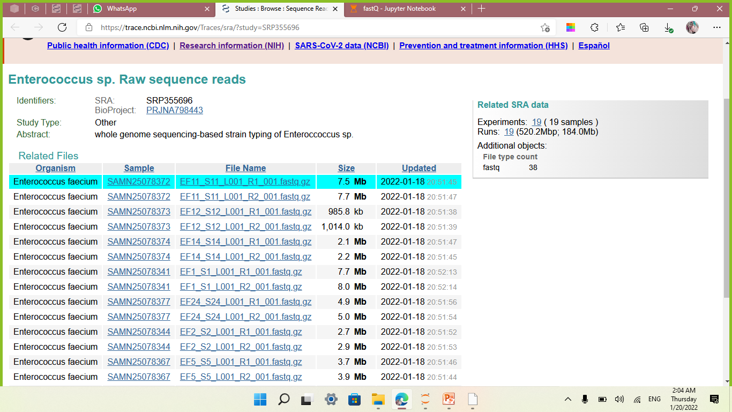

Slide 6
FASTQ
Introduction
FASTQ format stores sequences and Phred qualities in a single file. It is concise and compact. FASTQ is first widely used in the Sanger Institute and therefore we usually take the Sanger specification and the standard FASTQ format, or simply FASTQ format. Although Solexa/Illumina read file looks pretty much like FASTQ, they are different in that the qualities are scaled differently. In the quality string, if you can see a character with its ASCII code higher than 90, probably your file is in the Solexa/Illumina format.

Slide 7
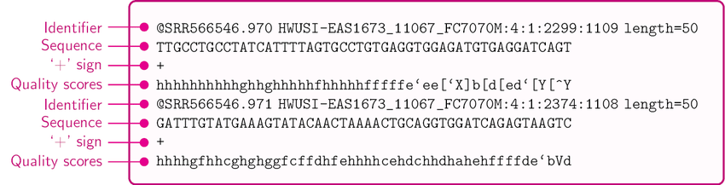
Format
A FASTQ file normally uses four lines per sequence :
Line 1 begins with a '@' character and is followed by a sequence identifier and an optional description (like a FASTA title line).
Line 2 is the raw sequence letters.
Line 3 begins with a '+' character and is optionally followed by the same sequence identifier (and any description) again.
Line 4 encodes the quality values for the sequence in Line 2, and must contain the same number of symbols as letters in the sequence.
A FASTQ file containing a single sequence might look like this:

Slide 8
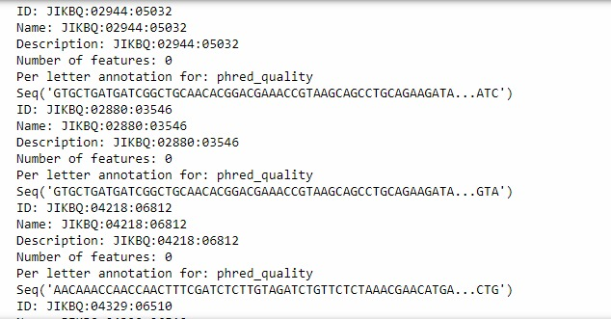

Slide 9
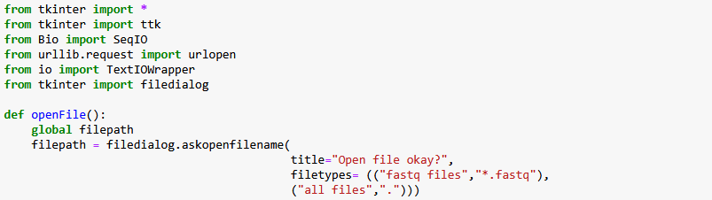
To open one NCBI [SRA] record locally
>>> from Bio import SeqIO
>>> handle = open("fastq files","*.fastq")

Slide 10
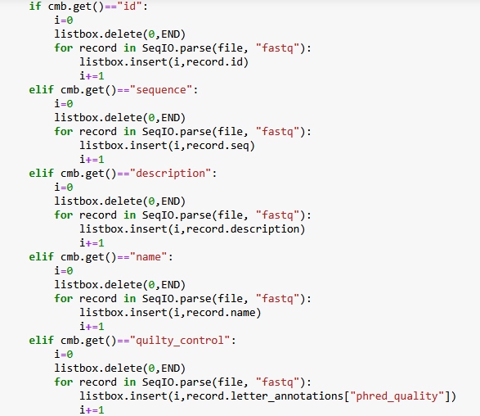
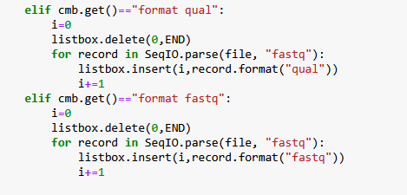
To read NCBI (SRA) record from the file, we use the function parse()
>>> record = SeqIO.parse(file, “fatsq”)

Slide 11
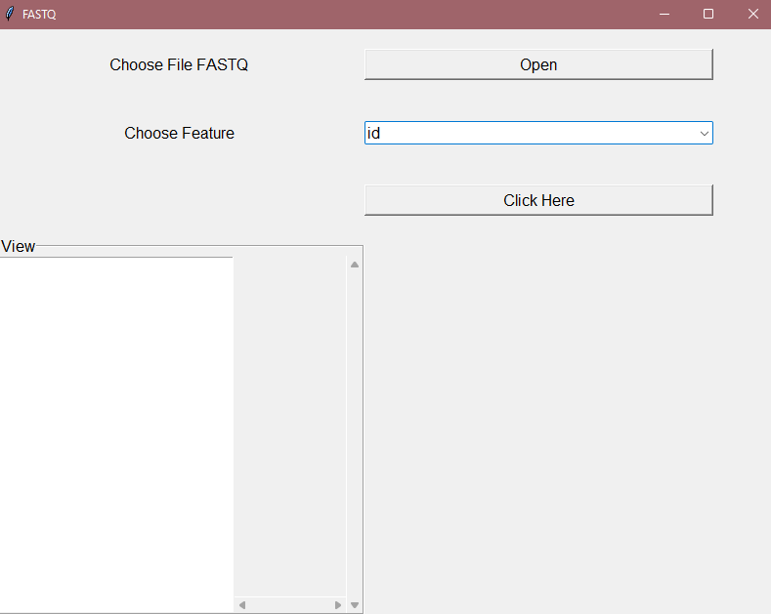
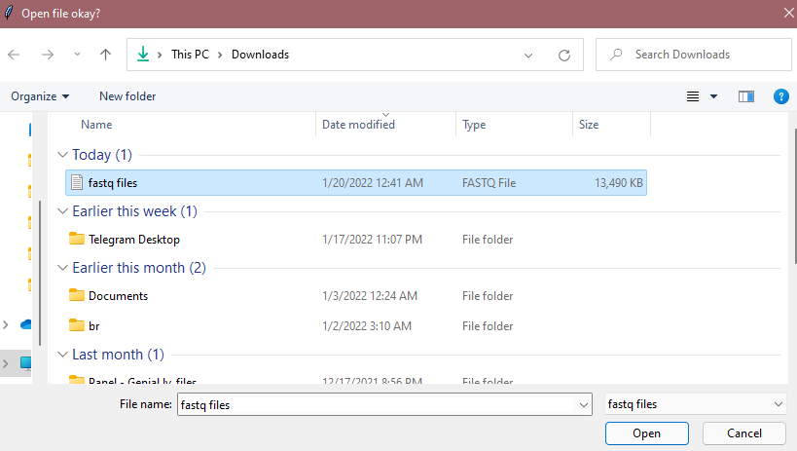
GUi

Slide 12
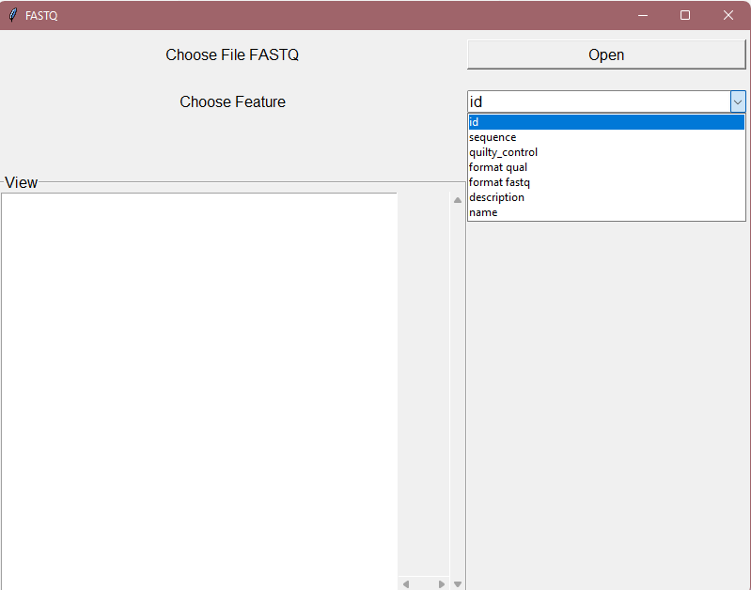

Slide 13
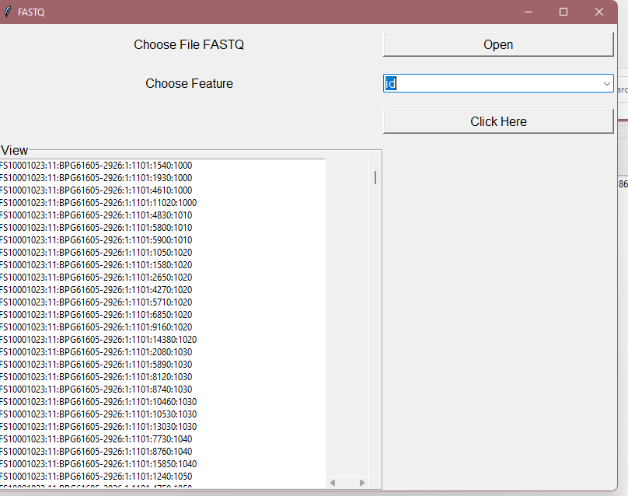
ID

Slide 14
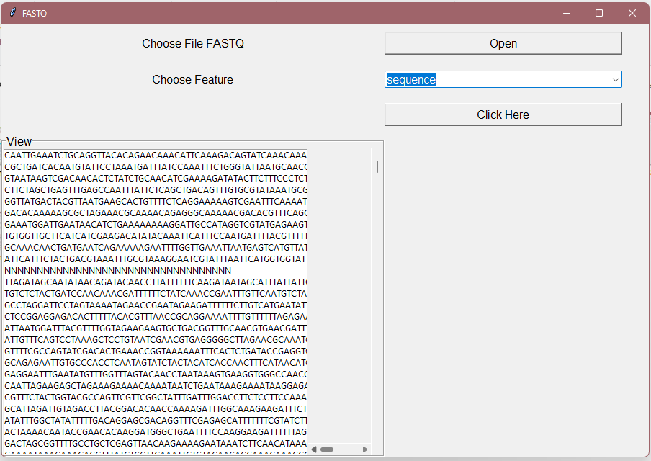
sequence

Slide 15
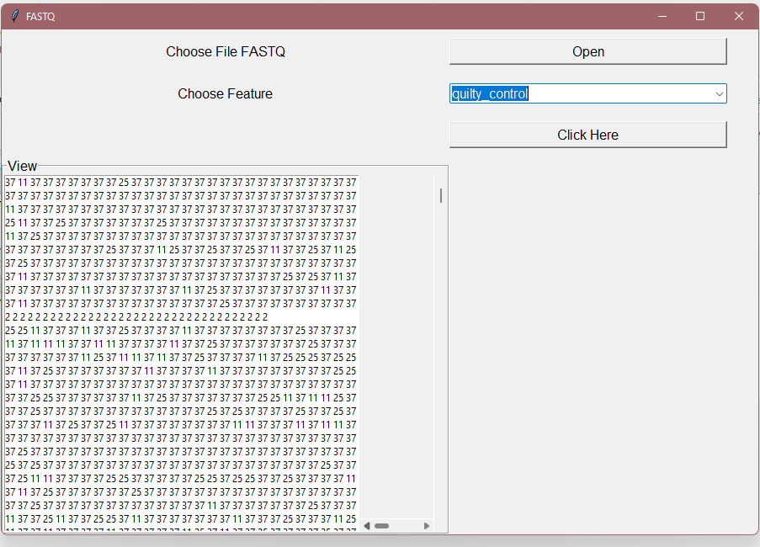
Quality control

Slide 16
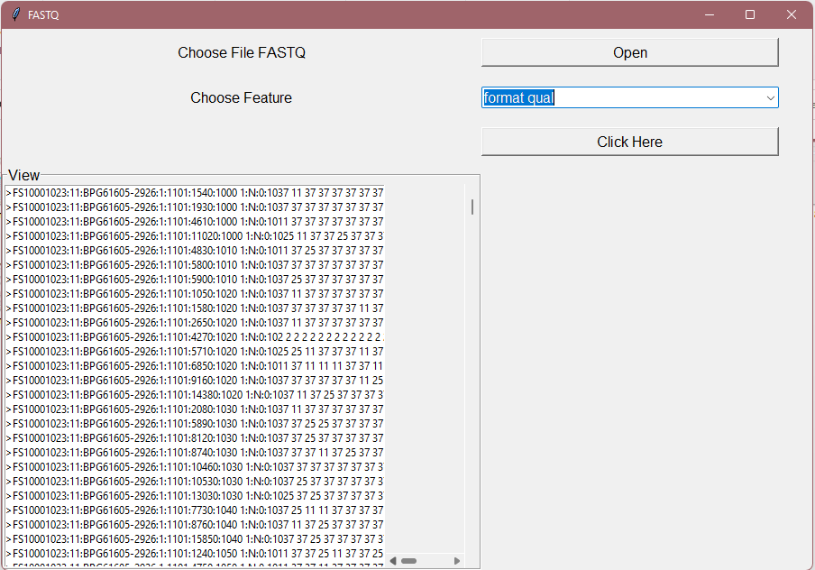
Format qual

Slide 17
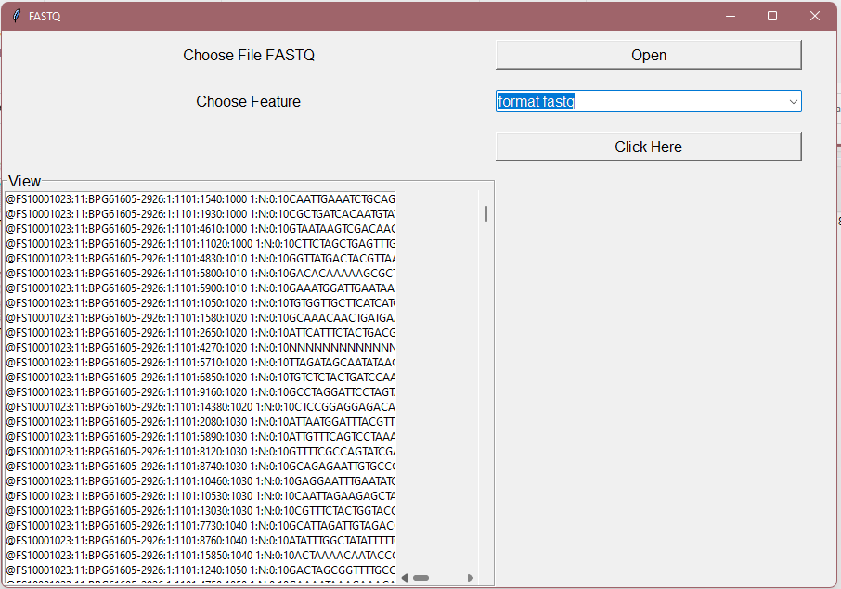
Format fastq

Slide 18
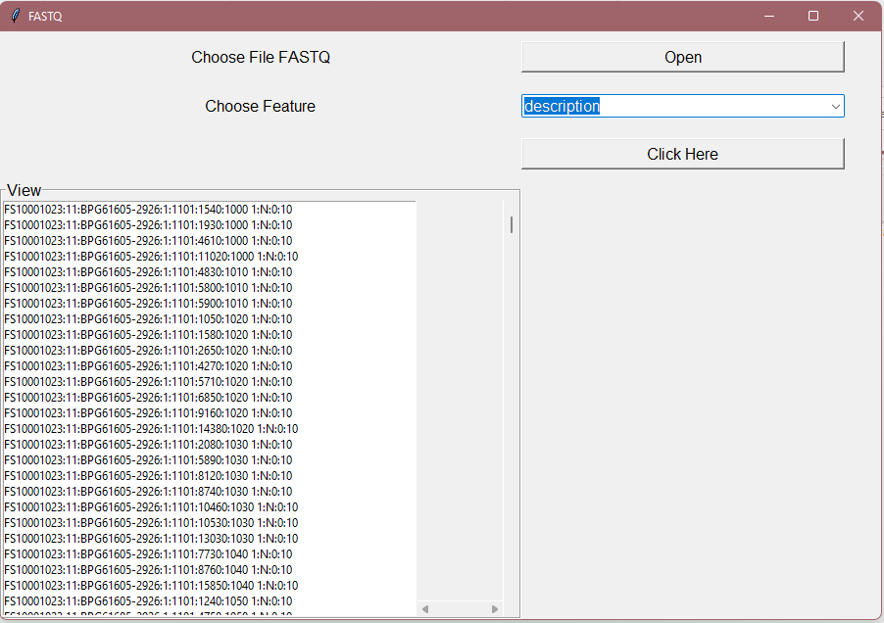
Description

Slide 19
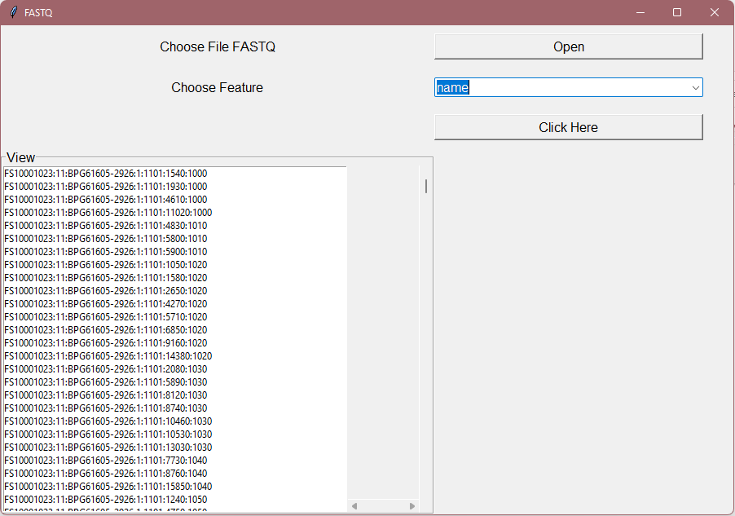
name

Slide 20
Thank you

