Slide 1
Embl

Slide 2
Introduction
Name of repositories : (European Molecular Biology Laboratory)
Description :
EMBL seeks to better understand the molecular basis of life
The European Molecular Biology Laboratory (EMBL) Nucleotide Sequence Database : is a comprehensive collection of primary nucleotide sequences maintained at the European Bioinformatics Institute (EBI)
Data are received from genome sequencing centres , New data are released daily into the EMBLNEW database and are immediately available
The EMBL and EMBLNEW databases are stored and maintained in an ORACLE data management system
The EMBL Database currently consists of 18 divisions with each entry belonging in exactly one division
In each entry the division is indicated using the three letter codes, e.g., PRO = Prokaryotes, HUM = Human, PHG = Bacteriophages, PLN = Plants etc

Slide 3
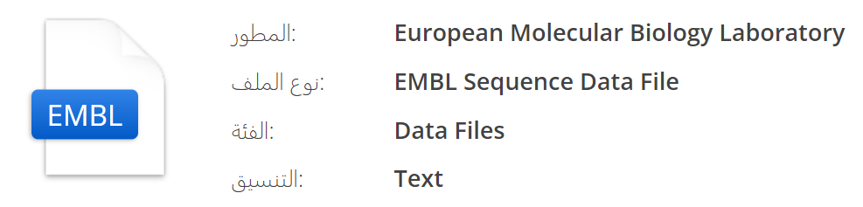
Repository URL : EMBL-EBI ENA Browser (ebi.ac.uk)
Format : EMBL FASTA
Keyword(s) : Chemicals DNA Genes Proteins RNA
Run : want to download from EMBL-EBI.

Slide 4
.EMBL
Introduction
EMBL format : DNA and protein sequence file format used by a variety of DNA sequence programs; contains sequence data, along with information about the sequence, such as the name, type, and description; can store multiple sequences.

Slide 5
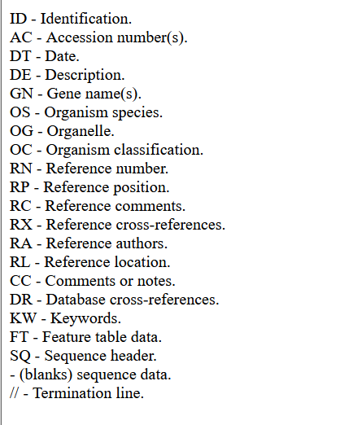
Format
EMBL files consist of individual sequence entries. The entries are made up of lines that contain different kinds of information. These lines can be identified by the first two letters of the line, such as "ID" for the sequence name and type, "SQ" for sequence data, and "DE" for the sequence description. The end of each sequence is marked by "//".

Slide 6
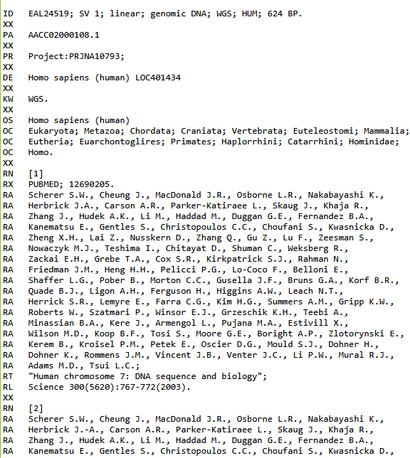
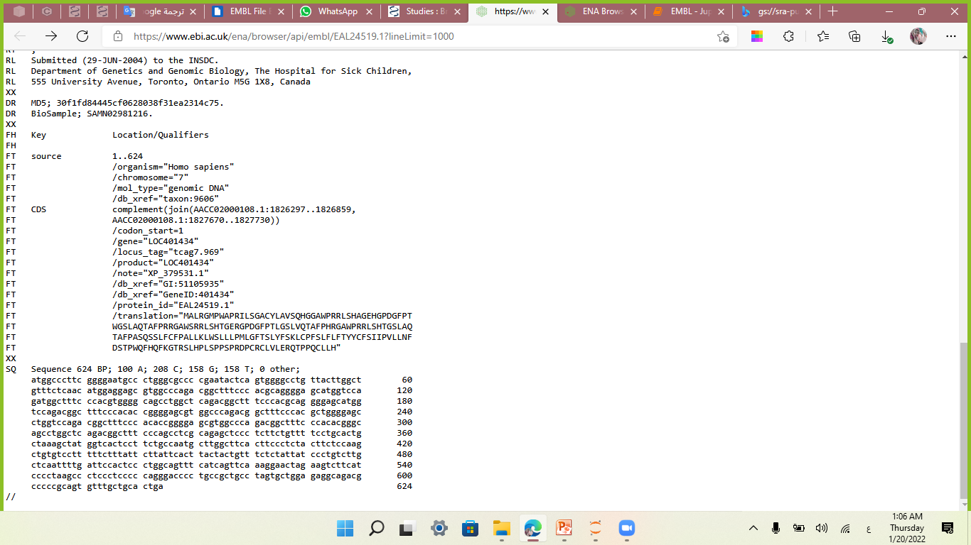

Slide 7
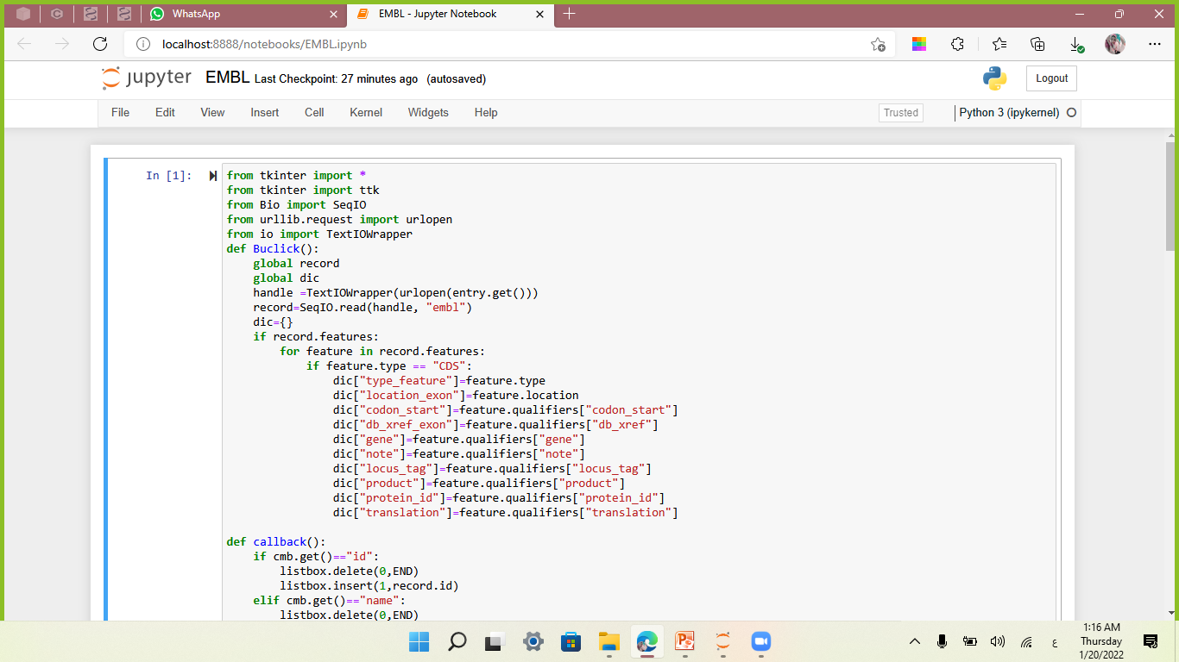
1- Open a EMBL file over the internet:
EMBL

Slide 8
2- To read one EMBL record from the handle, we use the function read()
>>> record = SeqIO.read(handle,”embl”)

Slide 9
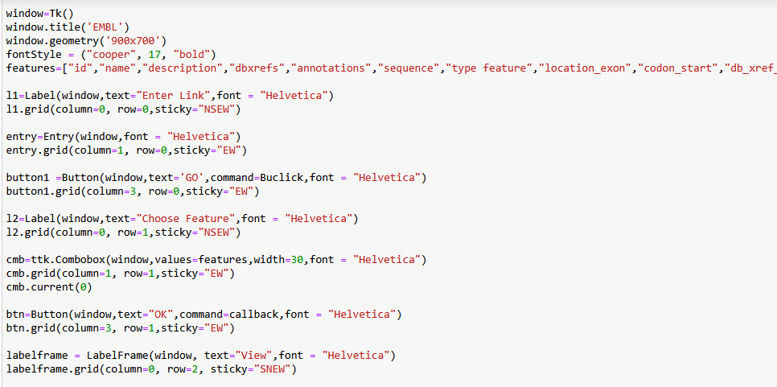
GUI

Slide 10
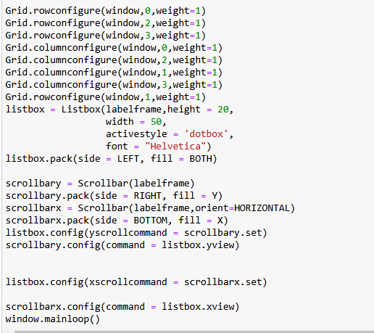

Slide 11
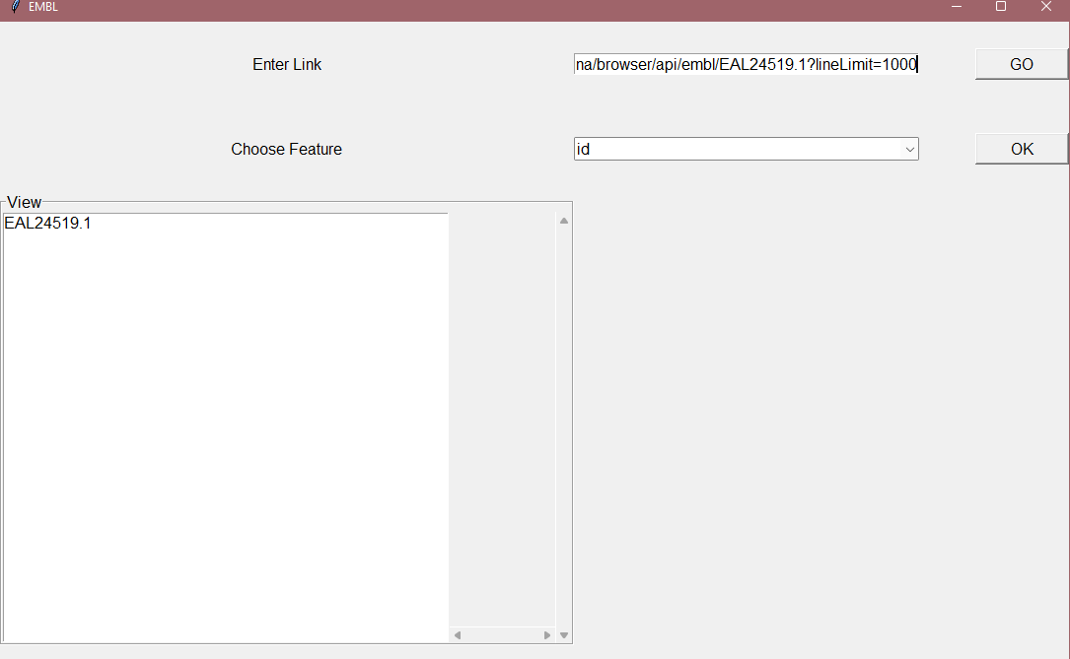
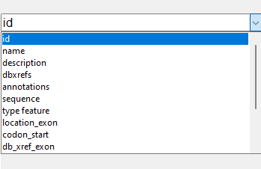

Slide 12
Thank you

