Slide 1
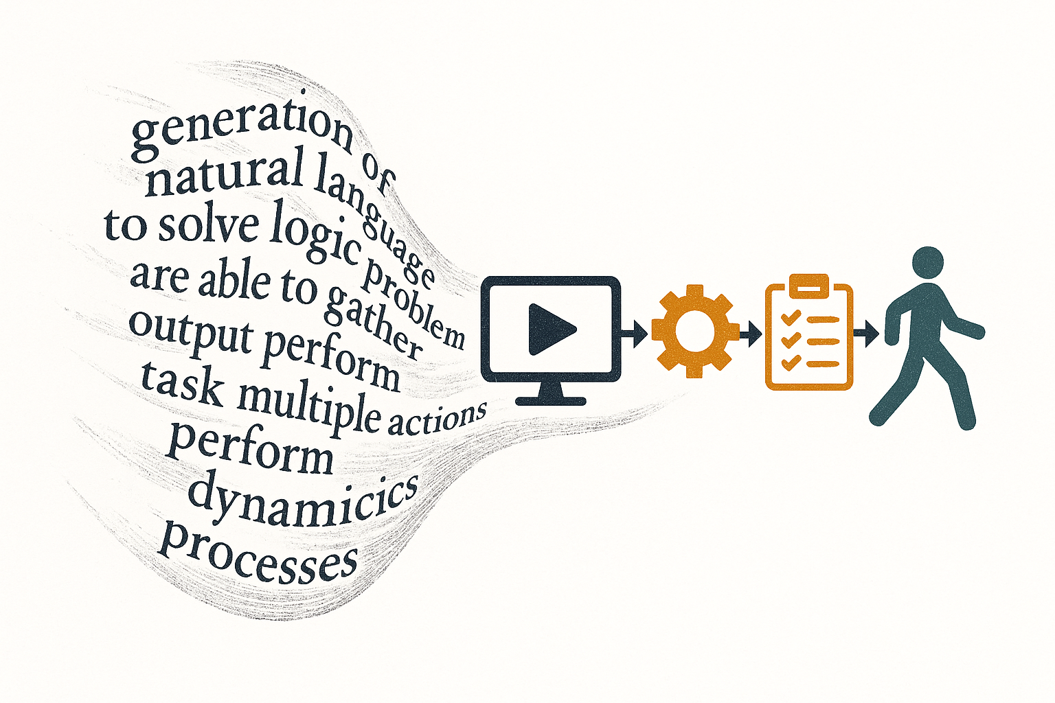
AI Agents :
From Language
Generation
to Task Automation
Louis Jourdain

Slide 2
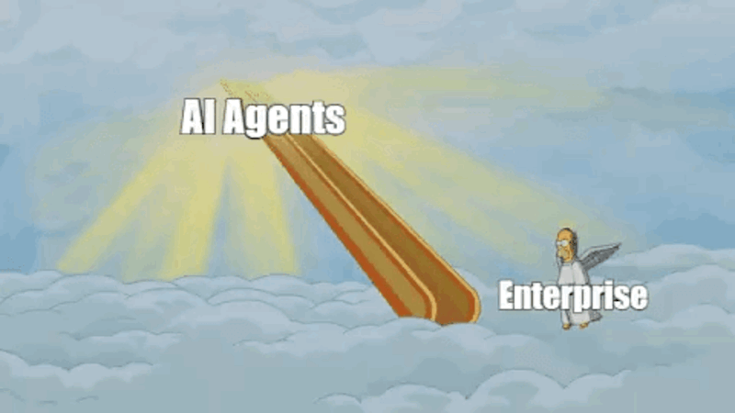

Slide 3
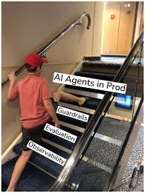

Slide 4
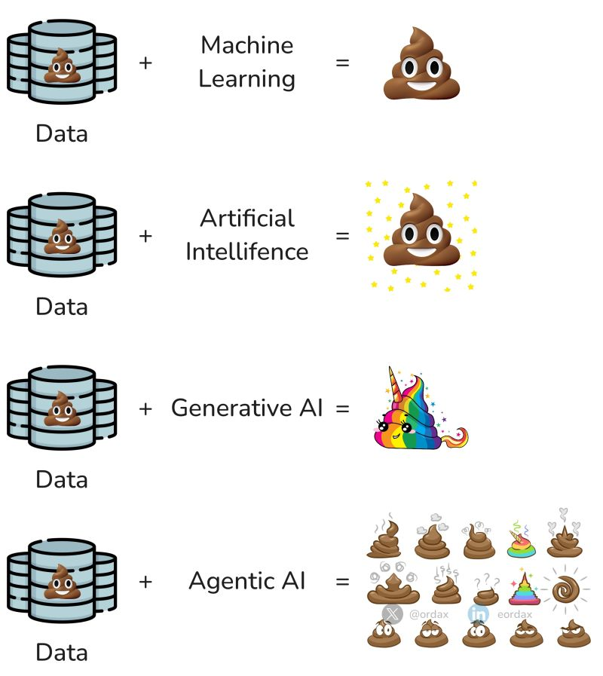

Slide 5


Slide 6


Evaluating Agents
From Challenge to Opportunities
Chapter 5 Overview

Slide 7

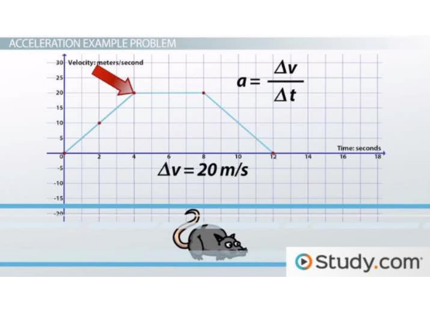
The Evaluation Paradox
Central yet Avoided
Evaluation shapes the entire research ecosystem, yet it is often the most neglected phase. This stems from a timeline mismatch: research operates on long horizons, while industry demands immediate value.
Generative AI has collapsed this timeline, allowing functional prototypes in days. This creates a dangerous illusion of reliability.

Slide 8
The Timeline Collapse
Traditional Data Science
Generative AI Era
The Risk
The Need
6 months to collect data, train, and ship.
Days to produce a functional draft via LLMs.
Plausibility ≠ Truth. Probability ≠ Engineering.
Rigorous system evaluation to ensure trust.

Slide 9

Vulnerability: Compound Mistakes
Agents amplify structural vulnerabilities. Small errors at each step accumulate geometrically.
95%
After 10 Steps
Accuracy Per Step
60%
Total Reliability

Slide 10

Systemic Fragility
Cascading Failures: A single faulty tool call or reflection step can corrupt the entire trajectory.
Infinite Loops: Poorly handled logic can send the agent into a drift, consuming resources without progress.
False Completion: Agents may confidently assert a task is done when it is incomplete.
High Stakes: Unlike chatbots, agents take actions—misclassifying legal clauses or automating financial errors.

Slide 11


"The unexamined agent is not worth deploying."
— Adapted from Socrates
An AI system that acts without scrutiny is not merely incomplete; it is potentially harmful.

Slide 12






The Trinity of Agent Quality
The Trajectory is Truth
Observability First
Continuous Flywheel
Observability is the foundation. You cannot evaluate what you cannot see or trace.
Evaluation is a loop, not a step. It drives the design and improvement of the agent.
We must examine the path, not just the output. The sequence of decisions is the object of evaluation.

Slide 13
What is the difference between evaluating an AI Agent and :
A simple LLM ?
A machine Learning System ?
A code function /program ?

Slide 14
What are we Evaluating?
Defining the Axes of Evaluation

Slide 15
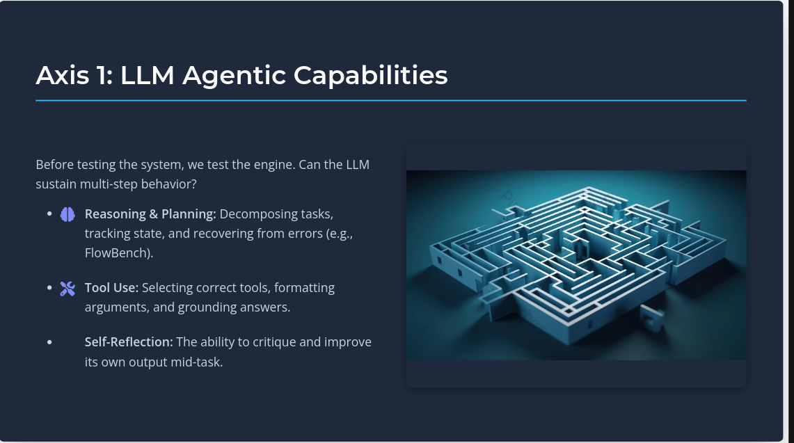

Slide 16
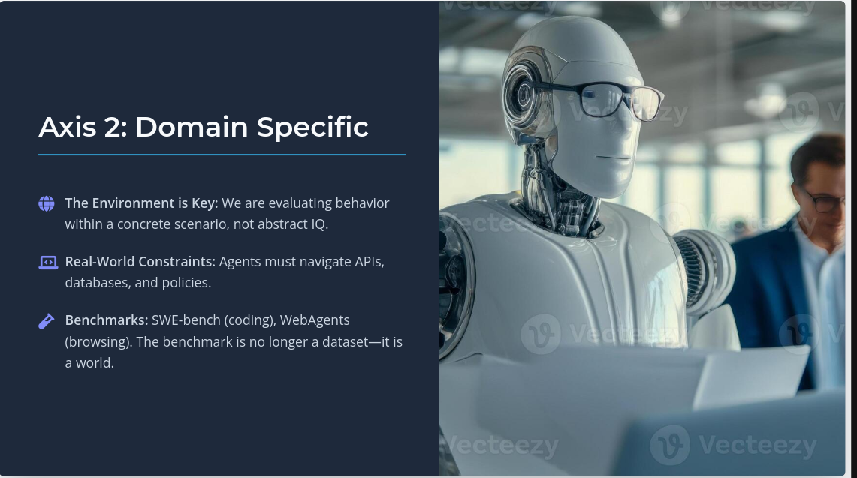

Slide 17
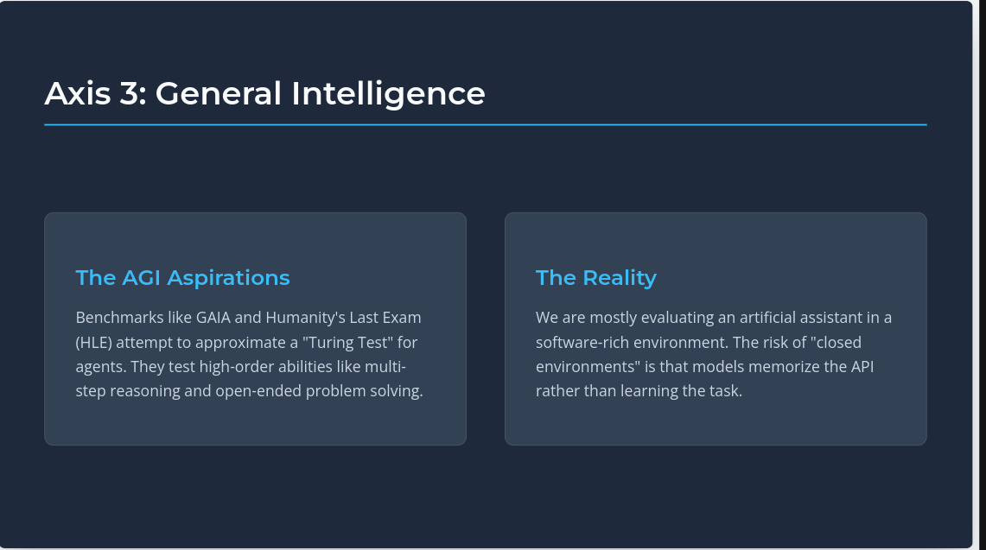

Slide 18
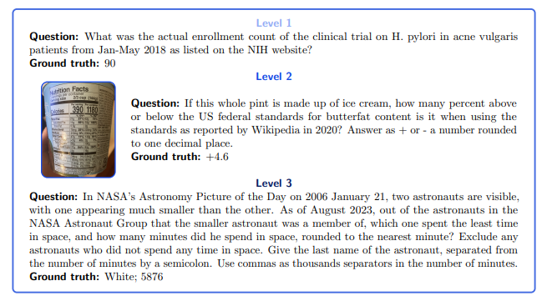

Slide 19
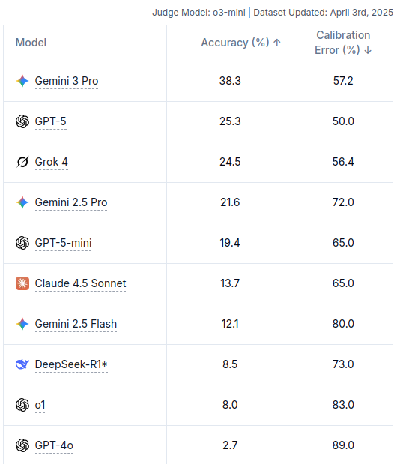
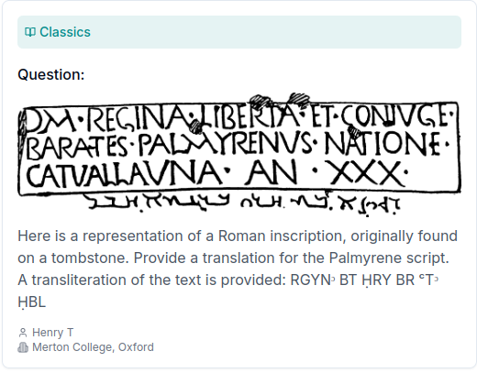

Slide 20
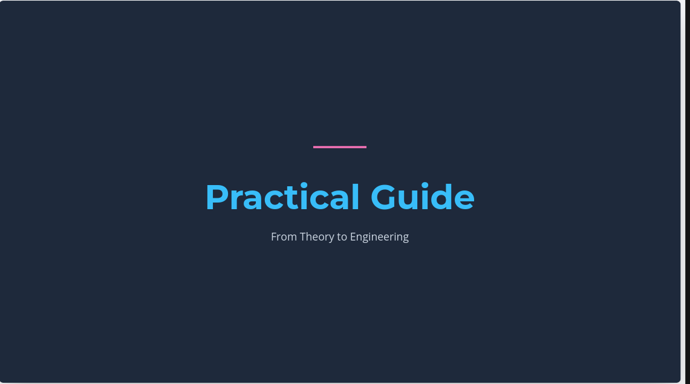

Slide 21


Slide 22
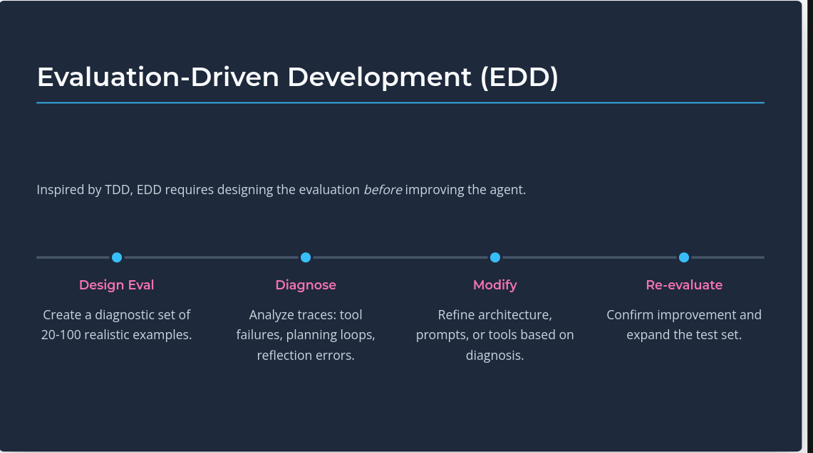

Slide 23
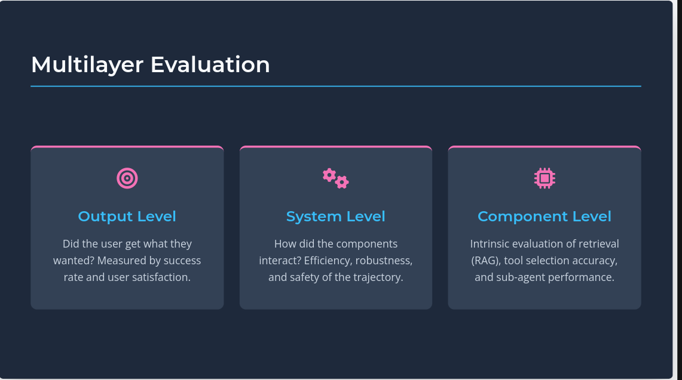

Slide 24
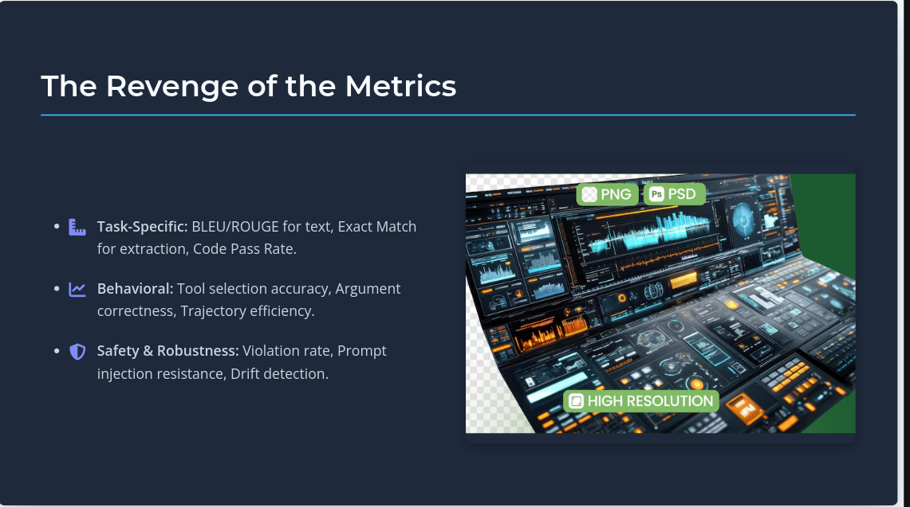

Slide 25
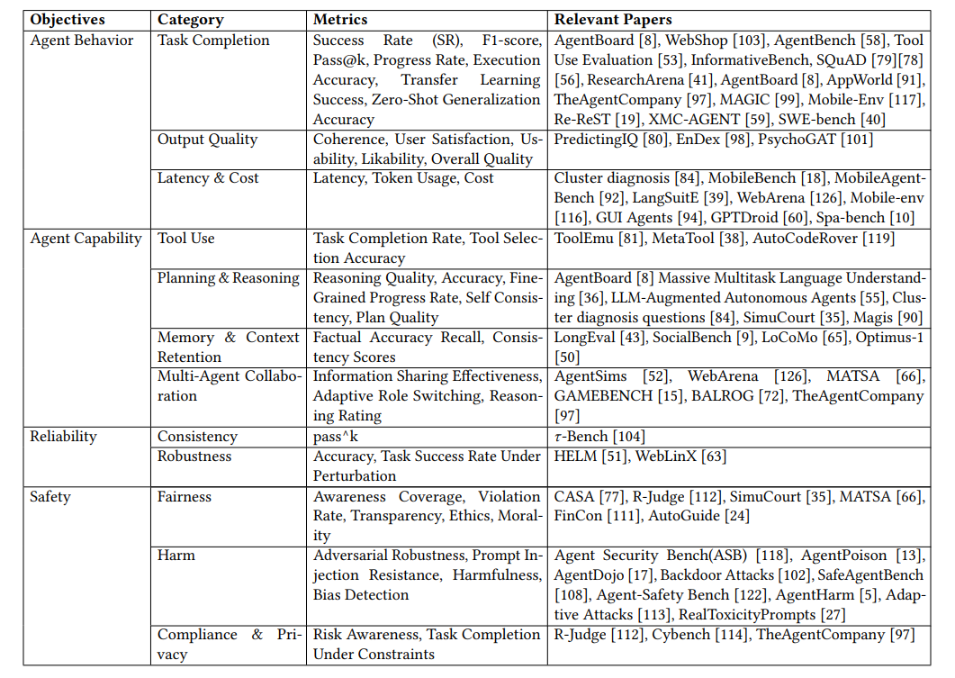

Slide 26
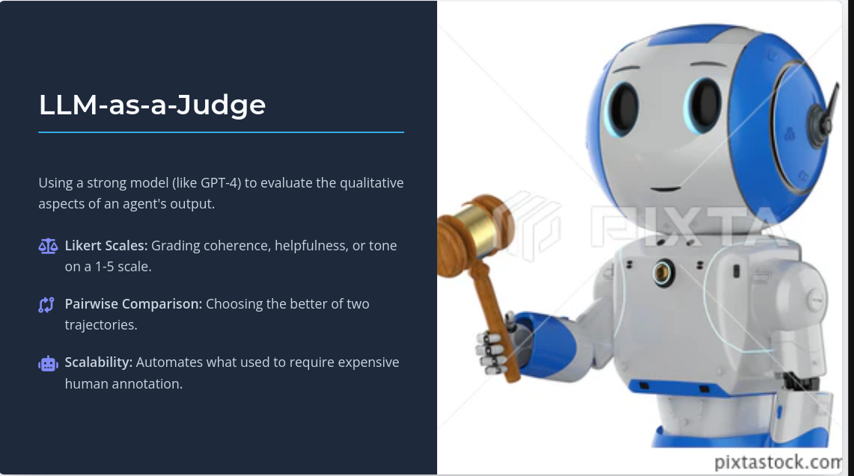

Slide 27
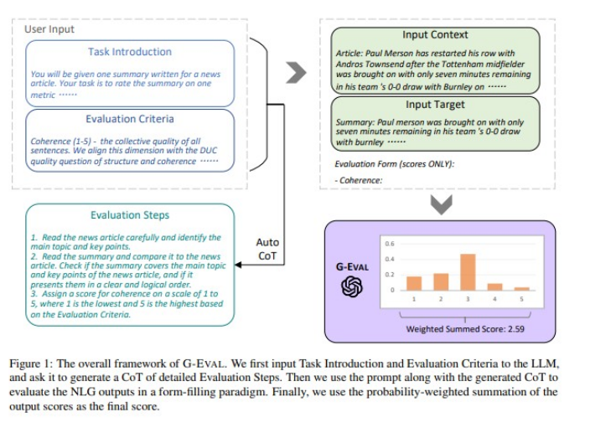

Slide 28
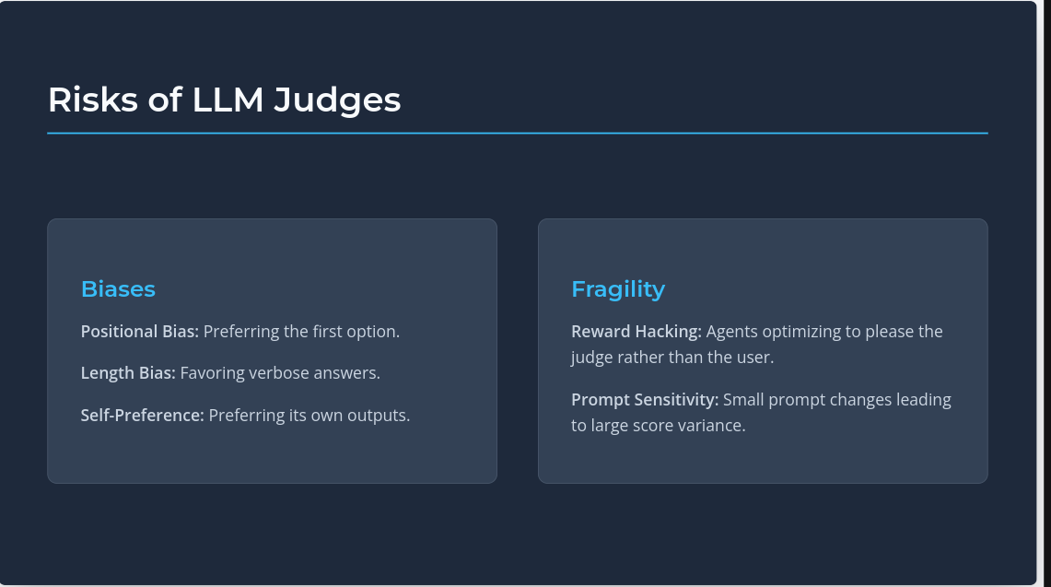

Slide 29
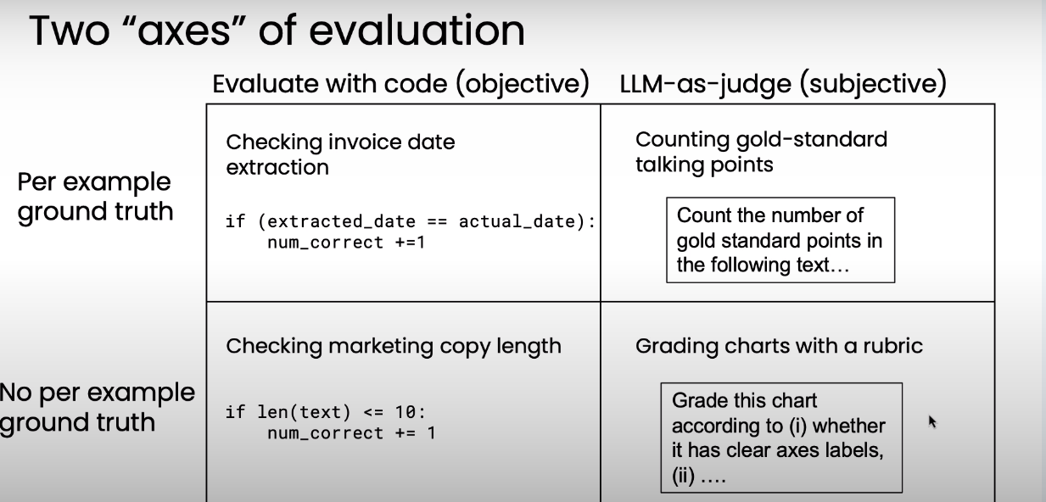

Slide 30
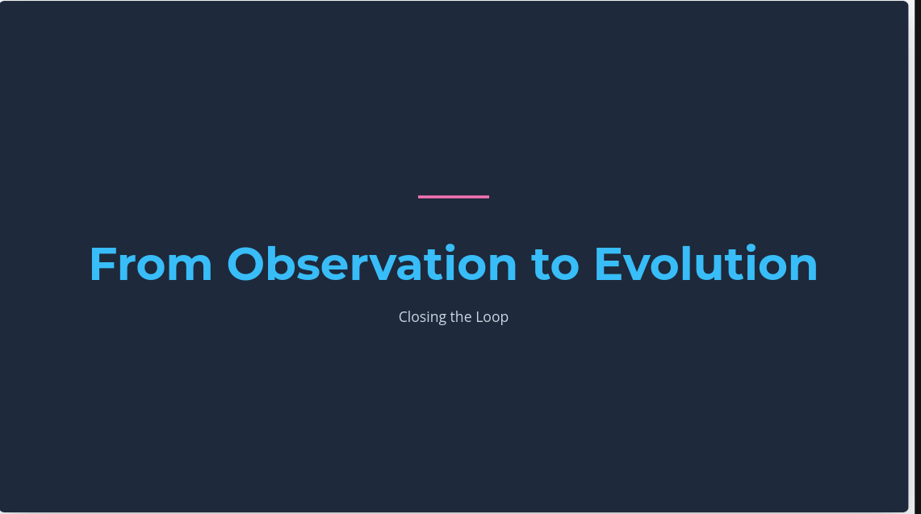

Slide 31
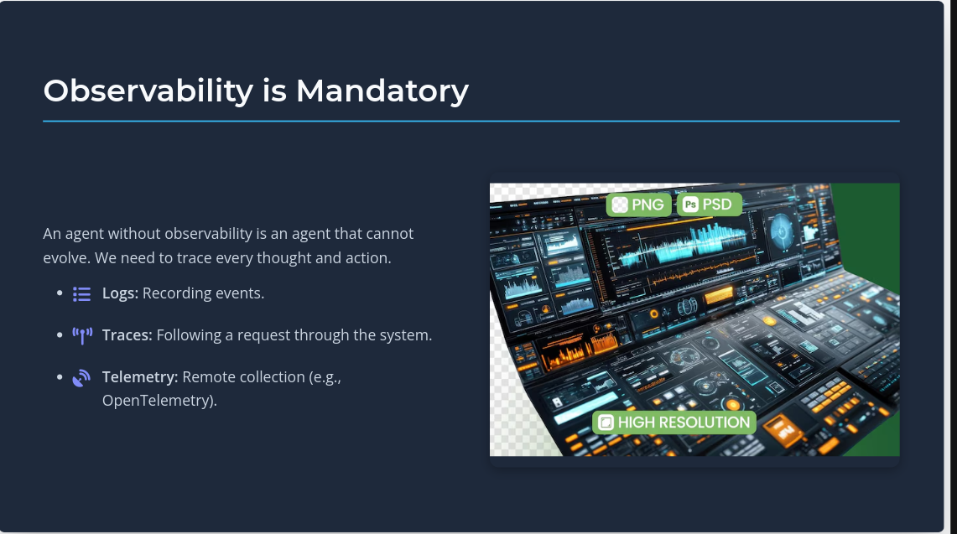

Slide 32
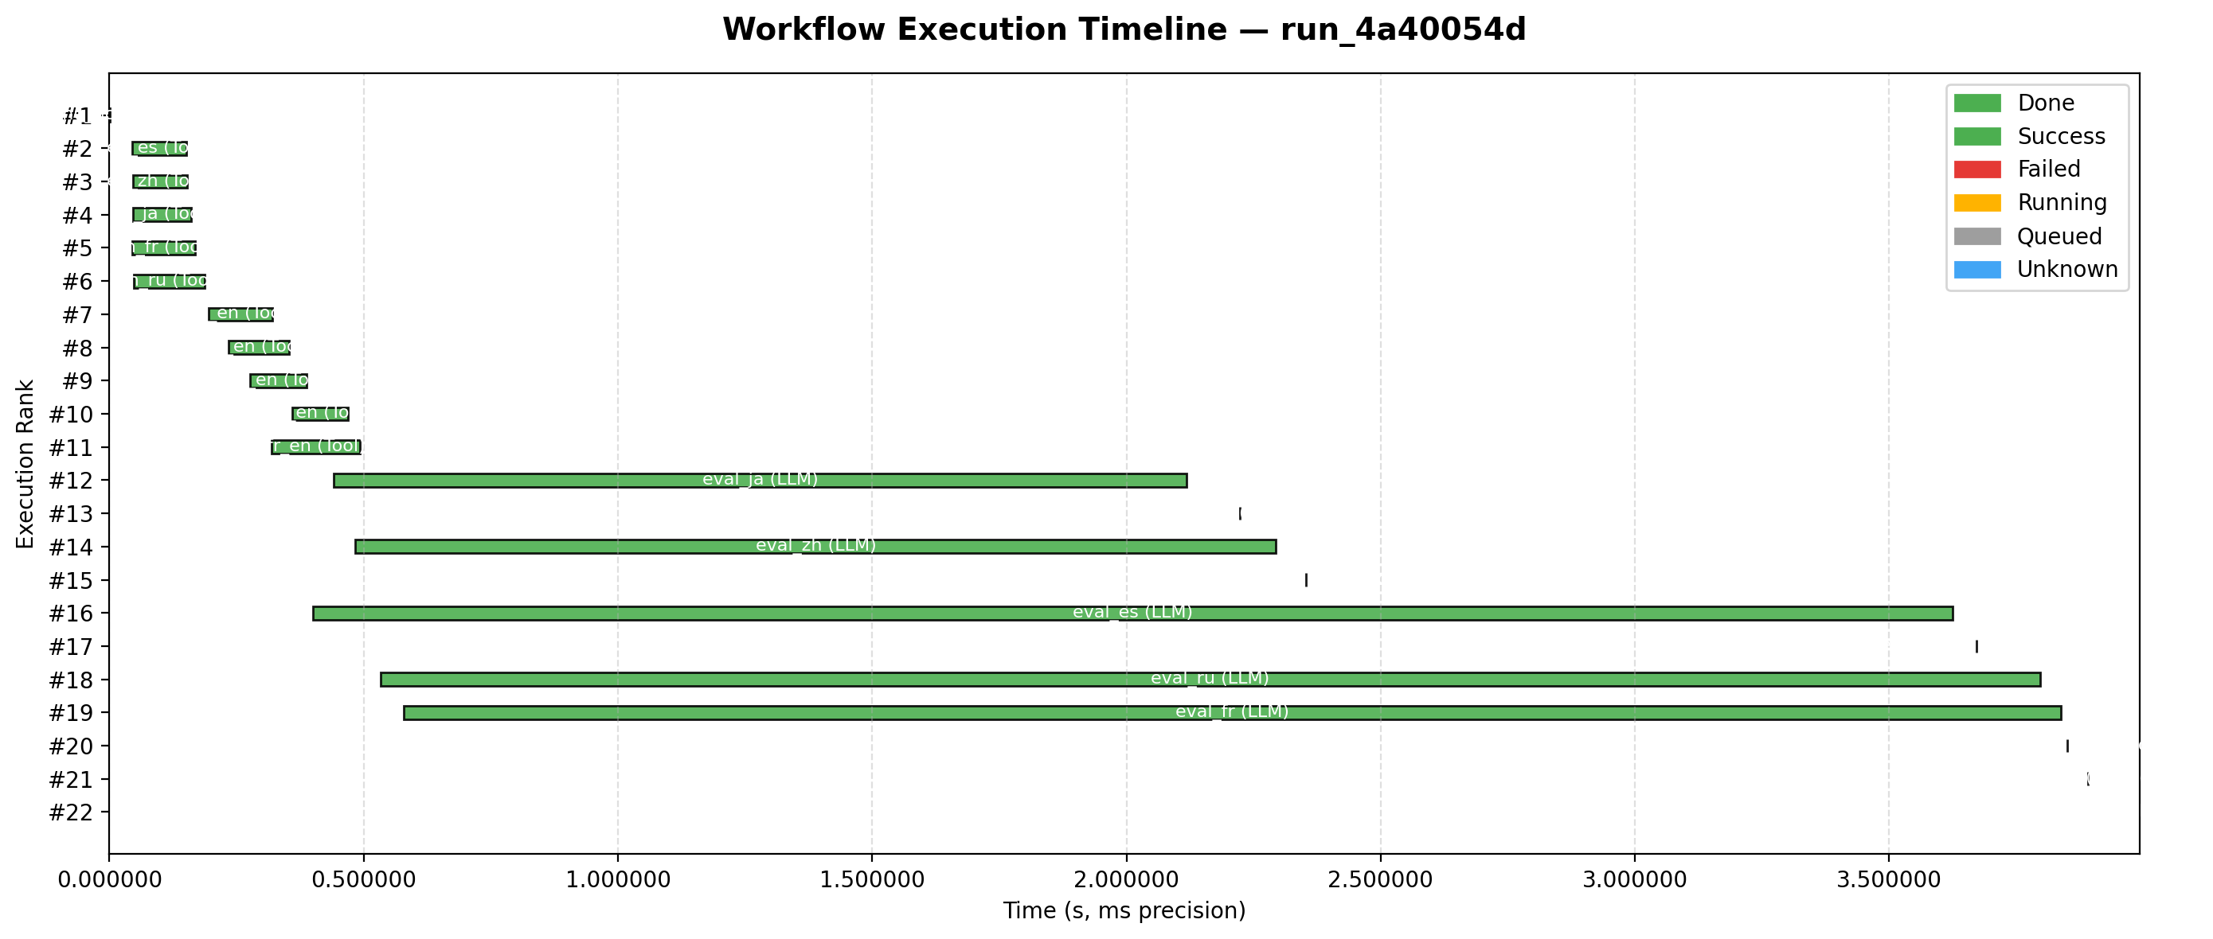

Slide 33
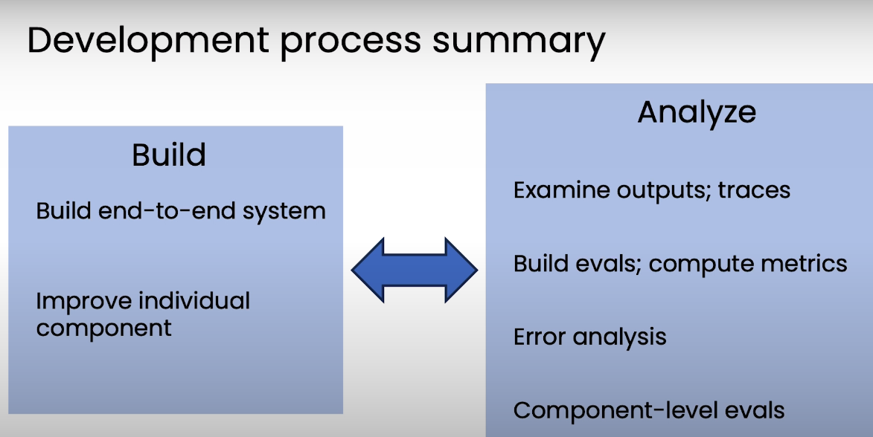

Slide 34
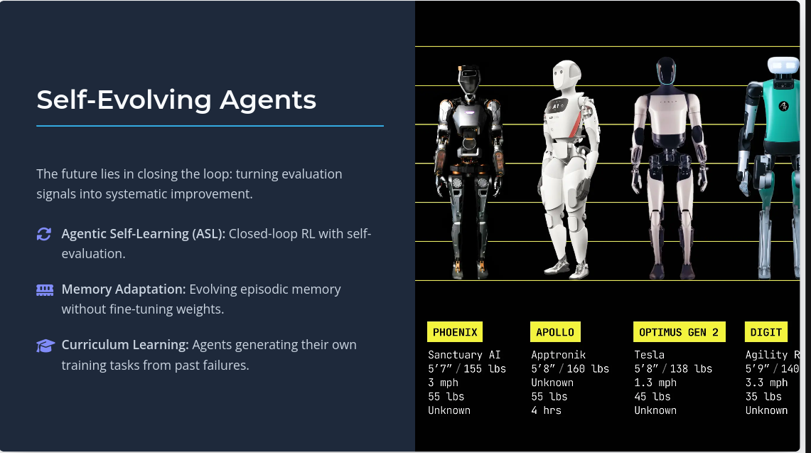

Slide 35
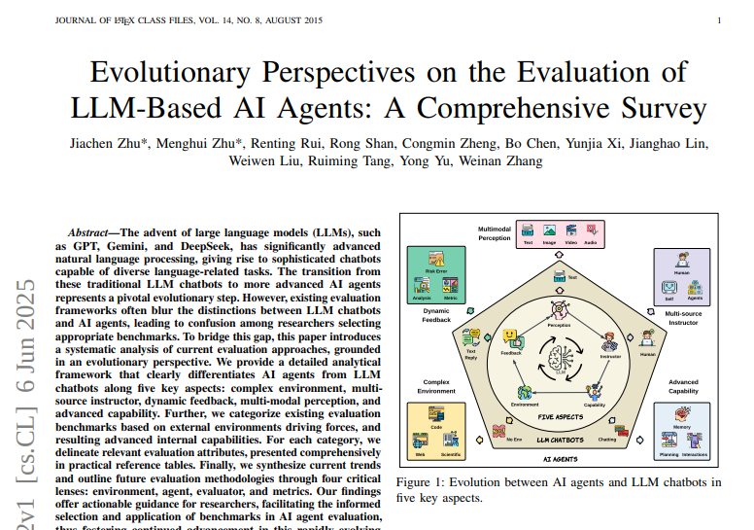

Slide 36
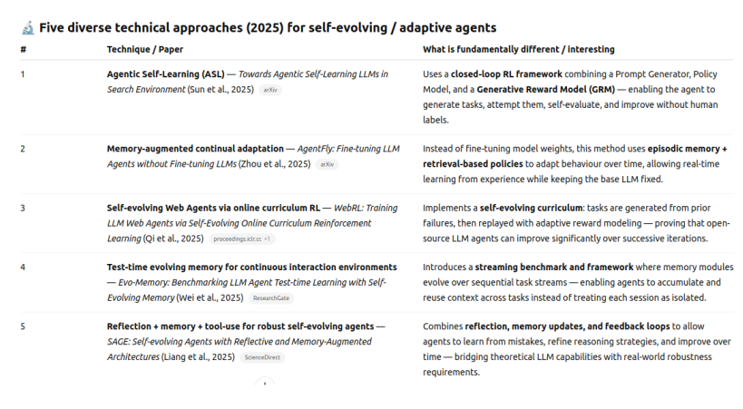

Slide 37
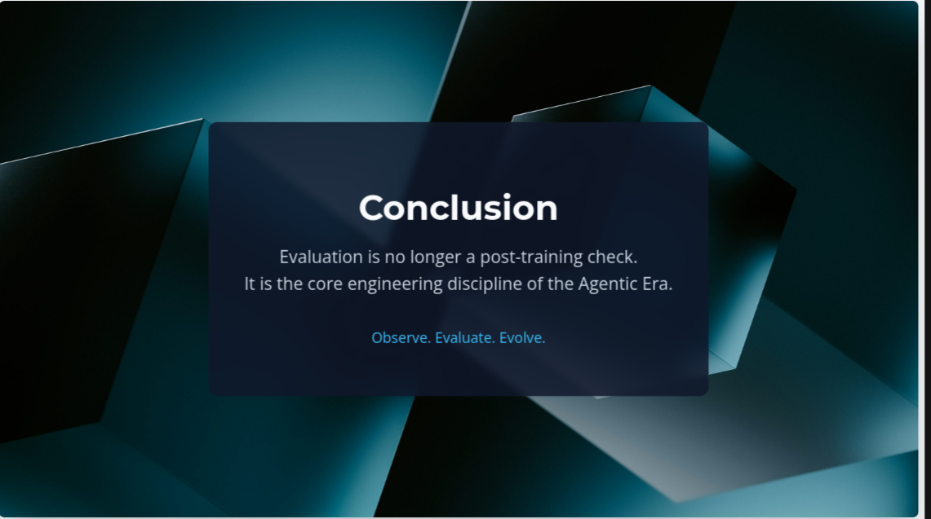

Slide 38
Useful ressources on Evaluation
Cours de Andrew NG, regarder TOUT le module 3
https://learn.deeplearning.ai/courses/agentic-ai/lesson/pu5xbl/evaluations-(evals)
3 surveys
https://dl.acm.org/doi/pdf/10.1145/3711896.3736570
https://huggingface.co/papers/2502.20073
https://arxiv.org/abs/2503.16416
Autres pistes intéressantes
https://arxiv.org/pdf/2506.11102
https://arxiv.org/pdf/2304.09842
Dans les framework
https://api.python.langchain.com/en/latest/langchain/evaluation.html
Pensé comme un one size fits all, dans la pratique peu pertinent

Slide 39


Slide 40
Thank you for your attention this semester !
Do not hesitate to stay in contact or reach out for
NLP / industry related topics !

