Slide 1
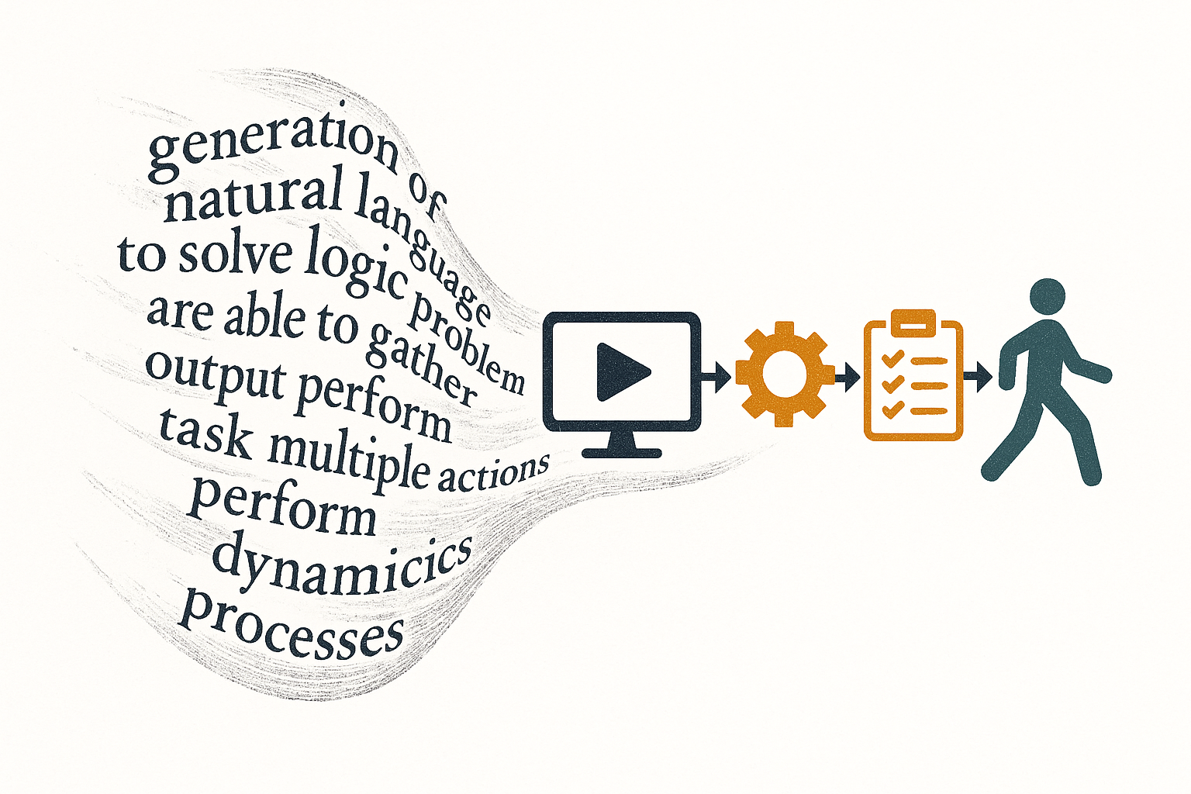
AI Agents :
From Language
Generation
to Task Automation
an essay in AI engineering history and epistemology
Louis Jourdain

Slide 2
For this course
3b13jourdainl@gmail.com
https://github.com/Dinarque/AI_Agents_Paris_Cite/tree/main

Slide 3
6 Weeks of intesive Agentic Activity
Chapter 1
What are AI Agents
Chapter 2
Expanding LLM
capacities with Tools
Chapter 3 :
Conditionning behaviour
Memory and Context
Chapter 4
Architectures and
Engineering
Chapter 5
Test yourself
Real use cases + Demo
Chapter 6
Agents Evaluation

Slide 4
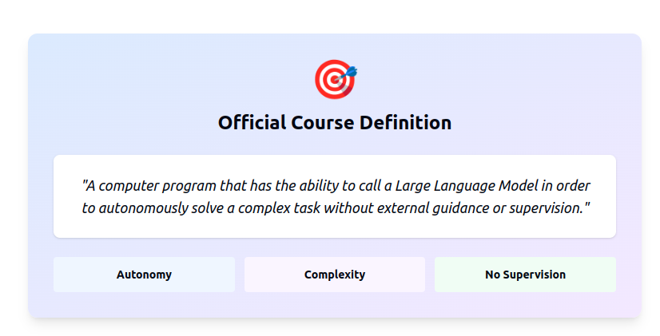

Slide 5
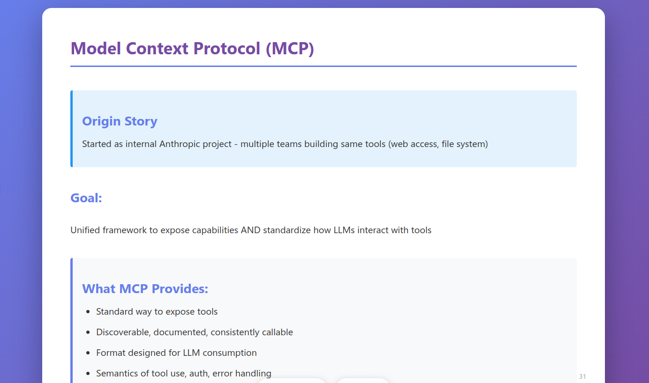

Slide 6
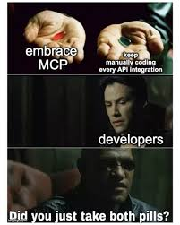
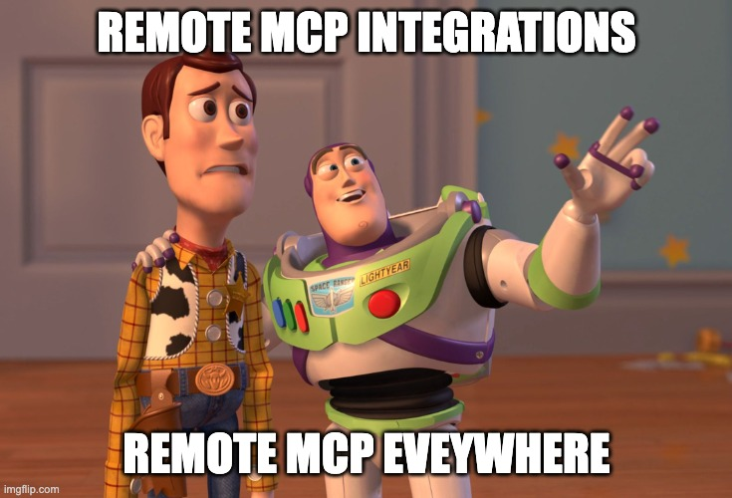

Slide 7
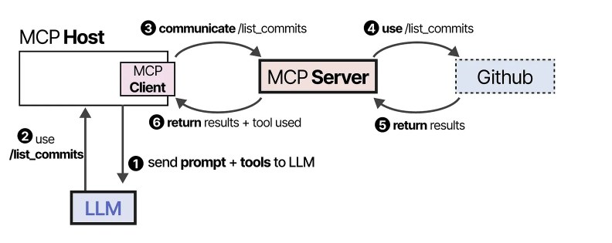

Slide 8
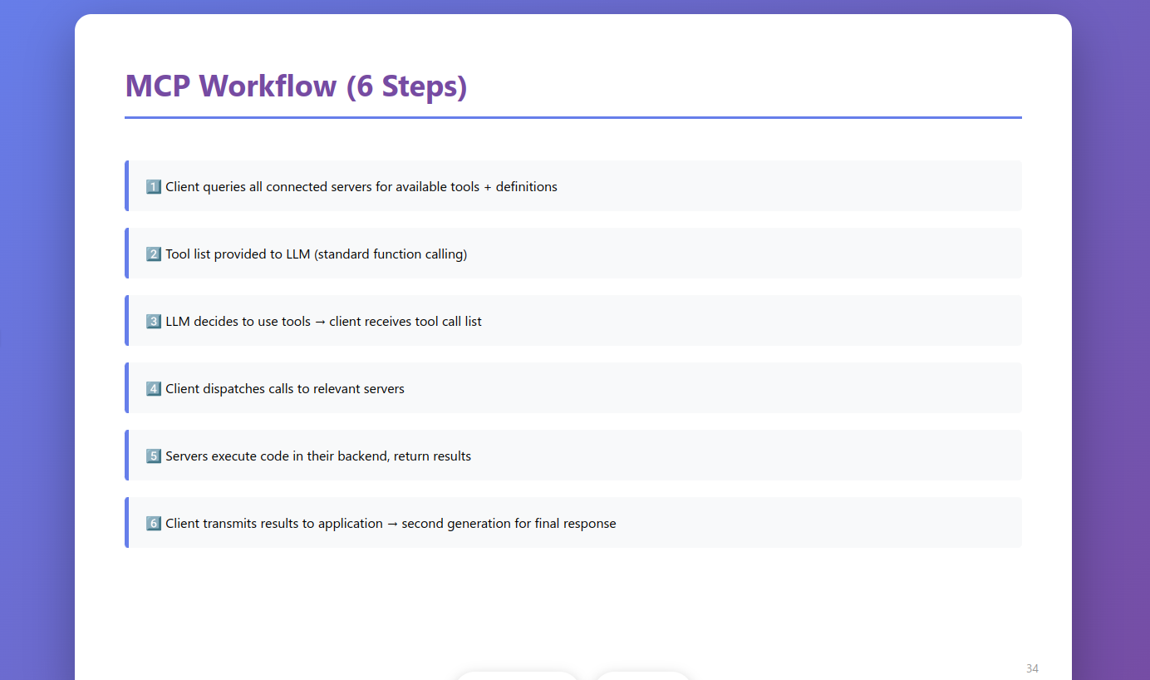

Slide 9
Activity (if we have enough time…)
What are the limitations of MCP ?
What critics is it facing so far ?
How could it prevent adoption ?
What do you think of the pros / cons of using this protocol ?

Slide 10
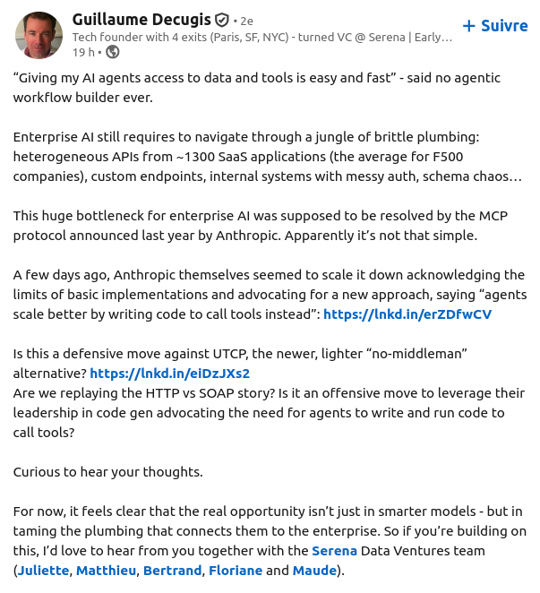
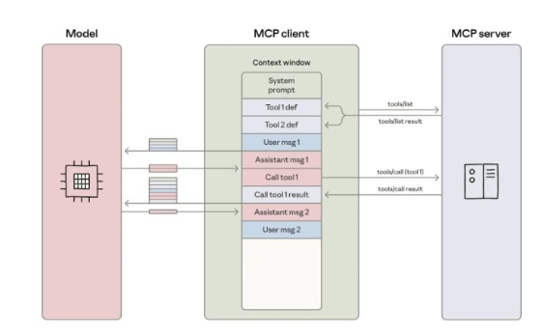

Slide 11
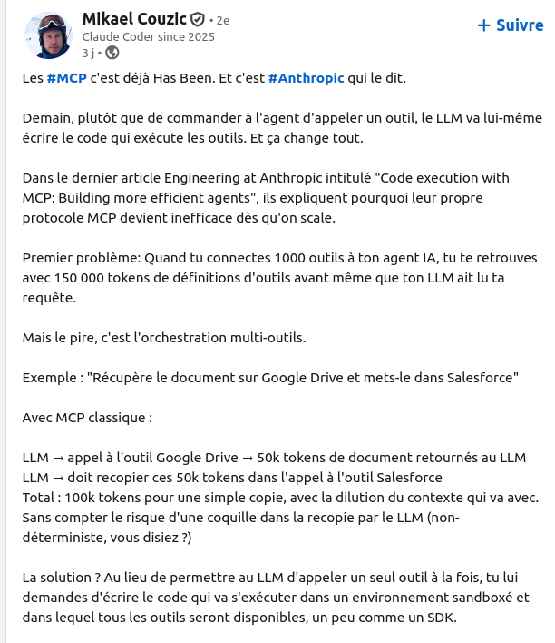
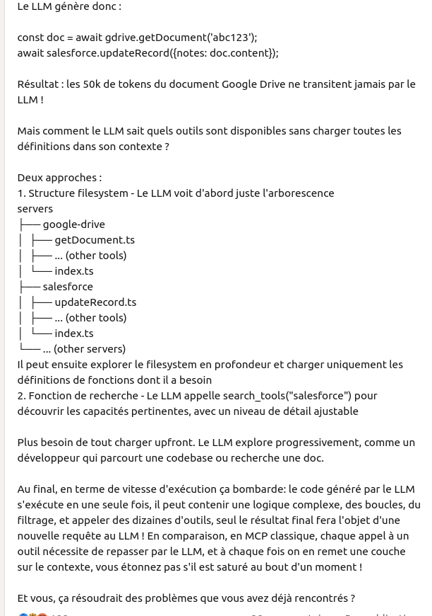

Slide 12

What do you think about MCP ?

Slide 13
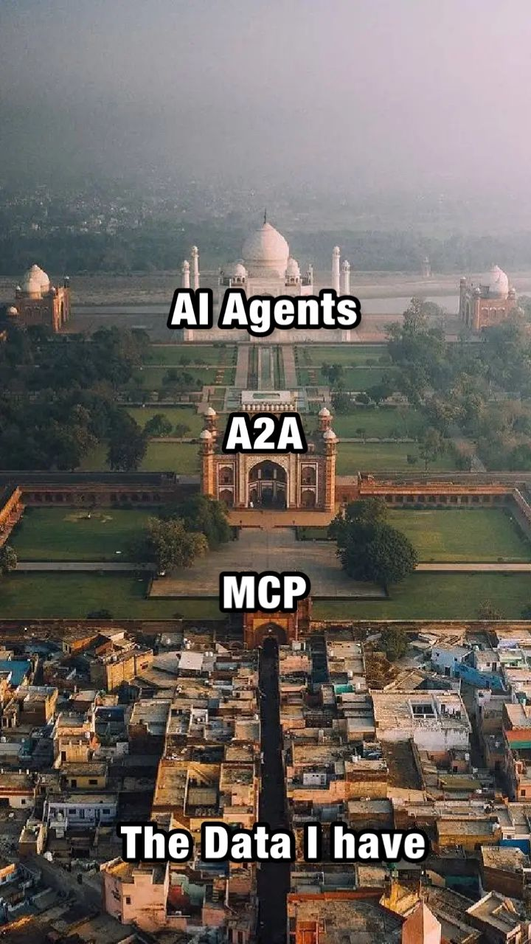

Slide 14
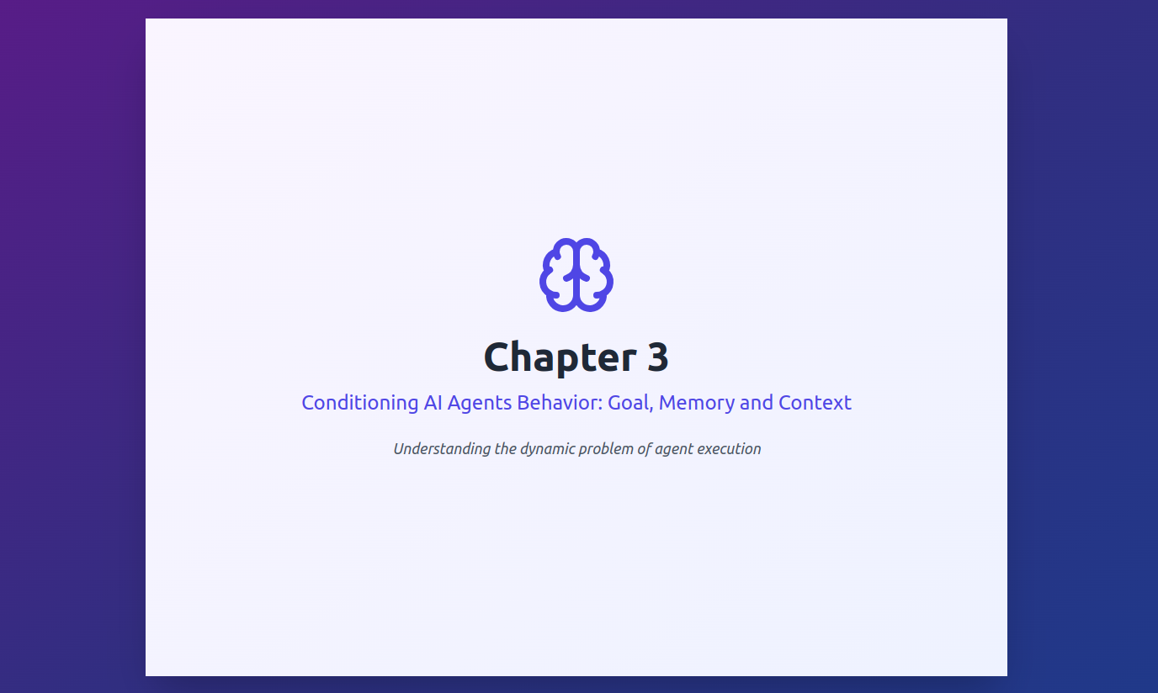

Slide 15
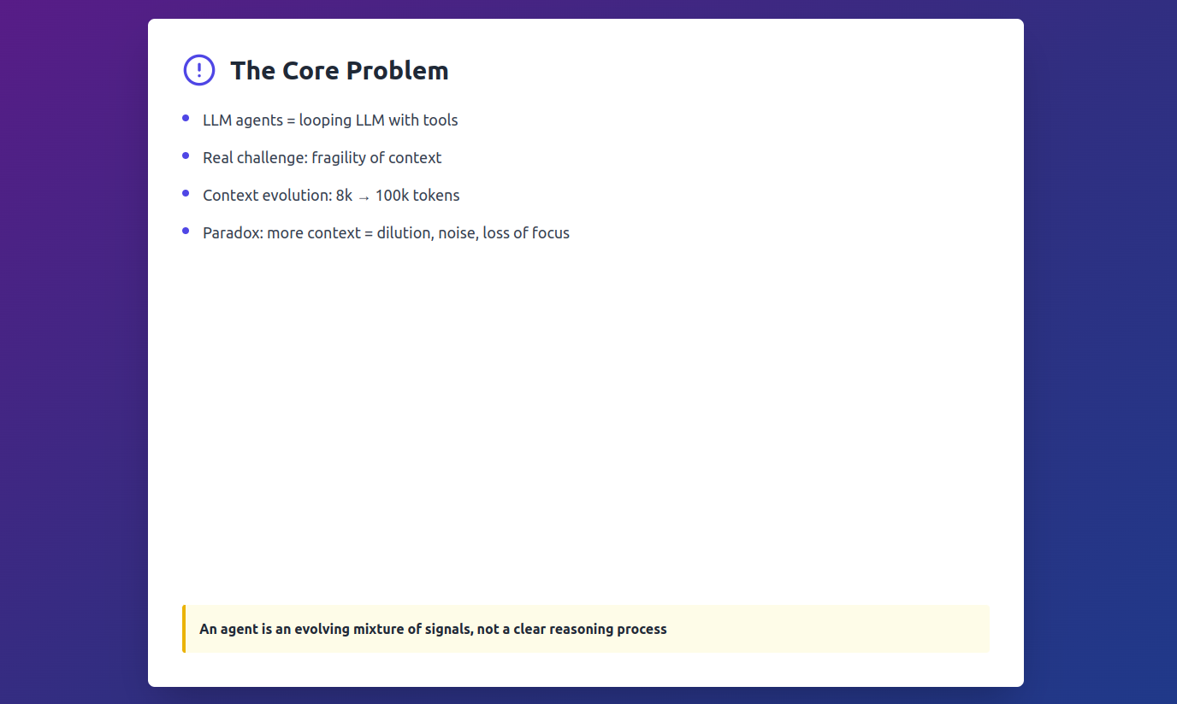

Slide 16
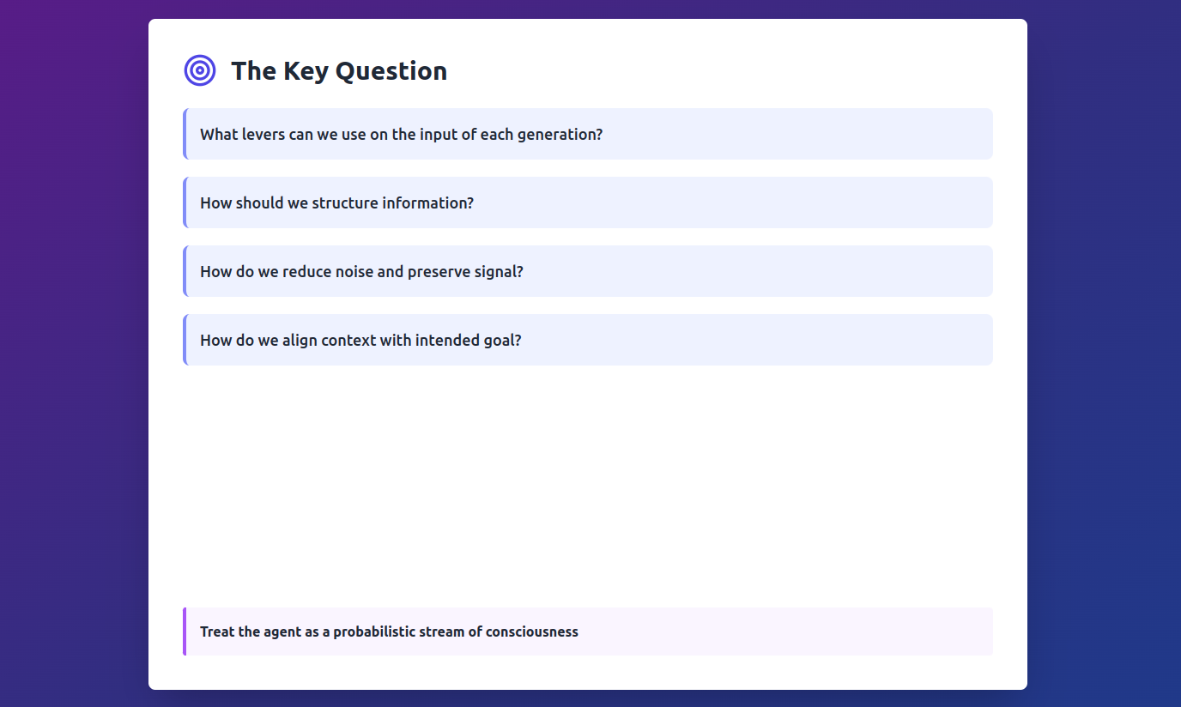

Slide 17
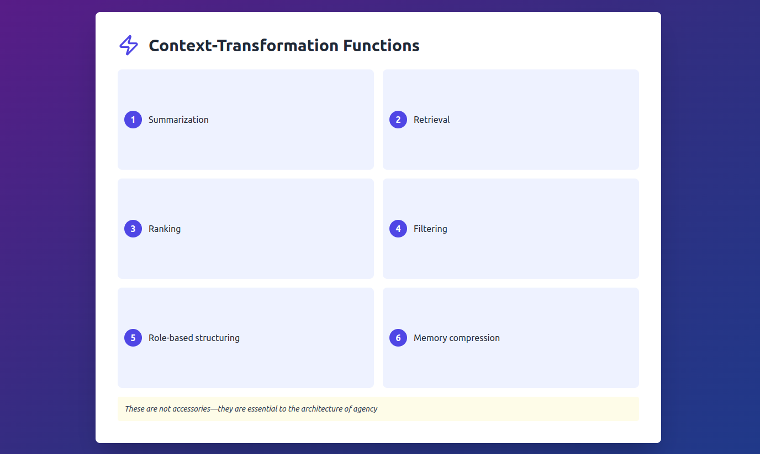

Slide 18
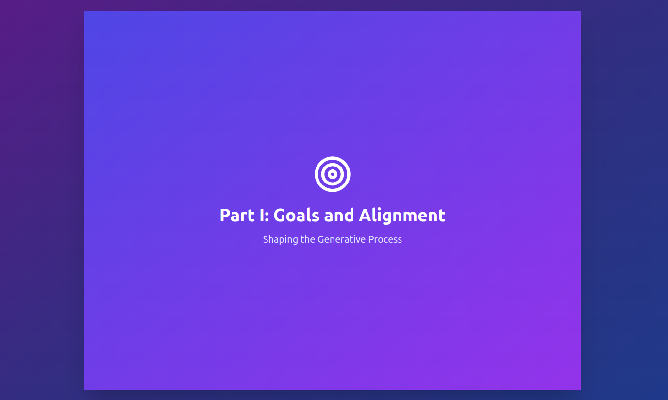

Slide 19
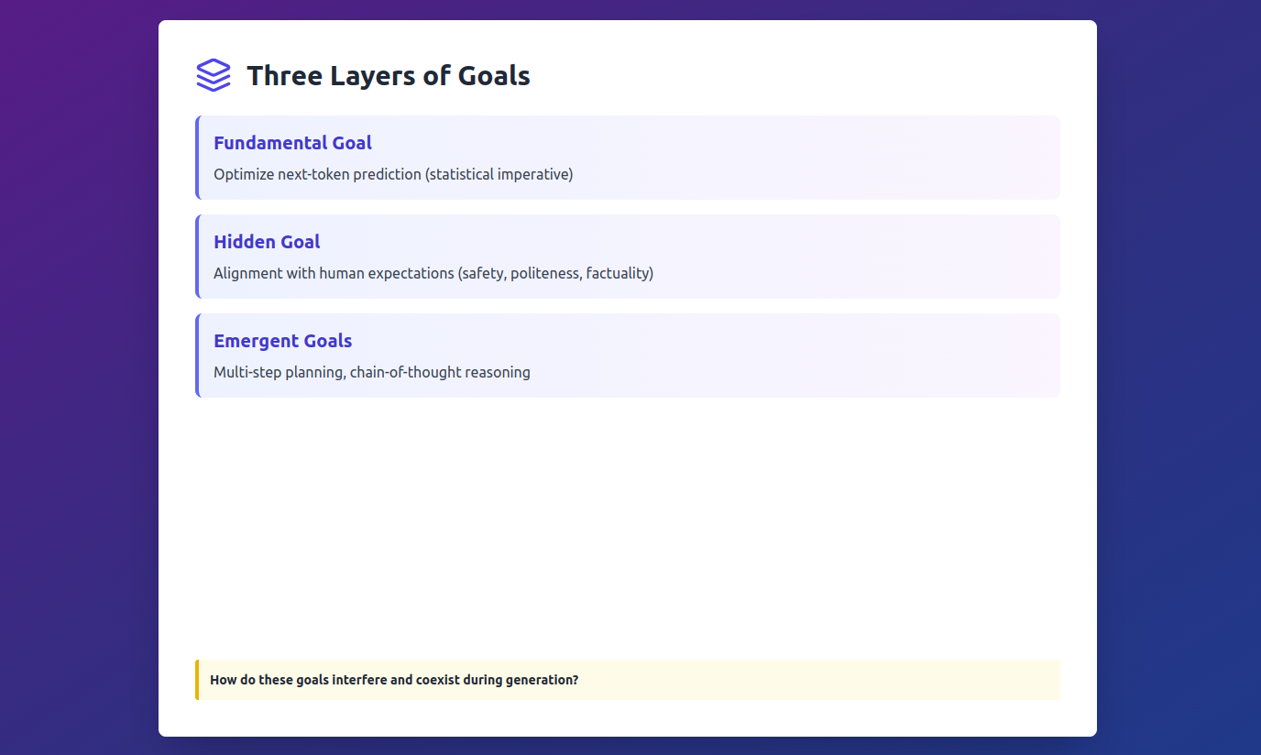

Slide 20
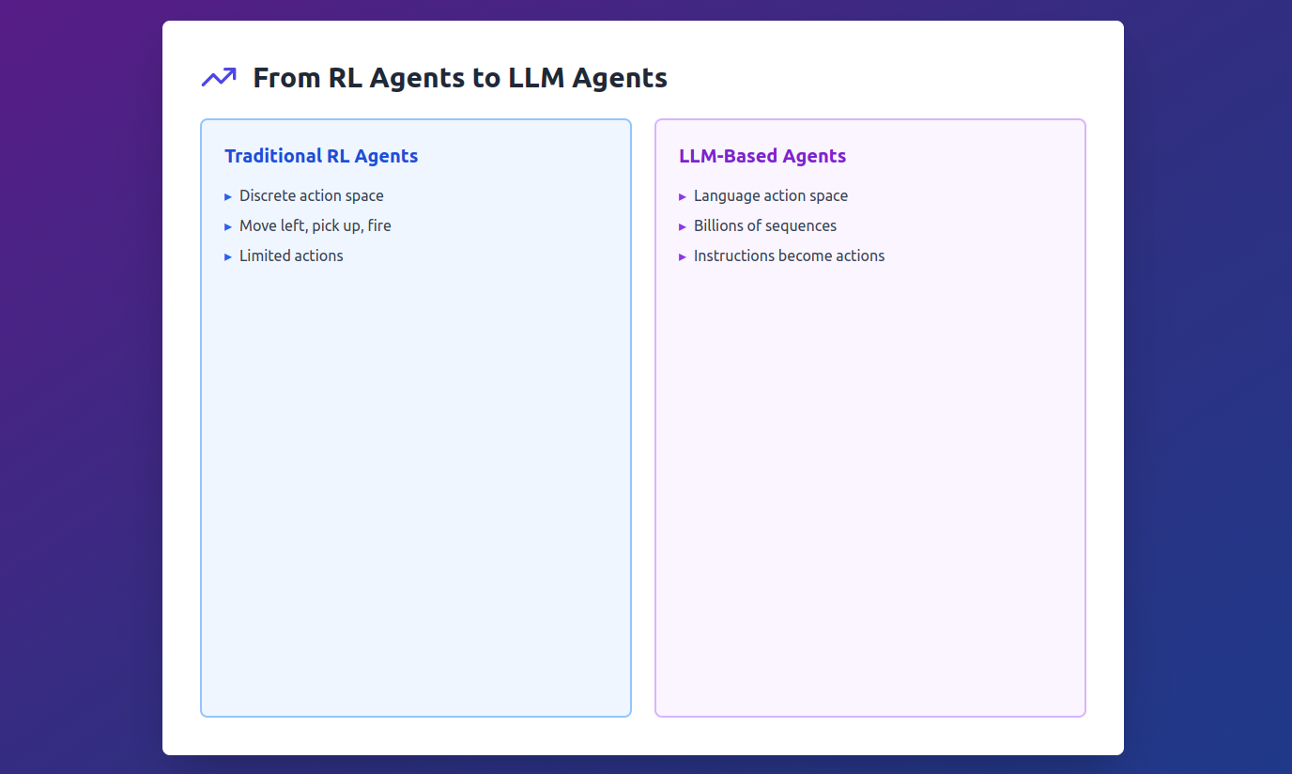
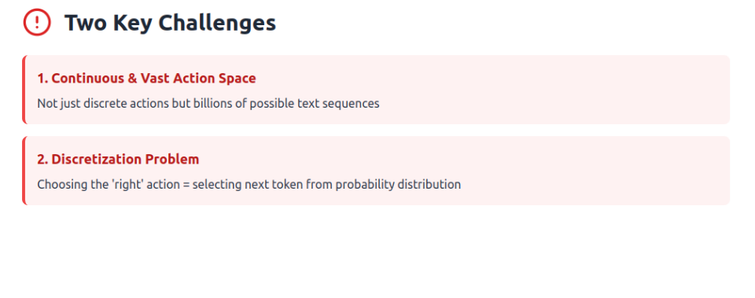

Slide 21
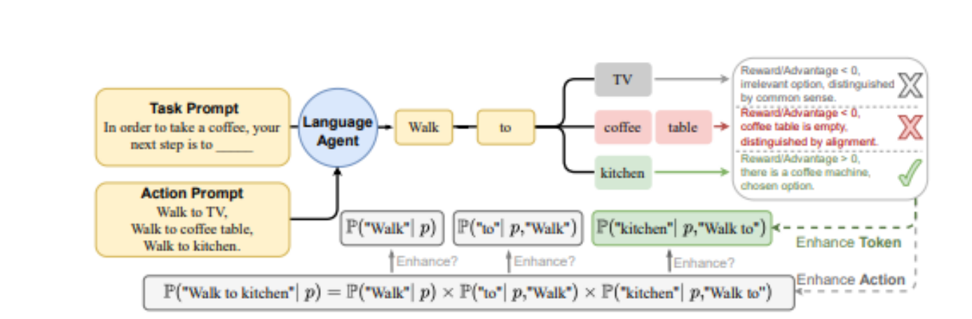

Slide 22
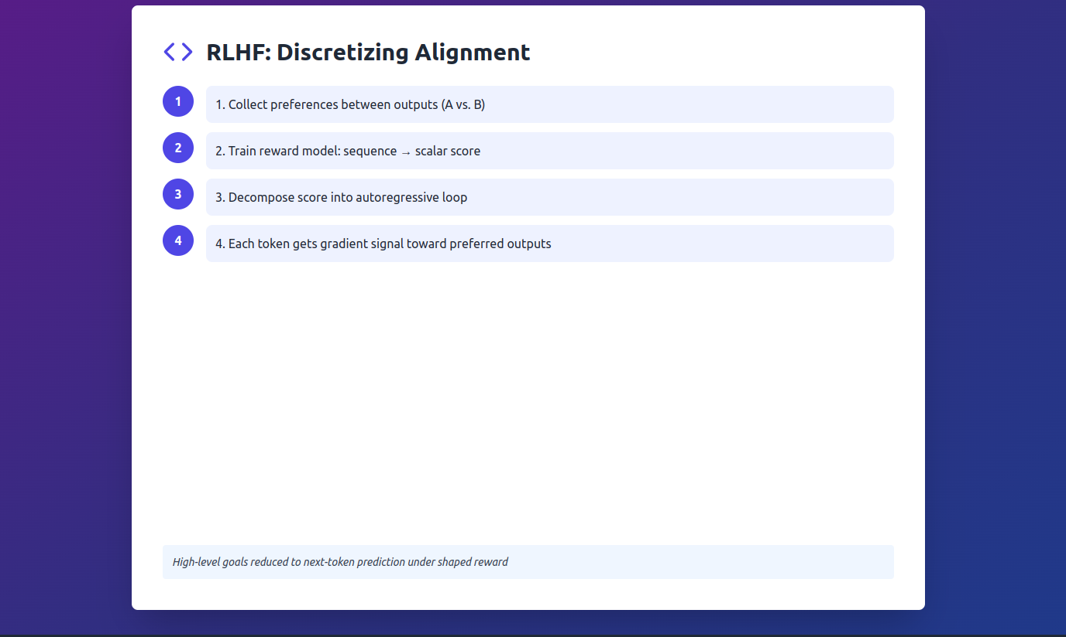
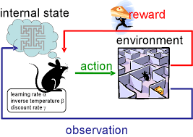

Slide 23
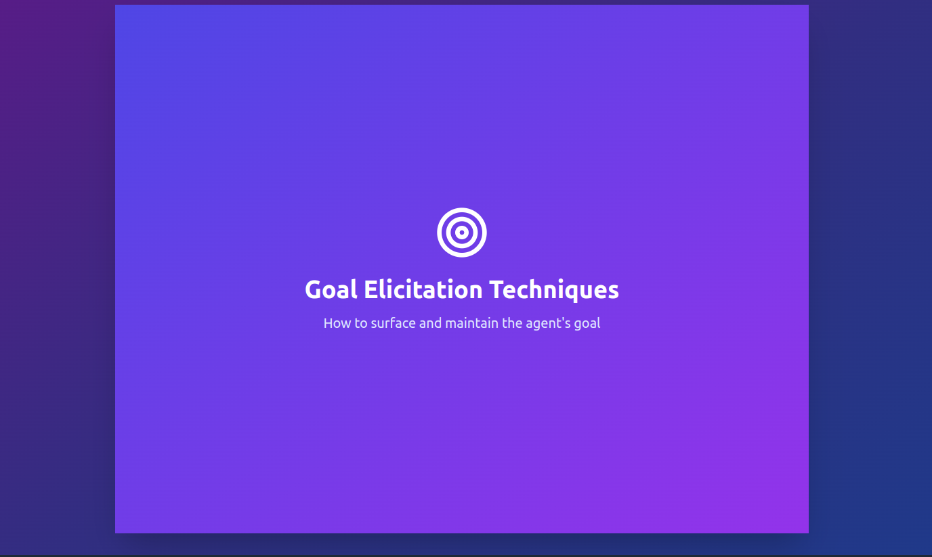

Slide 24
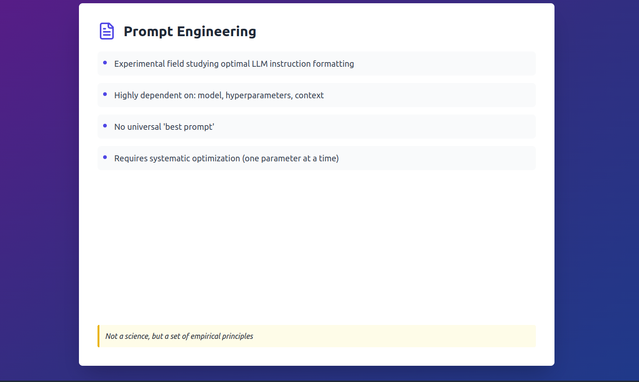

Slide 25
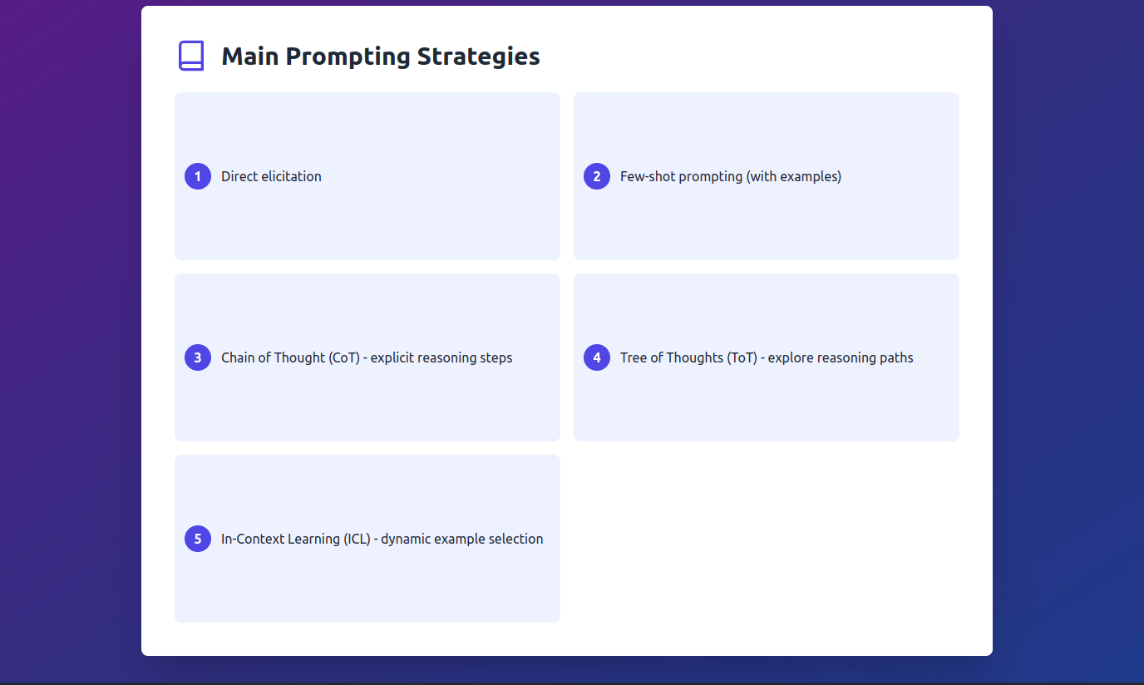

Slide 26
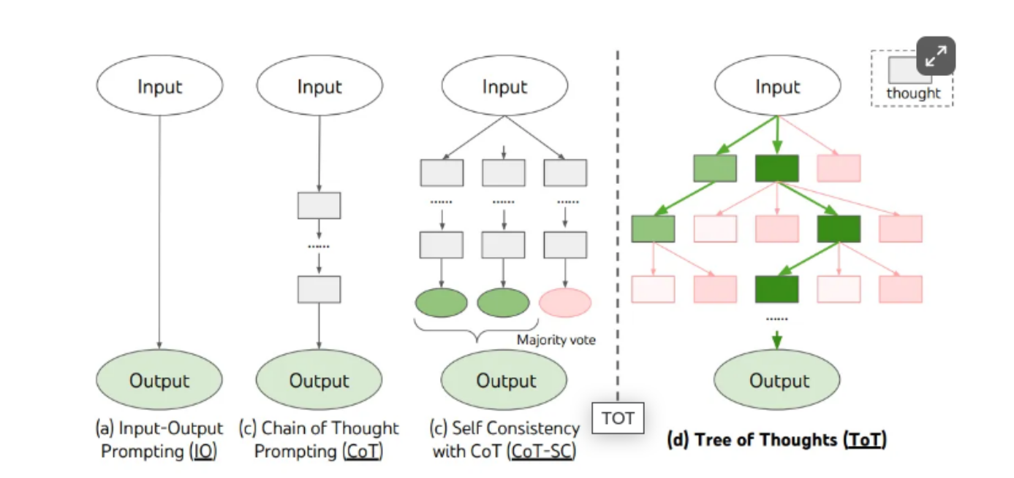

Slide 27
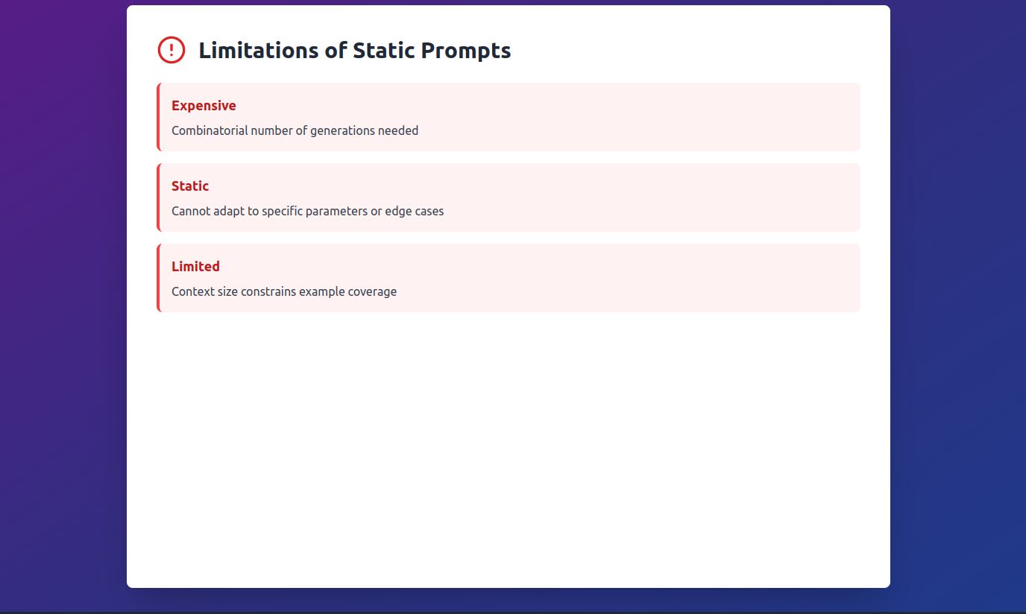

Slide 28
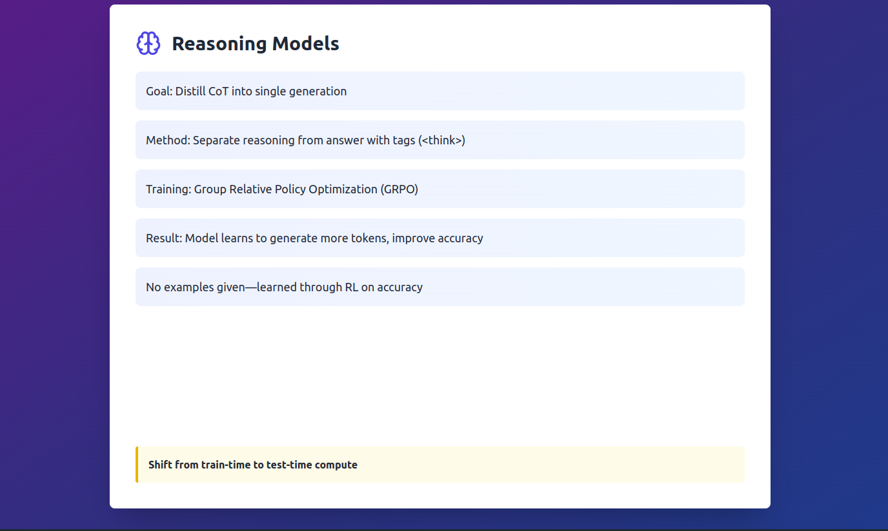

Slide 29
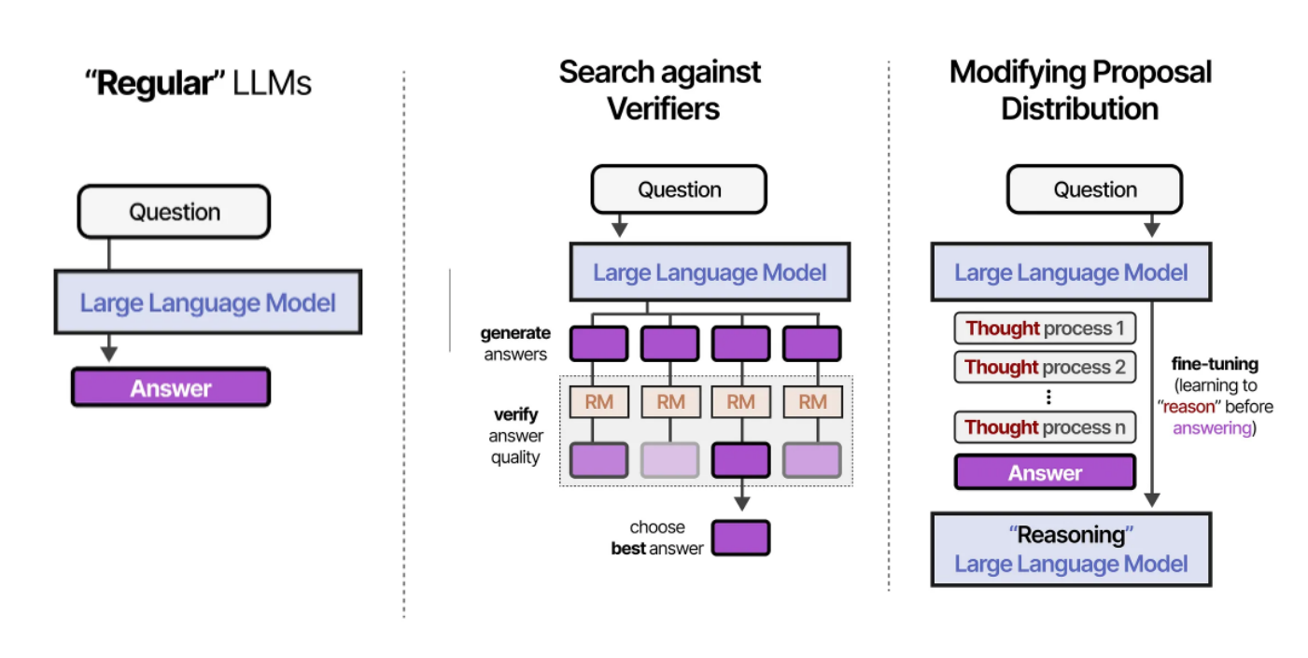

Slide 30
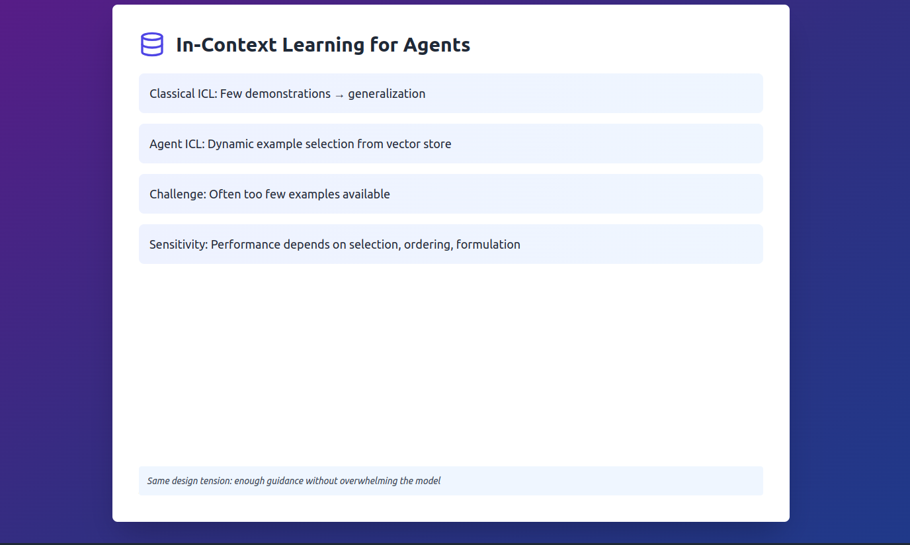

Slide 31
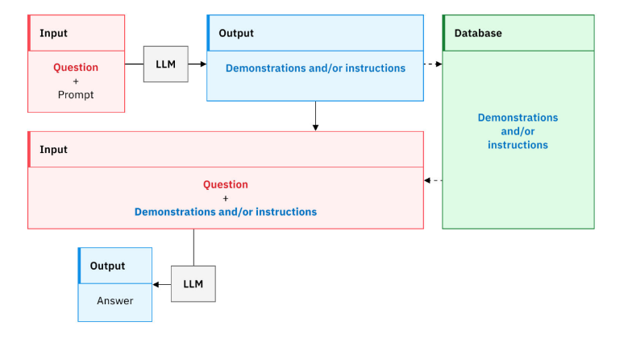
https://www.ibm.com/fr-fr/think/topics/in-context-learning

Slide 32
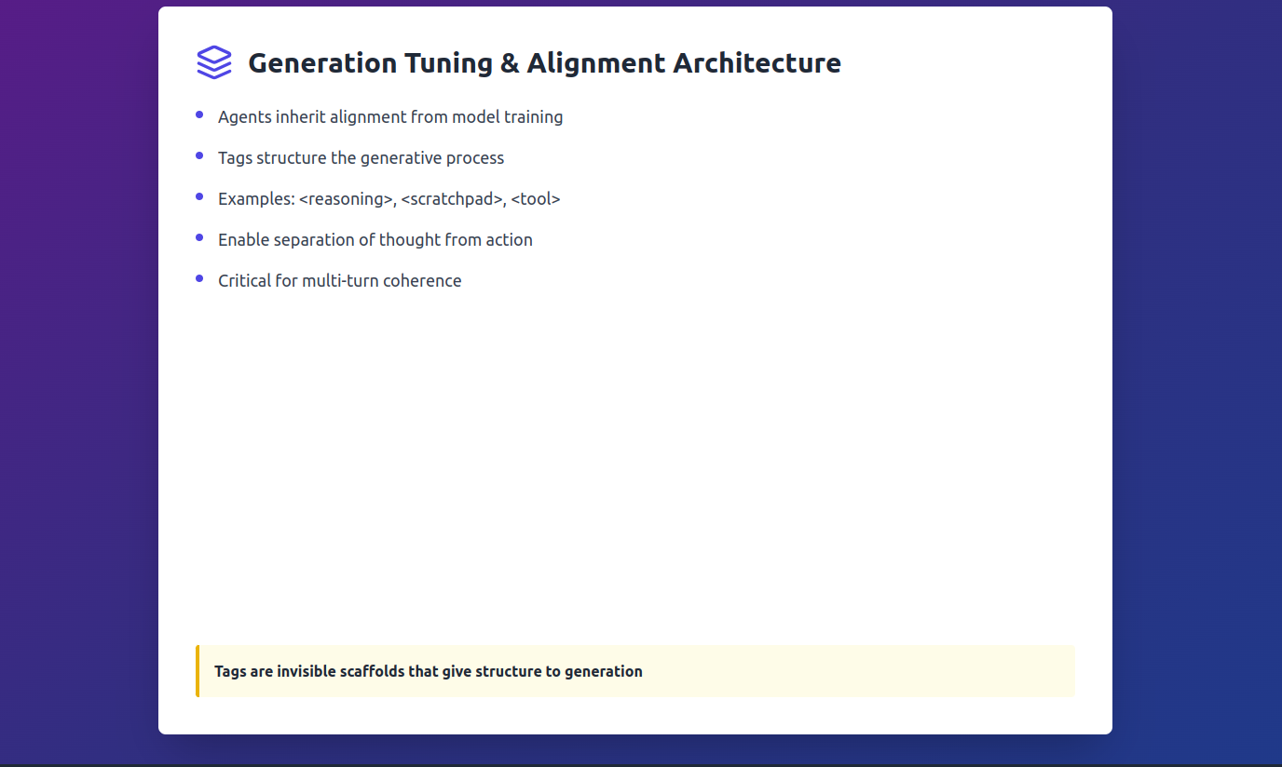

Slide 33
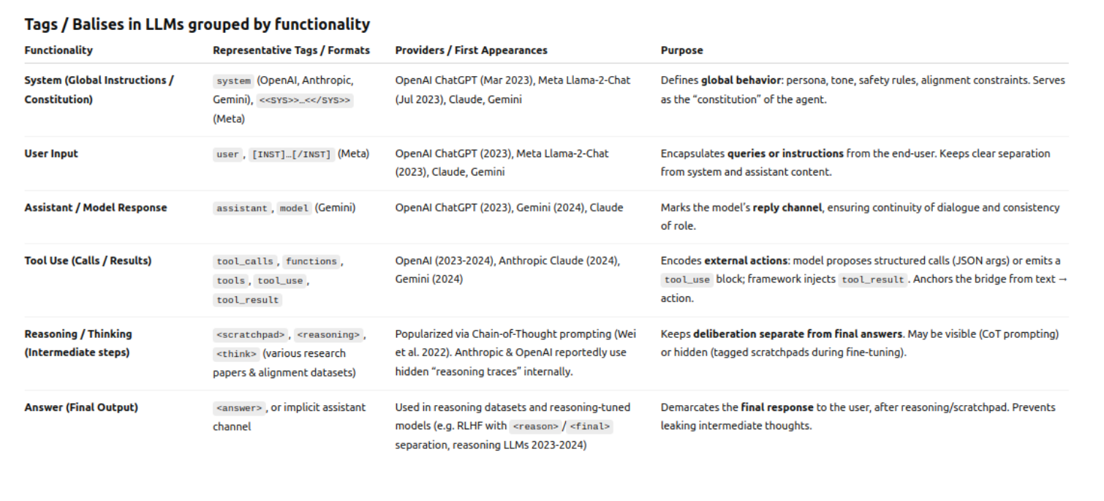

Slide 34
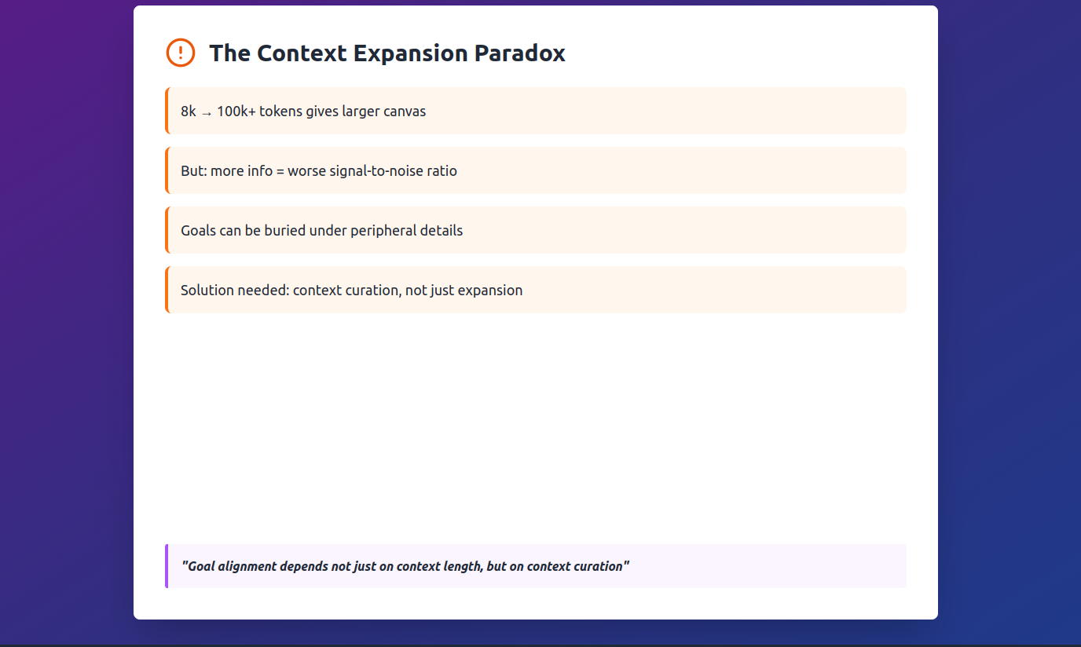

Slide 35
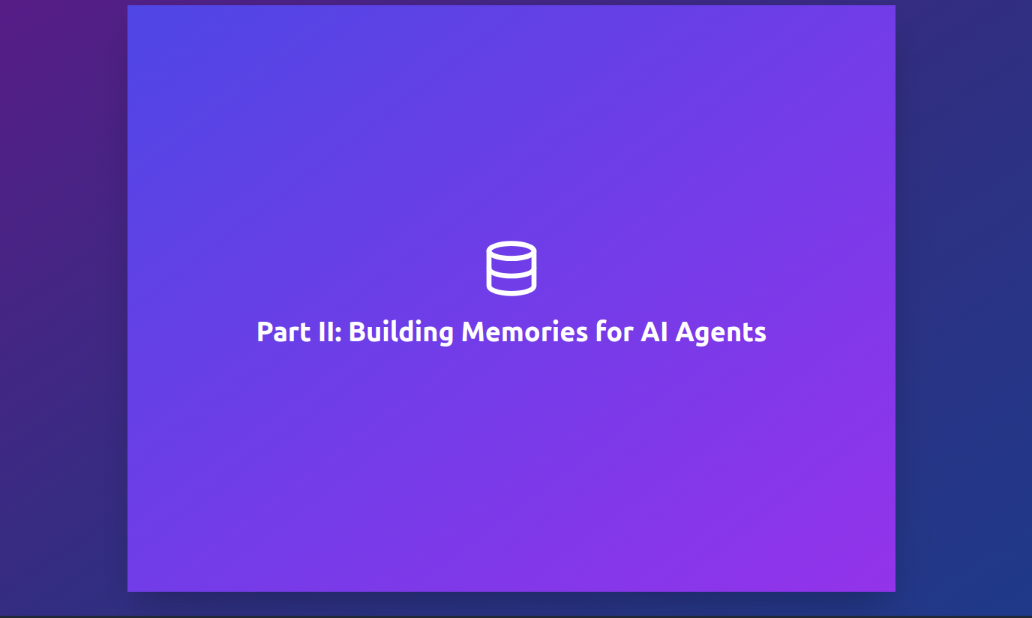

Slide 36
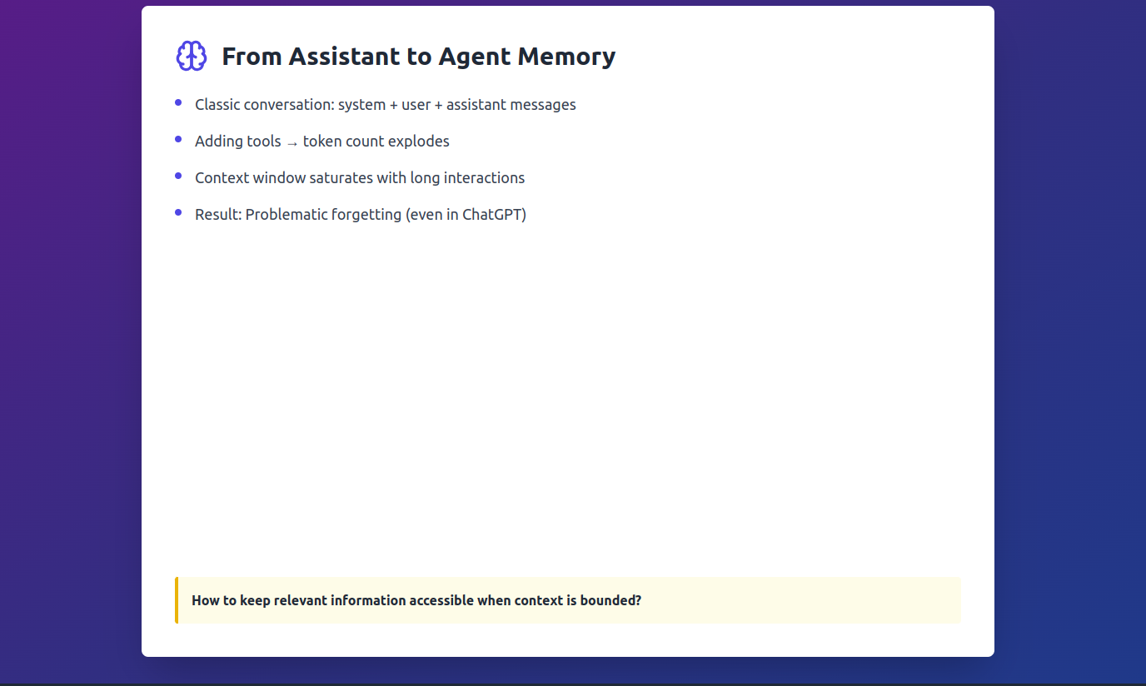

Slide 37
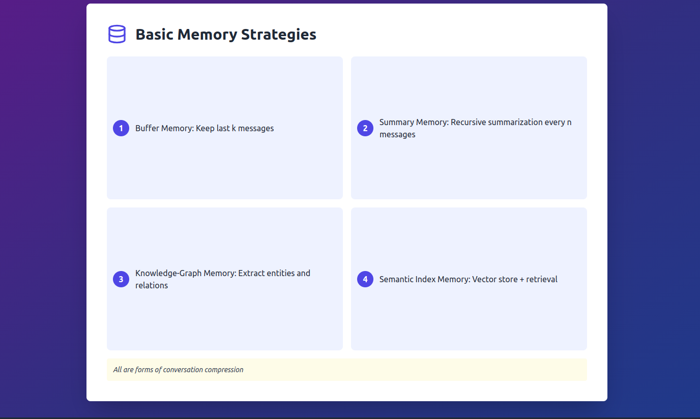

Slide 38
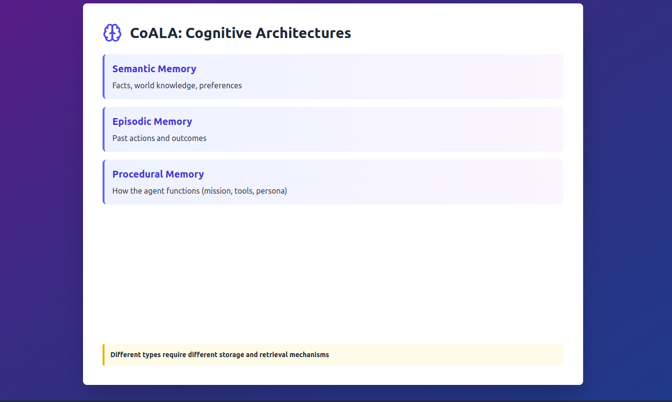
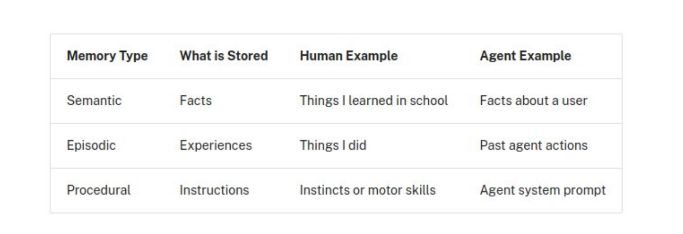

Slide 39
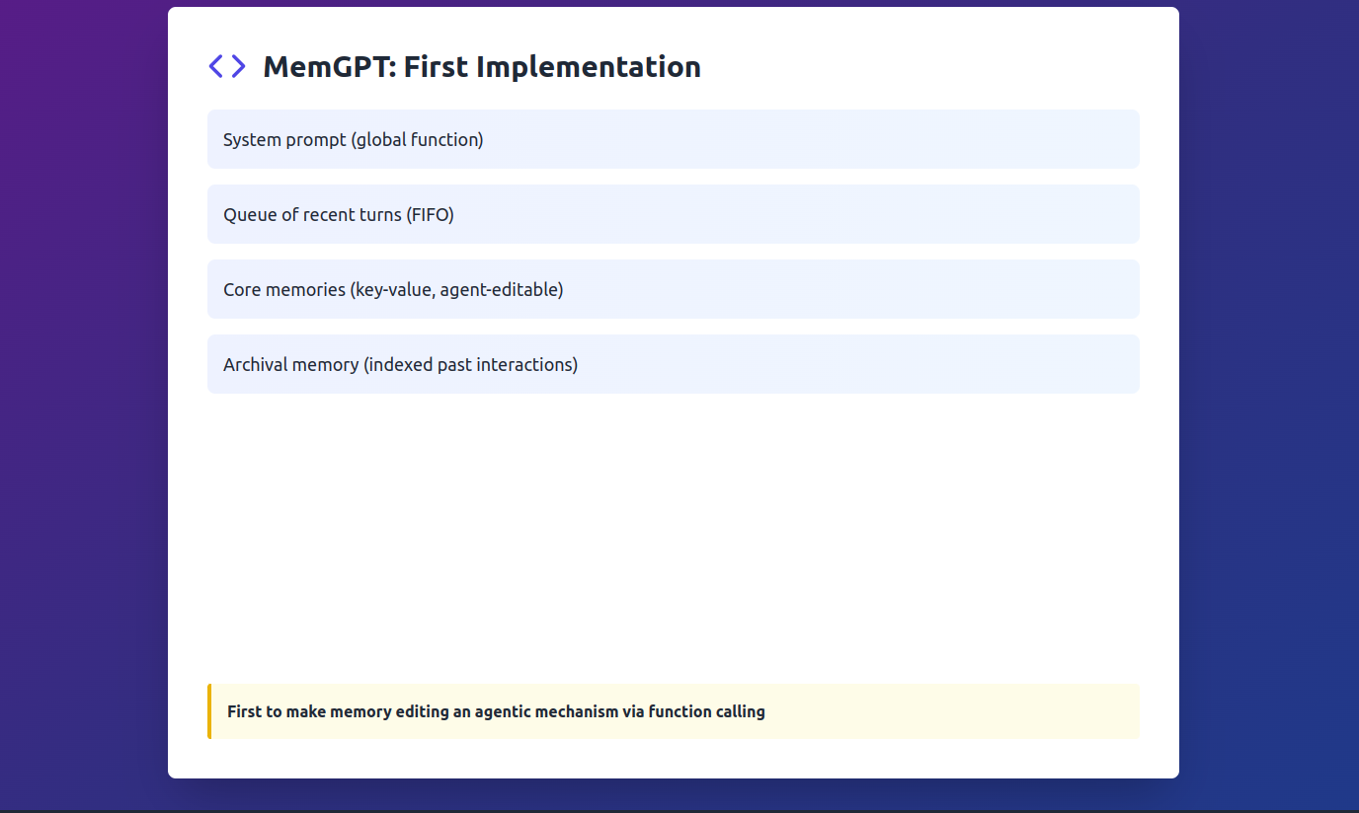

Slide 40
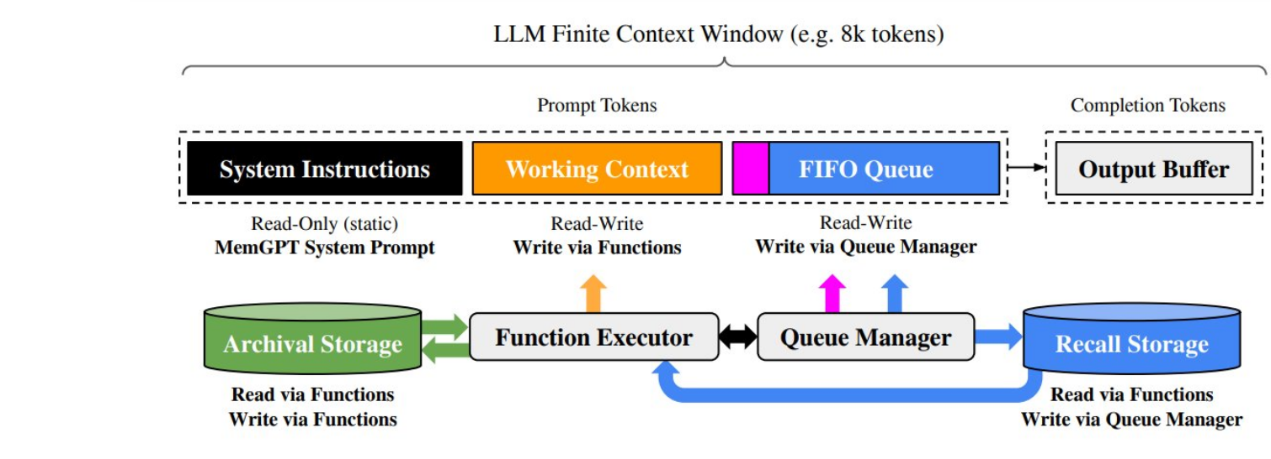

Slide 41
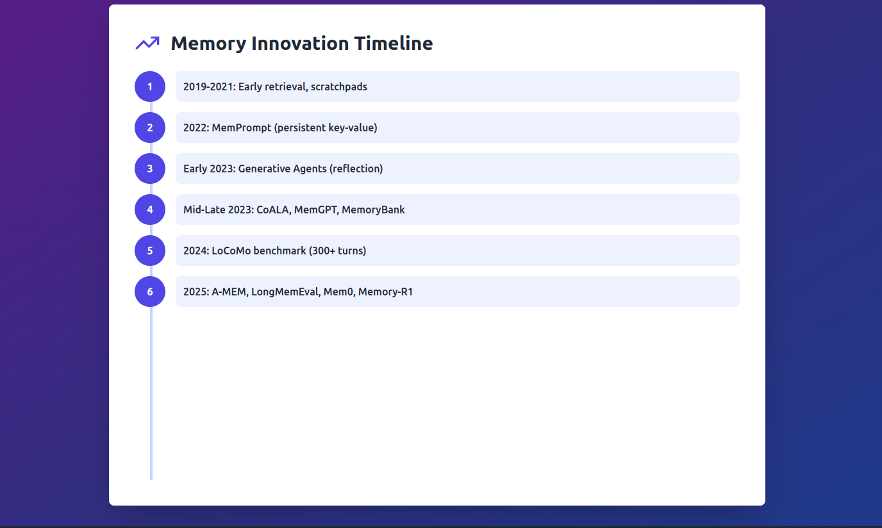

Slide 42
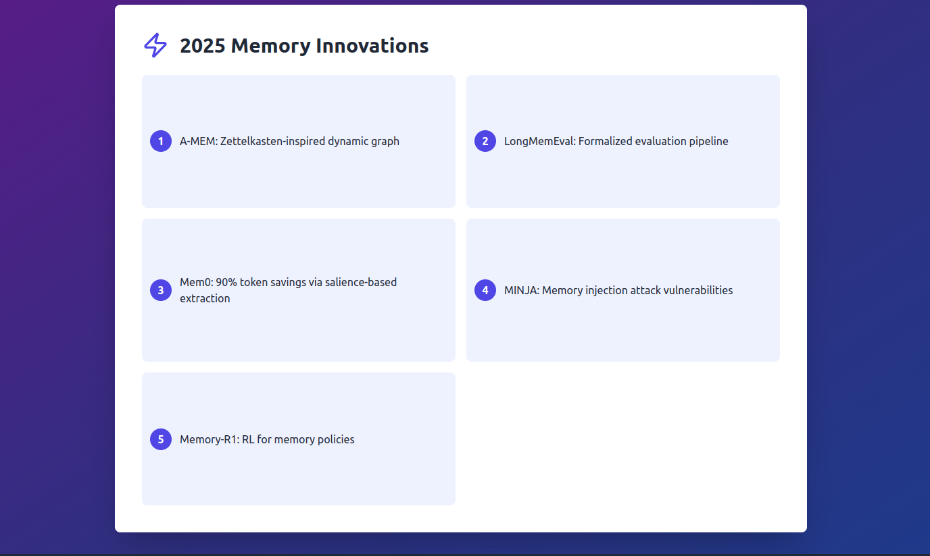

Slide 43
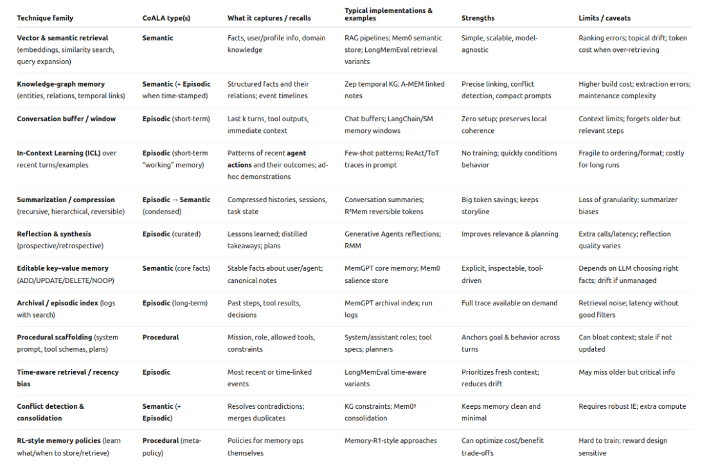

Slide 44
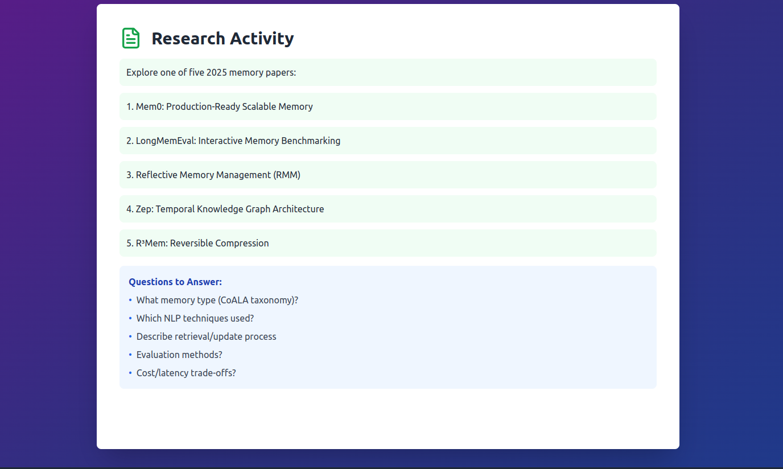

Slide 46
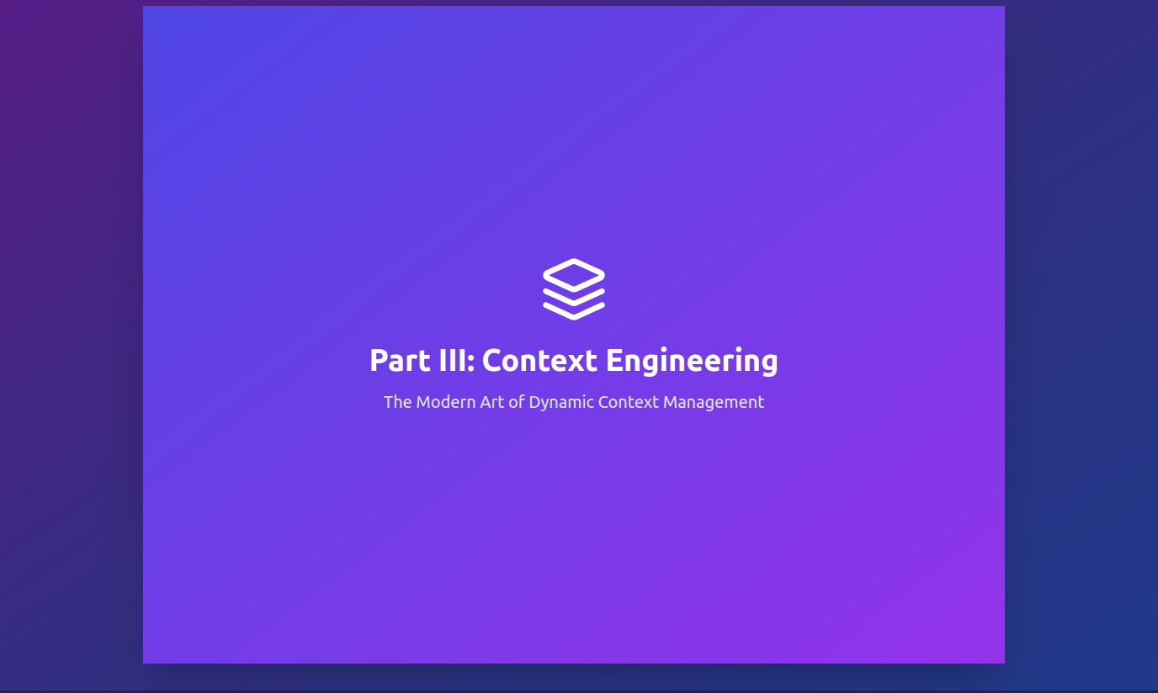

Slide 47
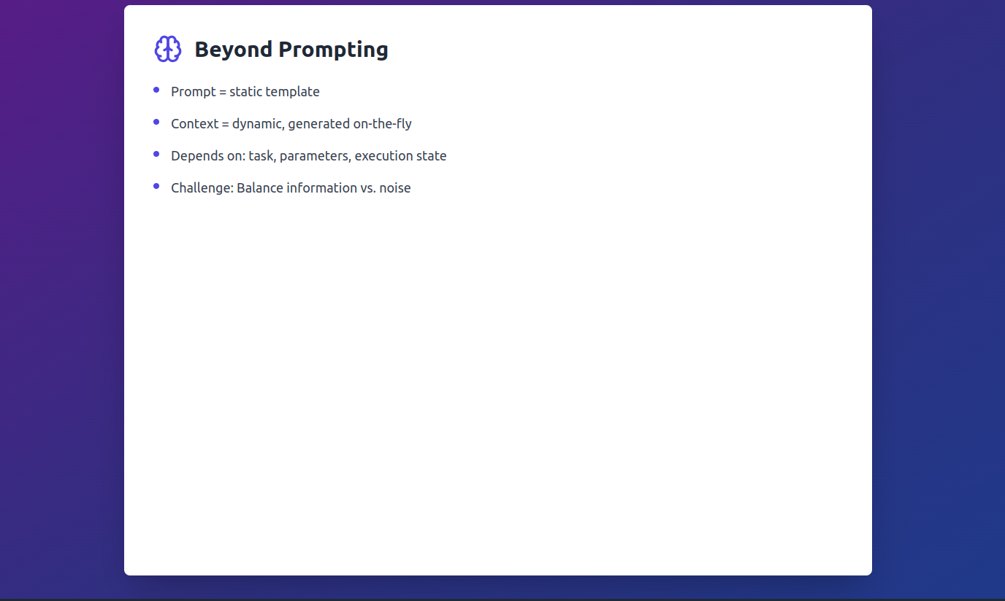

Slide 48
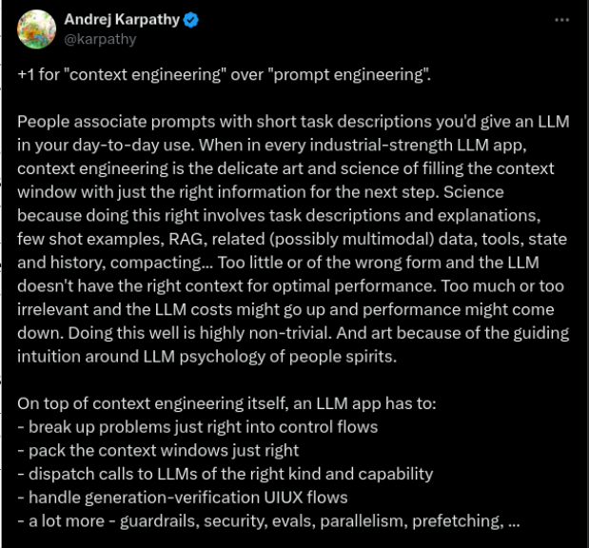
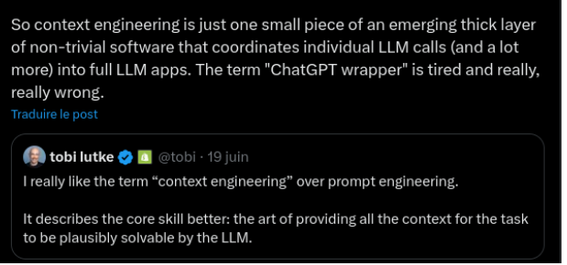

Slide 49


Slide 50


Slide 51


Slide 52




Slide 53


Slide 54


Slide 55


Slide 56


Slide 57


Slide 59


Slide 60


