Slide 1
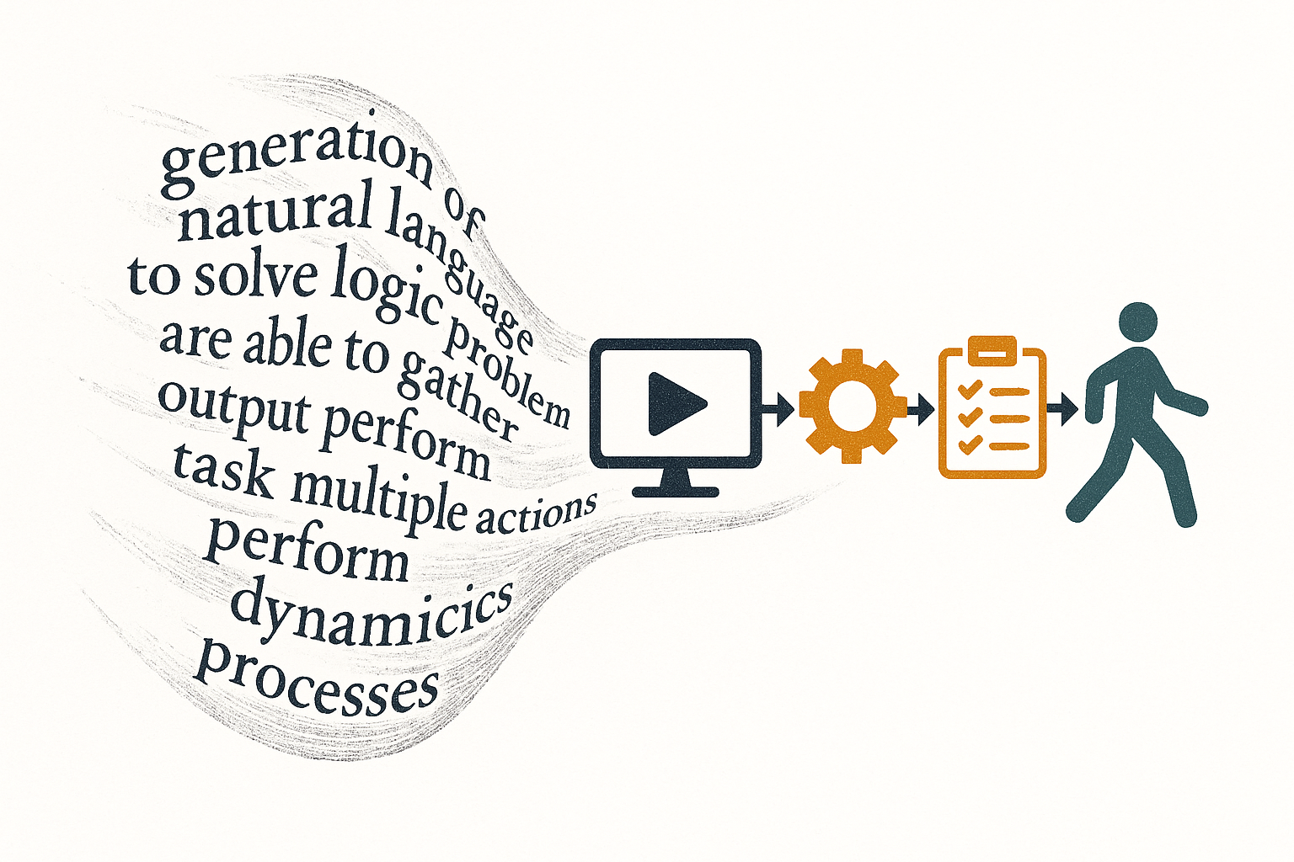
AI Agents :
From Language
Generation
to Task Automation
an essay in AI engineering history and epistemology
Louis Jourdain

Slide 2
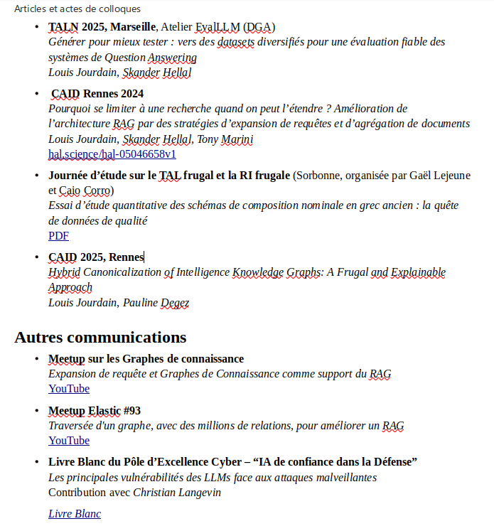

Who am I ?

Slide 3
For this course
3b13jourdainl@gmail.com
https://github.com/Dinarque/AI_Agents_Paris_Cite/tree/main

Slide 4
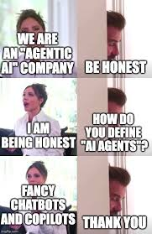
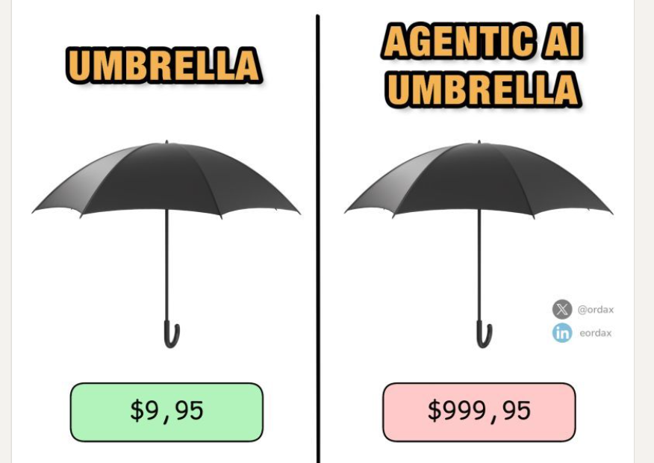
Lorem
Ipsum Dolor

Slide 5
What do you expect from the class ?

Slide 6
6 Weeks of intesive Agentic Activity
Chapter 1
What are AI Agents
Chapter 2
Expanding LLM
capacities with Tools
Chapter 3 :
Conditionning behaviour
Memory and Context
Chapter 4
Architectures and
Engineering
Chapter 5
Test yourself
Real use cases + Demo
Chapter 6
Demo

Slide 7
What you expect : Evaluation
/10 Individual
Written exam on week 5 :
05/12.
Content of the first 4 weeks
Question on course,
Code,
Practical use case
On Paper, no notes
/10 Group project,
2 or 3 students
Implement an Agent
or Agentic system to solve a
Domain specific issue.
Deadline 30/05
Several topics available

Slide 8
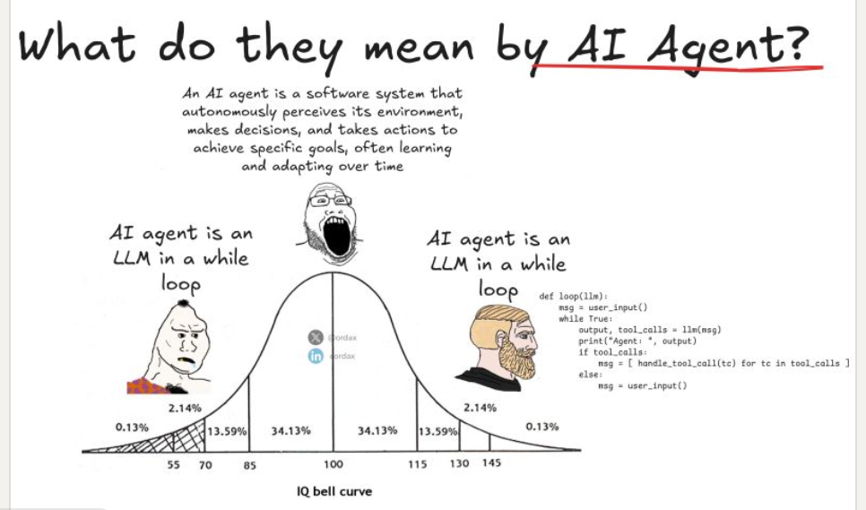

Slide 9
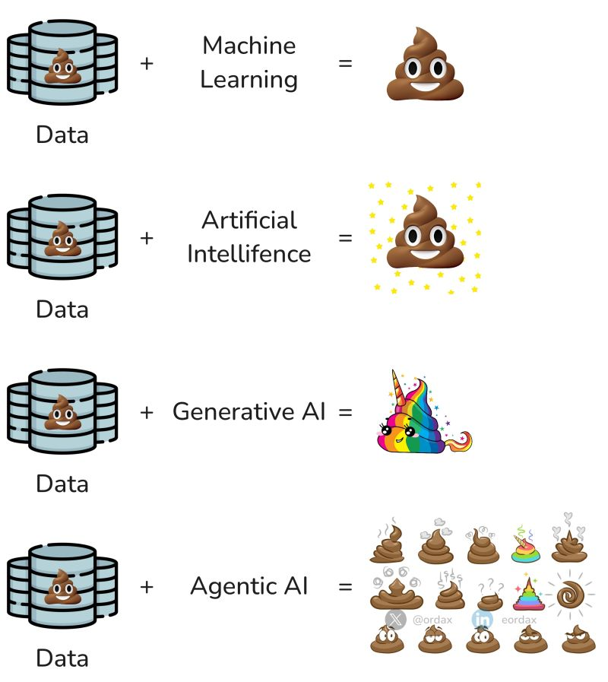

Slide 10
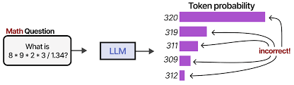
At the beginning, there was the LLM
This illustration and the ones in the same style all come from
the EXCELLENT Blog of https://newsletter.maartengrootendorst.com/
For the memes, see Eduardo Ordax on LinkedIn

Slide 11
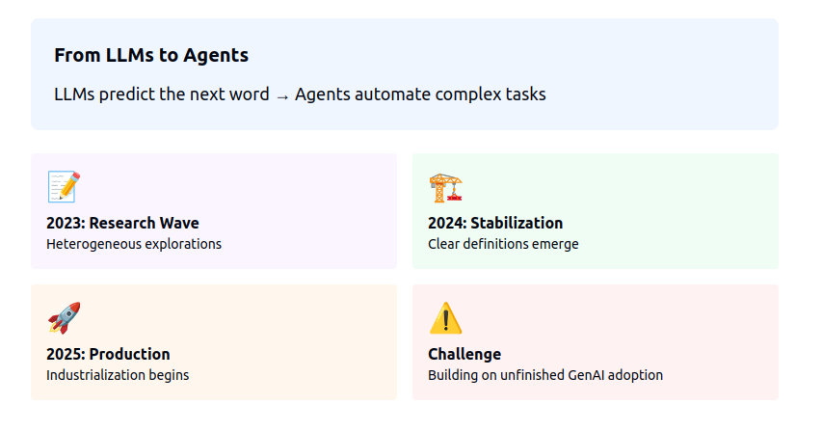

Slide 12
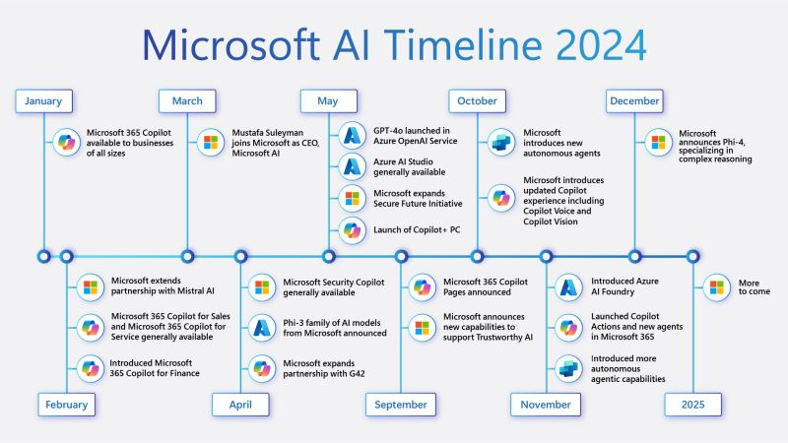
https://www.linkedin.com/posts/dipendra-shekhawat_2025-would-be-more-on-ai-agents-agentic-activity-7275708243501297664-5ogI

Slide 13
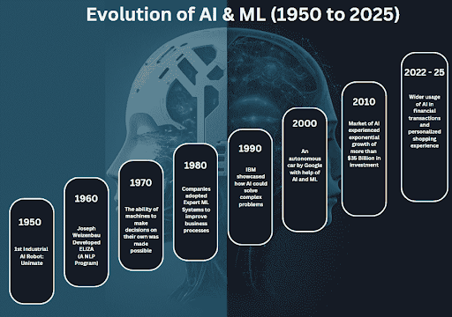
https://internetsearchinc.com/ai-agents-the-next-frontier-in-technology-for-2025/

Slide 14
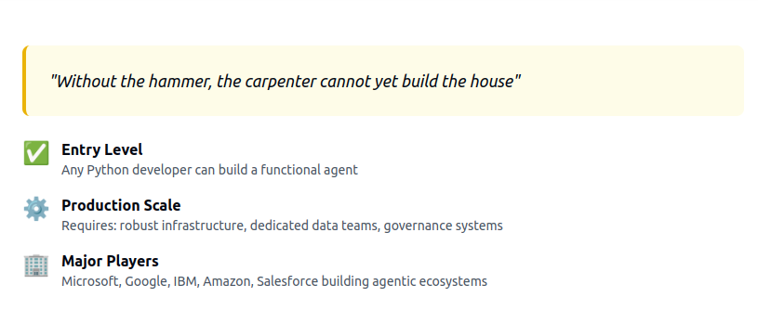
What characterizes a technological revolution ?

Slide 15
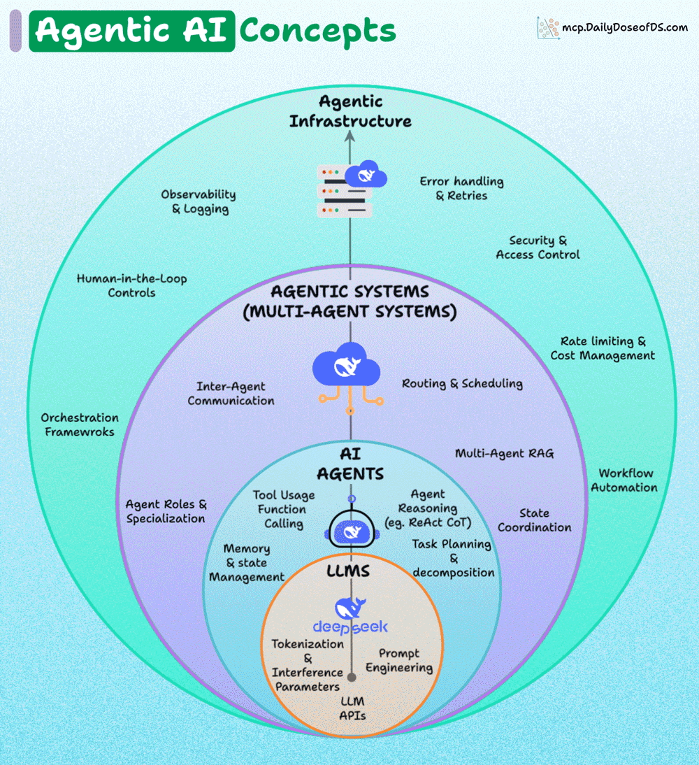
https://blog.dailydoseofds.com/p/4-layers-of-agentic-ai-systems

Slide 16
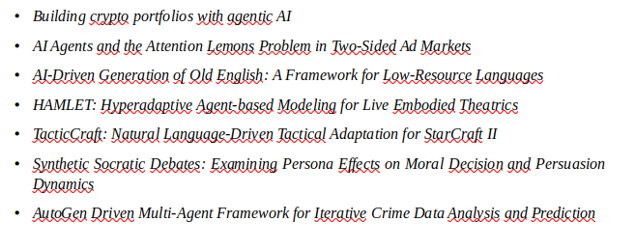
In Academia : the Paper Frenzy

Slide 17
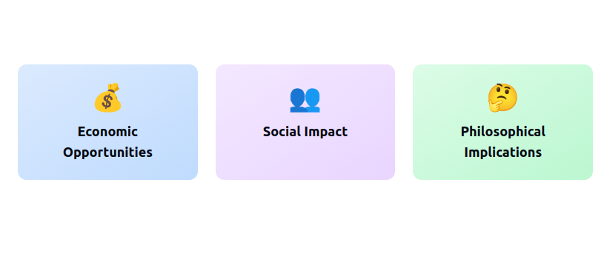
I) AI Agents and Society

Slide 18
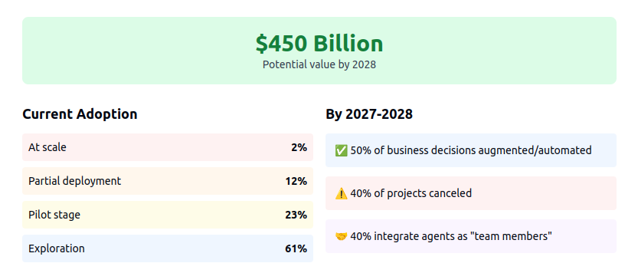

Slide 19

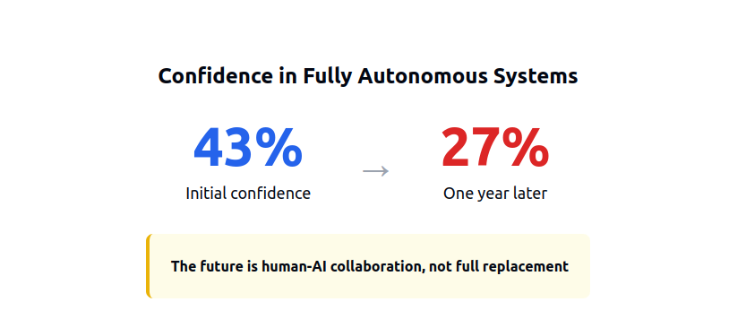

Slide 20
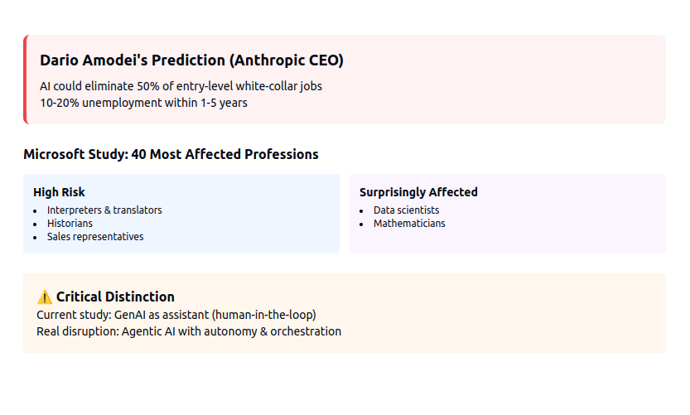

Slide 21
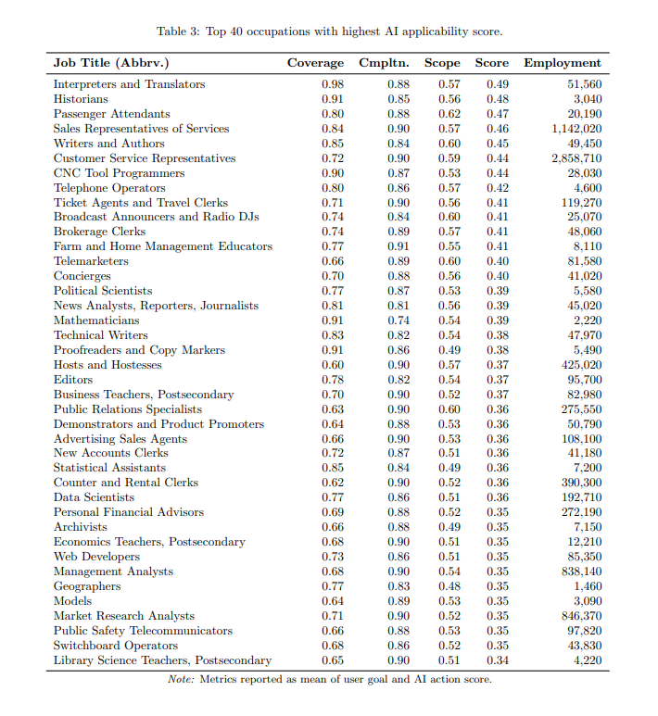

Slide 22
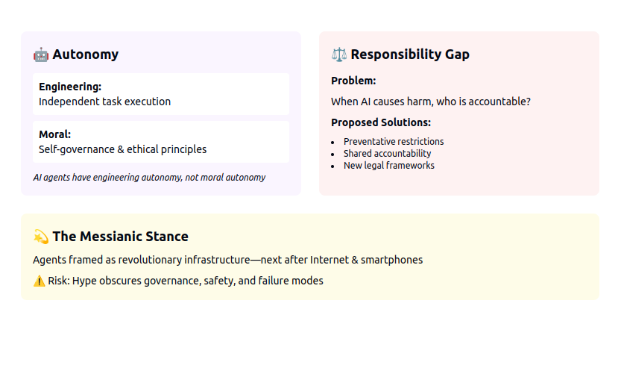

Slide 23
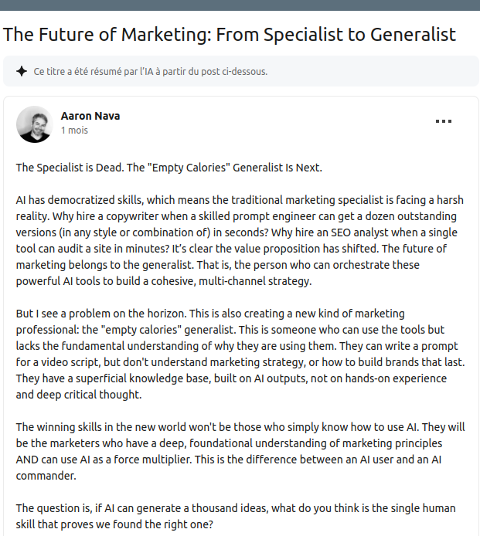
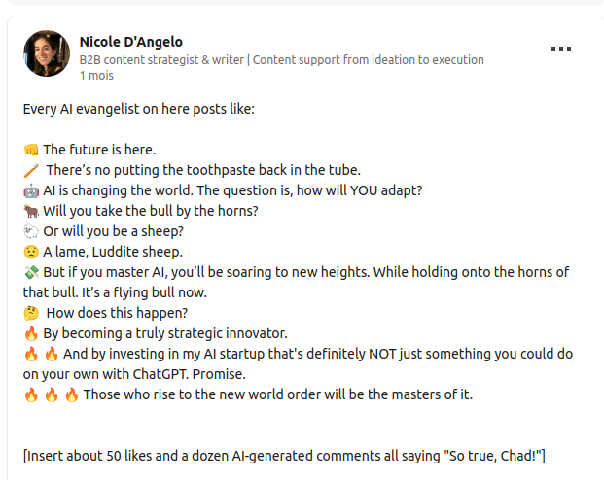

Slide 24
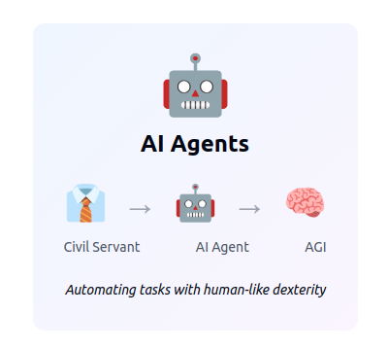
II) AI Agents, a contemporary definition

Slide 25
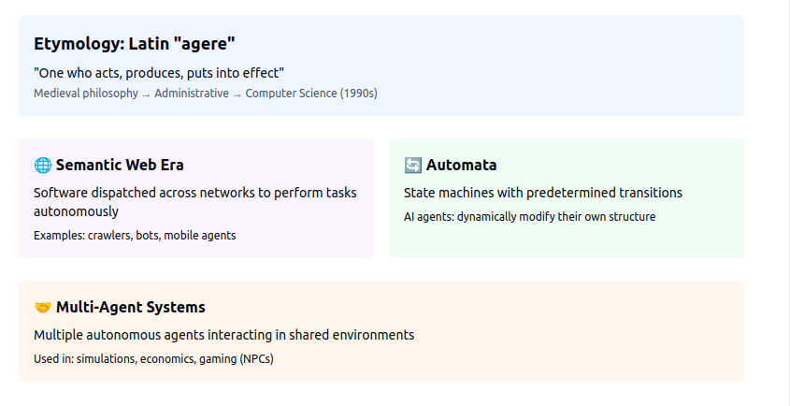

Slide 26
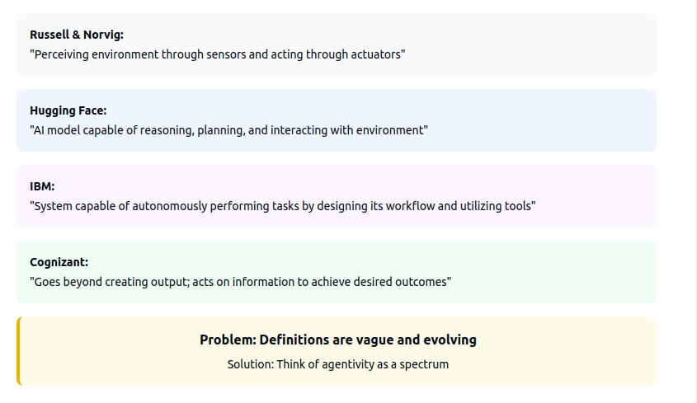

Slide 27
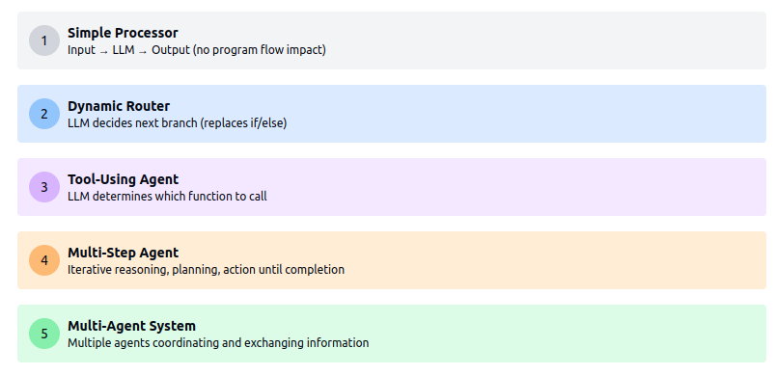

Slide 28
A little game
https://claude.site/public/artifacts/50c7cebf-4169-4616-9e33-24610c6679e5

Slide 29
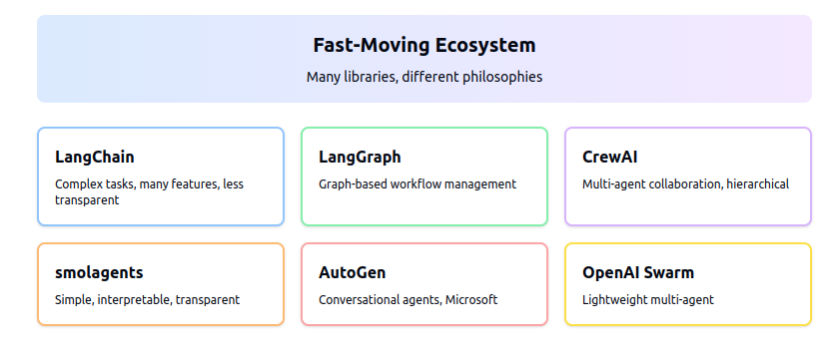

Slide 30
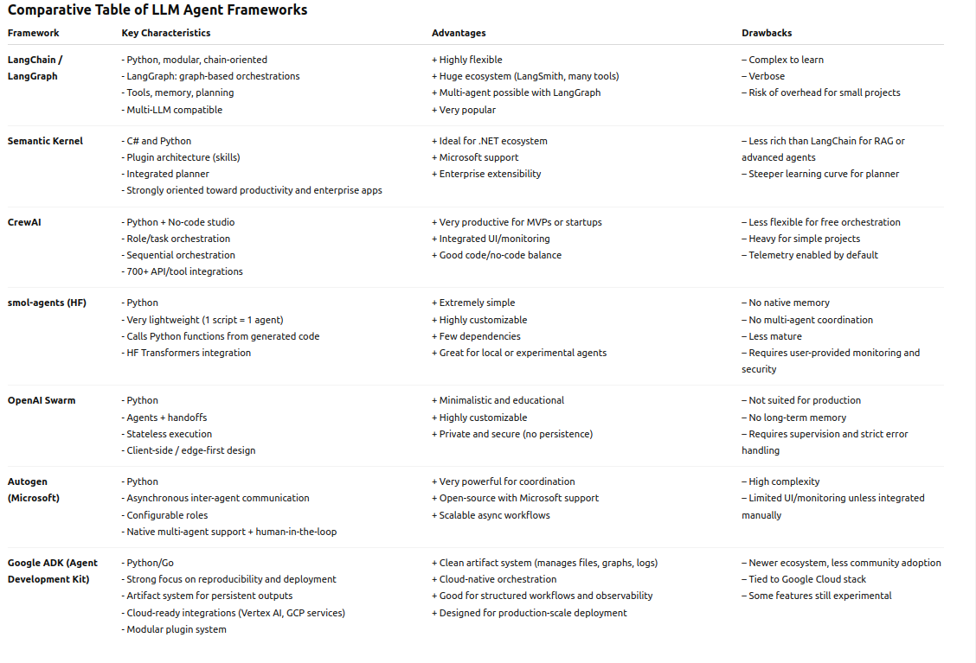

Slide 31
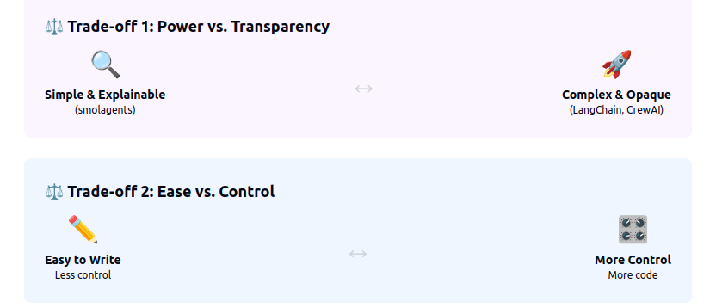

Slide 32
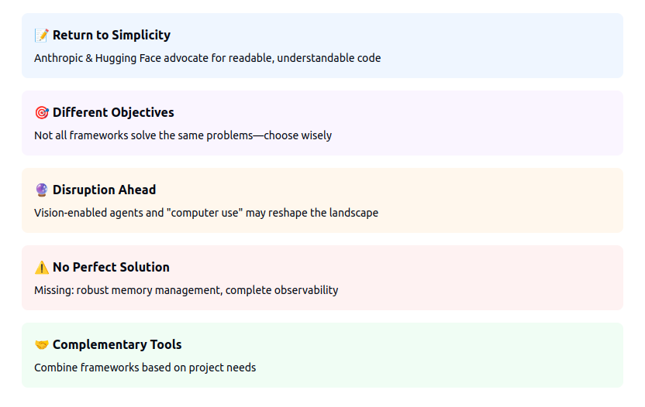

Slide 33
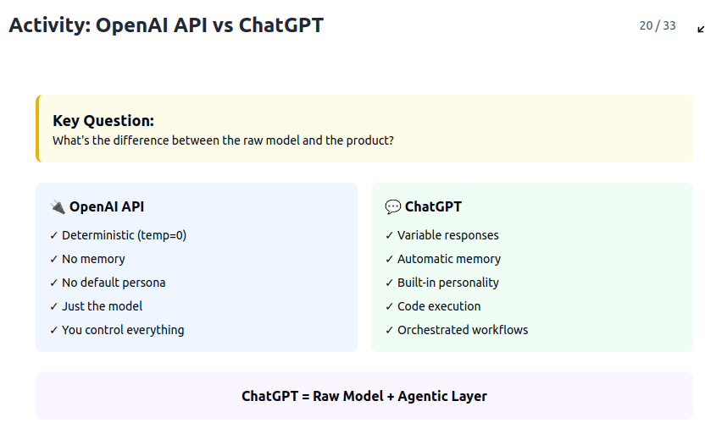

Slide 34
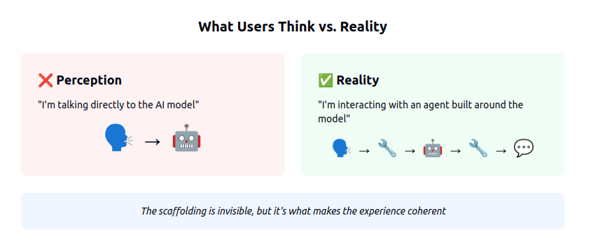
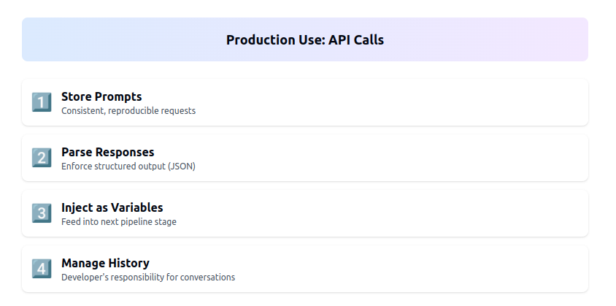

Slide 35
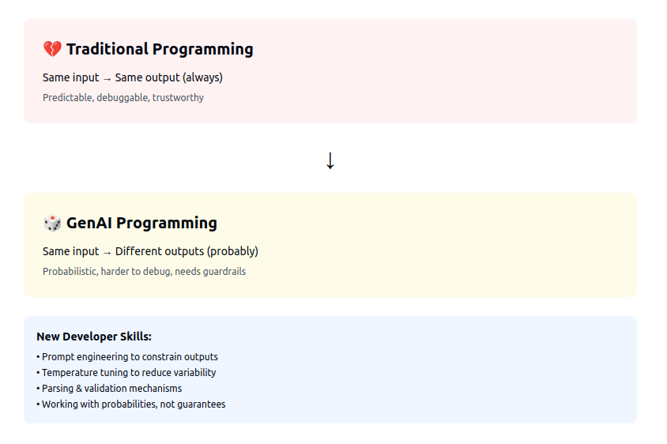

Slide 36
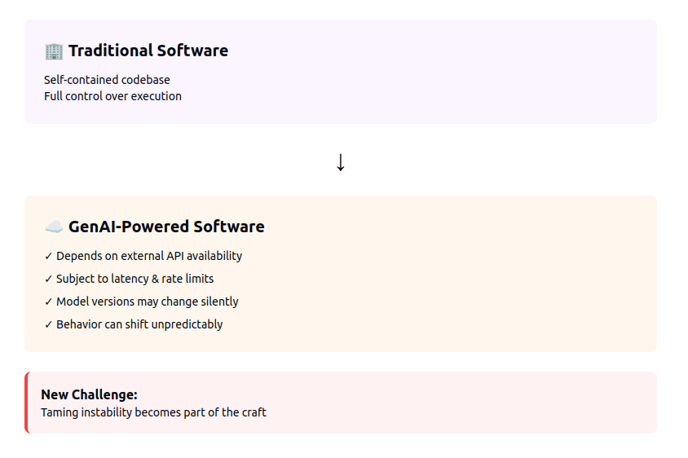

Slide 37
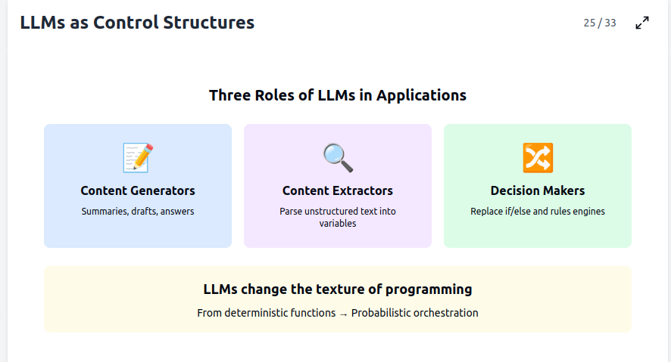

Slide 38
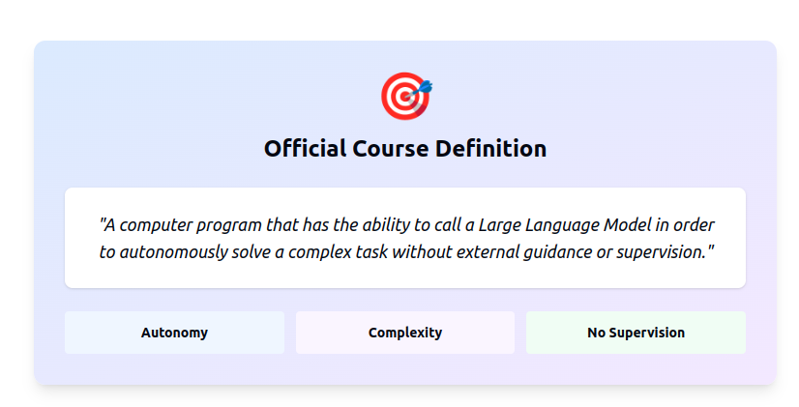

Slide 39
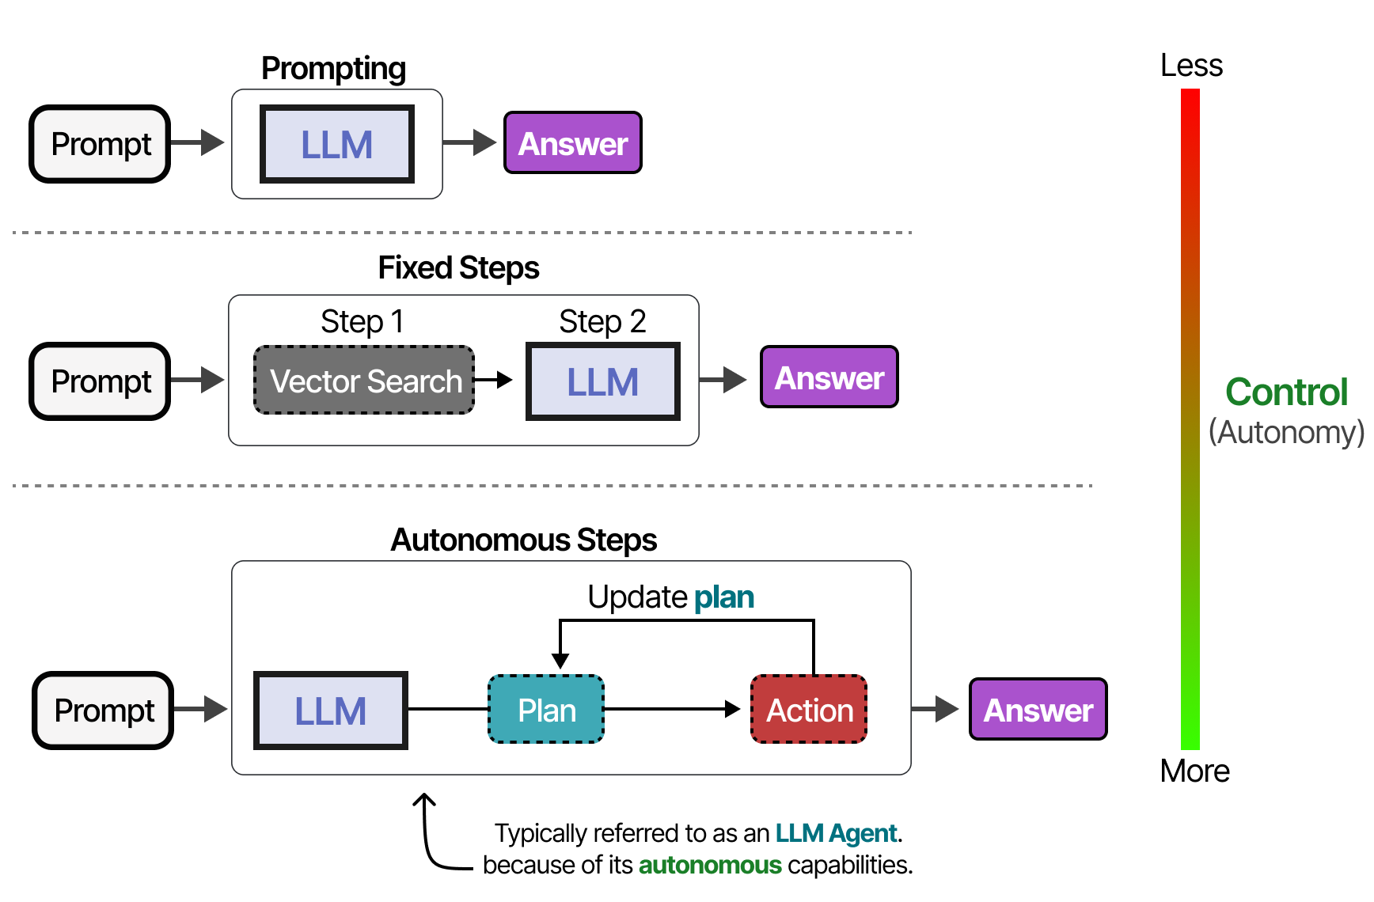

Slide 40
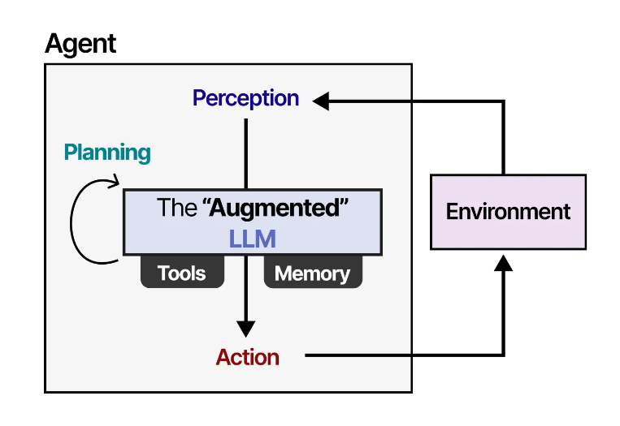

Slide 41
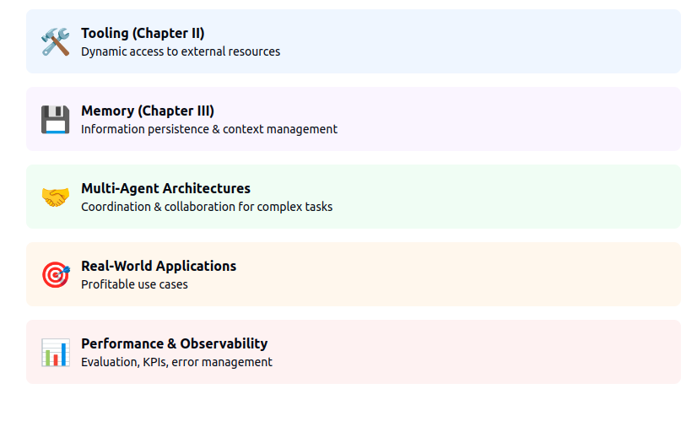
Essential components of AI Agents

Slide 42
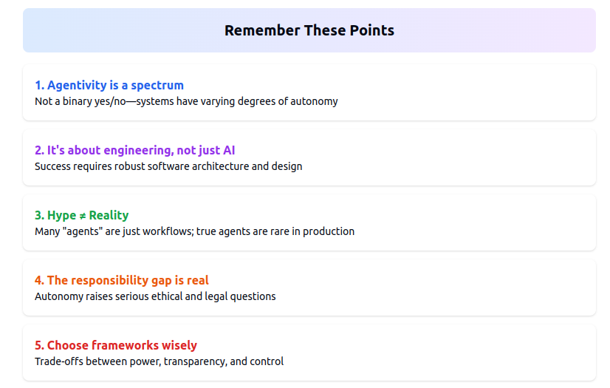

Slide 43
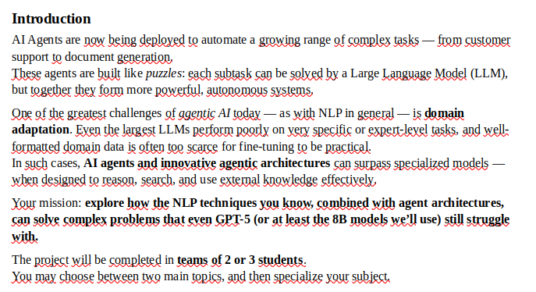
Final project :
Domain Adaptation of AI Agents

Slide 44
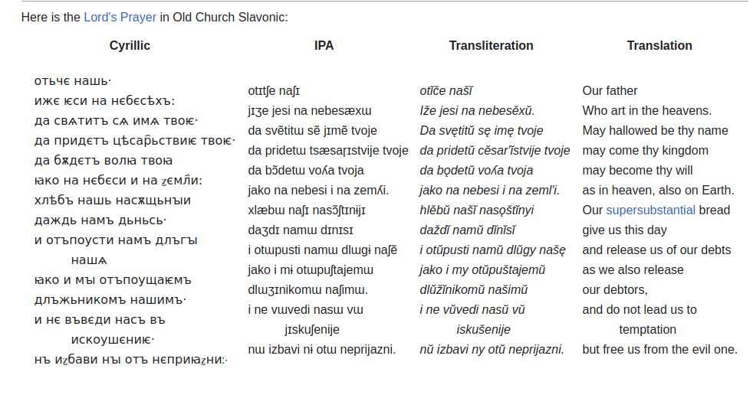
Topic 1 : Agentic translation

Slide 45
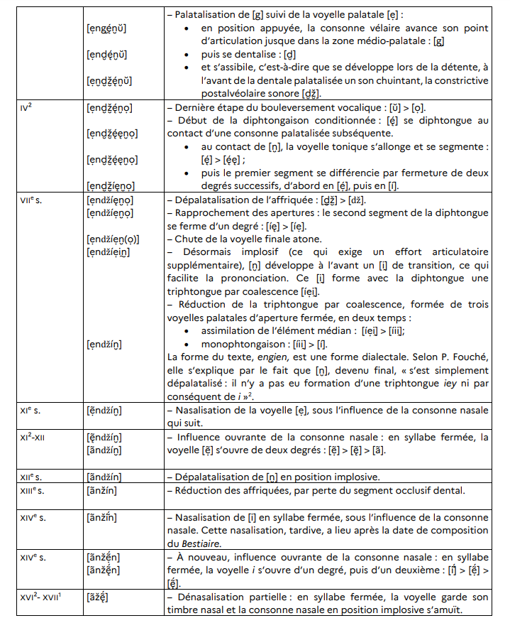
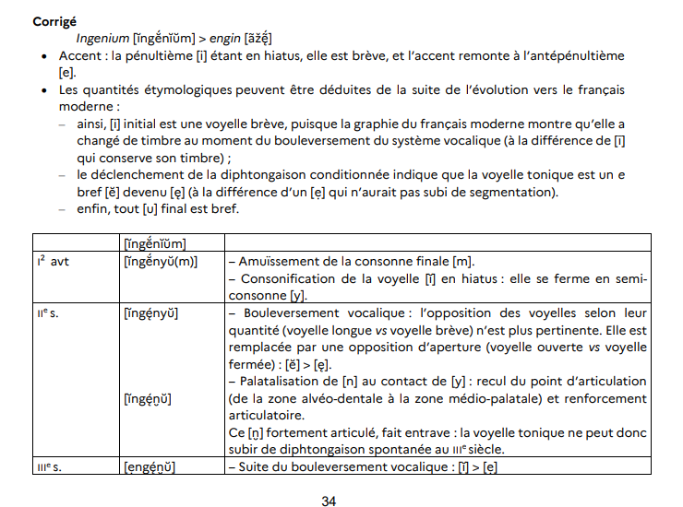
Topic 2 : Llama / Qwen 3 passe l’agrégation

Slide 46
Expectations:
Code /10
Code an agent for the domain specific task you chose
Gather relevant data
Create tools
Create an architecture adapted to the task
Make your agent accessible to me
Report + article /10 (10 + 6-10 pages)
Create an evaluation datasets
In a report document your experiments and justify your design decisions
Then write a conference like paper containing :
* A SoTA on the task you tackle
* A presentation of the architecture of your agent
* Presentation of its performance and comparison to other solutions

Slide 48
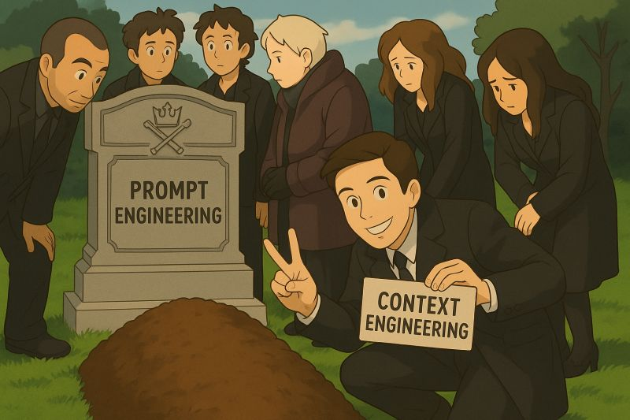

Slide 49
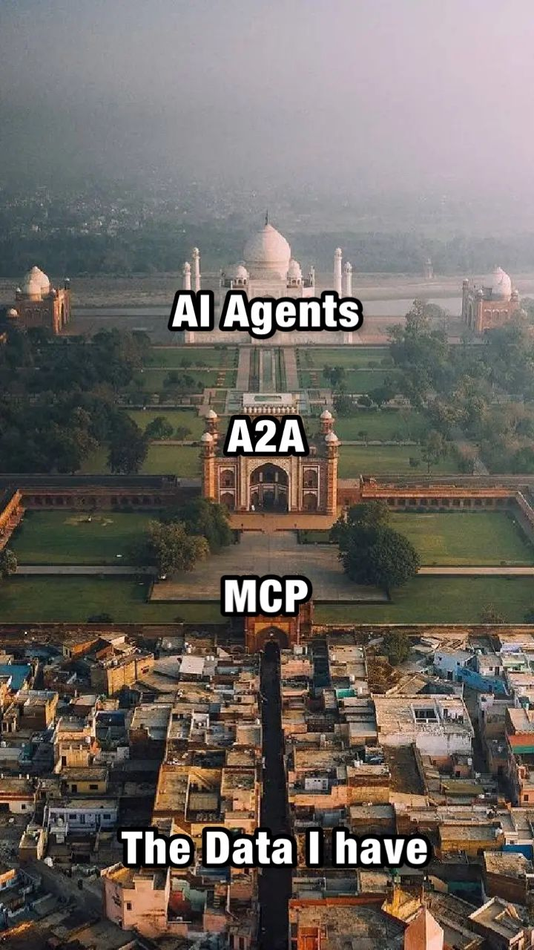

Slide 50
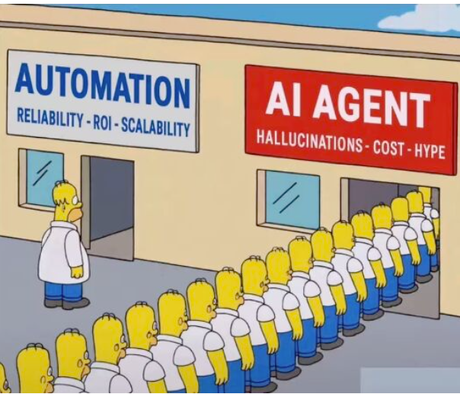

Slide 51


