Slide 1
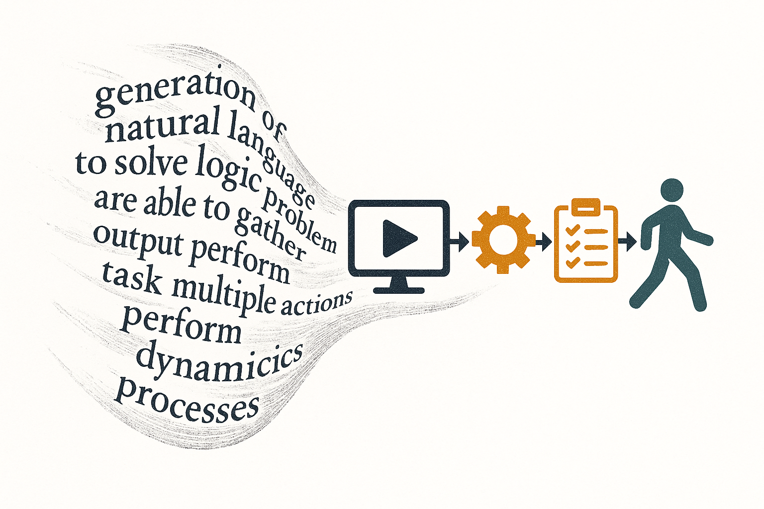
AI Agents :
From Language
Generation
to Task Automation
Louis Jourdain

Slide 2
For this course
3b13jourdainl@gmail.com
https://github.com/Dinarque/AI_Agents_Paris_Cite/tree/main

Slide 3
6 Weeks of intesive Agentic Activity
Chapter 1
What are AI Agents
Chapter 2
Expanding LLM
capacities with Tools
Chapter 3 :
Conditionning behaviour
Memory and Context
Chapter 4
Architectures and
Engineering
Chapter 5
Test yourself
Real use cases + Demo
Chapter 6
Agents Evaluation

Slide 4
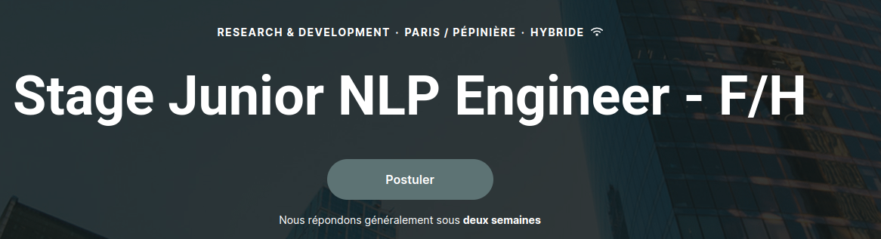


Slide 5
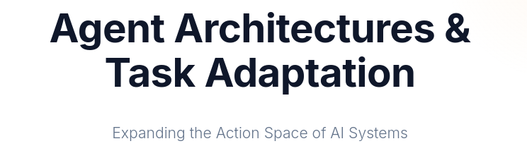
Agent Architectures and Task adaptation

Slide 6
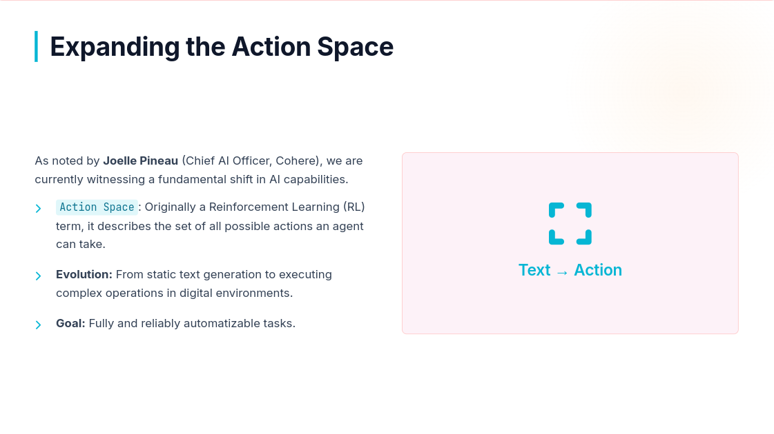

Slide 7
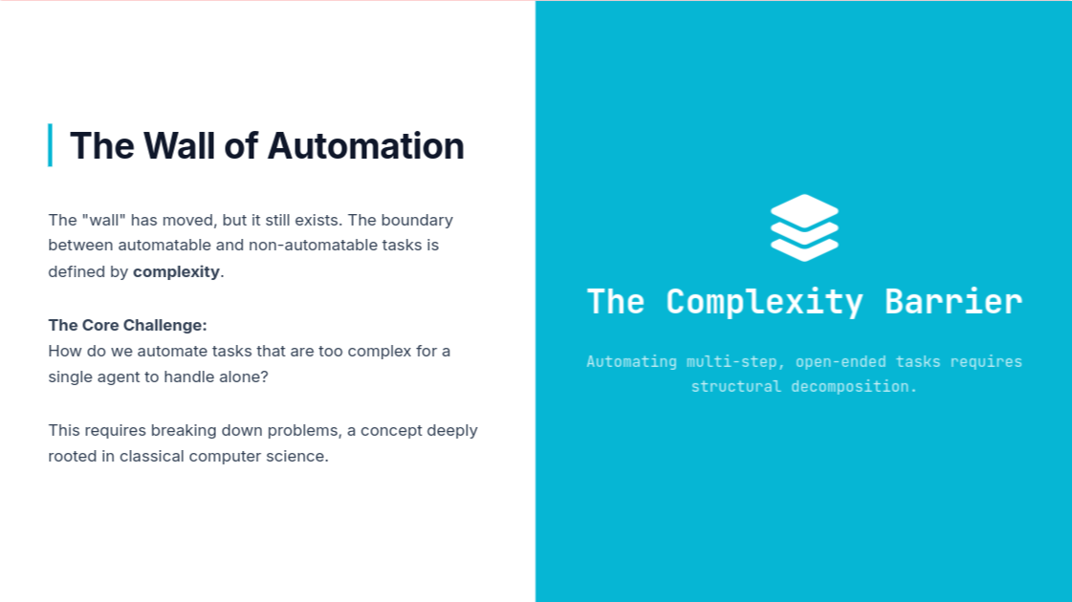

Slide 8
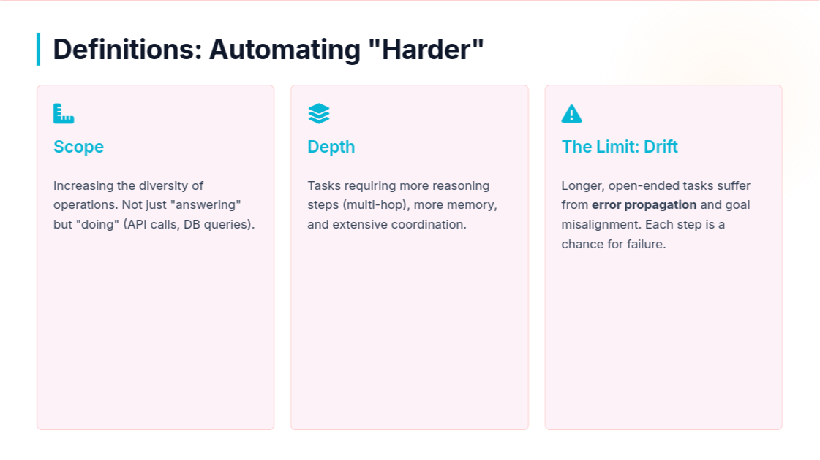

Slide 9
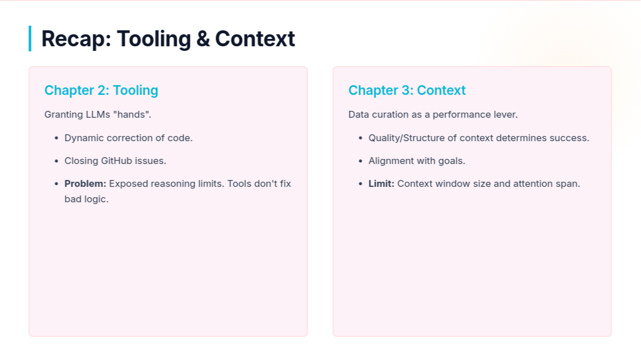

Slide 10
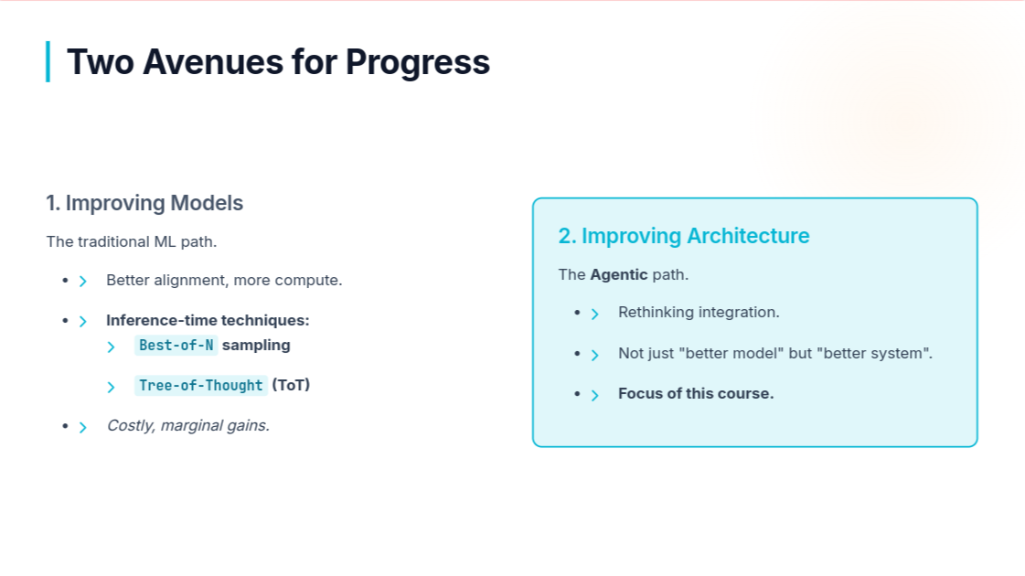

Slide 11
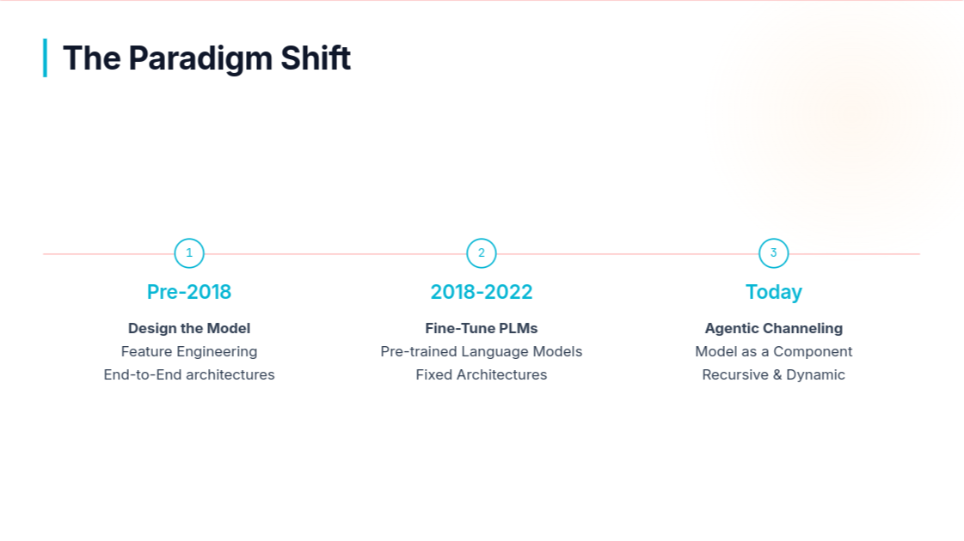

Slide 12
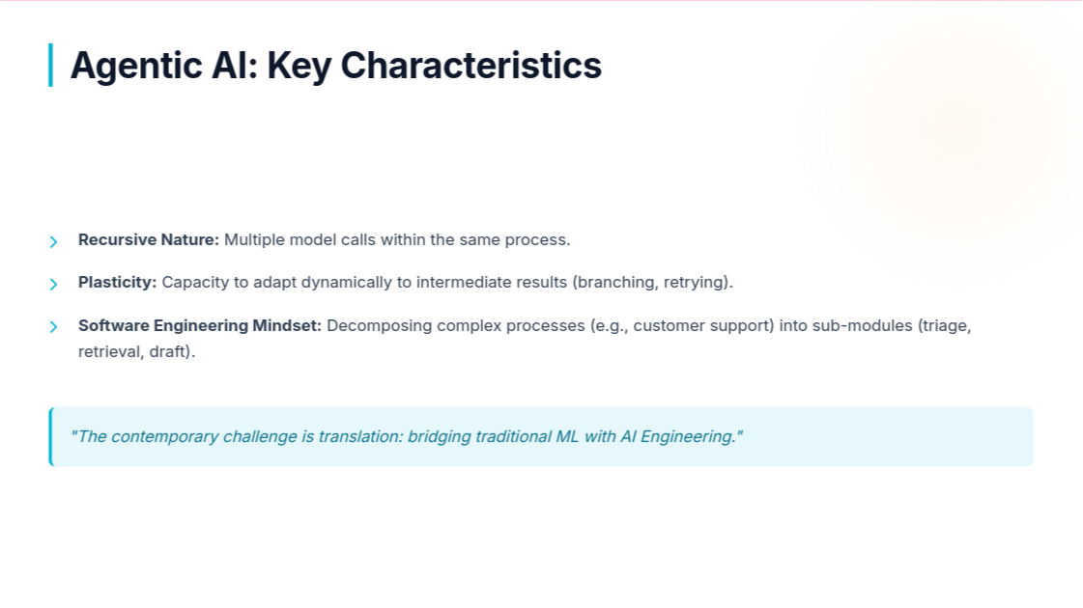

Slide 13



Optimization under Constraint
The core challenge remains the same as classical ML: finding the trade-off between cost and performance.
The Tension
Cost Function
Control vs. Exploration
Cost = Data + Compute + Inference
In agents, this includes token usage and latency.
Constrained = Reliable
Exploration = Creative/Correct

Slide 14

Part I: Evolution of Architectures
From Simple Loops to Multi-Agent Ecosystems

Slide 15




Architecture as Evolution
Tinkering
Convergence
Hardware Influence
Early designs were mutations. Suboptimal ones (e.g., Amazon StrandAgents) vanished.
Independent experiments converged on similar solutions (e.g., MS Agent Framework & LangGraph).
Design is often shaped by the tool (software engineering patterns) rather than pure theory.

Slide 16
Integration Patterns (Pre-Agent)
The Augmented LLM: Model + Tools. Good for chatbots.
The Workflow: Deterministic pipelines.
In -> LLM(Translate) -> LLM(Summarize) -> Out
Not truly "agentic" because execution path is fixed.
The Router: Using LLMs to make conditional decisions (if/else) on unstructured data.
Crucial Distinction: A system becomes agentic when the flow of execution is no longer enumerable in advance.

Slide 17
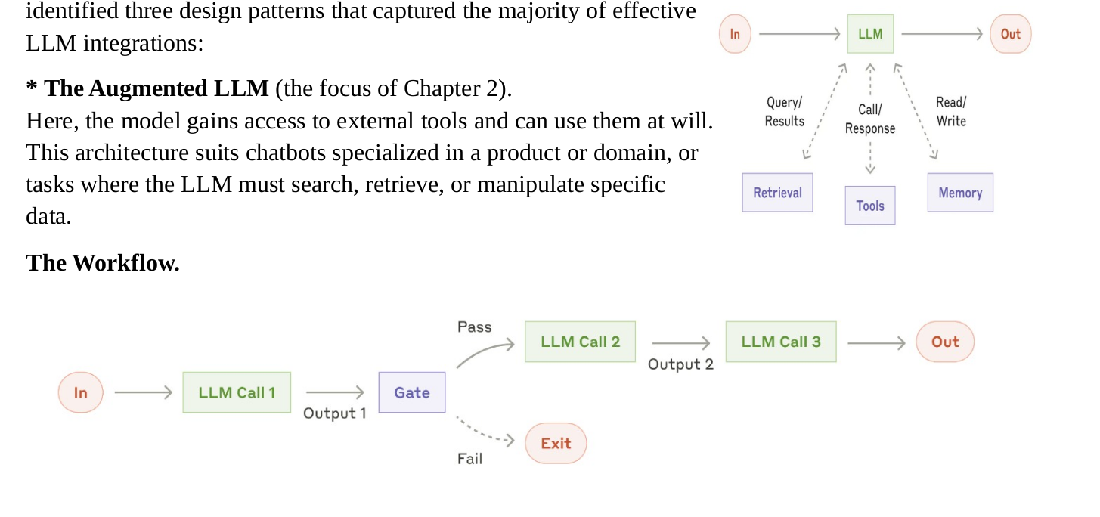

Slide 18

The ReAct Breakthrough (2022)
Paper: "ReAct: Synergizing Reasoning and Acting in Language Models"
The Formula
Core Innovation: Reasoning itself is treated as an action.
ReAct > CoT + Act-Only
Combined two previous methods:
•
Chain-of-Thought (CoT): Reasoning without action.
The combination outperforms the baselines.
•
Act-Only: Tool use without reasoning.

Slide 19
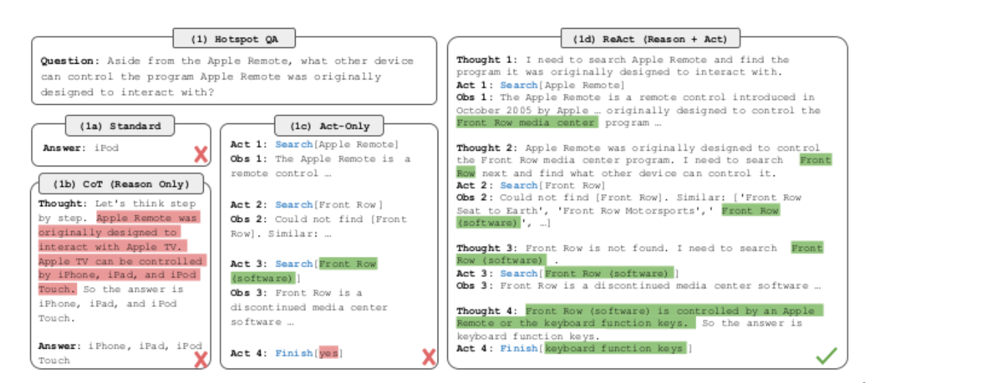

Slide 20




The ReAct Loop Mechanism
ReAct Cycle (Recursive)
The agent operates in a continuous loop until a stop criteria is met.
Thought: Model reasons about the current state.
→
→
Action: Model decides to call a tool.
Observation: Tool returns output (from environment).
↓
↓
Repeat: Model uses observation to update thought.

Slide 21
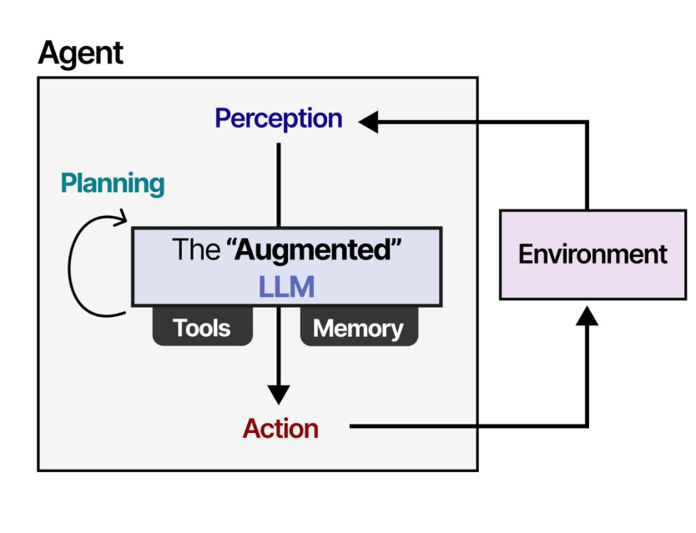

Slide 22
Agency resides in the Loop
The LLM is no longer just answering; it is driving the process.
Autonomy: No human in the loop between calls.
Termination:
Goal achieved.
Max iterations (to prevent infinite loops).
token generation.

Slide 23


Limitations of ReAct
Cognitive Bandwidth
Conflicting Objectives
Sequentiality
Single LLM context window is limited. Cannot hold deep domain expertise AND tool definitions simultaneously.
Hard to balance "Explore" vs "Exploit" in one prompt. A single agent struggles to self-correct effectively.
The loop is serial (Thought 1 -> Act 1). No parallel processing of sub-tasks. Slow and prone to context drift.

Slide 24


Why Multi-Agent?
Originating from industrial control systems, MAS applies the principle of Specialization.
Horizontal Expansion
Vertical Expansion
Dedicating specialized agents to distinct subtasks.
Compositionality: Agents can be used as tools by other agents.
Example: A "Coder" agent calling a "Linter" agent.
Example: Triage Agent → Support Agent → Refund Agent

Slide 25
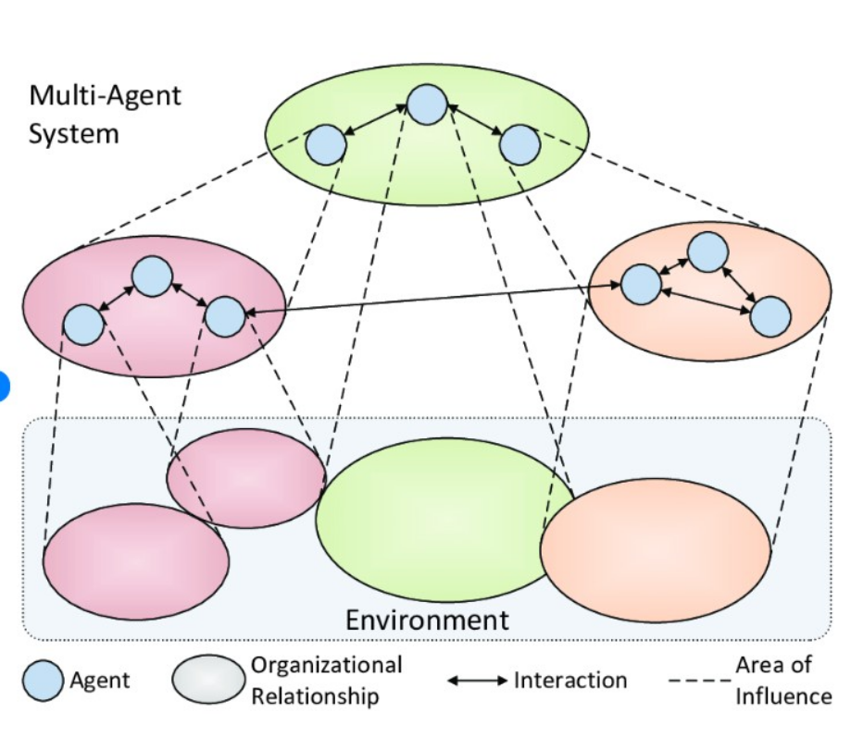
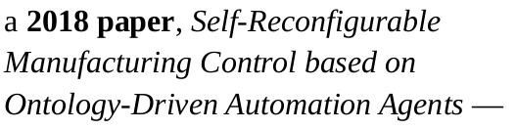

Slide 26
Handoffs & Delegation
Handoff: The mechanism where Agent A transfers control and context to Agent B.
In modern frameworks (OpenAI Swarm, LangGraph), this is explicit.
Tool Overload Solution: Instead of giving one agent 50 tools, group them into 5 sub-agents with 10 tools each.
Cost: Token Overconsumption. Context is often repeated/passed down, increasing cost.

Slide 27






Hierarchical (Supervisor) Pattern
A "Manager" or "Router" agent sits at the top.
•
Decomposes the user request.
•
Delegates to "Workers".
•
Aggregates results.
Pros: Clear control flow.
Cons: Bottleneck at the supervisor; isolated workers (no lateral communication).

Slide 28



Graph-Based Architectures
Modeling agents as Nodes and interactions as Edges.
State
Edges
Cyclic Graphs
Shared data structure passed between nodes (Global State).
Conditional logic determining which node runs next (e.g., "If error, go to Retry Node").
Allows for loops, retries, and complex non-linear flows.
Examples: LangGraph, AutoGen.

Slide 29

When is it "Multi-Agent"?
The boundary is Determinism.
Not Multi-Agent: A predefined sequence of LLM calls (Workflow).
Multi-Agent: When interactions between instances are not predetermined.
"Multi-agency begins where execution ceases to be deterministic. It moves from orchestration to cooperation."

Slide 30



Frontier: Self-Evolving Agents
Transition from static "Foundation Agents" to systems that adapt.
Definition: Agents capable of modifying their own structure (prompts, tools, memory) without model retraining.
→
Autonomy Loop: Agents Modifying Agent.
Currently, true self-evolution is rare; mostly "assisted adaptation."

Slide 31


Approaches to Adaptation
1. Model-Centric (External)
2. Prompt Optimization (Endogenous)
Fine-tuning the weights.
Agents rewriting their own instructions.
•
Supervised Fine-Tuning (SFT)
•
Analogy to Hyperparameter Search.
•
Reinforcement Learning (RL)
•
Agent generates variants of system prompts, tests them, and selects the best.
•
Relies on external evaluation loops.

Slide 32
Memory & Tool Discovery
Episodic Memory (In-Context Learning):
Storing successful traces. When facing a task, retrieve "how I solved this last time."
Tool Generation:
Agents writing their own Python functions to solve novel problems.
Risk: Code safety and validation.

Slide 33

Architecture Search
Treating the agent topology itself as a search problem.
Instead of manual design, use algorithms to find the optimal arrangement of nodes.
Methods:
•
Monte Carlo Tree Search (MCTS)
•
Genetic Algorithms

Slide 34
Part II: Engineering the Stack
Bottlenecks & Challenges in Production

Slide 35


The Rise of the AI Engineer
Industrial shift from Data Scientist to AI Engineer.
Data Scientist
AI Engineer
Focus: Understanding Data.
Focus: Building Systems.
Output: Models, Analysis.
Output: Robust software, Orchestration, Integrations.
"The second rise of the software engineer."

Slide 36





Parallelization & Scheduling
The Bottleneck: Latency. LLMs are slow.
We cannot wait for sequential execution.
↓ Schedule
Solution: Asynchronous Execution.
•
Microservice architecture.
↑ Aggregate
•
Manager agent waits for 3 sub-agents running concurrently.

Slide 37
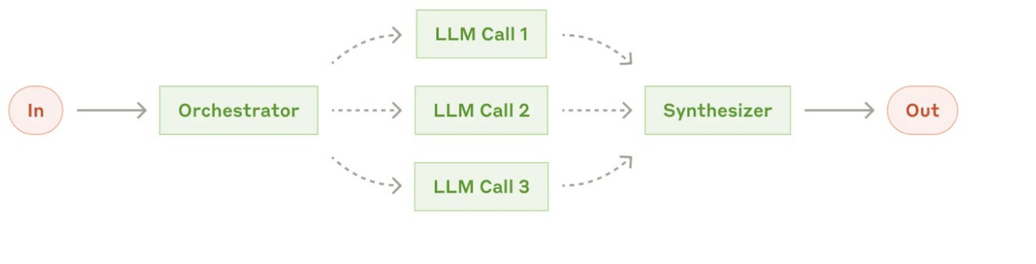

Slide 38
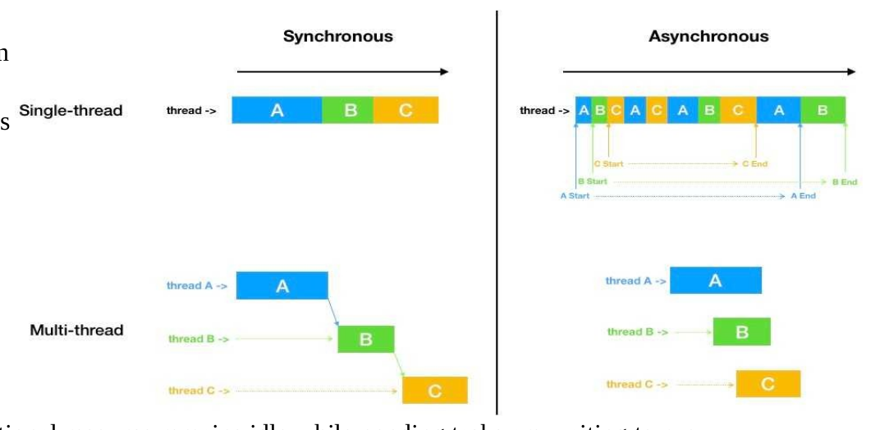

Slide 39

Distributed Execution Patterns
Timeouts
Retries
Checkpointing
Stop waiting after a set delay. Essential for hanging APIs.
Exponential backoff for transient failures (e.g., API rate limits).
Save state to DB. If crash occurs, resume from last step, not start.

Slide 40

Data Flow & Consistency
Race Conditions: When multiple agents try to write to the same memory/file simultaneously.
The Danger
Inconsistent states, duplicated writes, data corruption.
The Fix
Locks & Transactional Controls: Ensure atomic operations on shared resources.

Slide 41
The Language of Exchange
How do agents talk to each other?
Format | Pros | Cons
JSON | Easy to parse, standard. | Duplicate keys, verbose.
Markdown | Human-readable, hierarchical. | Harder to parse programmatically.
Code (Python) | Expressive, executable. | Security risks (Arbitrary Code Execution).

Slide 42



Middleware: The Nervous System
Software layers inserted between components to manage data flow.
↓
Summarization Middleware: Compresses context when token limit is reached.
HITL Middleware: Human-In-The-Loop gates for sensitive actions.
↓
Validation Middleware: Checks if outputs match the schema.
Interception & Transformation Layer

Slide 43
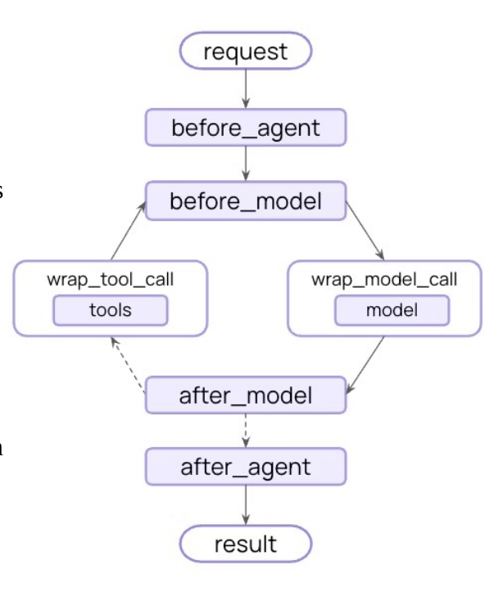

Slide 44
Infrastructure Scalability
Container Orchestration
Hardware Mapping
Tools like Kubernetes.
Mapping specific agents to specific hardware.
Agents are microservices. Need to scale up/down based on load.
Orchestrator -> CPU
Model Inference -> GPU

Slide 45

Governance & Security
Access Control
Anonymization
Injection Defense
Principle of Least Privilege. Agents should only see data they need.
PII redaction before sending data to external LLM providers.
Protecting against Prompt Injection where external data hijacks the agent's instructions.

Slide 46
Part III: Use Case - Deep Research
Building Agents for Long-Horizon Knowledge Tasks

Slide 47




What is "Deep Research"?
Not just "Googling". It combines:
•
LLMs (Reasoning)
→
•
Retrieval (Access to info)
↓ Loop & Retries
•
Agency (Multi-step planning)
→
Target: Literature reviews, market reports, legal analysis. Minutes of runtime, not seconds.

Slide 48
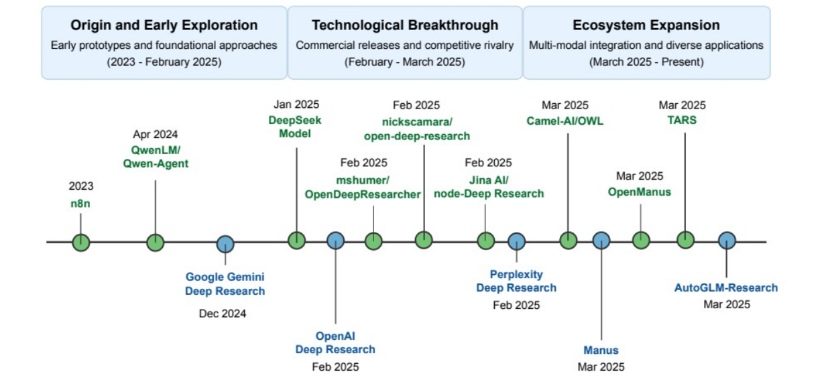



Evolution of Implementations
Dec 2024
Feb 2025
Present
Google Gemini
First integrated Deep Research feature.
OpenAI Deep Research
Reasoning models (o3) + Parallel browsing.
Open Ecosystem
LangChain, HuggingFace OpenDeepResearch.

Slide 49
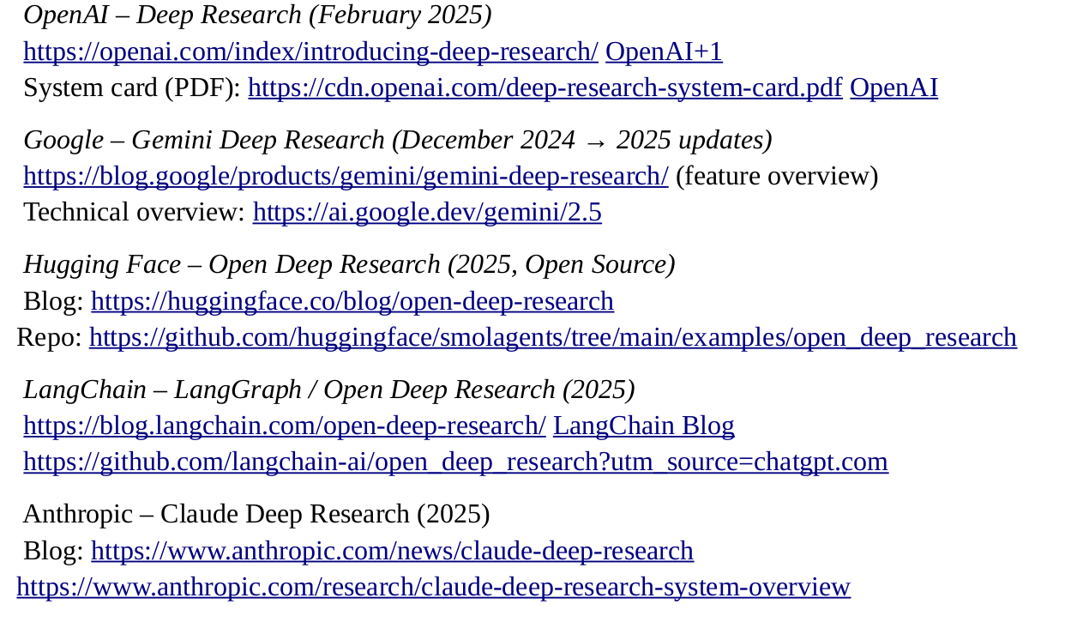
Activity : search about Deep Research

Slide 50
Architectural Choices
Monolith vs Graph
Retrieval Evolution
Monolith: Simple ReAct loop (Hard to control).
Old: SERP API (Ranked links).
New: Dynamic Browsing. Visiting pages, scrolling, reading PDFs, following links recursively.
Graph (State of the Art): Explicit nodes for Planner, Researcher, Writer, Reviewer.

Slide 51



Struggle for Domain Adaptation
General search is solved. The frontier is Specialized Domains (Law, Bio, Finance).
Topical
Format
Intent
Knowledge space & terminology.
Structure (e.g., Academic Paper vs Memo).
Rhetorical stance (Synthesis vs Actionable Insight).

Slide 52
Adaptation Techniques (1/2)
Specialized Tooling: Connect to PubMed/LexisNexis instead of Google.
Domain-Specific Prompting: "Act as a senior molecular biologist." Enforce epistemic norms.
Knowledge Base Integration (RAG): Ground reasoning in verified internal documents, not just the open web.

Slide 53
Adaptation Techniques (2/2)
Adapters (LoRA): Parameter-efficient fine-tuning for style/tone without retraining the base model.
In-Context Learning Loops: Retrieving "good examples" of past reports to guide the current run.
Feedback Loops: User feedback on intermediate drafts calibrates the agent's judgment.

Slide 54

Conclusion: Engineered Cognition
We are moving from "What can LLMs do?" to "How do we organize them?"
"We are building systems that remember, delegate, and improve themselves over time. This is the new programming language."

