Slide 1

Airport database system
Astana IT university
Developer: Orynbay Dinassil SE-2016
Teacher: Aidana Kalakova

Slide 2

Introduction
The airport is an aerodrome with advanced facilities, mainly for commercial air transport. Airports often have aircraft storage and maintenance facilities, as well as a control tower.

Slide 3
Purpose
My airport database is aimed at staff
The purpose of my database is to get data about staff who work at the airport
Also the purpose of this database is to get what planes are available and their models

Slide 4
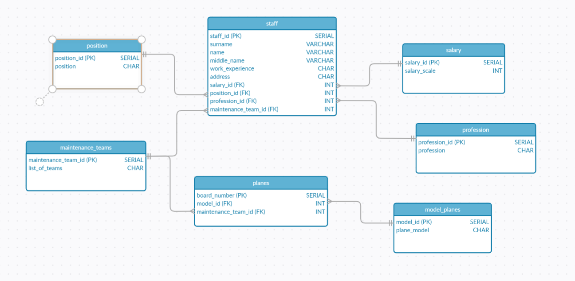
Create ER diagram

Slide 5
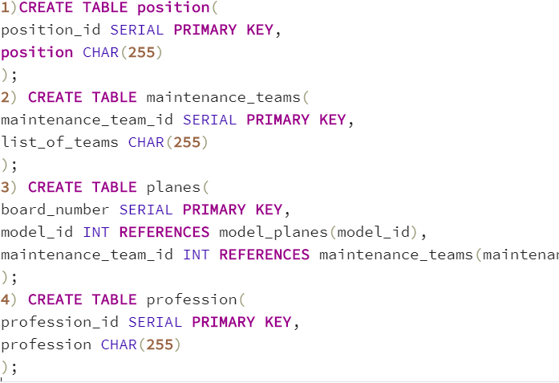
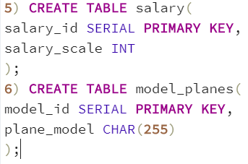
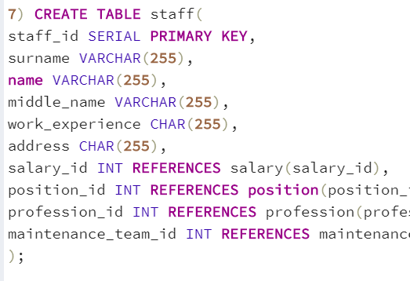
Create table in
POSTGRESQL

Slide 6
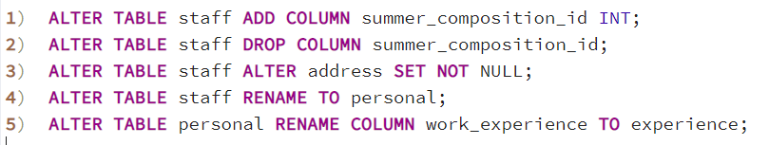
Create Alter table
statement

Slide 7
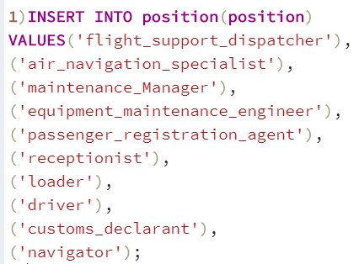
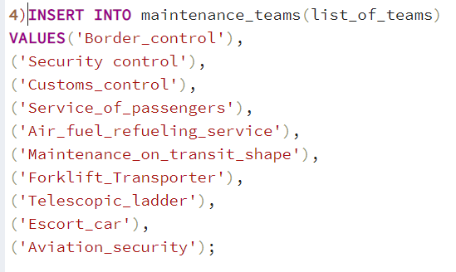
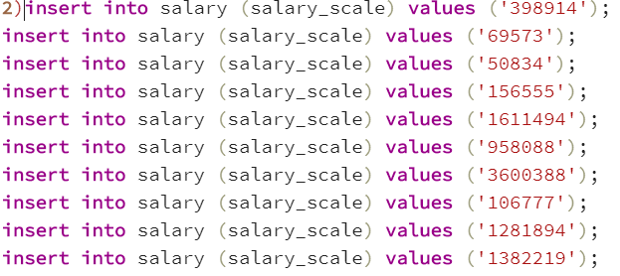
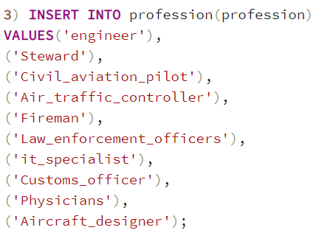
Insert
statement

Slide 8
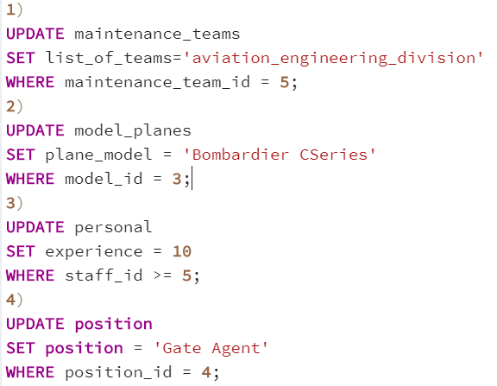
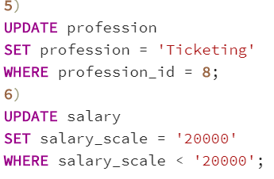
Update
statement

Slide 9
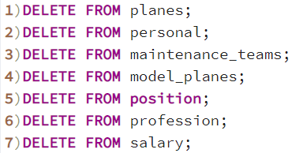
Delete
statement

Slide 10
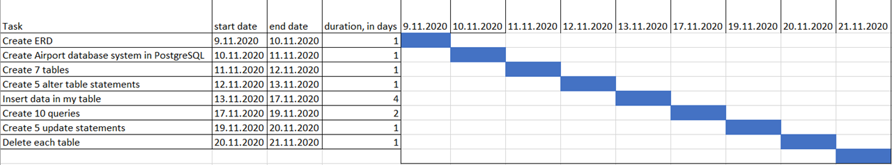
Gantt chart

Slide 11
References list
Creately. (2020, November 11). Create ERD Diagram. https://app.creately.com/diagram/nyipzjfy8f3/edit
PostgreSQL 13.1 Documentation. (2020, November 12). PostgreSQL Documentation. https://www.postgresql.org/docs/13/index.html
YouTube. (2019a, April 4). Learn PostgreSQL Tutorial - Full Course for Beginners. https://www.youtube.com/watch?v=qw--VYLpxG4&feature=youtu.be
YouTube. (2019b, June 2). Уроки SQL Для Начинающих / #1 - Что Такое SQL? Установка Локального Сервера. https://www.youtube.com/watch?v=lapMmGGFS7k&feature=youtu.be
YouTube. (2019c, December 15). Разбираем SQL На Примере PostgreSQL — SELECT, JOIN, GROUP, HAVING, Coalesce и Др. https://www.youtube.com/watch?v=WpojDncIWOw&feature=youtu.be
YouTube. (2020, April 23). 01 - Создание, Подключение и Удаление Базы Данных - Уроки PostgreSQL. https://www.youtube.com/watch?v=-vFnDLJ1blg&feature=youtu.be

Slide 12
Conclusion
In conclusion, I can make a summary of my airport database. I encountered problems when creating queries but was able to solve them successfully. I made the relationship between my tables logical thanks to which I did not encounter problems when inserting data into the table.

