Slide 1
D ANTIBIOTICS ASSOCIATED DIARRHEA
Hypothesis
Analysis
Inference
Biomedical Statistics
PROJECT
Presented By: Aya, Hazem, Dina & Marvy

Slide 2
Table of Content
Hypothesis
Analysis
Inference
Biomedical Statistics
01
02
Data reading
Descriptive statistics
04
03
Outlier detection
graphics
05
06
Testing normality
Statistical inference
08
07
Linear regression
Hypothesis testing

Slide 3
01
Reading
Hypothesis
Analysis
Inference
Biomedical Statistics
Data

Slide 4
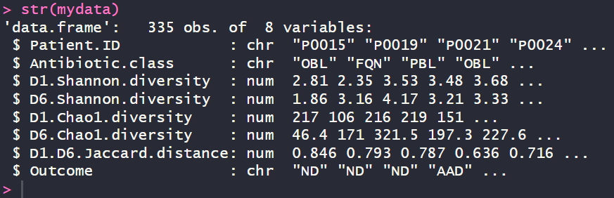
Hypothesis
Analysis
Inference
Biomedical Statistics
The data includes 8 columns, 3 character (categorical) and 5 numeric

Slide 5
02
statistics
Hypothesis
Analysis
Inference
Biomedical Statistics
Descriptive

Slide 6

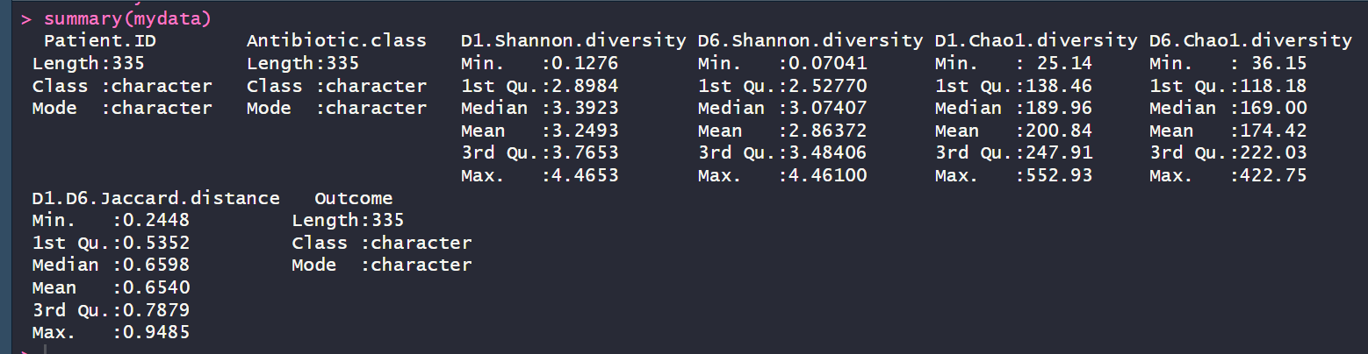
2.1. Summarize your data
Hypothesis
Analysis
Inference
Biomedical Statistics
We checked for any nulls in the data and
found none.

Slide 7
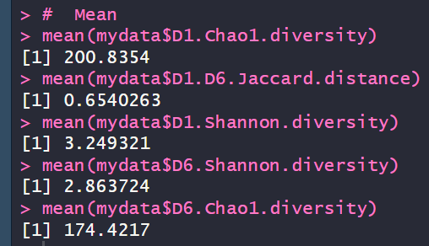
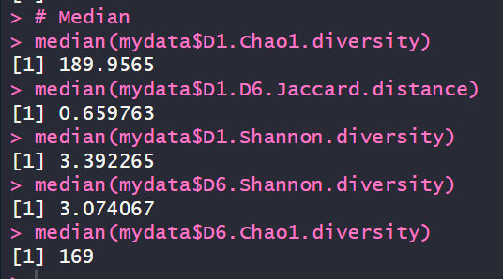
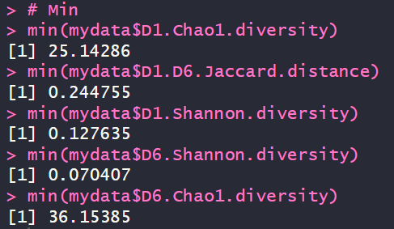
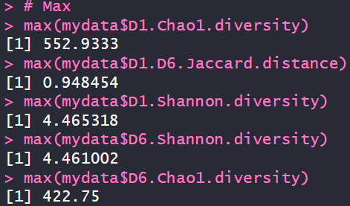
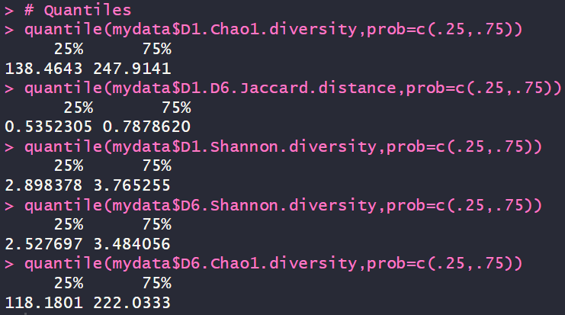
2.2. Calculations
Hypothesis
Analysis
Inference
Biomedical Statistics
Mean
Median
Min
Max
1st & 3rd Quantile

Slide 8
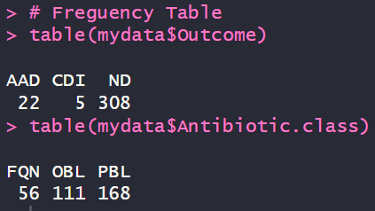
2.3. Frequency Table
Hypothesis
Analysis
Inference
Biomedical Statistics
We have two categorical columns that can be put in a frequency table:
Outcome
Antibiotics

Slide 9
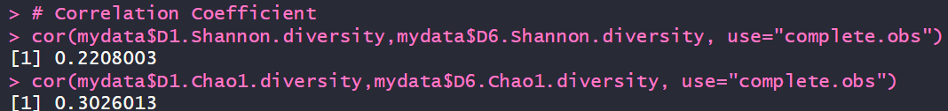
2.4. correlation coefficient
Hypothesis
Analysis
Inference
Biomedical Statistics
Correlation coefficient between (D1 Shannon and D6 Shannon = 0.2208003. Therefore, it is weak positive linear relationship between two variables.
Correlation coefficient between (D1 Chao and D6 Chao) = 0.3026013. Therefore, it is weak positive linear relationship between two variables.

Slide 10
03
Phics
Hypothesis
Analysis
Inference
Biomedical Statistics
Gra

Slide 11

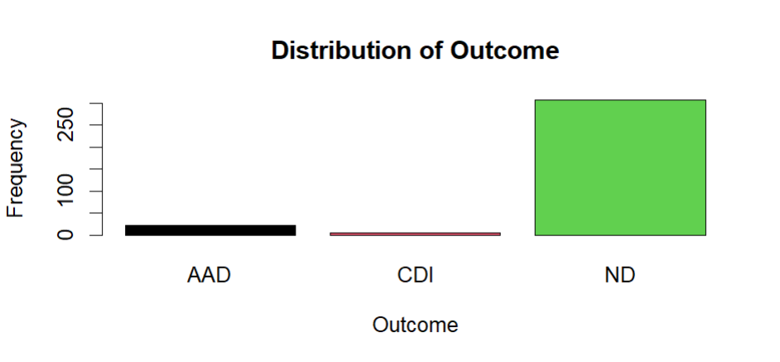
bar chart of a categorical variable for the Outcome
Hypothesis
Analysis
Inference
Biomedical Statistics

Slide 12
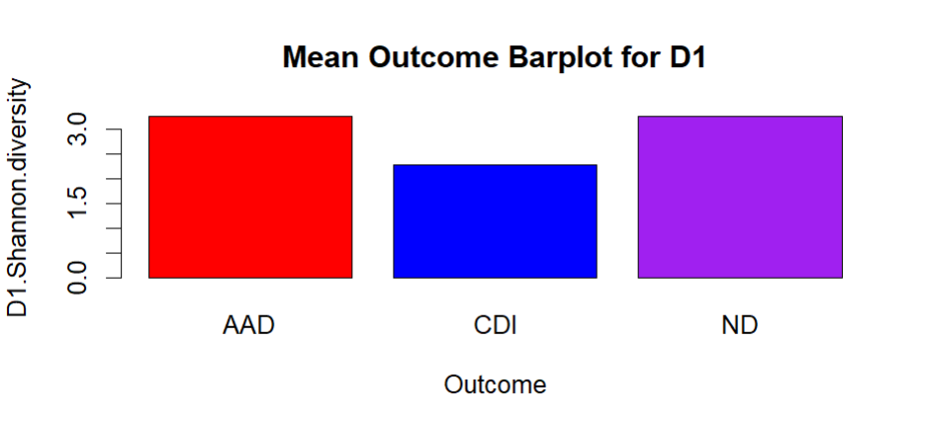
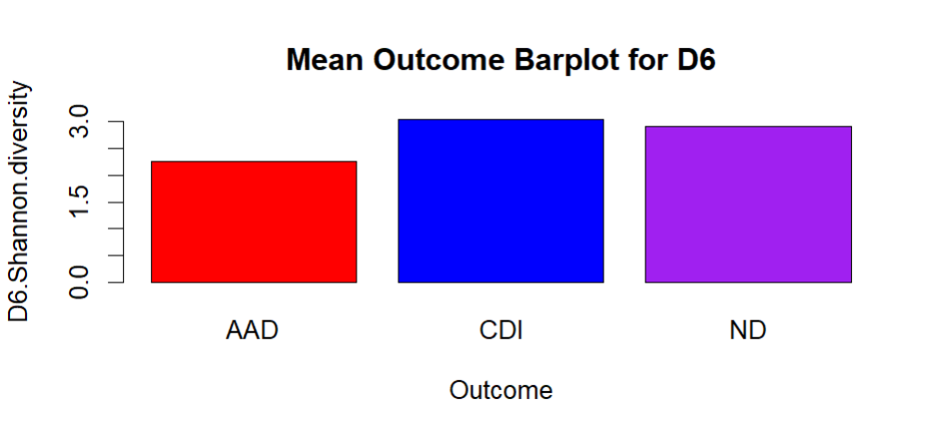
bar chart graph with mean Outcome in D1 and D6 Shannon
Hypothesis
Analysis
Inference
Biomedical Statistics

Slide 13

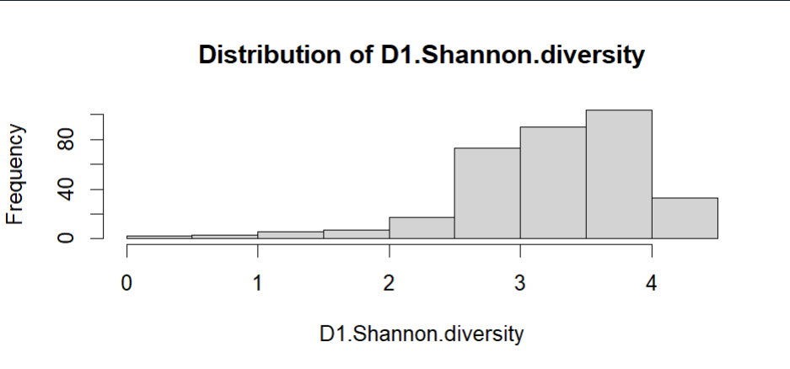
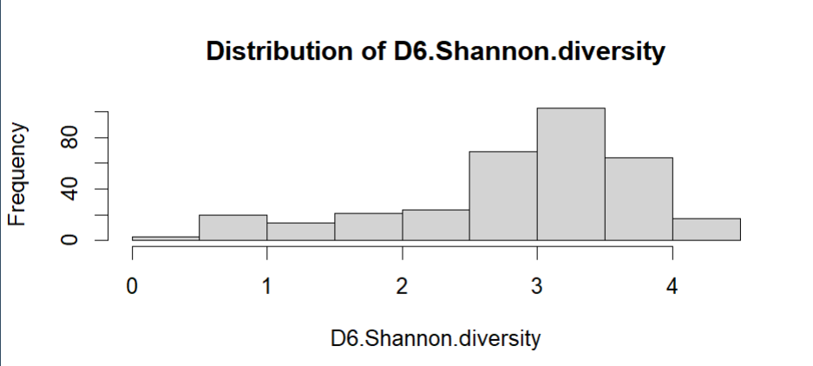
histogram of “D1 Shannon” And “D6 Shannon”
Hypothesis
Analysis
Inference
Biomedical Statistics

Slide 14

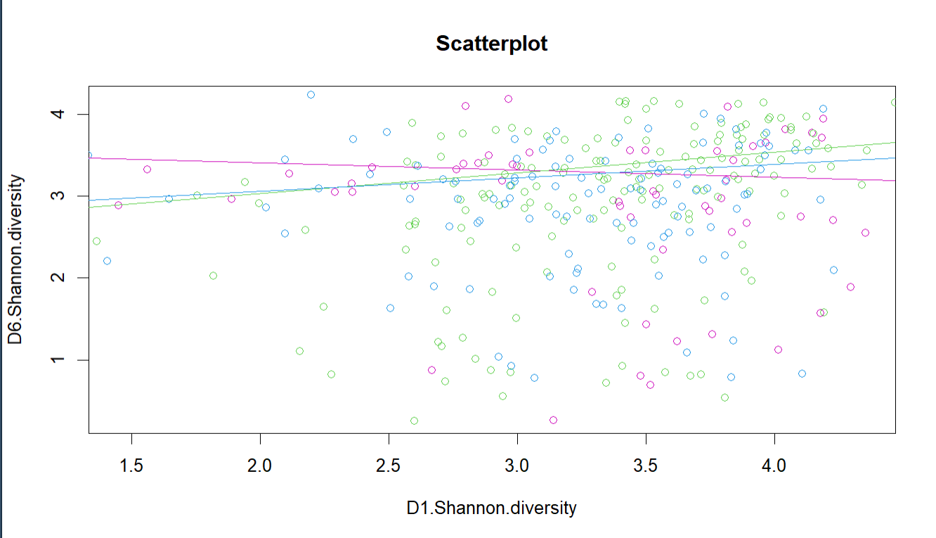
scatterplot of D1 Shannon and D6 Shannon, and add the regression lines for each antibiotic
Hypothesis
Analysis
Inference
Biomedical Statistics

Slide 15

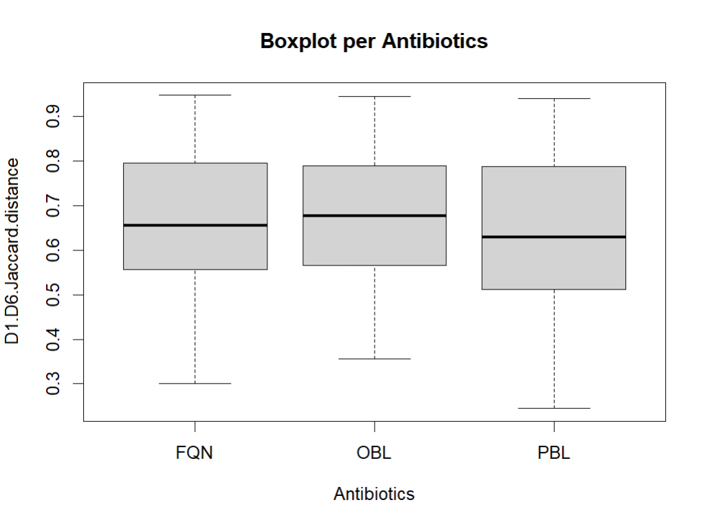
boxplot of Jaccard distance and a separate boxplots per Antibiotics
Hypothesis
Analysis
Inference
Biomedical Statistics

Slide 16
04
Detection
Hypothesis
Analysis
Inference
Biomedical Statistics
Outlier

Slide 17
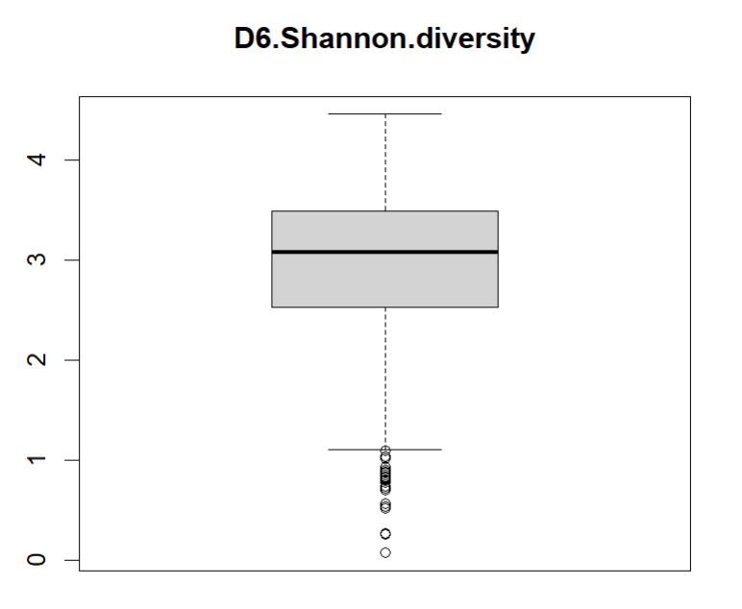
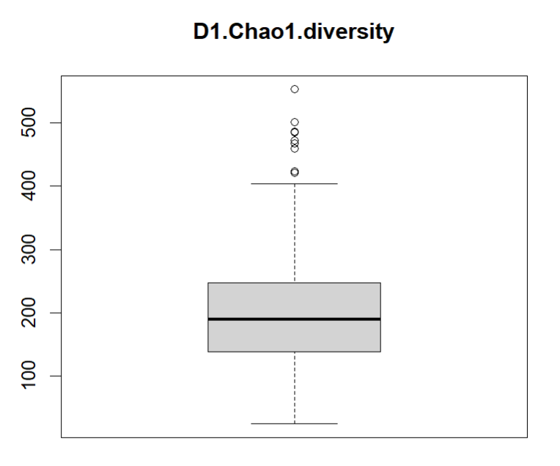
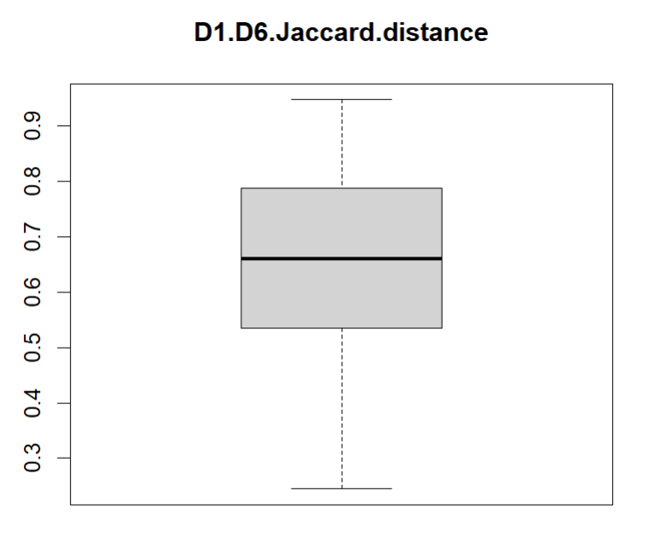
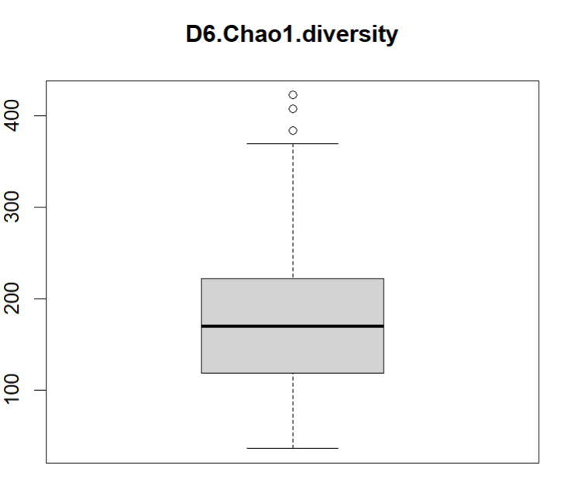
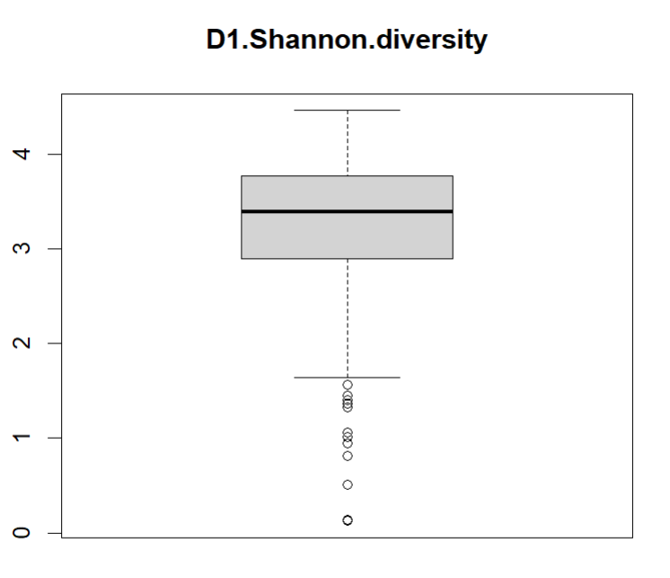
1. Detect Outliers Visually using Boxplot
Hypothesis
Analysis
Inference
Biomedical Statistics

Slide 18
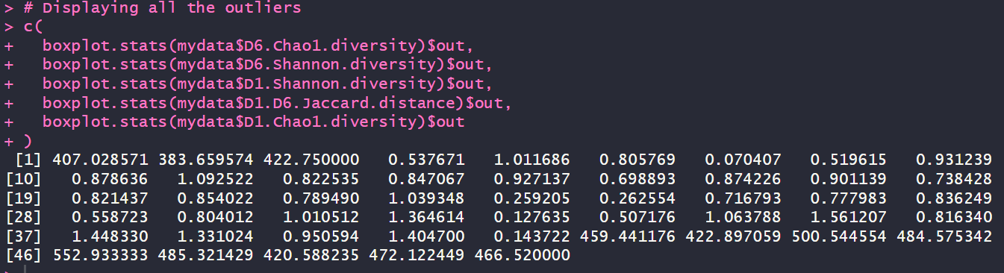
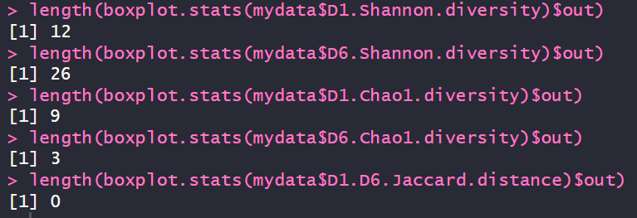
2. Detect Outliers Statistically
Hypothesis
Analysis
Inference
Biomedical Statistics
We displayed all the outliers in the data using $out
Then extracting outliers in each continuous columns and detecting their length.

Slide 19
05
normality
Hypothesis
Analysis
Inference
Biomedical Statistics
Testing

Slide 20
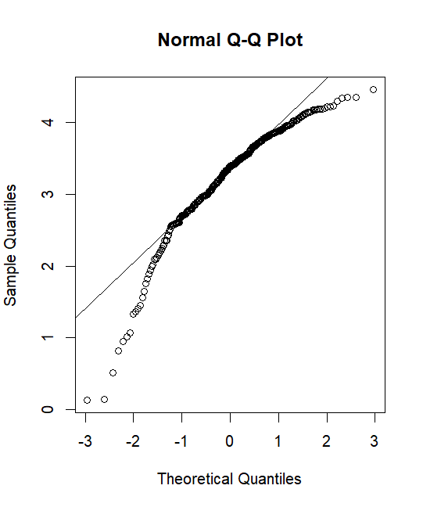
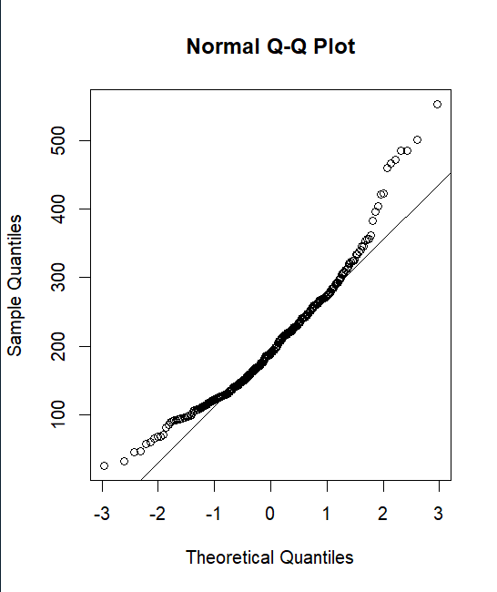
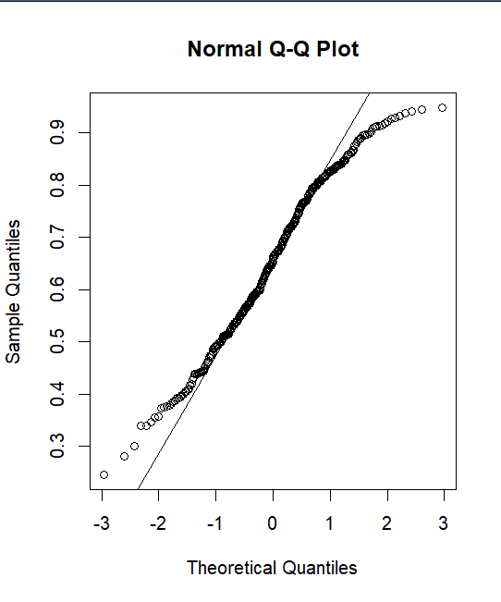
Checking Normality using Q-Q plot, Histogram & Shapiro:
Hypothesis
Analysis
Inference
Biomedical Statistics
D1.Shannon.diversity
D1.Chao1.diversity
D1.D6.Jaccard.distance

Slide 21
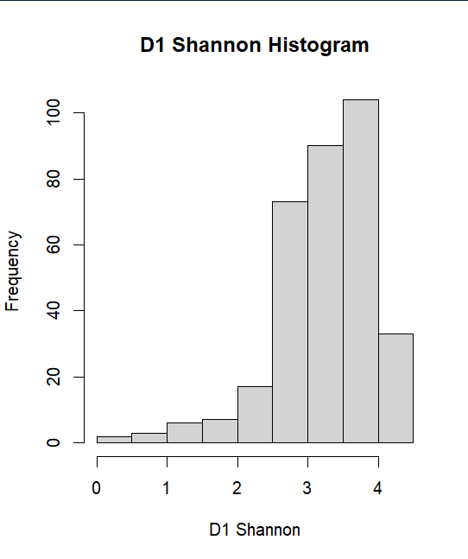
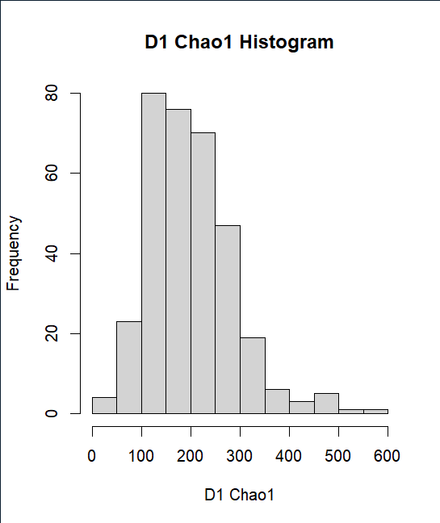
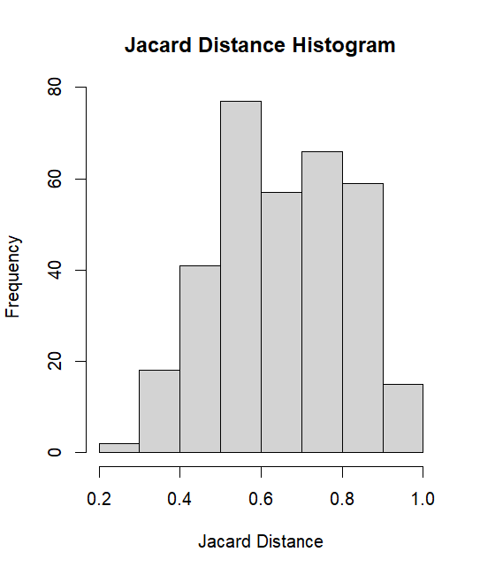
Checking Normality using Q-Q plot, Histogram & Shapiro:
Hypothesis
Analysis
Inference
Biomedical Statistics
D1.Shannon.diversity
D1.Chao1.diversity
D1.D6.Jaccard.distance

Slide 22
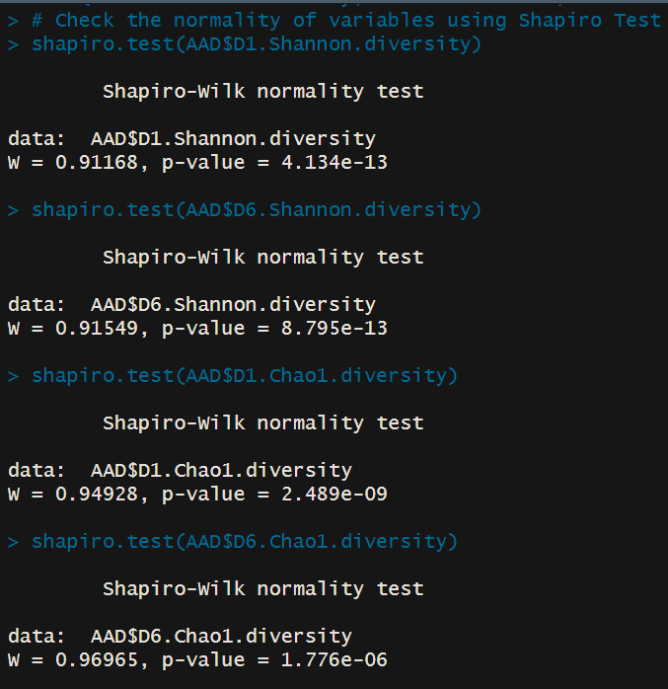
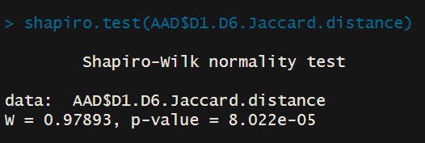
Checking Normality using Q-Q plot, Histogram & Shapiro:
Hypothesis
Analysis
Inference
Biomedical Statistics
According to the 3 tests done on the numerical variables, data are found to be not normal, where according to shapiro-test, the p-value of all of them are less than 0.05 so there is a significant difference, and we have enough evidence to reject the null hypothesis (normality).

Slide 23
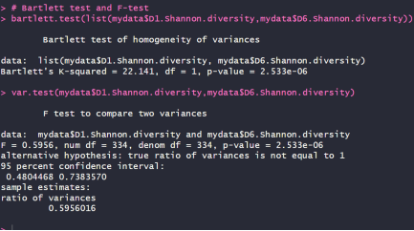
Checking Homoscedasticity using Bartlett test & F-test
Hypothesis
Analysis
Inference
Biomedical Statistics
According to the bartlett and F tests between D1 and D6 Shannon, the p-value = 2.533e-06, which means that there is a significant difference, so we have enough evidence to reject the null hypothesis, where the variance of both of them are not similar.

Slide 24
06
inference
Hypothesis
Analysis
Inference
Biomedical Statistics
Statistical

Slide 25
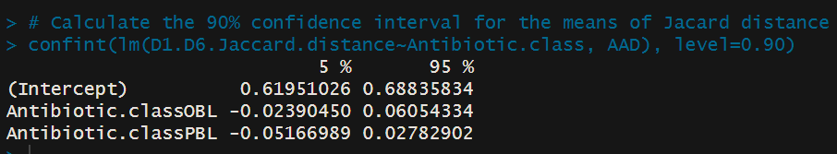
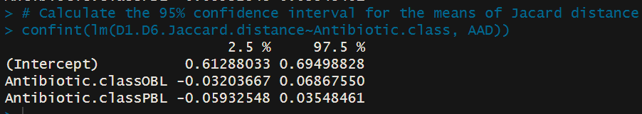
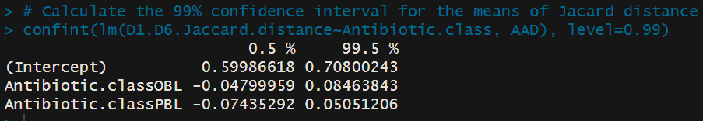
Calculate the 90%, 95%, 99% confidence interval for the means of Jaccard distance each Antibiotic
Hypothesis
Analysis
Inference
Biomedical Statistics
90% C.I.
95% C.I.
99% C.I.

Slide 26
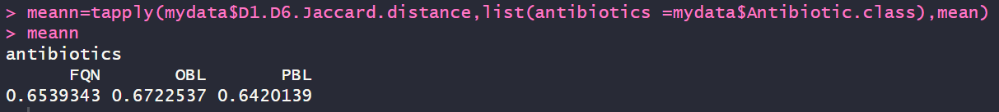
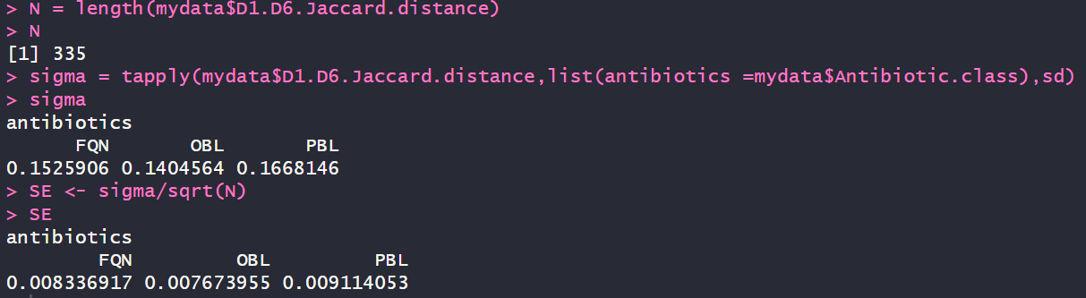
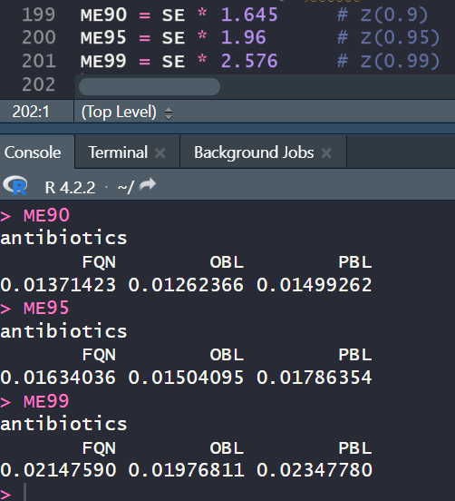
Calculate the 90%, 95%, 99% confidence interval for the means of Jaccard distance each Antibiotic
Hypothesis
Analysis
Inference
Biomedical Statistics
C.I = mean ± SE × Z score
We calculated the means of Jaccard distance for each Antibiotic.
We computed the standard error to calculate the confidence interval: SE=σ/√N
We used the Zscore method for each interval 90%, 95%, 99% which equals to 1.645, 1.96, 2.576 respectively. Then to calculate each margin error, we multiplied it by the standard error.

Slide 27
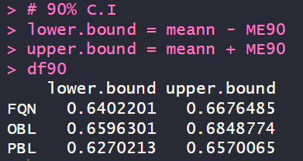
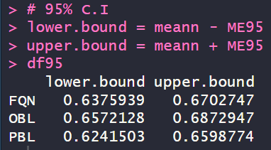
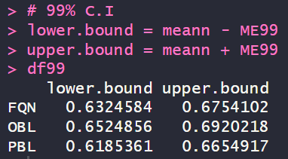
How would you describe those inferences and what do you observe in terms of the interval width when request higher confidence
Hypothesis
Analysis
Inference
Biomedical Statistics
We calculated lower and upper bound that represents the interval for each confidence interval.
We can see that all the antibiotics have narrow confidence intervals which means that we are confident that our estimate is close to our true population value. By increasing our C.I, the width increases due to the process of achieving high degree of certainty. So, we know that the resulting intervals will be wider and less precise.

Slide 28
07
Testing
Hypothesis
Analysis
Inference
Biomedical Statistics
Hypothesis

Slide 29
7.1. We hypothesis that Chao/Shannon at day 6 different between CDI vs ND
Hypothesis
Analysis
Inference
Biomedical Statistics
H0: Chao/Shannon at day 6 is the same for CDI vs ND.
HA: Chao/Shannon at day 6 different for CDI vs ND.
Assuming normality and homoscedasticity, we used Two-sample t-test for Chao and Shannon each.
D6.Chao1.diversity for CDI vs ND: p-value = 0.3362 which is bigger than α(0.05), thus we don't have enough evidence to reject the null hypothesis in support of alternative hypothesis, so we assume that the true difference in means for D6.Chao1.diversity CDI and ND are equal to 0; they are similar.
D6.Shannon.diversity for CDI vs ND: p-value = 0.7164 which is bigger than α(0.05), thus, we don't have enough evidence to reject the null hypothesis in support of alternative hypothesis and the true difference in means for D6.Shannon.diversity CDI and ND are equal to 0; they are similar.

Slide 30
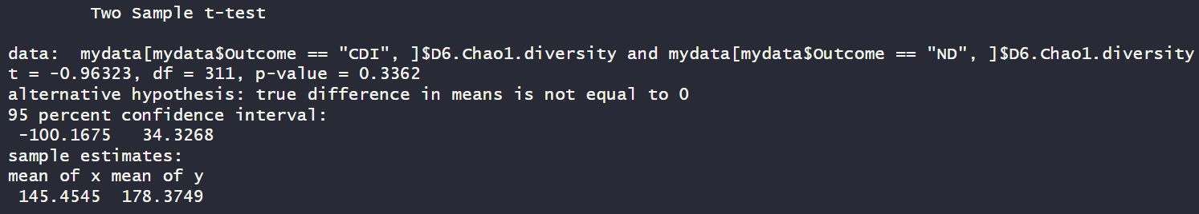
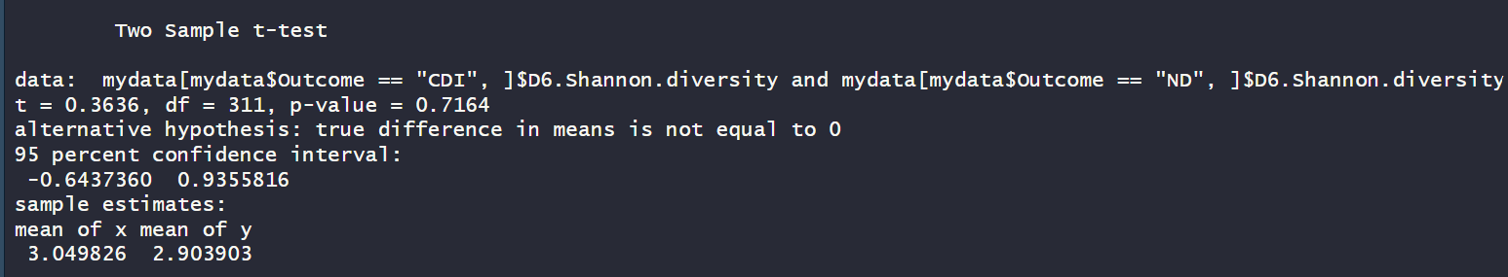
7.1. We hypothesis that Chao/Shannon at day 6 different between CDI vs ND
Hypothesis
Analysis
Inference
Biomedical Statistics

Slide 31
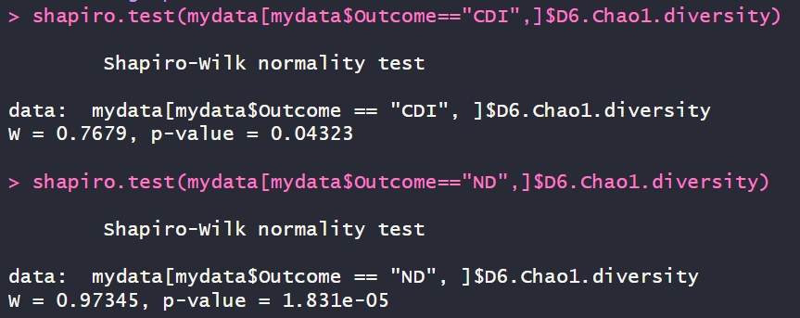
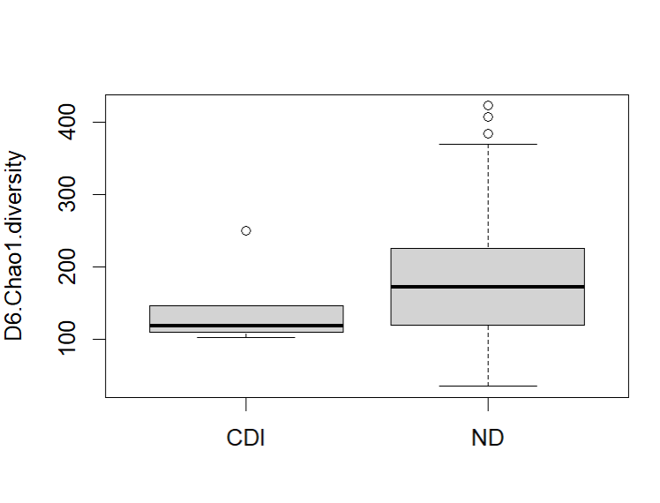
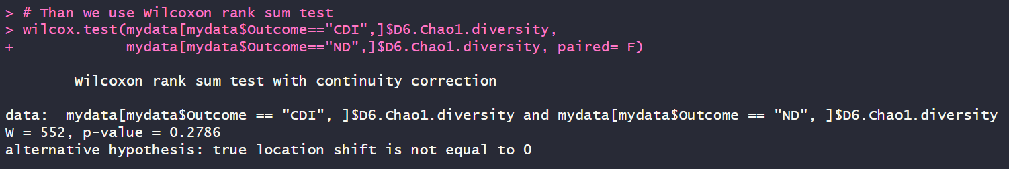
7.2. Assess whether the previous test assumptions have been met for the test
Hypothesis
Analysis
Inference
Biomedical Statistics
1. D6.Chao1.diversity for CDI vs ND:-
Test normality: The p-values are significant; thus, we have enough evidence to reject the null hypothesis and the data is not normal.
Test homoscedasticity: From the boxplot we can see that they don’t have the same variance, thus heteroscedasticity.
Since the assumptions have not been met for D6.Chao1.diversity, so we used Wilcoxon rank sum test. The p-value = 0.2786 which is bigger than α(0.05), thus we don't have enough evidence to reject the null hypothesis in support of alternative hypothesis and D6.Chao1.diversity in CDI and ND are similar.

Slide 32
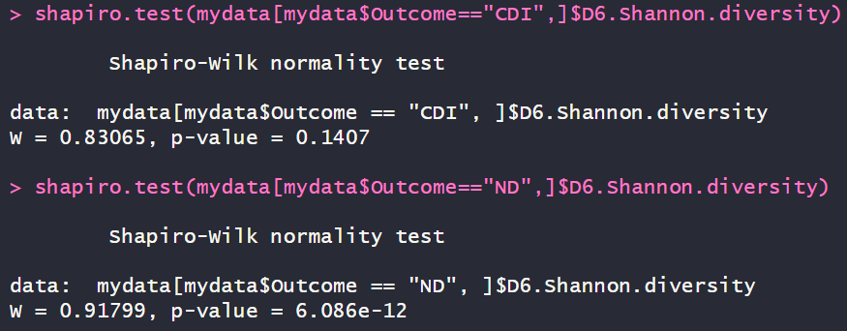
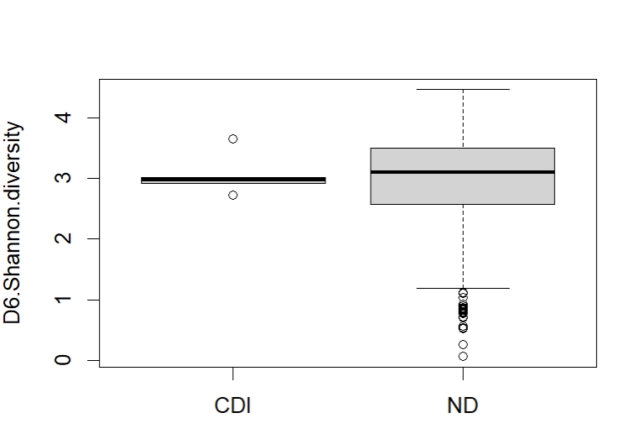
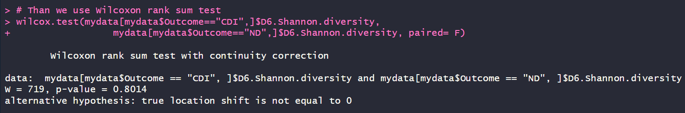
7.2. Assess whether the previous test assumptions have been met for the test
Hypothesis
Analysis
Inference
Biomedical Statistics
2. D6.Shannon.diversity for CDI vs ND:-
Test normality: The p-values one is significant and the other is not; thus, we have enough evidence to reject the null hypothesis and the data is not normal.
Test homoscedasticity: From the boxplot we can see that they don’t have the same variance, thus heteroscedasticity.
Since the assumptions have not been met for D6.Shannon.diversity, so we used Wilcoxon rank sum test. The p-value = 0.8014 which is bigger than α(0.05), thus we don't have enough evidence to reject the null hypothesis in support of alternative hypothesis and D6.Shannon.diversityin CDI and ND are similar.

Slide 33
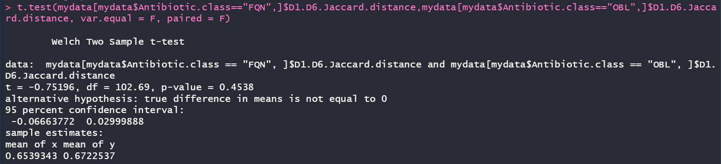
7.3. We hypothesis that Jaccard distance “different” in the group receiving BOL Antibiotics compared to the FQ antibiotics B
Hypothesis
Analysis
Inference
Biomedical Statistics
H0: Jaccard distance in the group receiving OBL compared to the FQN is similar.
HA: Jaccard distance in the group receiving OBL compared to the FQN is different.
Assuming heteroscedasticity, we used Two-sample Welch t-test. The p-value = 0.4538 which is bigger than α(0.05), thus we don't have enough evidence to reject the null hypothesis in support of alternative hypothesis and D1.D6.Jaccard.distance is similar between OBL and FQN Antibiotics.

Slide 34


7.4. Assess the previous test assumption
Hypothesis
Analysis
Inference
Biomedical Statistics
Test normality: The p-values are not significant; thus, we don’t have enough evidence to reject the null hypothesis in support of alternative hypothesis, so we assume normality.
Test homoscedasticity: The p-value = 0.4596 which is bigger than α(0.05), thus we don't have enough evidence to reject the null hypothesis in support of alternative hypothesis and D1.D6.Jaccard.distance has equal variance between OBL and FQN Antibiotics.

Slide 35

7.4. Assess the previous test assumption
Hypothesis
Analysis
Inference
Biomedical Statistics
The assumptions have not been met and we used Two-sample t-test. The p-value = 0.4407 which is bigger than α(0.05), thus we don't have enough evidence to reject the null hypothesis in support of alternative hypothesis and D1.D6.Jaccard.distance is similar between OBL and FQN Antibiotics.

Slide 36

7.5. We hypothesis that Jaccard distance is different between the different Antibiotics.
Hypothesis
Analysis
Inference
Biomedical Statistics
H0: There is no significant difference in Jaccard distances between the different Antibiotics.
HA: There is a significant difference in Jaccard distances between at least two of the different Antibiotics.
Assuming normality and homoscedasticity, we used ANOVA test, the p-value = 0.287 which is bigger than α(0.05), thus we don't have enough evidence to reject the null hypothesis in support of alternative hypothesis and D1.D6.Jaccard.distance is similar between the different Antibiotics.

Slide 37



7.5. We hypothesis that Jaccard distance is different between the different Antibiotics.
Hypothesis
Analysis
Inference
Biomedical Statistics
To determine which pairs of means are significantly different from each other we used Tukey multiple comparisons of means. And the result of the p-values shows that there’s no significant difference between any one of the Antibiotics. We can also see that in the boxplot and the Tukey result plotted.

Slide 38




7.5. We hypothesis that Jaccard distance is different between the different Antibiotics.
Hypothesis
Analysis
Inference
Biomedical Statistics
Assess assumption of normality by Shapiro and Q-Q plot. Based on Shapiro test, p-value = 0.573 for FQN, p-value = 0.05651 for OBL, p-value= 0.001216 for PBL and since all of them are bigger than α(0.05), except for PBL, thus it is significant; we have enough evidence to reject the null hypothesis and the data is not normal. Then we used Q-Q plot for certainty and the all the plots showed non-normality as well.

Slide 39


7.5. We hypothesis that Jaccard distance is different between the different Antibiotics.
Hypothesis
Analysis
Inference
Biomedical Statistics
The right test to be used in this case is Kruskal Wallis rank based test for non-normal data and Dunn test.

Slide 40
08
Regression
Hypothesis
Analysis
Inference
Biomedical Statistics
Linear

Slide 41
8.1. Fit a linear regression to the data and interpret the regression coefficient.
Hypothesis
Analysis
Inference
Biomedical Statistics
The right test to be used in this case is Kruskal Wallis rank based test for non-normal data and Dunn test.

Slide 42
8.2. Calculate the confidence interval for the slope(Bonus)
Hypothesis
Analysis
Inference
Biomedical Statistics
The right test to be used in this case is Kruskal Wallis rank based test for non-normal data and Dunn test.

Slide 43
THANKS!
Hypothesis
Analysis
Inference
Biomedical Statistics

