Slide 1


FinSight Lanka Customer Analytics Assessment
Prepared for Dialog Finance PLC
Dinali Chamodya
5/23/2026

Slide 2
Data Cleaning Summary
Data Issue | Action Taken
Missing values | Filled using median/mode
Duplicate records | Removed
Invalid ages | Filtered
Text inconsistencies | Standardized
Negative balances | Corrected/handled
The dataset required significant preprocessing to ensure reliable business analysis.

Slide 3
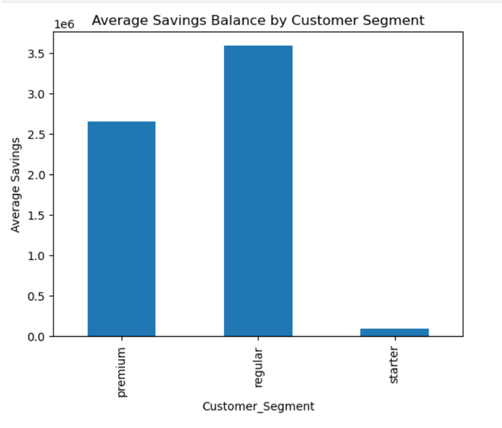
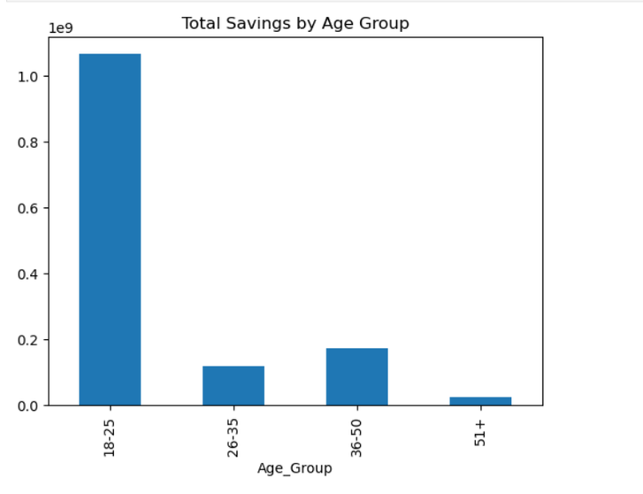
Savings Behaviour Findings
Customers aged 18–25 hold the highest total savings balances.
Regular and premium customers maintain significantly higher average savings balances.
Most customers are actively growing their savings balances each month.

Slide 4
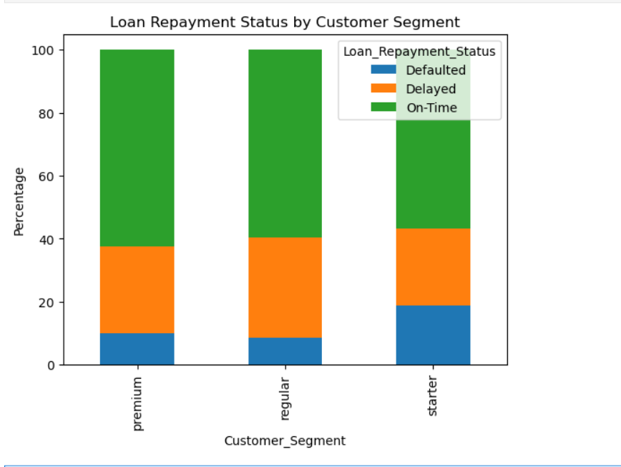
Loan Portfolio & Risk
• Loan penetration is high across the customer base.
• Certain customer groups demonstrate elevated repayment risk.
• Customers with high debt-to-savings ratios require closer monitoring.

Slide 5
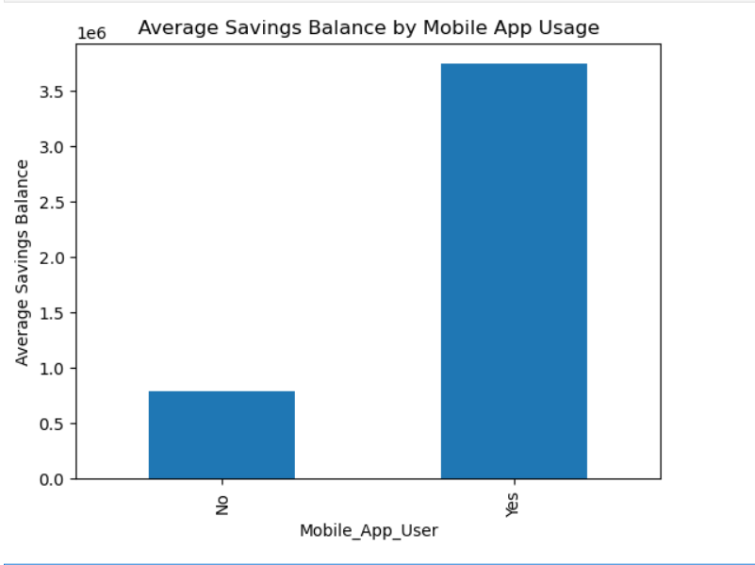
Digital Engagement & Cross-Sell Opportunity
• Mobile app users maintain significantly higher average savings balances.
• A large cross-sell opportunity exists among customers without fixed deposits or insurance.

Slide 6
KPI Summary
KPI | Current Value | Business Importance
Total Customers | 502 | Customer base size
Average Savings | 2.76M | Financial health
Customers with Loans | 497 | Product adoption

Slide 7
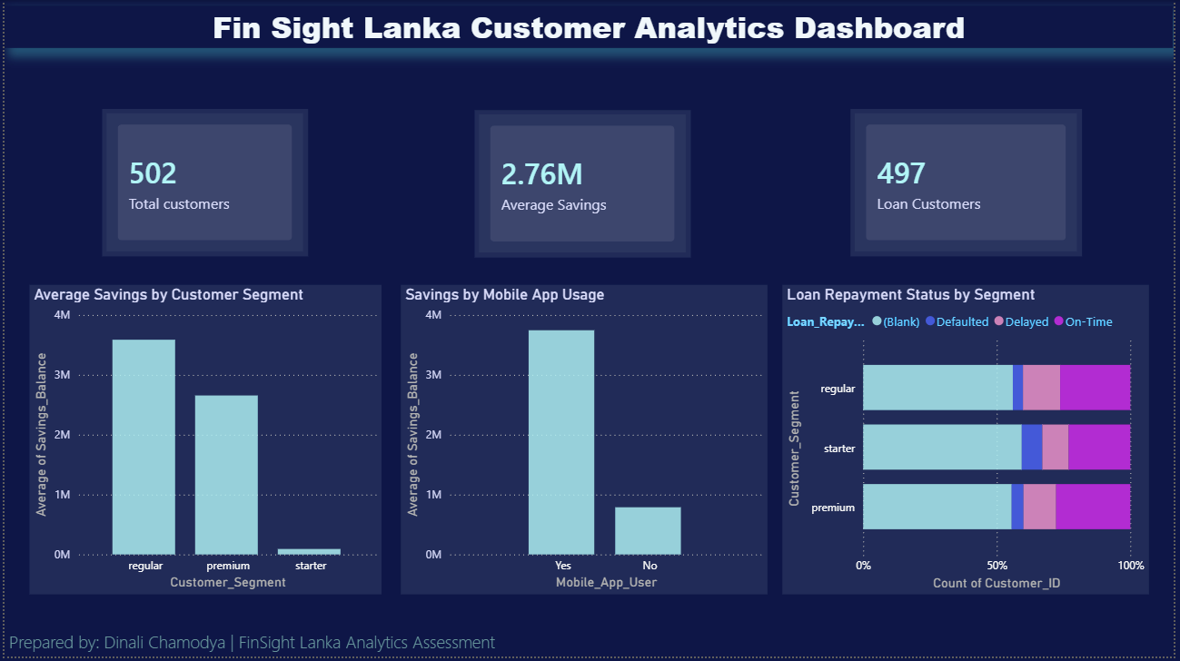
Dashboard
Overview
The dashboard provides a consolidated view of customer behaviour, financial risk, and digital engagement.

Slide 8
Key Business Findings
Younger customers demonstrate strong savings behaviour.
Digital engagement is positively associated with higher savings balances.
Cross-selling opportunities remain underutilized.
Certain customer segments show elevated repayment risk.
Limitations
Limitation | Severity
Missing income data | High
Limited historical transaction data | Medium
Some assumptions during cleaning | Medium
Recommendations
1. Increase mobile onboarding and digital engagement campaigns targeting younger customers.
2. Strengthen monitoring and risk controls for customers with high debt-to-savings ratios.

Slide 9

Conclusion
The analysis highlights strong digital adoption, healthy savings behaviour, and opportunities to improve cross-selling and risk management strategies.

Slide 10
Thank You

