Slide 1
✦ DINEEASE · FOR RESTAURANTS
Fill more tables.
Pay one flat fee.
The reservation platform built for Cyprus restaurants — plus a customer app that sends diners straight to your door.
Partner Presentation · 2026

Slide 2
THE PROBLEM
Taking bookings in Cyprus is harder than it should be
📞
Bookings scattered everywhere
Phone calls, Instagram DMs, WhatsApp and walk-ins — no single view of your night, and double-bookings happen.
🪑
Empty tables, costly no-shows
Without reminders or deposits, last-minute no-shows leave covers — and revenue — on the table.
💸
Commission platforms eat margin
Global booking sites charge a fee for every cover they send. The busier you get, the more you pay.
📵
No direct line to diners
Your guest data sits with someone else, so you can't bring customers back on your own terms.
DineEase · Partner Overview
2

Slide 3
WHAT IS DINEEASE
One platform. Two sides. Both working for you.
🍽 FOR YOUR RESTAURANT
A booking & floor manager
✓ Reservations & waitlist in one dashboard
✓ Visual floorplan calendar of your night
✓ Automatic reminders to cut no-shows
✓ Manage one venue — or your whole group
📱 FOR YOUR CUSTOMERS
A discovery & booking app
✓ Diners find you by cuisine, price & distance
✓ See real-time availability for your tables
✓ Book in seconds — no phone call needed
✓ Reviews & favourites keep them coming back
↔
DineEase · Partner Overview
3

Slide 4
WHAT YOU GET
Everything you need to run a busy service
📅
Reservations & Waitlist
Take, edit and track every booking in one place, with a smart waitlist for peak hours.
🗺
Floorplan Calendar
See your whole night at a glance and assign tables to match your real dining room.
🔔
No-show Protection
Automatic SMS / push reminders — and optional deposits — keep tables full.
📲
Customer App Listing
Your venue featured in the DineEase app, in front of diners searching nearby.
📊
Insights & Analytics
Understand covers, peak times and repeat guests to plan staffing and stock.
🏢
Multi-location Ready
Run two, three or five venues from a single account as you grow.
DineEase · Partner Overview
4

Slide 5
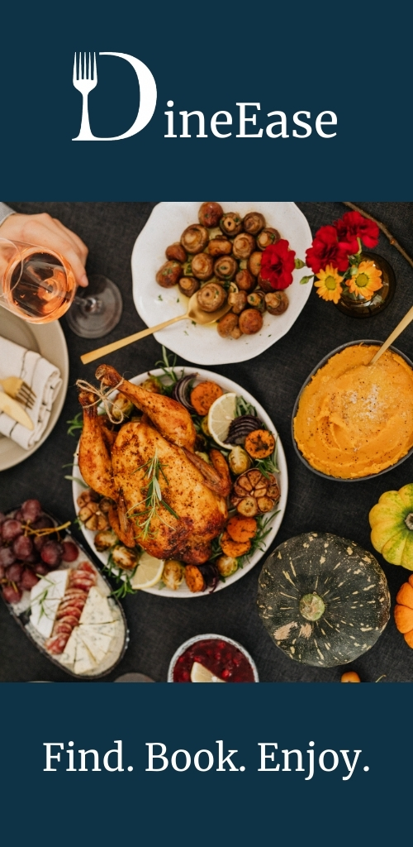
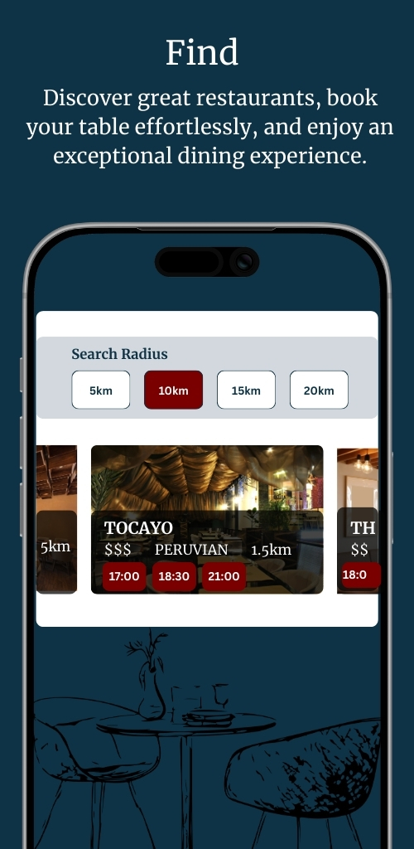
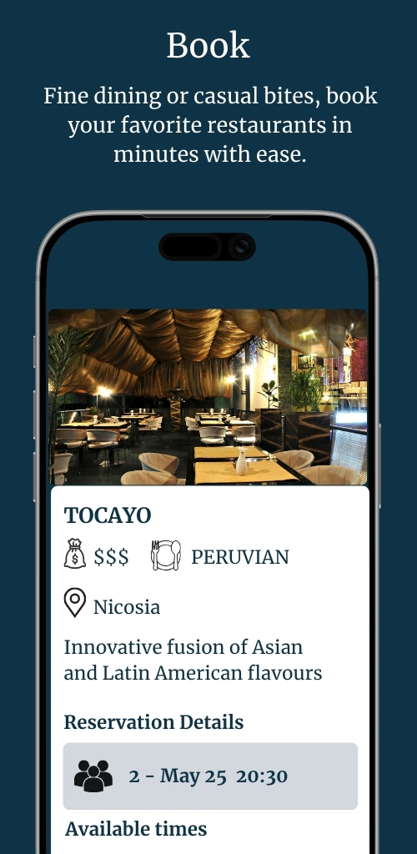
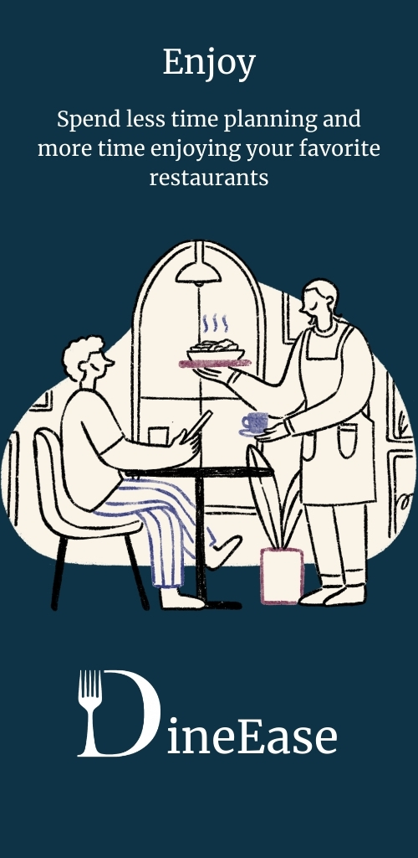
THE CUSTOMER APP
We bring the diners to you
Unlike booking software you have to fill yourself, DineEase is also a consumer app people open when they're deciding where to eat.
✦ Find. Book. Enjoy. — three taps to a table
✦ Search by cuisine, price and 5–20 km radius
✦ Real-time availability for your venue
✦ Secure in-app payments & confirmations
✦ Reviews and favourites build loyalty
WELCOME
FIND
BOOK
ENJOY
DineEase · Partner Overview
5

Slide 6
HOW IT WORKS
Live in days, not months
1
2
3
List your venue
We set up your profile, floorplan and tables. Your listing goes live in the DineEase app.
Manage bookings
Reservations from the app, your website and phone all land in one simple dashboard.
Fill your tables
Diners discover and book you; reminders cut no-shows. You just run great service.
DineEase · Partner Overview
6

Slide 7
SUBSCRIPTION MODEL
Simple, flat pricing — no commission, ever
Annual plans shown (save 20%) · VAT included · cancel anytime
MOST POPULAR
Essentials
€60 /mo
€719.90 / yr
1 location
or €74.99/mo monthly
All DineEase features
Reservations & waitlist
Floorplan calendar
Customer app listing
Duo
€104 /mo
€1,247.90 / yr
Up to 2 locations
or €129.99/mo monthly
All DineEase features
Reservations & waitlist
Floorplan calendar
Customer app listing
Group
€144 /mo
€1,727.90 / yr
Up to 3 locations
or €179.99/mo monthly
All DineEase features
Reservations & waitlist
Floorplan calendar
Customer app listing
Portfolio
€200 /mo
€2,399.90 / yr
4–5 locations
or €249.99/mo monthly
All DineEase features
Reservations & waitlist
Floorplan calendar
Customer app listing
DineEase · Partner Overview
7

Slide 8
HOW WE COMPARE
Built for Cyprus restaurants — not the other way round
 | DineEase | Eat App | OpenTable | TheFork / Quandoo | Klisto (CY)
Pricing model | Flat subscription | Flat subscription | Subscription + fees | Commission per cover | Marketplace
Per-cover commission | None | None | $1–1.50 / cover* | ~€2.60 / guest* | Varies
Restaurant-specialised | Yes | Yes | Yes | Yes | Multi-vertical
Own customer app | Yes | Limited | Yes | Yes | Yes
Cyprus-focused & EUR | Yes — VAT incl. | No (USD) | No (USD) | Limited in CY | Yes
Cost as you grow | Stays flat | Stays flat | Rises per cover | Rises per cover | Varies
*Competitor pricing from public sources, mid-2026, indicative. OpenTable / TheFork charge per seated guest, so cost rises with every booking.
DineEase · Partner Overview
8

Slide 9
OUR CLOSEST COMPETITOR
DineEase vs Eat App — built for Cyprus
Both are flat-fee and commission-free. The difference is how you're priced — and who fills your tables.
DINEEASE
Priced per location · covers never capped · EUR, VAT incl.
Essentials €60/mo · 1 location
Duo €104/mo · up to 2 locations
Group €144/mo · up to 3 locations
Portfolio €200/mo · 4–5 locations
+ your venue in the DineEase consumer app for Cyprus diners
EAT APP
Priced by covers & add-ons · USD · no local diner audience
Free $0/mo · up to 100 covers/mo
Starter $48/mo · up to 300 covers/mo
Essential $111/mo · unlimited covers
Pro $209/mo · unlimited covers
Reservation software only — you fill the tables yourself
Takeaway: Eat App caps covers on cheaper plans, prices in USD, and bills $19–$39/mo add-ons for waitlist, CRM & reports — even on its recommended plan. DineEase includes every feature in each tier, priced per location in EUR (VAT incl.), and sends Cyprus diners your way.
DineEase · Partner Overview
9
Eat App prices: yearly billing (30% off), per restaurant.eatapp.co, 2026.

Slide 10
THE COST ADVANTAGE
Flat beats commission as you get busy
Example: a restaurant seating 1,000 booked covers in a month
Commission platform
≈ €2,600
/month
at ~€2.60 per guest, every month — and it climbs as you grow
OpenTable-style
€140 + fees
/month
subscription plus $1–1.50 for every network cover
DineEase Duo
€104
/month
flat — VAT included, no per-cover fee, no matter how busy
With DineEase your cost is predictable. The more diners we send you, the more you save versus commission models.
DineEase · Partner Overview
10

Slide 11
WHY DINEEASE
The local advantage
🇨🇾 Made for Cyprus
Local team, EUR pricing with VAT included, and support that knows your market.
🚫 Zero commission
A flat monthly fee — we never take a cut of your covers or your revenue.
🤝 You own your guests
Your customer data and relationships stay yours, to bring diners back.
📈 Scales with you
From a single bistro to a five-venue group, on one account and one bill.
DineEase · Partner Overview
11

Slide 12
Ready to fill more tables?
Start with Essentials from €60/mo, or pick the plan that fits your group. No commission, no surprises — VAT included.
Get started today
dineeaseapp.com · Find. Book. Enjoy.

