Slide 1
MARKETPLACE FOR EDUCATIONAL SERVICES (EduMart) Project Phase - II
Presented by: Dinesh Singh
Enrollment No.: U2046035
Course: MCA Sem-IV
Project Guide: Ms. Sunita Tripathi

Slide 2
CONTENT
Introduction
Problem definition
Motivation
Objective
Goals
Functional Requirements
Non-Functional Requirements
Technical Requirements
System Requirements
System Design(Data Flow Diagram)
Project Output

Slide 3
INTRODUCTION
EduMart is a web-based platform connecting clients with skilled educational service providers.
It enables easy discovery, booking, and procurement of services like tutoring, graphic design, and app development.
Built using Django (backend), HTML/CSS/JS (frontend), SQLite (database)

Slide 4
PROBLEM DEFINITION
Difficulty in finding reliable educational services through traditional methods..
Lack of transparency, trust, and specialized platforms for educational services.
Service providers struggle to reach the right audience and highlight their skills.

Slide 5
MOTIVATION
To bridge the gap between clients and providers in the educational space.
Current platforms are cluttered and not education-focused.
Need for a dedicated, structured, and transparent platform to streamline service discovery and bookings.

Slide 6
OBJECTIVE
To build a secure, scalable, and user-friendly platform.
Ensure smooth discovery, booking, communication, and payment of educational services.
Empower professionals to showcase and manage their offerings effectively.

Slide 7
GOALS
1. Centralized Educational Marketplace
2. User-friendly Interface
3. Trust via Reviews & Ratings
4. Empowering Providers
5. Real-time Booking & Updates
6. Custom Profiles & Listings
7. Secure Payments
8. Scalable Architecture
9. Real-Time Communication
10. Continuous Improvement & Feedback Integration.

Slide 8
Functional Requirements
User Registration and Authentication
Service Listings with descriptions and categories
Advanced Search and Filters
Real-Time Booking and schedule sync
Secure Payment Gateway Integration
Review and Rating System
Messaging System for communication
Django Admin Panel for management
User Profiles for tracking and showcasing

Slide 9
Non-Functional Requirements
Performance: Handle high traffic efficiently.
Usability: Intuitive and responsive interface for all devices.
Scalability: Accommodate growth without performance issues.
Security: Encrypted data, secure payments, and compliance with data laws.
Compatibility: Works across browsers and operating systems.
Maintainability: Easy updates, bug fixes, and enhancements.
Backup and Recovery: Regular data backups to prevent loss.
Accessibility: Inclusive design for all users, including those with disabilities.

Slide 10
Technical Requirements
Frontend Technologies
HTML: Page structure and markup.
CSS: Custom styling and layout.
JavaScript: Interactive features.
Bootstrap: Prebuilt UI components.
Backend Technologies
Django: Framework for backend operations.
SQLite: Database for user and service data.
Django ORM: Database interactions.

Slide 11
SYSTEM REQUIREMENTS
SOFTWARE REQUIREMENTS
HARDWARE REQUIREMENTS
Processor : Intel/AMD/Ryzen
RAM : 4 GB or Higher
Speed: 1.00 GHz
System Type: 64-bit operating system
Operating System :Window/Linux/Mac
Frontend: HTML, CSS, JavaScript
Framework: Django, Bootstrap
Database : SQLite
IDE : Visual Studio Code, PyCharm
Browser: Chrome/Mozilla/Edge/Brave

Slide 12
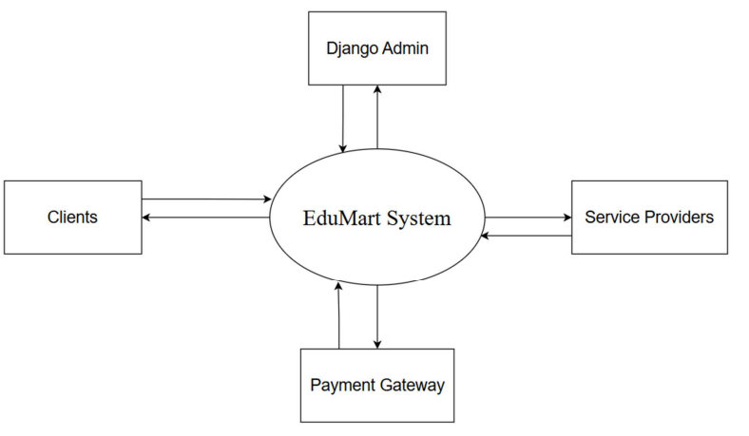
SYSTEM DESIGN
Detailed System design of EduMart using Data Flow Diagram (DFD)
Level - 0

Slide 13
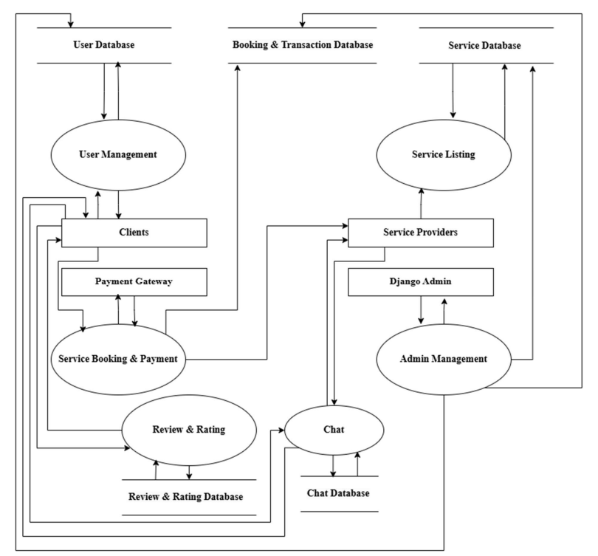
Level - 1

Slide 14
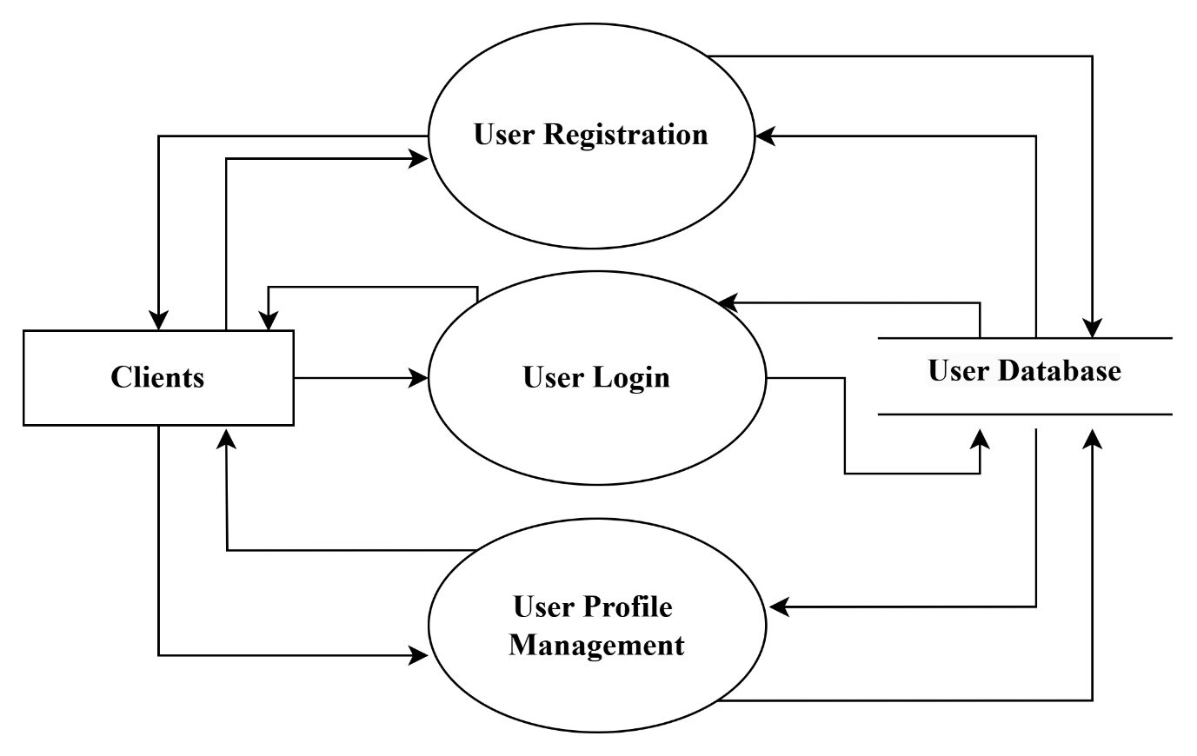
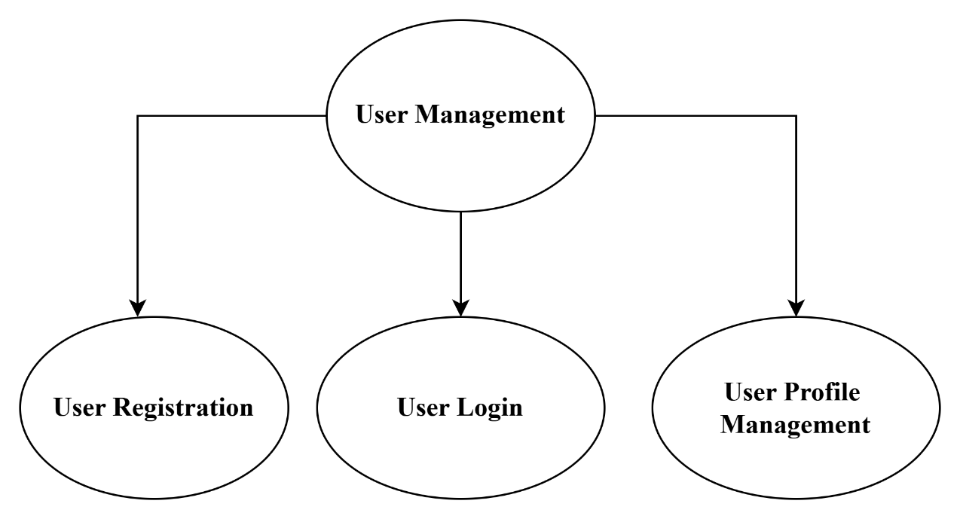
Level – 2
User Management

Slide 15
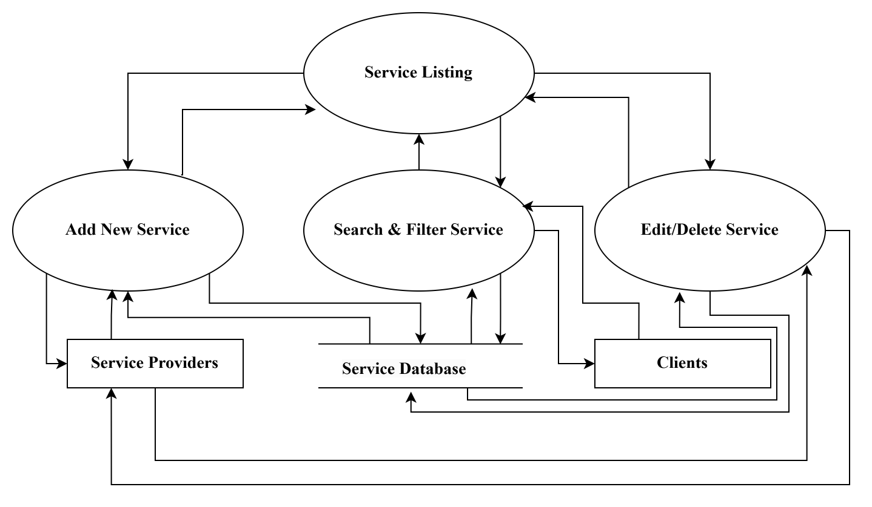
Level – 2 Continues
Service Listing

Slide 16
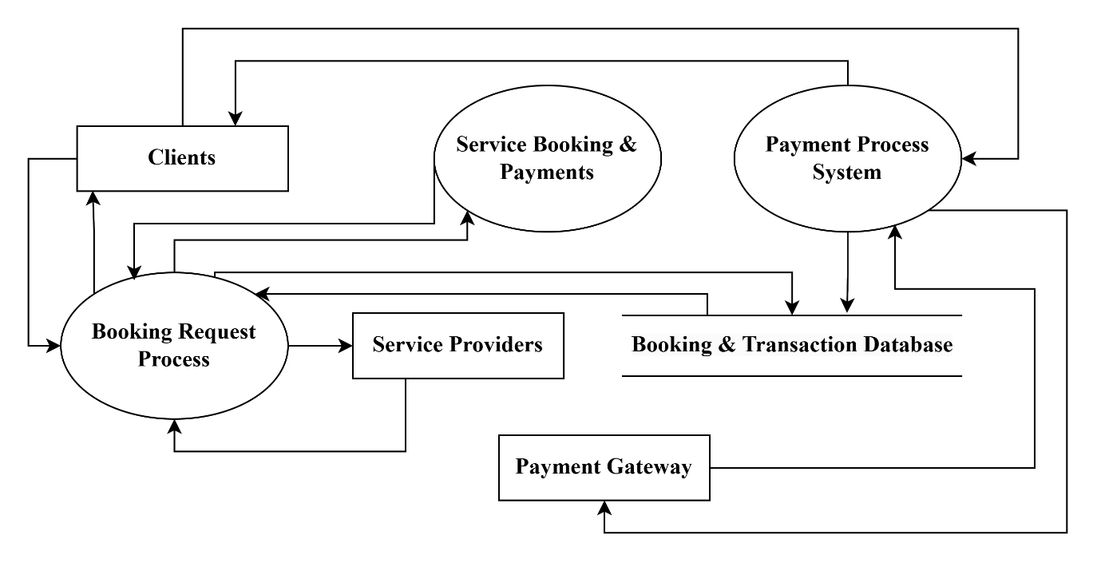
Level – 2 Continues
Service Booking & Payment

Slide 17
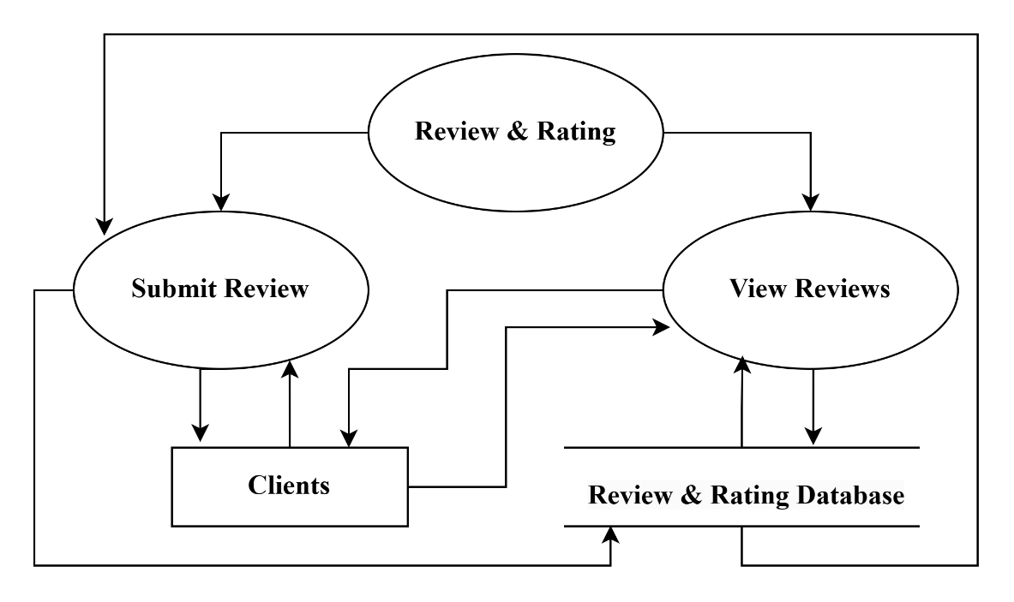
Level – 2 Continues
Review & Rating

Slide 18
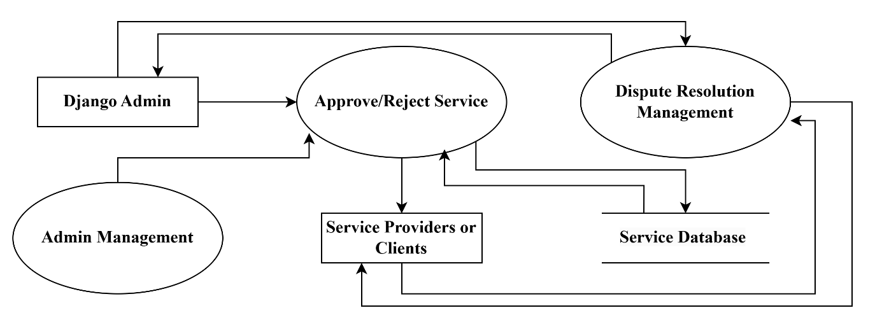
Level – 2
Admin Management

Slide 19
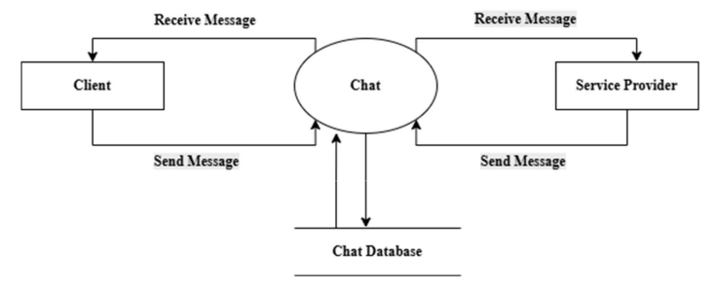
Level – 2 Continues
Chat

Slide 20
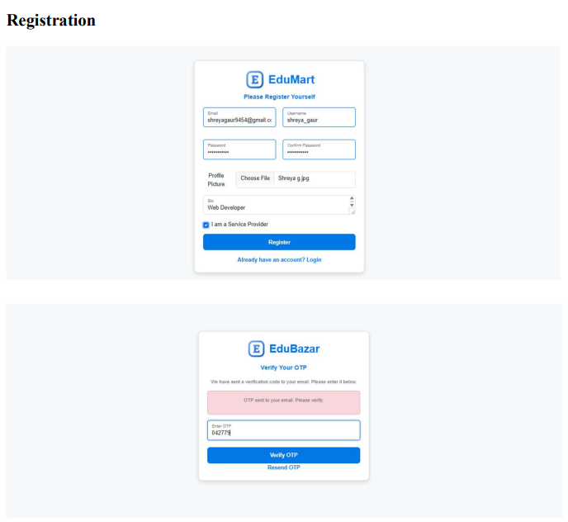
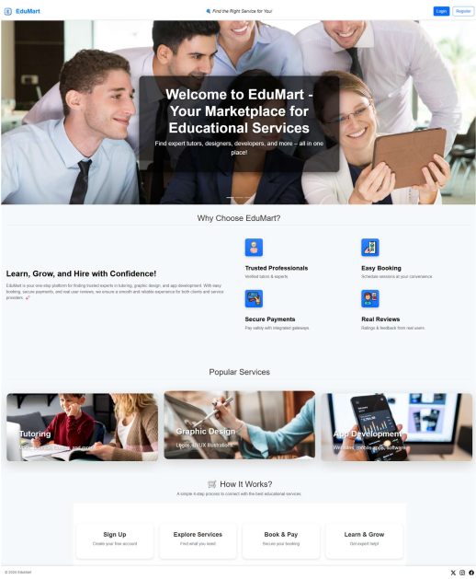
PROJECT OUTPUT

Slide 21
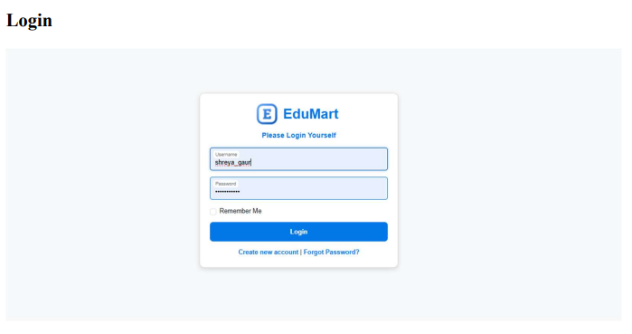
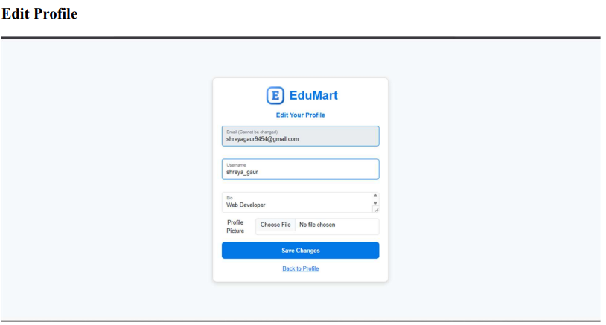
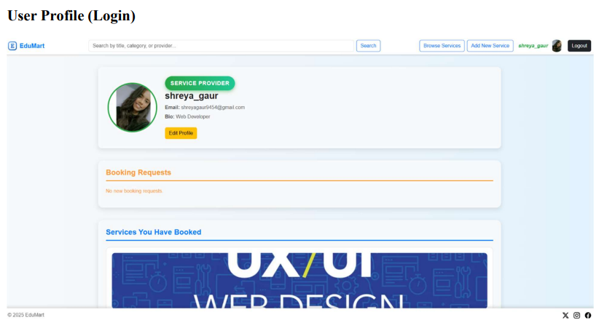
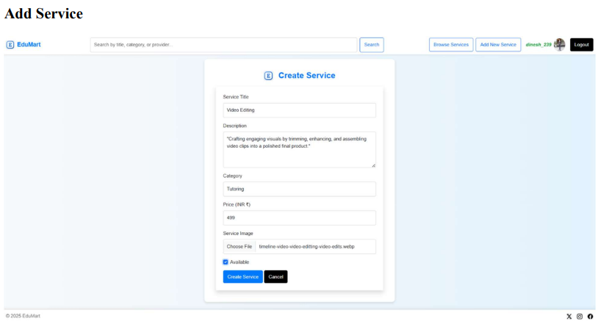

Slide 22
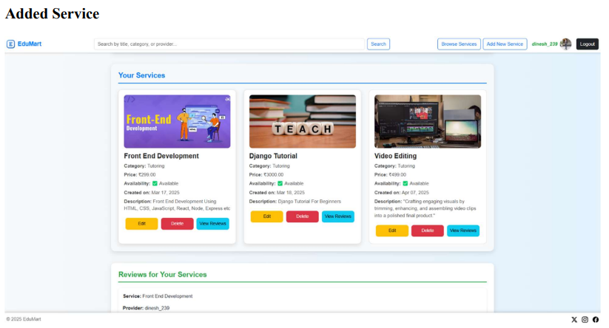
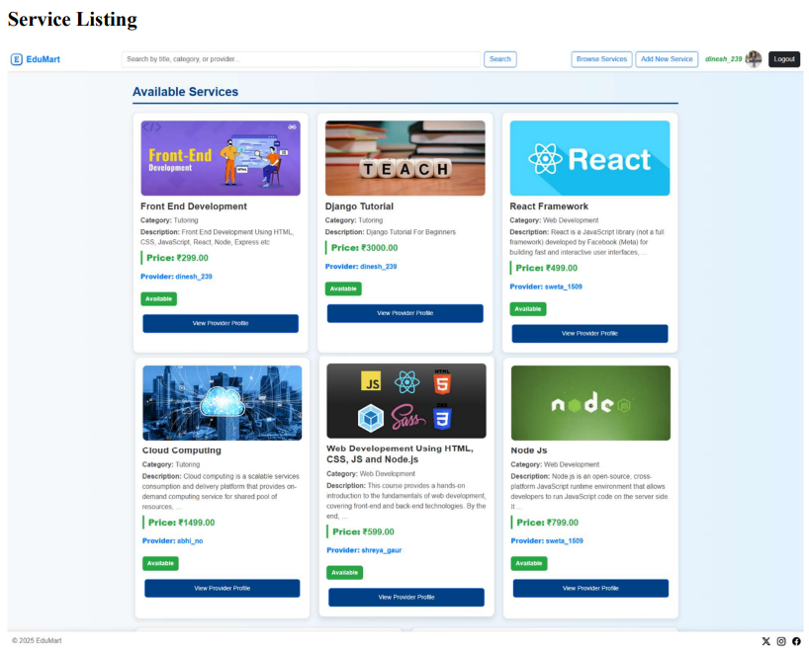
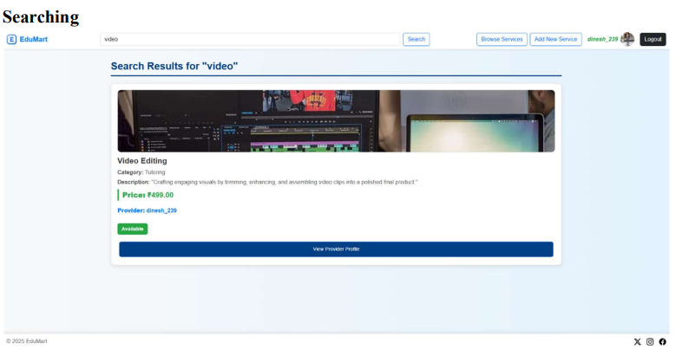

Slide 23
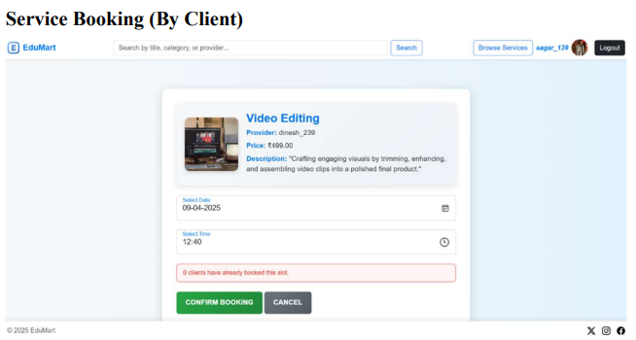
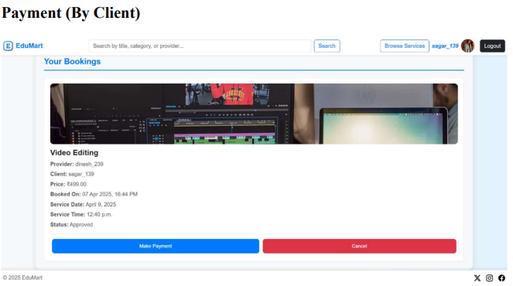
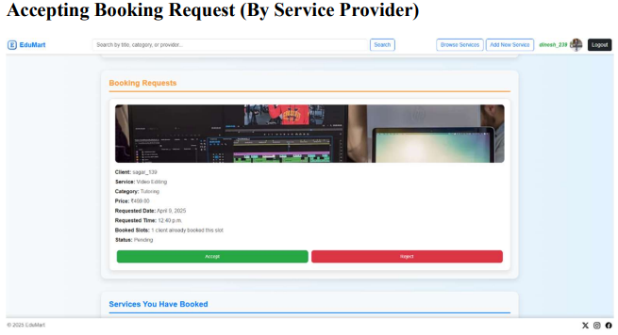
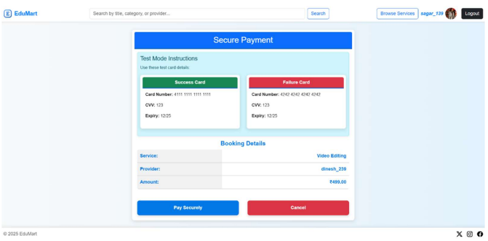

Slide 24
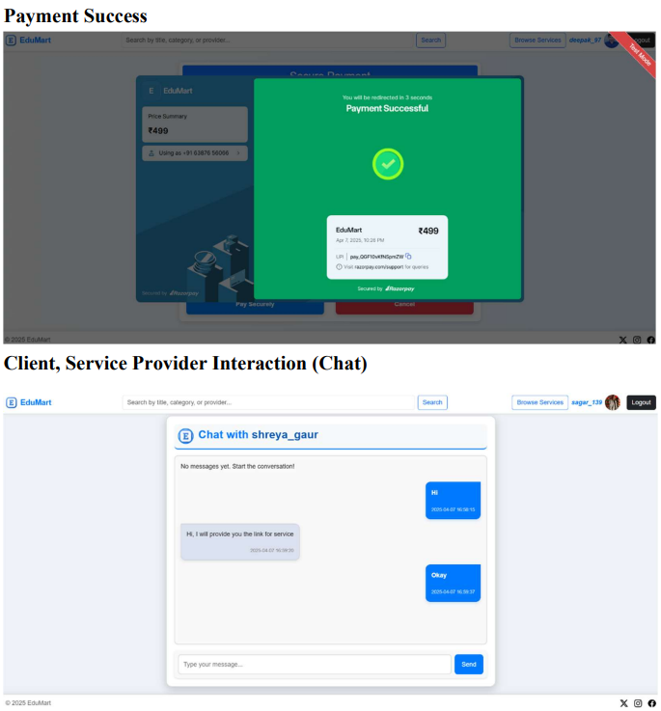
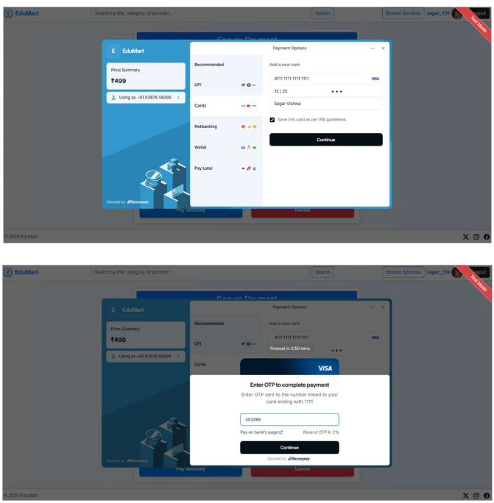

Slide 25
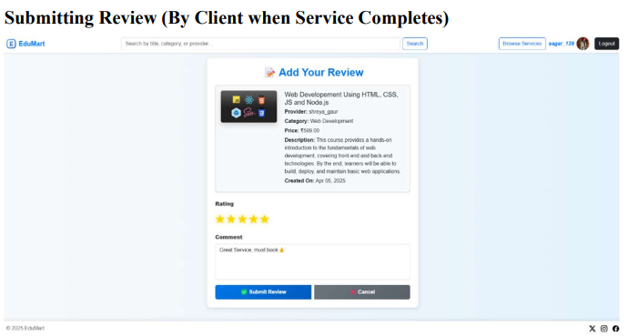
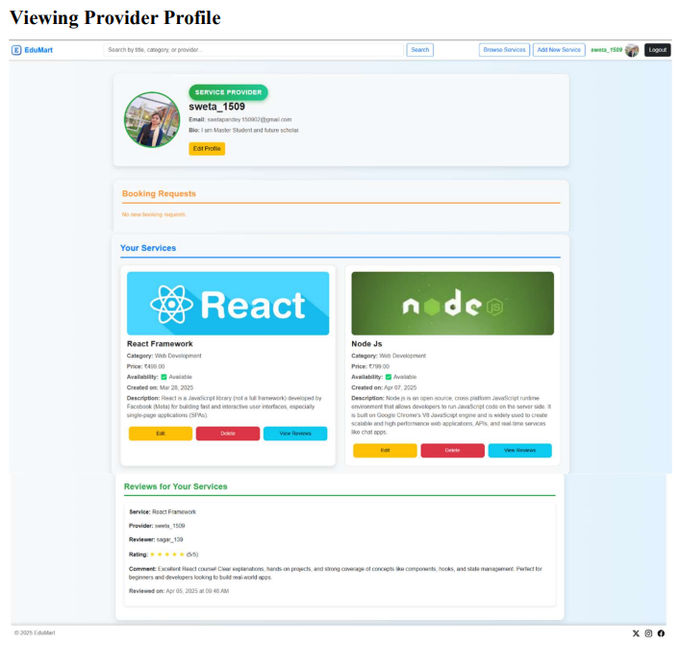
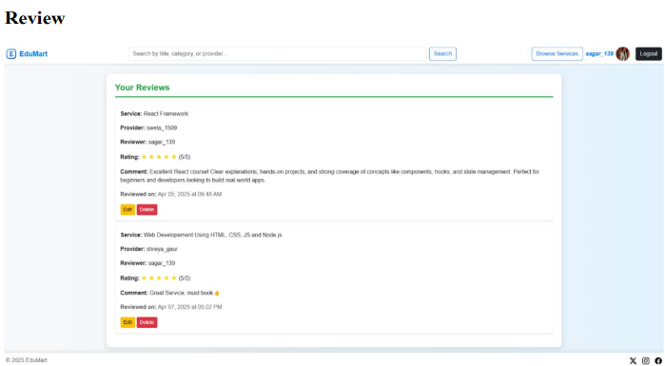

Slide 26
THANK YOU!

