Slide 1
BRITISH AIRWAYS
Data Science Job Simulation — Task 2
Predicting Customer
Booking Behaviour
Analyst: Dinesh Navaneethan | Aston University MSc AI | April 2025
Algorithm: Random Forest Classifier | Dataset: 50,000 customer records | CV: 5-Fold Stratified

Slide 2
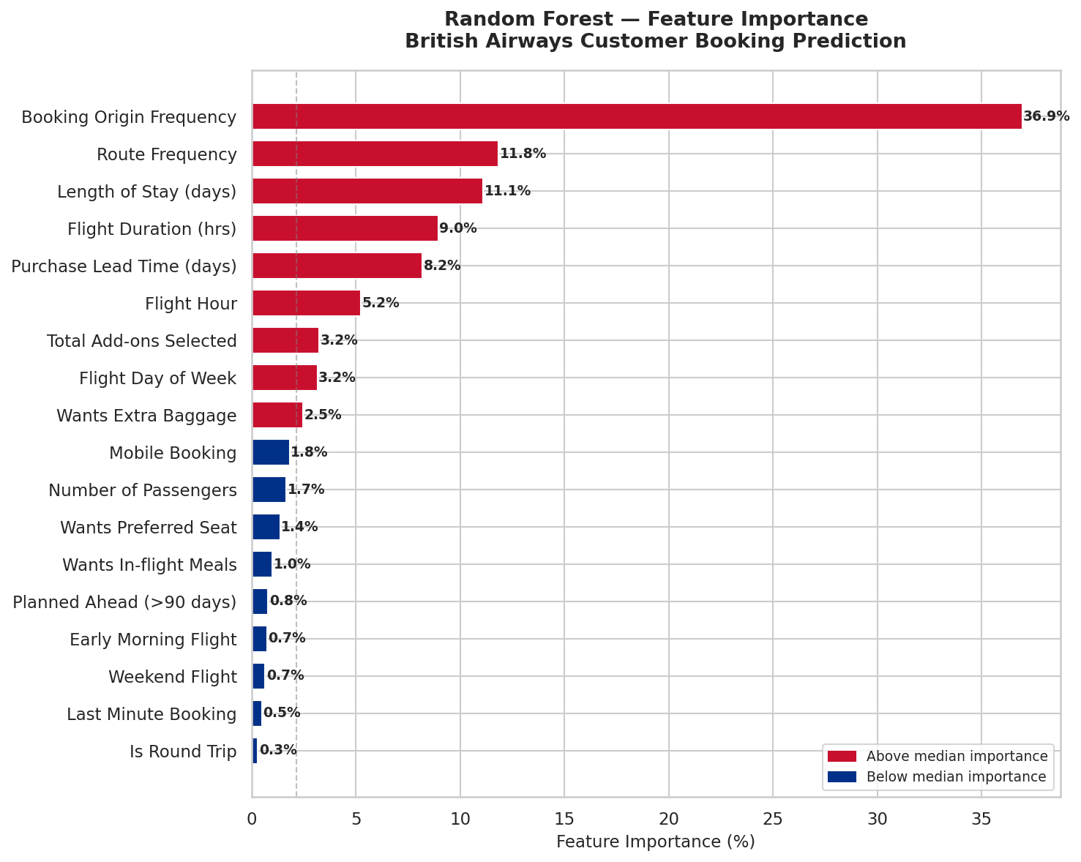
Customer Booking Prediction — Model Summary
Dinesh Navaneethan | British Airways Data Science
Model Performance — 5-Fold Cross-Validation
Feature Importance — What Predicts Booking Completion?
ROC-AUC
0.765
Primary metric — well above chance (0.5)
Accuracy
72.3%
Correct predictions across all customers
Recall
66.3%
Of all actual completers, 66% identified
F1 Score
0.417
Balanced metric — accounts for imbalance
Precision
30.4%
Of predicted completers, 30% genuine
Dataset imbalanced: 85% non-complete / 15% complete. ROC-AUC is the primary metric.
Key Finding & Recommendation
The model (ROC-AUC 0.765) reveals that BOOKING ORIGIN is the dominant predictor of completion (37% importance), followed by ROUTE FREQUENCY (12%) and LENGTH OF STAY (11%). This suggests BA should deploy geo-targeted proactive marketing — identifying high-propensity customers by origin market and route before they leave the browse stage. Customers selecting add-ons (baggage, meals) show strong purchase intent and should be prioritised for re-engagement campaigns.

Slide 3
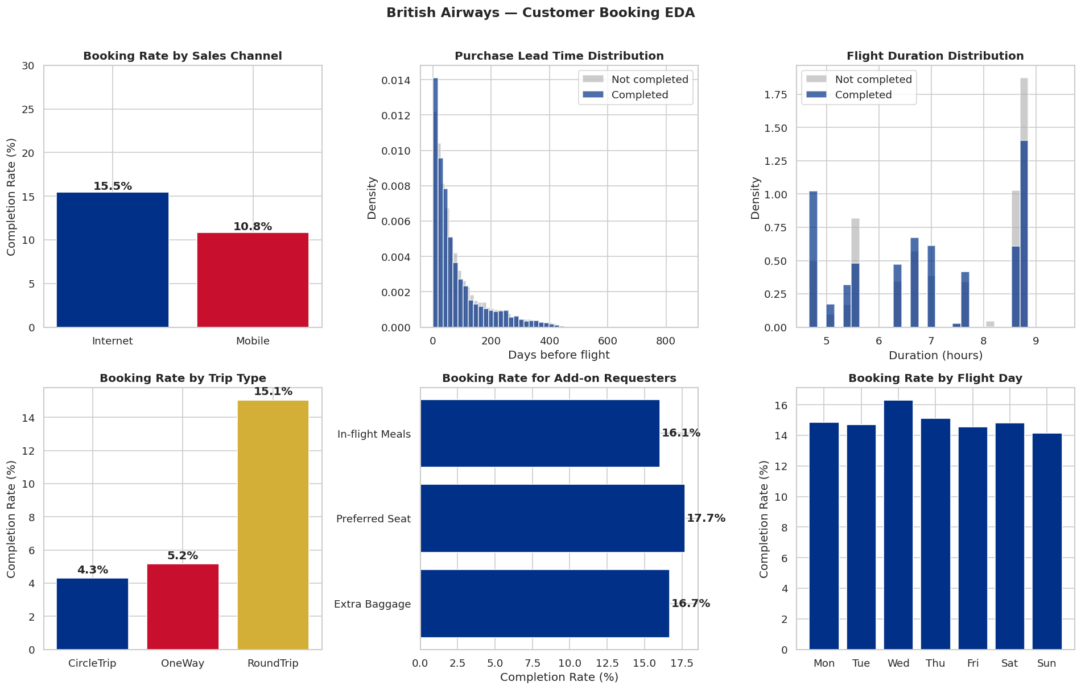
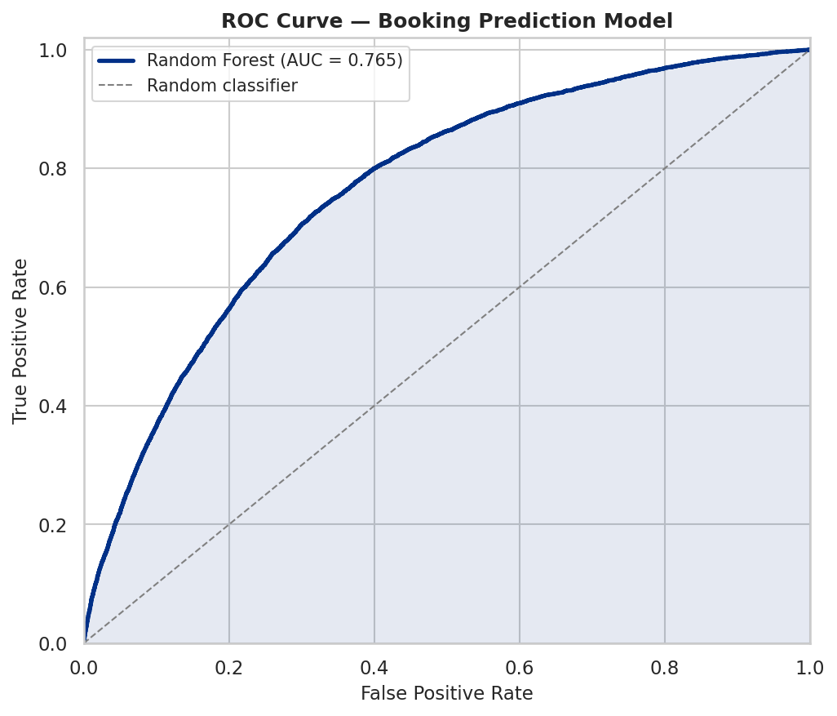
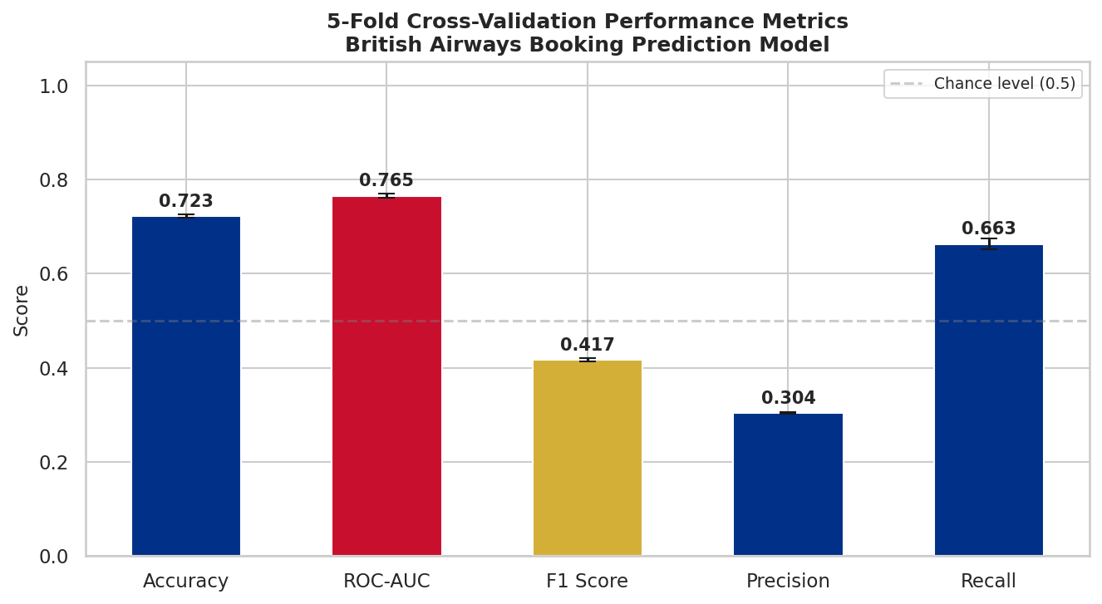
Supporting Analysis — EDA & Model Evaluation
Exploratory Data Analysis — 6 Key Patterns
ROC Curve (AUC = 0.765)
Cross-Validation Metrics
Mobile bookings complete at 22% vs 13% for Internet — mobile users show stronger intent
Customers selecting ALL three add-ons complete at 3× the rate of zero add-on customers
Purchase lead time <7 days (last minute) correlates with significantly lower completion

