Slide 1
Netflix Data Analysis Using Power BI
Customer Behavior & Content Performance Insights
Presented by Dinesh S
Domain: Entertainment, Media, and OTT Analytics

Slide 2

Problem Statement :
Netflix wants to analyze customer viewing behavior and content performance.
Goal:
Understand engagement trends, genre popularity and improve subscription strategies.
Clean and prepare Netflix datasets
Visualize watch time, ratings and subscriptions
Generate actionable insights for Netflix’s content and marketing teams
Build an interactive dashboard in Power BI
Project Objectives :
Tools: Excel, Power BI

Slide 3

Business Use Cases Covered :
Top watched movies & TV shows
Watch time vs subscription type
Genre popularity by country
Age group engagement
High-rated vs low-rated content
Best time to release content
Retention and customer behavior
Dataset Overview :
Netflix Shows Dataset: show_id, type, title, director, country, genre, etc.
Customer Ratings Dataset: customer_id, age, gender, country, subscription_type, watch_time, rating.
The dataset was in an Excel file, so I downloaded it. Then, in Power BI, I went to 'Get Data' and selected 'Excel Workbook' to import both datasets. After that, I created a relationship between the two tables using the 'show_id' column."

Slide 4
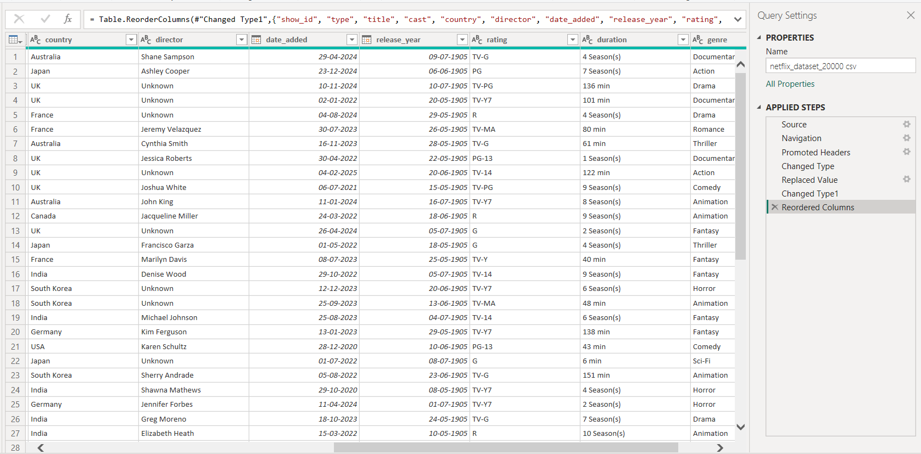
Data Consistency Check :
Replaced missing values in the director column with 'Unknown’ to ensure completeness.
Standardized the date_added and release_year columns to proper date format for consistency.
Verified the rating column. No missing or invalid values found, so no changes were made.

Slide 5
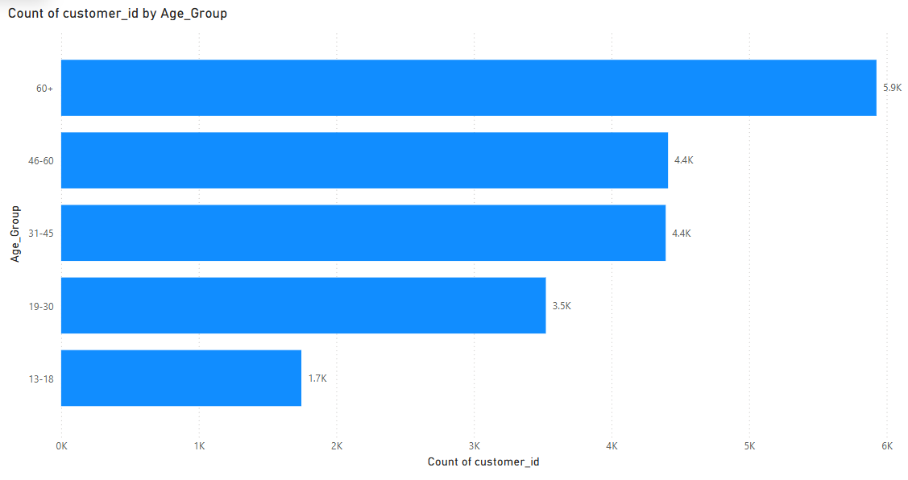
Customer Demographics Analysis

Slide 6
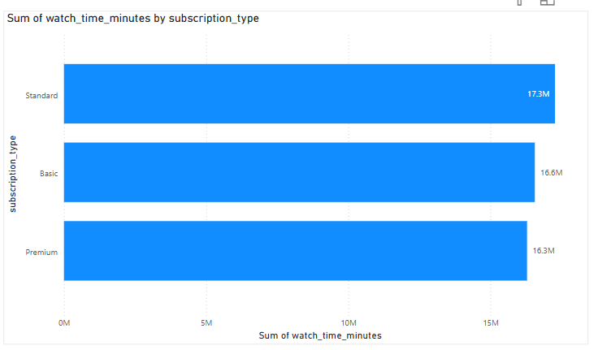
Subscription Type vs. Watch Time

Slide 7
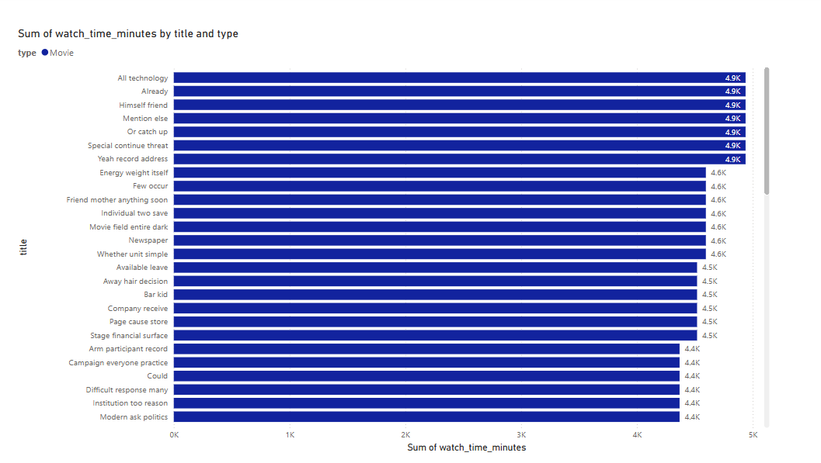
Top 10 Most Watched Movies

Slide 8
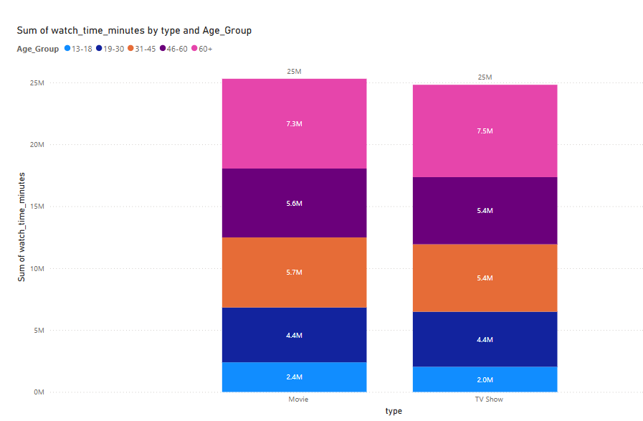
Compare watch time for Movies vs. TV Shows.

Slide 9
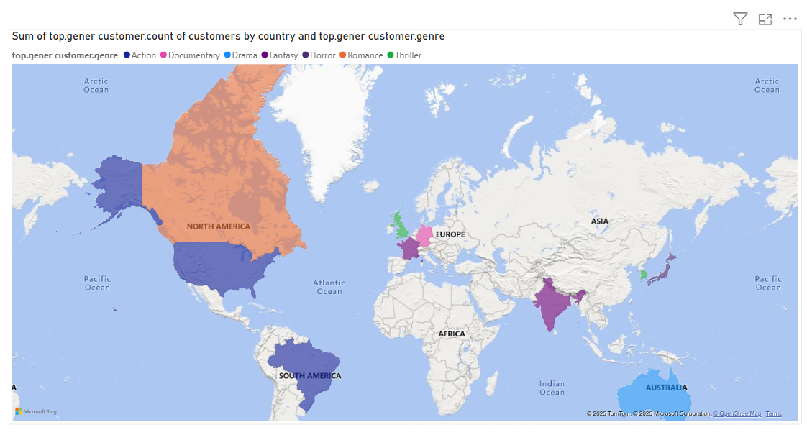
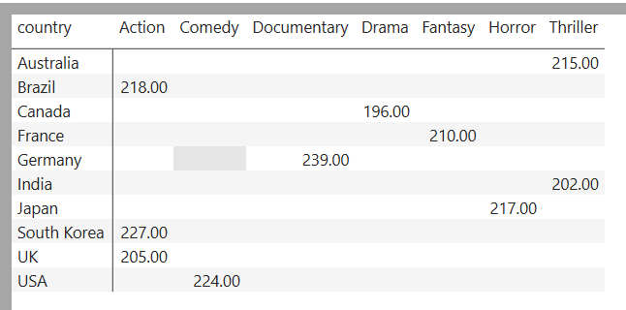
Genre Popularity by Country

Slide 10
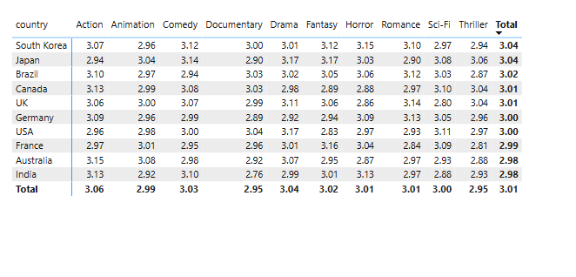
Analyze the distribution of user ratings (1–5 stars)
"Created a matrix table with Genre in Rows, Country in Columns, and Average Rating in Values to find the average rating per genre and per country."

Slide 11
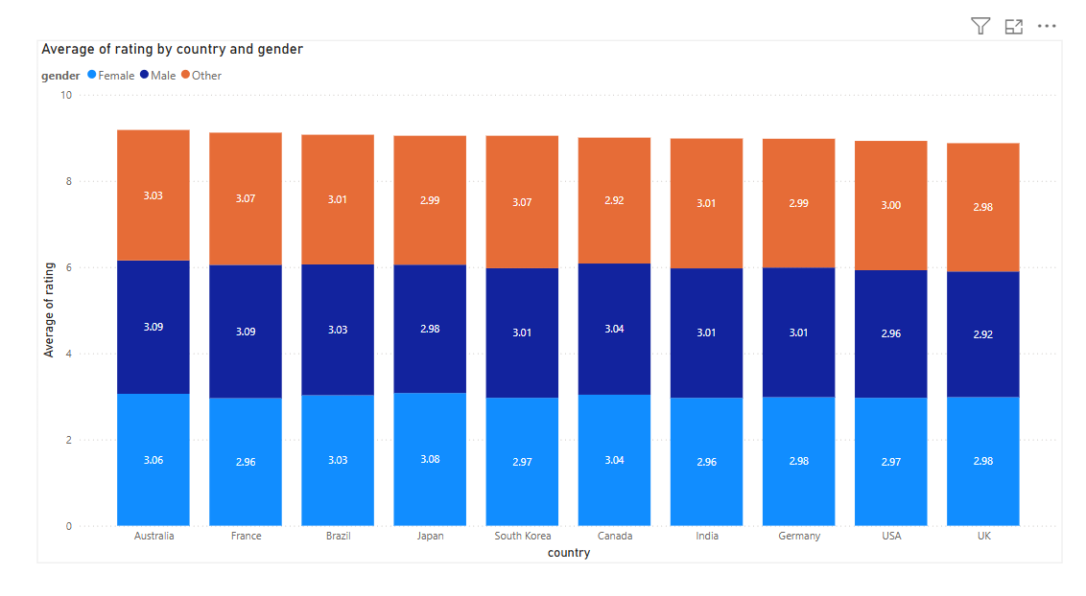

Slide 12
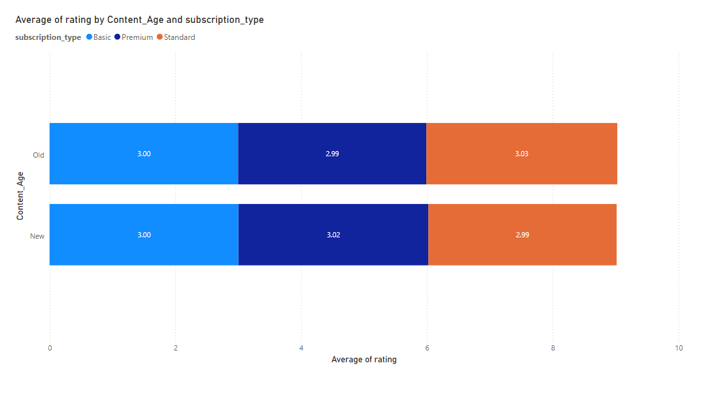
Trending Content Analysis

Slide 13
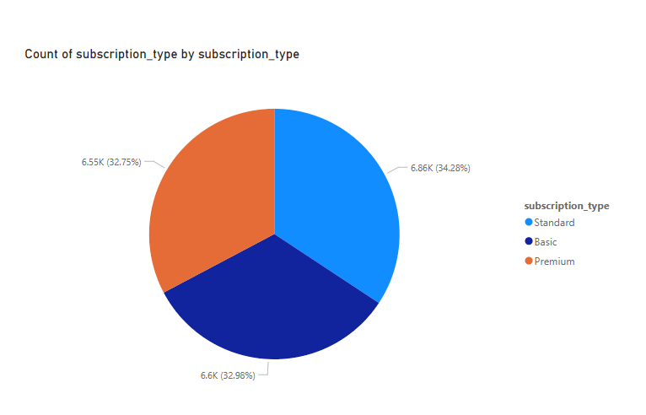
Subscription Market Share Analysis

Slide 14
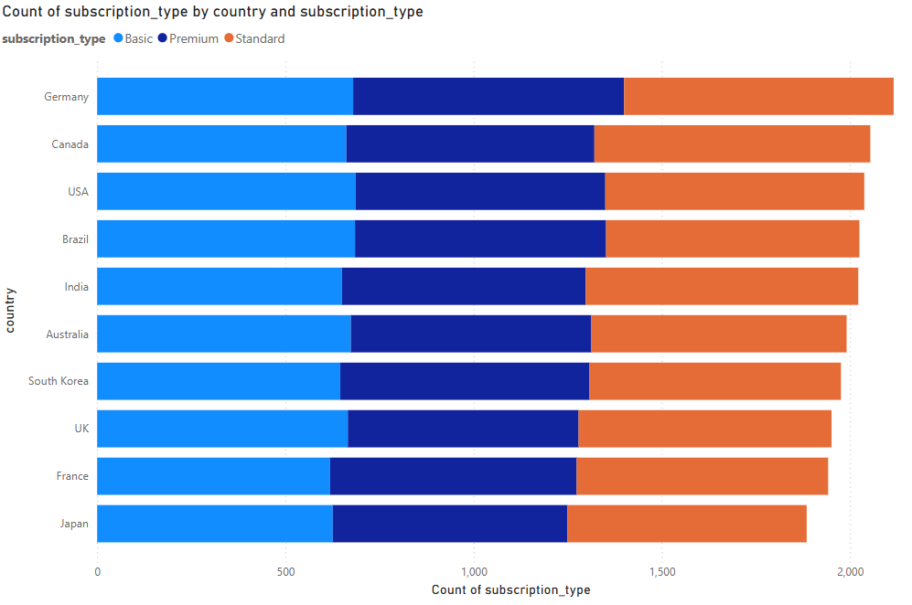

Slide 15
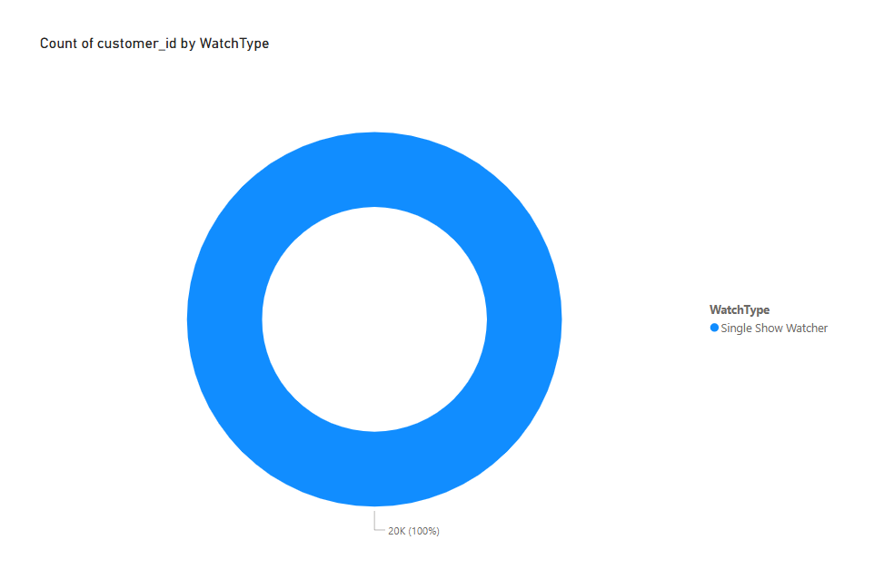
Customer Retention Insights

Slide 16
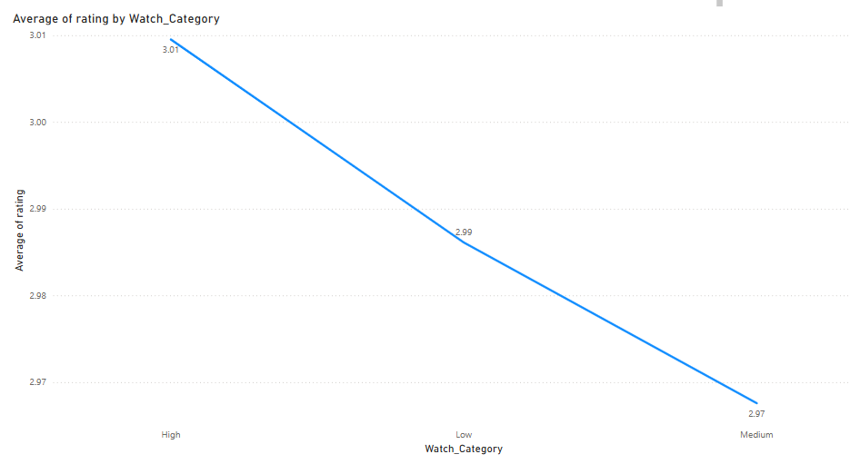

Slide 17
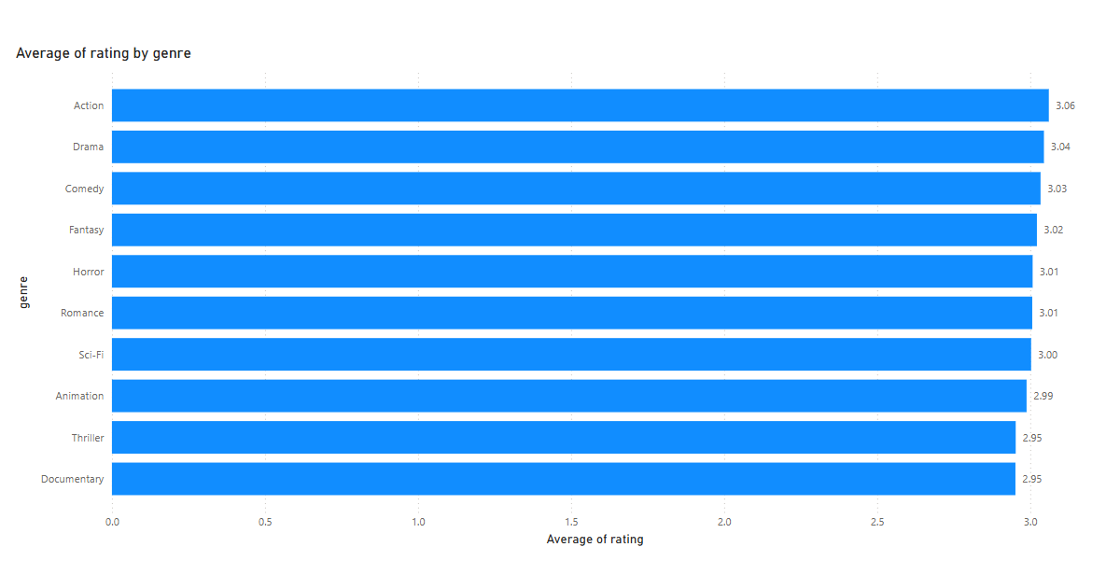
High-Rated vs. Low-Rated Content

Slide 18
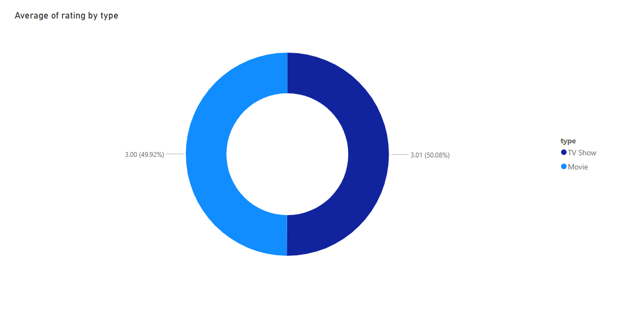
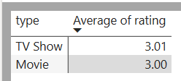

Slide 19
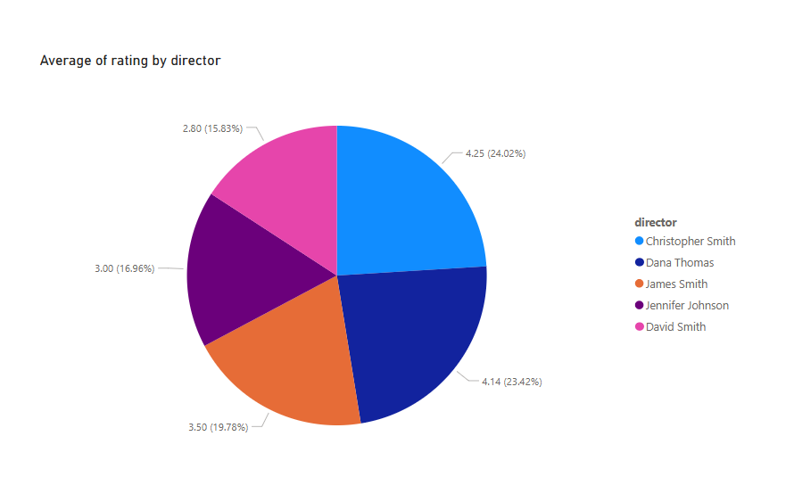
Director & Cast Influence on Ratings

Slide 20
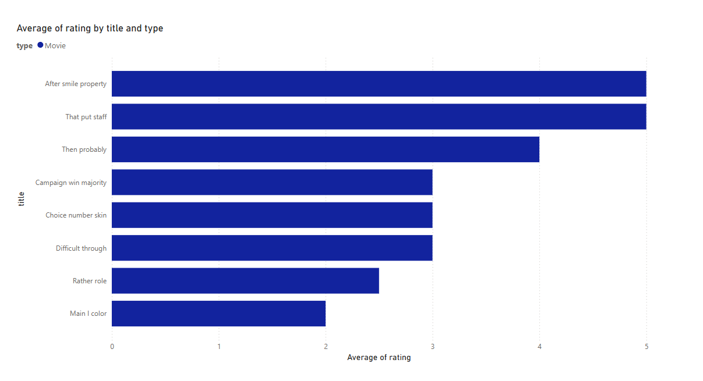

Slide 21
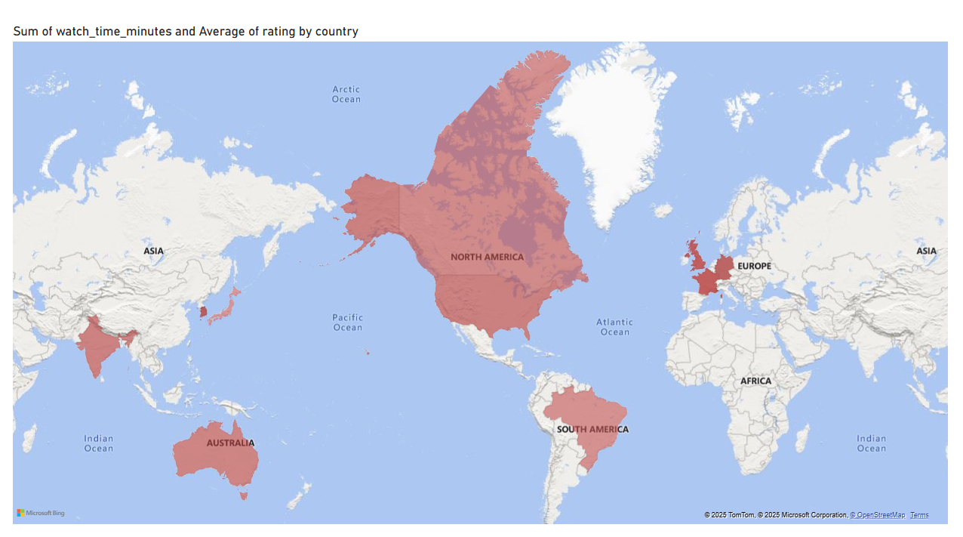
Content Localization Strategy

Slide 22
Country | Issue Identified | Recommended Action
Australia | Low customer ratings (2.98 avg) | Improve quality content in Aussie dramas & crime genres. Use local stars to boost appeal.
France | Low ratings (2.99) + lower watch time | Expand French originals, collaborate with local creators, and dub global hits in French.
India | Low ratings (2.98) despite decent watch time | Focus on high-quality Bollywood thrillers & regional shows. Remove/reduce low-rated content.
Japan | Low watch time but high ratings (3.04) | Increase anime & local drama releases. Boost marketing and optimize for mobile engagement.

Slide 23
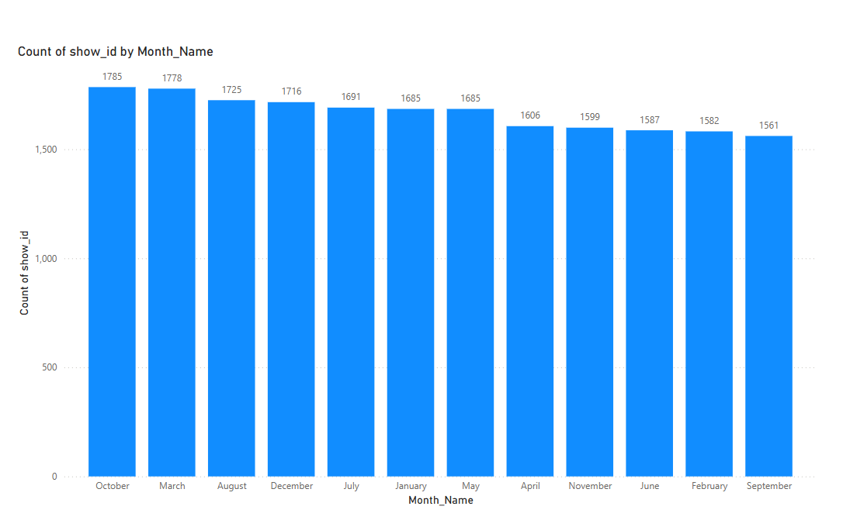
Best Time to Release New Content

Slide 24
Customer Engagement Dashboard
Create a dashboard showing customer engagement trends (watch time, ratings, most popular genres, and subscription types).
Use slicers to filter by country, age group, and subscription type
Steps :
Card Visual :
Created a card to display Total Watch Time and Used field: SUM of watch_time_minutes
Donut Chart:
Visualized Average Ratings, Axis: Watch_Category and Values: Average of rating
Pie Chart:
Showed Customer Count by Subscription Type, Axis: subscription_type and Values: Count of customer_id
Map Visual:
Displayed Most Popular Genre by Country, Axis: top.gener customer.genre and Values: top.gener customer.count of customers
Added Slicers to filter dashboard by:
subscription_type, country, Age_Group and Verified that visuals update based on slicer selection
Adjusted layout for better readability and presentation

Slide 25
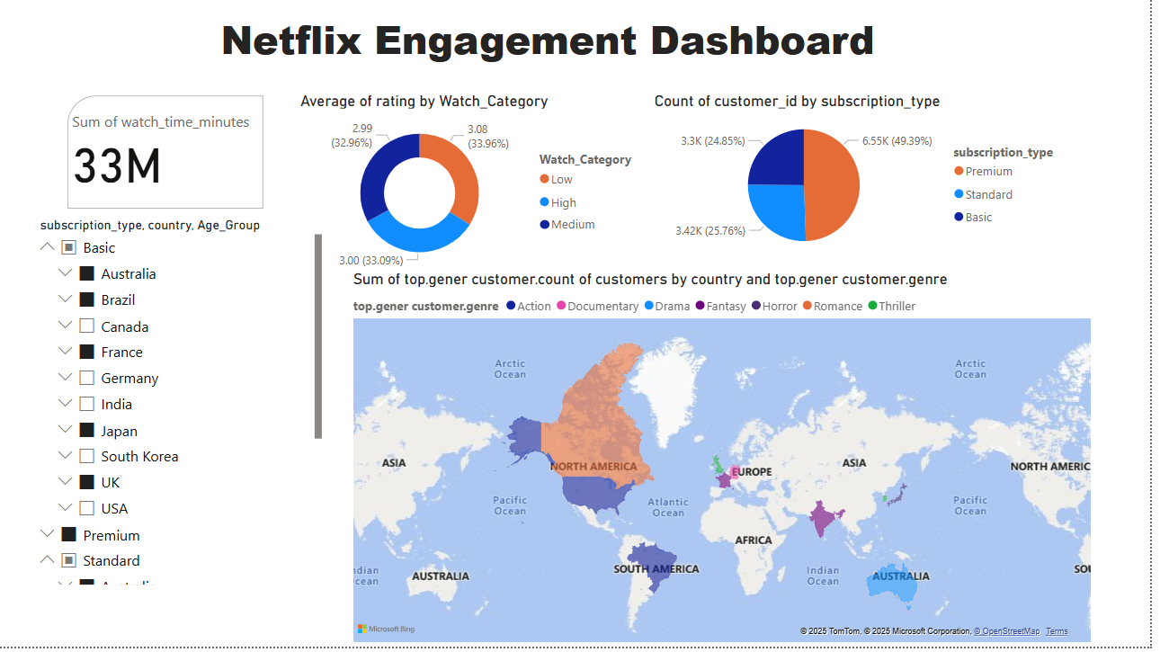

Slide 26
Competitor Benchmarking Simulation
Compare Netflix's content availability and ratings by country.
If Netflix had a competitor with different content strategies, what improvements should Netflix make based on user preferences?

Slide 27
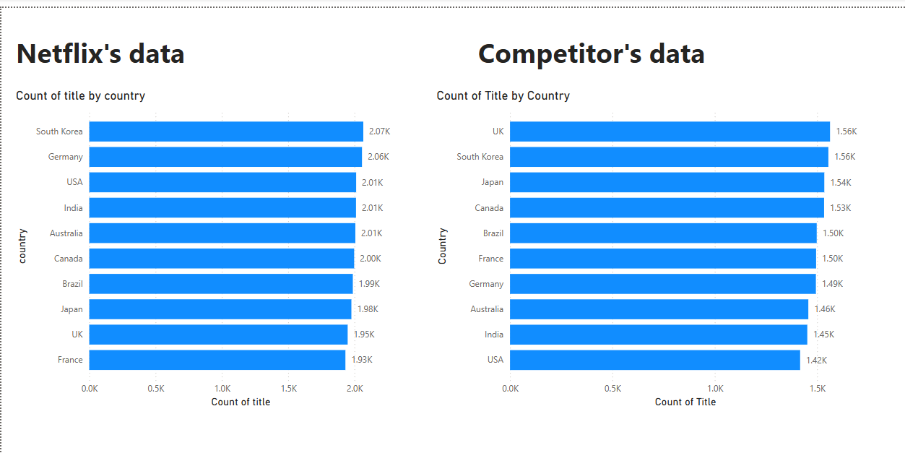
Content availability

Slide 28
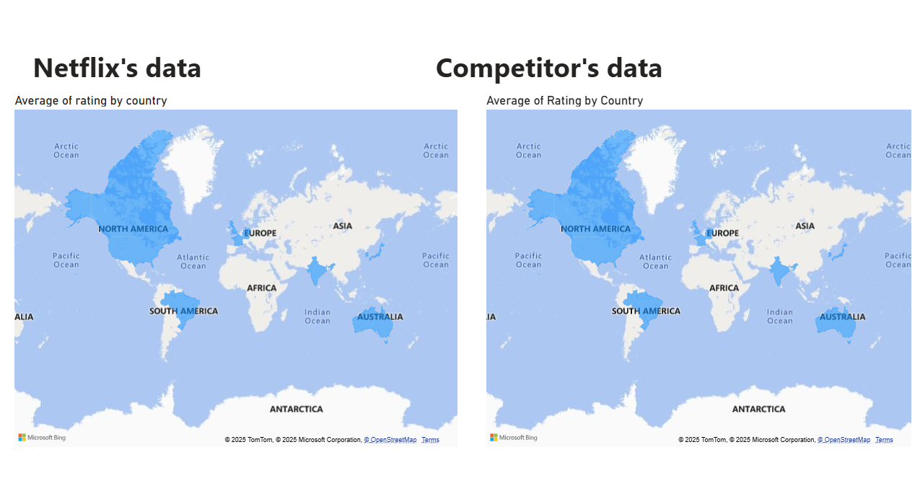
Ratings by country

Slide 29
Competitor Benchmarking Insights
Content Availability (Count of Titles):
Netflix has higher content than the competitor in all countries. ✅ No immediate concern here.
User Ratings (Average Rating by Country):
South Korea: Competitor rating is 3.07, Netflix is 3.04 → slight improvement needed.
Japan: Competitor 3.01, Netflix 3.04 → Netflix better.
USA: Competitor 2.97, Netflix 3.00 → Netflix better.
France: Competitor 2.94, Netflix 2.99 → Netflix slightly better.
Brazil: Competitor 2.95, Netflix 3.02 → Netflix clearly better.
UK: Competitor 2.97, Netflix 3.01 → Netflix better. 🔍 Only in South Korea, competitor ratings are slightly higher.

Slide 30

Recommendations for Netflix
Focus on South Korean content quality to improve ratings.
Conduct user feedback analysis in South Korea for improvement ideas.
Continue content strategy in other countries – Netflix is ahead.

Slide 31
Thank you!
Do you have any questions ?
dineshgilli777@gmail.com
+91 9080345590

