Slide 1

PenToPublic
Presented By:
Dinesh Dantal (250245920024)
Supriya Kulkarni (250245920044)
Sahil Kurhe (250245920046)
Amruta Nichale (250245920053)
Piyush Rajhans (250245920061)
Notes:
NOTE:
To change the image on this slide, select the picture and delete it. Then click the Pictures icon in the placeholder to insert your own image.

Slide 2
INTRODUCTION
This project is about building an online book platform that supports both authors and readers..
Authors can publish their books for free in PDF or audiobook format, without going through a complex or expensive process.
Readers can choose how they want to access books — they can read for free (for selected books) or subscribe for unlimited access to premium content. Audiobooks can also be used if available.
The platform is designed to be easy to use, flexible, and affordable, making it easier for authors to share their work and more convenient for readers to enjoy books in different formats.

Slide 3
PROBLEM DEFINATION
Traditional publishing is often costly, slow, and inaccessible for many aspiring authors.
Existing platforms come with high entry barriers.
Authors need a free, simple, and efficient way to share their work with a wider audience.
Readers also seek a platform that offers affordable, flexible, and format-rich access to books.

Slide 4
GOLAS AND OBJECTIVE
🎯 Goal
Simplify the publishing process for authors by offering a cost-free platform
Enhance the reading experience with flexible format options (PDF, audiobook)
Deliver user-friendly access through both free and subscription model.
✅ Objectives
Free Self-Publishing
Flexible Access for Readers
Audiobook Integration
User-Friendly Interface
Reading Progress Tracking
Secure Payment Gateway

Slide 5
SCOPE
Digital self-publishing platform with audio and text book support
Admin-controlled book approval mechanism
Payment tracking and book access history
Reading progress tracking and page-turn simulation
Designed for extensibility and future enhancements
Future Scope
✍️ Integrated Writing Environment for Authors
🌐 Community & Interaction Page
📊 Personalized Recommendations with AI
🔄 Dynamic Content Access Based on Subscription Tier

Slide 6
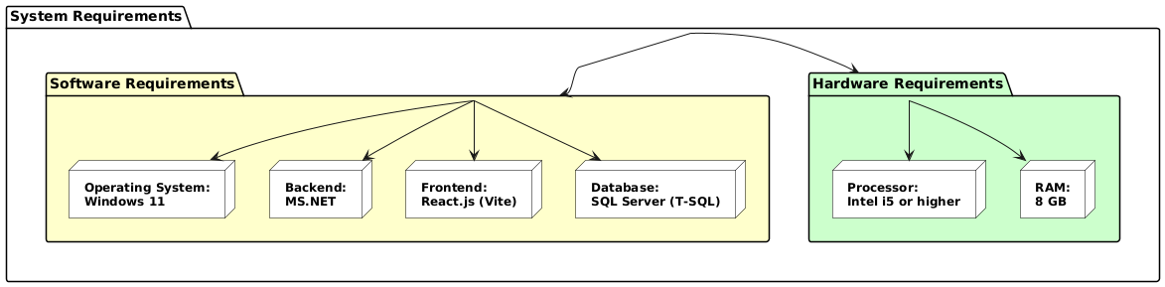

Slide 7
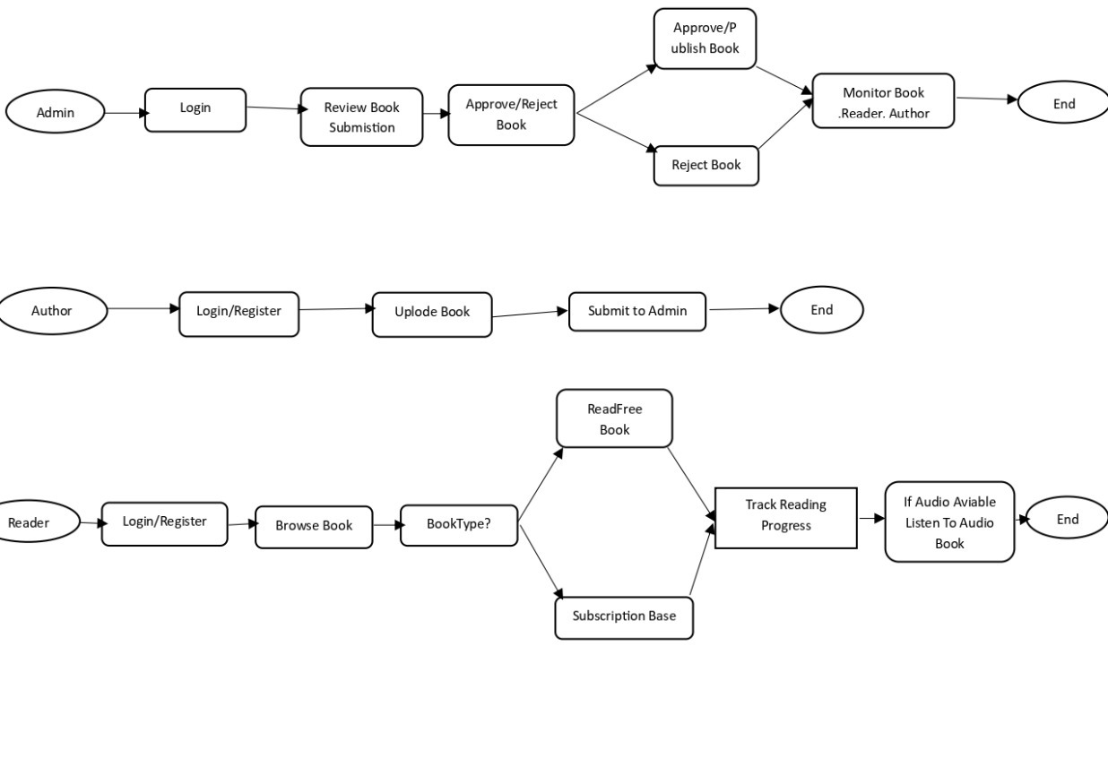
Activity Diagram

Slide 8
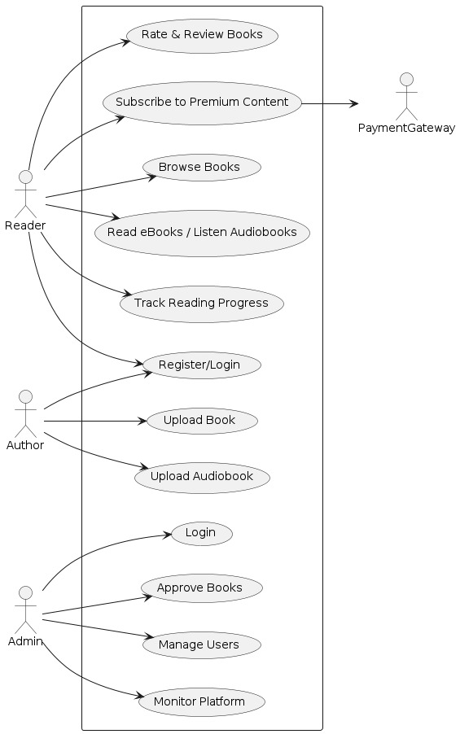
Use-Case Diagram

Slide 9
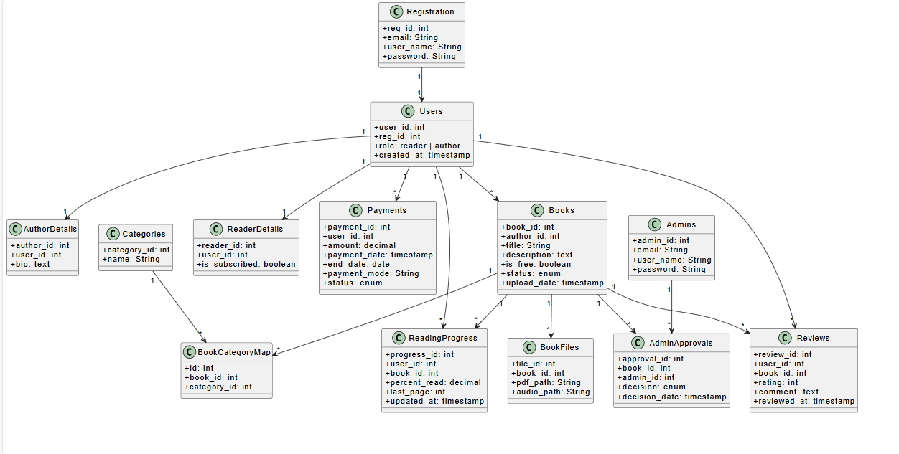
Class Diagram

Slide 10
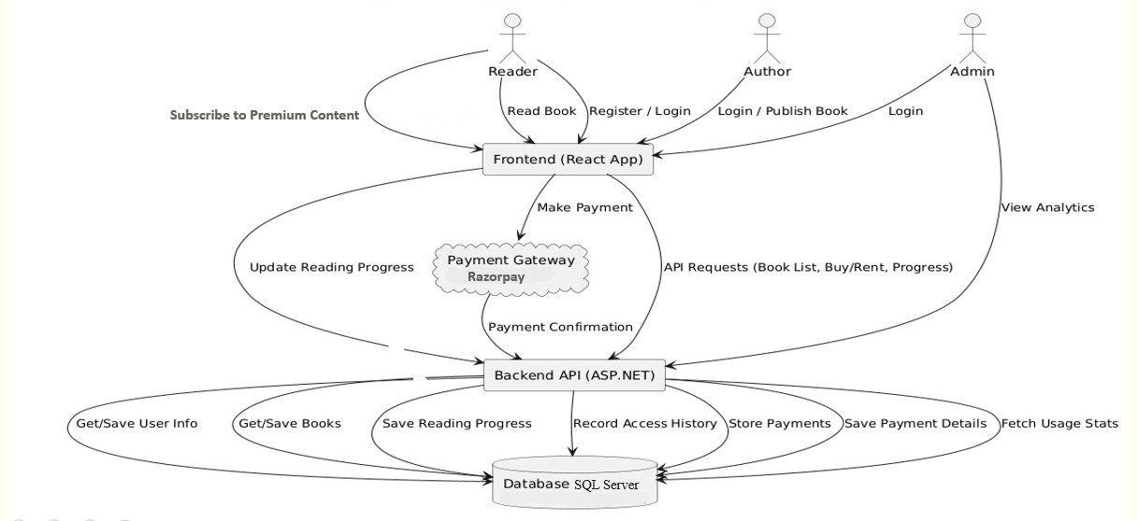
Data Flow Diagram

Slide 11
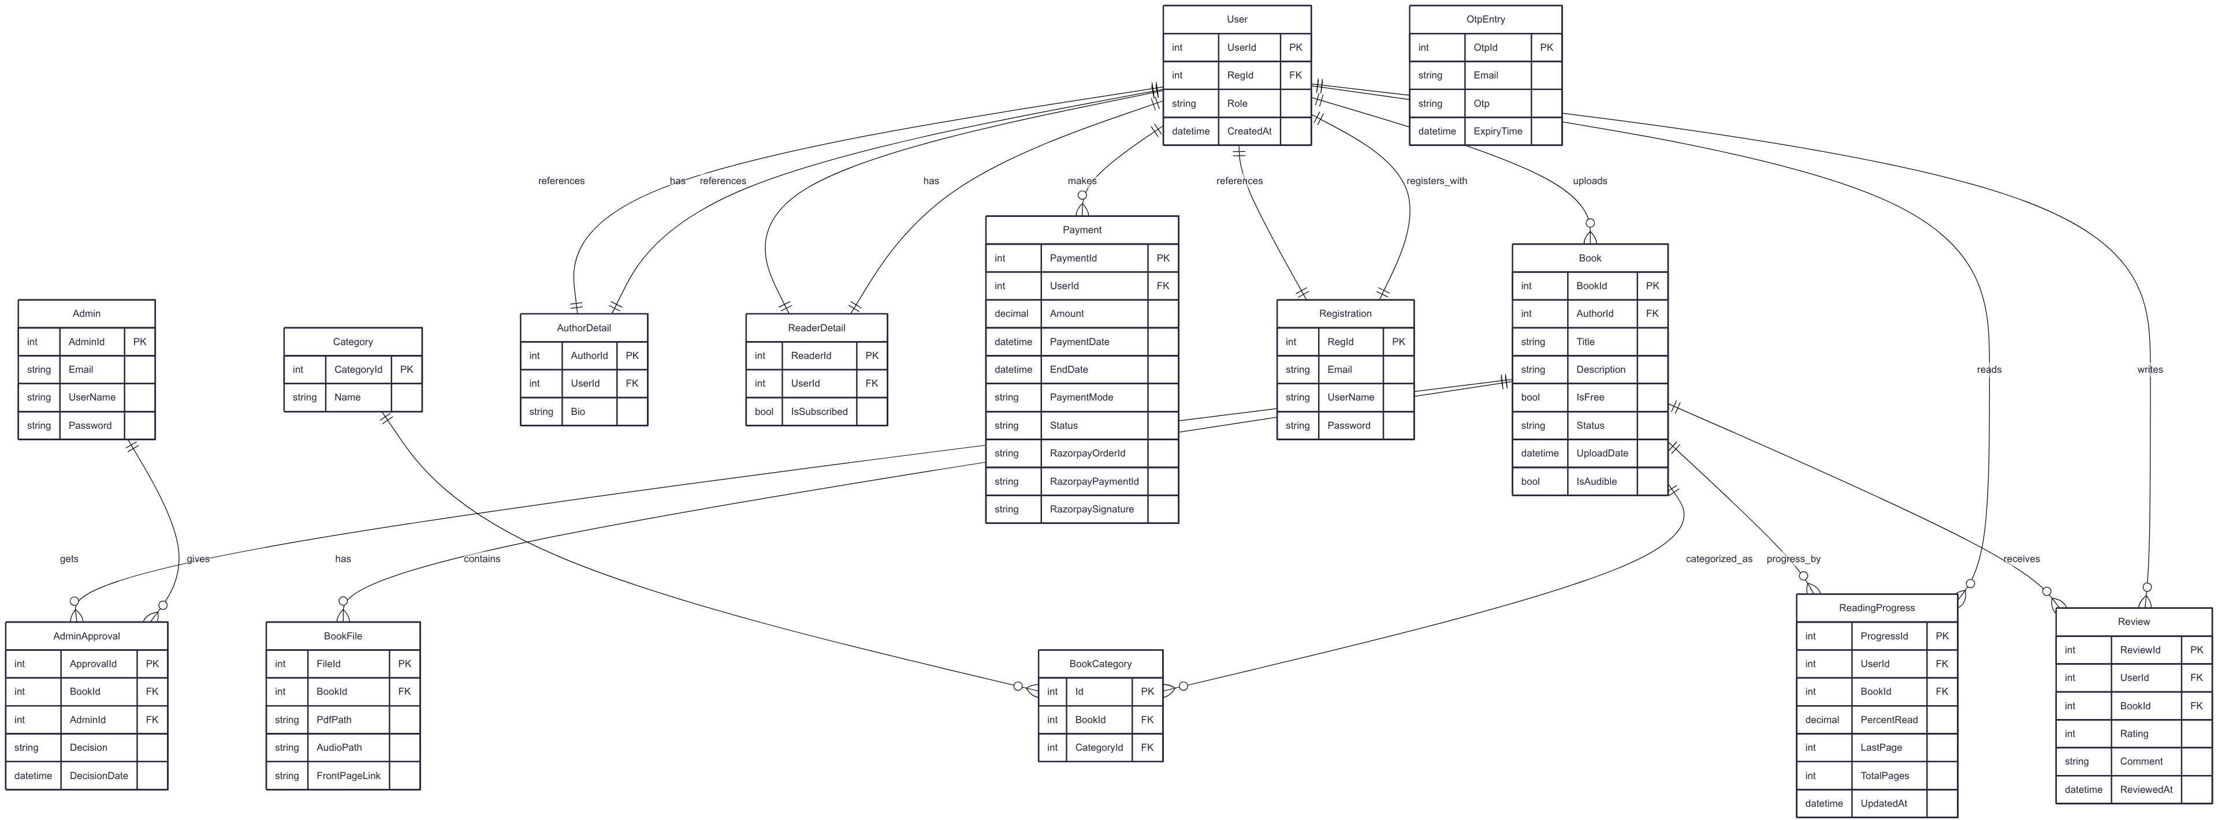
ER Diagram

Slide 12
Thank You

