Slide 1
GRIDLOCK HACKATHON 2.0
AI-Powered Traffic
Intelligence Platform
Prototype Round 2 | Decentralized Edge AI for Urban Mobility
TEAM MEMBERS
PRESENTED BY
DRACO 2.0
Gridlock Hackathon 2.0 – Round 2
JAYASURYA K
DHINESH R
DINESH E
DHIVYA PRAKASH J
Bengaluru Urban Traffic Intelligence | Edge AI | Explainable ML

Slide 2
2
Problem Statement
Urban Congestion Crisis
Resource Misallocation
Need for Predictive AI
Bengaluru loses 243 hours per year per commuter to traffic. Reactive systems fail to prevent bottlenecks before they form.
Emergency vehicles, traffic personnel and diversions are deployed reactively — without data-driven prioritization or cost modeling.
Existing systems lack explainability and edge deployment. Centralized models introduce latency and single-point-of-failure risks.
AI-Powered Traffic Intelligence Platform | Gridlock Hackathon 2.0

Slide 3
3
Proposed Solution
A Decentralized, Predictive Traffic Management Platform
1
2
3
4
Data Layer
ML Engine
▶
Edge AI
▶
Dashboard
▶
Traffic Incidents
Weather &
Geospatial Data
XGBoost Classifier
HistGradientBoost
SHAP Explainability
ONNX Runtime
On-device Inference
Fault Isolation
React+vite & No backend
Real-time Maps
Risk Alerts
KEY OBJECTIVES
Proactive congestion prediction 15–30 min ahead
Edge AI inference — no central server dependency
SHAP-driven model explainability
Real routing via OSRM for exact diversion planning
AI-Powered Traffic Intelligence Platform | Gridlock Hackathon 2.0

Slide 4
4
Dataset and Data Sources
DATASET OVERVIEW
DATA PREPROCESSING
Traffic incident dataset (Bengaluru)
01
Missing Value Handling
Identify & impute missing fields
Lat/Long coordinates (start & end)
02
Outlier Detection
IQR method on duration_minutes
Temporal features: hour, day, month
03
Label Encoding
Weather: rainfall, temperature, condition
Ordinal encoding for zone, vehicle type
04
One-Hot Encoding
Event cause: accident, construction, etc.
Weather, event type features
Priority and vehicle type attributes
05
Feature Scaling
StandardScaler for numeric columns
Congestion severity label (Low/Med/High)
06
Train/Test Split
80/20 stratified split
AI-Powered Traffic Intelligence Platform | Gridlock Hackathon 2.0

Slide 5
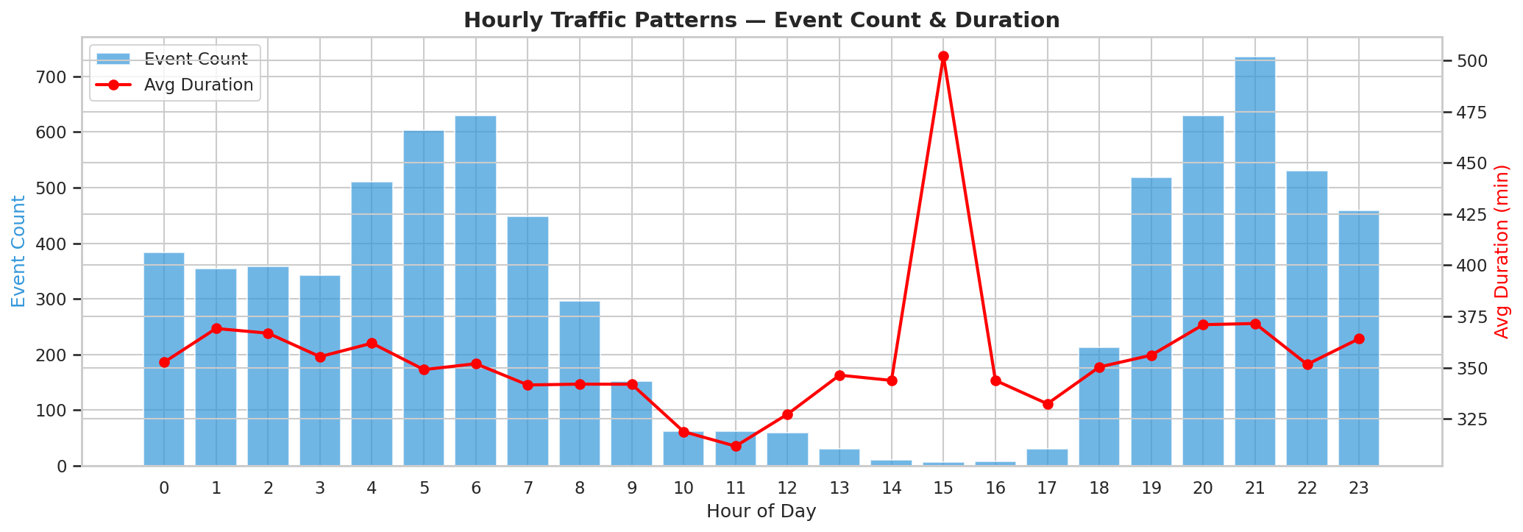
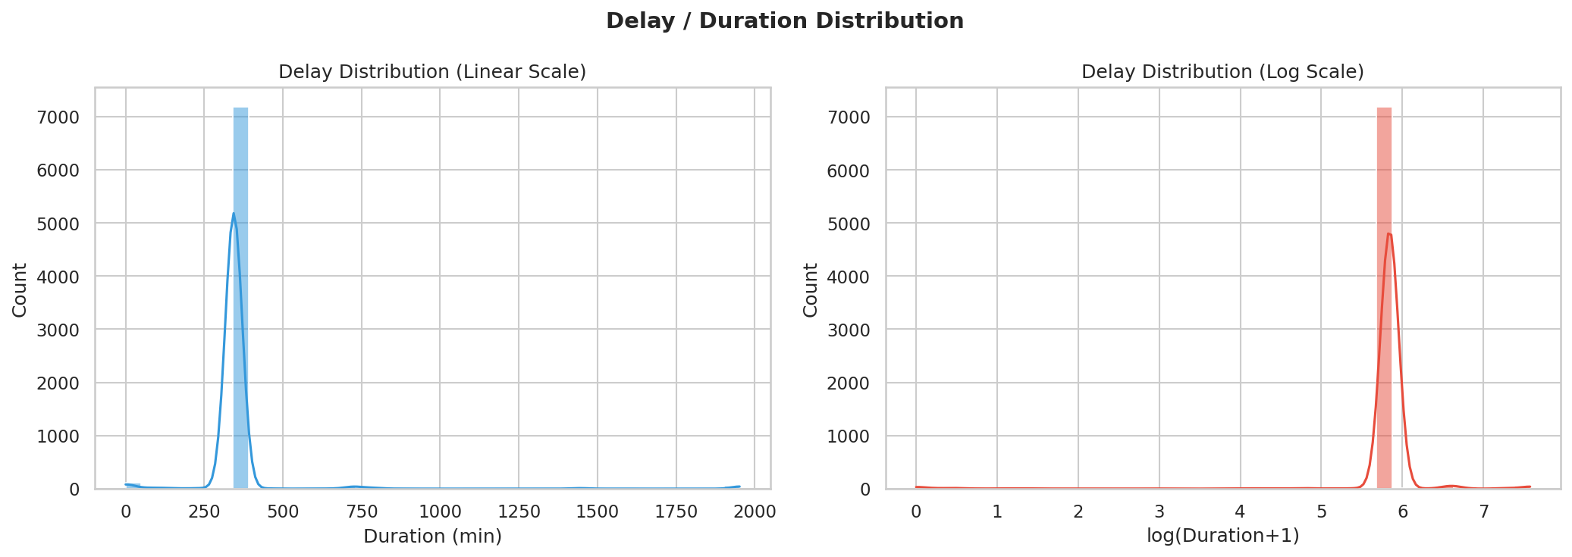
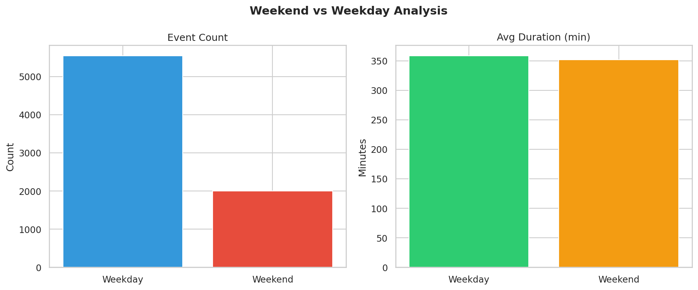
5
Exploratory Data Analysis
KEY EDA INSIGHTS
Peak incidents: 5–6 AM & 9–10 PM
Weekdays: 3× more events than weekends
Avg delay duration: ~350 minutes
15 PM spike: longest avg duration (500 min)
Duration is right-skewed with heavy tail
AI-Powered Traffic Intelligence Platform | Gridlock Hackathon 2.0

Slide 6
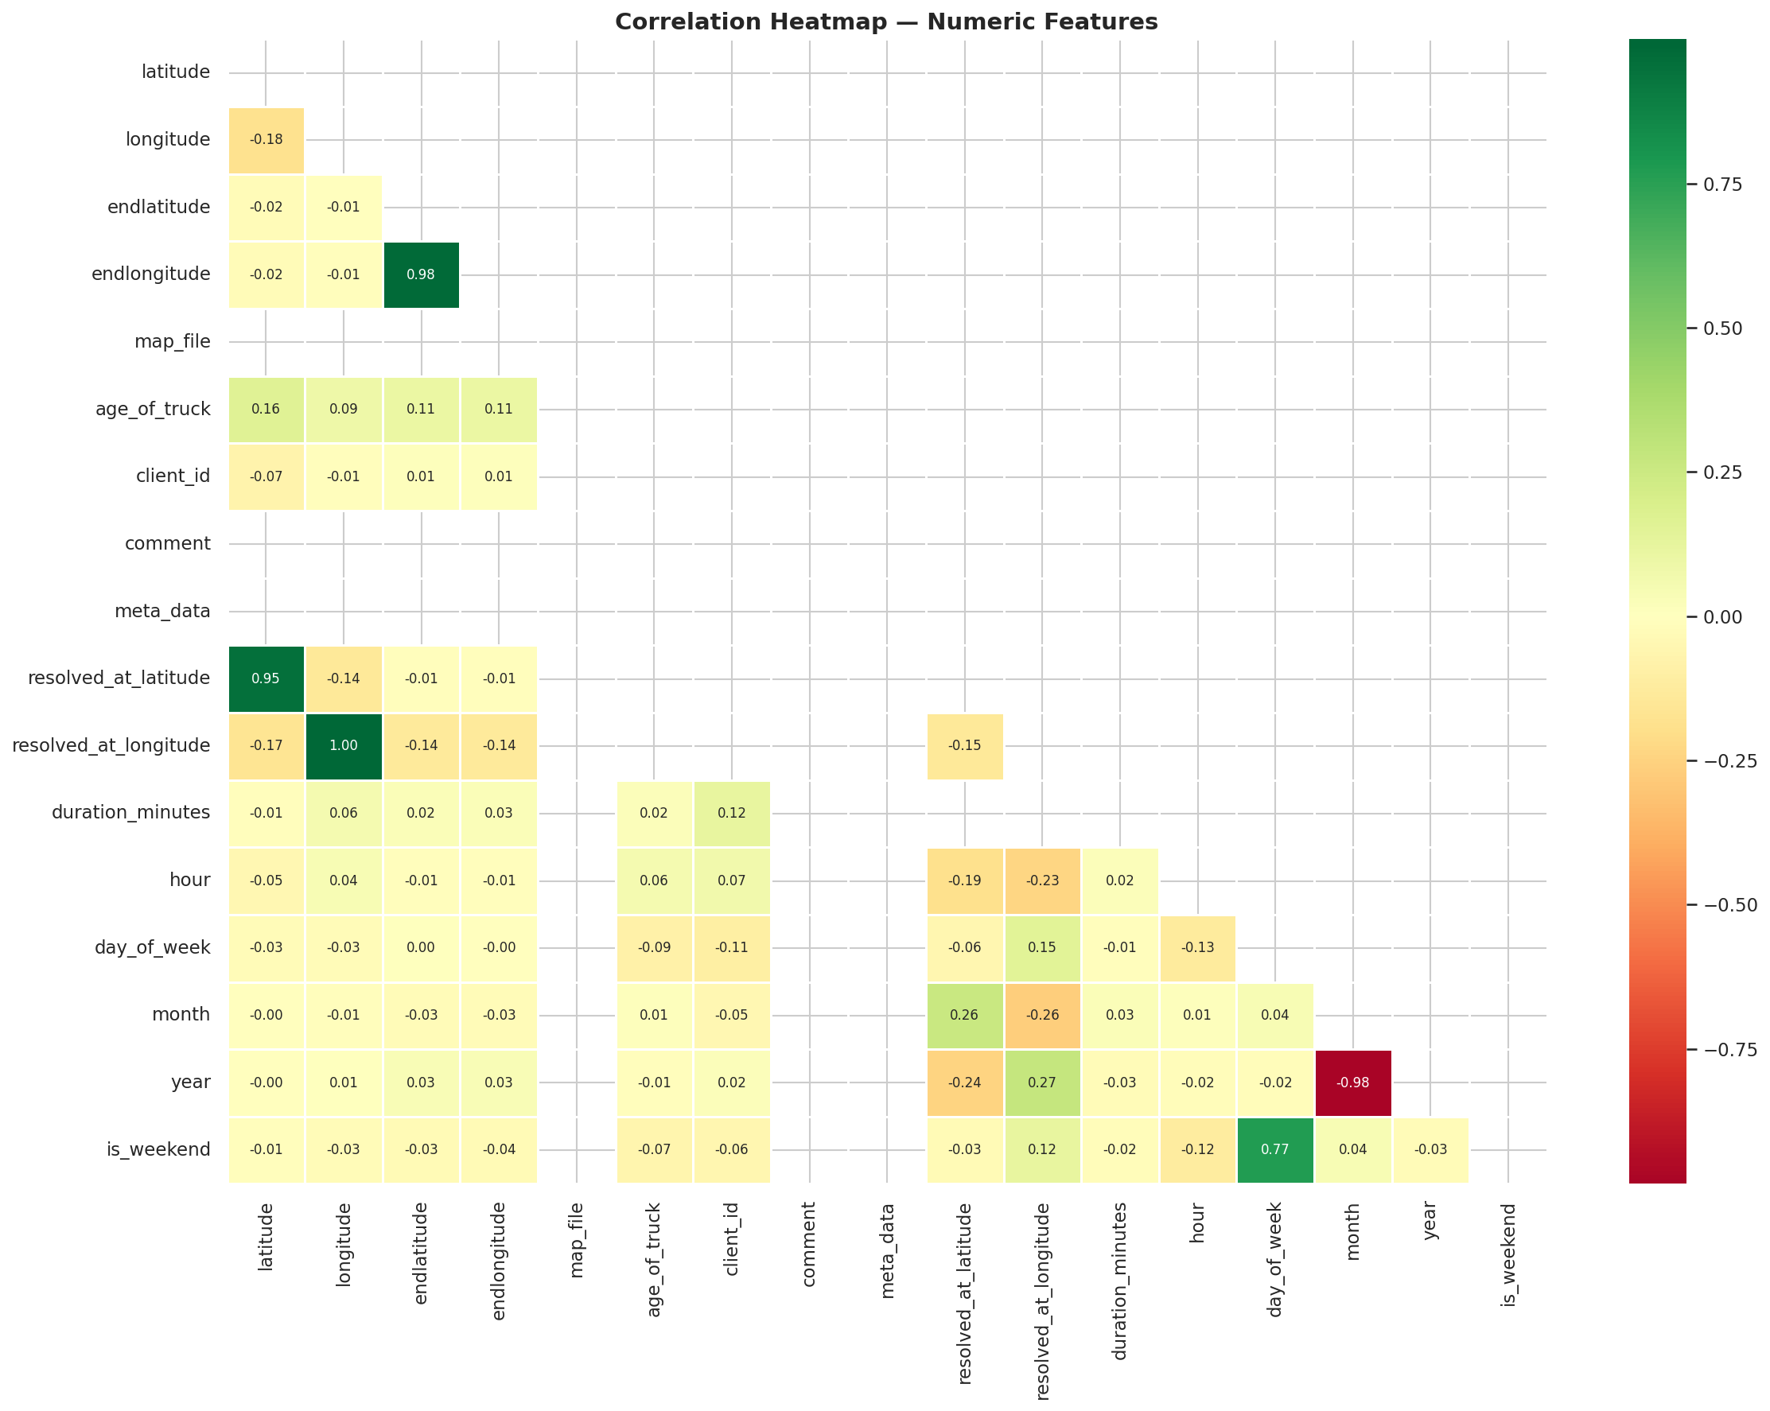
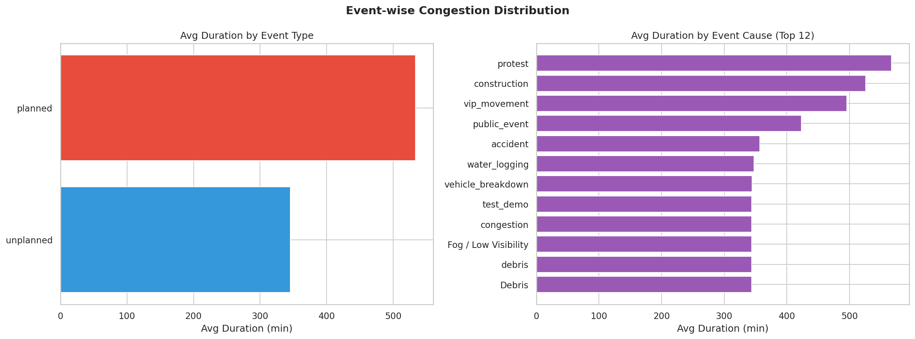
6
Geospatial Analysis
GEOSPATIAL HIGHLIGHTS
Interactive heatmaps using Folium
High-risk zones identified across Bengaluru
Protest & construction longest duration
Diversion routes via OSRM engine
endlongitude–longitude: 0.98 correlation
AI-Powered Traffic Intelligence Platform | Gridlock Hackathon 2.0

Slide 7
7
Feature Engineering
Derived Features
Risk Factors
Encoding Techniques
◆ hour (0-23 from timestamp)
◆ rainfall (mm)
◆ Label Encoding → ordinal features
◆ day_of_week (Mon=0…Sun=6)
◆ attendance (event size)
◆ One-Hot Encoding → weather, event
◆ month (1-12)
◆ nearby_parking (bool)
◆ Standard Scaling → numeric cols
◆ is_weekend (binary flag)
◆ event_cause_enc (ordinal)
◆ ONNX export for edge deployment
◆ historical_congestion score
◆ veh_type_enc (ordinal)
◆ JSON feature_cols for pipeline
◆ road_capacity estimate
◆ zone_enc (geographic zone)
◆ Pickle serialized scaler/encoder
AI-Powered Traffic Intelligence Platform | Gridlock Hackathon 2.0

Slide 8
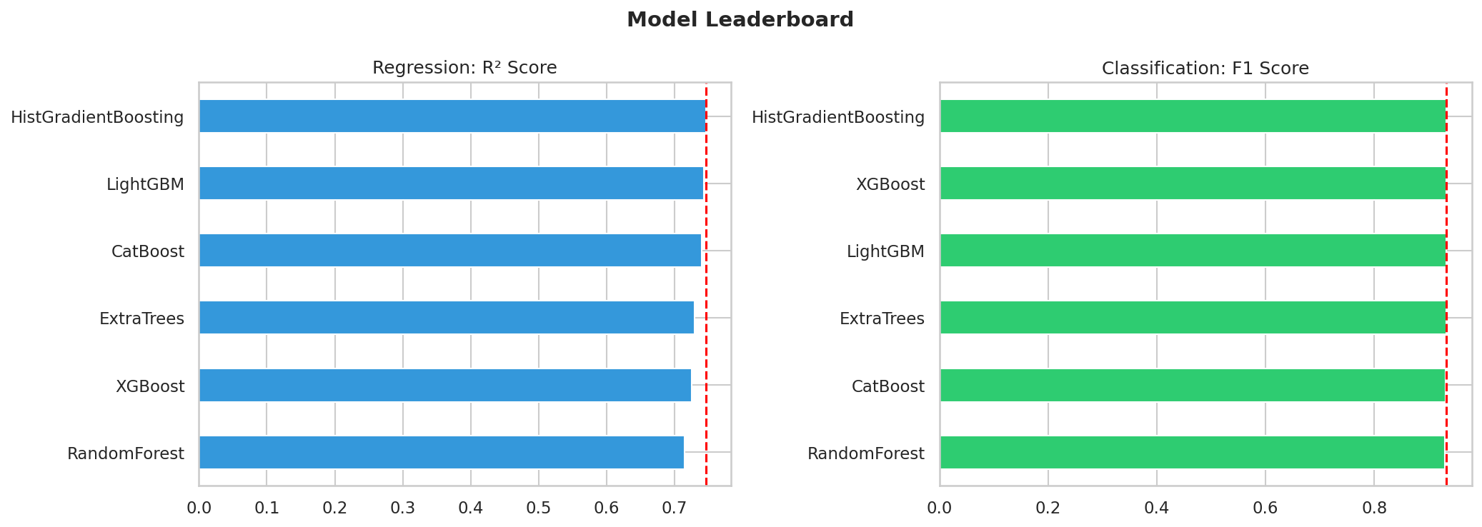
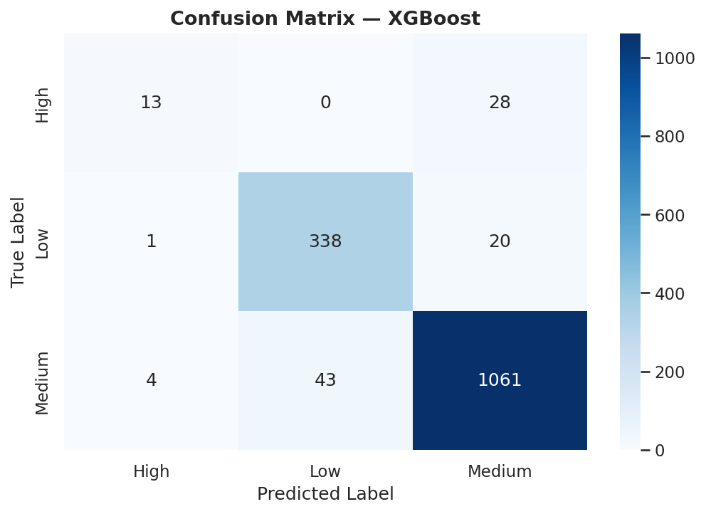
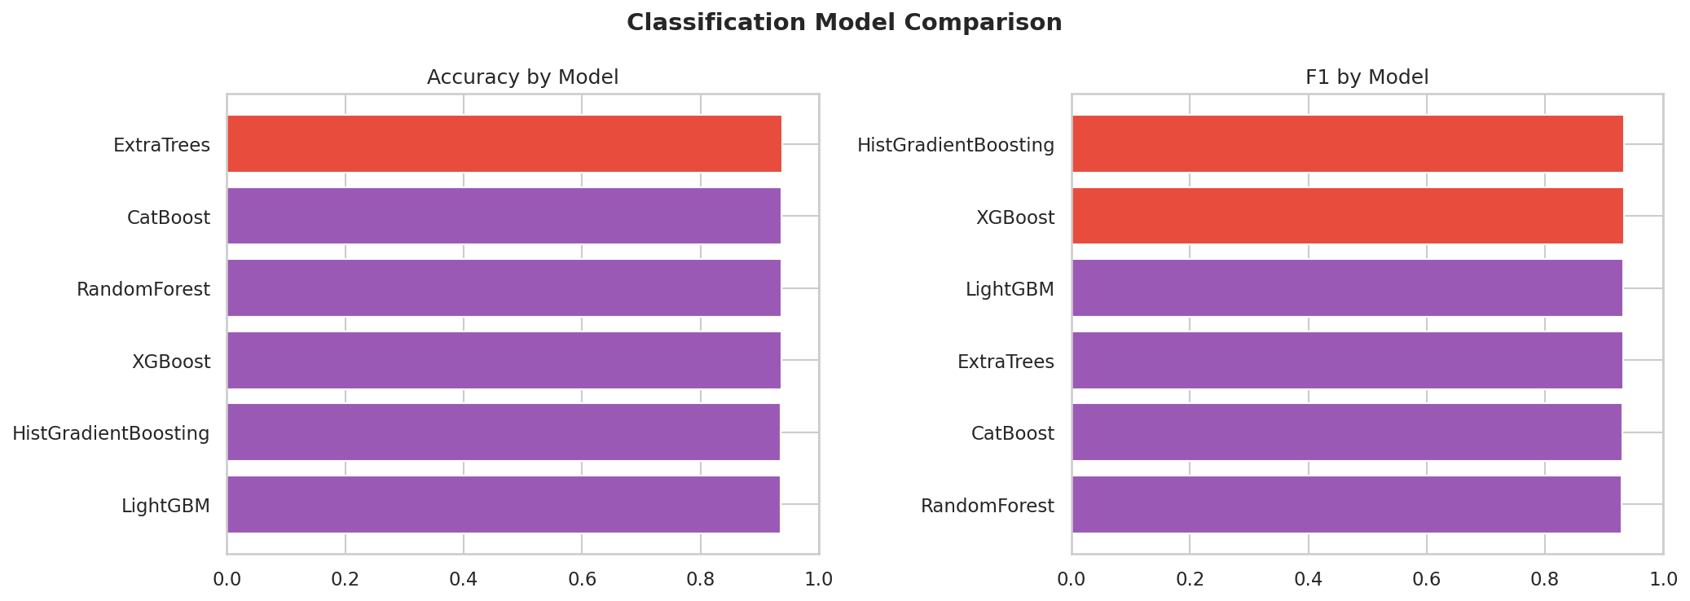
8
Congestion Prediction Model & Deployment
EDGE AI WITH ONNX
Decentralized
ONNX Runtime on-device, no central server
Fault Isolation
Local changes don't affect other users
Low Latency
Faster predictions, no network overhead
Privacy
Sensitive data stays on device
Scalable
No backend inference load increase
Reliability
Works offline / limited connectivity
AI-Powered Traffic Intelligence Platform | Gridlock Hackathon 2.0

Slide 9
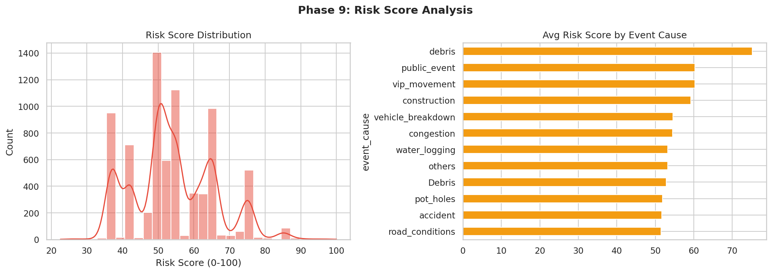
9
Risk Score Calculator
RISK METHODOLOGY
1
ML classifies congestion as Low / Medium / High
2
Risk Score (0-100) computed from weighted features
3
Rainfall, priority & attendance are top drivers
4
Score triggers alert level & resource dispatch
🔴 High Risk
🟡 Medium Risk
🟢 Low Risk
5
Historical scores feed back into model retraining
Score 70–100
Severe congestion expected
Immediate diversion needed
Score 40–70
Moderate slowdowns likely
Monitor & prepare resources
Score 0–40
Clear corridors
Normal traffic flow
AI-Powered Traffic Intelligence Platform | Gridlock Hackathon 2.0

Slide 10
10
Resource Optimization Engine
Smart allocation of traffic personnel, diversions & emergency vehicles — with INR cost modelling
ALLOCATION STRATEGY
COST MODELING (₹)
OPTIMIZATION LOGIC
▸ Risk-score-driven dispatch priority
▸ Resource cost vs. baseline in INR
▸ Minimize total delay × resource cost
▸ Emergency vehicle routing optimized
▸ Per-hour personnel deployment cost
▸ Greedy allocation by severity tier
▸ Personnel count vs congestion tier
▸ Vehicle dispatch overhead tracked
▸ OSRM distance/time for routing
▸ Parking & road capacity considered
▸ Savings from proactive diversion
▸ Simulation via What-If engine
AI-Powered Traffic Intelligence Platform | Gridlock Hackathon 2.0

Slide 11
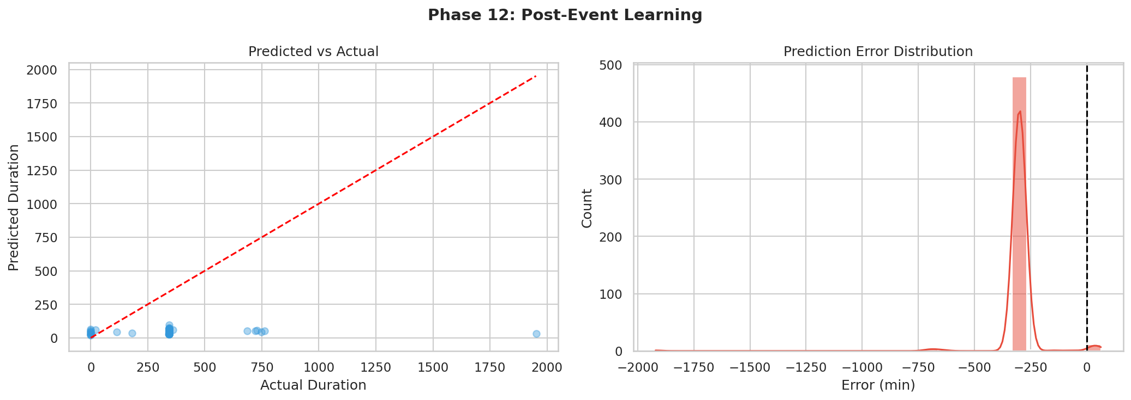
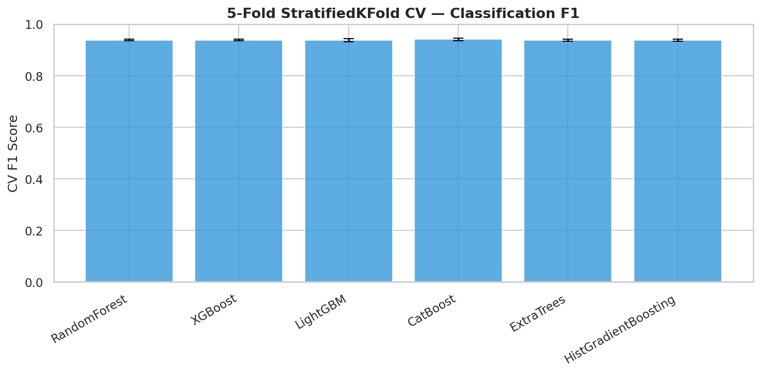
11
Digital Twin & What-If Simulation
SIMULATION FEATURES
Scenario Analysis
Test "What-if" traffic disruption scenarios before deployment
OSRM Routing
Real road network for exact distance & time-saved calculations
Congestion Sim
Simulate incident propagation and diversion impact
Post-Event Learning
Model updates from resolved incidents stored in SQLite DB
CV Validation
5-fold cross-validation ensures generalization
AI-Powered Traffic Intelligence Platform | Gridlock Hackathon 2.0

Slide 12
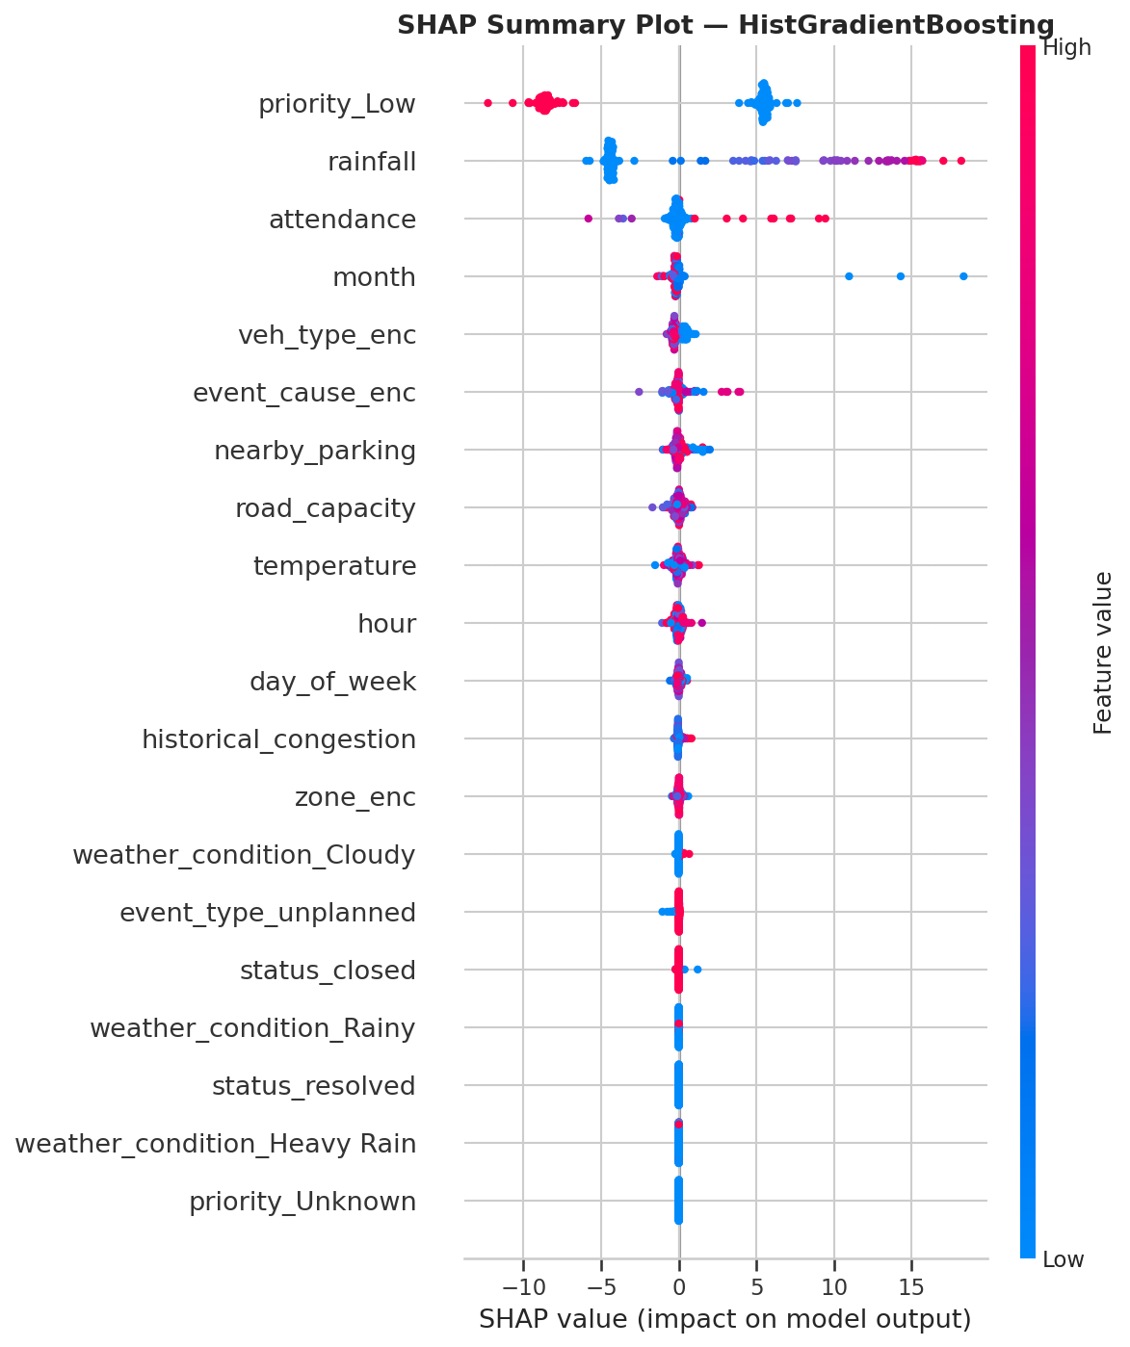
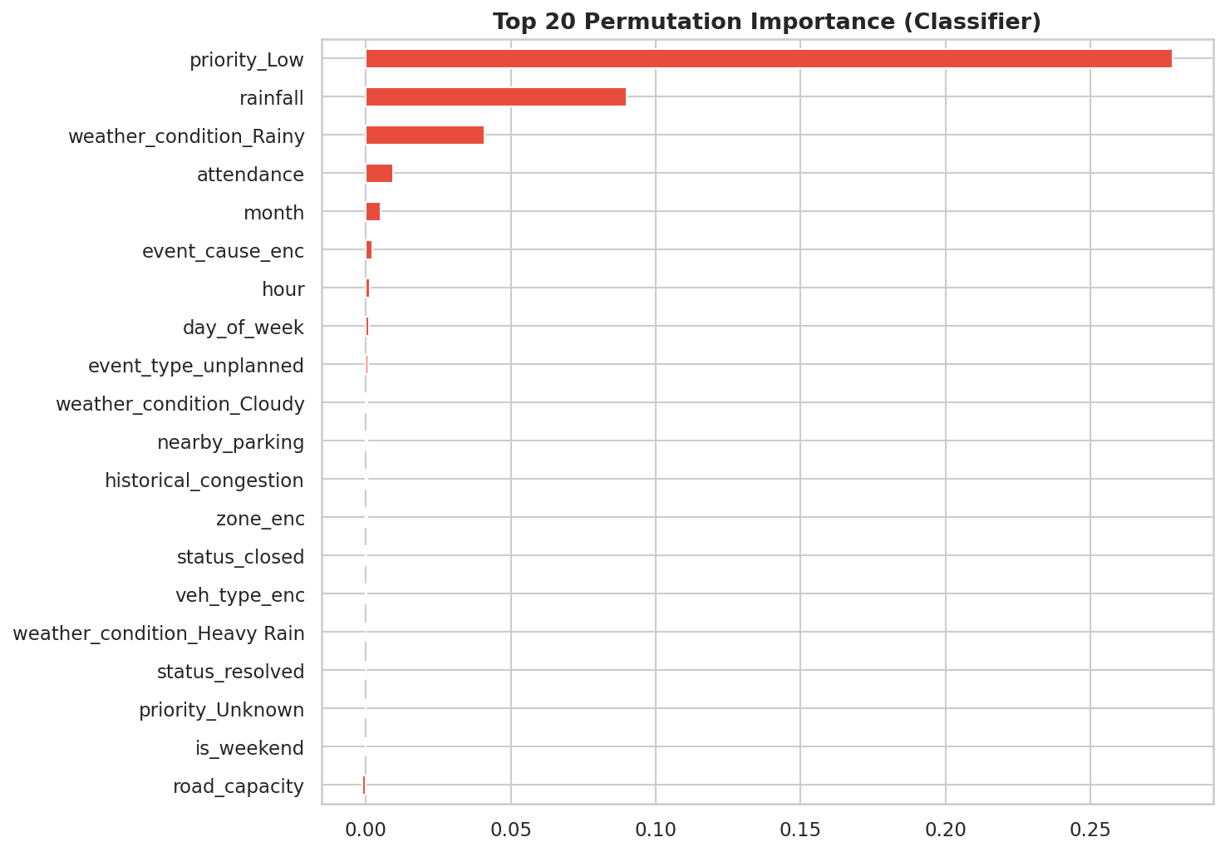
12
Explainable AI — SHAP Analysis
IINSIGHTS
priority_Low is the #1 SHAP driver
Rainfall has strong positive impact
Event attendance boosts delay
Month seasonality matters
Model decisions are fully explainable
AI-Powered Traffic Intelligence Platform | Gridlock Hackathon 2.0

Slide 13
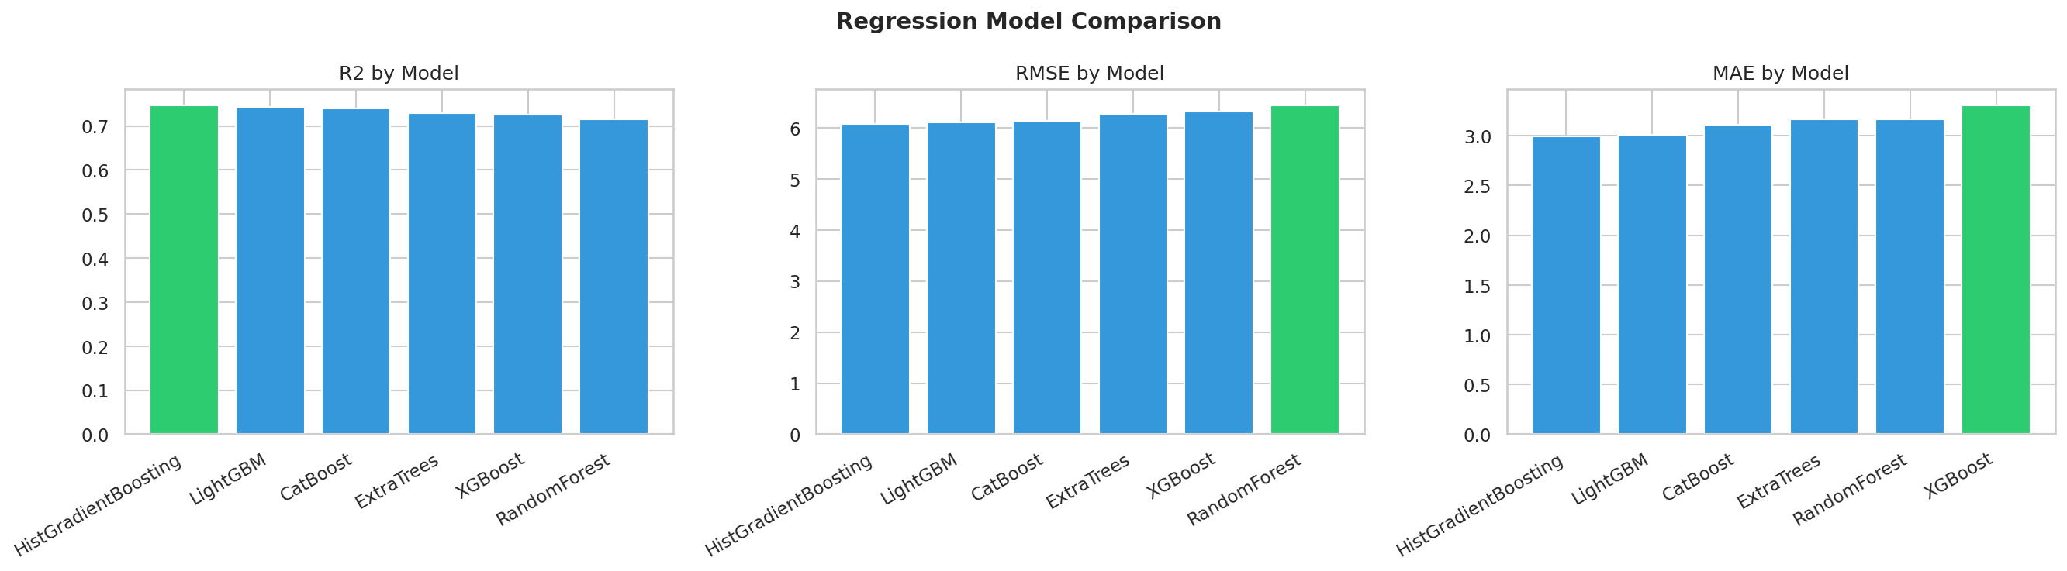
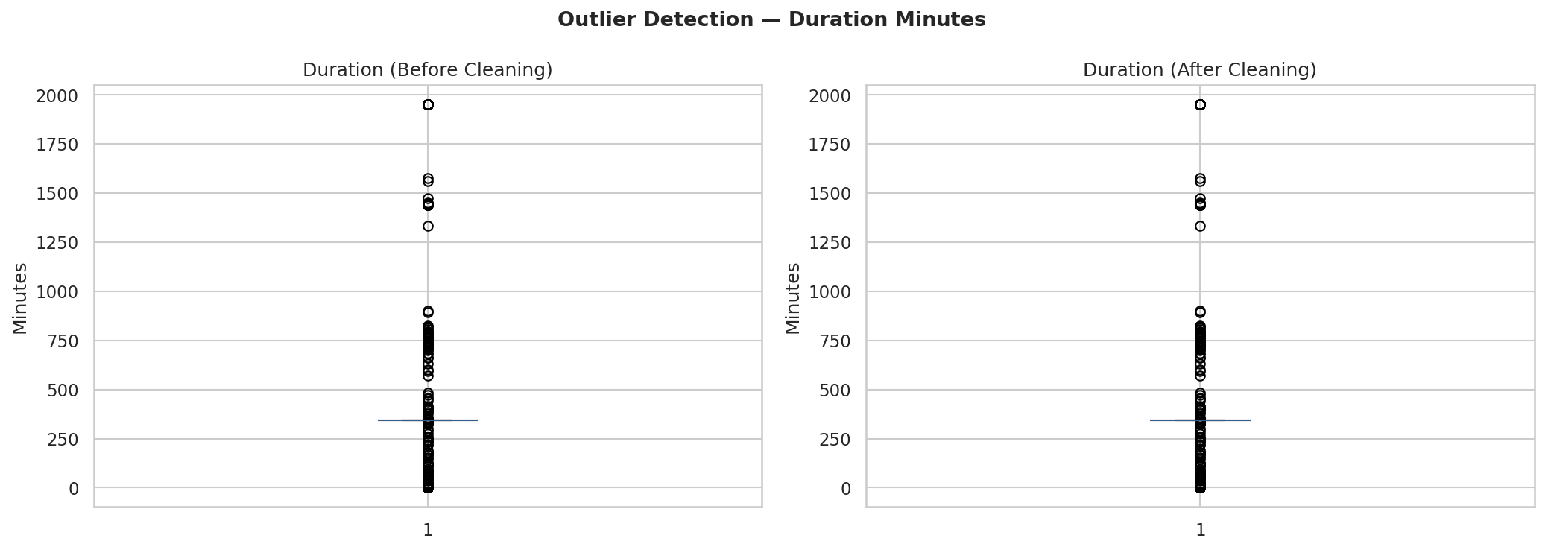
13
Results and Insights
~94%
~0.87
Classification Accuracy
F1 Score (XGBoost)
~0.73
ONNX
Regression R² Score
Edge Deployment Ready
KEY FINDINGS
HistGradientBoosting wins regression; XGBoost & HistGB tie for classification F1. Rainfall and event priority dominate predictions.
AI-Powered Traffic Intelligence Platform | Gridlock Hackathon 2.0

Slide 14
14
Working Prototype
Streamlit-powered dashboard with live risk scoring, diversion maps & What-If simulation engine
1
Input Event
2
ONNX Inference
3
Risk Score
User enters incident details: location, cause, weather, time of day
Edge model predicts severity class & delay duration locally
0–100 risk score computed; traffic light alert generated
4
Routing
5
Dashboard
OSRM calculates optimal diversion with exact distance & ETA
Folium heatmap + Streamlit UI shows live congestion overview
AI-Powered Traffic Intelligence Platform | Gridlock Hackathon 2.0

Slide 15
15
Tech Stack
Language
Data
ML
Python 3.10+
Pandas & NumPy
Scikit-Learn
ML
XAI
Geo
XGBoost
SHAP
Folium
UI
Edge
Routing
React+Vite
ONNX Runtime
OSRM
AI-Powered Traffic Intelligence Platform | Gridlock Hackathon 2.0

Slide 16
16
Impact and Benefits
Reduced Congestion
Emergency Response
✓ 30% fewer reactive incidents
✓ Faster ambulance routing
✓ Proactive alerts 15–30 min ahead
✓ INR cost tracking per dispatch
✓ Smarter signal coordination
✓ Priority-based resource queue
Urban Mobility
Smart Governance
✓ Reduced avg commute time
✓ Data-driven policy inputs
✓ Safer diversion corridors
✓ Real-time congestion maps
✓ Lower vehicle emissions
✓ Transparent AI decisions
AI-Powered Traffic Intelligence Platform | Gridlock Hackathon 2.0

Slide 17
17
Future Scope
Phase 3
Phase 3
Phase 4
Real-Time IoT Integration
Live Traffic APIs
Reinforcement Learning
Connect traffic cameras, loop detectors, and smart signals for live data ingestion. Auto-trigger alerts on anomaly detection.
Integrate HERE Maps, TomTom & BBMP APIs for real-time incident feeds and dynamic re-routing recommendations.
Train RL agents to optimize signal timings and resource dispatching dynamically based on live traffic state.
Phase 4
Phase 5
Research
Smart City Deployment
Citizen App
Federated Learning
Municipal dashboard for city administrators. Integration with Unified Command & Control Centre (UCCC).
Public-facing mobile app with personalized commute risk alerts, alternate routes & ETA improvements.
Multi-city model training across distributed devices — better generalization without centralizing raw data.
AI-Powered Traffic Intelligence Platform | Gridlock Hackathon 2.0

Slide 18
18
Conclusion
We built a complete, deployable AI system — not just a model.
01
End-to-End ML Pipeline
From raw traffic incident data → feature engineering → dual ML models (classification + regression) → SHAP explanations
02
Edge AI Architecture
ONNX-exported models run locally on any device — no central server, no single point of failure, privacy-first
03
Real Routing Intelligence
OSRM integration provides actual road-network distances and ETA — not estimates
04
Explainable & Accountable
SHAP plots expose what the model sees; every decision is auditable by traffic authorities
Expected Impact: 30%+ reduction in reactive incident response time | Scalable to any Indian metro city
AI-Powered Traffic Intelligence Platform | Gridlock Hackathon 2.0

Slide 19
Thank You!
Questions & Answers
Jayasurya's Team | Gridlock Hackathon 2.0 | Prototype Round 2
~93-94%
ONNX
SHAP
OSRM
Accuracy
Edge Ready
Explainable
Real Routing
AI-Powered Traffic Intelligence Platform | Bengaluru Urban Mobility | 2025

