Slide 1
DS_DataSpark: Illuminating Insights for Global Electronics
-Dinesh M
[MDTM30]

Slide 2
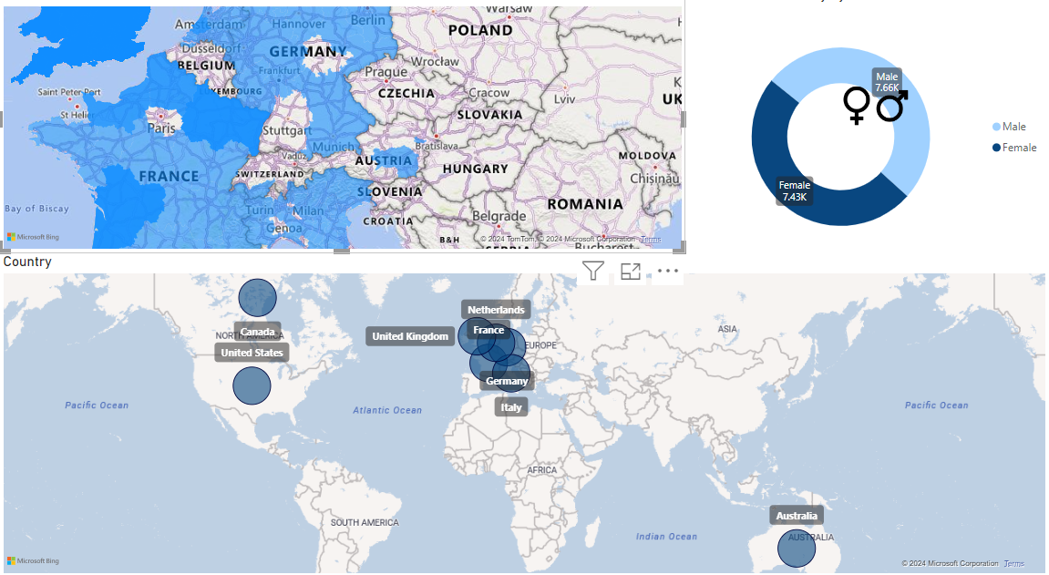
CUSTOMER ANALYSIS

Slide 3
CUSTOMER ANALYSIS
Customer Demographics: Currently, our customer base is dominated by male customers, with a noticeably lower proportion of female customers. This highlights an opportunity to enhance our marketing strategies and product offerings to better attract and engage female customers.
Key Markets in Europe: Our primary sales are concentrated in Germany, France, Switzerland, Austria, and Belgium. These regions represent the major selling spots in Europe. However, there is a significant opportunity for growth, as the current number of stores in these areas is limited, and some locations lack any presence at all.
Expansion Potential: To drive growth, we should focus on increasing our retail footprint in the aforementioned key markets while also exploring opportunities to expand into other regions across Europe that are currently underserved.

Slide 4
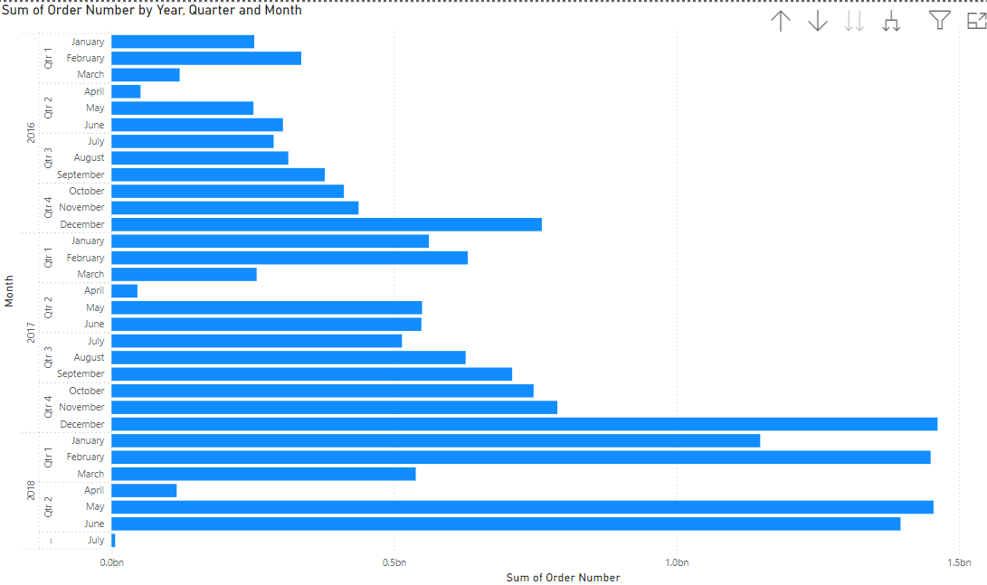
SALES ANALYSIS

Slide 5
SALES ANALYSIS
Sales Dip in March and April: Our data indicates a significant drop in sales during March and April. To address this seasonal decline, we can implement targeted promotional strategies, such as increased discounts and special offers, to stimulate customer demand and boost sales during these months.
Moderate Sales Period (June to September): Sales performance from June to September remains steady, showing moderate growth. To capitalize on this period, we can introduce seasonal product launches, limited-time bundles, or loyalty rewards to maintain customer engagement and further drive revenue.

Slide 6
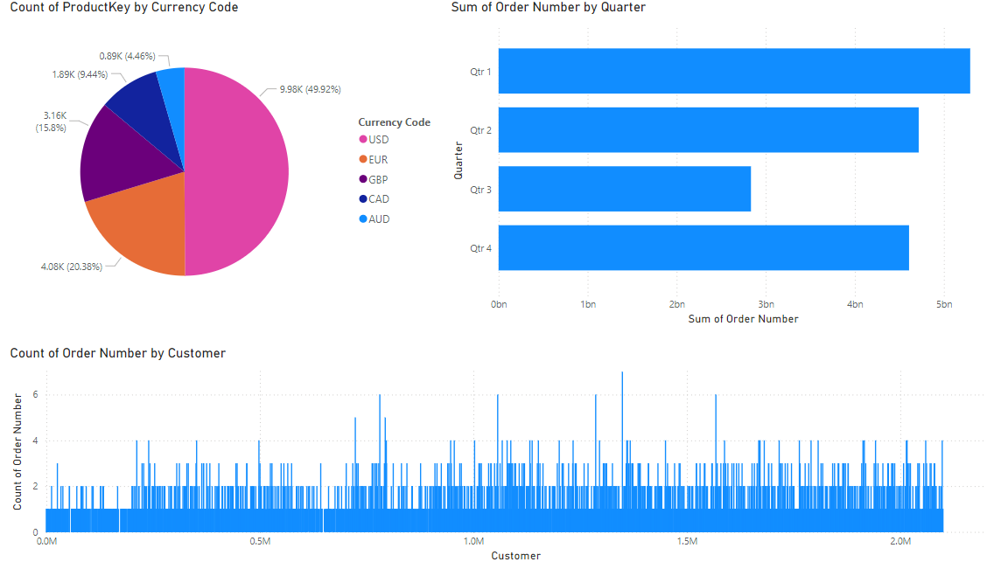
SALES ANALYSIS

Slide 7
SALES ANALYSIS
Customer Order Frequency: The majority of our customers place only a single order, with the maximum frequency reaching up to six orders. This indicates a need to strengthen customer retention strategies and encourage repeat purchases. Implementing loyalty programs, subscription models, or personalized follow-up offers could help increase the frequency of customer orders.
Low Sales in the Third Quarter: Sales tend to drop significantly during the third quarter of the year. To counter this trend, we could introduce targeted marketing campaigns, seasonal promotions, or product launches aimed at revitalizing sales during this period.
Currency Sales Insights: Sales in USD are the highest, while AUD sales lag behind. Efforts to improve sales in regions using the Australian dollar could involve region-specific marketing strategies, localized promotions, or partnerships to boost brand presence and customer engagement.

Slide 8
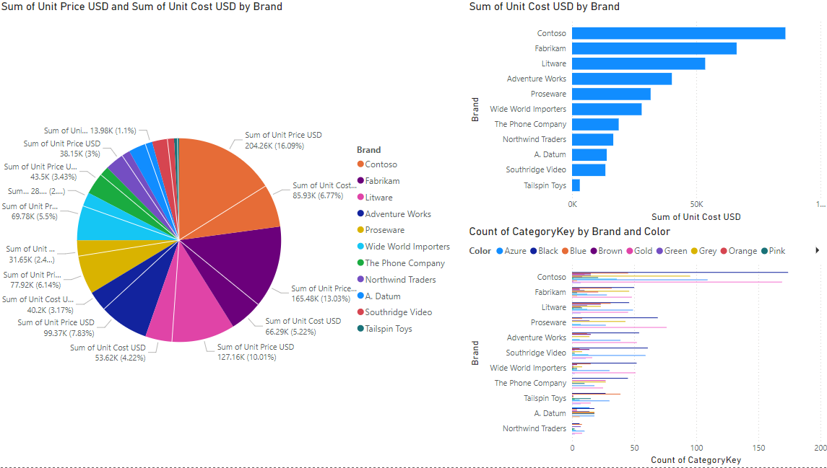
PRODUCT ANALYSIS

Slide 9
PRODUCT ANALYSIS
Brand Performance Overview: Our portfolio consists of a total of 11 brands. Some of these brands exhibit a high product investment rate alongside a correspondingly high revenue rate. This suggests potential for continued investment in top-performing brands while carefully assessing the return on investment for brands with lower revenue outcomes. Strategic decisions should prioritize scaling successful brands while optimizing investments in underperforming ones.
Color Preferences in Product Sales: Among the 11 brands, certain product colors are consistently popular and generate higher sales. Identifying these high-demand colors enables us to align production, marketing, and inventory strategies accordingly. By focusing on promoting popular color variations and expanding the range of best-selling colors, we can further enhance sales performance across the brands.

Slide 10
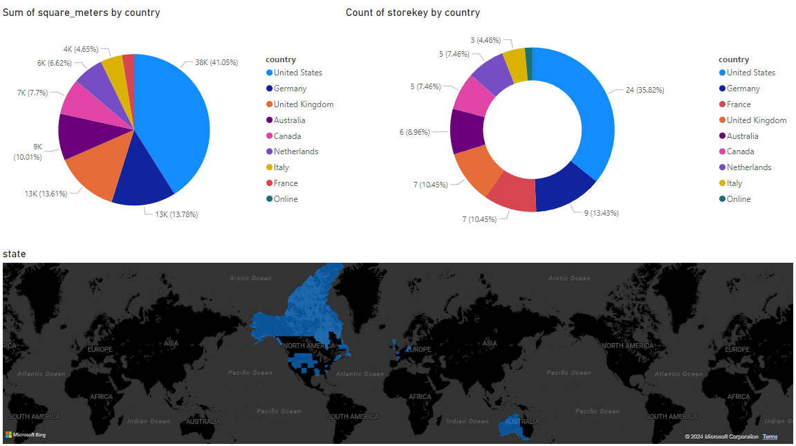
STORE ANALYSIS

Slide 11
STORE ANALYSIS
Sales and Store Presence Correlation: Countries with the highest number of stores correspondingly exhibit the highest sales, demonstrating a strong link between store availability and revenue. To maximize growth, we should prioritize expanding our store network to cover all feasible regions, ensuring accessibility and convenience for customers across various markets.
Leverage E-commerce to Complement Physical Stores: In addition to expanding physical store locations, enhancing our e-commerce presence can drive sales in areas where store openings are not yet feasible. By integrating seamless online and offline experiences, we can cater to a broader customer base, offering options for online ordering, in-store pickups, or local delivery to further boost sales.

Slide 12
THANK YOU

