Slide 1
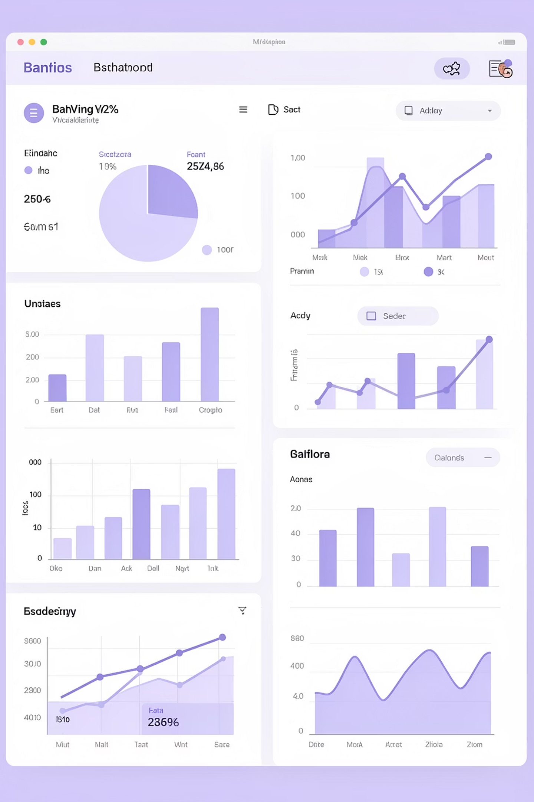
Banking Customer Analytics
Data-driven insights from 3,000+ customer records
BANKING & FINANCIAL SERVICES
PYTHON · SQL · TABLEAU

Slide 2


EXECUTIVE SUMMARY
Uncovering Customer Value & Risk
Uneven Distribution
Risk Exposure
Strategic Action
Limited segment drives majority of deposits
Loan exposure exceeds deposits for key subset
Enable informed customer prioritization decisions

Slide 3

The Business Challenge
Leadership lacked consolidated view
Which customers contribute most to deposits?
Where is lending risk concentrated?
How do relationship strategies perform?
Decisions were reactive, not strategic

Slide 4
PROJECT OBJECTIVES
What We Set Out to Achieve
01
02
03
Quantify Deposits
Identify Segments
Evaluate Loyalty
Total and average across portfolio
High-value and high-risk customers
Classifications vs. actual contribution
04
05
Assess Performance
Support Decisions
Advisor and relationship KPIs
Clear numerical evidence for leadership

Slide 5
Portfolio at a Glance
₹2.01B
₹6.72L
₹2.60B
3,000
Total Bank Deposits
Average Deposit
Business Lending
Customers Analyzed
Significant asset volume under management
Per customer across portfolio
Total loan exposure
Comprehensive dataset coverage
Key Insight: High lending exposure reinforces need for risk-aware monitoring

Slide 6

METHODOLOGY
Analytical Approach
Aggregate via SQL
Key Metrics Defined
Total & average deposits
Lending exposure
Loan-to-deposit ratios
Loyalty segment deposits
Advisor-level assets
Validate in Python
Visualize in Tableau
Tools applied complementarily to align analytics with business needs

Slide 7
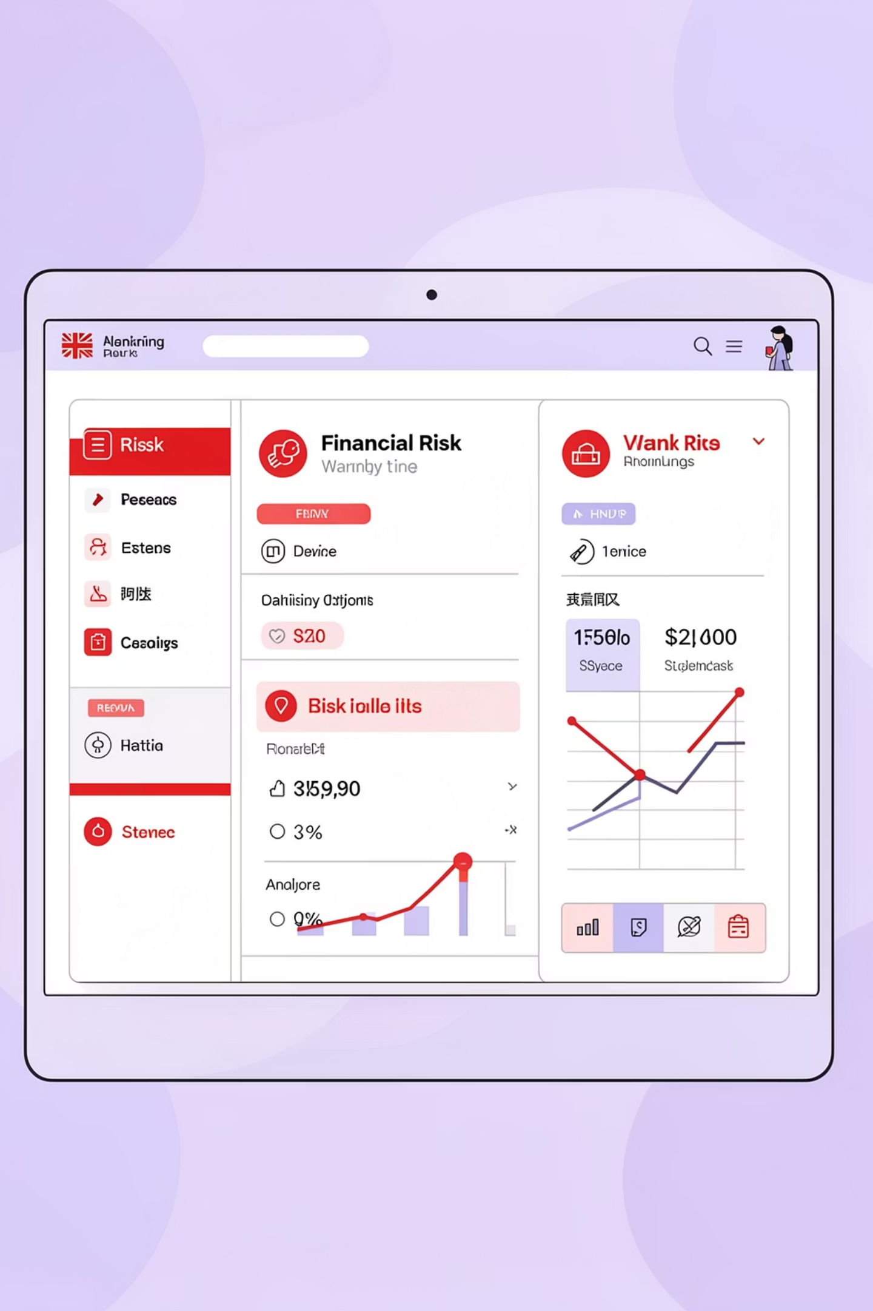
Critical Findings
Deposit Concentration
Higher loyalty tiers hold disproportionate share of total deposits. Lower-tier segments show significantly lower balances.
Risk Exposure Alert
Measurable subset holds loan balances exceeding deposits, indicating elevated financial risk.
Performance Gaps
Small number of advisors manage large portion of assets. Material variation in deposit contribution by advisor.

Slide 8

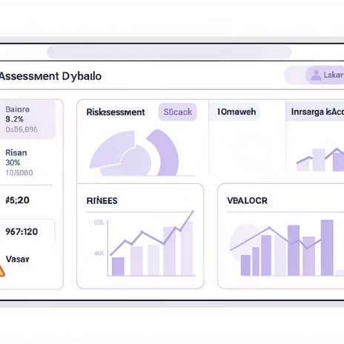

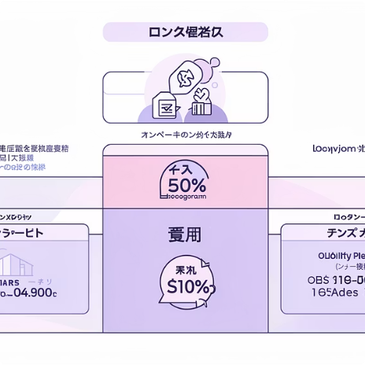
RECOMMENDATIONS
Strategic Actions for Leadership
Prioritize High-Value Customers
Strengthen Risk Monitoring
Optimize Advisory Allocation
Refine Loyalty Strategy
Focus engagement on highest deposit contributors
Proactive reviews for unfavorable loan-to-deposit positions
Align assignments based on measurable performance
Reassess classifications to reflect actual financial value

Slide 9
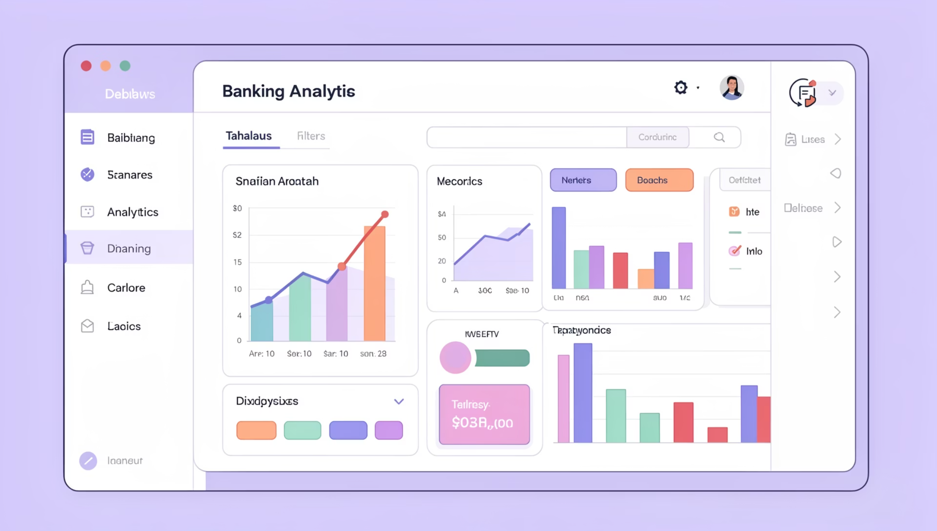

Dashboard & Monitoring
Interactive Tableau Dashboards
Developed for leadership reviews and ongoing monitoring:
Deposit and loan distribution by segment
High-value and high-risk customer identification
Advisor-level performance metrics
Interactive filters for scenario analysis
Dashboards enable exploration; this report focuses on insights and decisions

Slide 10

Business Impact & Next Steps
Immediate Impact
Leadership now has clear visibility into customer value concentration, lending risk, and relationship effectiveness.
Future Opportunities
Predictive risk and churn modeling
Time-based trend analysis
Transactional behavior integration
Regional and branch-level expansion
Raw data converted into decision-ready insights

