Slide 1


Early detection of Sepsis using
Machine Learning
GST - Bengaluru Campus
Department of Computer Science and Engineering
Project Phase-I Presentation
Under the guidance of
Dr Sanjeev Kumar A N
Assistant professor
Presented by
D. Dinesh 322010301049
M. Charan 322010301047
G. Rushikesh 322010301018
P. Ganesh Chowdary 322010301029

Slide 2

Outlines
Research Objectives
Abstract
Problem Statement
Introduction
Literature Work
Proposed Models
Architecture Diagram
List of Modules
Conclusion
References

Slide 3
Research Objectives
Develop machine learning algorithms that can reliably detect the early signs of sepsis in patients, allowing for prompt intervention and treatment.
Enhance patient outcomes by reducing sepsis-related illness and mortality rates through early detection and timely intervention.
Decrease healthcare costs associated with sepsis by minimizing prolonged hospital stays, intensive care unit (ICU) admissions, and expensive treatments through early detection.
Seamlessly integrate the sepsis detection system with existing healthcare systems, such as electronic health records (EHRs), and ensure its usability and acceptance by healthcare providers for effective clinical decision support.

Slide 4
Abstract
Sepsis is an organ failure disease caused by an infection resulting in extremely high mortality. Sepsis is activated by the immune system present in your body that works all the time in order to prevent infections from entering. During this stage, the enormous number of synthetic substances discharged into the blood causes broad irritation. For the patient the practicality of detecting the occurrence of sepsis in development is an important factor in the result. The primary goal of this project is to build a model that detect the occurrence of the disease sepsis in a person, so the treatment for the same begins at an early stage

Slide 5
Problem statement
The following are the problem statements for this project on Early Detection of Sepsis using Machine Learning.
To determine the presence of Sepsis in a patient using clinical data.
To perform exploratory data analysis on patients’ clinical data.

Slide 6
Introduction
The project on Early Detection of Sepsis using Machine Learning aims to address critical healthcare challenges by leveraging clinical data to determine the presence of sepsis in patients. Sepsis is a life-threatening condition that requires swift intervention, and early detection is crucial for improving patient outcomes. Additionally, the project includes an important component of exploratory data analysis, which involves delving into the wealth of clinical data to uncover patterns, insights, and potential risk factors associated with sepsis. By combining machine learning for early sepsis detection with comprehensive data exploration, this initiative seeks to enhance our understanding of sepsis in healthcare.

Slide 7
Literature Work
Paper-1
Title: "Examining Deep Learning Methods For The Detection Of Sepsis"
Research gap:
The paper discusses the application of deep learning models on the PhysioNet Challenge 2019 dataset. While the results are promising, there is a need for further clinical validation to assess the real-world effectiveness of these models in sepsis detection.

Slide 8
Literature Work
Paper-2
Title: “Bi-Directional Gated Recurrent Unit Based Ensemble Model for the Early Detection of Sepsis”
Research gap:
Further research is needed to enhance the explainability of the model and provide insights into why specific predictions are made, which is essential for gaining trust from medical professionals and facilitating clinical decision-making.

Slide 9
Literature Work
Paper-3
Title: “An Ensemble Machine Learning Model For the Early Detection of Sepsis From Clinical Data”
Research gap:
The paper acknowledges that the model performed well in offline tests but had a worse performance on the online full test sets, suggesting possible overfitting. Investigating techniques to improve model generalization, especially when applying the model to data from different hospitals or healthcare systems, would be valuable.

Slide 10
Literature Work
Paper-4
Title: “Early Prediction of Sepsis for ICU Patients using Gradient Boosted Tree”
Research gap:
A research gap could be in exploring the integration of additional clinical features or patient-specific data, such as laboratory results, comorbidities, or medication history, to enhance the prediction accuracy.

Slide 11
Proposed Models
Xgboost Algorithm.
Xgboost's (Extreme Gradient Boosting) versatility, efficiency, and ability to handle a variety of data types and tasks have made it a popular choice for both structured and unstructured data problems, including classification, regression, ranking, and recommendation systems. It has a strong track record of achieving state-of-the-art results in various machine learning competitions and real-world applications.
MLP Algorithm.
The MLP algorithm stands for "Multilayer Perceptron," which is a type of artificial neural network used in machine learning. It is a feedforward neural network model, meaning that the data flows in one direction, from input to output, through multiple layers of interconnected nodes (neurons).

Slide 12
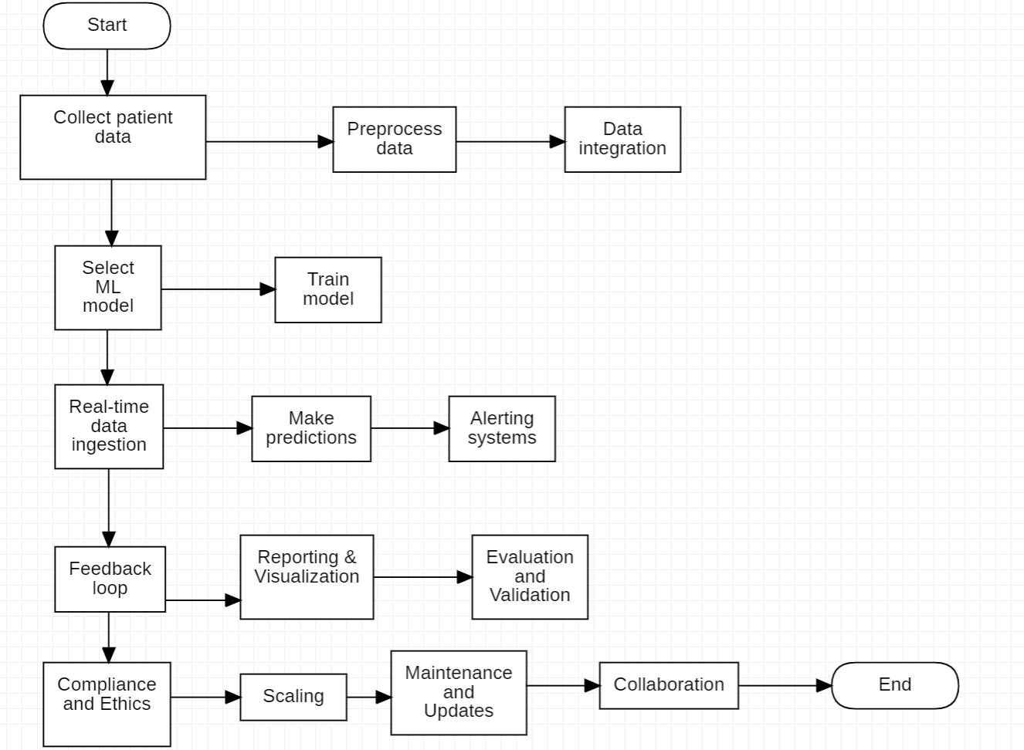
Architecture Design

Slide 13
List of Modules
Problem Statement
Designing
Implementation
Testing
Experimental results

Slide 14
Conclusion
Sepsis is a hazardous condition brought about by an infection of the body. To prevent fungi, virus or bacteria, the body generally discharges the chemicals into the circulatory system. Sepsis happens as the body responds to these chemicals out of control, which induces changes that can affect the structures of many organs. The symptoms of the disease, signs, complications, and treatment for the disease are presented. This project also presents the detection of this disease at early stages with higher accuracy using various classifiers mainly on using MLP classifiers in order to develop good prediction models which helps in avoiding long time-taking lab results.

Slide 15
References
Singer M, Deutschman CS, Seymour CW, Shankar-Hari M, Annane D, Bauer M, Bellomo R, Bernard GR, Chiche JD, Coopersmith CM, et al. The third international consensus definitions for sepsis and septic shock (sepsis-3). Jama 2016;315(8):801–810.
L. Tran, M. Nguyen and C. Shahabi. Representation Learning for Early Sepsis Prediction 2019 Computing in Cardiology (CinC), 2019, pp. 1-4, doi: 10.23919/CinC49843.2019.9005565.
L. Pruinelli et al., “Delay within the 3-hour surviving sepsis campaign guideline on mortality for patients with severe sepsis and septic shock,” Critical care medicine, vol. 46, no. 4, p. 500, 2018.
Desautels, T., Calvert, J., Hoffman, J., Jay, M., Kerem, Y., Shieh, L., Shimabukuro, D., Chettipally, U., Feldman, M. D., Barton, C., Wales, D. J., Das, R. (2016). Prediction of Sepsis in the Intensive Care Unit With Minimal Electronic Health Record Data: A Machine Learning Approach. JMIR medical informatics, 4(3), e28.https://doi.org/10.2196/medinform.5909.

Slide 16
References
Scherpf, M., Graber, F., Malberg, H., & Zaunseder, S. (2019). Predicting sepsis with a recurrent neural network using the MIMIC III database. Computers in Biology and Medicine, 113, 103395
J. S. Calvert, D. A. Price, U. K. Chettipally, C. W. Barton, M. D. Feldman, J. L. Hoffman, M. Jay, and R. Das, “A computational approach to early sepsis detection,” Computers in biology and medicine,vol. 74, pp. 69–73, 2016.

Slide 17
Thank you

