Slide 1


ECOM

Slide 2

Home
Service
About Us
Contact
Welcome To Our ECOM
Objective: To develop a user-friendly e-commerce platform with key features:
User Management: Secure user accounts with basic profile information.
Product Management: Detailed product listings with 100+ sample products.
Search Functionality: AI-enhanced search with personalized suggestions.
Recommendation System: AI-based personalized product recommendations updated based on user view history.

Slide 3





Home
Service
About Us
Contact
TECH STACK

Slide 4
Home
Service
About Us
Contact
Features
01
User Management
Product Management
02
Search Functionality
03
Recommendation System

Slide 5
Home
Service
About Us
Contact
User Management
01
02
03

Slide 6

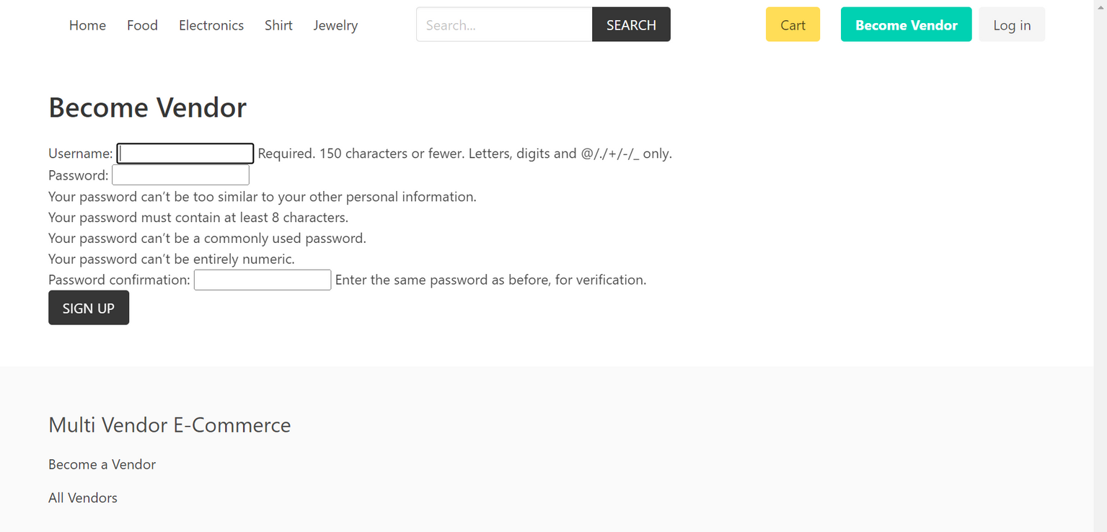
Home
Service
About Us
Contact
Signup
01

Slide 7
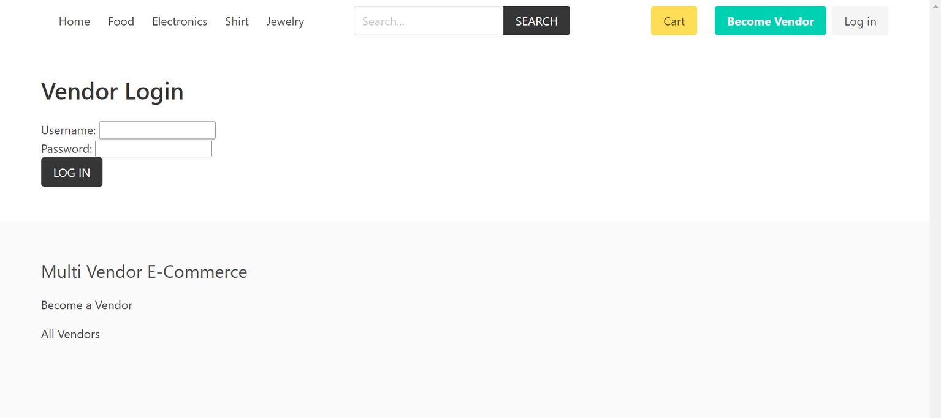
Home
Service
About Us
Contact
Login

Slide 8
Home
Service
About Us
Contact
Product Management
Included 100 sample products for demonstration
Created Product Listing Functionality on the basis of :
01
Name
Description
Price
Category
02

Slide 9
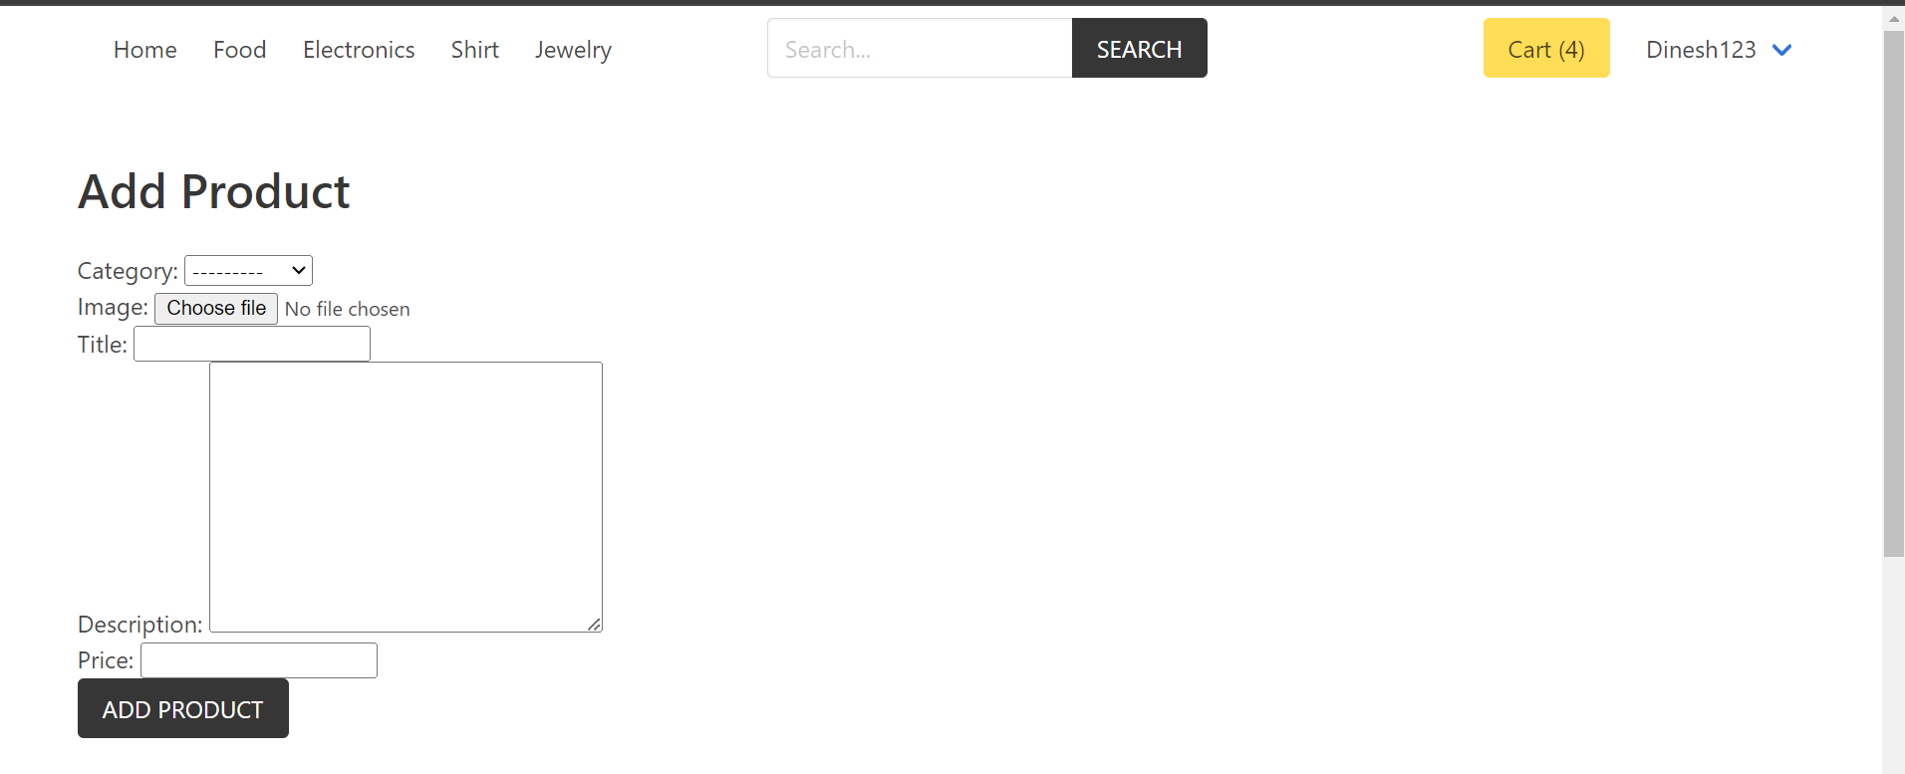
Home
Service
About Us
Contact
Product Management
01
02

Slide 10
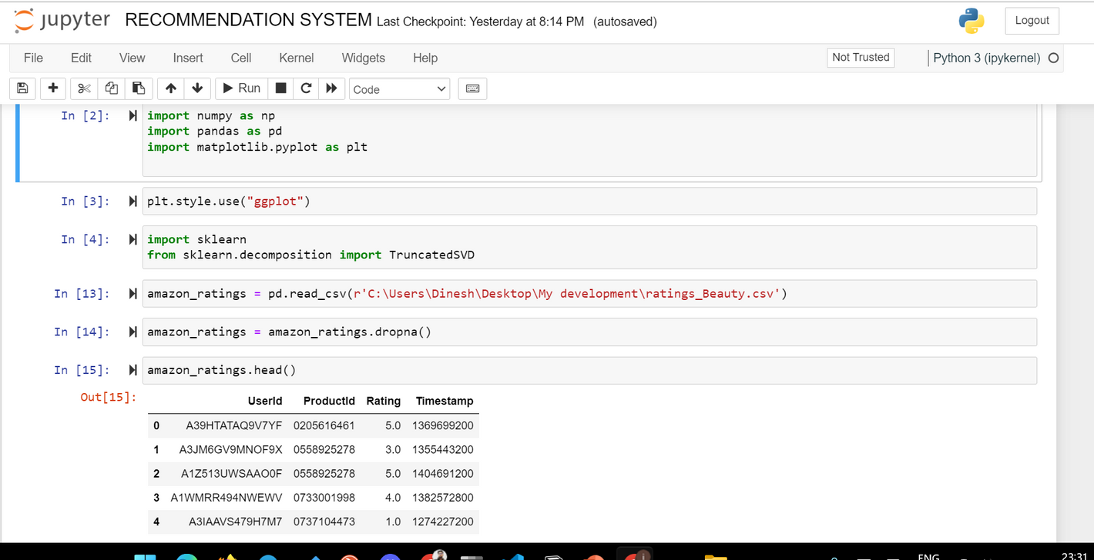
Home
Service
About Us
Contact
Recommendation AI

Slide 11
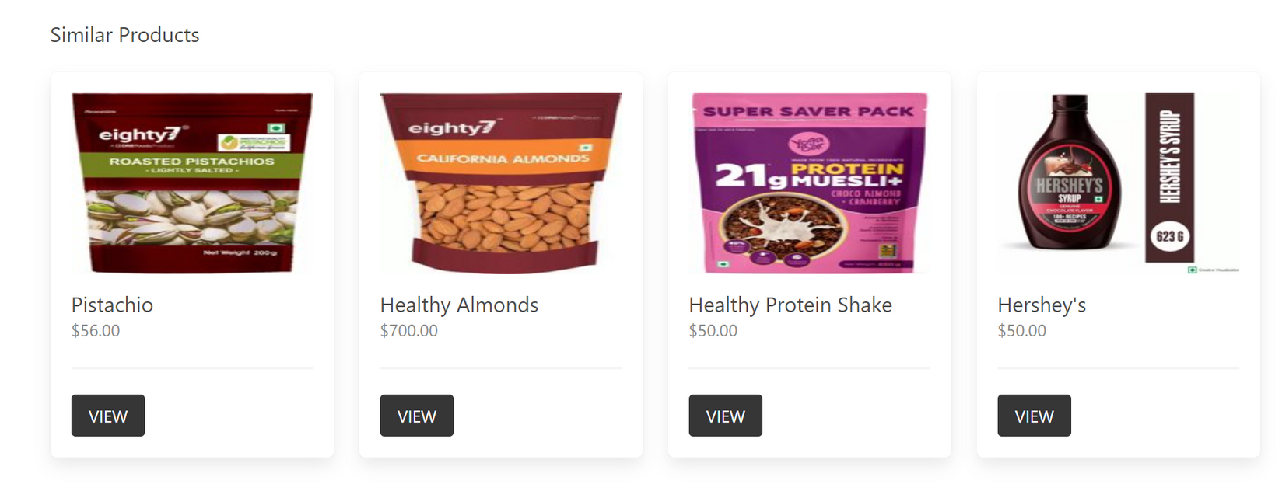
Home
Service
About Us
Contact
Recommendation based on category

Slide 12
Home
Service
About Us
Contact
Libraries used in Recommendation AI
NumPy:
A fundamental package for numerical computing in Python, providing support for arrays, matrices, and many mathematical functions.
Pandas:
A powerful data manipulation and analysis library for Python, offering data structures like DataFrames for handling structured data.
scikit-learn:
A machine learning library in Python that provides simple and efficient tools for data mining and data analysis.
Matplotlib:
A plotting library for Python that enables the creation of static, animated, and interactive visualizations.

Slide 13
Home
Service
About Us
Contact
Search Functionality
01
The user can search in searchbar based on his preference
The user will get search suggestions based on his previous search
02
03

Slide 14
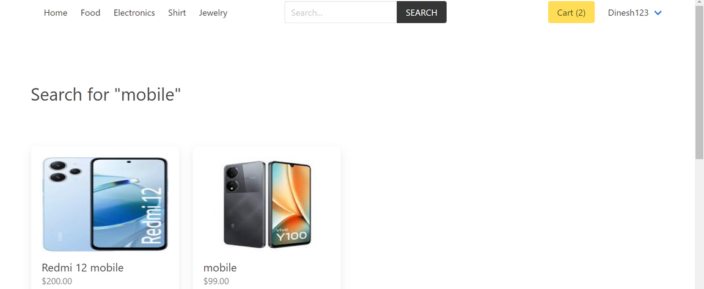
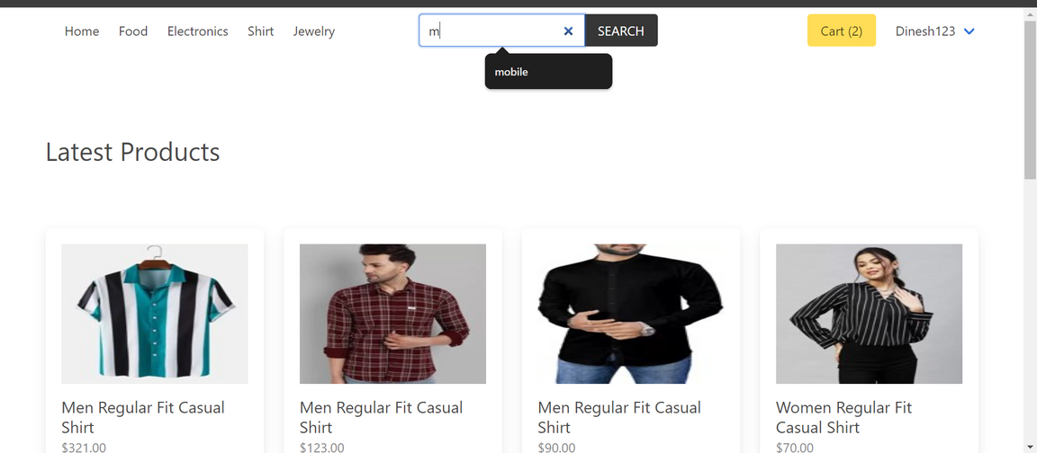
Home
Service
About Us
Contact
Search Functionality
01
02
03

Slide 15
Home
Service
About Us
Contact
Additional Feature
CART
01
Implemented cart functionality if a vendor want to purchase something he can added into cart
we can increase or decrease the number of products in the cart.
We can also remove the product
02
03

Slide 16
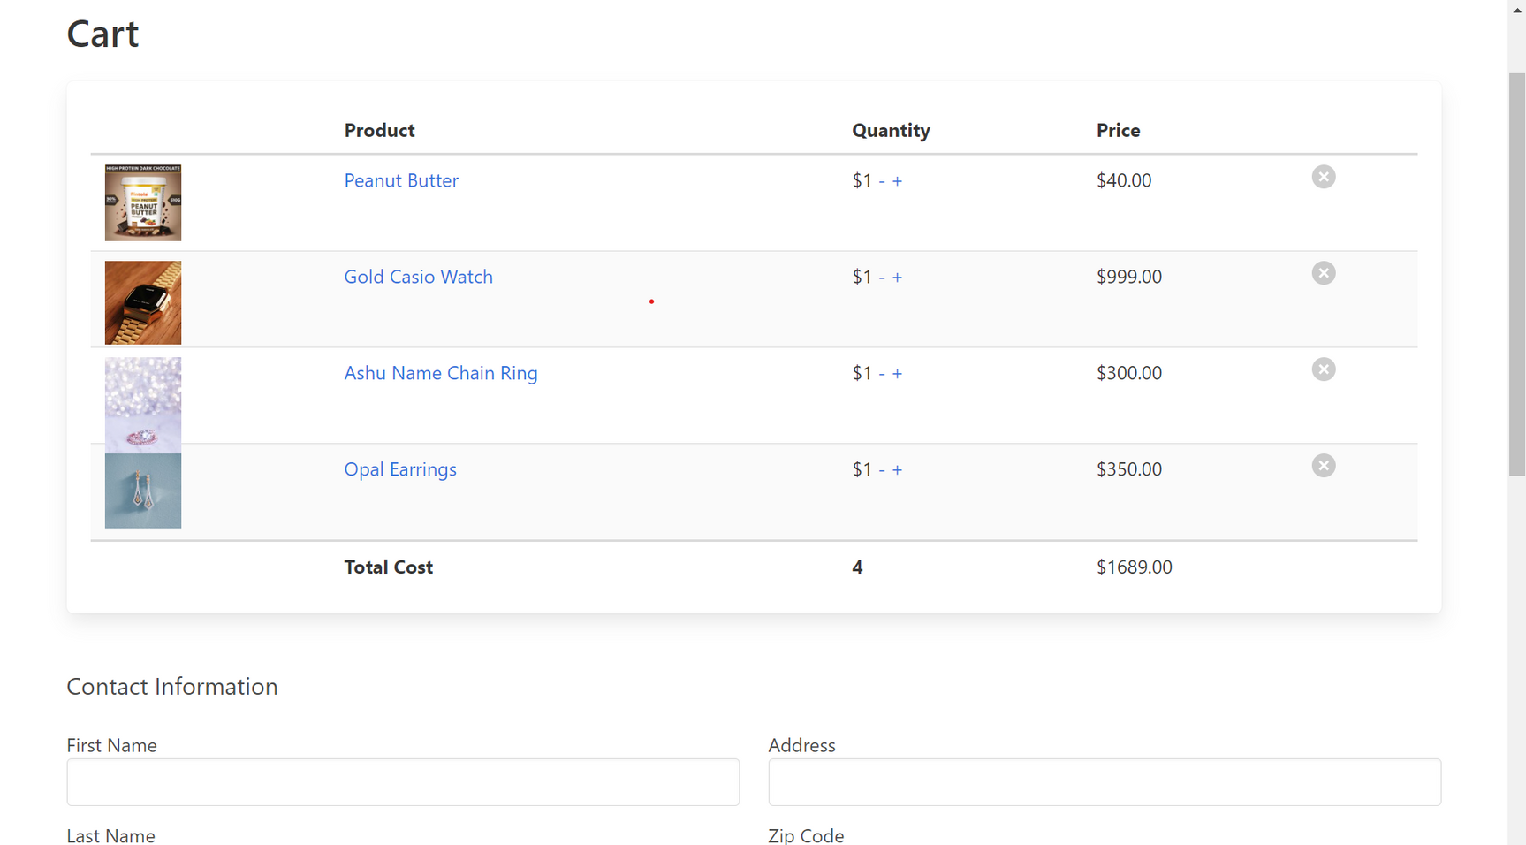
Home
Service
About Us
Contact
Additional Feature
01
02
03

Slide 17
Home
Service
About Us
Contact
Conclusion
Developed e-commerce platform seamlessly integrates user management, extensive product listings, and a sophisticated AI recommendation system. By leveraging advanced AI technologies, we provide personalized product suggestions and intelligent search capabilities, enhancing user satisfaction, driving sales growth and good user experience. This innovative solution positions us at the forefront of the e-commerce industry, delivering exceptional value to our users and stakeholders.
01
02
03

Slide 18
THANK YOU

