Slide 1
BASIC DETAILS
NAME: DINESH R
BATCH: BATCH 7
REGISTER NUMBER: 811324243035
DEPARTMENT: ARTIFICIAL INTELLIGENCE AND DATA SCIENCE
PROJECT NAME: BUS RESERVATION SYSTEM

Slide 2
🚌 Bus Reservation System
• Console-based Python application
• Uses Python, OOP and JSON file handling
• Customer operations: View Buses, Book Ticket, View Ticket
• Objective: Simple and efficient bus reservation system
Project Overview and Explanation

Slide 3
🧩 OOP Concepts
• Encapsulation: Private attributes with @property
• Abstraction: ReservationSystem using ABC and @abstractmethod
• Inheritance: BusReservation → PremiumBusReservation
• Polymorphism: book_ticket() method overridden
OOPS Implementation

Slide 4
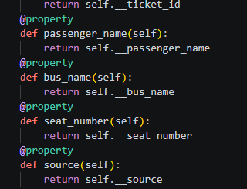
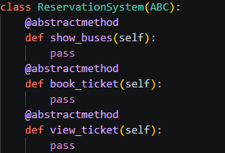


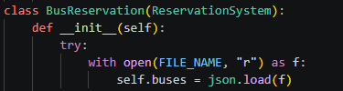

🧩 OOP IMPLEMENTATION
OOPS Implementation in code
Encapsulation
Abstraction
Polymorphism
Inheritance

Slide 5
🏗 Class Design & Architecture
• Ticket class stores passenger details
• ReservationSystem defines common methods
• BusReservation implements booking logic
• PremiumBusReservation extends booking functionality
• Bus details loaded from buses.json
ARCHITECTURE

Slide 6
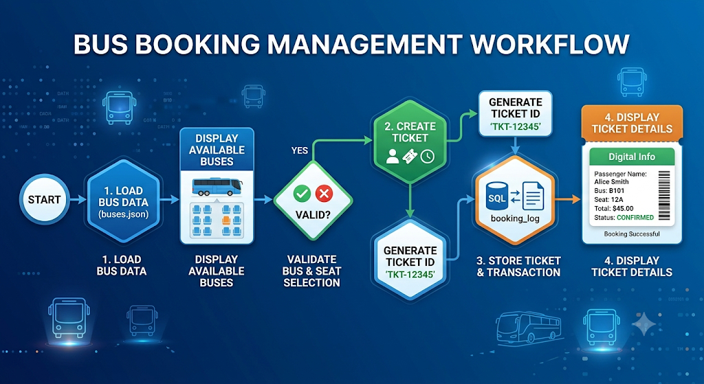
🔄 Reservation Workflow
• Load buses.json
• Display available buses
• Validate bus and seat
• Create Ticket object
• Generate Ticket ID
• Store ticket and display details
WORKFLOW

Slide 7
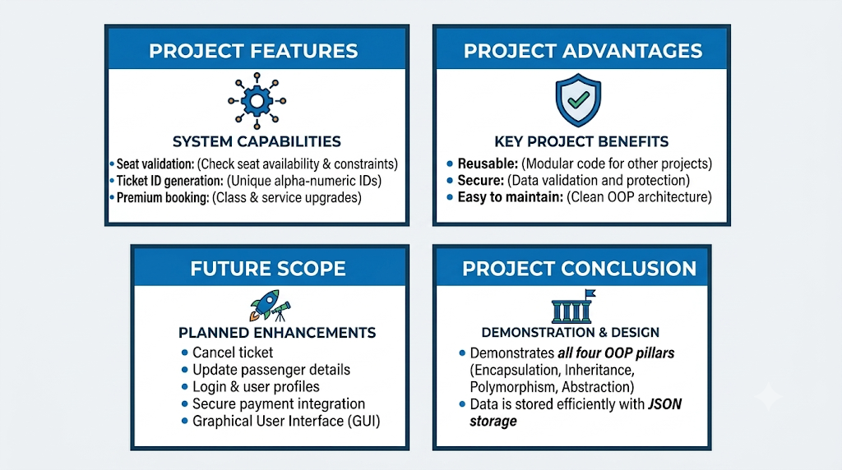
🚀 Features & Future Scope
• Features:

