Slide 1
🚌 Bus Reservation System
• Console-based Python application
• Uses Python, OOP and JSON file handling
• Customer operations: View Buses, Book Ticket, View Ticket
• Objective: Simple and efficient bus reservation system
Project Overview and Explanation

Slide 2
🧩 OOP Concepts
• Encapsulation: Private attributes with @property
• Abstraction: ReservationSystem using ABC and @abstractmethod
• Inheritance: BusReservation → PremiumBusReservation
• Polymorphism: book_ticket() method overridden
OOPS Implementation

Slide 3
🏗 Class Design & Architecture
• Ticket class stores passenger details
• ReservationSystem defines common methods
• BusReservation implements booking logic
• PremiumBusReservation extends booking functionality
• Bus details loaded from buses.json
ARCHITECTURE

Slide 4
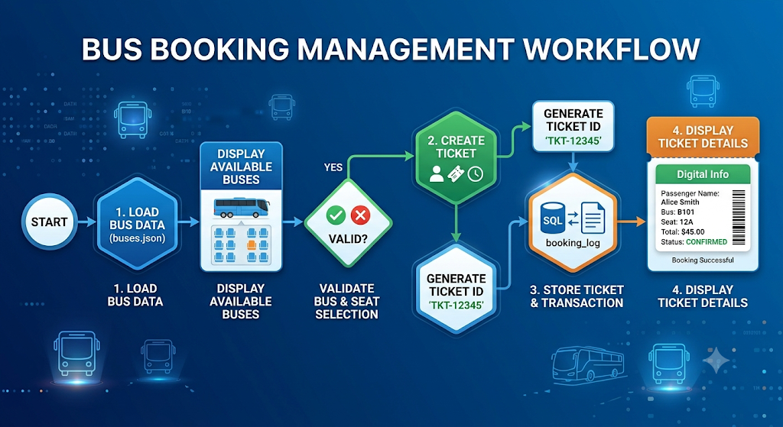
🔄 Reservation Workflow
• Load buses.json
• Display available buses
• Validate bus and seat
• Create Ticket object
• Generate Ticket ID
• Store ticket and display details
WORKFLOW

Slide 5
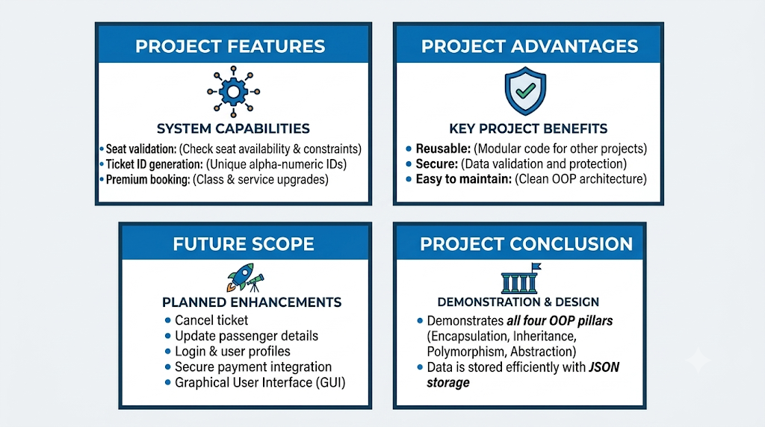
🚀 Features & Future Scope
• Features:

