Slide 1

Trip Booking System
29/02/2024
Dineshkumar C (73772221121)
Divya P (73772221122)
Fizur Rahman S (73772221123)
2nd Year – IT – A
61 IT 403 – Web Technology
Idea Presentation

Slide 2



Introduction
Our Project is a web page of a private travel agencies which helps the user to make their dream travel become true. It will be in a type of blog. That will be helpful for the users to know about the travelling packages we have and to plan accordingly.

Slide 3


Our Objective
The Web page consist of overall details of the package like the package amount for a trip to a particular place ,What are the adventures the one to travel will going to do in that place .What are the places they are going to visit there.

Slide 4

Work Flow
1
2
Search and Discover
Compare and Select
3
Smooth Bokking

Slide 5
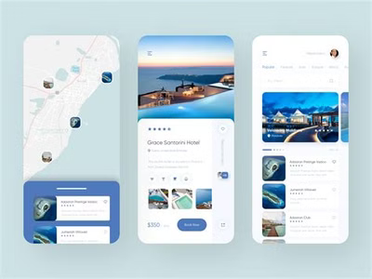


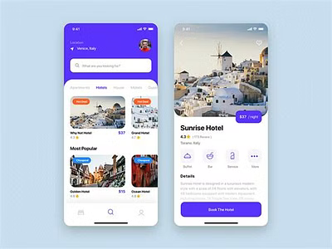
UI - Design
Mobile - Friendly Design
Interactive Desktop Interface
Provide a clean and organized layout for users to easily navigate their trips on large screen too.
Optimized for seamless use on smartphones and tablets, ensuring a great experience on-the-go.

Slide 6

Backend Integration
Robust Backend
API Integration
Leverages a powerful backend to handle user data, booking and other sensitive information securely.
Seamlessly integrates with various travel service providers’ APIs to fetch real time data and pricing.

Slide 7







Technical Stack
Robust Frontend
Utilizes modern web technologies like HTML, CSS, and JavaScript to deliver a fast and responsive user interface.

Slide 8

Outcome
We can make your dream come true.
We can increase your entertainment duration.
We can reduce your stress load.
Can clarify your doubts anytime.

Slide 9


Thank You !
LEARNING never stops.
Let's keep pushing the boundaries of ENGINEERING..
Thank you for your ATTENTION…
/ksrct1994
www.ksrct.ac.in

