Slide 1
Agentic RAG Chatbot with MCP
Modular AI Assistant for Document Q&A

Slide 2
Problem Statement
You are required to build an agent-based Retrieval-Augmented Generation (RAG) chatbot that can answer user questions using uploaded documents of various formats. Your architecture must follow an agentic structure and should incorporate Model Context Protocol (MCP) as the mechanism for communication between agents and/or agents ↔ LLMs.
What did I understand from the problem statement?
“From this problem statement, I understand that I need to build a chatbot that can answer questions from documents I upload. It should follow an agent-based structure where different agents handle tasks like document processing, retrieval, and generating answers. These agents will communicate with each other and the LLM using MCP, which ensures a clear and structured workflow.”

Slide 3
Objectives
🎯 Develop an agentic RAG chatbot capable of answering questions directly from uploaded documents.
📂 Support ingestion of multiple document formats (PDF, DOCX, PPTX, CSV, TXT) for flexibility.
🔒 Run LLM inference locally to ensure privacy and eliminate dependency on external APIs.
⚙️ Provide a modular, reproducible, and demo-ready codebase with an intuitive Streamlit UI.

Slide 4
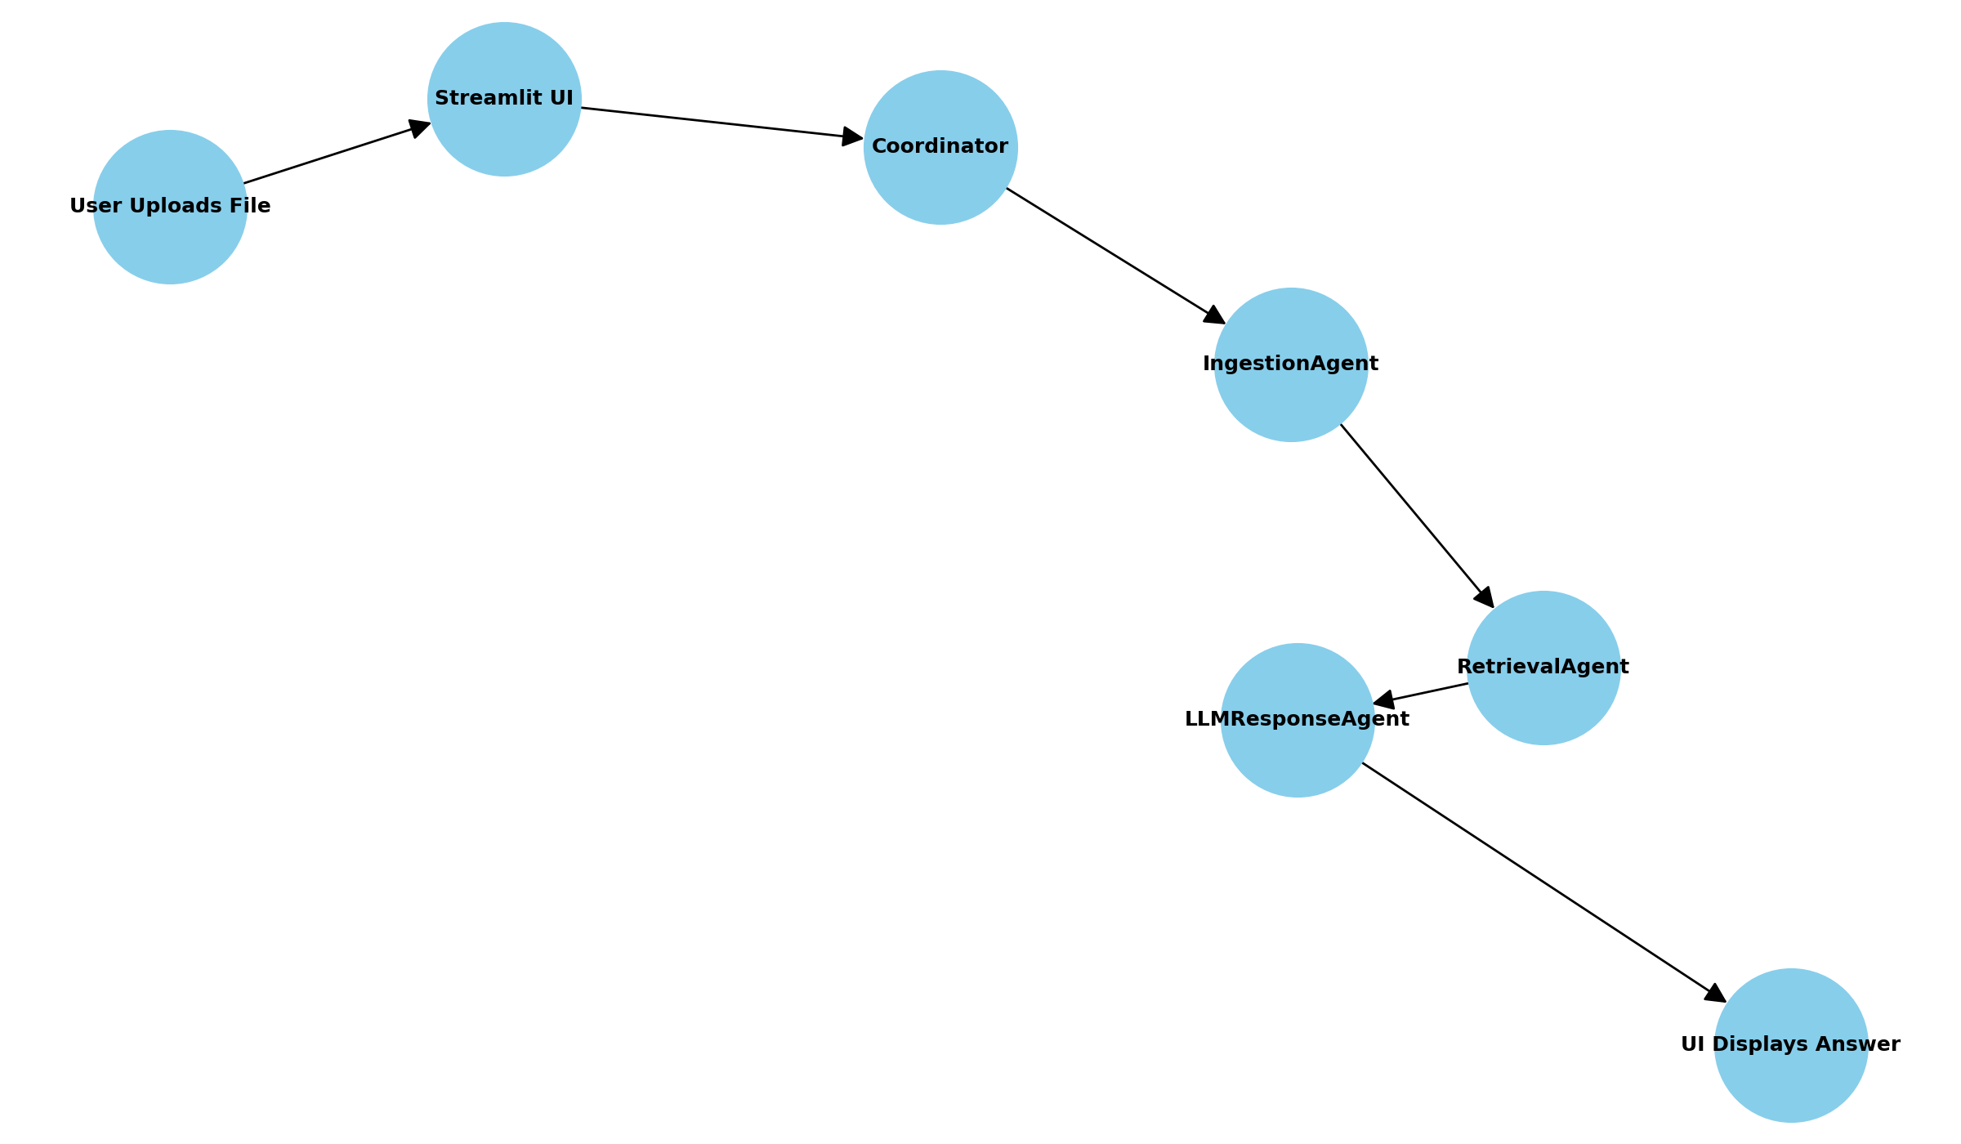
Architecture Workflow

Slide 5
Architecture Workflow
The user uploads a document and asks questions through the Streamlit UI. The Coordinator manages the flow by sending the file to the IngestionAgent, which extracts and cleans text. The RetrievalAgent then chunks the text, creates embeddings with MiniLM, and stores them in FAISS for quick retrieval. When a query is asked, it fetches the most relevant chunks. The LLMResponseAgent combines these chunks with the query, builds a prompt, and uses Flan-T5 to generate the final answer. The response is displayed back in the Streamlit UI, with chat history preserved for follow-up questions.
👤 User → 🖥️ Streamlit UI → 🔗 Coordinator
→ 📂 IngestionAgent (Extract + Clean)
→ 📊 RetrievalAgent (Chunk + Embed + FAISS)
→ 🧠 LLMResponseAgent (Generate Answer)
→ 💬 Streamlit UI (Answer + Chat History)

Slide 6
Workflow of the project
👤 User → Streamlit UI Uploads a document and asks questions via the web app.
🖥️ Streamlit UI → Coordinator Coordinator manages the flow and assigns tasks to agents.
📂 IngestionAgent Extracts and cleans text from PDF, Word, PPTX, or CSV files.
📊 RetrievalAgent
Splits text into chunks
Creates embeddings (MiniLM)
Stores & retrieves from FAISS vector DB
🧠 LLMResponseAgent Combines retrieved chunks with the user query and uses Flan-T5 to generate an answer.
💬 Answer → Streamlit UI Final answer displayed in chat format, with history saved for follow-up queries.

Slide 7
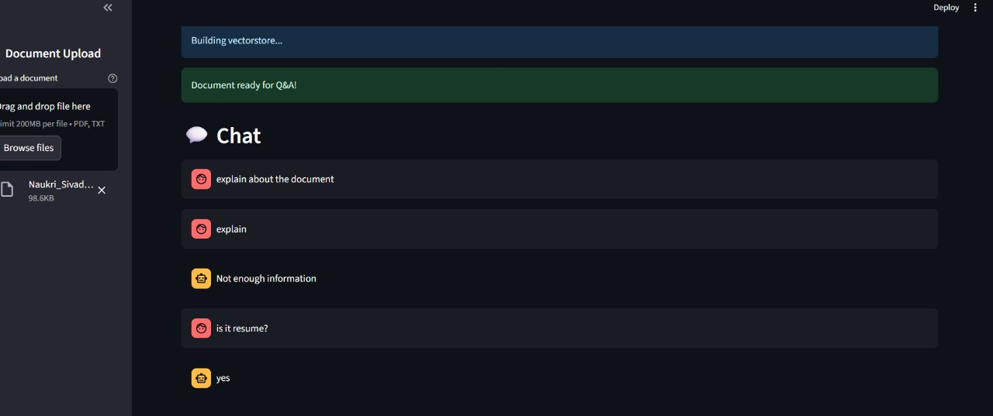
Demo Screenshot 1
This is the demo of the model ui here I uploaded my resume into the model and asked my 1st question explain about this document coz i uploaded first and empty resume it didn’t generate answer it gave me not enough information And later again I uploaded an filled resume with one page and asked the question is it a resume it answered yes

Slide 8
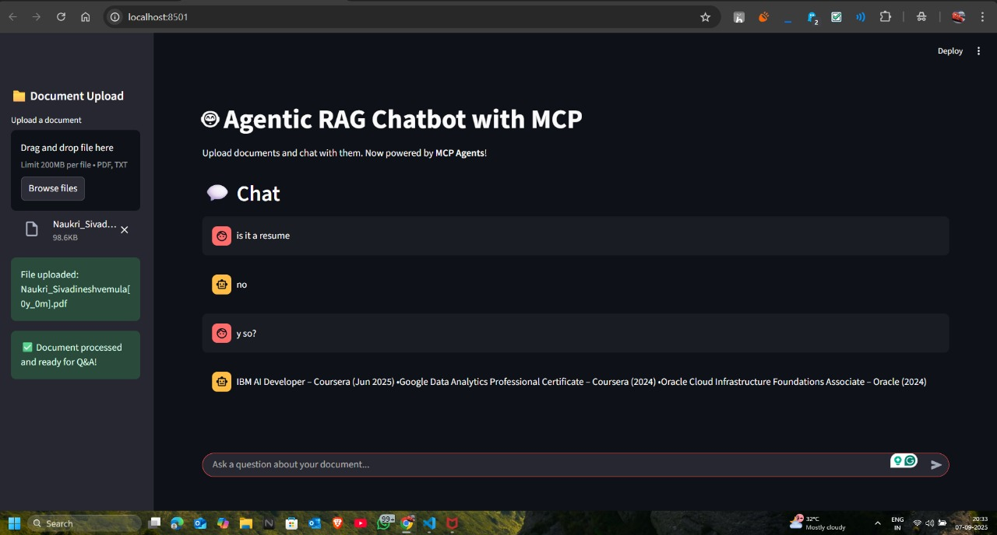
Demo Screenshot 2
This my 2nd demo of testing the model here I only uploaded an document with only some certification info in it I asked the first question as is it resume it answered as no and I asked the 2nd question as y so and it answered only information available in that file

Slide 9
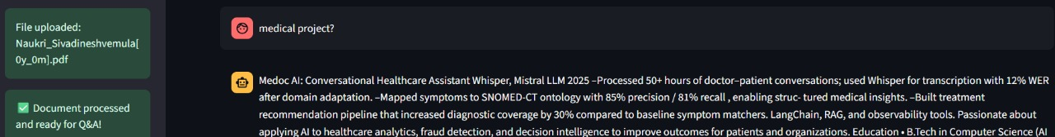
Demo Screenshot 3
In my 3rd testing here I asked about an medical project it gave me an answer of my project in the file

Slide 10
Limations of the model
Limitations of Current Model & System
Context limits: Flan-T5’s small window → heavy chunking, context loss.
Retrieval dependency: Accuracy depends on chunking & embeddings.
Latency & resources: Local inference is slow on CPU; larger models need GPU.
Index persistence: FAISS is in-memory; fragile without persistence/concurrency control.
Parsing issues: PDFs/PPTX/DOCX often produce noisy text.
No evaluation: Lacks QA metrics to measure accuracy/reliability.
Privacy concerns: Local models help, but uploaded docs still need access/security measures.
What’s Next
Persistent storage → Keep document indexes saved with ChromaDB/FAISS.
Long-context models → Use Llama-2/Ollama to handle larger docs with less chunking.
Better UI/UX → Add progress bars, clearer answers, and show sources.
Testing & stability → Basic tests + CI pipeline to ensure reliability.

Slide 11
Technology used to develop this model
Tech Stack & Libraries
Frontend/UI → Streamlit 1.22.0 – lightweight framework for interactive web apps and demos.
Embeddings → Sentence-Transformers (all-MiniLM-L6-v2, 2.2.2) – generates semantic embeddings for text chunks.
Vector Database → FAISS 1.7.4 – efficient similarity search and retrieval of embeddings.
LLM (local inference) → Flan-T5 with Transformers 4.31.0 + Torch 2.1.0 – instruction-tuned model for generating final answers.
Parsing & Ingestion →
PyPDF2 3.0.1 – extract text from PDFs.
python-docx 0.8.11 – handle Word documents.
python-pptx 0.6.21 – parse PowerPoint slides.
pandas 2.1.0 – process CSVs and structured tables.
Utilities & Data Processing → scikit-learn 1.2.2, tqdm 4.65.0 – chunking, preprocessing, progress tracking.
Testing & CI → pytest 7.3.1, black 23.3.0, flake8 6.0.0 – automated testing, formatting, and code quality checks.

