Slide 1
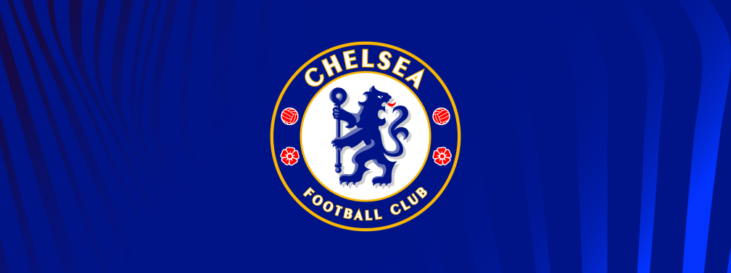
web scraping project By: Dinesh Kripalani
The subject is to take an in depth dive into Chelsea football club’s
current manager: Graham Potter

Slide 2
Is Graham Potter a good fit?
Let’s take a look at the numbers to find out

Slide 3
Here is where we stand on the 1st of march 2023
With a huge amount of the fanbase turning on the manager
A win percentage of only 28% of his games (the worst in Chelsea football clubs history)
A squad beaming with the best players in the world
Chelsea having spent over 600 million on new signings in January alone, in support of the manager
A team historically quick to change management whenever the results look bad
Is there a prospect that the team gets better with time
Or have Chelsea got to make a decision to change the management

Slide 4
With such a big decision to make in the upcoming days/ weeks
“ - in the end you have to win football matches because you know that, if the loosing run continues, it is unsustainable,”
Mikel Arteta on Graham Potter
What should the Chelsea owners and board do, and how can they handle this decision. I try to put emotion aside to have a look at the numbers through Python, Web Scraping, charting, and try to make the best business decision, for the club as a whole, based on them.

Slide 5
Graham Potter’s scraped Bio
Graham Potter was appointed head coach of Chelsea on 8 September 2022, replacing Thomas Tuchel. The 47-year-old joined Chelsea after three successful years at Brighton & Hove Albion, where he had replaced Chris Hughton after the 2018/19 Premier League campaign. Potter had a 13-year playing career, mostly spent in the Football League as a full-back with clubs including Birmingham City, Stoke City and West Bromwich Albion. He made eight Premier League appearances for Southampton in 1996/97, playing in a famous 6-3 win over Manchester United, while also being selected for an England Under-21 match against Moldova that season. Potter finished his playing career in 2005 and became a football development manager at Hull University, with a spell on secondment as the technical director of Ghana’s women’s team at the 2007 World Cup. In April 2008 he was appointed the assistant coach for the England Universities Squad, and he then had a period with Leeds University. Potter’s first senior managerial appointment came in December 2010 when he became the coach of fourth-tier Swedish side Ostersunds. He led them to successive promotions in 2011 and 2012 and then, in October 2015, took the club into the top flight for the first time in their history. Eighteen months later Potter’s side won the Swedish cup and earned a place in the Europa League, where they won three qualifiers and finished second in their group to set up a showdown with Arsenal in the last 32. After a 3-0 home defeat, Ostersunds won the second leg at Emirates Stadium 2-1 but bowed out on aggregate. In June 2018 Potter returned to the UK to take charge of Swansea City, who had just been relegated from the Premier League. He led them to a 10th-place finish in the Championship while reaching the quarter-finals of the FA Cup, where his side lost 3-2 to eventual winners Manchester City. That proved to be Potter’s only season with Swansea and he joined Brighton in May 2019 on a four-year contract. In his first season at the helm he guided the Seagulls, playing in a more expansive fashion, to a 15th-placed finish. Potter's side produced even greater results in 2021/22, finishing in an impressive eighth place. A few standout fixtures include Manchester United at home, where the Seagulls won 4-0, and Liverpool away having come from 2-0 down to earn a point. He oversaw Brighton's best start to a Premier League season in 2022/23, with 13 points from the opening six matches and a fourth place before Chelsea came calling.

Slide 6
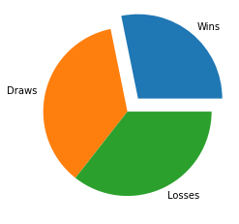
Scraped Data
record | Numbers
0 | Matches | 138
1 | Wins | 39
2 | Draws | 50
3 | Losses | 49
4 | Goals For | 149
5 | Goals Against | 165

Slide 7
the last match’s stats in depth
Tottenham | 2 - 0 | Chelsea
41% | Ball Possession | 59%
8 | Total Shots | 10
3 | Shots On Target | 2
4 | Shots Off Target | 4
1 | Blocked Shots | 4
4 | Shots Inside Box | 1
4 | Shots Outside Box | 9
4 | Corner Kicks | 4
0 | Offsides | 2
10 | Fouls | 10
2 | Yellow Cards | 3
0 | Red Cards | 0
2 | Goalkeeper Saves | 1
407 | Passes | 588
335 (82%) | Accurate Passes | 524 (89%)

Slide 8
From the previous slide’s stats, we notice
That Chelsea and Tottenham were quite evenly matched.
Chelsea dominated ball possession and passes.
They still lost 2-0

Slide 9
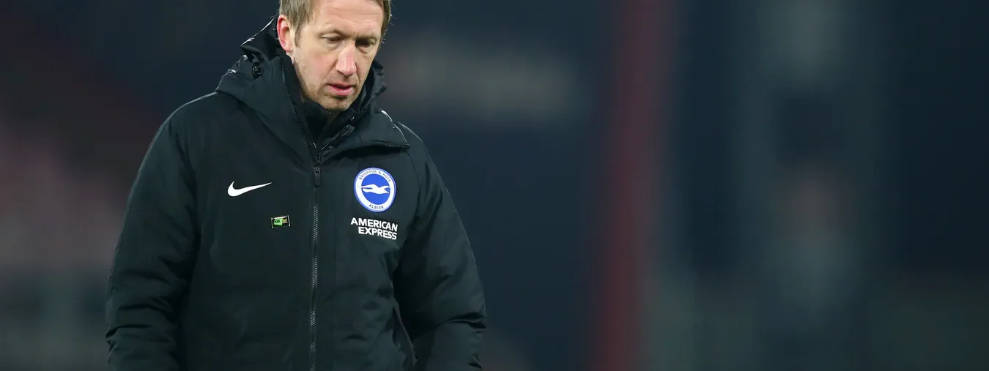
Conclusion:
So in spite of calls for his sacking or resignation from all corners, his overall team stats are not far from what is expected.
It seems that the difference of the winning and loosing right now comes down to intangibles such as motivation, desire or luck.
I think in a business sense, Chelsea should continue in this project, and keep him in place, bar any extreme results.

Slide 10
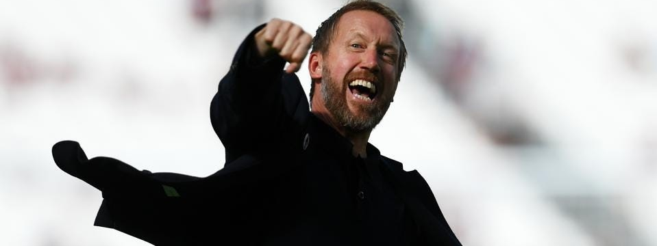
For cleaning the data:
I used Beautiful soup library to parse and use the data, and .text to make it readable.
The challenge for this was because I could only scrape 1 site, it made the data input quite limited.
Next steps, would be to scrape through more stats and go in depth with data like xG, xGA, xG/sh and xG90 of all the players and see if there is an improvement with time.

Slide 11
My sources:
For the web scraping project: | Using BeautifulSoup, requests, matplotlib and numpy libraries | https://www.premierleague.com/managers/25095/Graham-Potter/overview
For the last game stats |  | https://www.reddit.com/r/chelseafc/comments/11cjz8l/postmatch_thread_tottenham_20_chelsea_premier/

