Slide 1



AD HOC Insights Consumer Goods
Codebasics Resume Challenge #4 Presented by : Dinesh Kumar S
Notes:
Welcome to the Ad-Hoc Insights Presentation for Codebasics Resume Challenge #4, set in consumer goods domain.
A big thanks to the Codebasics team for providing a real-world dataset that made this analysis possible.
Let’s jump right in and take a look at the Agenda!

Slide 2
Agenda
Objectives
Company Detail’s
Data and Tools
AD HOC Request
Notes:
These are the four main agenda In Objectives we will Understand the purpose behind this challenge and the problem we're aiming to solve.
In Company Details we will see A quick overview of AtliQ Hardwares, its products and global presence.
In Data and Tools we will Dive into the data sources and technologies used to solve the challenge.
In Ad-Hoc Request we will Explore a real-world scenario

Slide 3
Objectives
AtliQ Hardwares is a fictional company used for analytical case studies. It represents a leading computer hardware producer in India with a strong global footprint.
AtliQ Hardwares’ management realized they lack timely and actionable insights for quick, data-driven decisions.
To bridge this gap, they aim to strengthen the data analytics team by hiring junior data analysts.
Tony Sharma, the Director of Data Analytics, is looking for candidates with a solid mix of technical skills and strong communication abilities.
To assess both skill sets effectively, he designed a SQL challenge that tests not just technical know-how but also problem-solving and clarity in communication.
Notes:
Let’s take a closer look at the main objectives. This will help us understand why the SQL challenge was created and what AtliQ Hardwares is aiming to achieve by hiring data professionals with strong communication skills. "AtliQ Hardwares realized they’re missing the insights needed for quick, smart decisions."
"To fix this, they’re planning to hire junior data analysts."
"Tony Sharma, the analytics director, isn’t just looking for SQL experts—he wants people with strong soft skills too."
"So, he designed a SQL challenge to test both—technical skills and communication.“

Slide 4
Company Detail’s
About the Company:
AtliQ Hardwares is a leading computer hardware manufacturer headquartered in India.
With a strong reputation for innovation and quality, AtliQ has successfully expanded across global markets.
.
Notes:
Let’s take a closer look at the company details. This will help us understand AtliQ Hardwares’ background, its market presence, and why it's a key player in the global computer hardware industry. AtliQ Hardwares is a top computer hardware brand based in India, known for its innovation and quality."
"It has successfully expanded into global markets, making a strong impact across multiple regions."

Slide 5
Company Detail’s
🌍 Global Market Presence
AtliQ Hardwares is actively serving 28 countries across four major regions:
APAC (Asia-Pacific)
India, China, Japan, Indonesia, Pakistan, Bangladesh, Philippines, South Korea, Australia, New Zealand.
EU (Europe)
Germany, France, United Kingdom, Italy, Spain, Austria, Netherlands, Norway, Poland, Portugal, Sweden.
NA (North America)
USA, Canada.
LATAM (Latin America)
Brazil, Chile, Mexico, Columbia.
Notes:
AtliQ Hardwares isn’t just a local success—it’s a global player."
"The company operates in 28 countries across four key regions: APAC, Europe, North America, and Latin America."
"This wide reach highlights AtliQ’s strong international presence and its ability to cater to diverse markets around the world."

Slide 6
Company Detail’s
🖱💻💾 Product Divisions
P & A – Peripherals and Accessories Examples: Keyboards, mice, USB drives, gaming headsets
PC – Notebooks and Desktops Examples: Gaming laptops, ultrabooks, all-in-one PCs
N & S – Networking and Storage Examples: Wi-Fi extenders, routers, external hard drives, NAS devices
Notes:
"AtliQ Hardwares has three main product divisions that cover a wide range of customer needs."
"P & A focuses on peripherals and accessories—things like keyboards, mice, and gaming headsets."
"PC includes notebooks and desktops, from everyday ultrabooks to high-performance gaming laptops."
"And N & S covers networking and storage solutions—like routers, Wi-Fi extenders, and external drives."
"Each division plays a key role in driving AtliQ’s global success."

Slide 7
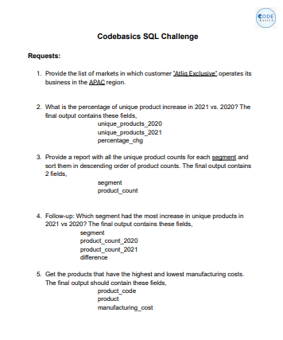
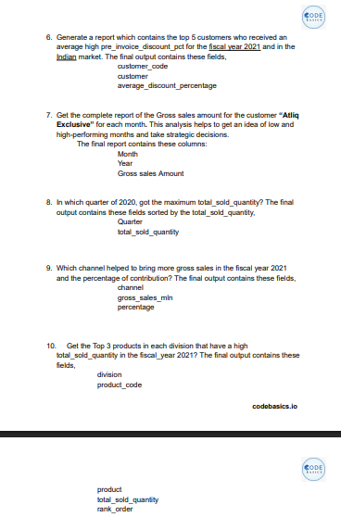
AD Hoc Request
Notes:
Let’s take a closer look at the ad-hoc requests from management. These were designed to uncover key insights around customer behavior, product performance, and sales trends—empowering quicker, data-driven decisions. Now, let’s walk through each request and explore the insights

Slide 8
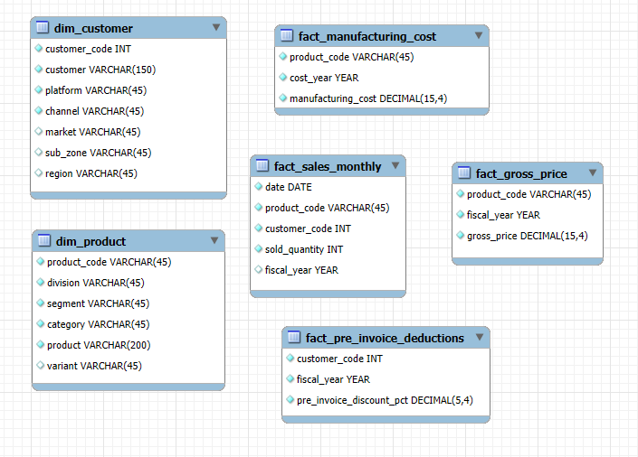


For output:
For Visualization:
Notes:
To get the specific insights needed for this presentation, I used MySQL to run ad-hoc queries, pulling data from across these tables. Then, I brought that output into Power BI to create the compelling visuals you’re about to see.

Slide 9
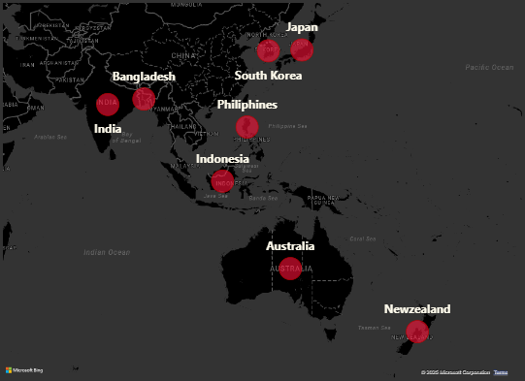

1. Provide the list of markets in which customer "Atliq Exclusive" operates its business in the APAC region.
Insight:
Atliq Exclusive has established a strong presence across multiple countries in the APAC (Asia-Pacific) region, reflecting a well-diversified market strategy.
This wide geographic spread indicates Atliq Exclusive’s strategic focus on tapping into both emerging and developed markets within APAC, enhancing its regional footprint and growth potential.
Notes:
Let’s begin with the first request from the management. Atliq Exclusive" has a strong presence across the APAC region, operating in 8 diverse markets. This wide geographic coverage—including countries like India, Indonesia, Japan, and Australia—indicates a well-established distribution network and a strategic focus on regional expansion. Let’s move on to the second request

Slide 10

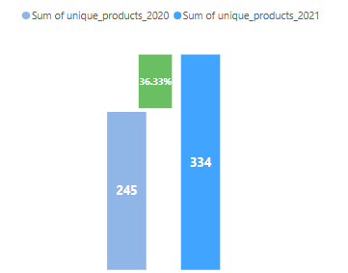
2. What is the percentage of unique product increase in 2021 vs. 2020 ?
Insight:
Between 2020 and 2021, the number of unique products offered by the company increased significantly
This 36.33% growth highlights the company’s strong product expansion strategy, potentially aimed at meeting evolving customer demands, entering new market segments, or boosting competitiveness in the industry.
Such a surge in product variety can positively impact overall sales, customer satisfaction, and market presence—if supported by effective inventory and supply chain management.
Notes:
Atliq Exclusive expanded its product portfolio significantly in 2021, with unique products increasing from 245 to 334. This marks a 36.33% year-over-year growth, reflecting the company’s focus on product diversification and innovation. Let’s move on to the third request

Slide 11
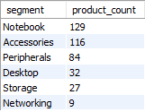
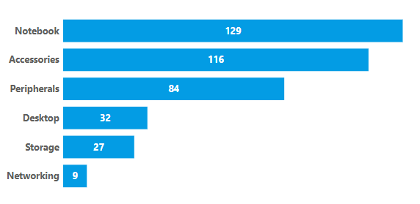
3. Provide a report with all the unique product counts for each segment and sort them in descending order of product counts.
Insight:
Product offerings are heavily focused on the Notebook and Accessories segments.
Networking and Storage have the least variety, indicating possible gaps or niche focus.
There is potential to diversify the product portfolio in underrepresented segments.
Notes:
The Notebook and Accessories segments lead in product variety with 129 and 116 unique products respectively, highlighting their importance in Atliq Exclusive's portfolio. In contrast, Networking and Storage segments offer fewer products, indicating potential areas for future expansion or specialization.

Slide 12
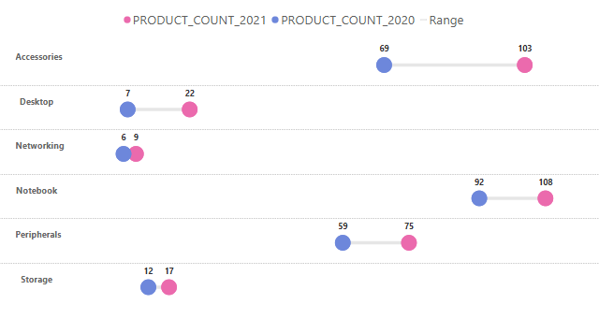
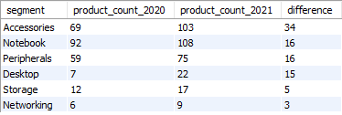
4.Which segment had the most increase in unique products in 2021 vs 2020?
Insight:
The segment with the most increase in unique products in 2021 compared to 2020 is Accessories, which saw an increase of 34 products (from 69 in 2020 to 103 in 2021).
Notes:
The Accessories segment saw the highest growth in unique products in 2021, adding 34 new products compared to the previous year. This suggests a strategic push to diversify offerings in that category, outpacing other segments like Notebook and Peripherals, which each saw an increase of 16 products.

Slide 13
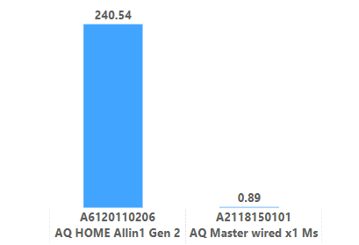



5. Get the products that have the highest and lowest manufacturing costs.
Insight:
The product with the highest manufacturing cost is AQ HOME Allin1 Gen 2 ($ 240.5364), and the product with the lowest manufacturing cost is AQ Master wired x1 Ms ($ 0.8920).
Notes:
The product “A-Q Home All-in-One Gen Two” has the highest manufacturing cost at ₹240.54, while “A-Q Master Wired X-One M-S” has the lowest, at just ₹0.89. This highlights the wide cost range in the product lineup, likely driven by varying levels of complexity and component usage.

Slide 14
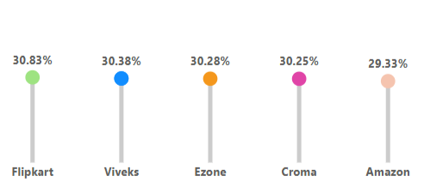
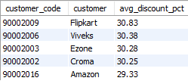
6. Generate a report which contains the top 5 customers who received an average high pre_invoice_discount_pct for the fiscal year 2021 and in the Indian market.
Insight: Flipkart received the highest average pre-invoice discount percentage among the top 5 customers in the Indian market for fiscal year 2021, with an average discount of 30.83%.
Notes:
In the Indian market for fiscal year 2021, Flipkart received the highest average pre-invoice discount at 30.83%, followed closely by Viveks, Ezone, and Croma—all receiving discounts above 30%. Amazon rounds out the top 5 with 29.33%, reflecting strong promotional strategies offered to major retail partners.

Slide 15
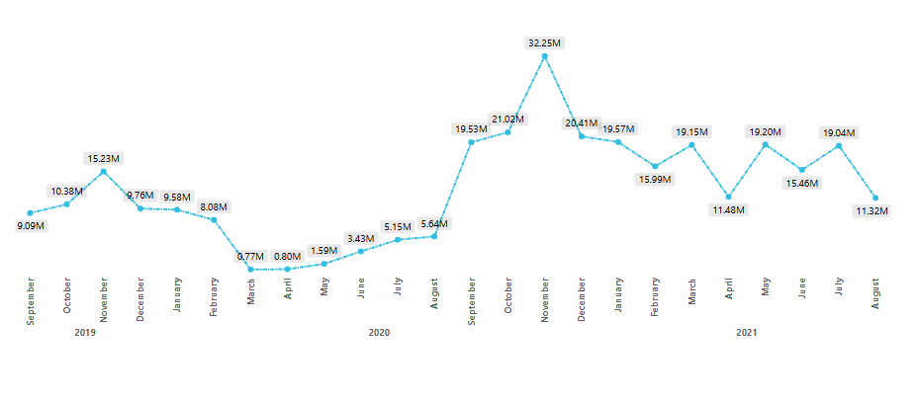
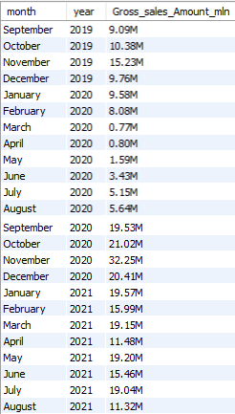
7. Get the complete report of the Gross sales amount for the customer “Atliq Exclusive” for each month.
Fiscal Year 2020
Fiscal Year 2021
Insight:
High-Performing Months: November consistently stands out as a high-performing month across all years. October and December also show strong sales figures.
Low-Performing Months: March, April, May, June, July and August of 2020 were relatively low-performing months.
Year-over-Year Growth: A comparison of monthly sales across different years indicates significant growth in 2020 compared to 2019.
Notes:
The monthly gross sales trend for Atliq Exclusive reveals strong growth from mid-2020 to 2021. Notably, November 2020 marked the highest sales at ₹32.25M, followed by consistently high sales throughout 2021. This trend suggests effective business recovery and strong customer demand post early-pandemic disruptions.

Slide 16
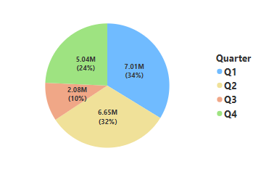

8. In which quarter of 2020, got the maximum total_sold_quantity?
Insight:
Q1 sales were significantly higher than all other quarters.
Q2 sales were the lowest of the year.
Q3 saw a partial recovery compared to Q2.
Q4 sales were moderate, higher than Q2 but lower than Q1 and Q3.
Notes:
In 2020, Q1 recorded the highest total sold quantity with over 7 million units sold, indicating strong demand early in the year. This was followed by a dip in Q3, possibly due to pandemic-related slowdowns, before partial recovery in Q4.

Slide 17

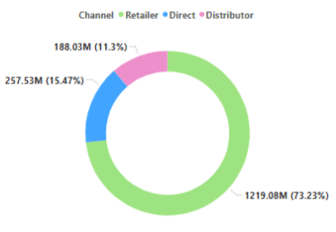
9. Which channel helped to bring more gross sales in the fiscal year 2021 and the percentage of contribution?
Insight:
In the fiscal year 2021, the Retailer channel accounted for the highest gross sales with $1219.08M, contributing 73% to the total gross sales.
Notes:
In fiscal year 2021, the Retailer channel was the top contributor, generating a significant 73% of gross sales. Direct sales followed with 15%, while Distributors accounted for 11%. This highlights the dominant role of retail partnerships in driving revenue.

Slide 18
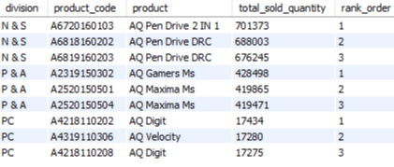
10. Get the Top 3 products in each division that have a high total_sold_quantity in the fiscal_year 2021?
Insight:
N&S: Dominated by Pen Drives.
P&A: AQ Gamers Ms and AQ Maxima Ms are the top performers.
PC: AQ Digit and AQ Velocity lead in sales.
Notes:
This is the 10th and final request. We've gathered the top 3 products in each division with the highest total sold quantities in fiscal year 2021. Let’s now move on to the visualization to explore these insights!

Slide 19
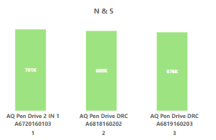
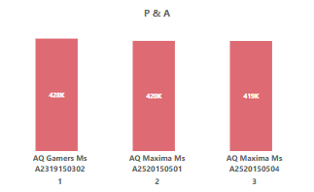
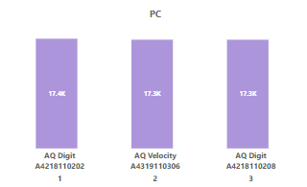
Notes:
Starting with the Networking & Storage division, AQ Pen Drive 2 IN 1 was the clear leader with 701 thousand units sold. Interestingly, two variants of AQ Pen Drive DRC followed closely behind, with 688 thousand and 676 thousand units respectively. When combined, the DRC models reached 1.36 million units
Moving to the Peripherals & Accessories division, AQ Gamers Ms secured the top spot with 428 thousand units sold. Right behind were two variants of AQ Maxima Ms, each selling 419 thousand units. Together, these two variants sold 839thousand units
Finally, in the PC division, although overall sales volumes were lower, AQ Digit and AQ Velocity emerged as top performers, each selling around 17 thousand units. AQ Digit appeared twice with two different models, and when combined aq digit sold nearly 34 thousand units

Slide 20
Thank you
Dinesh Kumar S dinesh.works@gmail.com My Portfolio GitHub
Notes:
special thanks to Dhaval Patel sir, Hemanand Vadivel sir, and the entire Codebasics team for creating this insightful Resume Challenge. It has helped me gain valuable domain knowledge in the consumer goods industry.
check out my GitHub and portfolio projects to explore more of my work Thank you so much for taking the time to watch this presentation! I hope you found the insights valuable!

