Slide 1



AD HOC Insights Consumer Goods
Codebasics Resume Challenge #4 Presented by : Dinesh Kumar S

Slide 2
Agenda
Objectives
Company Detail’s
Data and Tools
AD HOC Request

Slide 3
Objectives
AtliQ Hardwares is a fictional company used for analytical case studies. It represents a leading computer hardware producer in India with a strong global footprint.
AtliQ Hardwares’ management realized they lack timely and actionable insights for quick, data-driven decisions.
To bridge this gap, they aim to strengthen the data analytics team by hiring junior data analysts.
Tony Sharma, the Director of Data Analytics, is looking for candidates with a solid mix of technical skills and strong communication abilities.
To assess both skill sets effectively, he designed a SQL challenge that tests not just technical know-how but also problem-solving and clarity in communication.

Slide 4
Company Detail’s
About the Company:
AtliQ Hardwares is a leading computer hardware manufacturer headquartered in India.
With a strong reputation for innovation and quality, AtliQ has successfully expanded across global markets.
.

Slide 5
Company Detail’s
🌍 Global Market Presence
AtliQ Hardwares is actively serving 28 countries across four major regions:
APAC (Asia-Pacific)
India, China, Japan, Indonesia, Pakistan, Bangladesh, Philippines, South Korea, Australia, New Zealand.
EU (Europe)
Germany, France, United Kingdom, Italy, Spain, Austria, Netherlands, Norway, Poland, Portugal, Sweden.
NA (North America)
USA, Canada.
LATAM (Latin America)
Brazil, Chile, Mexico, Columbia.

Slide 6
Company Detail’s
🖱💻💾 Product Divisions
P & A – Peripherals and Accessories Examples: Keyboards, mice, USB drives, gaming headsets
PC – Notebooks and Desktops Examples: Gaming laptops, ultrabooks, all-in-one PCs
N & S – Networking and Storage Examples: Wi-Fi extenders, routers, external hard drives, NAS devices

Slide 7
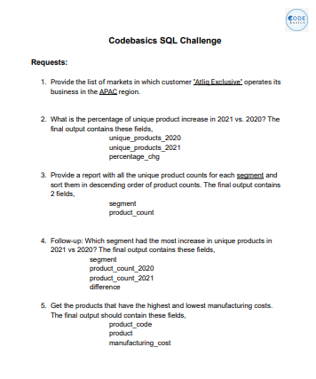
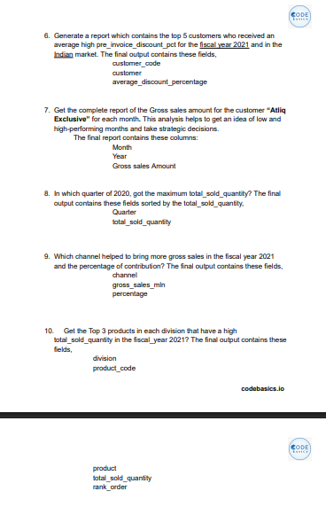
AD Hoc Request

Slide 8
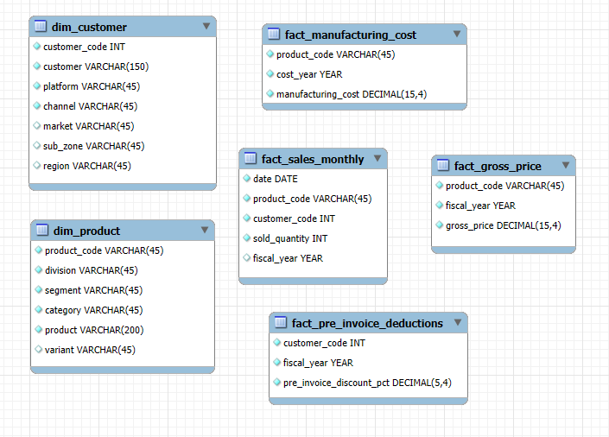


For output:
For Visualization:

Slide 9
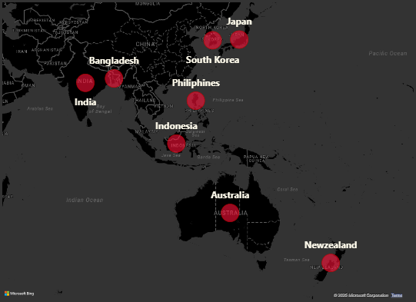

1. Provide the list of markets in which customer "Atliq Exclusive" operates its business in the APAC region.
Insight:
Atliq Exclusive has established a strong presence across multiple countries in the APAC (Asia-Pacific) region, reflecting a well-diversified market strategy.
This wide geographic spread indicates Atliq Exclusive’s strategic focus on tapping into both emerging and developed markets within APAC, enhancing its regional footprint and growth potential.

Slide 10

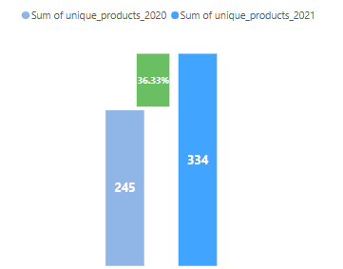
2. What is the percentage of unique product increase in 2021 vs. 2020 ?
Insight:
Between 2020 and 2021, the number of unique products offered by the company increased significantly
This 36.33% growth highlights the company’s strong product expansion strategy, potentially aimed at meeting evolving customer demands, entering new market segments, or boosting competitiveness in the industry.
Such a surge in product variety can positively impact overall sales, customer satisfaction, and market presence—if supported by effective inventory and supply chain management.

Slide 11
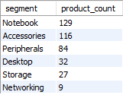
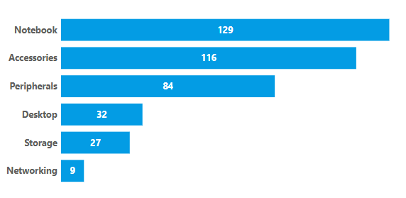
3. Provide a report with all the unique product counts for each segment and sort them in descending order of product counts.
Insight:
Product offerings are heavily focused on the Notebook and Accessories segments.
Networking and Storage have the least variety, indicating possible gaps or niche focus.
There is potential to diversify the product portfolio in underrepresented segments.

Slide 12
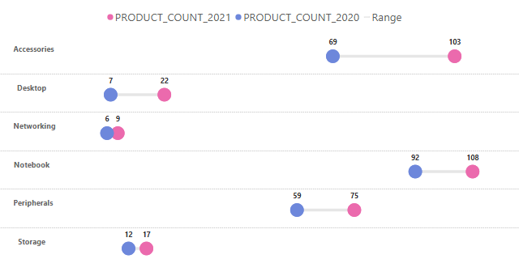
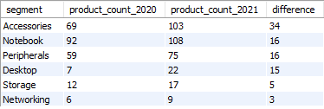
4.Which segment had the most increase in unique products in 2021 vs 2020?
Insight:
The segment with the most increase in unique products in 2021 compared to 2020 is Accessories, which saw an increase of 34 products (from 69 in 2020 to 103 in 2021).

Slide 13
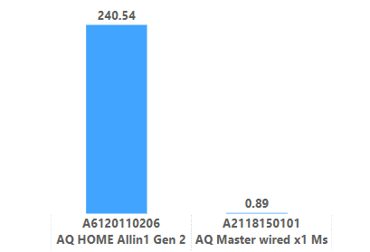



5. Get the products that have the highest and lowest manufacturing costs.
Insight:
The product with the highest manufacturing cost is AQ HOME Allin1 Gen 2 ($ 240.5364), and the product with the lowest manufacturing cost is AQ Master wired x1 Ms ($ 0.8920).

Slide 14
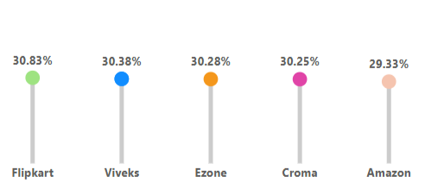
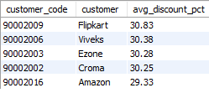
6. Generate a report which contains the top 5 customers who received an average high pre_invoice_discount_pct for the fiscal year 2021 and in the Indian market.
Insight: Flipkart received the highest average pre-invoice discount percentage among the top 5 customers in the Indian market for fiscal year 2021, with an average discount of 30.83%.

Slide 15
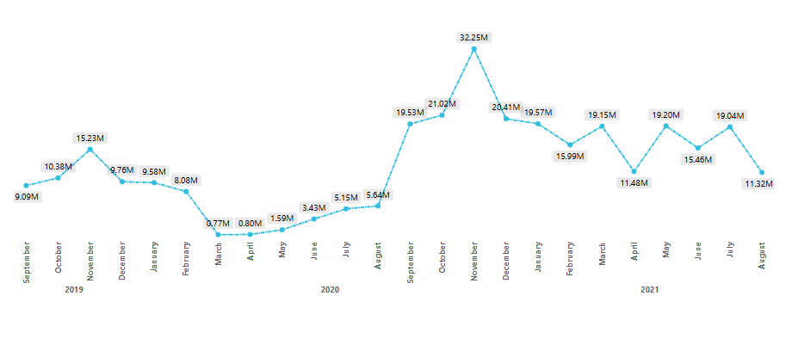
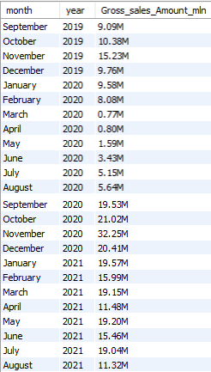
7. Get the complete report of the Gross sales amount for the customer “Atliq Exclusive” for each month.
Fiscal Year 2020
Fiscal Year 2021
Insight:
High-Performing Months: November consistently stands out as a high-performing month across all years. October and December also show strong sales figures.
Low-Performing Months: March, April, May, June, July and August of 2020 were relatively low-performing months.
Year-over-Year Growth: A comparison of monthly sales across different years indicates significant growth in 2020 compared to 2019.

Slide 16
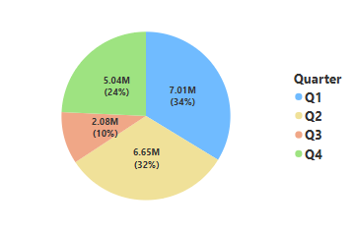

8. In which quarter of 2020, got the maximum total_sold_quantity?
Insight:
Q1 sales were significantly higher than all other quarters.
Q2 sales were the lowest of the year.
Q3 saw a partial recovery compared to Q2.
Q4 sales were moderate, higher than Q2 but lower than Q1 and Q3.

Slide 17

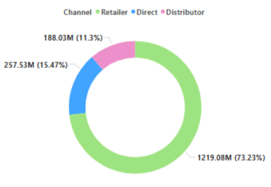
9. Which channel helped to bring more gross sales in the fiscal year 2021 and the percentage of contribution?
Insight:
In the fiscal year 2021, the Retailer channel accounted for the highest gross sales with $1219.08M, contributing 73% to the total gross sales.

Slide 18
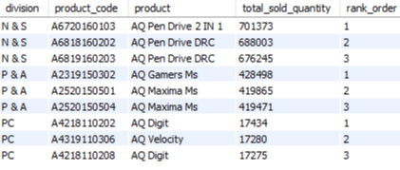
10. Get the Top 3 products in each division that have a high total_sold_quantity in the fiscal_year 2021?
Insight:
N&S: Dominated by Pen Drives.
P&A: AQ Gamers Ms and AQ Maxima Ms are the top performers.
PC: AQ Digit and AQ Velocity lead in sales.

Slide 19
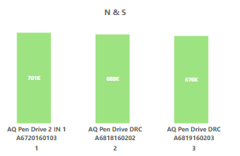
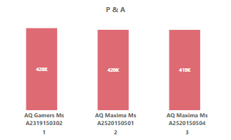
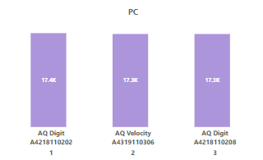

Slide 20
Thank you
Dinesh Kumar S dinesh.works@gmail.com My Portfolio GitHub

