Slide 1




Group Code - B25AH02
IoT Data Analytics Using DRL
Mentor - Dr.Abhishek Hazara

Slide 2
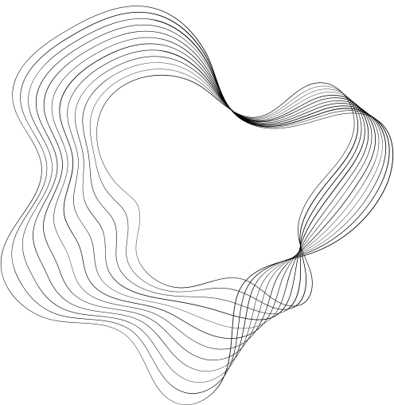


Our team
Sushant Gadyal - S20220010218
Bathina Santosh Kiran - S20220010035
Dinesh Peddina - S20220010062

Slide 3

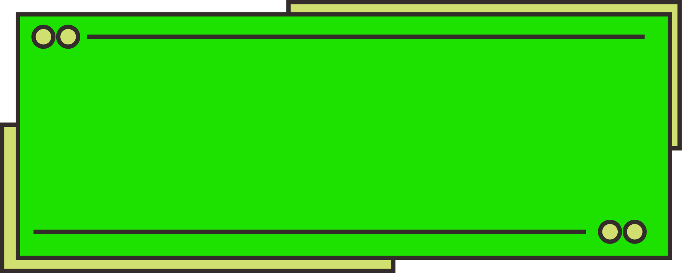

Content
Problem Statement
Basic Diagram of DRL
Problem Statement Diagram
Implementation
Formulas
Previous Results
Current Results
TimeLine
References

Slide 4

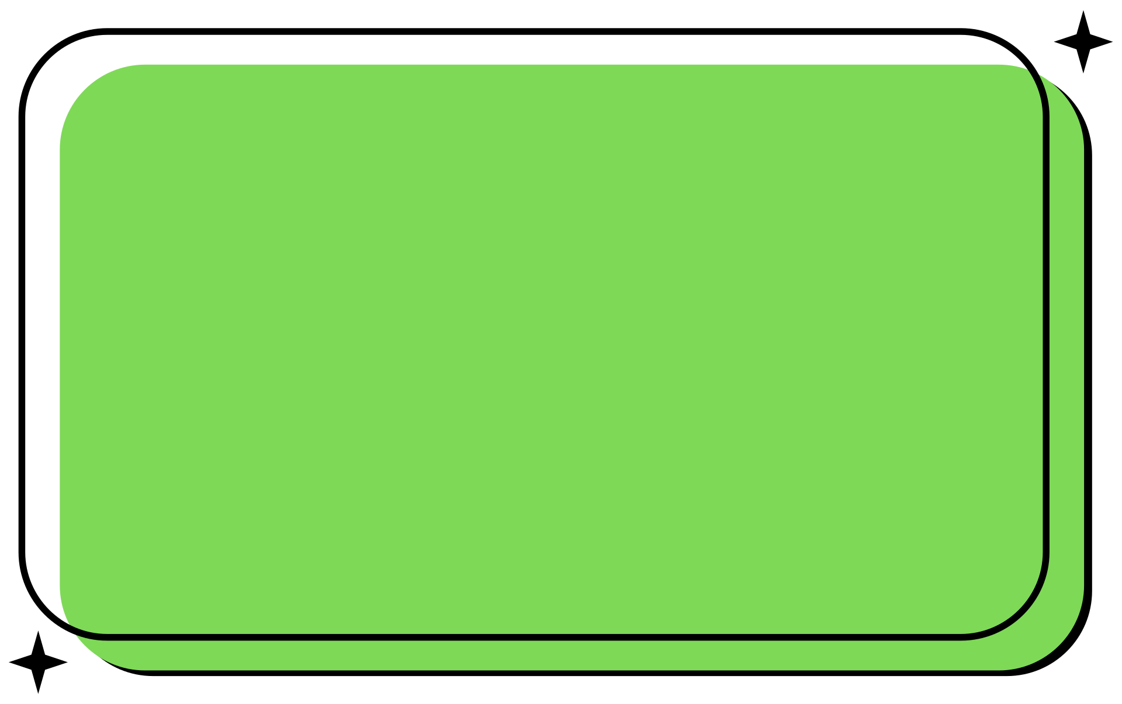
Problem Statement
Our focus is to design a system where the Master UAV classifies whether to execute a task locally or offload it, and if offloading is chosen, uses Deep Reinforcement Learning (DRL) to select the optimal external device for task execution
Reduce the energy consumption and latency
that is required for
task offloading and computation.

Slide 5




Basic Diagram
Agent
State
Action
Reward(Rt)
Environment

Slide 6


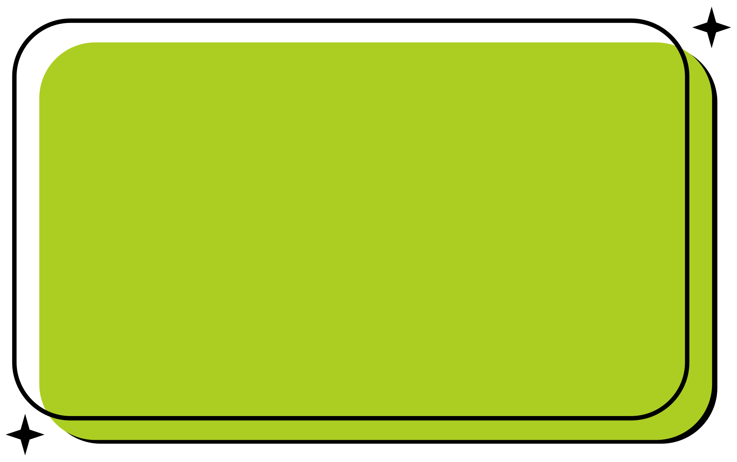




Diagram Overview
Cloud Server
Task
Master UAV
Classification and DRL
IOT Devices
....
UAV1
UAV2
UAVn

Slide 7

Implementation
Module-4
Numerical Analysis (Experiment and Results)
Module-1
Network model & Problem Formulation
DRL-Based task offloading
Classification Algorithm
Module-3
Module-2

Slide 8




DRL Environment Setup
  Master UAV
2. IoT Device
Generate Random Tasks
3. Slave UAV
Module 1
4. Cloud Server
Network Model and Problem Formulation
Task Execution Methods
1.Master UAV Execution
Get State
2. IoT Execution
3. Slave UAV Execution
4. Cloud Server Execution
Reset Environment

Slide 9
Compute Required Energy
Compute Required
Execution Time
Module 2
Classification Algorithm
Check Battery Sufficiency
Check Time Constraint
Return Execution Feasibility (True/False)

Slide 10

Task Partitioning
Deep Q - Learning ( DQN)
Module 3
Algorithm Implementation
DRL - Based Task
Offloading
ERS – Enhanced Reward Shaping
1.Always negative rewards → hard learning
Micro-Deadline Check
2. Add bonuses for fast and
efficient tasks.
3. Better guidance → quicker learning
, less negative reward

Slide 11
Steps
What DQN does?
Initialize the agent
The agent starts with no knowledge.
Module 3
Take an Action
The agent offloads a task (Local, Master UAV, SlaveUAV, Cloud).
DRL - Based Task
Offloading
Recieve a Reward
Based on delay & energy consumption, the agent gets
a negative reward.
Store Experience
The agent saves (state, action, reward, next_state).
Train the Neural Network
The agent learns which actions maximize reward.
Reduce Randomness
The agent shifts from random choices to smart decisions.
Improve over Time
After many episodes, the agent chooses the best action every time.

Slide 12


Performance Metrics
Module 4
Comparison with BenchMarks
Numerical Analysis
Graphs and Analysis

Slide 13

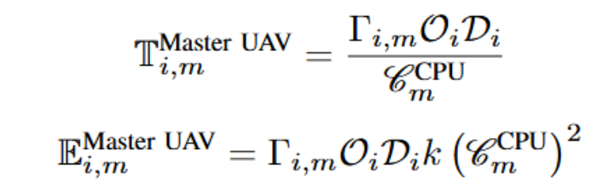
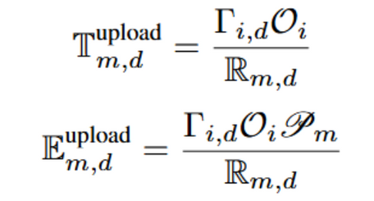
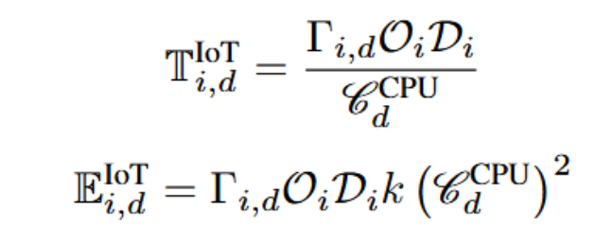
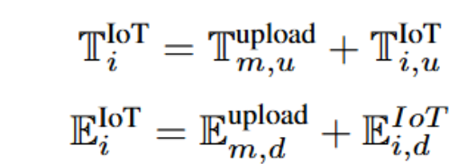
Formulas Used
1. Local Master UAV Execution
2. Master UAV to IoT Device Execution

Slide 14
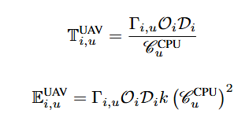
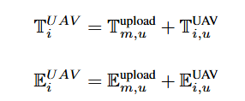
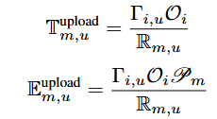

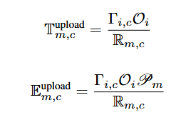
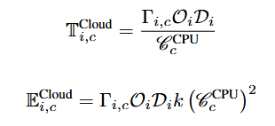
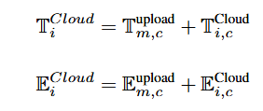
Formulas Used
3. Master UAV to UAV Execution
4. Master UAV to Cloud Device Execution

Slide 15
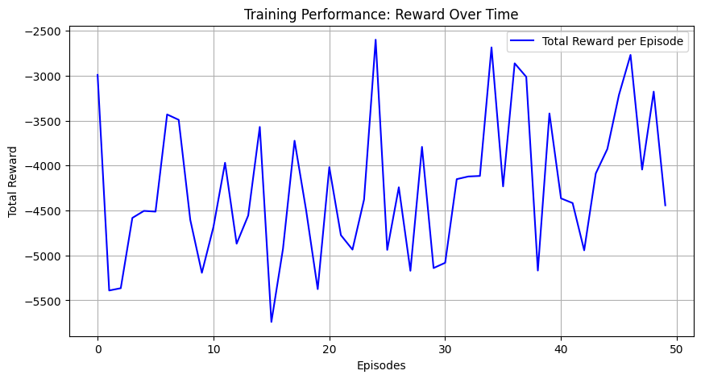
Phase 1 Results
Epsilon (ε) is decreasing from 1.0 to 0.01 .
Training Performance

Slide 16
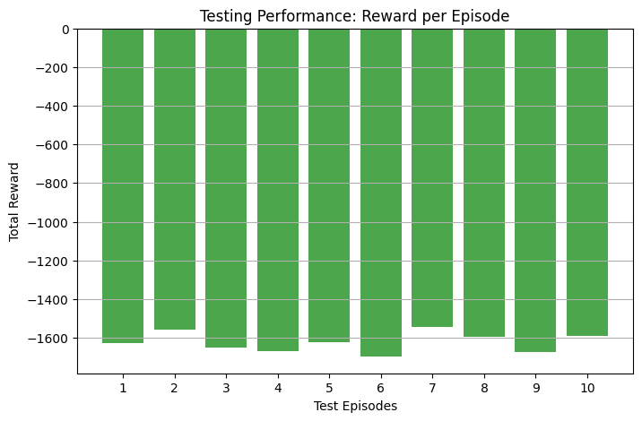
Phase 1 Results
Testing Performance
Epsilon (ε) is 0.

Slide 17
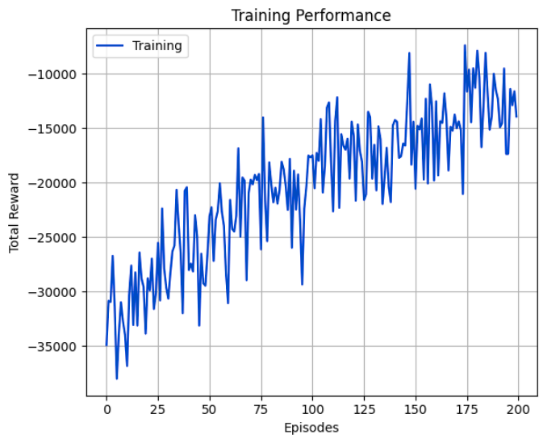
Phase 2 Results
Training Performance
Epsilon (ε) is decreasing from 1.0 to 0.01 .
Due to Classification
Algorithm

Slide 18
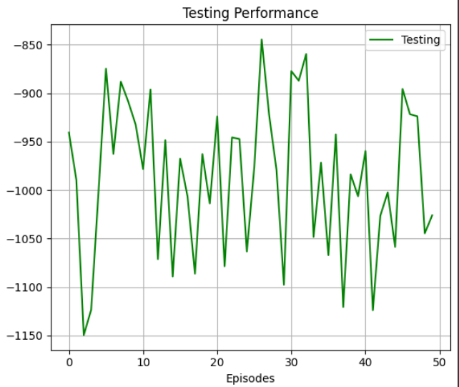
Phase 2 Results
Testing Performance
Epsilon (ε) is 0.

Slide 19
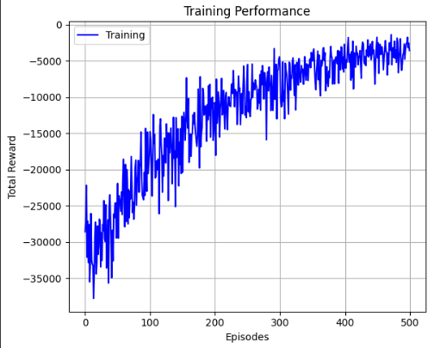
Phase 3 Results
Training Performance
Epsilon (ε) is decreasing from 1.0 to 0.01 .
Due to Enhanced
Reward Shaping

Slide 20
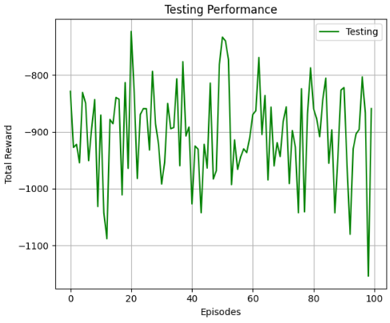
Phase 3 Results
Testing Performance
Epsilon (ε) is 0.

Slide 21
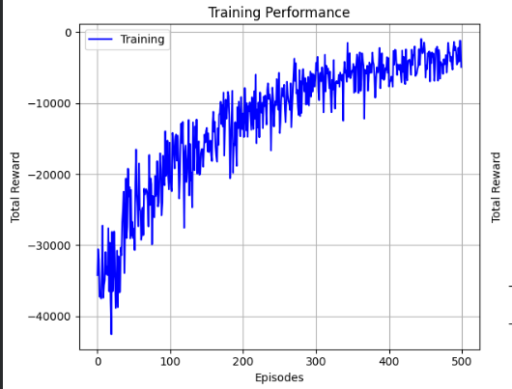
Phase 4 Results
Epsilon (ε) is decreasing from 1.0 to 0.01 .
Training Performance
Due to Micro deadline
check

Slide 22
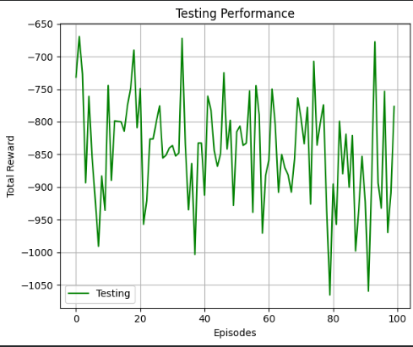
Phase 4 Results
Testing Performance
Epsilon (ε) is 0.

Slide 23



Why Negative Reward System?
Goal - Minimum time and energy consume
If positive Reward System
If negative Reward System
+y
+y
Max time and energy
reward
reward
Min time and energy
0
episodes
0
-x
+x
-x
+x
episodes
Min time and energy
-y
-y
Max time and energy

Slide 24
TimeLine
Improvised DRL Agent accuracy
with the enhanced
reward shaping algorithm
Developed the model with average
accuracy from scratch
Evaluation1
Evaluation2
Evaluation3
Evaluation4
Going through various sources and
understand how does the
algorithm works
Improvised DRL Agent accuracy
with the classification algorithm

Slide 25
References
[1]
[2]
[3]
Deep Reinforcement Learning for Task Partitioning and Partial Offloading in UAV Networks
Intelligent Service Deployment Policy for Next-Generation Industrial Edge Networks
Collaborative AI-enabled Intelligent Partial Service Provisioning in Green Industrial Fog Networks
Srivikas Varasala, Veera Manikantha Rayudu Tummala, Suhas N Reddy, Sampath Kumar Talada, Abhishek Hazra, Mohan Gurusamy
Abhishek Hazra, Mainak Adhikari, Tarachand Amgoth, Satish Narayana Srirama
Abhishek Hazra, Mainak Adhikari, Tarachand Amgoth, Satish Narayana Srirama

Slide 26
Thank
you!

