Slide 1
Sales Tracking Dashboard Summary
Created using Excel & Tableau

Slide 2
Objective
To track sales performance and monitor improvement over time.

Slide 3
Tools Used
- Excel for data processing
- Tableau for visualization

Slide 4
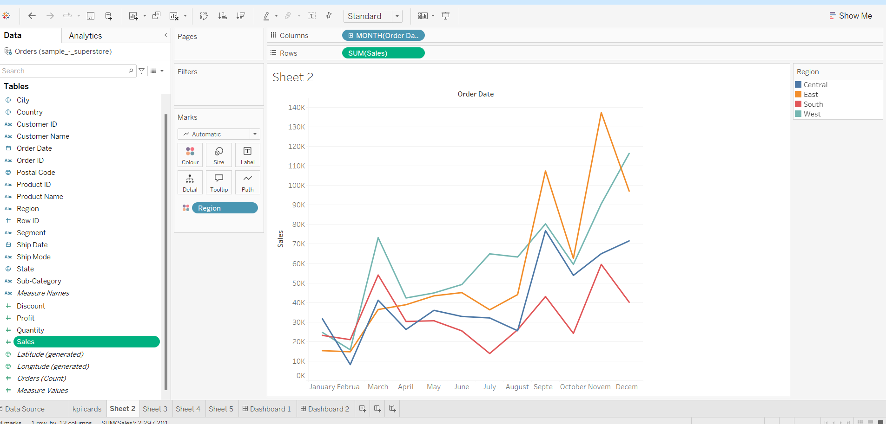
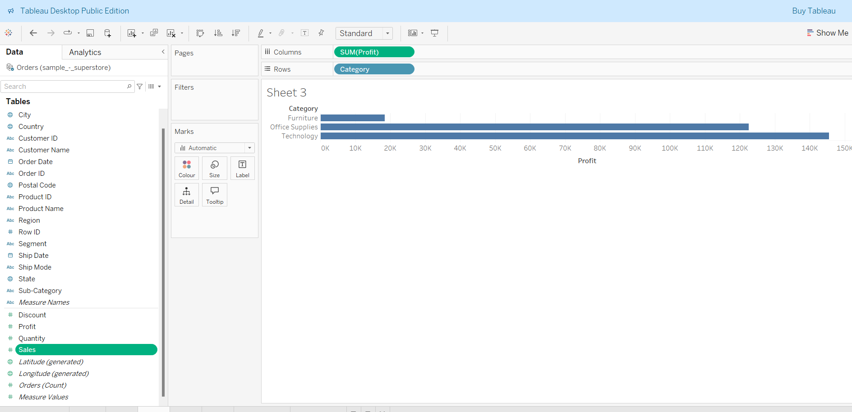

Slide 5
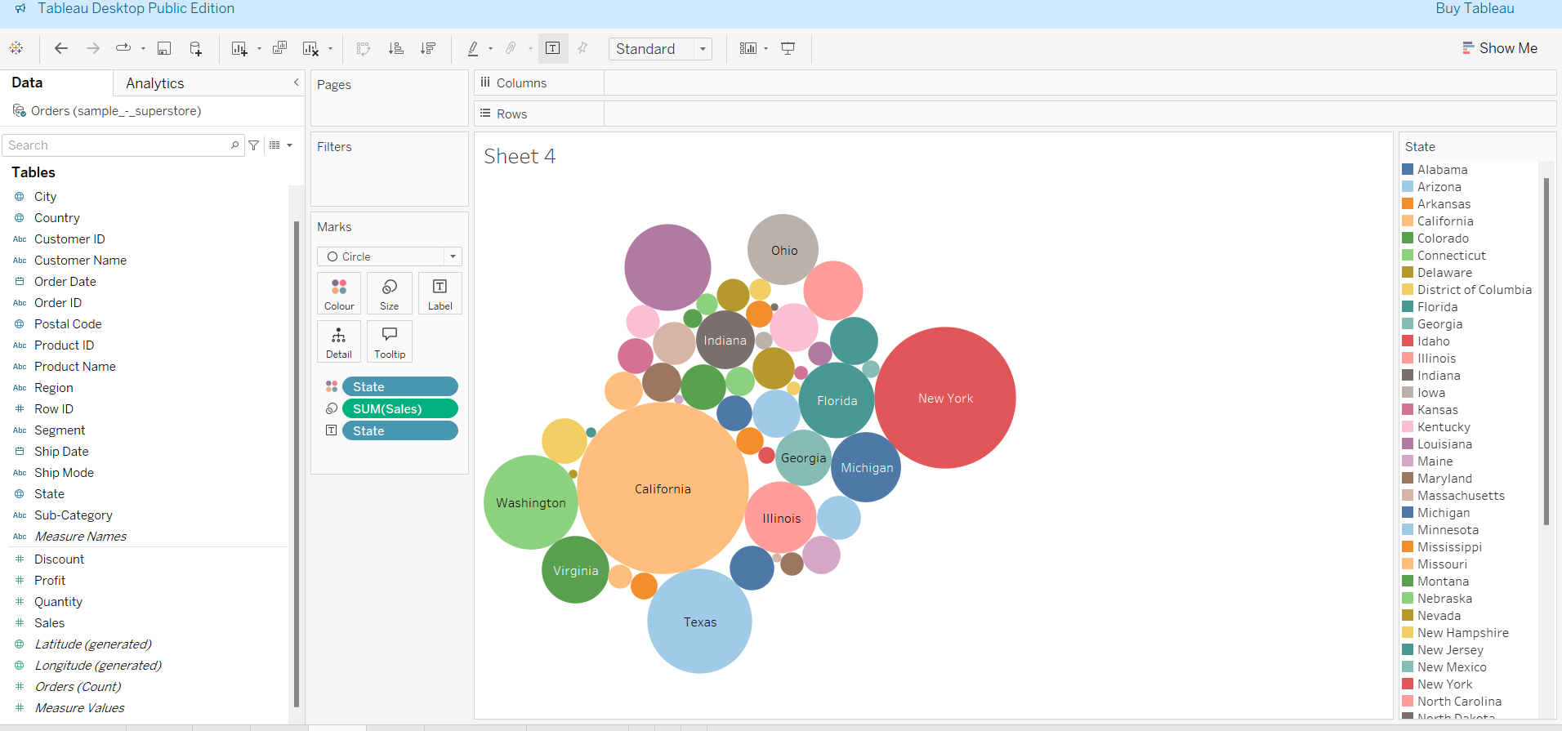
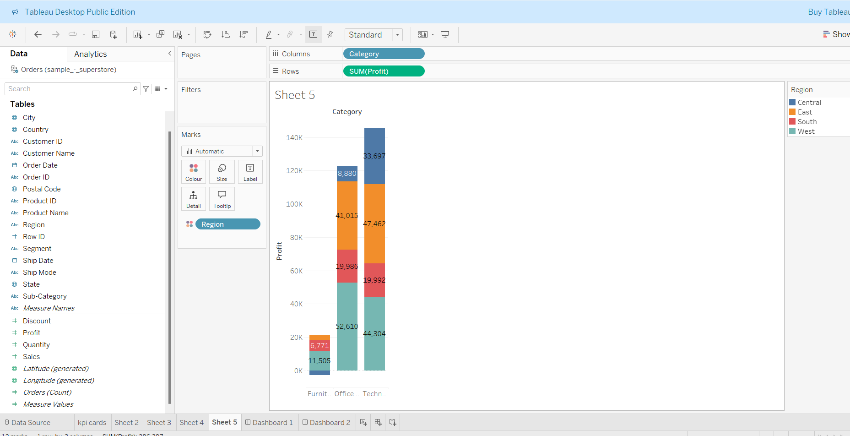

Slide 6
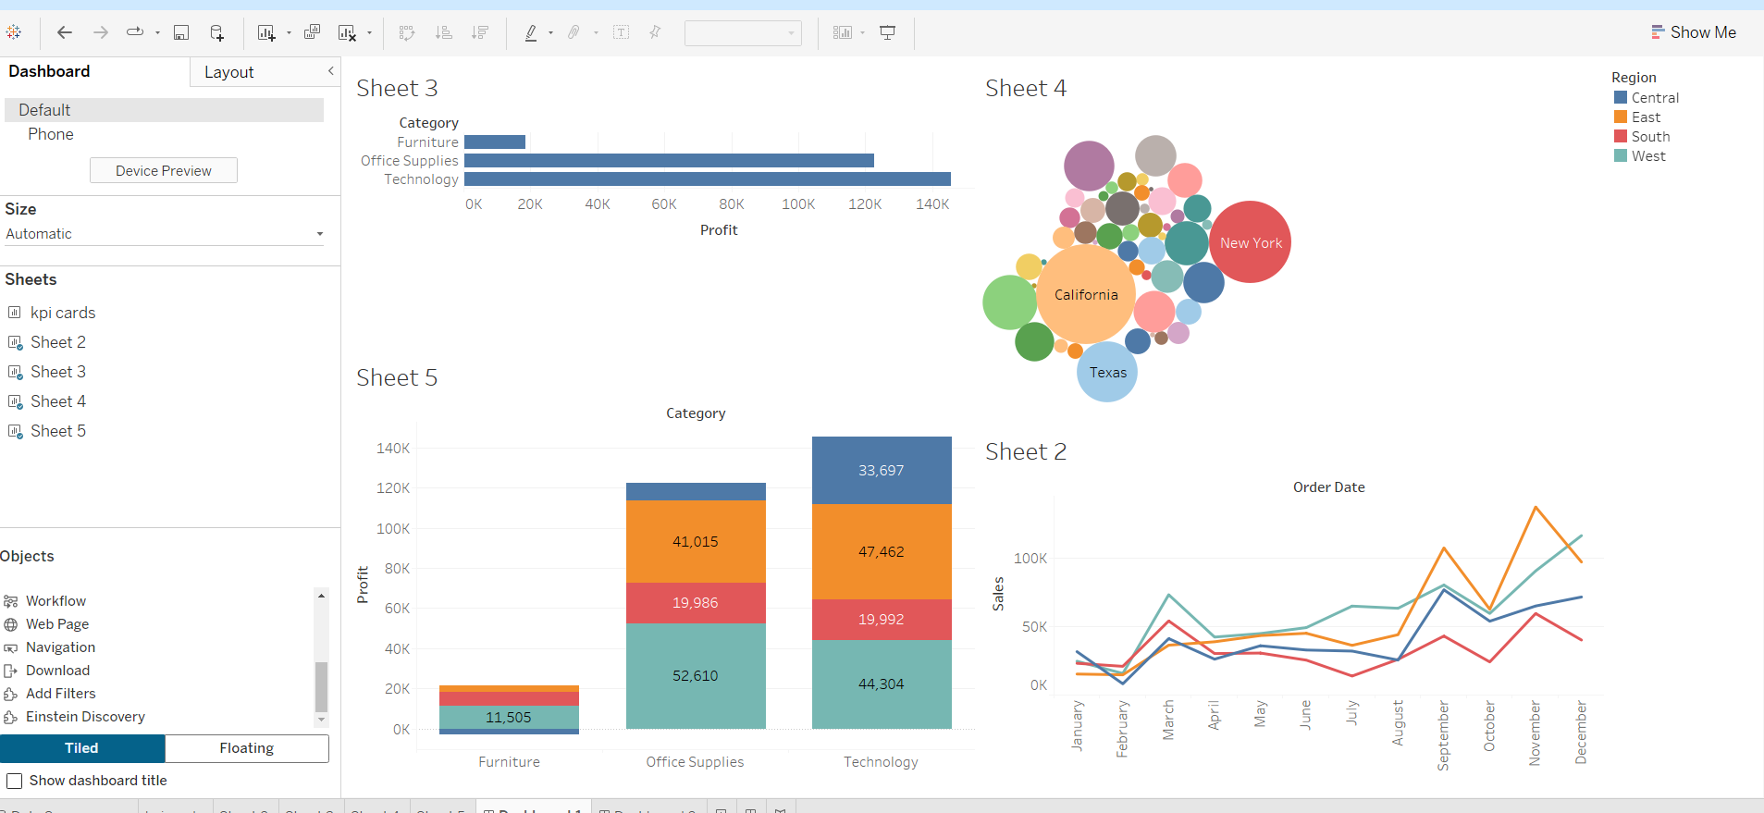

Slide 7
Summary
This dashboard allows the team to visualize sales trends and improvements across different time periods, providing a data-driven foundation for decisions.

