Slide 1

Comprehensive Analysis of Parkinson’s Dataset
Group:
Dinesh Kumar Gummadavelli
Maneesh Modepalli
Rakul A. Venkatesan

Slide 2

Motivation
Parkinson’s disease is a progressive neurological disorder that affects movement and quality of life. Early detection is essential for effective treatment, but symptoms are often subtle and hard to identify in the early stages.
By using Data Mining techniques on voice data, we aim to support earlier and more accurate diagnosis, helping improve outcomes for patients.

Slide 3
Dataset Description
Source: UCI ML Repository
197 instances, 22 features
Voice recordings from 31 subjects (23 with Parkinson’s)
Features include frequency, amplitude, noise, nonlinear dynamics
Target: status (1 = Parkinson’s, 0 = Healthy)

Slide 4
Research Questions Explored
How useful are the given features in predicting Parkinson’s disease (Using logistic regression and analyzing the p coefficients)
Parametric vs non-parametric models, which perform better?
Can regularization and dimension reduction improve logistic regression?
What is the trade-off between model interpretability and predictive performance in diagnosing Parkinson’s disease?
How does model performance vary with different cross-validation strategies (e.g., k-fold vs leave-one-out)?

Slide 5
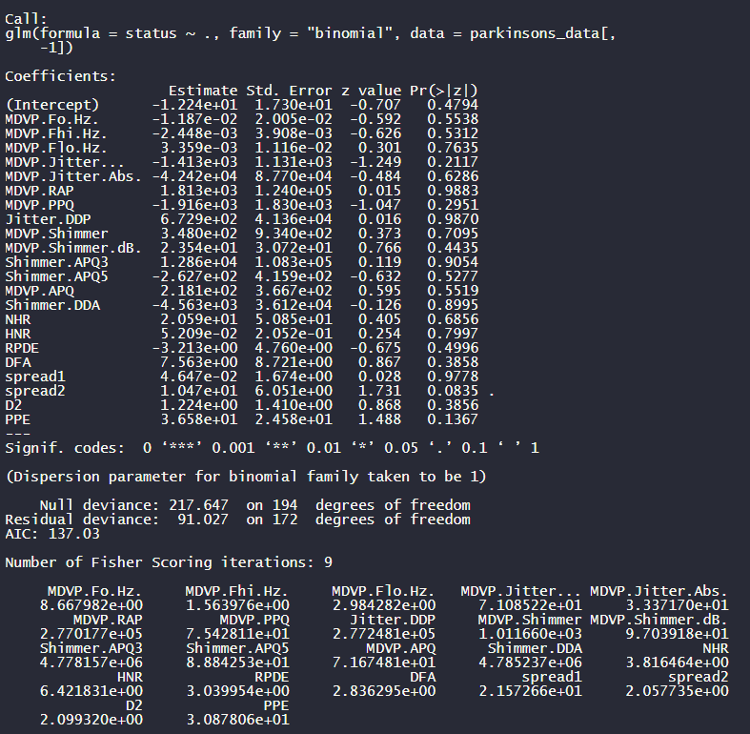
Feature Significance Analysis
We initially used p-values from the logistic regression model to assess feature importance, but most were not significant due to multicollinearity, which obscures individual effects.
Despite this, the model fit was strong, as shown by the drop in residual deviance.
This suggests that while individual features may not stand out, the features collectively contribute meaningfully to the model’s predictive power.
A better approach for identifying key features could be using best subset selection.

Slide 6
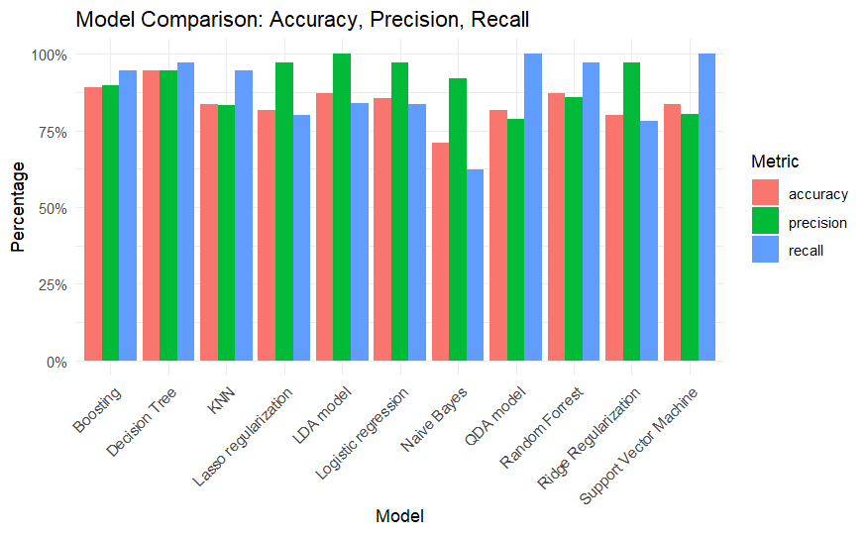
Parametric v Non-Parametric
We analyzed the model performance based on three metrics Accuracy, Precision and recall.
Here is a bar plot that shows the various metrics by each model where each bar represents a different metric from the same model.

Slide 7
Verdict after comparing different model
From the bar plot on the previous slide, we observe that non-parametric models generally outperformed parametric models in terms of predictive metrics.
Note: Cross-validation was used for models like lasso, ridge, KNN, SVM and Boosting to tune hyperparameters and prevent overfitting.
For LDA, the first five features were removed due to constant within-class variance, which violated model assumptions.

Slide 8

Can Regularization and Dimensionality Reduction Improve Performance?

Slide 9
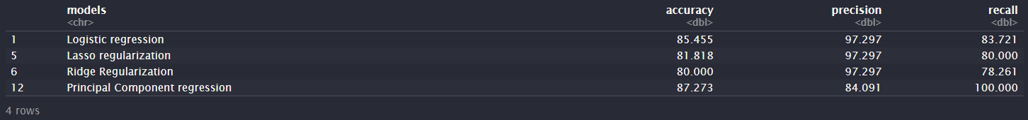
Regularization Techniques (Lasso & Ridge):Help reduce overfitting by penalizing complex models, but in our case, did not significantly outperform standard logistic regression. This suggests that the features may already be relatively well-structured.
Dimensionality Reduction (PCA + Logistic Regression):Achieved perfect recall and stable accuracy even after cross-validation. This shows that PCA effectively handled multicollinearity and preserved the most informative components for classification.
Conclusion:While regularization had limited impact, PCA-based dimensionality reduction clearly improved model performance and generalizability, especially in high-sensitivity applications like medical diagnosis.

Slide 10
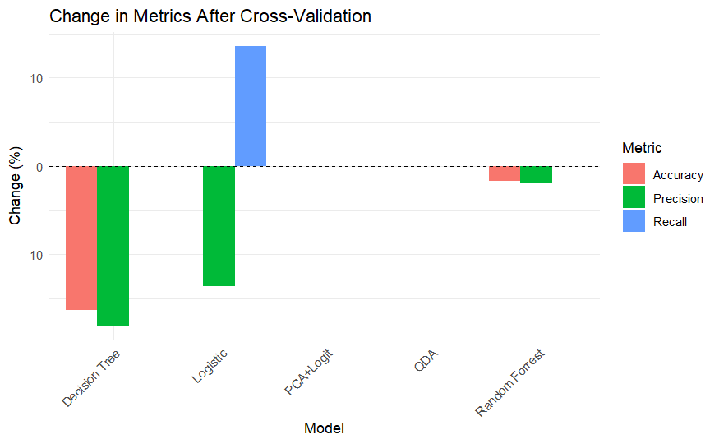
Cross-Validation Impact
The application of cross-validation techniques reveals that parametric models generally maintain stable performance, with minimal changes across accuracy, precision, and recall.
In contrast, non-parametric models show greater variability, particularly the Decision Tree, which exhibits a notable drop in accuracy and precision.
This suggests that parametric models may generalize better on this dataset, while some non-parametric models, though powerful, are more prone to overfitting without regularization or tuning.

Slide 11

Interpretability vs Performance
Logistic Regression, LDA: Interpretable, feature-driven
Random Forest, Boosting, SVM: Higher performance but black-box
In Medical Settings: Interpretability is key for trust, but recall (sensitivity) must be prioritized to avoid missing Parkinson’s diagnoses.

Slide 12
Conclusion
Overall, the PCA + Logistic Regression model is a better choice for our dataset. It provides strong predictive performance with perfect recall, while remaining more interpretable than complex black-box models.
This makes it both effective and trustworthy for medical diagnosis tasks like Parkinson’s detection.

Slide 13
Thank you
We appreciate your time and attention.
Questions or feedback are welcome!

