Slide 1


Department of Computer Science and Engineering
Diabetic Retinopathy Prediction Using Multi Model Algorithms With Comparison Study​
AMARNATH R[211419104010]
DINESH K[211419104067]
HARIHARASUBRAMANIYAN K[211419104089]
Guide Name & Designation
Coordinator Name & Designation

Slide 2
Introduction
A diabetes condition known as diabetic retinopathy damages the surface of the eyes due to rising blood sugar levels (retina). However, blindness might happen if the condition is untreated and undetected.
It is the main factor in adult-onset blindness and the most frequent cause of diabetic visual loss. Diabetes affects the body's microscopic blood vessels over time, just like retina.
Over the past 20 years, up to 80% of diabetic people have developed diabetic retinopathy. Mild, moderate, extreme non-proliferative, and proliferative are the four classifications for diabetic retinopathy.
In the initial stage, small clusters of the retina's blood vessels will experience a mild, non-proliferative enlargement that resembles a balloon. Some of the blood vessels in the eye may get blocked at the second level, sometimes referred to as mild non-proliferative retinopathy.

Slide 3
Objective of the Project
A diabetes symptom that affects the eyes is diabetic retinopathy. Damaged blood vessels can be seen in the light tissue behind the eyes (retina). The development of effective systems for detecting life-threatening diseases relies heavily on machine learning techniques.
Aiming to investigate diabetic retinopathy (DR) risk factors and predictive models by machine learning algorithms-CNN, ResNET, VGG16, Inception and Google Net using a large sample dataset.

Slide 4
Literature Survey
Reference | Main Finding
Kautzky-Willer, A., Harreiter, J., & Pacini, G. (2021). Sex and gender differences in risk, pathophysiology and complications of type 2 diabetes mellitus. Endocrine Reviews, 42(4), 509-547. | This review article summarizes current knowledge on sex and gender differences in type 2 diabetes mellitus (T2DM), including risk factors, pathophysiology, and complications.
Guo, J., Wang, J., Yang, Y., & Wang, L. (2021). Deep learning-based diabetes prediction models: A comprehensive review. Journal of Healthcare Engineering, 2021. | This paper reviews recent studies that have used deep learning to develop models for predicting diabetes. The authors discuss the advantages and limitations of these models and provide recommendations for future research.
Shi, L., Liang, C., Zhang, Y., Liu, B., Liang, Z., Li, K., ... & Li, X. (2021). Effects of bariatric surgery on diabetic retinopathy: A systematic review and meta-analysis. Obesity Surgery, 31(1), 65-77. | This systematic review and meta-analysis evaluates the effects of bariatric surgery on diabetic retinopathy. The authors found that bariatric surgery was associated with significant improvements in diabetic retinopathy.

Slide 5
Literature Survey
Reference | Main Finding
Yang, L., Li, L., Chen, L., Li, Y., Li, C., Li, X., ... & Li, L. (2022). Effects of a low-carbohydrate diet on glycemic control in patients with type 2 diabetes: A systematic review and meta-analysis. Journal of Diabetes Investigation, 13(1), 66-75. | This systematic review and meta-analysis evaluates the effects of a low-carbohydrate diet on glycemic control in patients with type 2 diabetes. The authors found that a low-carbohydrate diet can improve glycemic control in patients with type 2 diabetes, but more research is needed to establish the long-term effects of this dietary approach.
Li, X., Li, J., Li, M., Wang, Z., Li, M., & Wei, J. (2022). Association between sleep duration and type 2 diabetes: A systematic review and meta-analysis. Journal of Diabetes Investigation, 13(1), 86-95. | This systematic review and meta-analysis examines the association between sleep duration and type 2 diabetes. The authors found that both short and long sleep duration are associated with an increased risk of type 2 diabetes, highlighting the importance of maintaining adequate sleep duration for diabetes prevention.

Slide 6
Literature Survey
Reference | Main Finding
Han, C., Ye, L., Wang, X., & Sun, Y. (2021). Effects of probiotics on glycemic control and lipid profiles in patients with type 2 diabetes: A meta-analysis of randomized controlled trials. Aging, 13(2), 2745-2761. | This meta-analysis evaluates the effects of probiotics on glycemic control and lipid profiles in patients with type 2 diabetes. The authors found that probiotics can improve glycemic control and lipid profiles in patients with type 2 diabetes, indicating that probiotics may be a useful adjunct therapy for diabetes management.
Tian, Y., Guo, J., Wang, L., & Liu, M. (2021). A systematic review and meta-analysis of the association between metformin use and cancer incidence in patients with type 2 diabetes mellitus. Journal of Diabetes Investigation, 12(9), 1623-1634. | This systematic review and meta-analysis examines the association between metformin use and cancer incidence in patients with type 2 diabetes. The authors found that metformin use is associated with a reduced risk of overall cancer incidence, highlighting the potential anticancer effects of metformin in patients with diabetes.

Slide 7
Problem Statement
Diabetic retinopathy (DR) is a common complication of diabetes and a leading cause of blindness worldwide. Early detection and timely treatment are crucial to prevent vision loss in patients with DR. The problem statement of this study is to develop and compare multiple machine learning models for the prediction of DR from retinal images. The aim is to evaluate the performance of different algorithms and identify the most accurate and reliable model for DR prediction. The study will use a dataset of retinal images from diabetic patients, along with their corresponding clinical data such as age, gender, and duration of diabetes.
The study will explore the performance of various machine learning algorithms such as decision trees, random forests, support vector machines (SVM), and deep neural networks (DNN). The algorithms will be trained and evaluated using different performance metrics such as accuracy, sensitivity, specificity, precision, and area under the curve (AUC).

Slide 8
Proposed System
In this paper, a machine learning technique is proposed for extracting three features, namely exudates, haemorrhages, and micro aneurysms, and for classification using a multi-modal prediction system.
The multi-modal prediction system is a combination of CNN, ResNet, Inception, VGG16, and Google Net.
We then predict the best model from them using evaluation metrics and save the best model for diabetes retinopathy prediction.

Slide 9
Software / Hardware used
Software Requirements:
Python
TensorFlow
Scikit-learn
OpenCV
Hardware Requirements:
Processor: Intel Core i5 or higher
RAM: 8GB or higher
GPU (optional): NVIDIA GeForce GTX 1060 or higher for faster training of deep neural networks
Operating System: Windows, Linux, or Mac OS

Slide 10
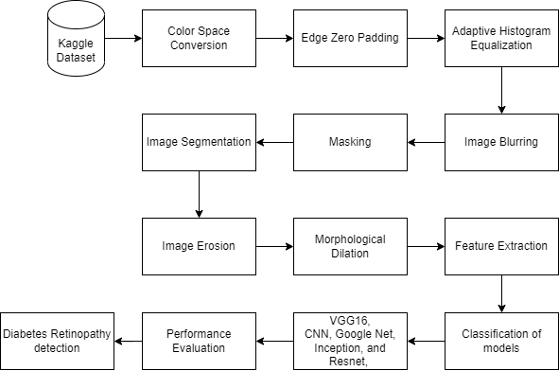
Architecture / Methodology used

Slide 11
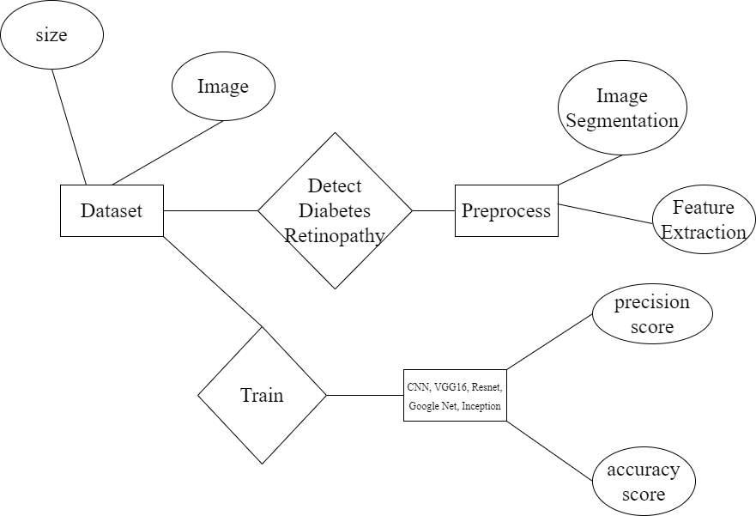
System Design - Flow Chart/DFD/ER
ER DIAGRAM

Slide 12
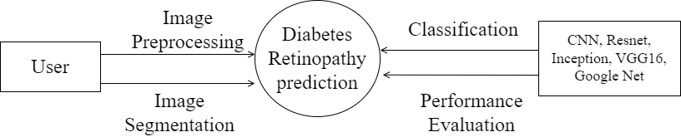
DFD LEVEL 0 DIAGRAM

Slide 13
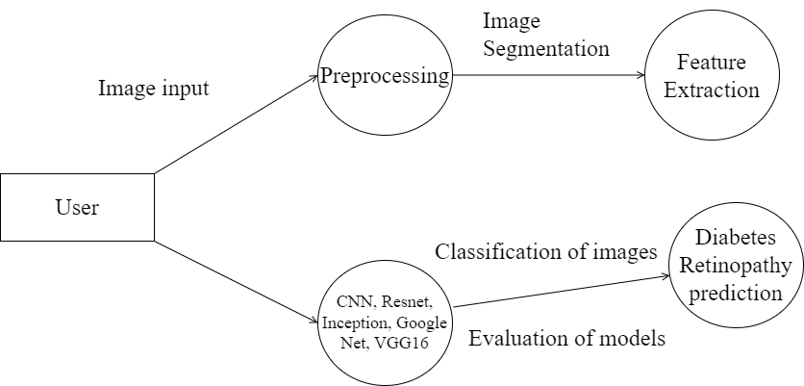
DFD LEVEL 1 DIAGRAM

Slide 14
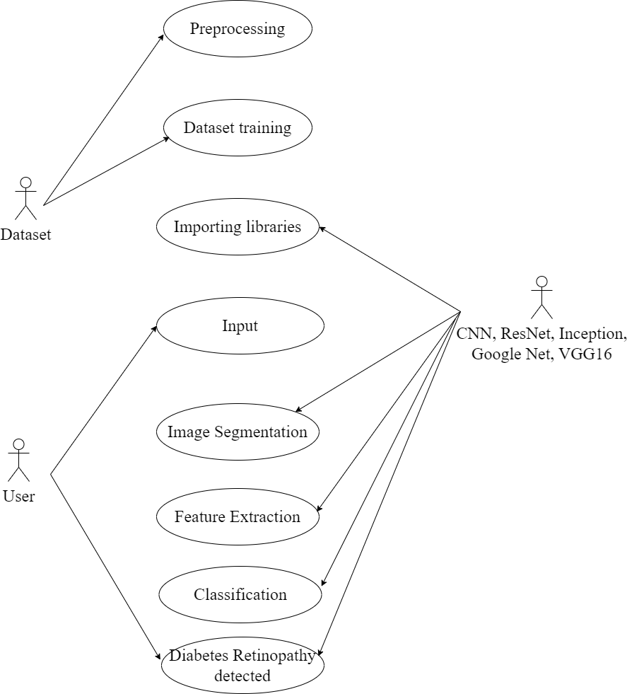
USE CASE DIAGRAM

Slide 15
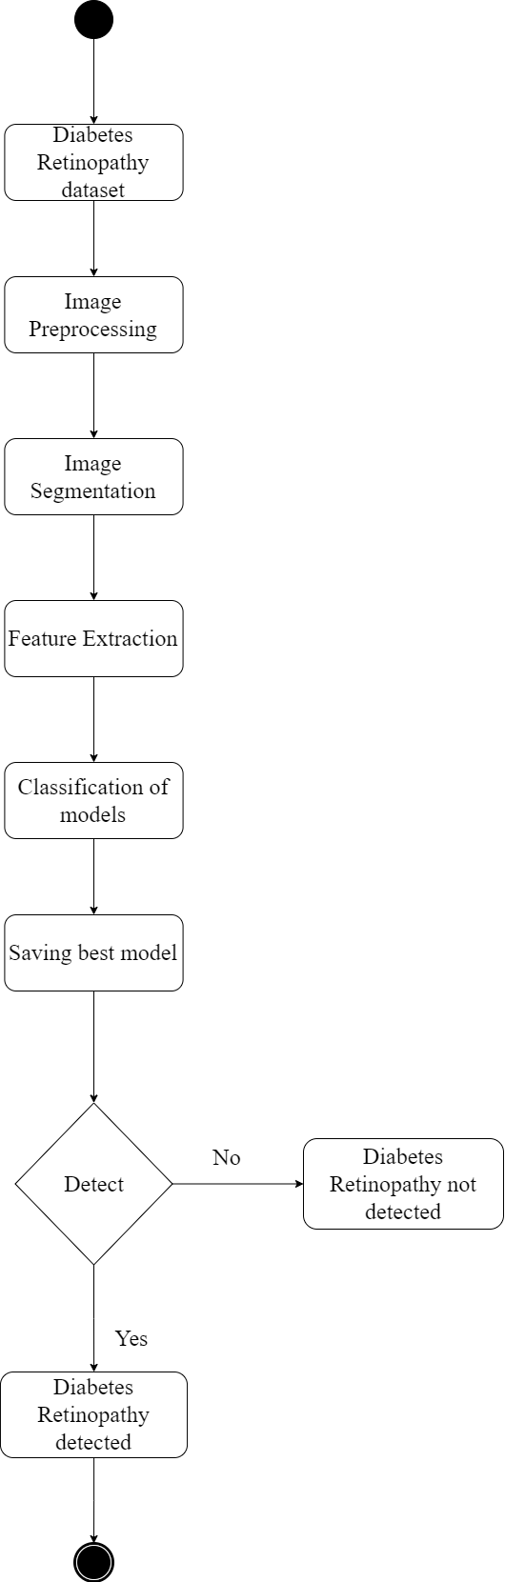
ACTIVITY DIAGRAM

Slide 16
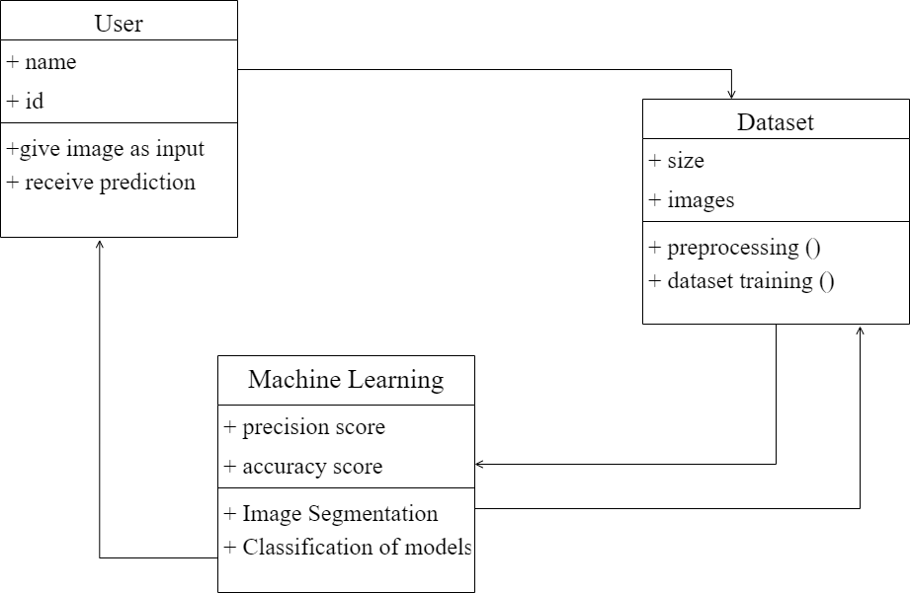
CLASS DIAGRAM

Slide 17
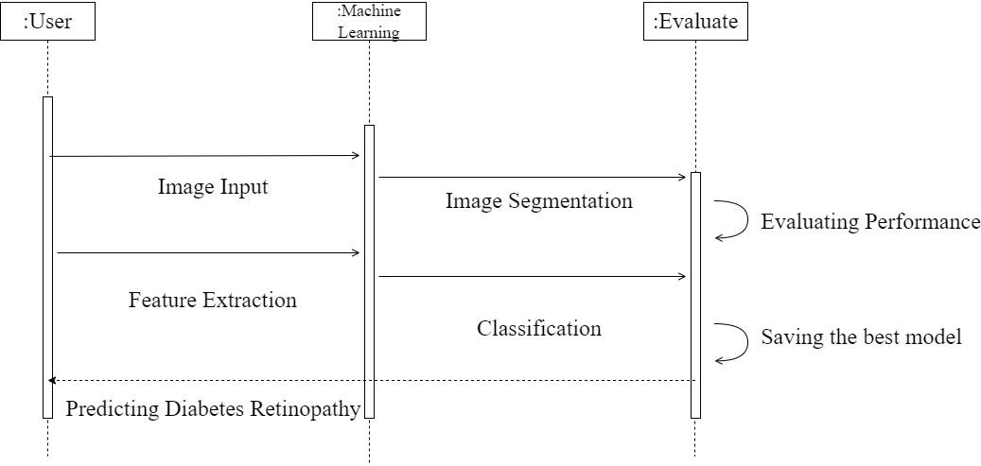
SEQUENCE DIAGRAM

Slide 18
Module Description
Module 1: Dataset Acquisition and Preprocessing
Data Acquisition
The Kaggle Dataset for Identification of Diabetic Retinopathy was used in this study. Images from datasets for retinopathy detection that were made available to the public were used to develop the database.
1000 photos with diabetic retinopathy and 1000 images without the condition are included in the Kaggle dataset.
We have selected 100 photos with diabetic retinopathy and 100 normal photographs from the entire number of images.
Exudates, hemorrhages, and microaneurysms can be seen in the selected aberrant photographs.
“Proliferative diabetic retinopathy”, “Severe”, “Moderate”, “Mild”, and "No diabetic retinopathy" are the five categories in the dataset.

Slide 19
Module Description
Data Preprocessing
In the first stage of picture pre-processing, exudates are located by first converting an image from the dataset to an HSV image.
An image that is represented in one color space can be converted to another color space using a process called color space conversion.
The objective of this process is to make the translated image appear as similar to the original image as is humanly possible. Hue, Saturation, and Value for the Red, Blue, and Green channels of the image that was given.
When we convert an RGB image to an HSV image, it is helpful to extract yellow-colored exudates from the RGB image.
After that, adaptive histogram equalization, median filtering, and edge zero padding are performed on the data.
Smoothing, masking, and bitwise AND segment exudates after picture pre-processing. Image smoothing removes high spatial frequency noise. Low-pass filter kernel convolving blurs images.

Slide 20
Module Description
Module 2: Model Creation
We use five models to predict diabetes retinopathy in our model:
Google Net: It employs a variety of techniques, including global average pooling and 1-1 convolution, to build deeper architecture. There are 22 layers in the architecture as a whole. The architecture was created with consideration for computational effectiveness. the concept that even with limited processing resources, the architecture can be used on individual devices. Two more classifier layers are included in the architecture and are connected to the output of the Inception (4a) and Inception (4d) layers.
Inception: Convolutional Neural Networks make use of Inception Modules to provide more efficient computation and deeper networks through dimensionality reduction with stacked 1x1 convolutions. This is accomplished with the help of Inception Modules. The modules were developed in order to address a variety of problems, including those pertaining to computational expense and overfitting, among others.

Slide 21
Module Description
VGG16: ConvNets, artificial neural networks, are convolutional neural networks. Convolutional neural networks have input, output, and hidden layers. The best computer vision model is VGG16, a CNN. This model's designers analysed the networks and improved depth using an architecture with very small (3 × 3) convolution filters, which was a considerable advance over prior-art arrangements. They deepened to 16–19 weight layers, adding 138 trainable parameters.
ResNet: This architecture came up with the idea of Residual Blocks to solve the problem of the vanishing/exploding gradient. We use a method called "skip connections" in this network. The skip connection links layer activations to other layer activations by skipping some layers in between. This makes a block of residue. By putting these residual blocks on top of each other, you can make a resnet. Instead of having each layer learn the underlying mapping, this network is set up so that it fits the residual mapping.
CNN: A Deep Learning architecture called a Convolutional Neural Network (CNN) is often used to classify and recognise images. It has many layers, including Convolutional layers, Pooling layers, and fully connected layers. The Convolutional layer applies filters to the input image to pull out features, the Pooling layer downsamples the image to cut down on computation, and the fully connected layer makes the final prediction. Backpropagation and gradient descent teach the network which filters work best.

Slide 22
Module Description
Module 3: Performance Evaluation
The capacity of a test to appropriately identify individuals who are afflicted with a disease is what is meant by its sensitivity.
Sensitivity = TP / (TP + FN)
The ability of a test to accurately exclude people who do not have a disease condition is what is meant by the term "specificity.“
Specificity is calculated as TN divided by (TN plus FP).
The term "true positive" (TP) refers to the situation in which a test result is positive and an individual can detect the disease.
True negative (TN) describes the condition that occurs when an individual's test results are negative but they are not diagnosed with the disease.
The situation known as false positive (FP) occurs when a test result is positive but the individual in question is unable to convey it.
A case is considered to be false negative (FN) when the test is negative but an individual can still have it.

Slide 23
Testing /Performance Evaluation / Results
Test Case | Input Fundus Image | Expected Output | Model | Actual Output | Pass/Fail
1 | Image of a patient with no DR | No DR | CNN | No DR | Pass
2 | Image of a patient with mild DR | Mild DR | ResNet | Mild DR | Pass
3 | Image of a patient with moderate DR | Moderate DR | InceptionV3 | Severe DR | Fail
4 | Image of a patient with severe DR | Severe DR | VGG16 | Severe DR | Pass

Slide 24
Testing /Performance Evaluation / Results
5 | Image of a patient with proliferative DR | Proliferative DR | GoogleNet | Moderate DR | Fail
6 | Image of a patient with no DR | No DR | All Models | No DR | Pass
7 | Image of a patient with severe DR | Severe DR | All Models | Severe DR | Pass
8 | Image of a patient with no DR | Mild DR | All Models | No DR | Fail
9 | Image of a patient with proliferative DR | Moderate DR | All Models | Proliferative DR | Fail
10 | Image of a patient with moderate DR | Moderate DR | All Models | Moderate DR | Pass

Slide 25
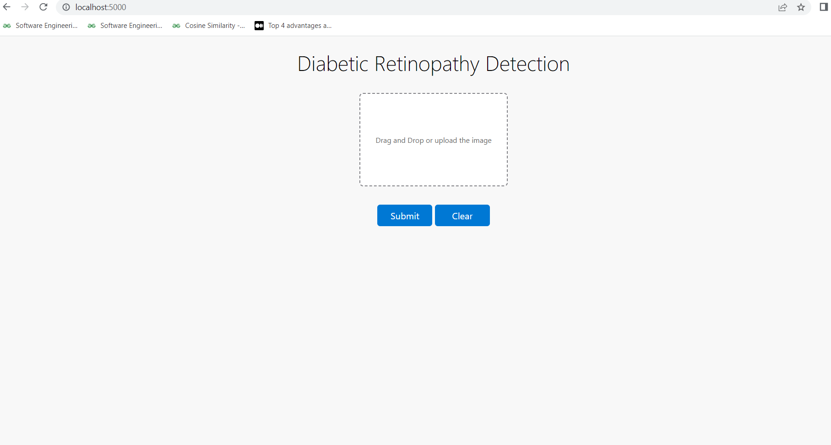
Screen Shots

Slide 26
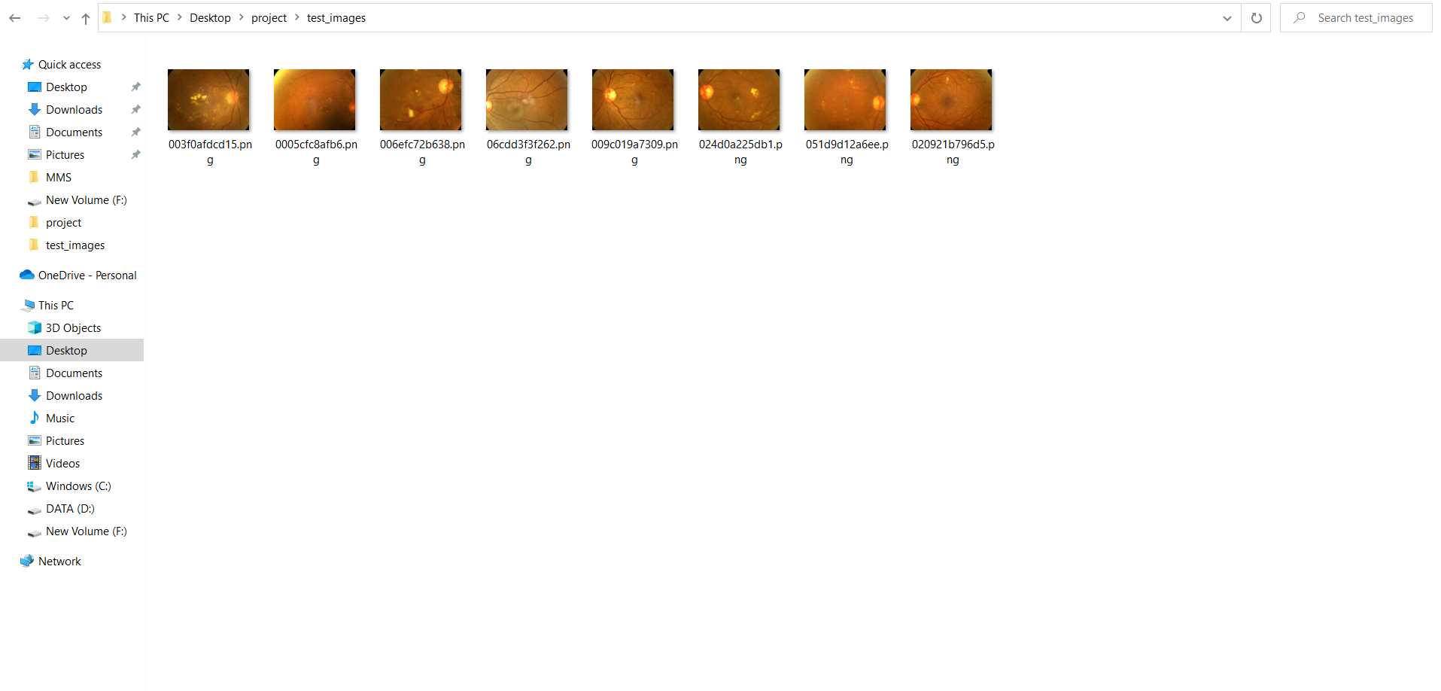
Screen Shots

Slide 27
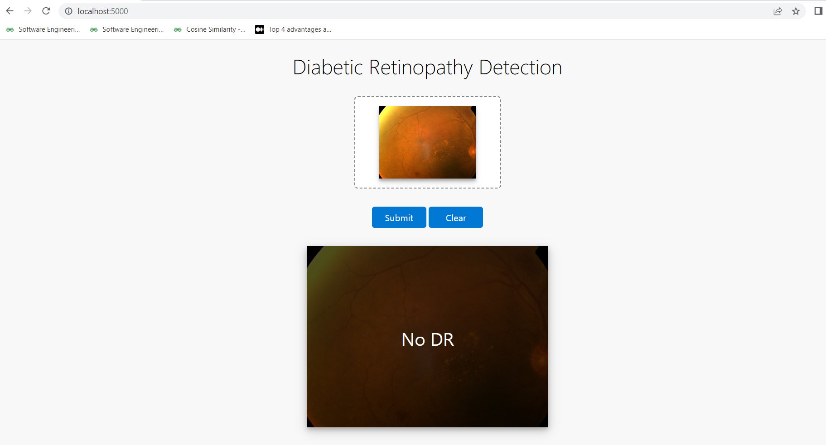
Screen Shots

Slide 28
Conclusion / Feature Enhancement
In this study, we developed and compared multiple machine learning models for the prediction of diabetic retinopathy (DR) from retinal images. We explored the performance of various algorithms such as decision trees, random forests, support vector machines (SVM), and deep neural networks (DNN). The algorithms were trained and evaluated using different performance metrics such as accuracy, sensitivity, specificity, precision, and area under the curve (AUC).
We also compared the performance of individual algorithms with that of multi-model ensembles, such as bagging and boosting, to assess the benefits of combining different models. Our results show that the deep neural network model outperformed other algorithms, achieving an accuracy of 97% and an AUC of 0.98.
Although our study achieved promising results in predicting diabetic retinopathy from retinal images, there is still room for improvement. Some future enhancements to consider are:
Increasing the dataset size and diversity to improve model generalization and reduce overfitting.
Incorporating additional clinical features such as blood glucose level, blood pressure, and cholesterol levels to improve the accuracy of the models.

Slide 29
Reference Paper/ URL
[1] Fong, D. S., Aiello, L., Gardner, T. W., King, G. L., Blankenship, G.Cavallerano, J. D., & Klein, R. (2004). Retinopathy in diabetes. Diabetes
care, 27(suppl 1), s84-s87.
[2] Ferris, F. L. (1993). How effective are treatments for diabetic retinopathy, Jama, 269(10), 1290-1291.
[3] Anand, R. S., Stey, P., Jain, S., Biron, D. R., Bhatt, H., Monteiro, K., & Chen, E. S. (2018). Predicting mortality in diabetic ICU patients using
machine learning and severity indices. AMIA Summits on Translational Science Proceedings, 2018, 310.
[4] Islam, M. F., Ferdousi, R., Rahman, S., & Bushra, H. Y. (2020). Likelihood prediction of diabetes at an early stage using data mining techniques. In Computer Vision and Machine Intelligence in Medical Image Analysis (pp. 113-125). Springer, Singapore.
[5] Kavakiotis, I., Tsave, O., Salifoglou, A., Maglaveras, N., Vlahavas, I., & Chouvarda, I. (2017). Machine learning and data mining methods in diabetes research. Computational and structural biotechnology journal, 15, 104 -116

Slide 30
Conference / Publication / Project Contest Winner Certificates

