Slide 1
India General Elections Intelligence Dashboard (1977-2015) Done by Dhanashri Kadam Hasini Kolluri Moturi Sai Dinesh Piyush Churhe Siddamshetty Saipriya

Slide 2
Data Preprocessing (Power Query)
Key Steps Performed:
Cleaned dataset by removing invalid and inconsistent records
Eliminated blank and incomplete entries
Filtered relevant data for accurate analysis
Renamed columns for better clarity and usability
Standardized categorical values (party names, gender, etc.)
Resolved inconsistencies using value replacements
Transformations:
Data type corrections (numeric and text fields)
Removal of errors and noise in data
Filtering of meaningful records
Standardization for uniform analysis

Slide 3
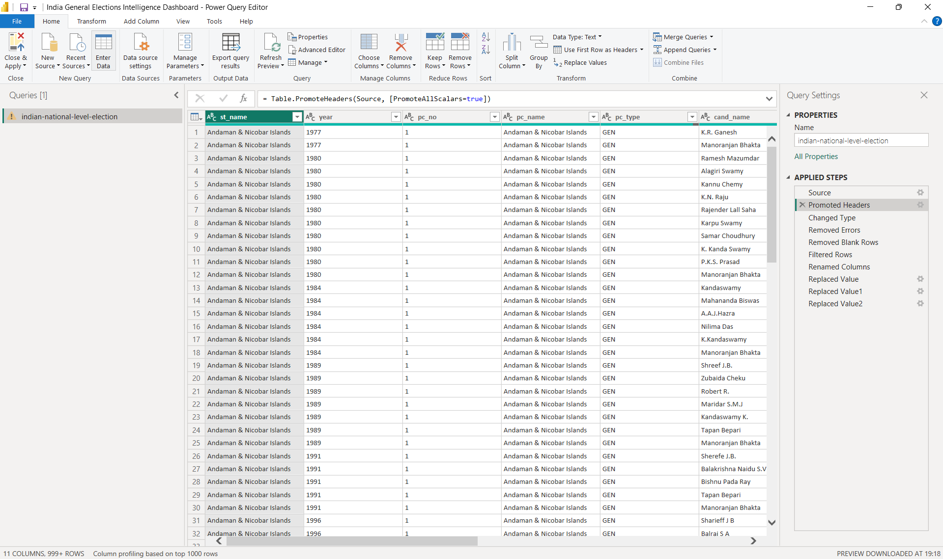
DATA PREPROCESSING

Slide 4
DAX Calculations
Turnout % =DIVIDE(SUM(totvotpoll), SUM(electors))
Total Votes =SUM(totvotpoll)
Total Parties =DISTINCTCOUNT(partyabbre)
Winner Vote Share % =DIVIDE([Winner Votes], [Total Votes]) * 100
Other Vote Share % =1 - ([Winner Vote Share %] + [Runner Up Vote Share %])
Rank =RANKX(ALLEXCEPT(pc_name, year),SUM(totvotpoll),DESC)

Slide 5
Overview Analysis
Objective: National-level snapshot
Key Insights:
Winner Party vs Runner-Up comparison
Vote share distribution
Other candidates’ impact
Total Votes & Candidate count
Visuals Used:
KPI Cards
Decomposition Tree
Interactive Filters

Slide 6
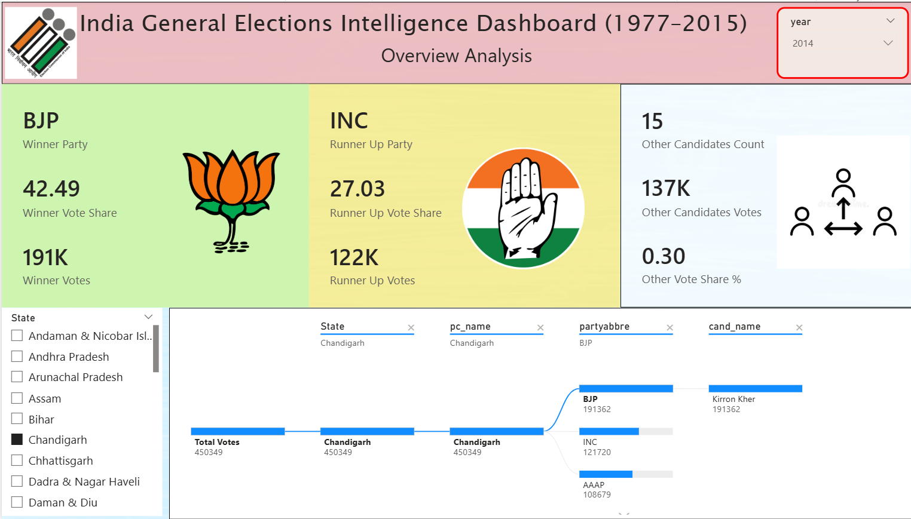
OVERVIEW ANALYSIS

Slide 7
State Analysis
Objective: Regional performance comparison
Key Insights:
State-wise total votes
Party distribution across states
Turnout variation
Visuals Used:
Donut Chart → Votes by State
Map → Turnout % by State
Bar Chart → Total Parties by State
Business Value:
Identifies high-performing regions
Detects regional political dominance

Slide 8
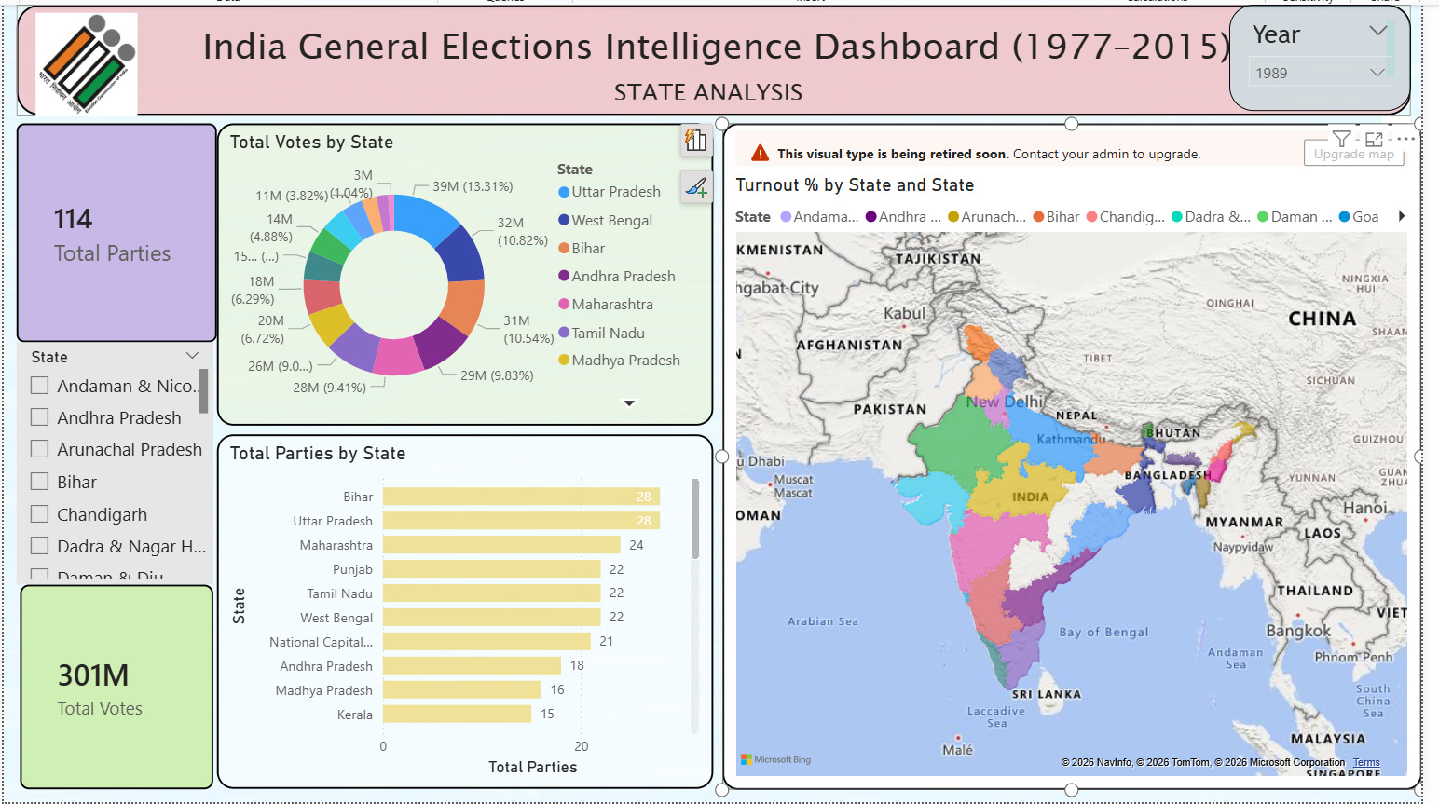
STATE ANALYSIS

Slide 9
Constituency Analysis
Objective: Micro-level election insights
Key Insights:
Winner vs Runner-up comparison
Vote margins
Candidate-level performance
Visuals Used:
Bar Chart → Votes by Candidate
Cards → Winner & Runner details
Slicers → State & Constituency
Outcome:
Understand competitiveness
Identify strong vs weak seats

Slide 10
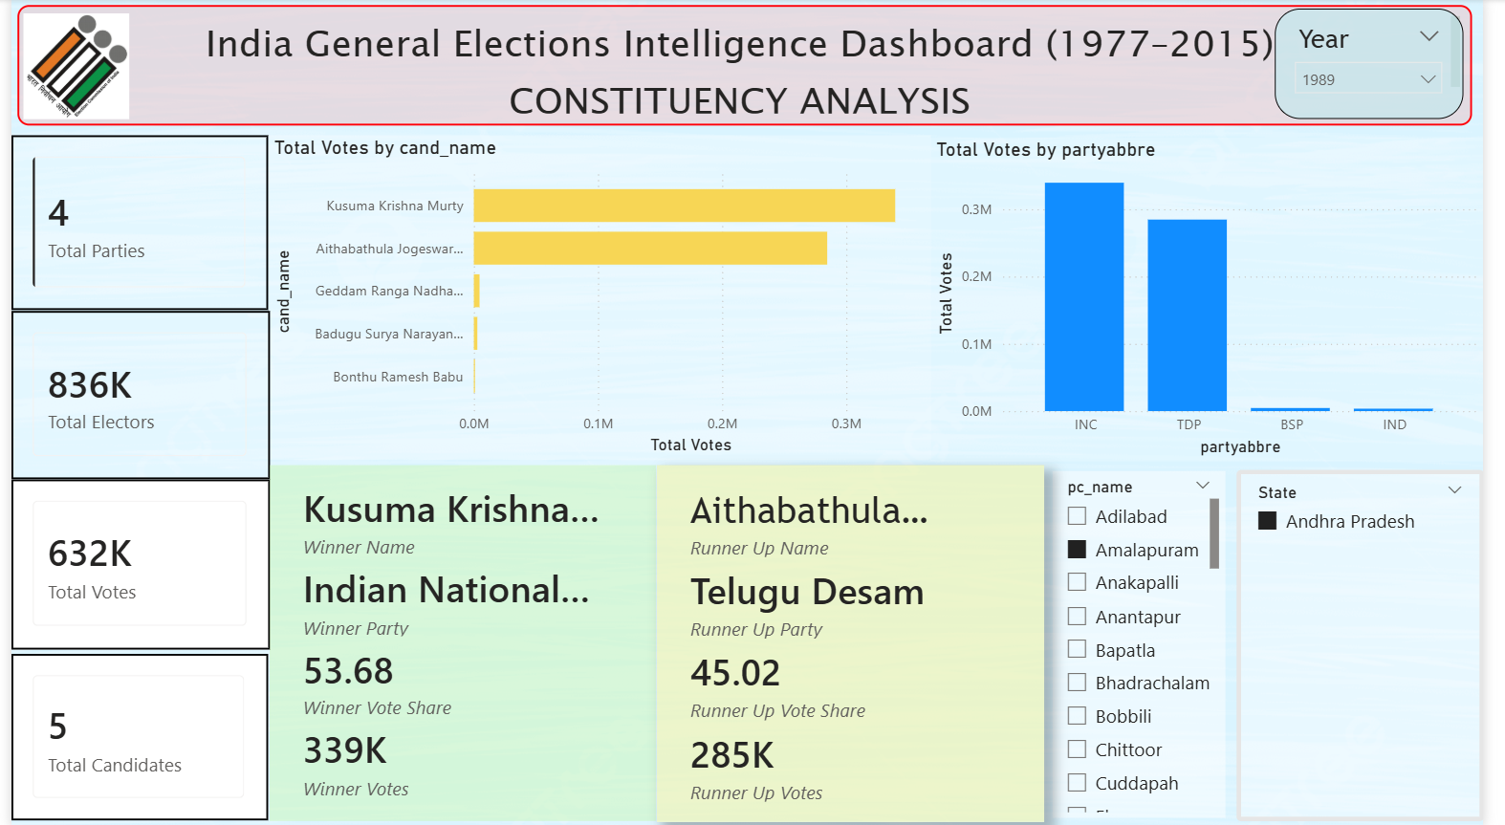
CONSTITUENCY ANALYSIS

Slide 11
Party Strategy & Performance
Objective: Analyze party-level performance
Key Insights:
Vote share vs total votes
Leading party identification
Competitive landscape
Visuals Used:
Donut Chart → Party vote share
Scatter Plot → Vote share vs votes
Table → Party performance metrics
Advanced Analytics:
Key Influencers
Decomposition Tree

Slide 12
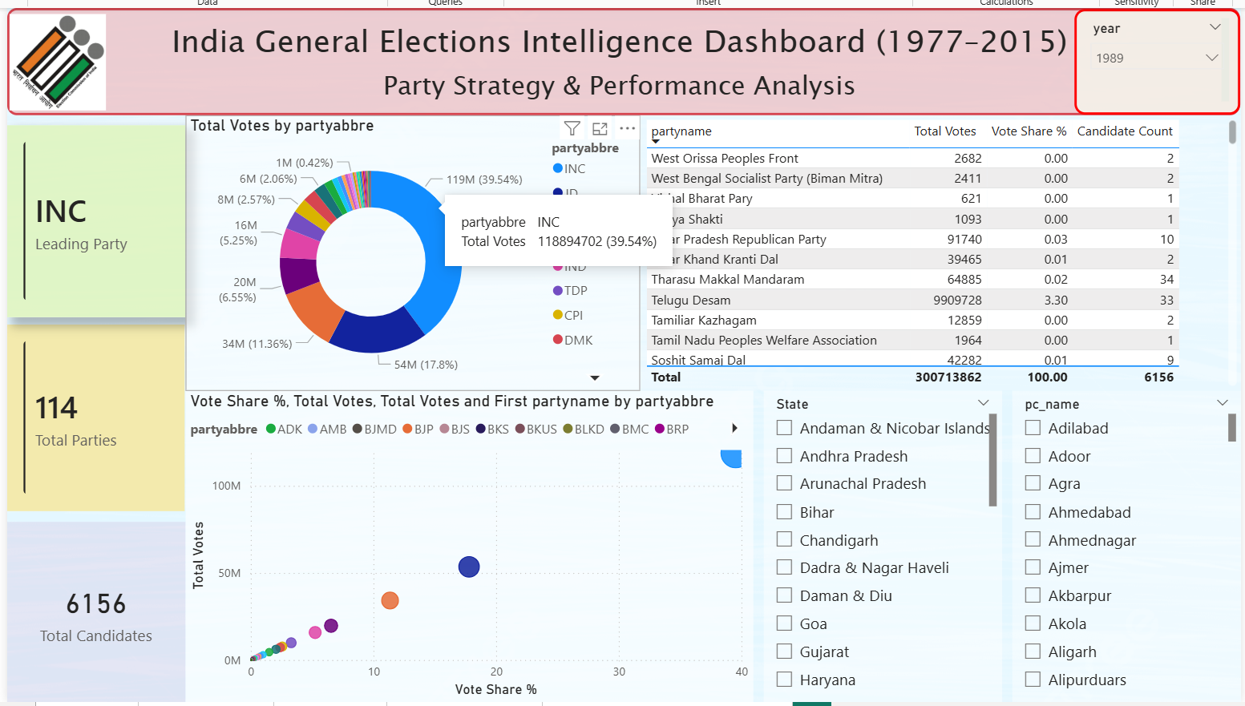
PARTY STRATEGY & PERFORMANCE ANALYSIS

Slide 13
Conclusion
Successfully developed an interactive dashboard using Microsoft Power BI to analyze Indian General Elections data
Transformed raw data into meaningful insights across national, state, constituency, and party levels
Implemented DAX measures for dynamic calculations like turnout %, vote share, and ranking
Enabled data-driven decision-making through intuitive and interactive visualizations
Gained strong understanding of:
Data preprocessing
Data modeling
Business intelligence concepts
Future Scope
Add more recent election data for better analysis
Improve dashboard design and visuals
Include more insights like seat share and trends
Make the dashboard more interactive with filters
Share the dashboard online using Power BI Service

Slide 14
THANK YOU

