Slide 1
Predictive Maintenance of Industrial Machinery
IBM AICTE PROJECT
Presented By:
MOTURI SAI DINESH
LOVELY PROFESSIONAL UNIVERSITY (BTech CSE)

Slide 2
OUTLINE
Problem Statement
Proposed System/Solution
System Development Approach
Algorithm & Deployment
Result (Output Image)
Conclusion
Future Scope
References

Slide 3
Problem Statement
Example: In the manufacturing and industrial sector, unexpected machinery failures lead to unplanned downtime, production losses, and increased maintenance costs. Modern machines generate vast amounts of real-time sensor data during operation. Despite this, industries still struggle to interpret these signals effectively to prevent faults. The challenge lies in identifying patterns from sensor data that can indicate specific failure modes before they actually occur. Recognizing these signs early is crucial for ensuring safety, efficiency, and continuous operation.

Slide 4
Proposed Solution
The proposed system aims to address the challenge of anticipating machine failures before they occur by developing a predictive maintenance model for a fleet of industrial machines. This involves leveraging sensor data to identify patterns that precede a failure. The solution will consist of the following components:
Data Collection:
Utilize the "Predictive Maintenance Classification" dataset from Kaggle, which contains real-time operational data.
The primary goal is to predict the specific 'Failure Type' of the machinery, such as Power Failure or Tool Wear Failure..
Data Preprocessing:
Clean the data by removing irrelevant columns and converting the categorical 'Type' feature into a numerical format..
Standardize all the Sensor data using StandardScalar to ensure all features are on common scale.
Machine Learning Algorithm:
Implement a Random Forest Classifier to learn the patterns that lead to machine failures..
Apply the SMOTE technique to balance the training data, which helps the model accurately predict even rare failures..
Deployment:
Deploy the final solution on the IBM Cloud platform as required by the project.
Publish the model as a live, online API endpoint using the IBM Watson Machine Learning service.
Evaluation:
Assess the model's performance using Accuracy for an overall score and the F1-Score for a balanced view of its effectiveness.
Use a Confusion Matrix to visually analyze the model's predictions and identify where it excels or makes mistakes.

Slide 5
System Approach
The system approach for this project involves leveraging a cloud-based data science platform to build, train, and deploy a machine learning model capable of predicting industrial machinery failures from sensor data. The entire lifecycle, from data preparation to a live API, is handled within an integrated environment
System requirements
Cloud Platform: An IBM Cloud account (Lite tier is sufficient) is mandatory for hosting the services.
Core Services:
IBM Watson Studio: To create and manage the project, including the Jupyter Notebook for development.
IBM Cloud Object Storage (COS): To store the dataset (predictive_maintenance.csv) securely.
IBM Watson Machine Learning Service: To save the trained model and deploy it as a live API.
Library required to build the model
The model is built using Python 3, and the following key libraries are required:
pandas: For loading, manipulating, and cleaning the dataset.
scikit-learn: The primary machine learning library used for:
Data splitting (train_test_split) , Feature scaling (StandardScaler) , Model creation (RandomForestClassifier). and Evaluation metrics (classification_report, accuracy_score).
imbalanced-learn: To use the SMOTE technique for handling the imbalanced dataset.
IBM-watson-machine-learning: The official IBM client library to save the model and prepare it for deployment.
matplotlib & seaborn: For creating visualizations like the confusion matrix to evaluate model performance.

Slide 6
Algorithm & Deployment
Algorithm Selection:
We chose a Random Forest Classifier because it's highly accurate and excels at finding complex patterns in sensor data.
Data Input:
The model uses real-time sensor data as input, including temperature, rotational speed, torque, and tool wear.
Training Process:
The model is trained on 80% of the data. We use the SMOTE technique to balance the data, which is critical for learning to predict the rare failure types.
Prediction Process:
The deployed API receives new sensor readings in real-time and instantly predicts a specific failure type or "No Failure".

Slide 7
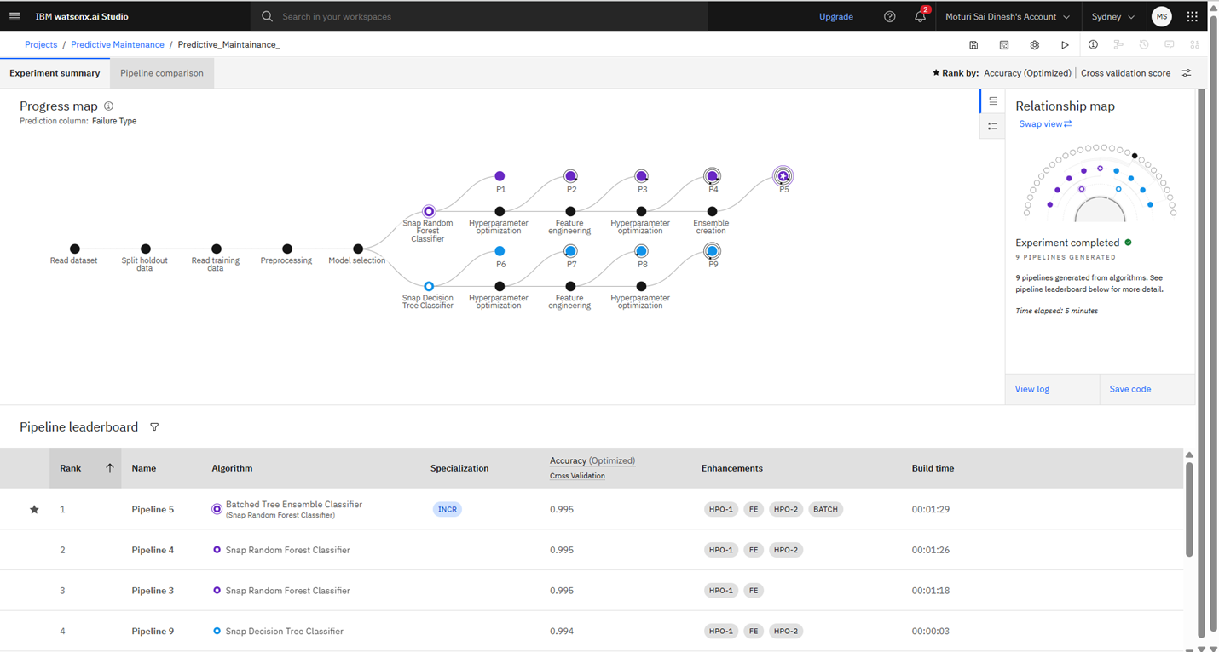
Result

Slide 8
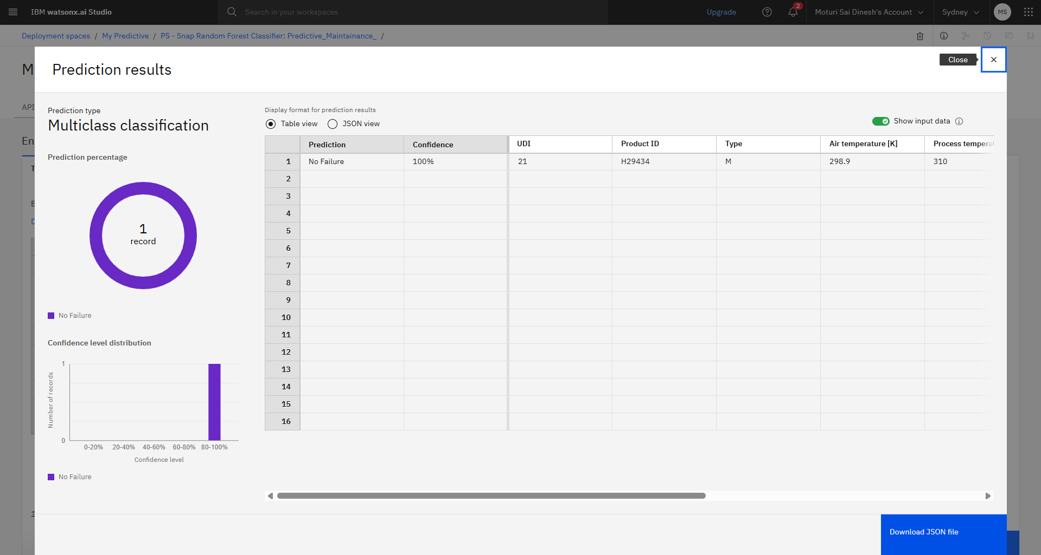

Slide 9
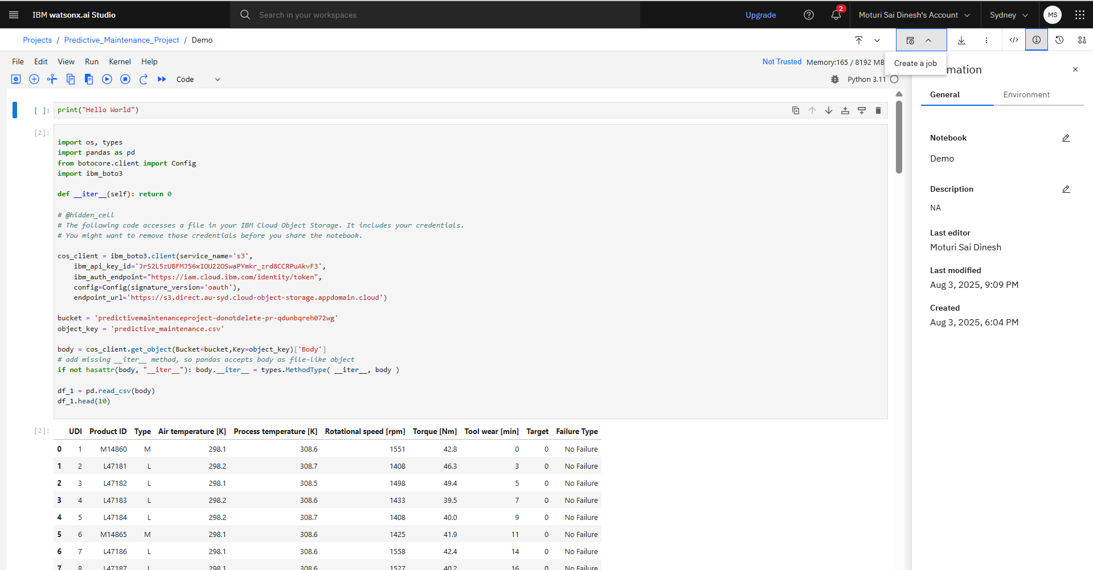

Slide 10
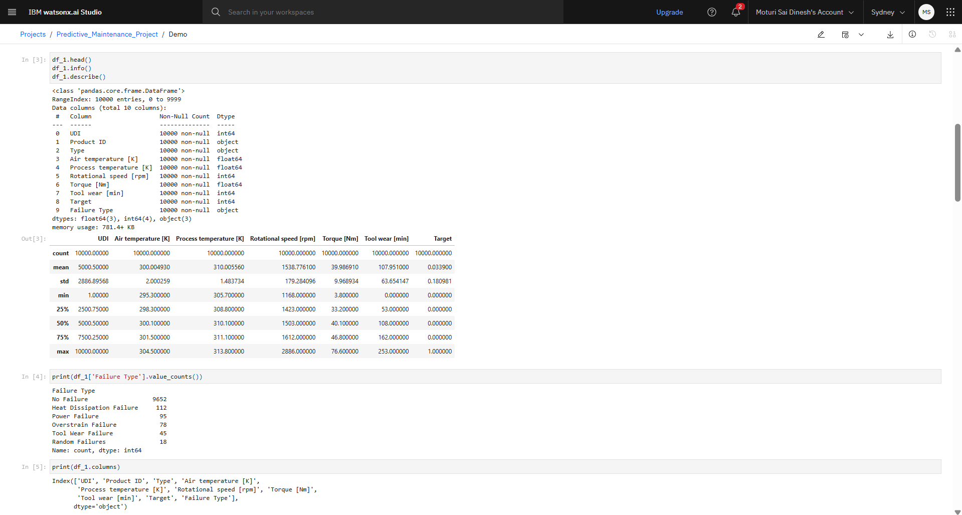

Slide 11
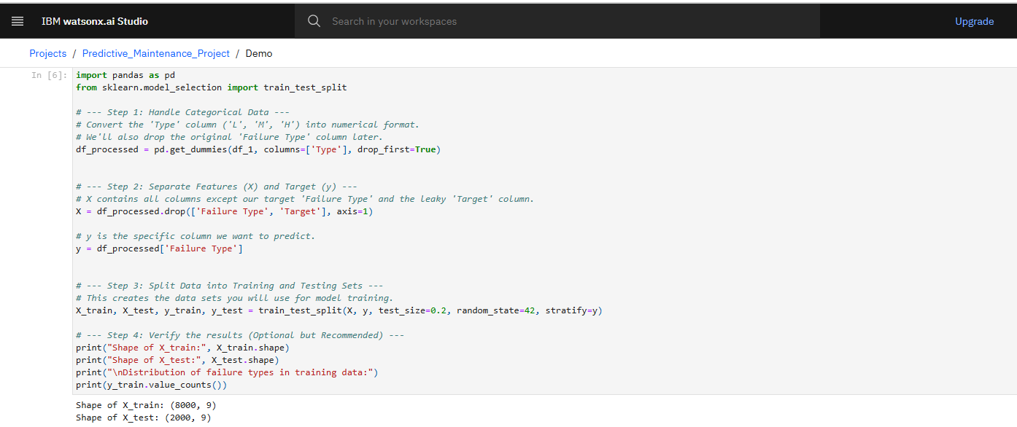

Slide 12
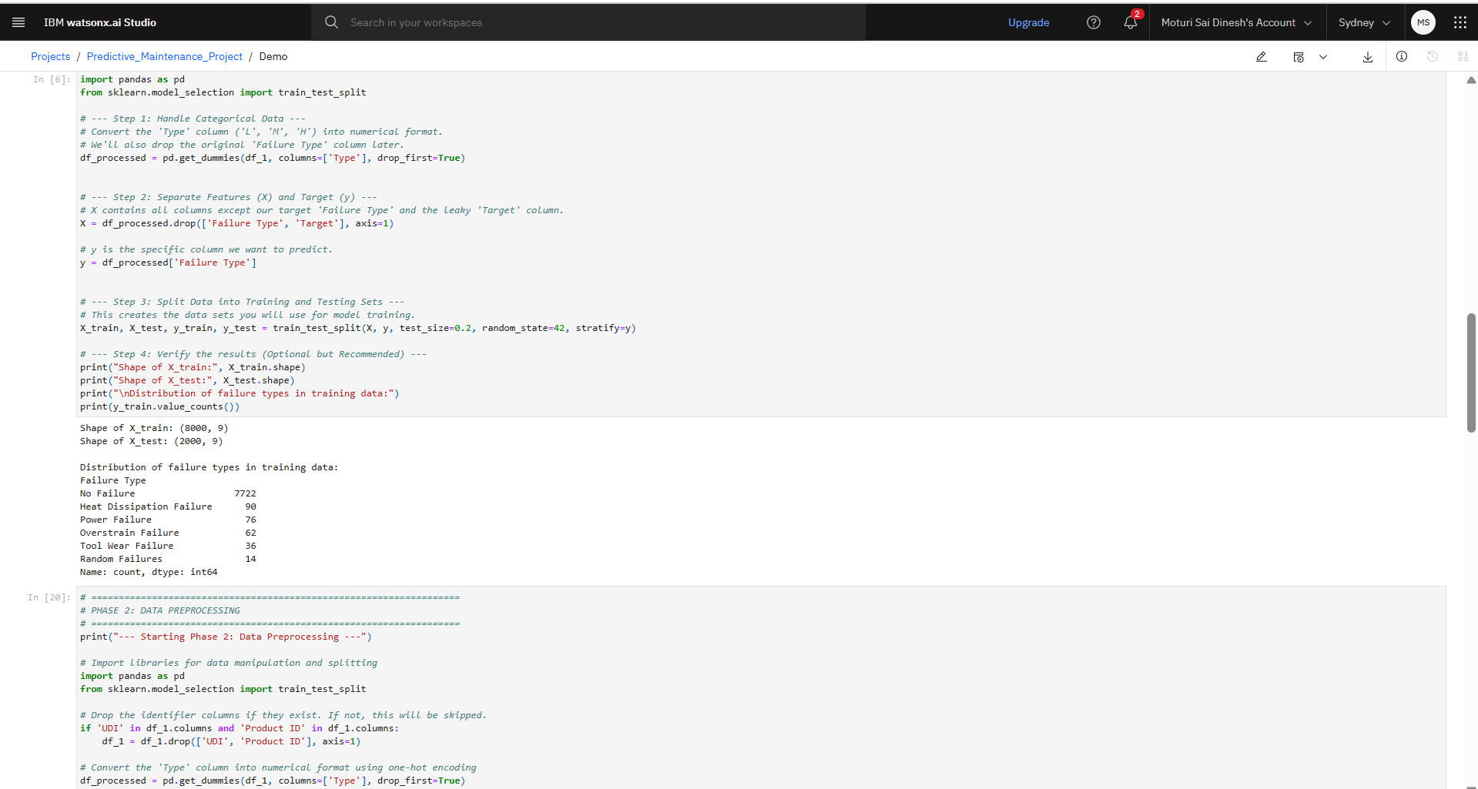

Slide 13
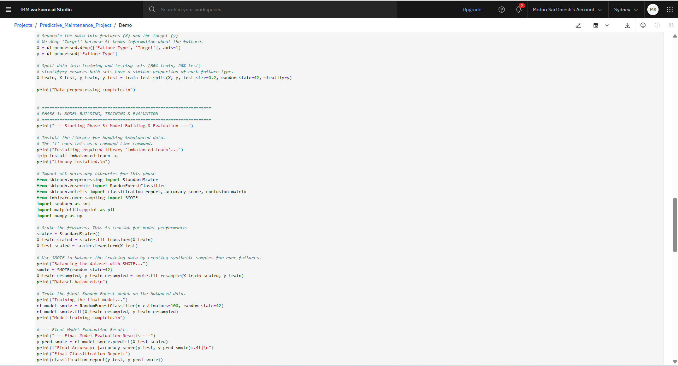

Slide 14
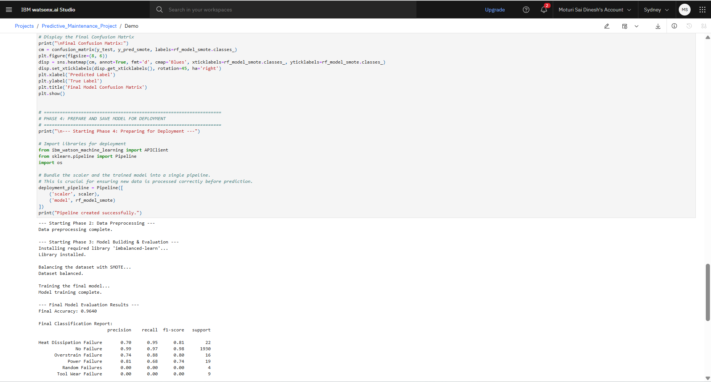

Slide 15
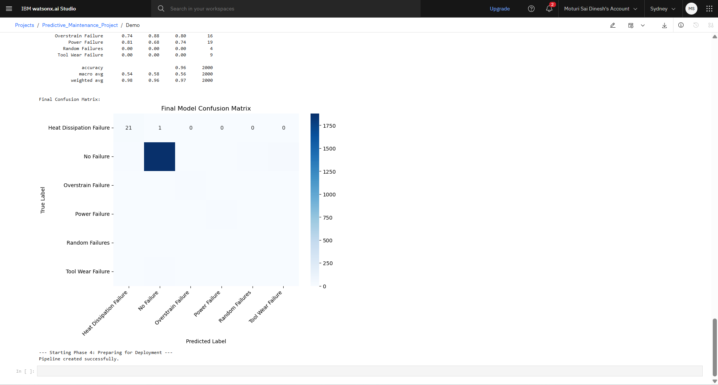

Slide 16
Conclusion
This project successfully achieved its objective of developing and deploying an end-to-end predictive maintenance solution. By using a Random Forest algorithm combined with the SMOTE data balancing technique, we created a model that can accurately predict specific machine failures before they occur. The final deployed API on IBM Watson Machine Learning serves as a robust tool that can be integrated into real-world industrial systems to reduce downtime, lower operational costs, and enable proactive maintenance scheduling. The project demonstrates a complete machine learning lifecycle, from data preprocessing to live deployment

Slide 17
Future scope
Real-time Integration: Connect the deployed API to live machine sensors and build a dashboard to visualize real-time operational status and failure alerts.
Advanced Modeling: Explore more complex algorithms like XGBoost or LSTMs to potentially improve prediction accuracy further..

Slide 18
References
Dataset: Kaggle, Predictive Maintenance Classification: https://www.kaggle.com/datasets/shivamb/machine-predictive-maintenance-classificationPlatform:
IBM Cloud & Watson Studio: https://cloud.ibm.com/.

Slide 19
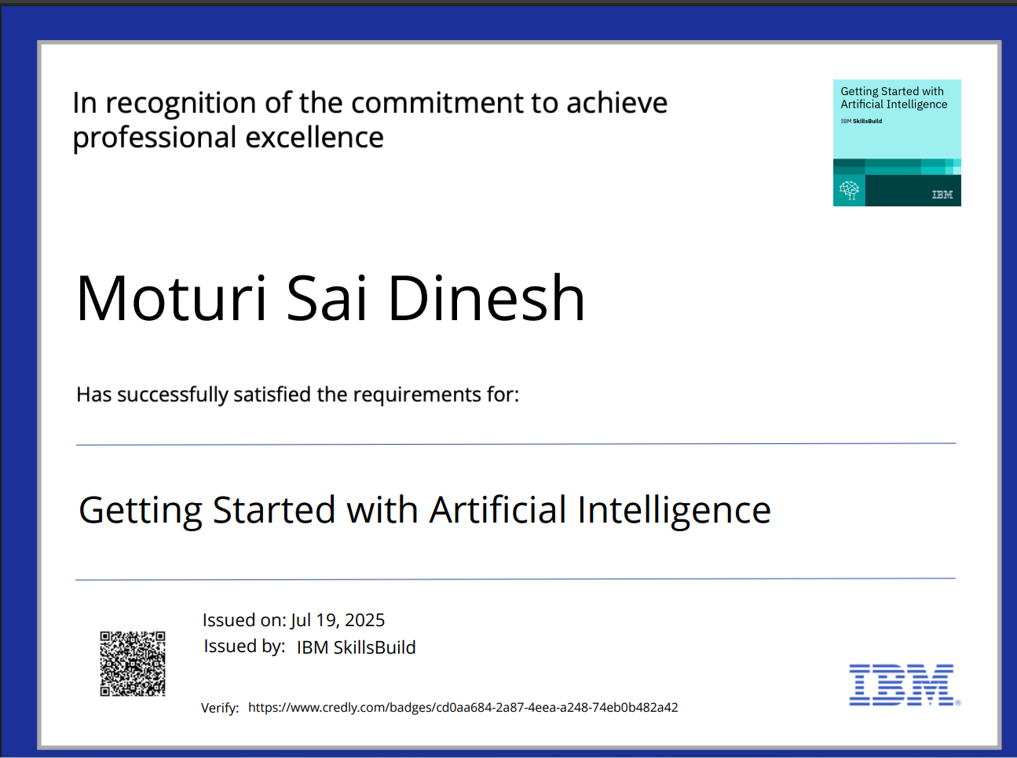
IBM Certifications

Slide 20
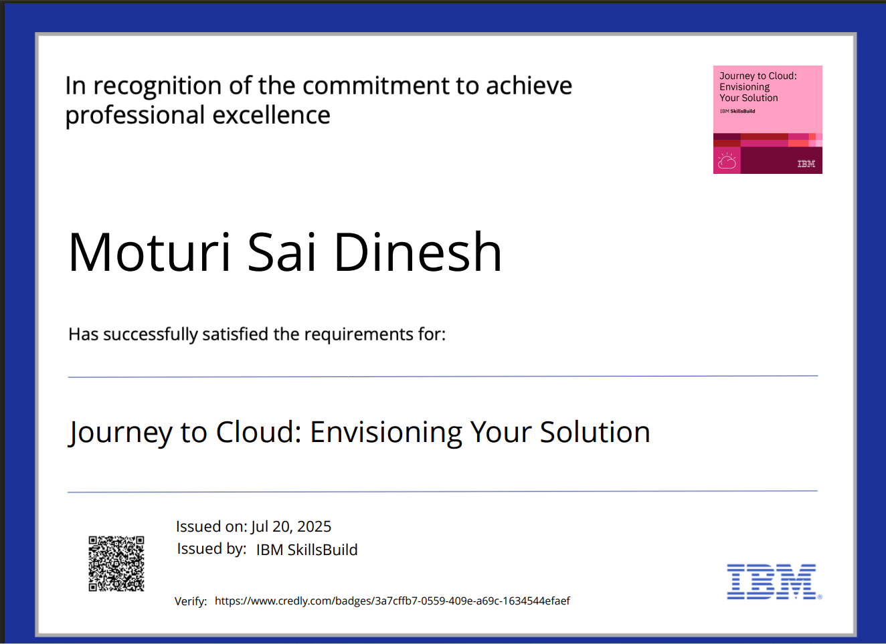
IBM Certifications

Slide 21
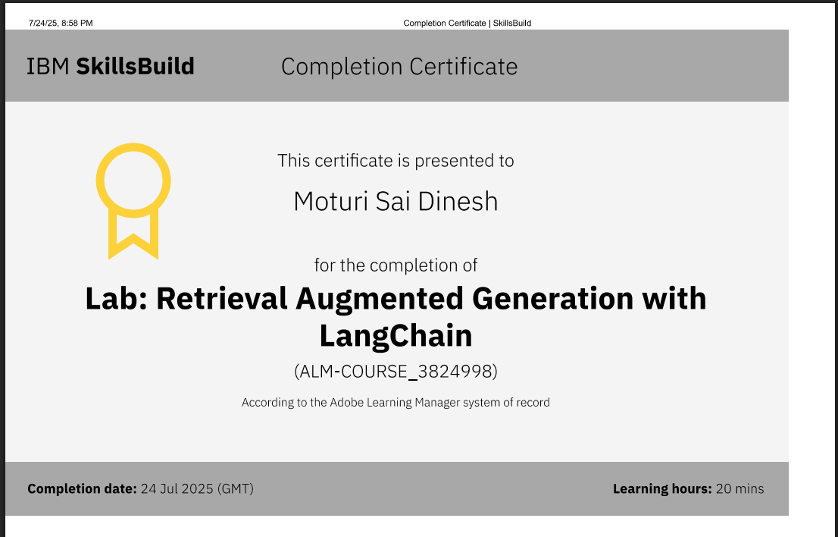
IBM Certifications

Slide 22
GITHUB Link:
https://github.com/Dinesh9831/Predictive-Maintenance-of-Industrial-Machinery

Slide 23
THANK YOU

