Slide 1

Spar Stores 171 New Cross Road London SE14 5DG
Client: Suguna Kumar

Slide 2
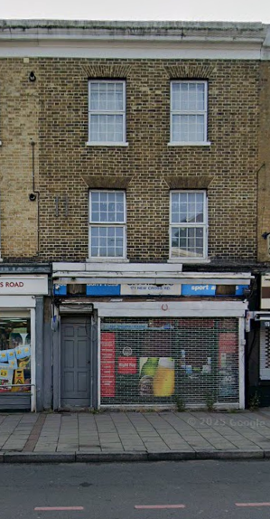
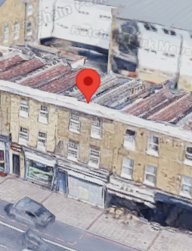
Spar Stores 171 New Cross Road London SE14 5DG
Notes:
Add property image from OS map using nimbus or landinsight. Add type of property & the site area. Do the critical checks.

Slide 3
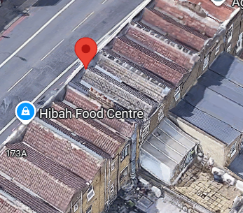
Property Images
Notes:
views from google earth with marking of the property boundary

Slide 4
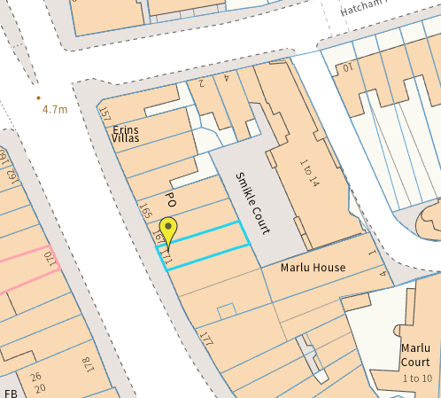
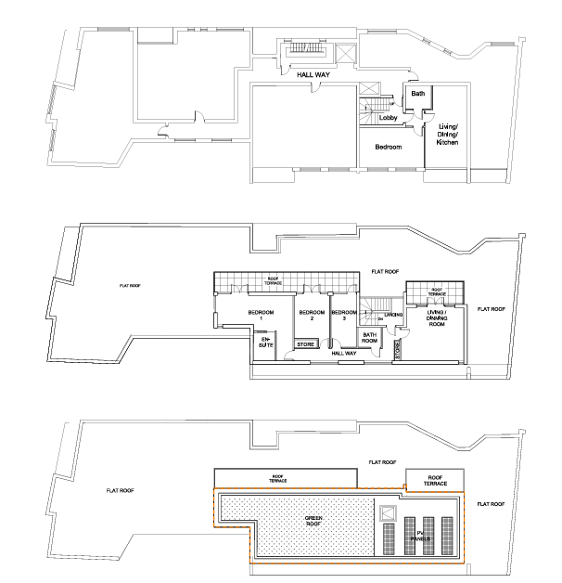
Property Images
Notes:
views from google earth with marking of the property boundary

Slide 5
Property Information
Property type- Class E & Class C3
Council : Lewisham Council.
Built Area - 97 Sqm
As of now, we don't have any major constraints on site
Notes:
Add property image from OS map using nimbus or landinsight. Add type of property & the site area. Do the critical checks.

Slide 6
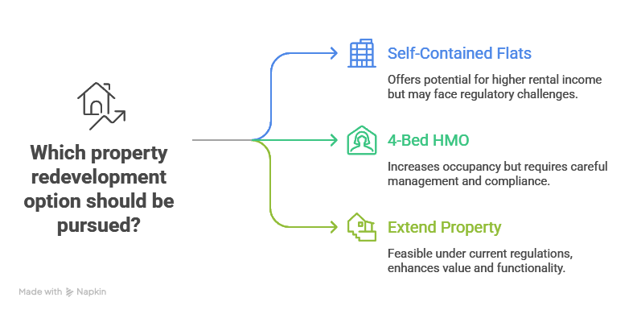
Scope of Works
Notes:
Add in the brief provided by the client

Slide 7
Conceptual design
Conceptual design
Notes:
views from google earth with marking of the property boundary

Slide 8
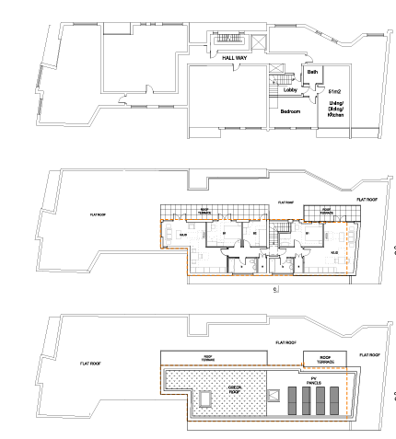
Conceptual design - Plan
Notes:
views from google earth with marking of the property boundary

Slide 9
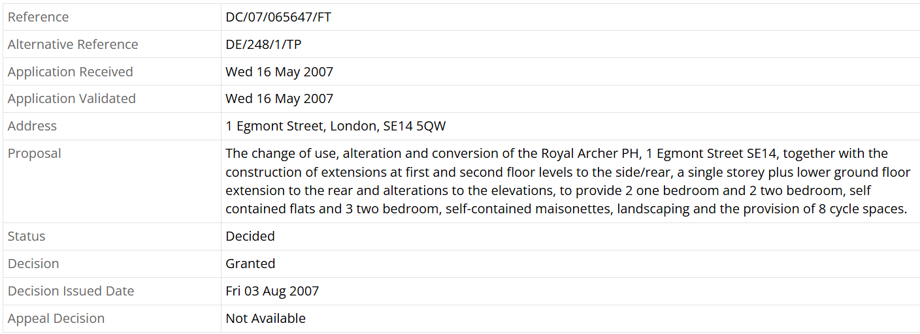
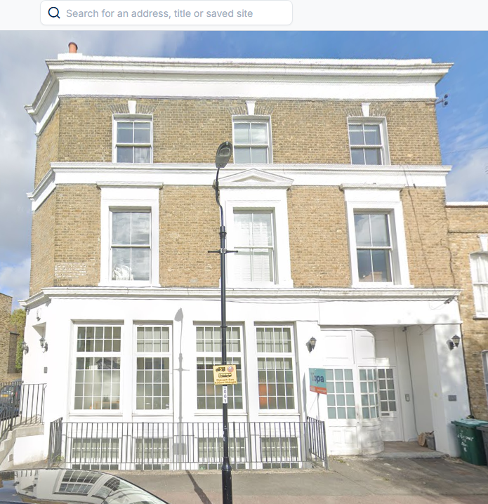
Similar Planning Applications
1 Egmont Street, London, SE14 5QW
Timeline : 3 months
A short Link

Slide 10
Existing and Proposed Floor Plan
10
Notes:
Add in the brief provided by the client

Slide 11
Existing and Proposed Elevations
11
Notes:
Add in the brief provided by the client

Slide 12
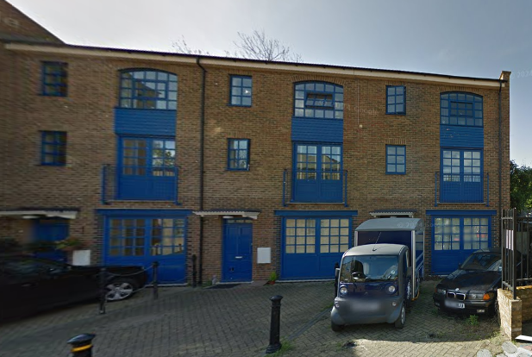
Similar Planning Applications
SMIKLE COURT, HATCHAM PARK MEWS, LONDON, SE14 5DG
Timeline : 6 months
A short link 2

Slide 13
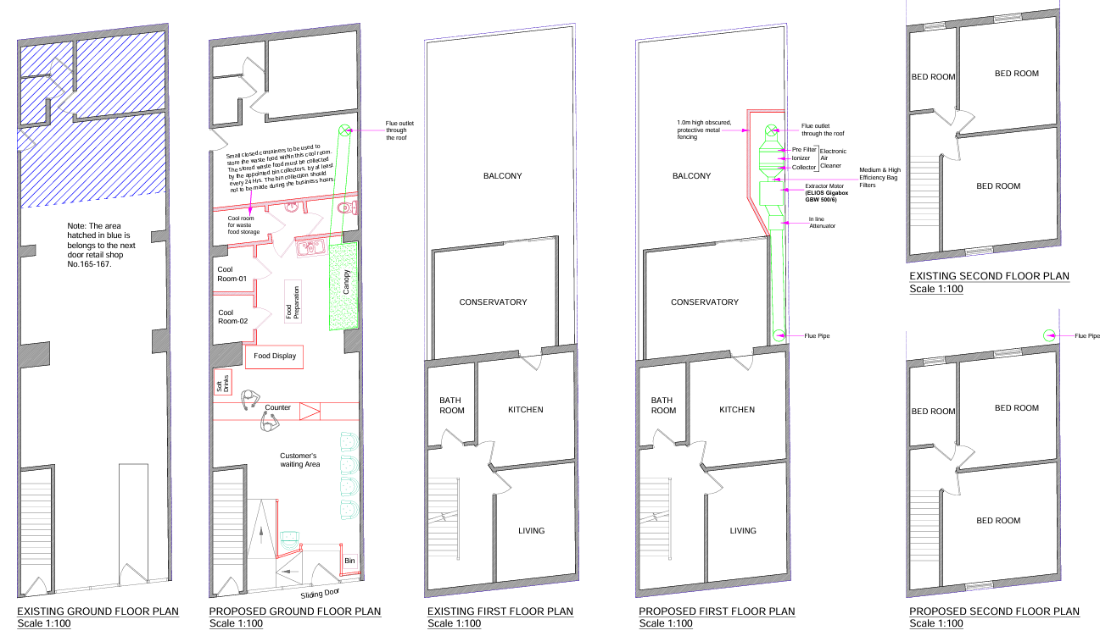
Existing and Proposed plans
13
Notes:
Add in the brief provided by the client

Slide 14
Existing and Proposed elevations
14
Notes:
Add in the brief provided by the client

Slide 15
Reasons for rejection
15
Notes:
Add in the brief provided by the client

Slide 16
How to bypass
16
Notes:
Add in the brief provided by the client

Slide 17
Documents to be Submitted
Full application- 3 Months (from submission) Till Decision Notice
Required Documents:
Fire Strategy (a third party document), Heritage statement (a third party document), CIL (a third party document), Structural Survey (a third party document), Sustainable Drainage assessment (a third party document)

Slide 18
Process of Works
Site Assessment and Feasibility: Evaluate the property to design development focusing on space optimization, accessibility, and the intended function, while ensuring full compliance with planning regulations.
Measured Survey & Architectural Drawings: Perform a measured survey and produce architectural drawings, including floor plans, elevations, sections, and site plans, ensuring accuracy for both planning and construction purposes.
Pre-Planning application : Prepare and submit a schematic planning application for the proposed development, ensuring compliance with local planning standards and requirements.
Full planning Planning Application: Prepare and submit a detailed planning application for the proposed development, ensuring compliance with local planning standards and requirements.
Notes:
Add in the brief provided by the client

Slide 19
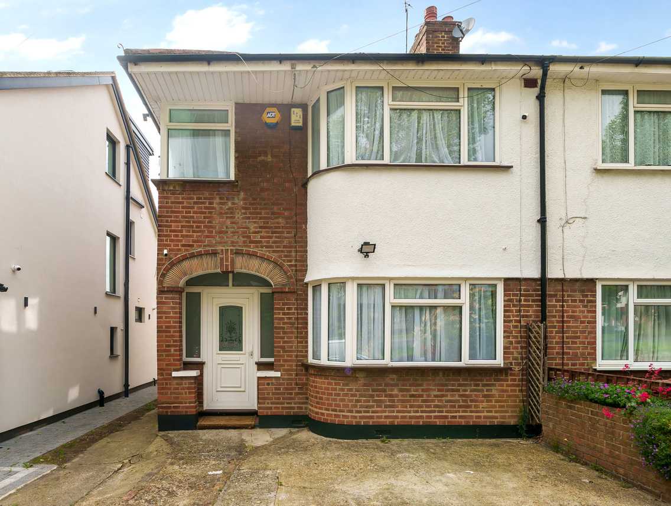
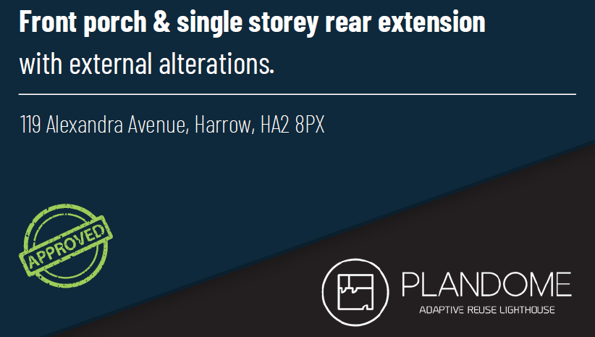
Track Records

Slide 20
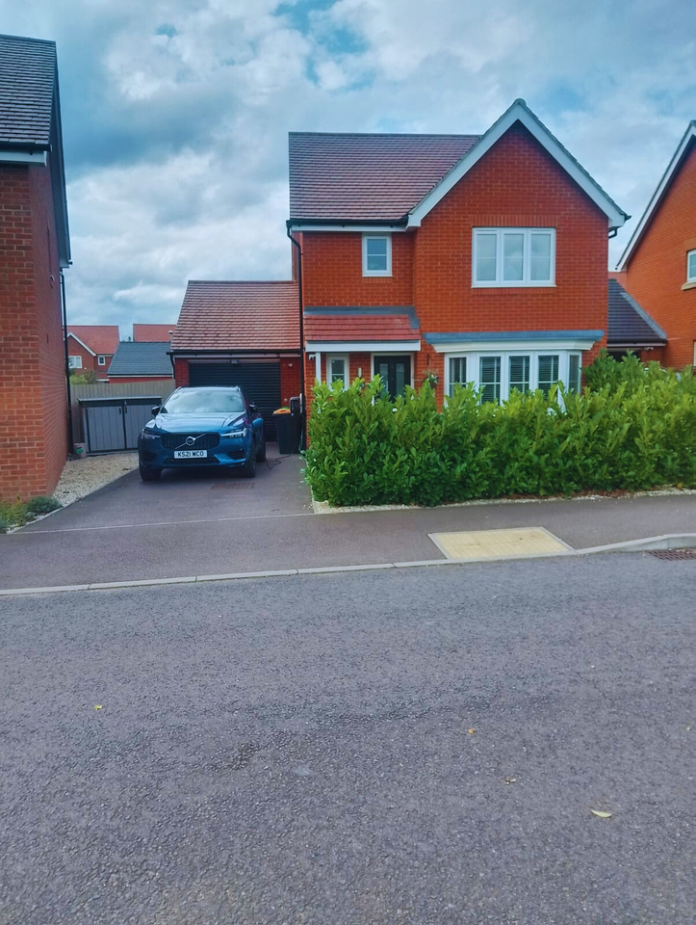
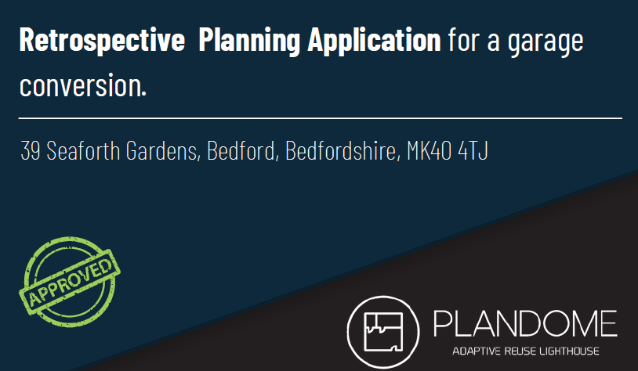
Track Records

Slide 21
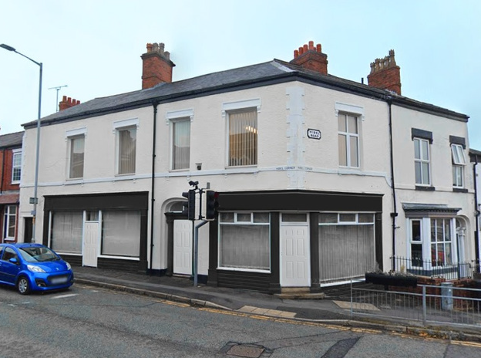
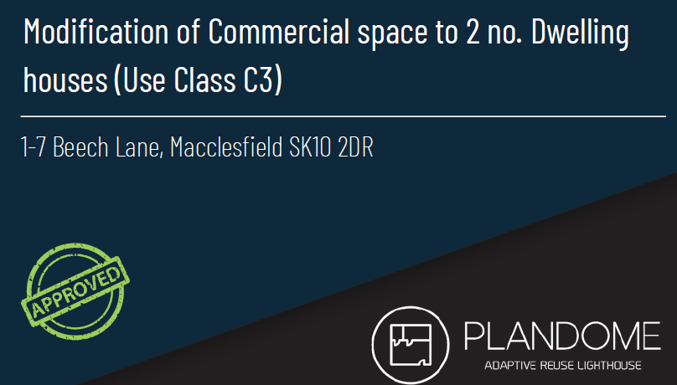
Track Records

Slide 22
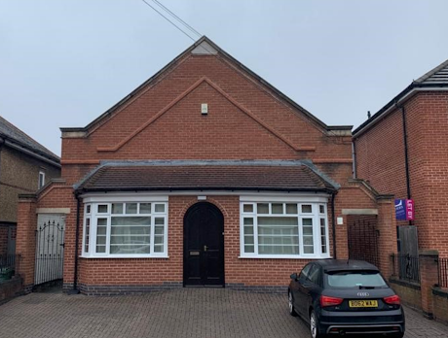
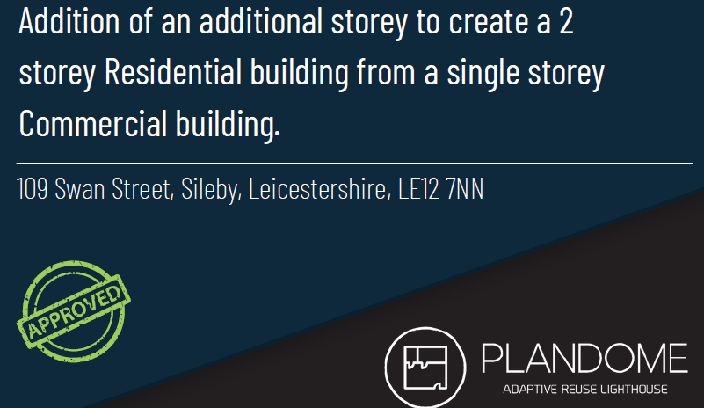
Track Records

Slide 23
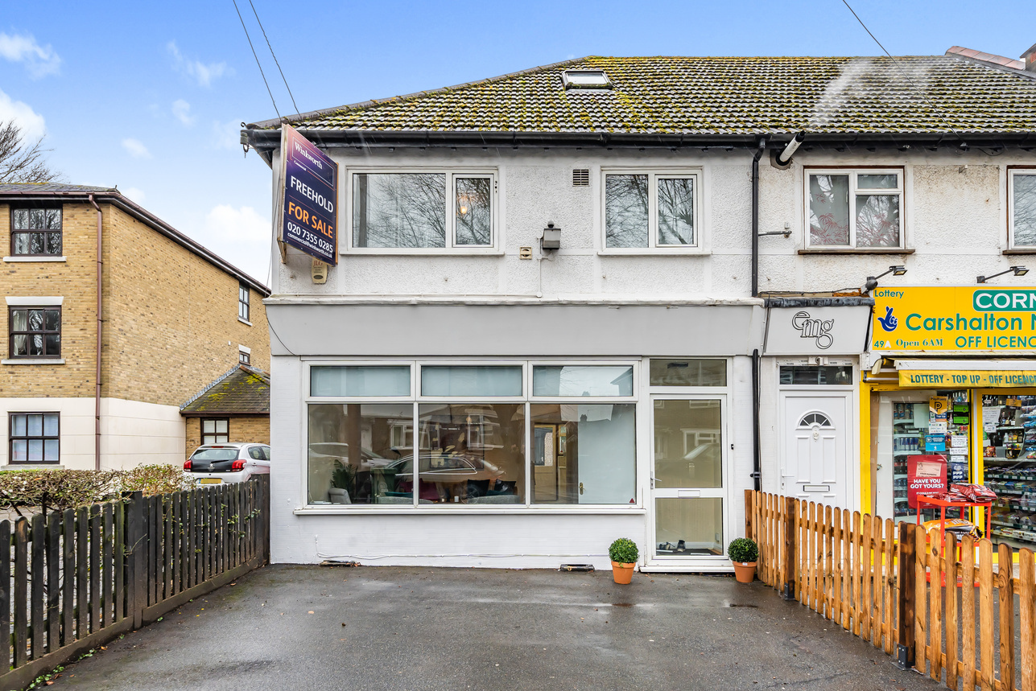
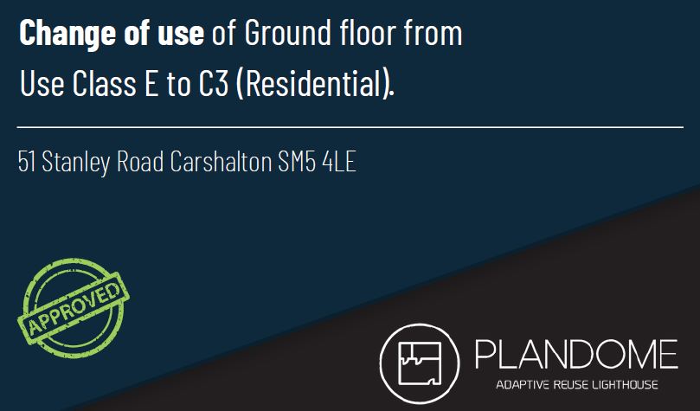
Track Records

