Slide 1

{{property address}}
Client: {{client name}}

Slide 2
{{property address}}
{{Property image 1}}
{{Property image 2}}
Notes:
Add property image from OS map using nimbus or landinsight. Add type of property & the site area. Do the critical checks.

Slide 3
Property Images
{{Property 3D images 1}}
{{Property 3D images 2}}
Notes:
views from google earth with marking of the property boundary

Slide 4
Property Images
{{Interior image 1}}
{{Interior image 2}}
{{Interior image 3}}
{{Interior image 4}}
Notes:
views from google earth with marking of the property boundary

Slide 5
Property Information
{{OS Map}}
Property type- {{existing use}}
Council : {{local council name}} Council.
Built Area - {{total area}} Sqm
{{constraints}}
Notes:
Add property image from OS map using nimbus or landinsight. Add type of property & the site area. Do the critical checks.

Slide 6
Scope of Works
{{scope of work}}
Notes:
Add in the brief provided by the client

Slide 7
Conceptual design
Conceptual design
{{Conceptual Design Chatgpt}}
Notes:
views from google earth with marking of the property boundary

Slide 8
Conceptual design - Plan
{{Conceptual Floor Plan}}
Notes:
views from google earth with marking of the property boundary

Slide 9
Similar Planning Applications
{{property address - sample 1}}
{{property - sample 1 - screenshot}}
{{property - sample 1 - image}}
Timeline : {{timeline 1}} months
{{Link 1}}

Slide 10
Existing and Proposed Floor Plan
{{Sim app Floor plan 1}}
10
Notes:
Add in the brief provided by the client

Slide 11
Existing and Proposed Elevations
{{Sim app elevation 1}}
11
Notes:
Add in the brief provided by the client

Slide 12
Similar Planning Applications
{{property address - sample 2}}
{{property - sample 2 - screenshot}}
{{property - sample 2 - image}}
Timeline : {{timeline 2}} months
{{Link 2}}

Slide 13
Existing and Proposed plans
{{Sim app floor plan 2}}
13
Notes:
Add in the brief provided by the client

Slide 14
Existing and Proposed elevations
{{Sim app elevation 2}}
14
Notes:
Add in the brief provided by the client

Slide 15
Reasons for rejection
{{ rejected application- image}}
15
Notes:
Add in the brief provided by the client

Slide 16
How to bypass
16
Notes:
Add in the brief provided by the client

Slide 17
Documents to be Submitted
Full application- {{timeline 1}} Months (from submission) Till Decision Notice
Required Documents:
{{ list of documents required}}

Slide 18
Process of Works
Site Assessment and Feasibility: Evaluate the property to design development focusing on space optimization, accessibility, and the intended function, while ensuring full compliance with planning regulations.
Measured Survey & Architectural Drawings: Perform a measured survey and produce architectural drawings, including floor plans, elevations, sections, and site plans, ensuring accuracy for both planning and construction purposes.
Pre-Planning application : Prepare and submit a schematic planning application for the proposed development, ensuring compliance with local planning standards and requirements.
{{PD/ Full PP/ House holder}} Planning Application: Prepare and submit a detailed planning application for the proposed development, ensuring compliance with local planning standards and requirements.
Notes:
Add in the brief provided by the client

Slide 19
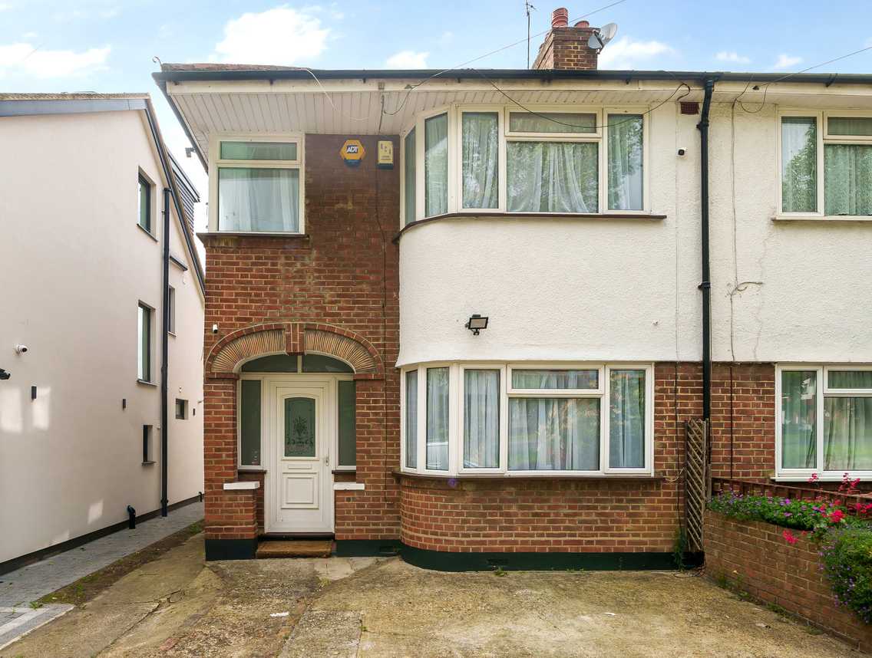
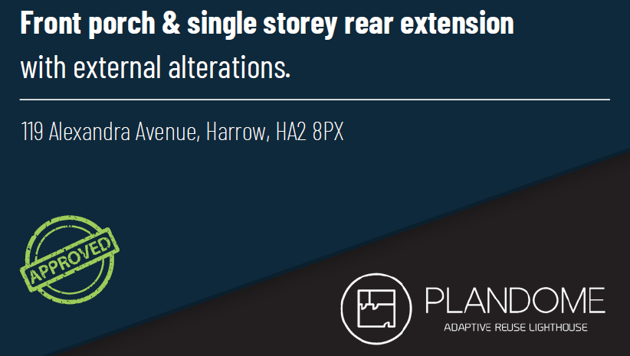
Track Records

Slide 20
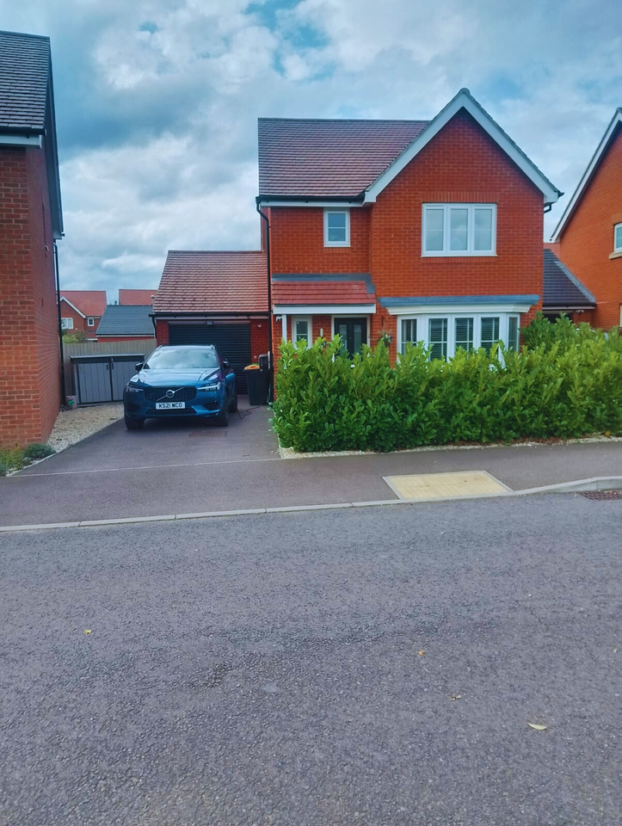
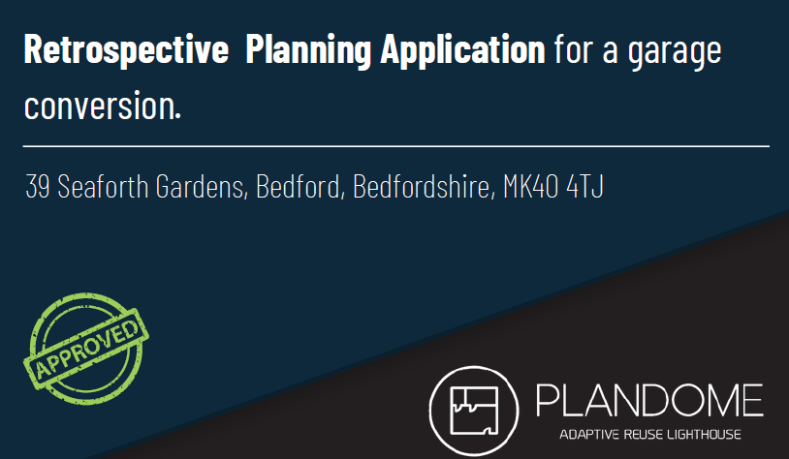
Track Records

Slide 21
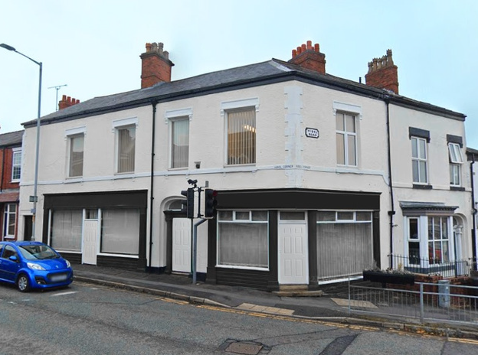
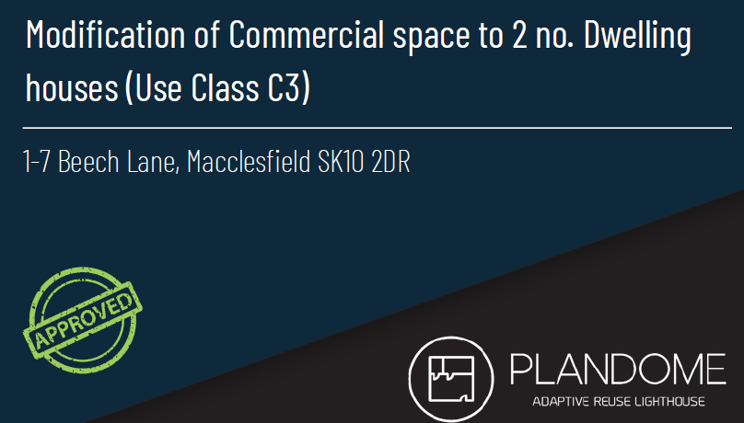
Track Records

Slide 22
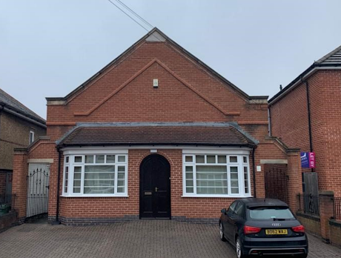
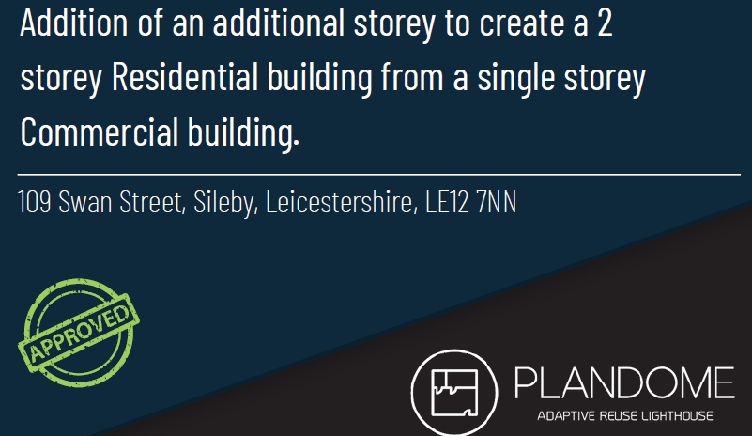
Track Records

Slide 23
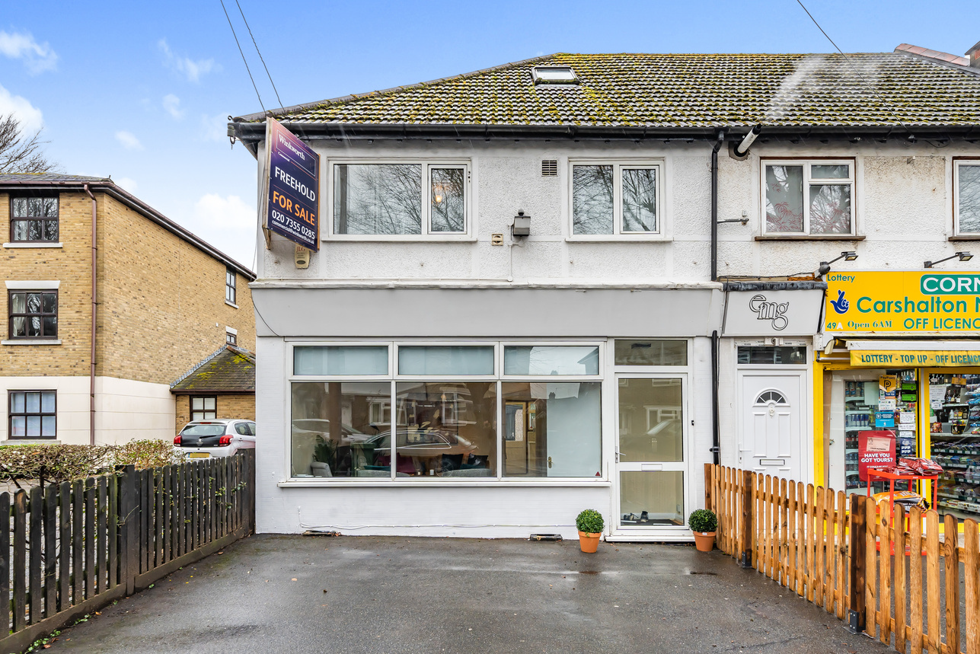
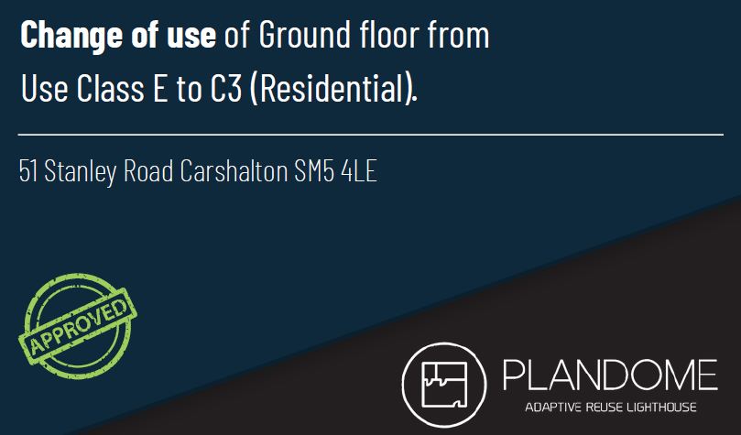
Track Records

