Slide 1

{{property address}}
Client: {{client name}}

Slide 2
{{property address}}
Property image
Notes:
Add property image from OS map using nimbus or landinsight. Add type of property & the site area. Do the critical checks.

Slide 3
Property Images
3d views
3d views
Notes:
views from google earth with marking of the property boundary

Slide 4
Property Information
OS Map
Property type- {{existing use}}
Council : {{local council name}} Council.
Built Area - {{total area}} Sqm
{{constraints - e.g.,}}
Notes:
Add property image from OS map using nimbus or landinsight. Add type of property & the site area. Do the critical checks.

Slide 5
Scope of Works
{{scope of work}}
Notes:
Add in the brief provided by the client

Slide 6
Conceptual design
Conceptual design
Notes:
views from google earth with marking of the property boundary

Slide 7
Conceptual design - Plan
Notes:
views from google earth with marking of the property boundary

Slide 8
Similar Planning Applications
{{property address - sample 1}}
{{property - sample 1 - screenshot}}
{{property - sample 1 - image}}
Timeline : {{timeline 1}} months
{{Link 1}}

Slide 9
Existing and Proposed Floor Plan
9
Notes:
Add in the brief provided by the client

Slide 10
Existing and Proposed Elevations
10
Notes:
Add in the brief provided by the client

Slide 11
Similar Planning Applications
{{property address - sample 2}}
{{property - sample 2 - screenshot}}
{{property - sample 2 - image}}
Timeline : {{timeline 2}} months
{{Link 2}}

Slide 12
Existing and Proposed plans
12
Notes:
Add in the brief provided by the client

Slide 13
Existing and Proposed elevations
13
Notes:
Add in the brief provided by the client

Slide 14
Reasons for rejection
14
Notes:
Add in the brief provided by the client

Slide 15
How to bypass
15
Notes:
Add in the brief provided by the client

Slide 16
Documents to be Submitted
Full application- {{timeline 1}} Months (from submission) Till Decision Notice
Required Documents:
{{ list of documents required}}

Slide 17
Process of Works
Site Assessment and Feasibility: Evaluate the property to design development focusing on space optimization, accessibility, and the intended function, while ensuring full compliance with planning regulations.
Measured Survey & Architectural Drawings: Perform a measured survey and produce architectural drawings, including floor plans, elevations, sections, and site plans, ensuring accuracy for both planning and construction purposes.
Pre-Planning application : Prepare and submit a schematic planning application for the proposed development, ensuring compliance with local planning standards and requirements.
{{PD/ Full PP/ House holder}} Planning Application: Prepare and submit a detailed planning application for the proposed development, ensuring compliance with local planning standards and requirements.
Notes:
Add in the brief provided by the client

Slide 18
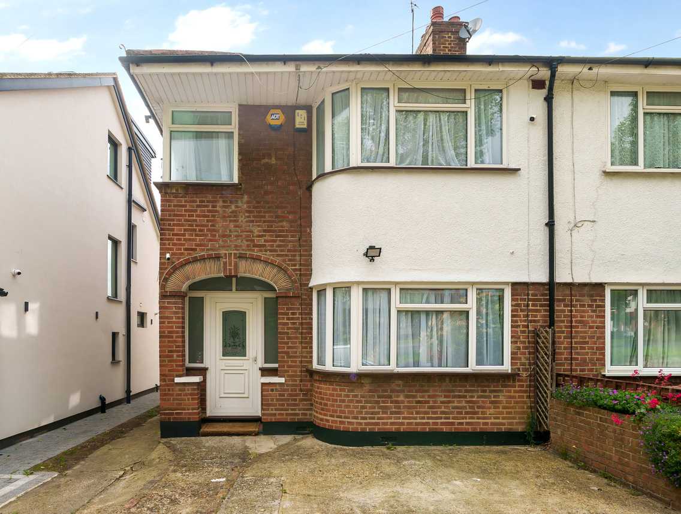
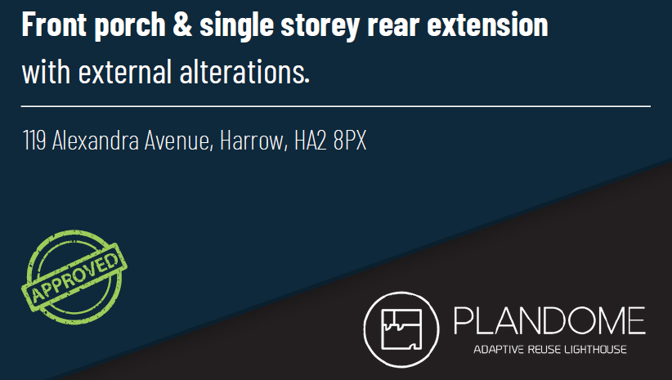
Track Records

Slide 19
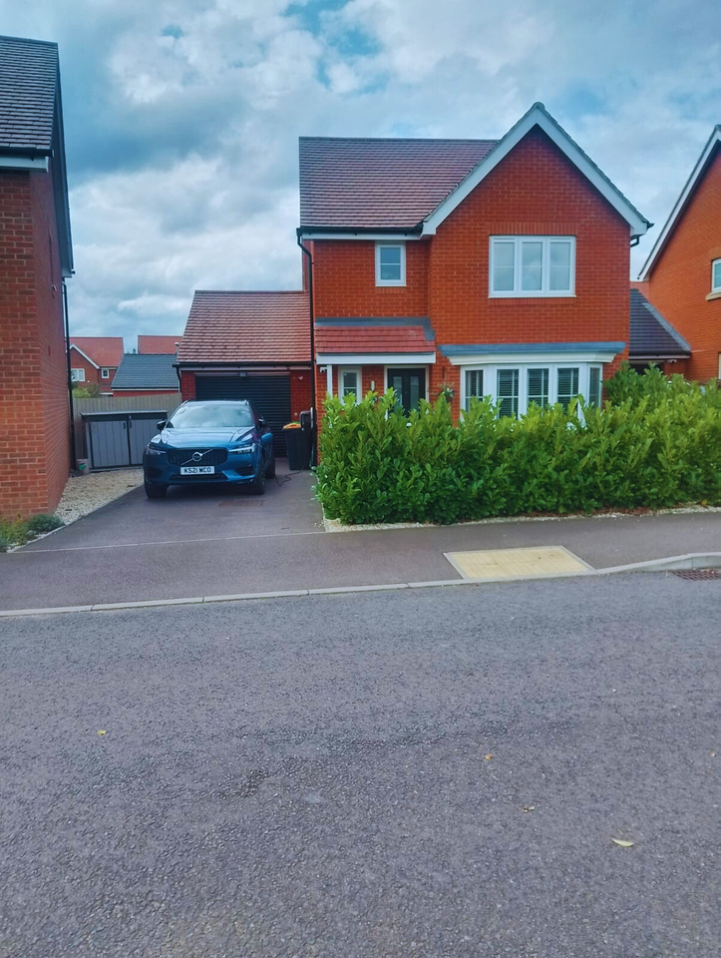
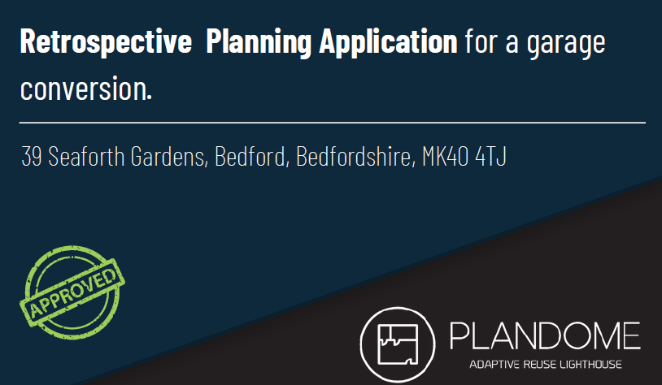
Track Records

Slide 20
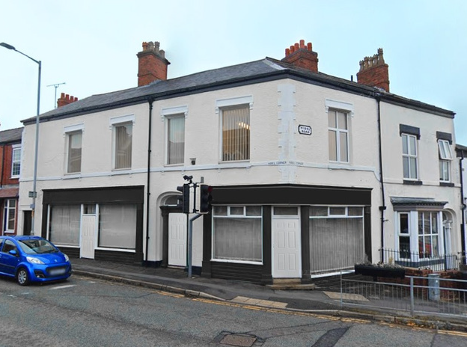
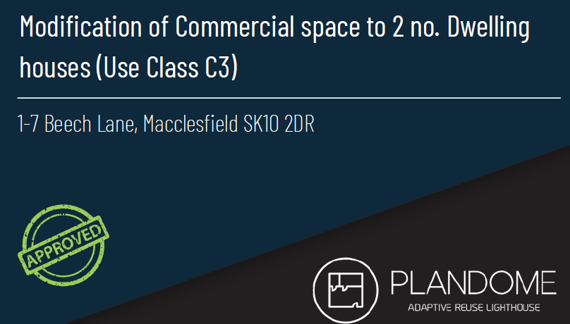
Track Records

Slide 21
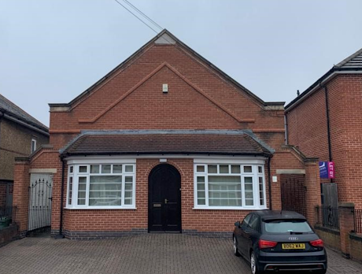
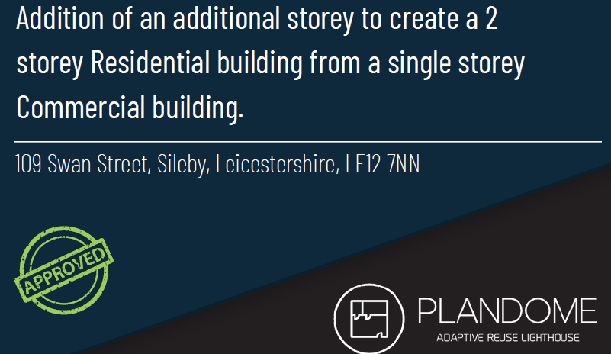
Track Records

Slide 22
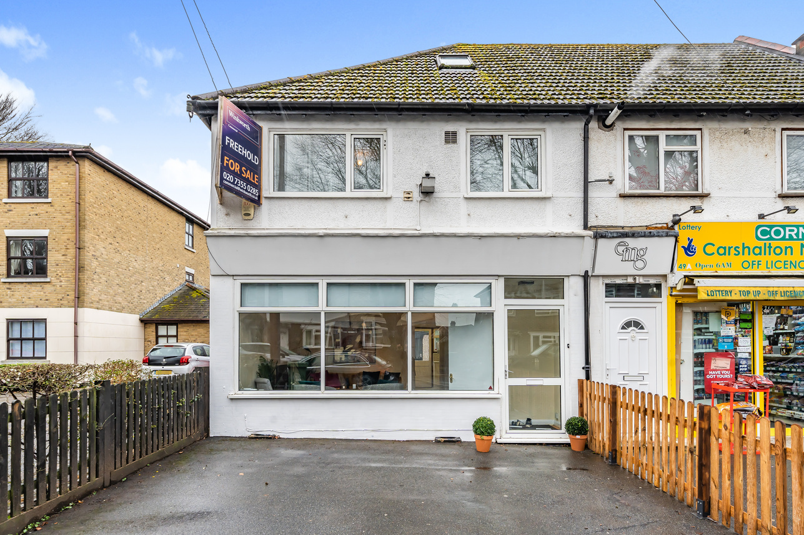
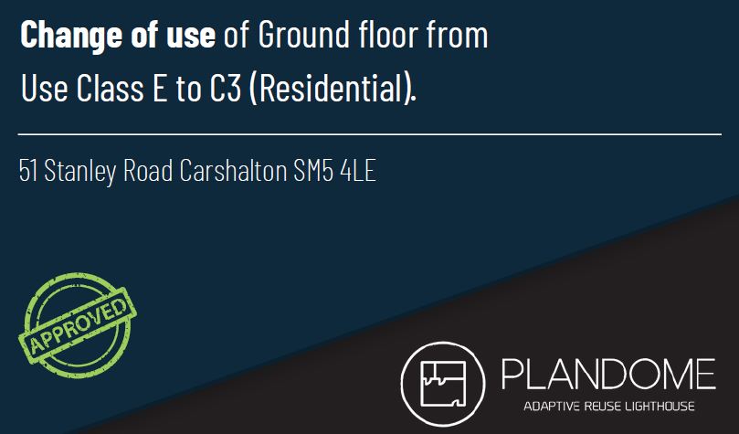
Track Records

