Slide 1
NLP Natural Language Processing

Slide 2
NLP – Natural Language processing
What is NLP ?
NLP focuses on analyzing meaning of text and speech.
Starts with recognition – what words are given in text /speech ?
Next, sentiment for those words
Is a review positive or negative ?
Generating new text
Writing a song or script from scratch
In this course we will mainly focus is on text, not speech.

Slide 3
Applications of NLP
Sentiment analysis
Dictation
Translation
Voice assistant
Smart speakers
Smart home devices
And more!

Slide 4
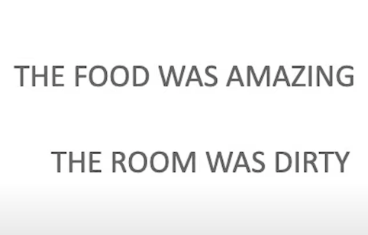
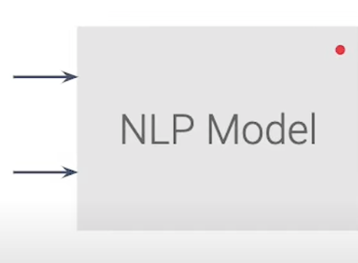
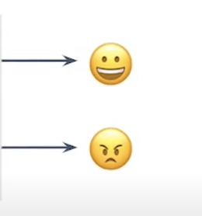
NLP - Sentiment Example

Slide 5
NLP – Prepare Data
Tokenize the words
Create sequences for the sentences
Make the sequences all the same length by padding and truncating

Slide 6
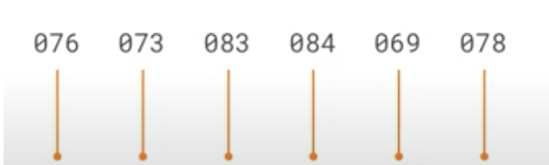
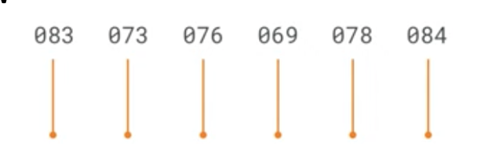


NLP – Prepare Data
Tokenize the words

Slide 7

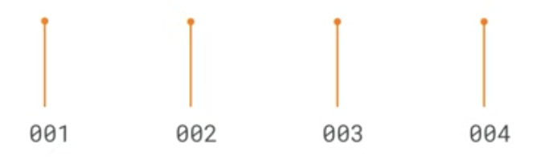

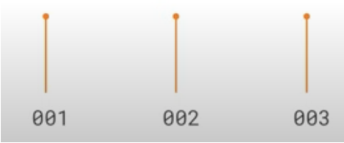
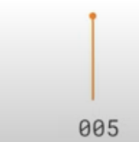
NLP – Prepare Data
Tokenize the words
Encode words instead of letters

Slide 8
NLP – Prepare Data
Tokenize the words
Encode words instead of letters
#Import required libraries
import tensorflow as tf
from tensorflow.keras.preprocessing.text import Tokenizer
sentences = [
'I love my dog’,
'I love my cat'
]
Maximum number of words to keep
tokenizer = Tokenizer(num_words = 100)
tokenizer.fit_on_texts(sentences)
word_index = tokenizer.word_index
print(word_index)
{'i': 1, 'love': 2, 'my': 3, 'dog': 4, 'cat': 5}
https://colab.research.google.com/drive/1cIzXH_yp6lXipRPV5QDi0tJJnAJmSZ1s#scrollTo=wlcbaQiQoGEe

Slide 9
NLP – Prepare Data
Sequencing – Turning sentences into data
sentences = [
'I love my dog’,
'I love my cat'
]
{'i': 1, 'love': 2, 'my': 3, 'dog': 4, 'cat': 5}
sequences = tokenizer.texts_to_sequences(sentences)
print(sequences)
[[1, 2, 3, 4], [1, 2, 3, 5]]
https://colab.research.google.com/drive/1_d6xX8wbmcLHlewLnObf7nicTGcfBYo1#scrollTo=nItx1MV7xBGl

Slide 10
NLP – Prepare Data
Sequencing – Turning sentences into data
?
test_data = [
'I really love my dog’,
'My dog love my company'
]
test_sequences = tokenizer.texts_to_sequences(test_data)
print(test_sequences)
?
[[1, 2, 3, 4], [3, 4, 2, 3]]
{'i': 1, 'love': 2, 'my': 3, 'dog': 4, 'cat': 5}

Slide 11
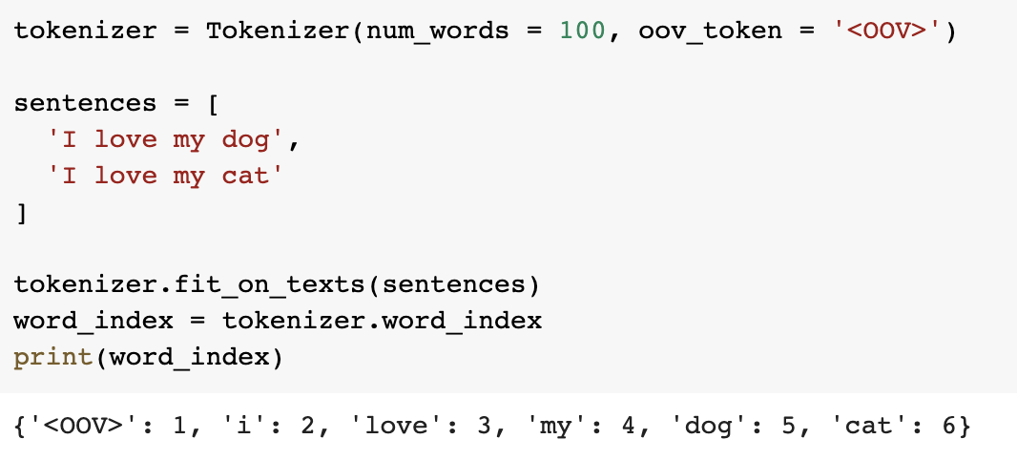
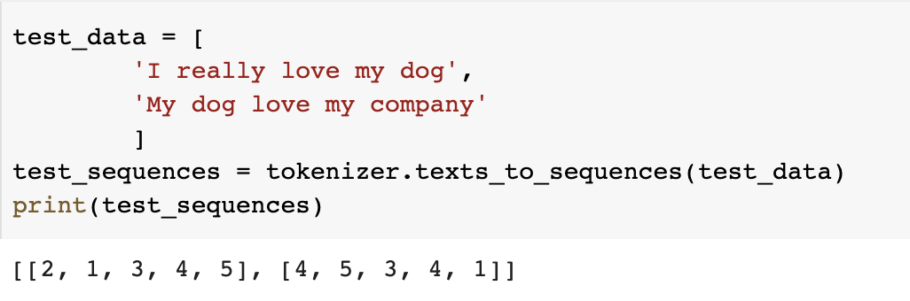
NLP – Prepare Data
Sequencing – Turning sentences into data

Slide 12
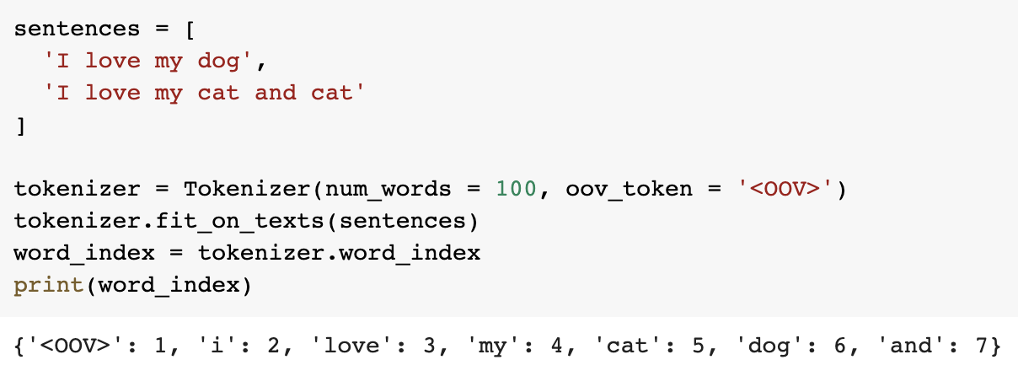
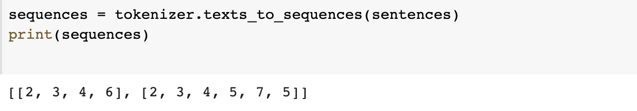
NLP – Prepare Data
Pad sequences

Slide 13
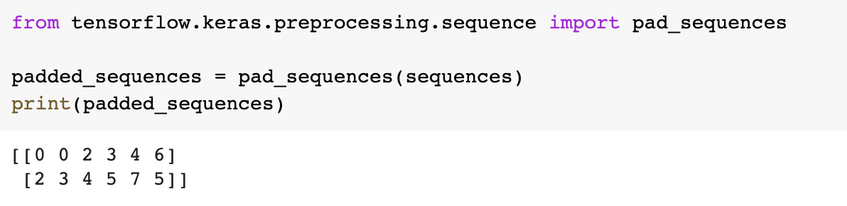
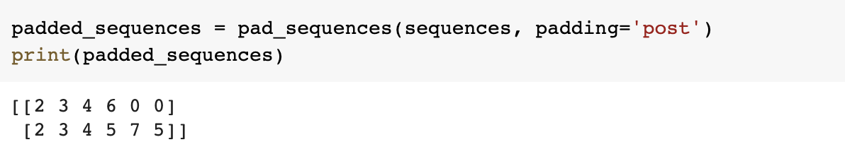
NLP – Prepare Data
Pad sequences

Slide 14
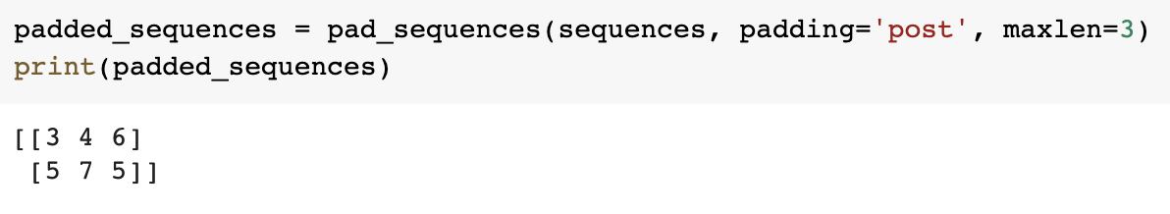
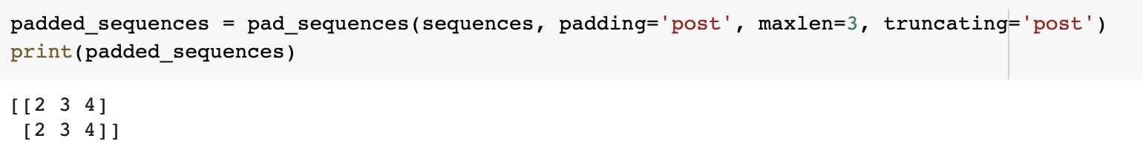
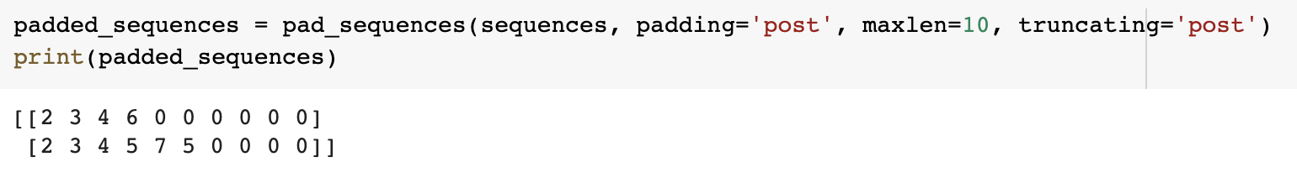
NLP – Prepare Data
Pad sequences
https://colab.research.google.com/drive/1NBhYiiOSvHb5myNkIxT5eFoqn7SNtHgn#scrollTo=gir-1M5N9Mm7

Slide 15
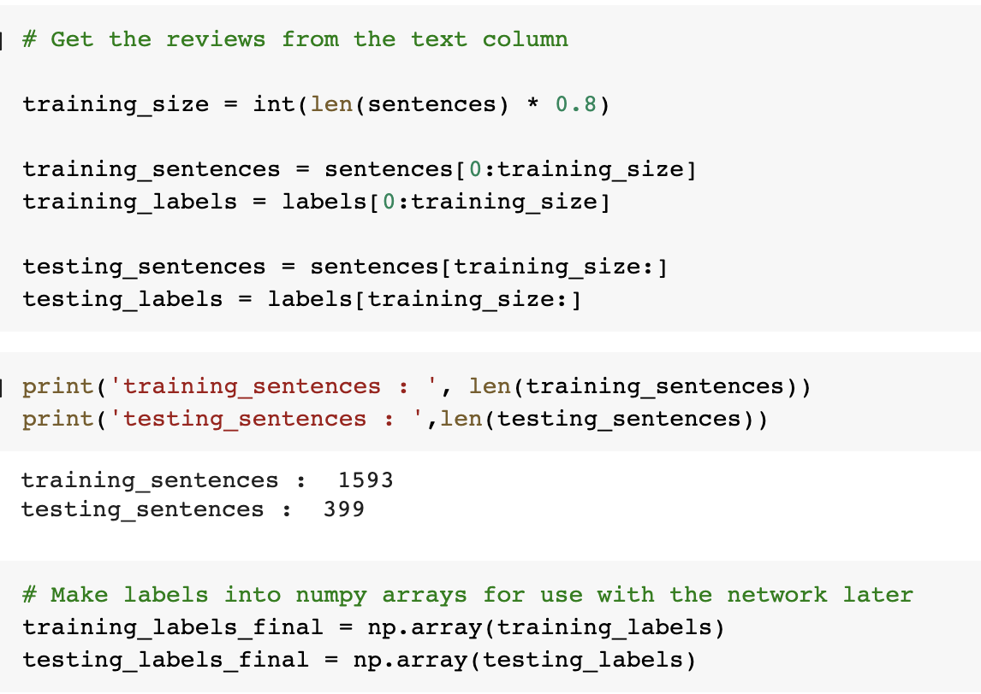
Segregate data into Train and Test set

Slide 16
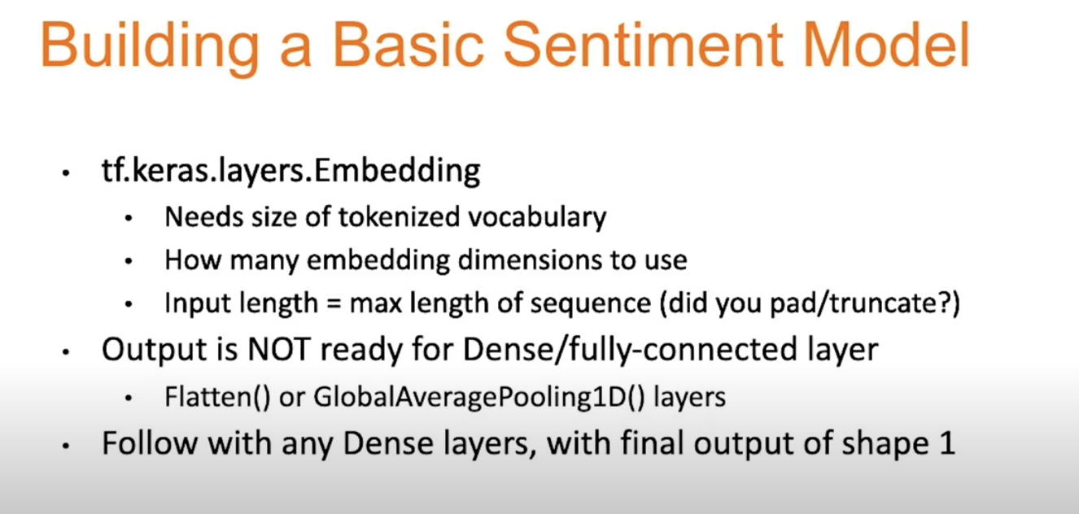

Slide 17
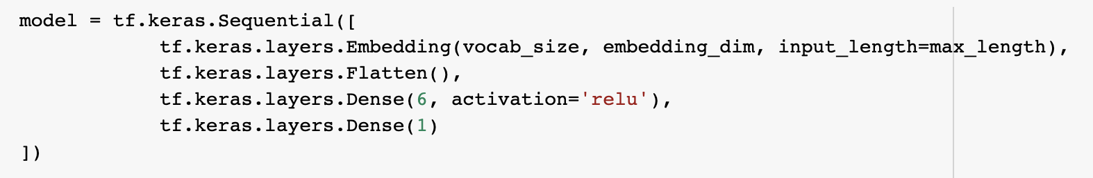
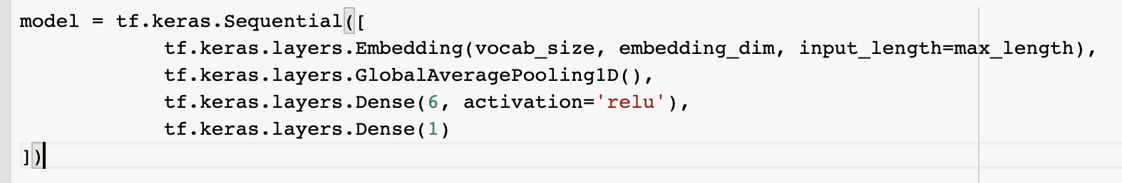
Create Basic Sentiment Modal
https://colab.research.google.com/drive/1jDwV8Smj7WhJn-4RtLpKxM5_jUT1HSDL#scrollTo=Je08W5bmHVjH

Slide 18
Compile and Train Modal
https://colab.research.google.com/drive/1bwooLbuAaLhhQrH87qfwXx32z7dLdet-#scrollTo=moPvI0ATjQz3

Slide 19
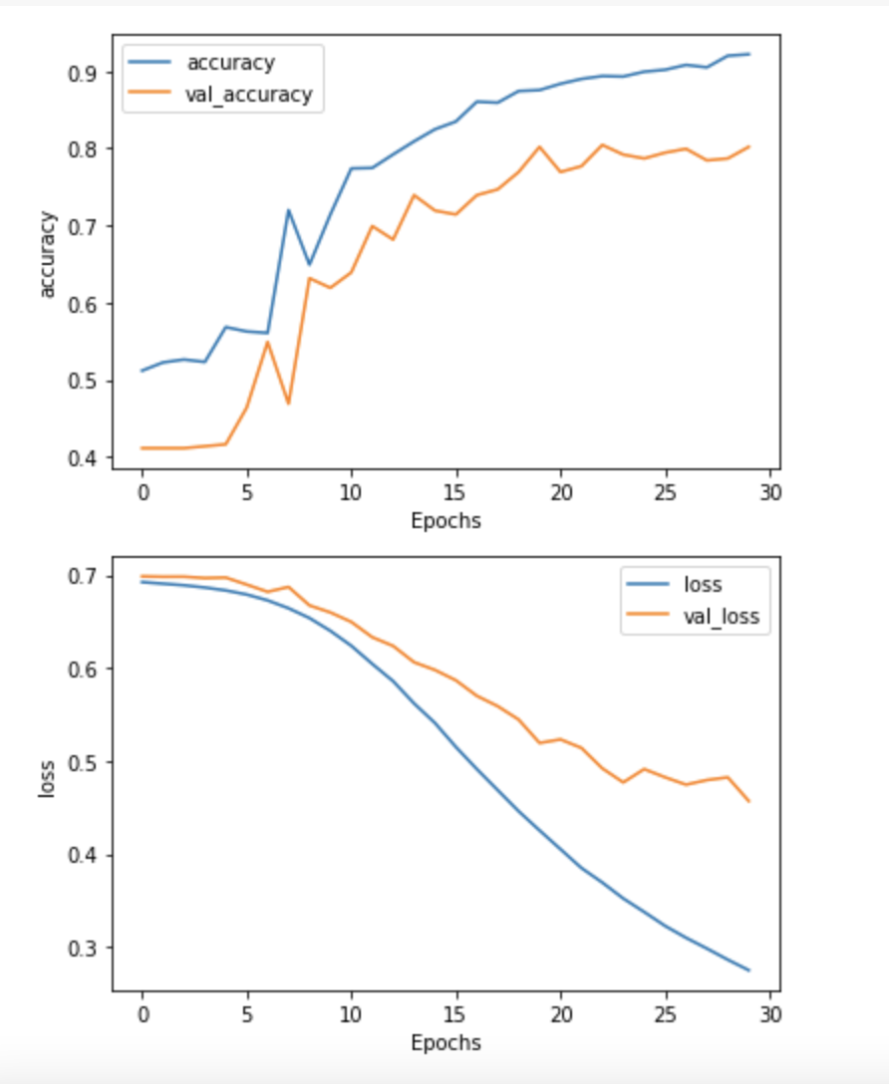
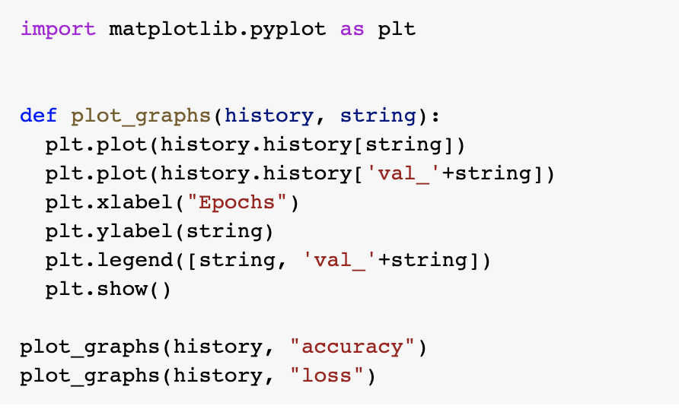
Visualize the Training Graph

Slide 20
Resources
https://www.youtube.com/watch?v=fNxaJsNG3-s&list=PLQY2H8rRoyvzDbLUZkbudP-MFQZwNmU4S
Udacity course: Lesson 9

Slide 21
Thankyou

