Slide 1
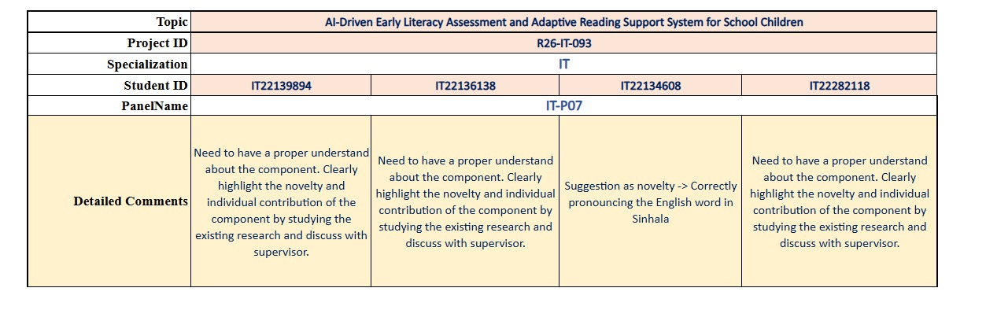


Why Did We Change the Topic?
P r o j e c t I D – R26 – IT - 093
12/5/2026

Slide 2
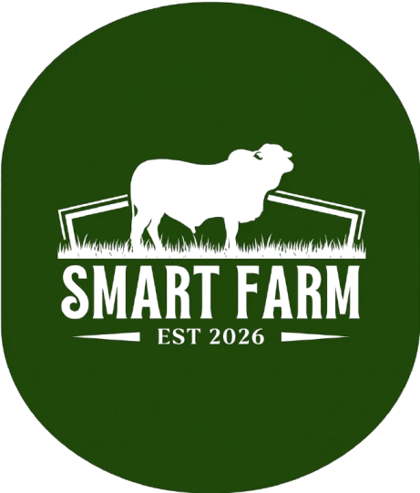
AI SMART
FARM
P r o j e c t I D – R26 – IT - 093
12/5/2026

Slide 3
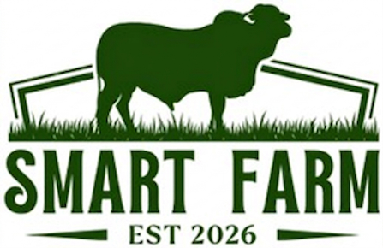

CONTENT
Introdution
Proposed Solution User Requirements Addressed of the components
Design Excellence and User Feedback of the components
Commercialization/Sustainability of Solution

Slide 4


Converting Traditional farm to Smart Farm
Traditional farming still faces several major challengers,
Lack of automated feeding and nutrition management in traditional livestock farming
Difficulty in early detection of cattle diseases using manual observation methods
Absence of reliable egg hatching and birth prediction mechanisms in conventional farms
Limited access to market prediction tools for informed livestock product pricing and sales decisions
12/5/2026

Slide 5
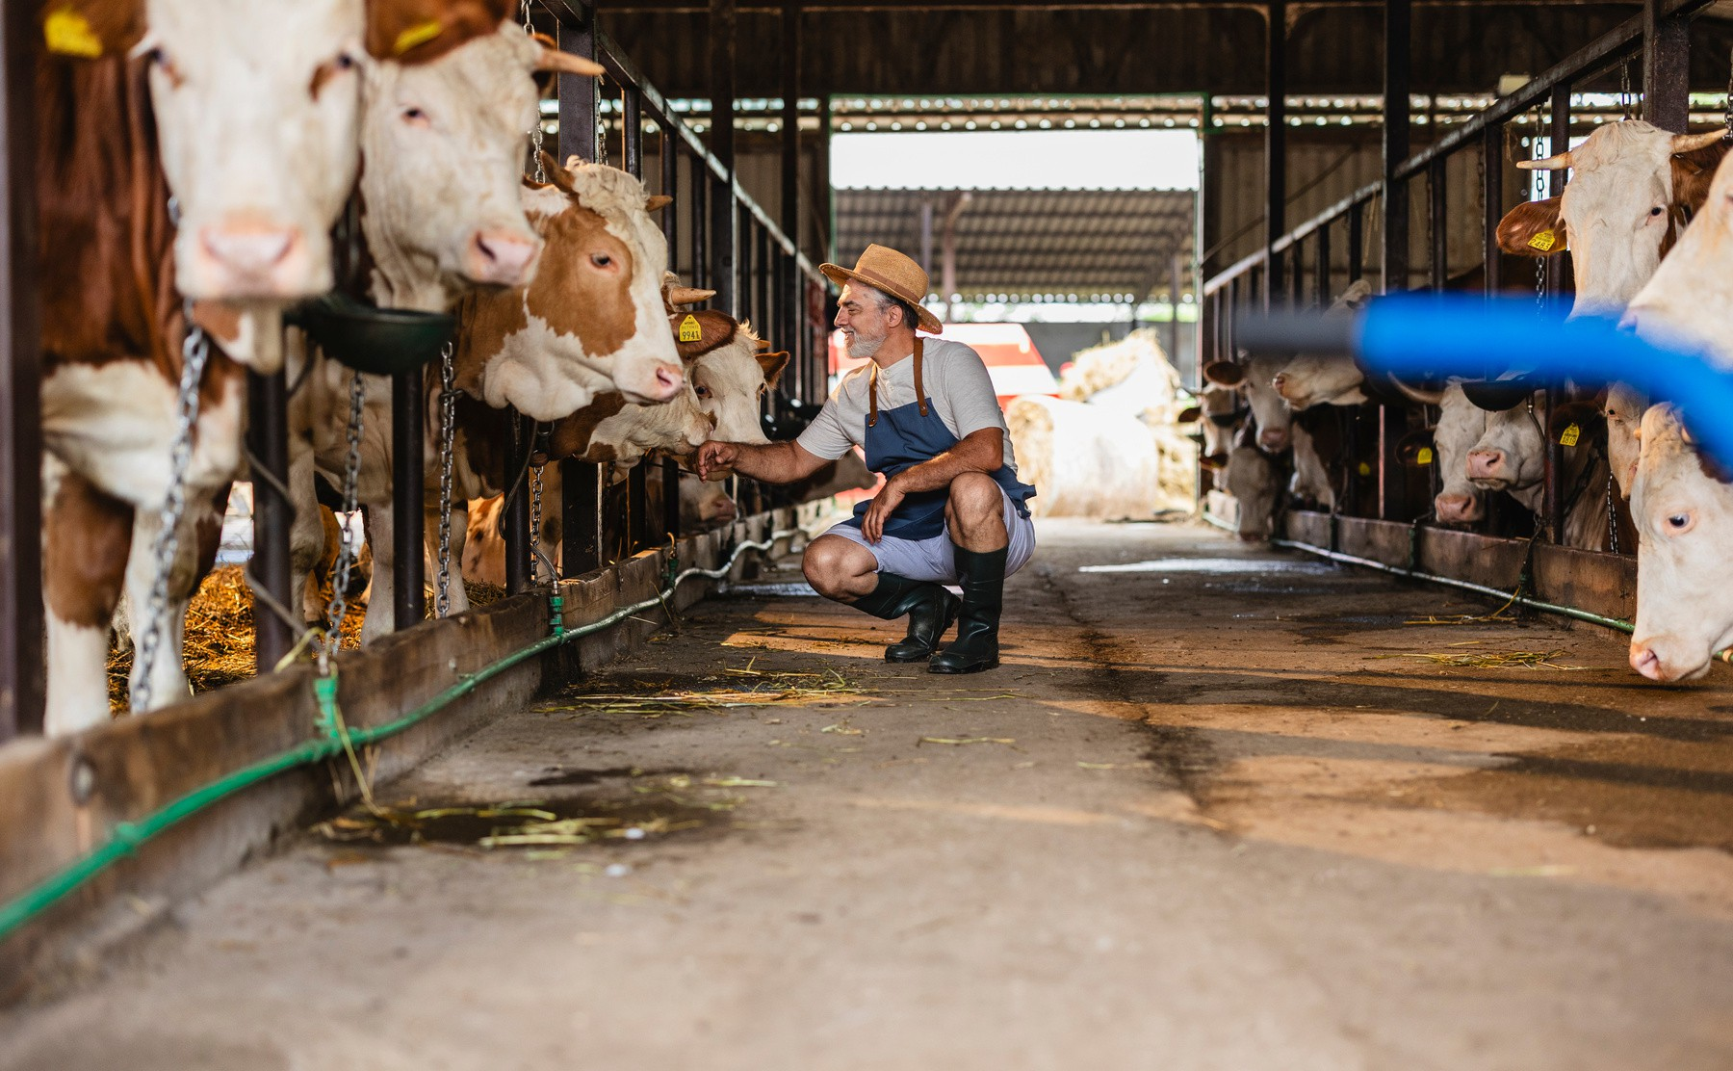
Design Excellence of the Overall Solution
Intelligent & Automated
Farmer-Centric
Multi-Component Smart System Efficient & Time-Saving
PP1 Video
12/5/2026

Slide 6
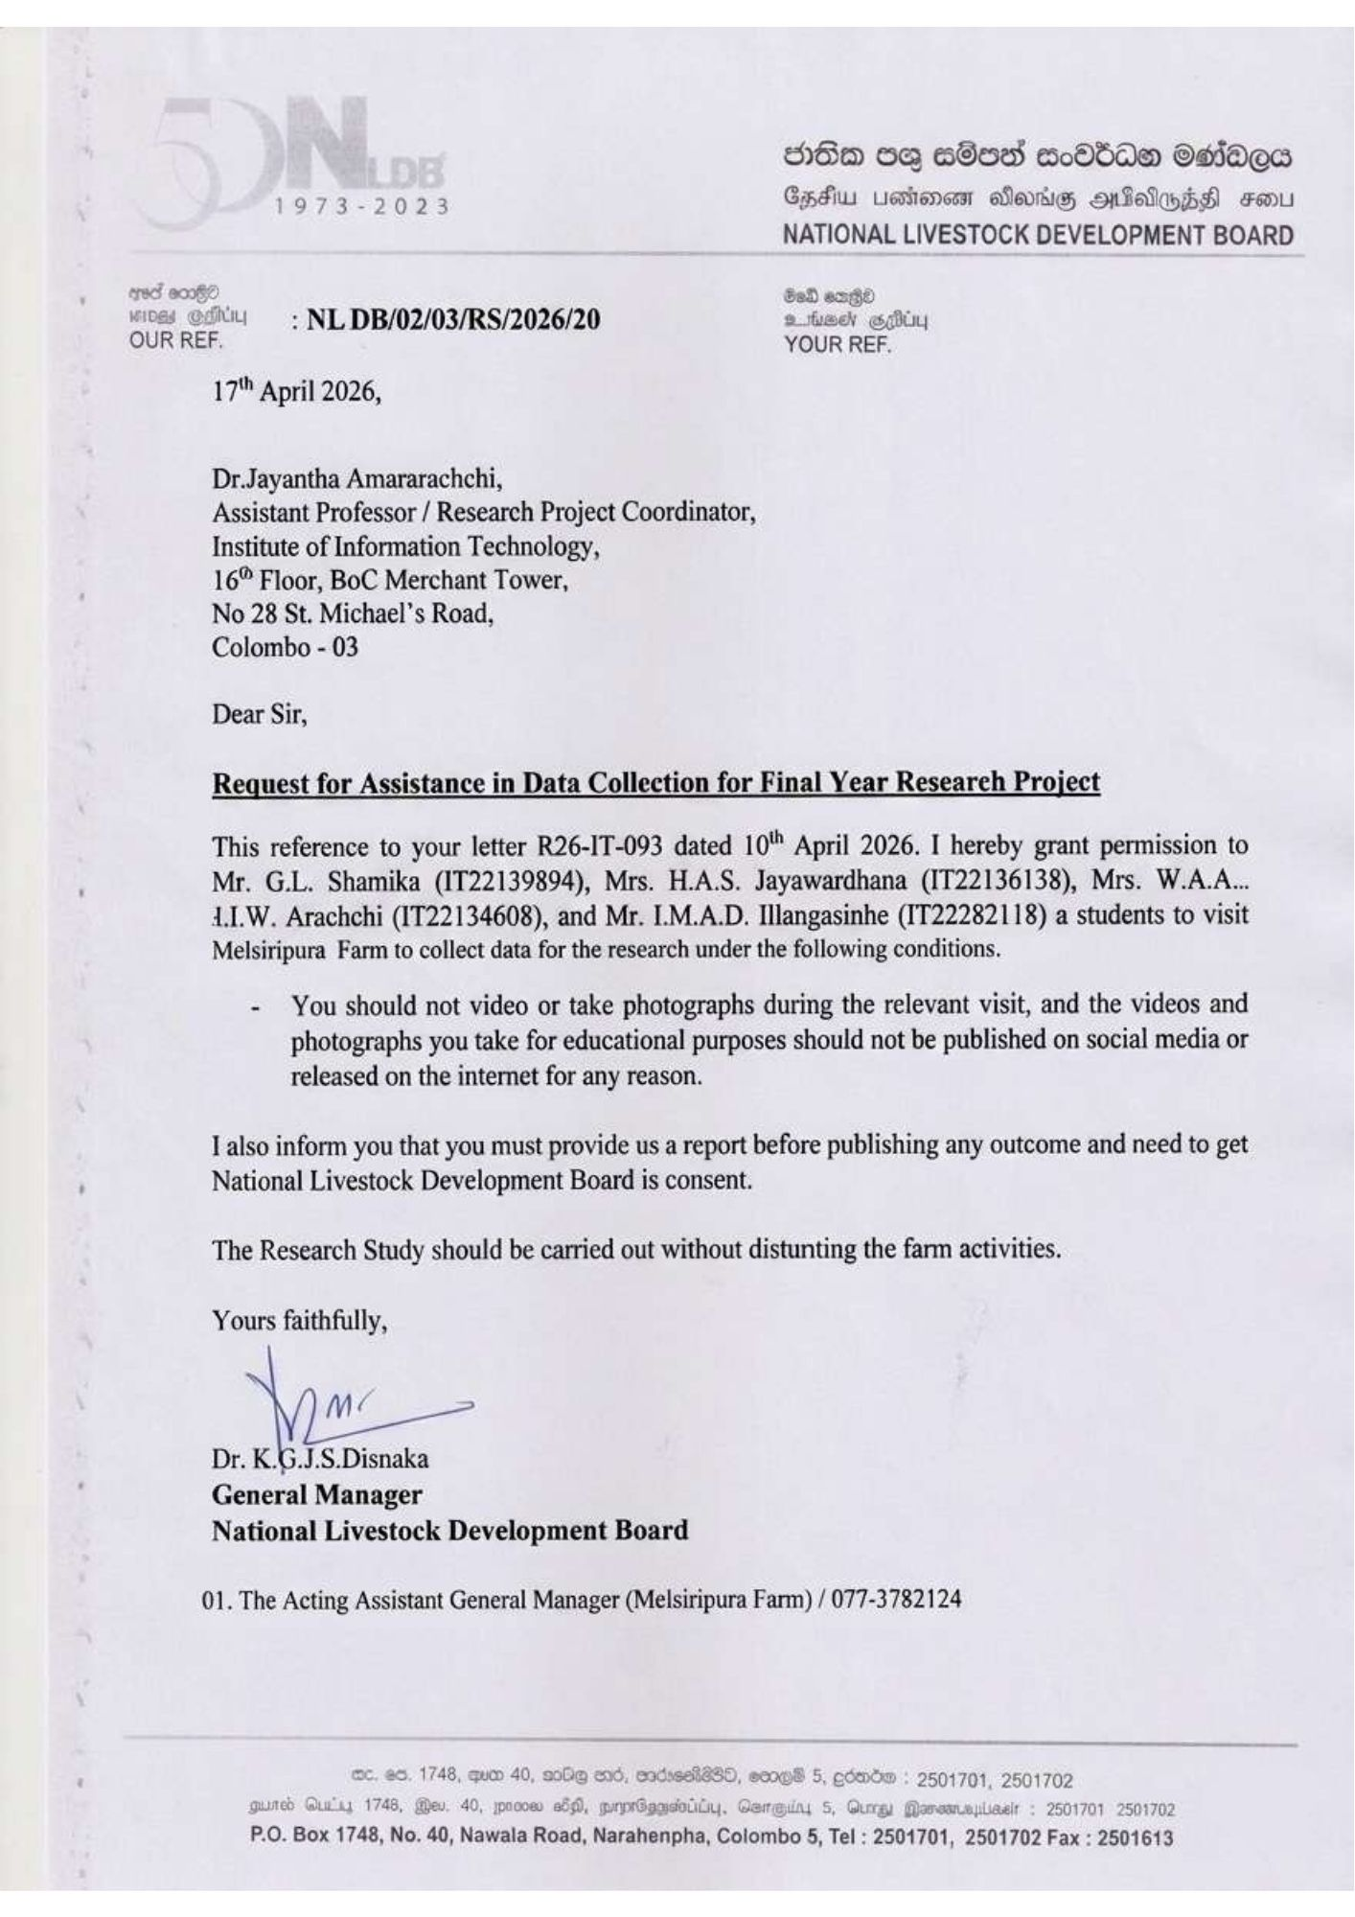
Data Collection Permission Letter
12/5/2026

Slide 7
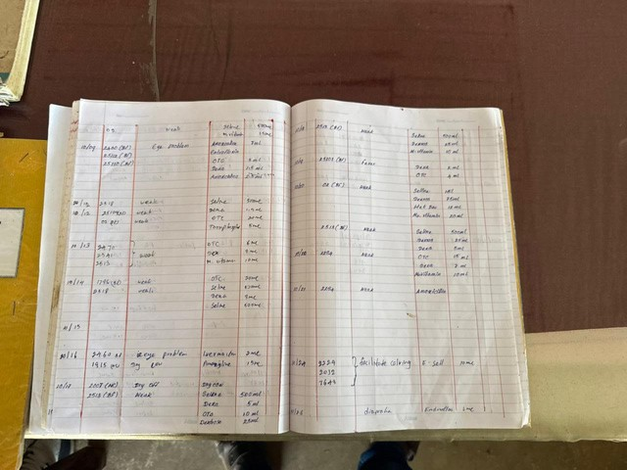
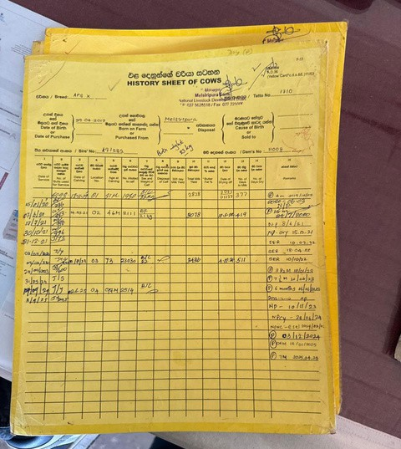
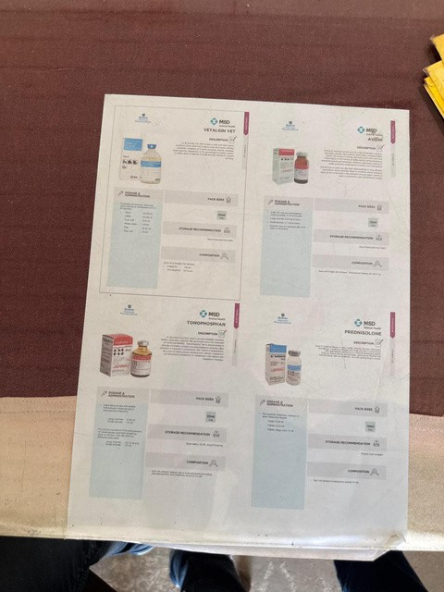
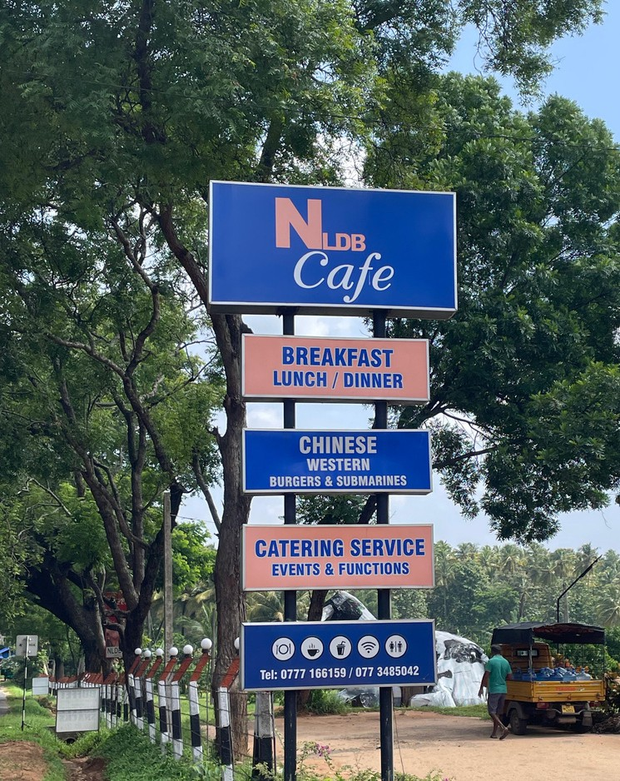
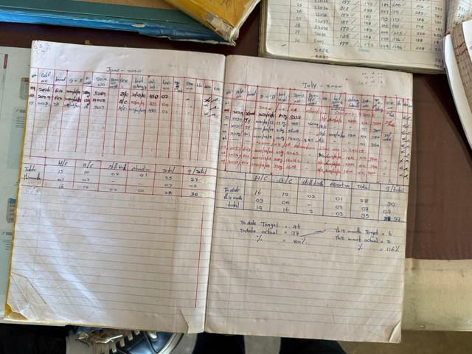
Data Collection Activities
12/5/2026

Slide 8
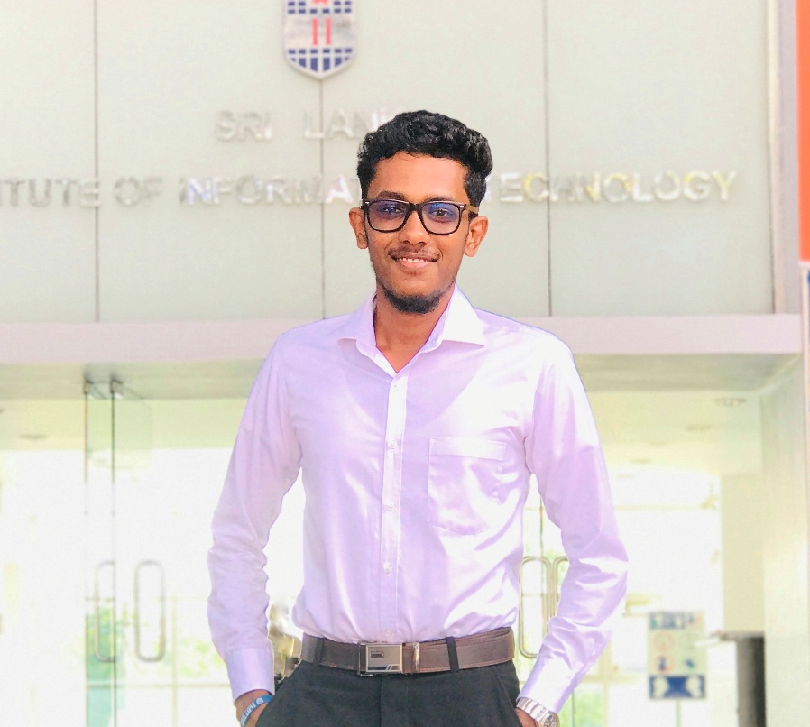

ANIMAL BIRTH AND EGG HATCH PREDICTION
IT22139894 | Shamika G. L .| R26 – IT - 093
BSc (Hons) Degree in Information Technology specialization information Technology
IT22139894 |
Shamika G.L |
|
R26 –IT- 093
12/5/2026

Slide 9
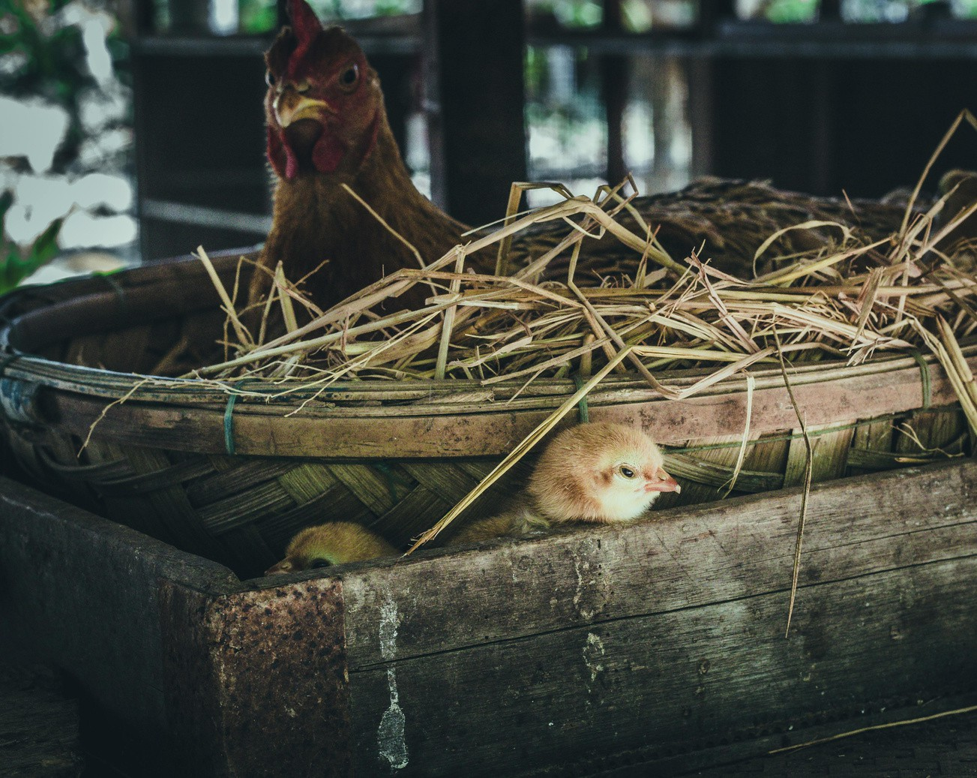


Proposed Solution
Early detection of animal birthing events
Higher egg hatching success rate
Increased farmer income and productivity
Modules Implemented
Animal Birth Prediction Model Egg Hatch Prediction Model
IT22139894 |
Shamika G.L |
R26 –IT- 093
12/5/2026

Slide 10
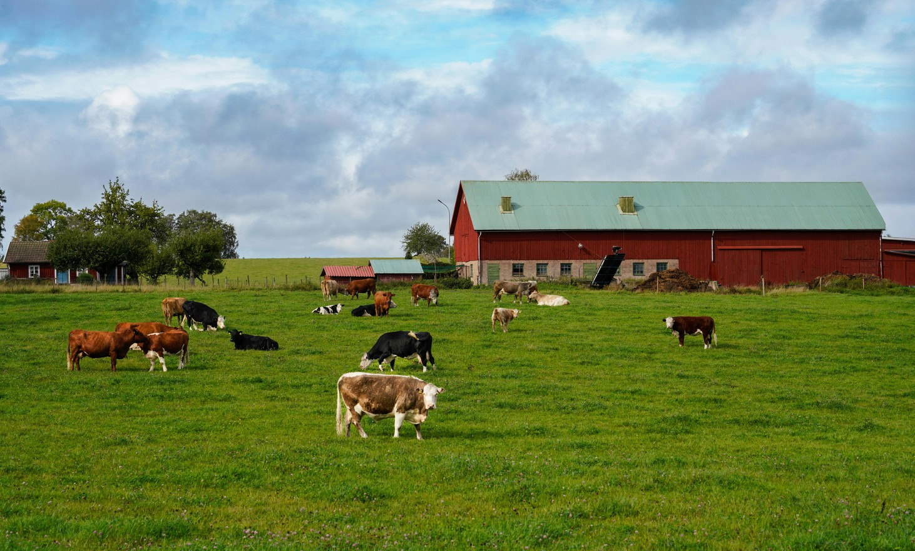

DESIGN CONTRIBUTION AND USER FEEDBACK
Design Excellence
AI-driven prediction for animal birth and egg hatching outcomes. Pattern-based learning from historical and real-time farm data.
Actionable insights to support timely farming decisions.
IT22139894 |
Shamika G.L |
R26 –IT- 093
12/5/2026

Slide 11
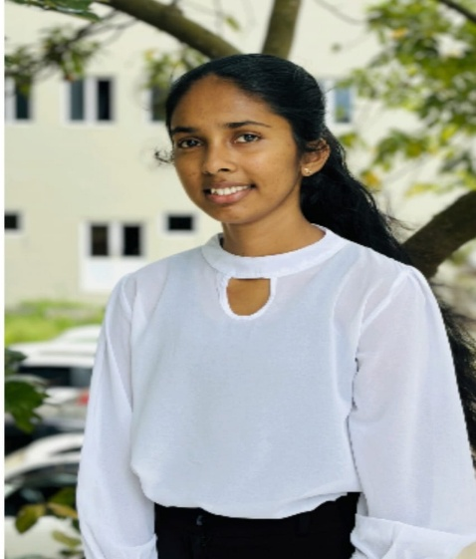

Automated Feeding System & Nutrition Recomender
Student Must add a professional photo to this cage
IT22136138 | Jayawardhana H.A.S. | R26 – IT - 093
BSc (Hons) Degree in Information Technology specialization information Technology
IT22136138 |
Jayawardhana H.A.S
|
R26 –IT- 093
12/5/2026

Slide 12
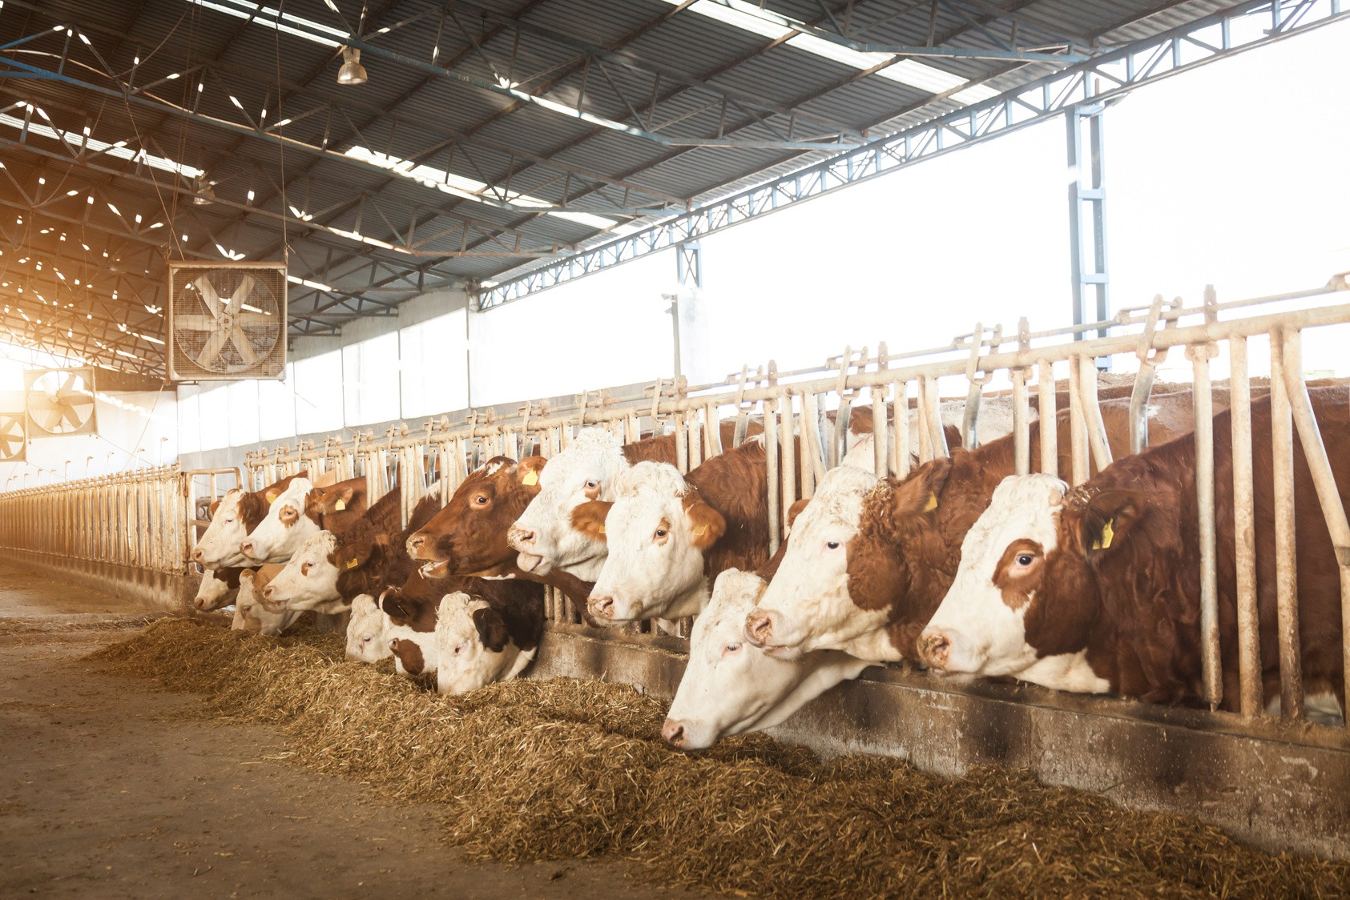

Proposed Solution
Maintain Cattle profile
Receive daily feeding quantities (kg): Receive nutrition recommendations:
Modules Implemented
Cattle Feeding Prediction Model Nutration Recomender Model
IT22136138 |
Jayawardhana H.A.S
R26 –IT- 093
12/5/2026

Slide 13

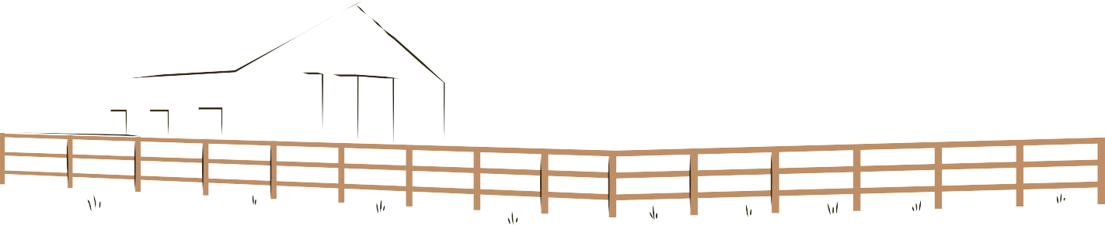
DESIGN CONTRIBUTION AND USER FEEDBACK
Farmers were able to provide the required feed amount individually for each animal based on its weight and breed, while also reducing discomfort for the cattle.
Farm operators valued the automated feed calculations that reduced guesswork and feed waste.
:
Stakeholders recognized the system’s potential to improve productivity through data-driven management.
IT22136138 |
Jayawardhana H.A.S
R26 –IT- 093
12/5/2026

Slide 14
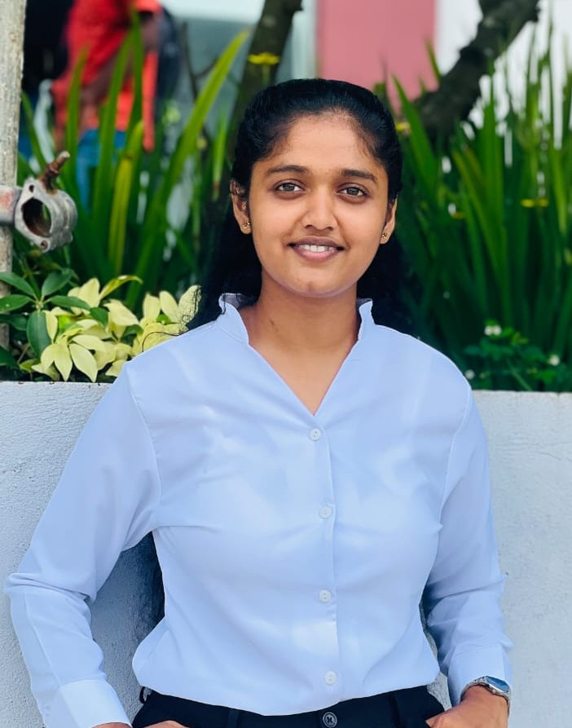

Customized Live Milk Market prediction with AI/ML
Student Must add a professional photo to this cage
IT22134608 | Arachchi W.A.A.I.W. | R26 – IT - 093
BSc (Hons) Degree in Information Technology specialization information Technology
IT22134608 |
Arachchi W.A.A.I.W
|
R26 – IT - 093
12/5/2026

Slide 15
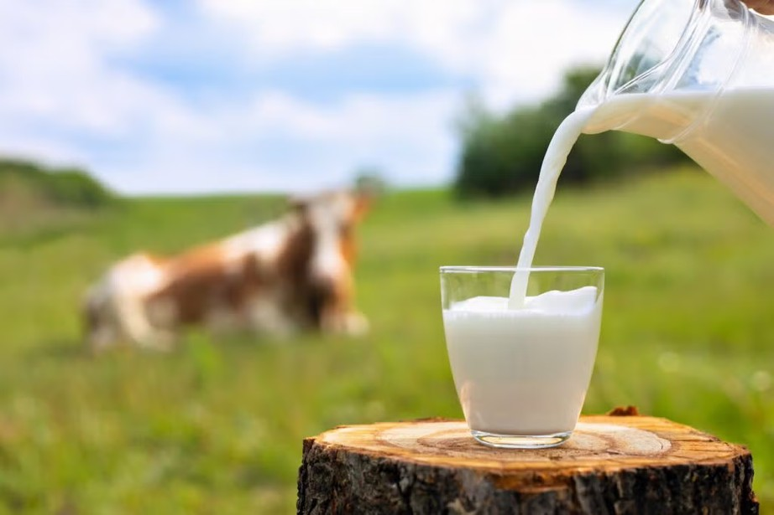

PROPOSED SOLUTION AND USER REQUIREMENTS ADDRESSED
Proposed Solution (Milk Prediction Component): Multi-modal data fusion (production, pricing)
Real-time market data collection from industry sources
Prediction Engine: 1-month forecasting for farmers and businesses
User Requirements Addressed:
For Farmers: Better planning & optimized product mix decisions For Businesses: Competitive advantage & risk management
For Industry: Market stability & informed decision-making
IT22134608 |
Arachchi W.A.A.I.W
|
R26 – IT - 093
12/5/2026

Slide 16

DESIGN CONTRIBUTION AND USER FEEDBACK
Design Excellence Performance Optimization
Community & Collaboration
Mobile-First Design User-friendly & scalable
User Feedback on Prototype:
Real-time Data Collection - Continuous performance monitoring Data Collection – Farm data and farmer inputs.
Data Quality Assessment - Validation of input data sources and accuracy
Suggested improvements- Allow predictions and reports to be accessed on
low-connectivity rural networks..
IT22134608 |
Arachchi W.A.A.I.W
|
R26 – IT - 093
12/5/2026

Slide 17


Disease Detection and Emergency Alerts for Cattels
Student Must add a professional photo to this cage
IT22282118 | Illangasinhe I.M.A.D. | R26 – IT - 093
BSc (Hons) Degree in Information Technology specialization information Technology
IT22282118 |
Illangasinhe I.M.A.D.
R26 – IT - 093
12/5/2026

Slide 18

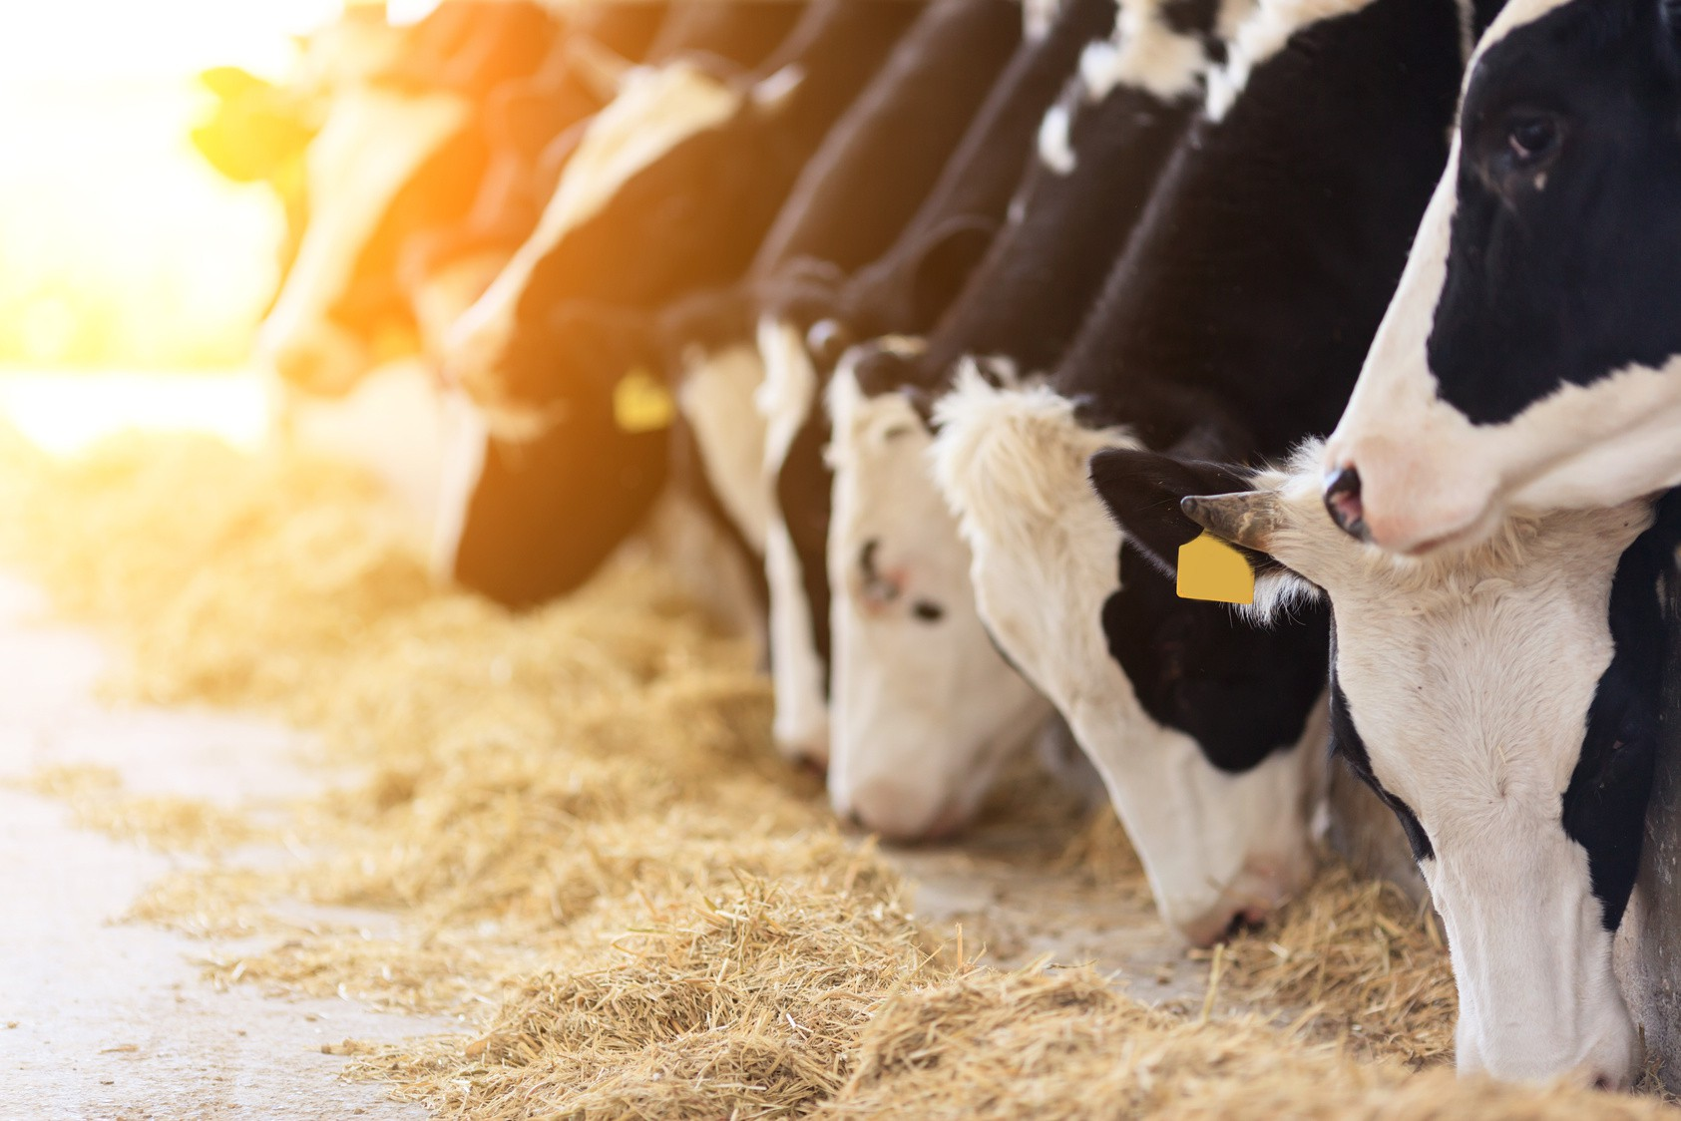

PROPOSED SOLUTION AND USER REQUIREMENTS ADDRESSED
Proposed Solution (Disease & Behavior Monitoring Component):
Automated Disease Identification. Real-time Behavior Tracking.
Hybrid Health Analysis.
User Requirements Addressed:
Early Disease Detection. Automated Monitoring.
Data-Driven Decisions.
IT22282118 |
Illangasinhe I.M.A.D.
R26 – IT - 093
12/5/2026

Slide 19
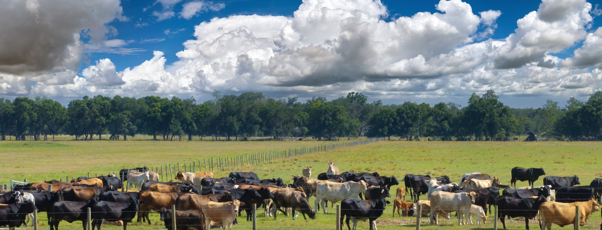
DESIGN CONTRIBUTION AND USER FEEDBACK
Farmers found the automated monitoring system easier and more convenient than traditional manual checking methods
They also appreciated the disease detection feature because it helped reduce confusion and supported faster treatment decisions
:
IT22282118 |
Illangasinhe I.M.A.D.
R26 – IT - 093
12/5/2026

Slide 20
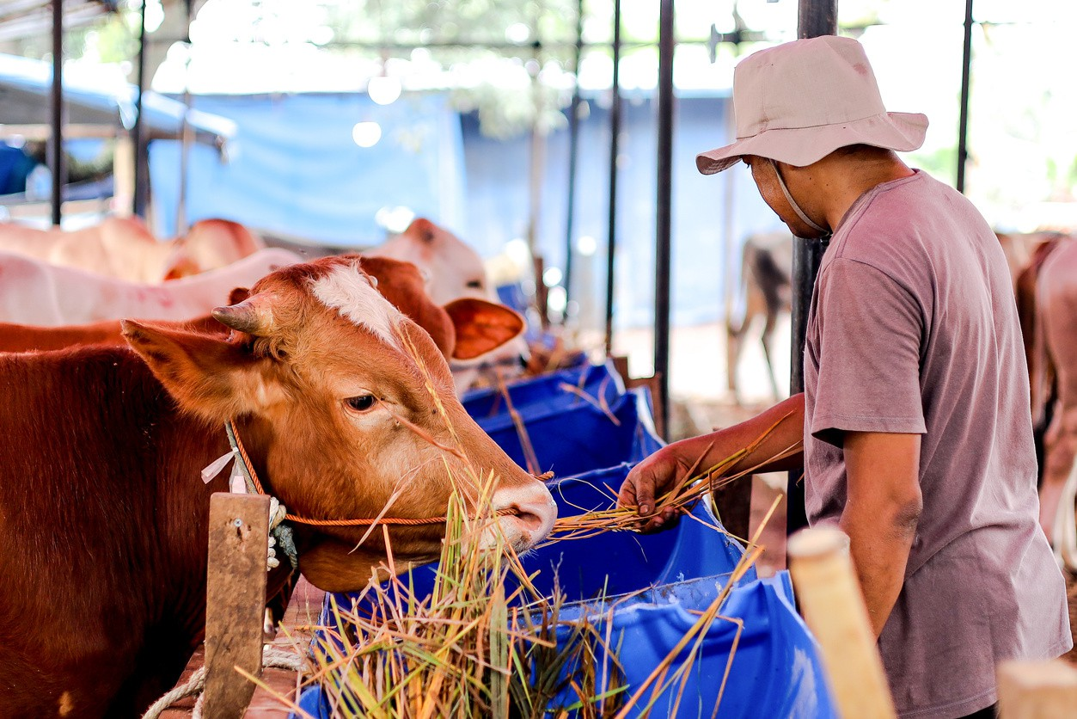
Converting Traditional farm to Smart Farm
Commercialization
Subscription-based model for small, medium, and large-scale farms
Tiered pricing plans based on the number of cattle and enabled features
Partnerships with agricultural institutions, dairy farms, and cooperatives
Integration with IoT devices and farm management tools
12/5/2026

Slide 21
Project Progress Overview (50%+ Completion)
Completed Tasks
Automated Daily Feeding Calculation – Feed quantity (kg/day) generated
Disease Detection using Camera – Image-based disease identification completed Nutrition Recommendation Prediction – Implemented based on cattle parameters
Egg Hatching & Birth Prediction – Prediction model implemented Milk Market Prediction System – Initial prediction model developed Frontend Development – ~15% completed
Backend Development – ~50% completed
Backend Integration – Core modules integrated with models
12/5/2026

Slide 22
Project Progress Overview (50%+ Completion)
To-Do / Remaining Tasks
Frontend Completion & UI Refinement
(dashboards, reports, user experience improvements)
Backend Completion
(API optimization, validation, security)
Market Prediction Enhancement
(accuracy improvement and real-time data integration)
Field Visit & Data Validation
(on-site data collection and real-world testing)
12/5/2026

Slide 23

THANK YOU!
12/5/2026

