Slide 1
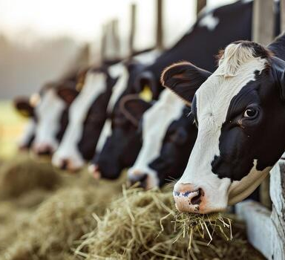
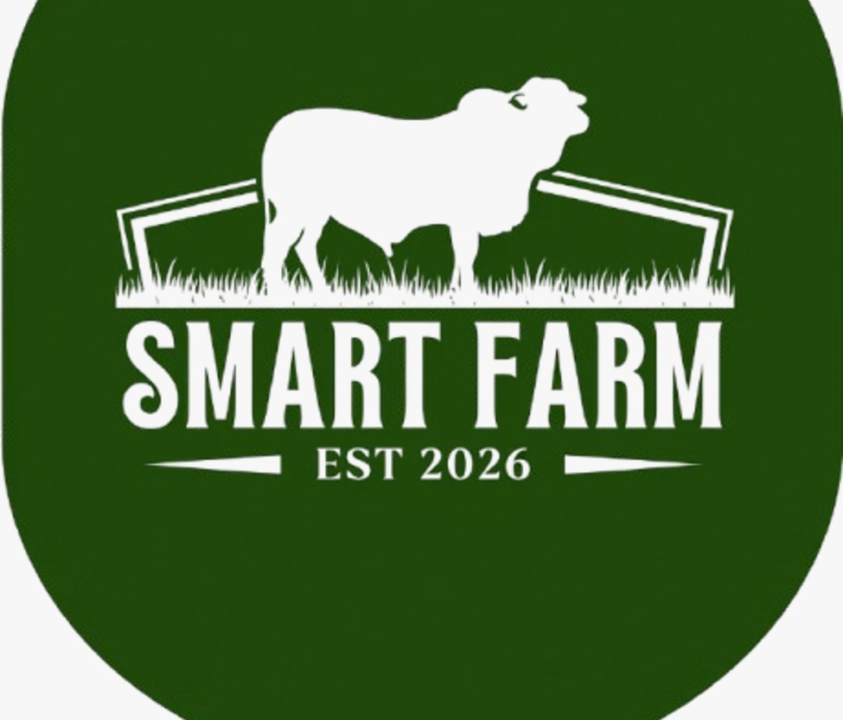
Converting a Traditional Farm into an
AI/ML-Powered Automated Smart Farm
R26-IT-093

Slide 2





Our Team → R26 – IT - 093
IT22139894
Shamika G.L.
(Group Leader)
IT22282118
Illangasinhe I.M.A.D.
IT22136138
Jayawardhana H.A.S.
IT22134608
Arachchi W.A.A.I.W.

Slide 3
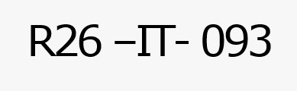
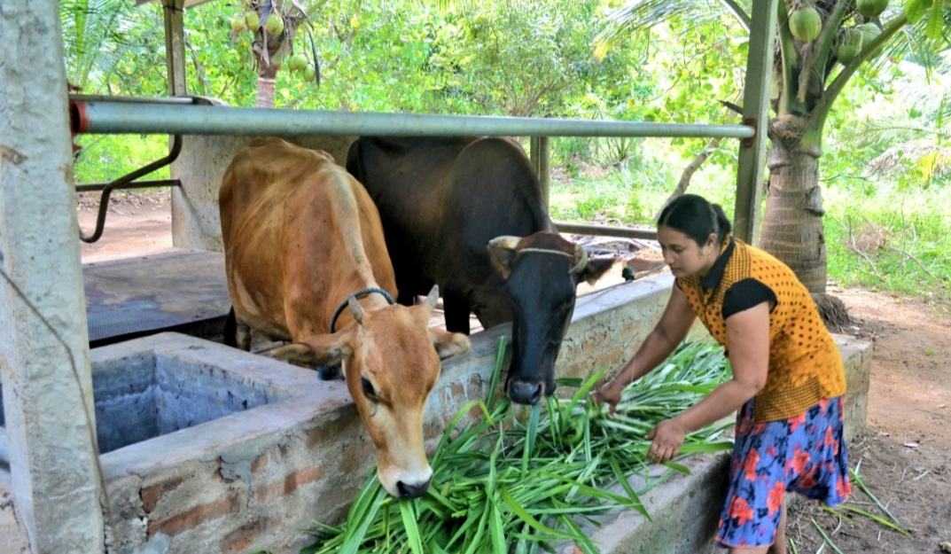
Problem & Motivation
Context
Traditional livestock farming still depends heavily on manual observation and experience for feeding, animal health monitoring, reproduction management, and market decisions.
Observed Problems
Inconsistent feeding practices and difficulty in providing personalized nutrition.
Delayed detection of diseases and abnormal animal behavior.
Difficulty in predicting healthy births and successful egg hatching.
Limited real-time information about livestock market prices and demand.
Manual farm management reduces efficiency and increases operational costs.
Lack of one integrated intelligent platform for livestock management.

Slide 4
Solution Overview
An integrated AI/ML-powered smart livestock management platform that transforms traditional farm operations through intelligent monitoring, prediction, automation, and decision support.
Birth & Egg Hatch Prediction
  Analyze image, sensor and historical data.
  Predict healthy calf birth or successful egg hatching.
Personalized Animal Feeding
  Identify animal type, size and health condition.
  Recommend suitable feed quantity and Nutrition.
Disease Detection & Emergency Alerts
  Monitor animal behavior using cameras and sensors.
  Detect abnormal behavior and early disease symptoms.
  Notify farmers or veterinarians.
AI-Based Market Prediction
  Analyze historical and real-time market information.
  Forecast livestock/product prices and demand.
Non-Functional Goals
Easy-to-use farm management interface
Real-time monitoring
Fast AI/ML predictions
Reliable recommendations
Scalable architecture
Secure farm data management

Slide 5
Overall Research Gap
Feature | Traditional Farm Management | Existing Single-Purpose Smart Systems | Proposed Smart Farm
Integrated livestock decision support platform | ✕ | ✕ | ✓
Real-time animal monitoring | ✕ | ✓ | ✓
Personalized feeding recommendation | ✕ | Partial | ✓
Personalized nutrition recommendation | ✕ | Partial | ✓
AI-based abnormal behavior detection | ✕ | ✓ | ✓
Disease alerts & preliminary recommendations | ✕ | Partial | ✓
Calf birth / egg hatch prediction | ✕ | Partial | ✓
Real-time livestock market forecasting | ✕ | Partial | ✓
Buy / Sell recommendations | ✕ | Partial | ✓
Integration of all four modules | ✕ | ✕ | ✓
Research Gap: Existing approaches mainly address individual livestock management problems separately. The proposed solution integrates feeding automation, health monitoring, reproduction prediction, and market forecasting into a single AI/ML-powered smart farm platform.

Slide 6
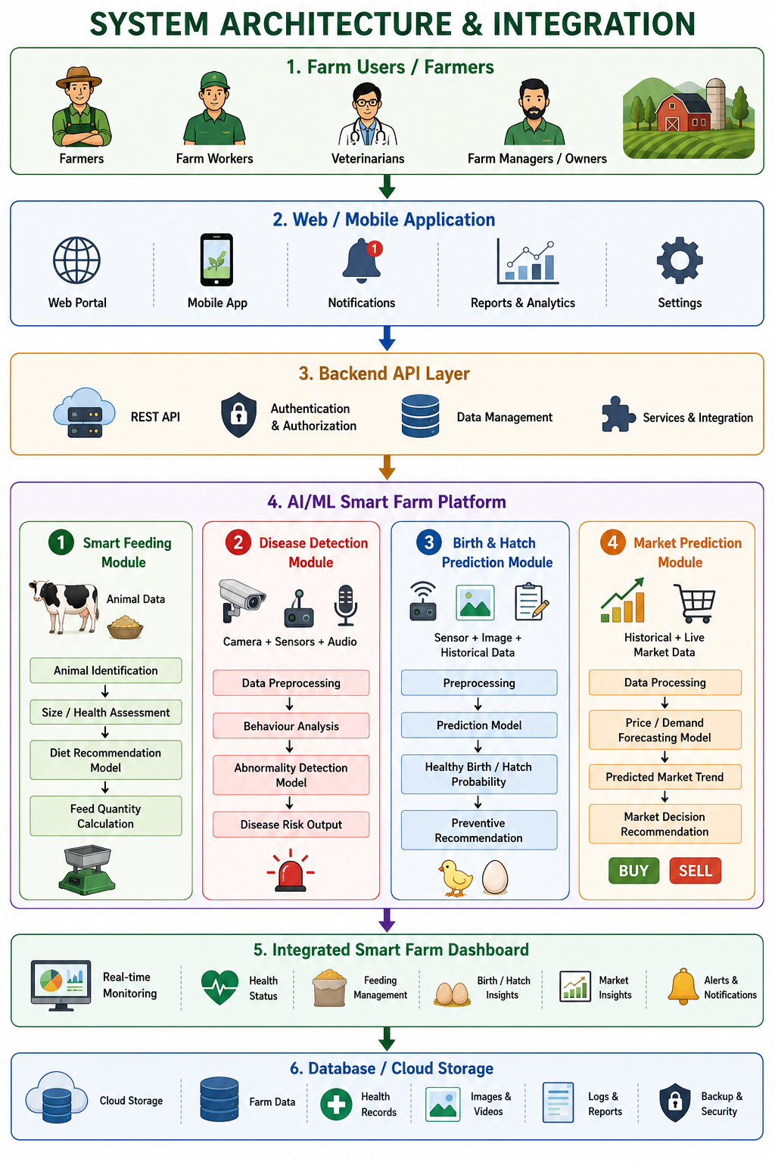
System Architecture & Integration

Slide 7
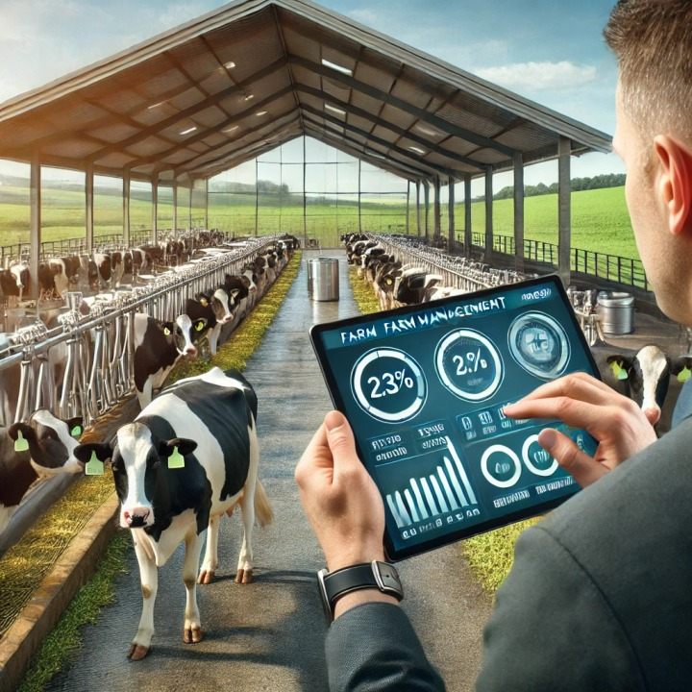
Commercialization
Value Proposition
An integrated AI-driven livestock management platform that improves animal nutrition, health monitoring, reproduction management, farm productivity, and market decision-making.
Target Users / Market
Livestock farmers
Dairy farms
Poultry farms
Farm managers and workers
Veterinarians
NLDB and other livestock organizations
Livestock buyers and sellers
Cost & Feasibility
Can be developed using open-source AI/ML technologies.
Existing farm cameras and sensors can be integrated.
Cloud-based backend can support centralized farm data.
Modular architecture allows gradual implementation.
NLDB farm data can support model development and validation.
Adoption Plan
Phase 1: Model development and testing
Phase 2: Individual module integration
Phase 3: Pilot testing using farm data
Phase 4: Real-world testing in livestock farms
Phase 5: Full smart farm deployment

Slide 8
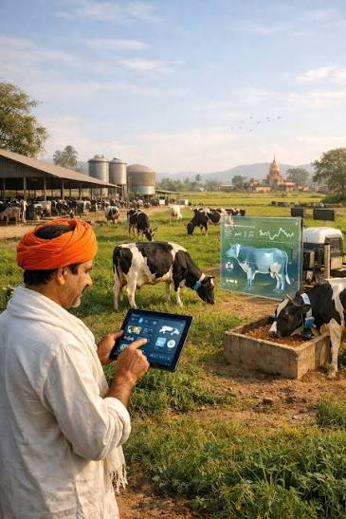
System Architecture & Integration
Components
Animal Birth & Egg Hatch Prediction System – IT22139894
Personalized Animal Diet Recommender & Automated Feeding System – IT22136138
Animal Disease Detection and Emergency Alert System – IT22282118
Customized Live Market Prediction & AI Recommendation System – IT22134608
Integration Points
REST API communication
JSON data exchange
Image uploads from farm cameras
Historical animal records
Feeding and health information
Market price and demand data
Shared database
Centralized dashboard

Slide 9
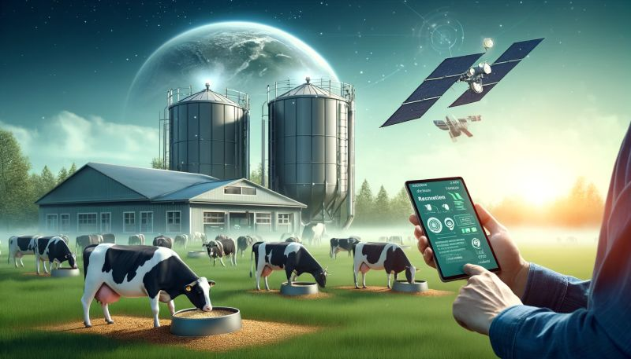
Expected Impact
Personalized and balanced animal nutrition
Reduced feed wastage
Early detection of health problems
Faster veterinary intervention
Reduced disease spread
Improved healthy birth and egg hatch rates
Reduced livestock losses
Better market decisions
Increased farmer profitability
Reduced manual workload
Improved animal welfare
Data-driven farm management

Slide 10
