Slide 1

CHAT REVIEWS
Project ID :- 17-066

Slide 2
MEMBERS
1
E. Dinesh Lakmal
IT 14 0858 40
2
B.S.U.M Cooray
IT 14 0320 66
3
M.A.H Theekshana
IT 14 0299 50
4
K.P.I.E Harischandra
IT 14 0937 60

Slide 3
AGENDA
INTRODUCTION
RESEARCH PROBLEM
SOLUTION PROPOSED
LITERATURE TABLE
MAIN OBJECTIVES
SUB OBJECTIVES
SYSTEM OVERVIEW DIAGRAM
WORK BREAKDOWN STRUCTURE
OBJECTIVE DESCRIPTION
BENIFITS TO USER
RESEARCH VALUE
BUSINESS VALUE
REFFERENCES

Slide 4
INTRODUCTION
Social network or the social web is overwhelmed with spammers
and bogus profiles.
Instant Messaging (IM) is a peer to peer service for remote users
to communicate with each others. They are many IM systems such
as MSN Messenger and Yahoo Messenger which are used by millions
of users every day.
Intelligent application(IM monitoring systems) connected with
social networks.
IM monitoring systems have been developed for monitoring chat messages.
Although most of these systems can provide good monitoring functions,
they only provide simple message analysis features such as browsing and
simple keyword based searching of the recorded messages.

Slide 5


RESEARCH PROBLEM
Online Fake Users.
Identify The Chatting Partner.
Reading Long Message Threads.

Slide 6

SOLUTION PROPOSED
We Propose
We propose a web application which is able to analyze chat messages of our chatting partner. Also it generates a summery or review of particular chat session based on analytical data.
Also Chat Reviews will be capable of showing its analytical data graphically to its user.
REVIEW PARTICULAR CHAT SESSION
ANALYZE THE CHATTING PARTNER
People never waste their time by chatting anymore.

Slide 7

LITERATURE TABLE
 | Intelligent Diagnosis System | Honey Chatting | GroupWize | Proposed System
Keyword based Searching
Topic Identification
Emotion Extraction
Message Encryption
Detect Personal Information
Evaluate Healthy

Slide 8
MAIN OBJECTIVE
To introduce a mechanism to analyze trustworthiness of chatting partner.

Slide 9
SUB OBJECTIVES
01. Topic Detection.
02. Emotion Extraction.
03. Evaluate Healthy.
04. Personal Information Sharing analysis.

Slide 10

SYSTEM OVERVIEW DIAGRAM
ANALYZE THE CHATTING PARTNER (Trust worthiness)
EXTERNAL DATA
REVIEW PARTICULAR CHAT SESSION
MODULES
TOPICS
Emotions
PERSONAL INFORMATION
HEALTHY
CHAT LOG
Chat Session

Slide 11
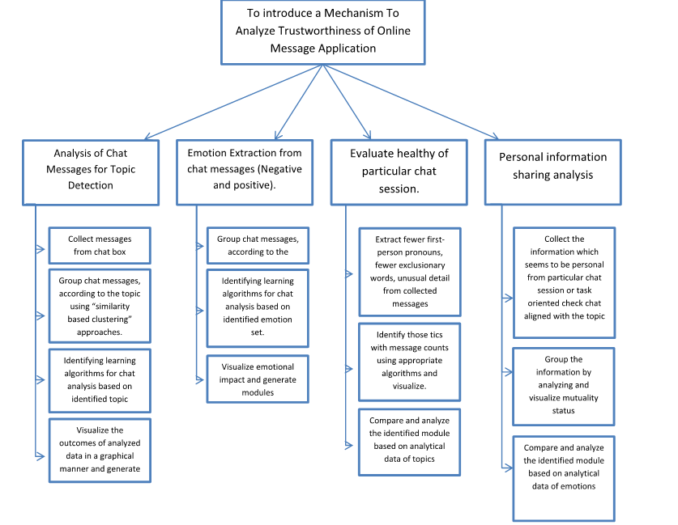
WORK BREAKDOWN STRUCTURE

Slide 12
OBJECTIVE DESCRIPTION
Analysis of Chat Messages for Topic Detection
1
E. Dinesh Lakmal
IT 14 0858 40
(Group Leader)

Slide 13
OBJECTIVE DESCRIPTION
Analysis of Chat Messages for Topic Detection
Collect messages from chat box.
Collected messages will be stored in data based in a usable format.
Group chat messages, according to the topic using “similarity based clustering” approaches.
Here similarity is determined by the number of overlapping word between two messages, weighted by the uniqueness of the word.

Slide 14
Identifying a learning algorithm for topic analysis based on identified topic.
Introduce a learning algorithm to learn the distribution of the topics for particular chat session.
Identified learning algorithm will be used to analyze the distribution of topics and it will generate statistics.
Visualize the outcomes of analytical data in a graphical manner and generate modules.

Slide 15
OBJECTIVE DESCRIPTION
Emotion Extraction from chat messages (Negative and positive).
2
B.S.U.M Cooray
IT 14 0320 66

Slide 16
OBJECTIVE DESCRIPTION
Emotion Extraction from chat messages (Negative and positive).
Get messages from database which collected from chat box.
Categorize messages under the selected emotion set.
Anger , Fear , Joy , Surprice …. Etc.

Slide 17
OBJECTIVE DESCRIPTION
Emotion Extraction from chat messages (Negative and positive).
Identify the final imotion is negative one or positive one.
Using identified emotion set.
Visualize the outcomes of analytical data in a graphical manner and generate modules.

Slide 18
OBJECTIVE DESCRIPTION
Evaluate healthy of particular chat session.
3
M.A.H Theekshana
IT 14 0299 50

Slide 19
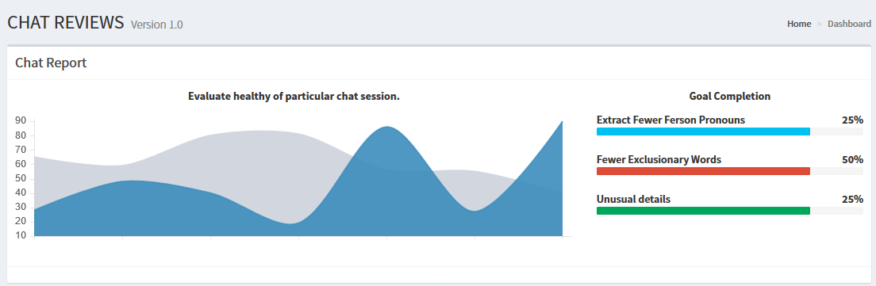
OBJECTIVE DESCRIPTION
Evaluate healthy of particular chat session.
Extract fewer first-person pronouns, fewer exclusionary words, unusual detail from collected messages

Slide 20
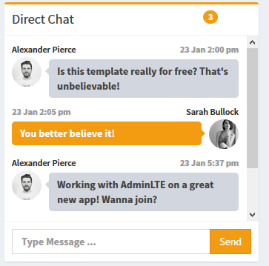
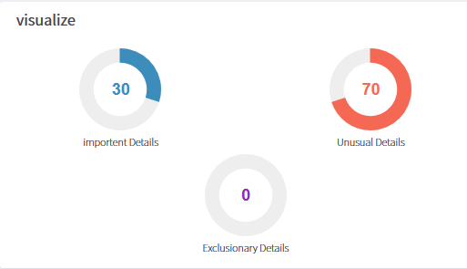
OBJECTIVE DESCRIPTION
Evaluate healthy of particular chat session.
Identify those tics with message counts using appropriate algorithms and visualize.

Slide 21
OBJECTIVE DESCRIPTION
Evaluate healthy of particular chat session.
Compare and analyze the identified module based on analytical data of topics
Using N-Gram Language model and Static Coding Scheme

Slide 22
OBJECTIVE DESCRIPTION
Personal information sharing analysis.
4
K.P.I.E Harischandra
IT 14 0937 60

Slide 23
OBJECTIVE DESCRIPTION
Personal information sharing analysis.
Collect the information which seems to be personal from particular chat session or task oriented check chat aligned with the topic.
Collect personal information and categorize into many parts such that lifestyles , feelings , behavior, educational, relationships, etc..

Slide 24
OBJECTIVE DESCRIPTION
Personal information sharing analysis.
Group the information by analyzing and visualize mutuality status.
Analyze the information and represent in graphical way. Identify the trustworthiness in particular chat sessions.
Compare and analyze the identified module based on analytical data of emotions
Use the algorithms and patterns to represent the graphical view and percentage value of particular chat session.

Slide 25
BENIFITS TO USER
This proposed system will give following benefits to users
Identify the reliable chatting partners.
Users will be able to analyze the chatting partner.
Users can protect their self.
User will be capable of reviewing specific long chat session in short time of period.
Capable of identifying characteristics of chatting partner.

Slide 26
BUSINESS VALUE
As the final step , we plan to release this project as a marketing product.
As a product :
This is a totally new invention.
Can market as a web application.
Can access any time any where.
Come up with terms and conditions.
It’s Free.

Slide 27
CONCLUSION
What we focused ?? 􀁕􀁈􀁗􀁕􀁌􀁈􀁙􀁈􀁇􀀃 􀁒􀁑􀀃 􀀤
Saving time.
Identify the characteristics of chatting partner.􀁏􀀃
􀀖􀀓􀁗􀁋􀀏􀀃􀀕􀀓􀀔􀀕􀀑􀀃

Slide 28
Thanks!

