Slide 1
PGDCA
Programming & Logic Techniques
Logic Building With C
Object Oriented Programming with C++
Database Management System with Ms Access
Event Driven Programming with Visual Basic
Website Development with Front Page 2000
Project

Slide 2
Chapter -1
Definition of Program……………………………………….3
Programmer………………………………………………….4
User….……………………………………………………….5
Programming Life Cycle……………………………………6
Programming Elements…………………………………...10
Exercise…………………………………………………….20

Slide 3
Definition of Program
A Set of Instruction is called as program. A program is a collection of instruction that tells the computer to carry out a defined task. It is a procedure to transforming the input data into information.

Slide 4
Programmer
A Person who write a program for user is called as programmer.

Slide 5
User
Who operate the program is called as user.

Slide 6
Programming Life Cycle :
Statement of Problem
Mathematical Decision
Flowchart
Psuedocode
Dryrun
Testing
Coding
Psuedocode…

Slide 7
Programming Life Cycle :
Statement of Problem: What the problem of program asked and how to solving that program.
Knowledge of mathematical decision.
Flow Chart :A Graphical presentation of logical step that involve in a program is called flow chart.
Start
Sum = 0
Input a, b
Sum = a+b
Print Sum
Stop
Continued Flowchart Graphics

Slide 8
Programming Life Cycle :
Pseudocode : Instead of using symbol to represent program logic step is called pseudocode. Also We can Define Psuedocode is a program analysis tools that is used for planning program logic. It is an imitation of actual computer instruction written ordinary natural language Such as English.
Example
Begin
Input n1,n2
Sum=n1+n2
Display Sum
End

Slide 9
Programming Life Cycle :
Dry Run : Dryrun is a manual way of testing on a algorithm for its correctness and functionality.
Testing : To Test the Program (True or False)
Coding : In Which language to develop a program.
Characteristics Features of Program
Accuracy (Should able to provide accurate result.)
Reliability (Should display correct error message it it is out of defined Scope. Should not accept 5 digits if it is designed for 3 digits.)
Efficiency (The program should able to manage the resources)
Ease to use (The program should provide sufficient help to the user)
Ease of Modification (Should be able to change without much modification of the program)
Readability (The program provide easy labels and interface for the user for which it can be understand easily.)

Slide 10
Programming Elements
(Variable)
1. Variable : Variable is a quantity which may vary (Changes) during program execution.
It is a memory Elements which allocates some memory space in the memory.
Some Points on Variable
Variable is a combination of alphabets, digits or underscore.
Variable name must be within 32 characters.
It should be started from an alphabet.
Variable name does not support the blank space or any special symbol like @, &, #, $, !, ^ etc Except (_) underscore.
It can be uppercase and lowercase both; Usually C variables are in lowercase letters.

Slide 11
Programming Elements (Variable)
Keyword or reserve word are not used as variable.
We can declare more than one variable in a single line.
All the variable should be declare before the use inside in the program.
Valid Variable
Basic_Pay
Name
Address
Invalid Variable
Student name Space is not Allowed
123 Only digits are there, no character
$A Can’t begin with special character
Example of Variables :-
Age =25
City =“CUTTACK”
Counter = counter +1

Slide 12
Programming Elements (Constant)
2. Constant :
A Constant is a value which never changes during program execution. It is a quantity which value remain unchanged during program execution.
There are three types of constant :
Numeric
String
Character
Numeric is also again devided into two types
a. Integer
b. Float

Slide 13
Programming Elements (Constant)
Examples :
Numeric Constant :
1335
Float Constant
25.60
Character Constant (Used in Single Quote)
‘r’
‘5’
String Constant (Used in Double Quote)
“Ram”
“MIIT”
“MIIT is the Computer Education”

Slide 14
Programming Elements (DataType)
Examples :
Invalid Constants :
22,100 Comma is not allowed in numeric Constant
22 100 Space is not allowed
‘MIIT” Quatotation mark is not given properly
‘MIIT’Computers” Quatotation mark is not given properly
3. Data Types :
Data can be termed as a combination of one or more alphabets (a-z), digits (0 – 9) and/or symbols that represents facts, figures, ideas, objects, incidents. As a result of the elements that are combined to form data and also due to the purpose for which it is used.
Data can be various types :-

Slide 15
Programming Elements (DataType)
Data Types
Alphabets
Numeric
Alphanumeric
Logical
Date
Currency

Slide 16
Programming Elements (Expression)
Expression
Expression is a combination of operators and operands that express some computed value. The operators can be various types. Such As
Arithmetic
Relational
Logical
String
The operands can consists of variable constants and functions.

Slide 17
Programming Elements (Expression)
Arithmetic Operators
Arithmetic operators are those that performs computations on numeric values.
( ) Parentheses
^ Exponentiation
- Negation
* Multiplication
/ Division
+ Addition
- Subtraction

Slide 18
Programming Elements (Expression)
Relational Operators
These operators are used to establish comparative relationship between two operands or expression
= Equal to
< Less Than
<= Less than or equal to
# Not Equal to
> Greater than
>= Greater than or equal to

Slide 19
Programming Elements (Expression)
Logical Operators
Logical operators are used to combine several relational expression to form a complex condition.
AND Result TRUE, When both the adjoining expression are true
OR Results TRUE, When either or both the adjoining expression are true.
NOT Negates the result of the expression.

Slide 20
Exercise - 1
Fill in the blanks:
  A set of instructions is called ______________.
  In Constant the __________ remain unchanged during the execution of program.
  The main function of a computer program is to process ________.
  32767 is __________ type of constant.
  In logical data type data values are either _______ or _______.
  ____________ is the combination of operator and operands that express some computed value.
  Type of operators are ________, ________, ________& ________.
  Type of function are ________, ________ & ________.
  ________ operators are used to establish relationship between two operands or expression.
Write Short notes on the following
        a. Variable c. Constant
        b. Program Life Cycle d. Operators

Slide 21
Exercise – 1
3. Multiple Choice
I. Which of the following term is not related to computer.
a. Output b. Process
c. Program d. Polish
II. Whose value changes during processing it.
a. Value b. Variable
c. Constant d. None of above.
III. Which of the following is not constant
a. 1234 b. “MIIT”
c. NIAT c. 3.14
IV. Tick the valid arithmetic operator.
a. ( ) b. +
c. * d. None of the above
V. Characteristic feature of a program is
a. Survey b. Life Cycle
c. Reliability d. Basic_Pay
VI. In ______ logical operator, result TRUE, if both adjoining expression have the same logical value, I.e. both are true or both are false.
a. NOT b. XOR
c. EQV d. IMP

Slide 22
Chapter –2
Flow Chart
System Flowchart
Program Flowchart
Flowchart Symbol
Program Structure
  Type of processing
    Sequence
    Selection
    Iteration or loop

Slide 23
Flowchart
Flowchart is a graphical or pictorial presentation of the logical steps and sequence involve in a procedure or a program. The Two types of flowcharts are most widely used
1. System Flowchart
2. Program Flowchart
System Flowchart : System Flowchart describes data flow operation for a data processing system. It provides a logical diagram of how the system operates.

Slide 24
Flowchart Symbols
Terminal Symbol : The Terminal Symbol appears at only two places in a flowchart. The Beginning and at the End.
Flow Line :The flow-line show the order in which the program will execute the operations of a flowchart. The Ideal direction of flow within a flowchart is from top to bottom and from left to right.
Input/Output :Input or output symbols used for taking input data or giving out results or messages.
Process : Process symbols show where within a programs logic assignment statements are found or indicates the state foreword computation assignment operation.

Slide 25
Flowchart Symbols
Decision : The Decision symbol used to show a logical operation in a flowchart. A logical operation is one in which a question posed. Sometimes called Condition.There are two possible answer to the question that is yes or no. The decision symbol then passes control to one or two possible points within the flowchart depending on the answer.
Connectors : Connectors shows where a sequence of operations continue if they are connected to another part of the flowchart. There are two types of connectors
      On page connector
      Off page connector
  On page Connectors : These are used when the next operation is to be executed in on the same page of the flowchart.
  Off Page Connector : Off page connectors are used when the next operation is to be executed in on a different page of the flowchart.

Slide 26
Exercise - 2
Fill in the blanks:
  ____________ is a graphical presentation of the logical steps and sequence involved in a program.
  _____________ box appears at the beginning and end of the flowchart.
  _____________ box is used for taking input or giving output or messages.
  _____________ is used in a flowchart when the next operation is to be executed is in a different page.
  ____________ is the link between the computer and the user through which one can give instruction to the computer.
  A __________ is a set of instructions.
  When a set of ______________ need to be executed a number of times in a program is called Iteration or loop.
State True or False
  A set of program is called an instructions.
  The decision symbol is used to show a logical operation in a flowchart.
  Connectors are used for taking input or giving output or message.

Slide 27
Exercise - 2
  4. Relational operators are used for checking multiple conditions, also results in true or false value.
  5. In selection construct two or more sets of statements are written but only one of these sets is executed or selected.
  6. Onpage connectors are used when the next operation is to be executed in, on the same page of the flowchart.
  7. Flowchart is a logical presentation of the logical steps and sequences involved in a procedure or a program.
  8. AND, OR & NOT are relational operators and are used for comparing values.
  9. When all the instructions are executed one after another in a program is called sequentially structured program.
3. Write Short notes on the followings :
a. Flowchart b. Iteration/Loop
c Relational Operator

Slide 28
Chapter – 3
Type of Processing
Inspite of differences in structure of programs, the flow of logic in all the programs can be explained as a combination of one or more of the following structures.
    Sequence
    Selection
    Loop or Iteration

Slide 29
Type of Processing (Sequence)
Sequence : When all the instruction are executed one after another in a program, is called sequentially structured program. In sequence processing the instructions are not repeated and the order of execution is also not changed.
Question Bank :
Draw a flowchart to calculate simple interest.
Draw a flowchart to input a Fahrenheit value and convert into celcious.
Draw a flowchart to find out the area and perimeter of a circle.
Draw a flow chat to find out the area of a rectangle .
Draw a flow chat to input a day value and convert into how many days and how many month are there.

Slide 30
Type of Processing (Selection)
Selection : In stead of executing all instructions some times only suitable instructions are executed depending upon the inputs and conditions involved. In selection constructs two or more statements are written. But only one of these sets is executed or selected.
The selection/conditional construct are three category :
1. One way selection construct
2. Two way selection construct
3. Multiple selection construct
One way selection construct : In this construct if the condition is true then the action takes place and then go to the next statement and if false the actions skipped and go to the next statement.
Example : Input a number, If the number is equal to 5 then add five to the inputed numer and then print the number else print only the input number.

Slide 31
Example of One Way Selection Construct
Start
Input A
If
A=5
N
Y
A=a+5
Print A
Stop

Slide 32
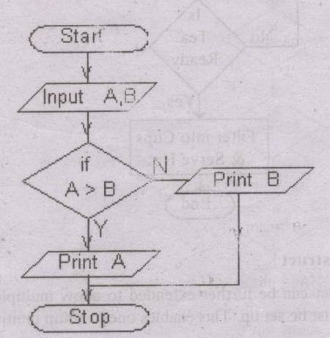
Type of Processing (Selection)
2. Two way Selection Construct : If the Condition is true then action takes place and then go the next statement or if false the action takes place and then go the next statement.
Example : Draw a flow chart to find out the greatest number between two numbers.

Slide 33
Type of Processing (Selection)
Question Bank for Two way Selection:
Input a number and check it whether it is a odd or even number.
Input the age to find out whether the person is citizen or not.
In a company an employee’s pay as under
if the BASIC < 15000 then
HRA = 10% of BASIC
DA=25% of BASIC
If his BASIC > 15000 then
HRA=15% of BASIC
DA= 30% of BASIC.
Now draw a flowchart to find out the Gross salary.

Slide 34
Type of Processing (Selection)
Question Bank for Two way Selection:
IV. The current year and the year in which the employee join in the organization is entered. If the number of year for which the employee has served in the organization
Year is > 5 then BONOUS is 2500/-
otherwise BONOUS is not given.
Draw a flow chart to display the BONOUS.

Slide 35
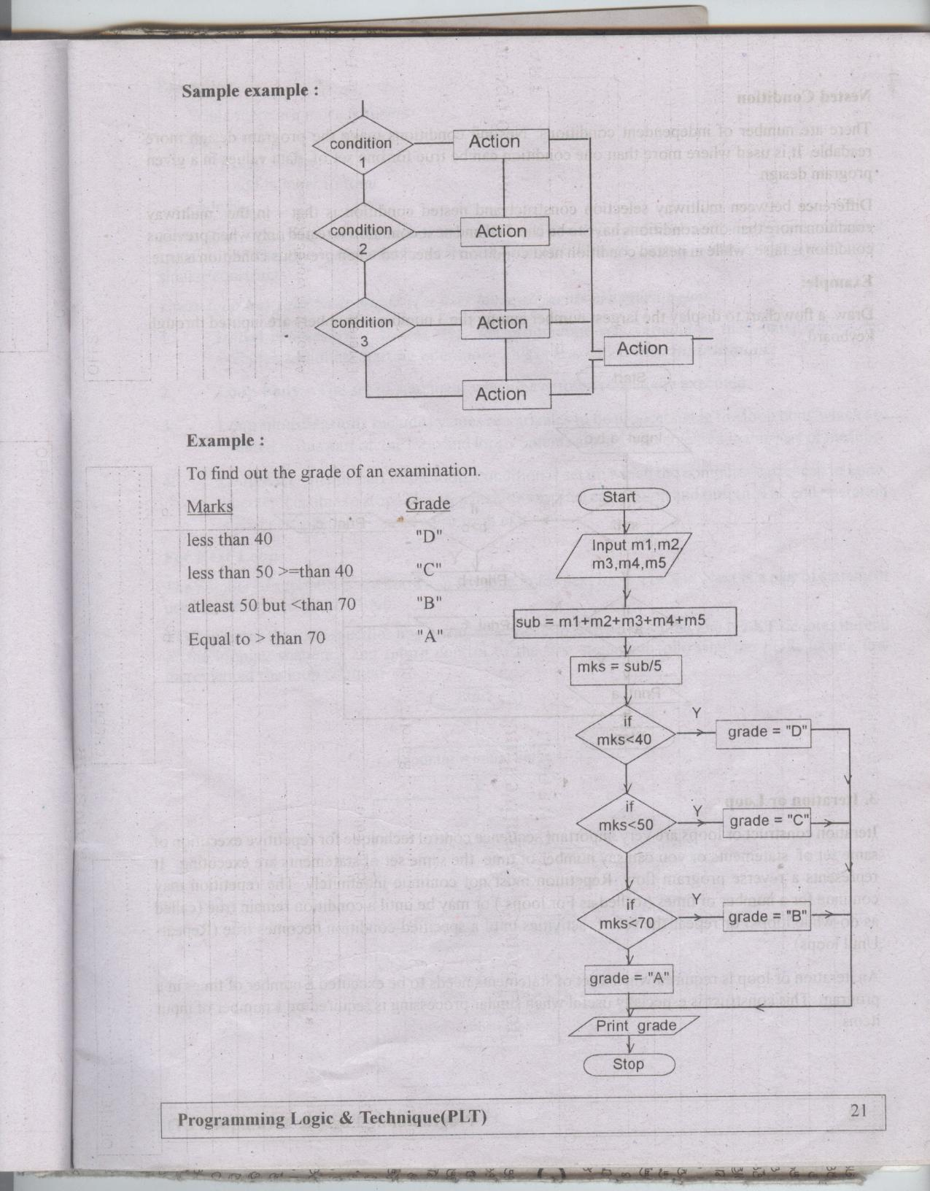
Type of Processing (Selection)
3. Multiple Selection Construct : Two way selection construct can be further extended to allow multiple selection. In place of the action another condition must be setup. This enable one to setup multiway selection. These are also two types :
1. Complex IF 2. Nested IF
Syntax
Complex If:

Slide 36
Type of Processing (Selection)
Example of Complex If

Slide 37
Type of Processing (Selection)
Question Bank for Multi Way Selection (Complex IF)
A Travel Company Charges the following rates for a tour, If a person buys
< 5 Tickets then Ticket Per Pc = Rs. 10
>5 and <10 then ticket per pc =Rs.8
>10 then ticket per pc = Rs.7
Draw a flowchart to calcualate the customer Bill Amount.

Slide 38
Type of Processing Selection
Example of Nested IF`
Start
If
A > B
If B > C
N
Y
Input A, B, C
Print B
N
Y
If a>c
N
Print C
Y
Print A
Stop

Slide 39
Type of Processing (Selection)
Question Bank for Multi Way Selection (Nested IF)
Input Three Numbers and display the lowest number.

Slide 40
Type of Processing (Loop)
Loop : An It or loop is required when a set of statements needs to be executed a number of times in a program. This construct is especially useful when similar processing is required on a number of input items.
Every loop has 4 basic steps :
Initial Processing :In this step the program sets variable to their initial values and executes additional starting operation. It is also called loop initialization.
2. Loop body: The set of statements which have to be repeatedly executed.
3. Loop Modification : Includes values or variables to be processed in the loop body which are updated in this part of loop and loop contains are also incremented in this part of the loop.
4. Loop Exit : In this part of the loop, condition is setup which the computer can check to know whether it is time to stop. This step include any final calculation and output. The end operation is also part of final processing or loop exit.

Slide 41
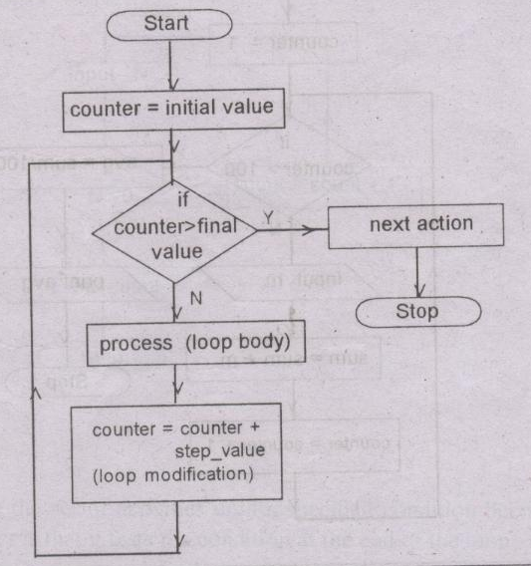
Type of Processing (Loop)
Syntax :
Loop Initialization
Loop Body
Loop Modification
Loop Exit

Slide 42
Type of Processing (Loop)
Question & Solve : Display the 1st 10 Natural Number.
Start
Input N
N=1
If
N <= 10
N
Stop
Y
Print N
N= N+1

Slide 43
Type of Processing (Loop)
Question Bank :
Draw a Flowchart to display all the even numbers between 10 to 50.
Draw a Flowchart to display the first 50 natural numbers and finally display the sum of all numbers.
Draw a Flowchart to calculate average marks of 20 students.
Draw a Flowchart to display all odd numbers less than 50.
Draw a Flowchart to calculate the factorial of “n” natural numbers.
Draw a Flowchart to input a number and to reverse it.
Draw a Flowchart to input three sets of value of Principal, Time, Rate of interest and calculate the simple interest.
Input a name and reverse it.
Draw a Flowchart to input a number and display the addition results of digits of the number.

Slide 44
Programming Aids
Checking Program Design : Once a program has been typed in, different types of errors may show up. These includes
Syntax / Semantic Errors
Logic Errors
Run time Errors
1. Syntax / Semantic Errors : Syntax is a rules governing the structure of the relationship between syntax, words and phrases in a language statements. A syntax error occurs when a program can’t understand the commands that has been entered.
2. Logic Errors : Logic Errors refers to a sequence of operations performed by a software or hardware. Logic errors are the errors that have been entered in the instructions created because of the mistake made by a programmer.
For Example : Find out the addition result of A & B and display in C.
C=A+B but while typing the programmer has typed C=A-B;

Slide 45
Programming Aids
This program will run properly but will give incorrect result. Because the value of C is will not be the sum of A and B. But it will be the substraction result of A and B. Which is quite wrong.
Such Errors can only be detected with the help of test data that will give the input value of A & B and the resultant value that should come out from the program as a result of the operation performed on A and B. If the result given by the computer and the result manually with the help of a calculator are same, then you can say that there is no more logic error. Otherwise a logic error may be present in the program.
3. Runtime Error : Runtime error occurs when a program runs on the computer and the result are achieved due to some misinterpretation of a particular instructions. It occurs when instructions are not able to understand by the computer. To overcome this problem there is built in error detector in the language interpreter or compiller will give the message and that will reflect the reason for the runtime error.
For Example : Dividing a number with Zero which results in a vary large value of the quotient.

