Slide 1

Speech Emotion Recognition with Combination of CNN-LSTM and DNN
Internship Training(EC 402)
Name: PONNA DINESH
Admission Number: U20EC009
Venue: Electronics and Communication Department
Duration: 01/01/2024 to 26/04/2024
Guided By:
Dr Suman Deb (Assistant Professor, DoECE)

Slide 2
PRESENTATION OUTLINE
INTRODUCTION
OBJECTIVE
LITERATURE REVIEW
METHODOLOGY
RESULTS & DISCUSSION
CONCLUSION
REFERENCES

Slide 3
INTRODUCTION
Speech Emotion Recognition (SER) is a field within natural language processing that aims to detect emotions from spoken language.
It plays a crucial role in various applications such as human-computer interaction and sentiment analysis.

Slide 4
Applications of SER
Human-Computer Interaction
Health care
Education
Customer services
Market Research
Security

Slide 5
OBJECTIVE
Feature Extraction
Model Development
Model Evaluation
Comparative Analysis
Emotional Classifications
Optimization

Slide 6
LITERATURE REVIEW
Mishra et al. [1] advances speech emotion recognition by utilizing a combination of MFCC, spectrograms, and mel-spectrograms as inputs to CNNs and DNNs. This innovative fusion approach yielded significant performance enhancements across multiple datasets.
Bertero et al. [2] enhance interactive dialogue systems by integrating CNN models that detect user emotion and sentiment in real-time, bypassing traditional feature engineering. Their method surpasses feature-based SVM classification with an improved accuracy of 65.7% across six emotion categories.
Yadav et al. [3] introduce a language-independent framework for emotion classification using a novel combination of CNN and Bi-LSTM. This approach effectively captures both MFCC-based and high-level features, enhancing emotional context analysis. The system's efficacy was validated against multilingual datasets, EmoDB for German and RAVDESS for English.
[1] S. Mishra, P. Warule, and S. Deb, “Speech emotion classification using feature level and classifier-level fusion,” Evolving Systems, vol. 15, pp. 1–14, 11 2023
[2] D. Bertero, F. Siddique, C.-S. Wu, Y. Wan, R. Chan, and P. Fung, “Real-time speech emotion and sentiment recognition for interactive dialogue systems,” 012016, pp. 1042–1047
[3] A. Yadav and D. K. Vishwakarma, “A multilingual framework of cnn and bi-lstm for emotion classification,” in 2020 11th international conference on computing, communication and networking technologies (ICCCNT). IEEE, 2020, pp. 1–6

Slide 7
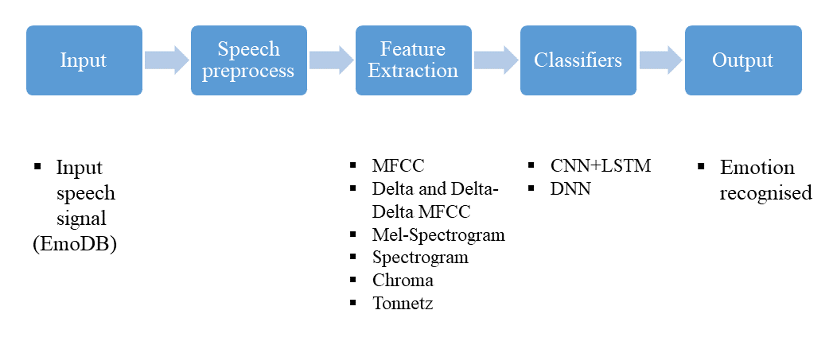
Methodology and Algorithm

Slide 8
EmoDB Dataset
Anger
Boredom
Disgusted
Anxiety
Happiness
Sadness
Neutral

Slide 9
Speech Pre-processing
Preprocessing Includes:
Pre-emphasis
Normalization
Framing/Segmentation

Slide 10
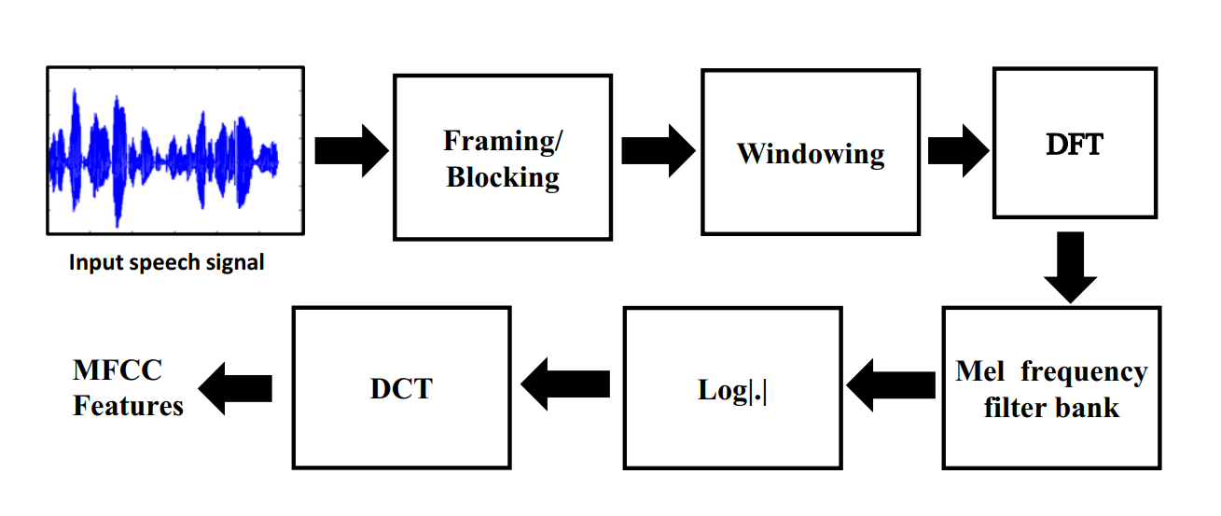
Feature Extraction
MFCC
Source: S. Mishra, P. Warule, and S. Deb, “Speech emotion classification using feature level and classifier-level fusion,” Evolving Systems, vol. 15, pp. 1–14, 11 2023

Slide 11
Mel Spectrogram
A mel spectrogram is a visual representation of the frequency spectrum of sounds, scaled to the human ear's perception of pitch, providing a detailed analysis of audio signals over time.
It is widely used in audio processing applications, such as speech recognition and music analysis, to capture the textural details of sounds effectively.
Spectrogram of speech signal
A spectrogram of a speech signal displays the intensity of various frequencies over time, offering a visual snapshot of speech characteristics such as pitch, tone, and rhythm.
Source: Oppenheim, Alan V., and Ronald W. Schafer. Discrete-Time Signal Processing. 3rd ed., Prentice-Hall, 2009 [4]

Slide 12
Chroma
Chroma features represent the pitch content of speech signals, highlighting harmonic patterns that are essential for speaker and speech recognition.
Tonnetz
Tonnetz features capture harmonic relationships between audio frequencies.

Slide 13
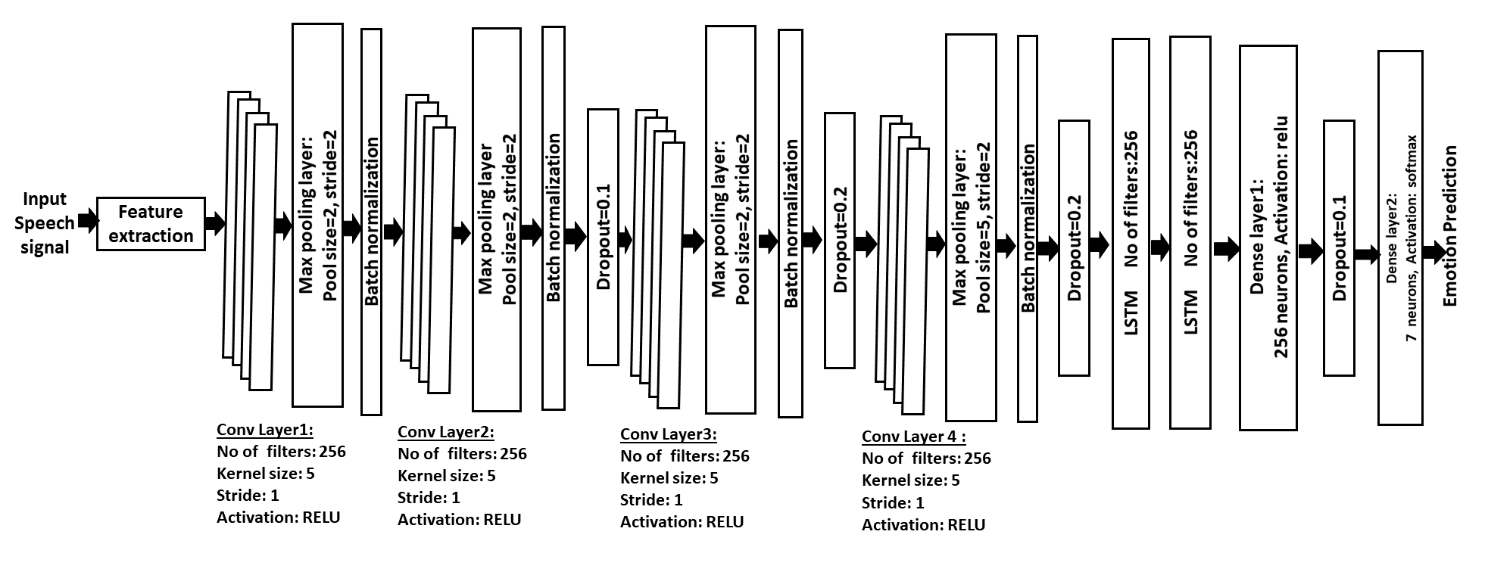
Classifiers
CNN-LSTM Architecture

Slide 14
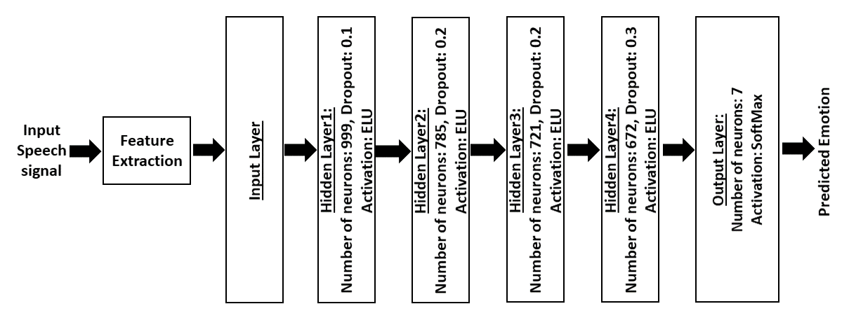
Classifiers
DNN Architecture

Slide 15
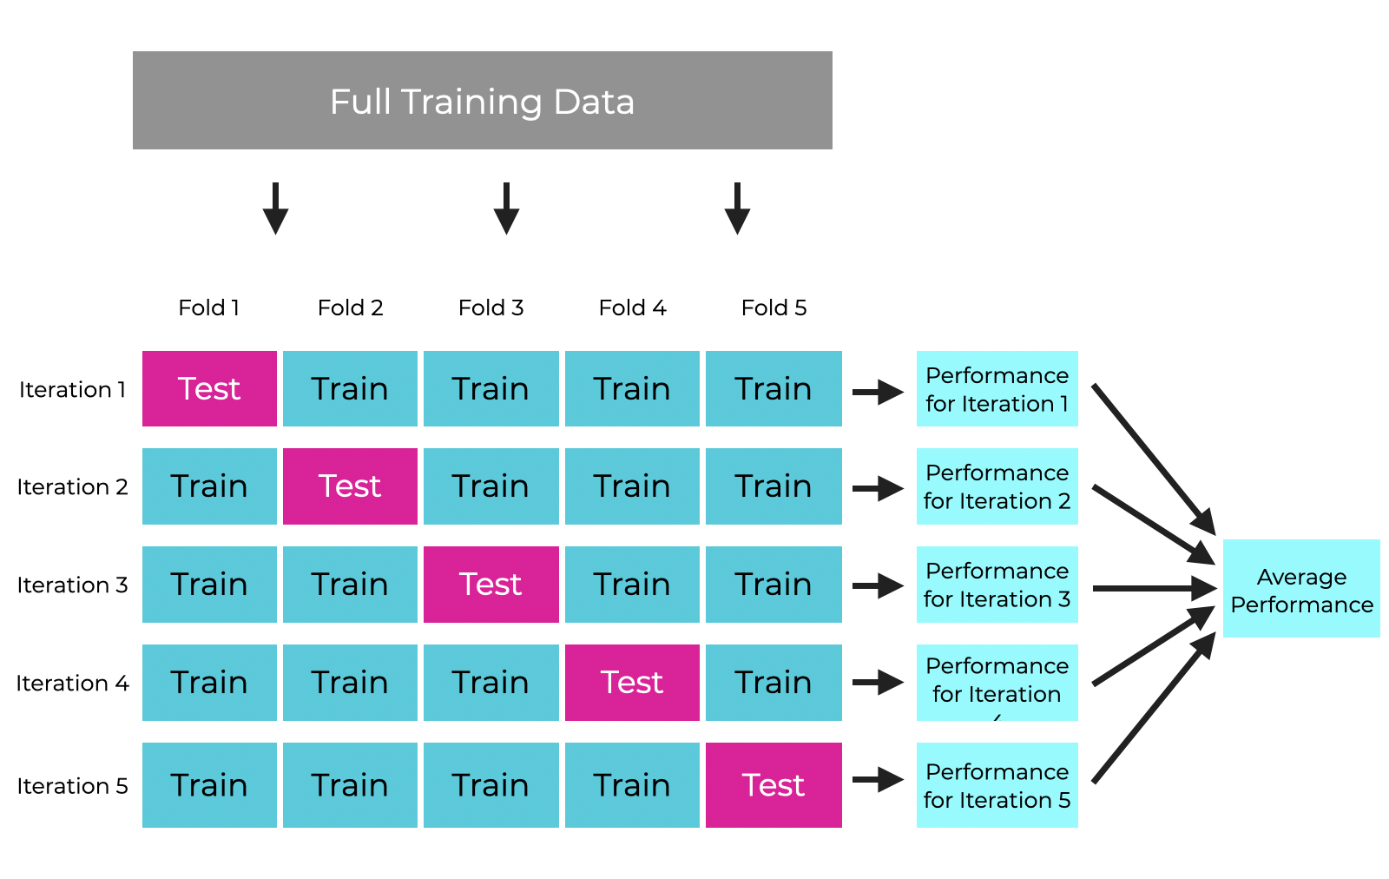
5-Fold cross-validation Strategy
Figure-4 : 5-fold cross-validation diagram [5]

Slide 16
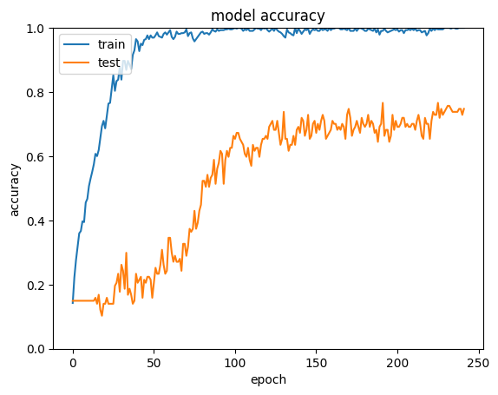
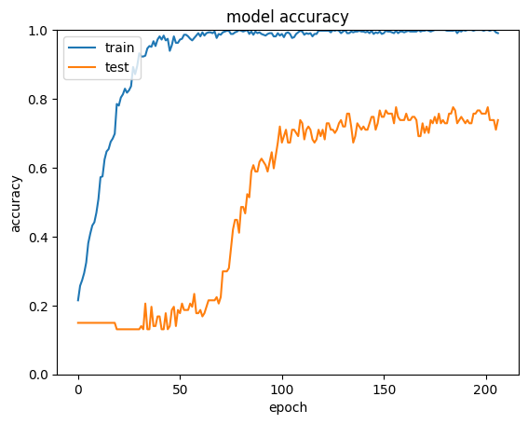
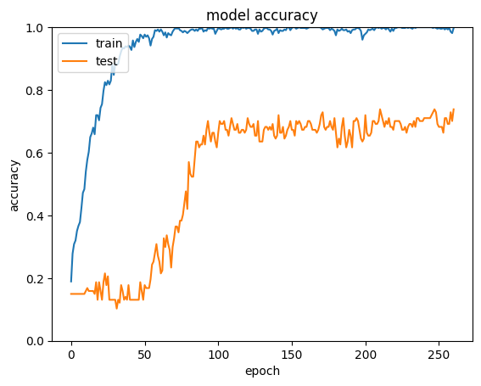
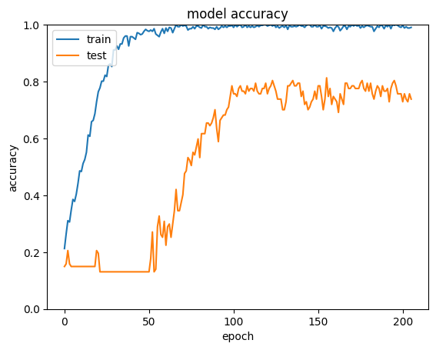
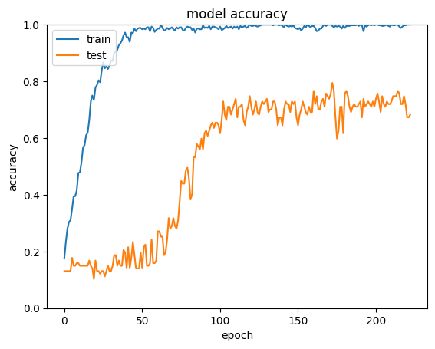
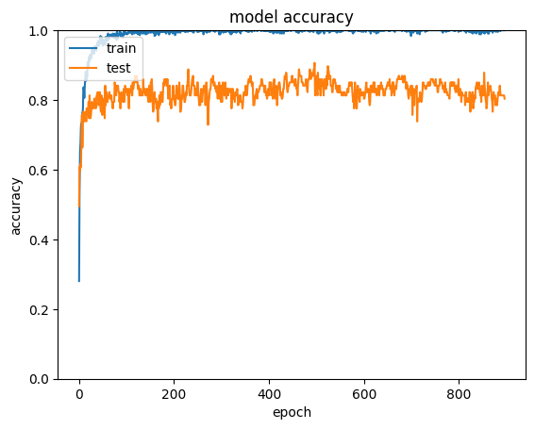
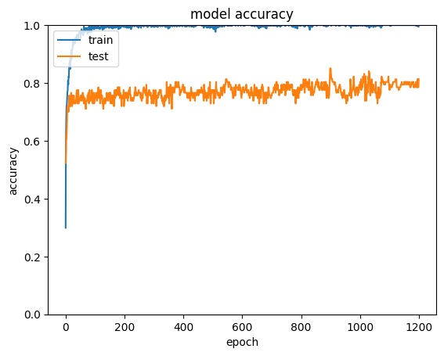
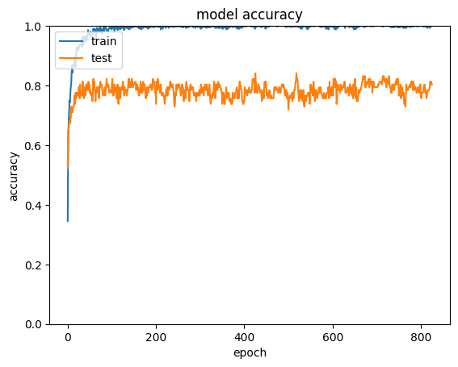
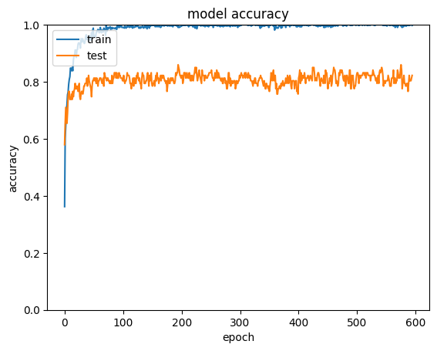
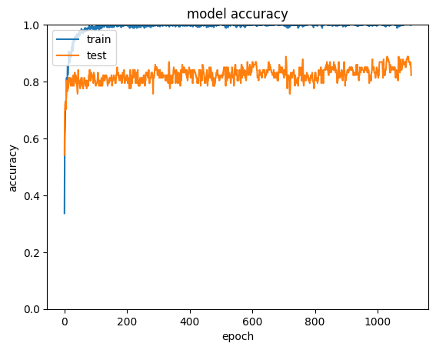
Results And Analysis
CNN+LSTM 5-Fold Accuracy Plots
DNN 5-Fold Accuracy Plots

Slide 17
Results And Analysis
Using 5-Fold cross-validation strategy
Fold | Validation accuracy with CNN+LSTM in % | Validation accuracy with DNN in %
Fold-1 | 76.63 | 90.65
Fold-2 | 75.70 | 85.05
Fold-3 | 73.83 | 84.98
Fold-4 | 81.38 | 85.98
Fold-5 | 79.44 | 88.79
Average of 5-Folds | 77.38 | 87.09

Slide 18
Results And Analysis
Individual accuracies from train-test-split
Emotion | precision with CNN+LSTM model | precision with DNN model
anger | 0.80 | 0.94
boredom | 0.71 | 0.93
disgust | 0.80 | 0.91
fear | 0.80 | 0.82
happiness | 0.71 | 0.80
neutral | 0.73 | 0.79
sadness | 0.92 | 0.86

Slide 19
Conclusion
The DNN model achieved an impressive average accuracy of 87.09% across the five folds, outperforming the CNN+LSTM model, which achieved an average accuracy of 77.38%.
A combination of features (Mel Spectrogram, MFCC, Delta MFCC, Tonnetz and Chroma) gives better accuracy than the individual.
The impact of various hyperparameters and training strategies significantly influences model performance in optimizing accuracies for deep learning-based speech emotion recognition.
DNN is very simple compared to the CNN+LSTM model and requires very little time to execute compared to CNN+LSTM.

Slide 20
References
[1] S. Mishra, P. Warule, and S. Deb, “Speech emotion classification using featureleveland classifier-level fusion,” Evolving Systems, vol. 15, pp. 1–14, 11 2023
[2] D. Bertero, F. Siddique, C.-S. Wu, Y. Wan, R. Chan, and P. Fung, “Real-timespeech emotion and sentiment recognition for interactive dialogue systems,” 012016, pp. 1042–1047
[3] A. Yadav and D. K. Vishwakarma, “A multilingual framework of cnn and bi-lstmfor emotion classification,” in 2020 11th international conference on computing,communication and networking technologies (ICCCNT). IEEE, 2020, pp. 1–6
[4] Oppenheim, Alan V., and Ronald W. Schafer. Discrete-Time Signal Processing. 3rd ed., Prentice-Hall, 2009
[5] “DenseNet architecture, note=image, url=https://www.sharpsightlabs.com/blog/crossvalidation-explained/,.”

Slide 21


